Slide 1
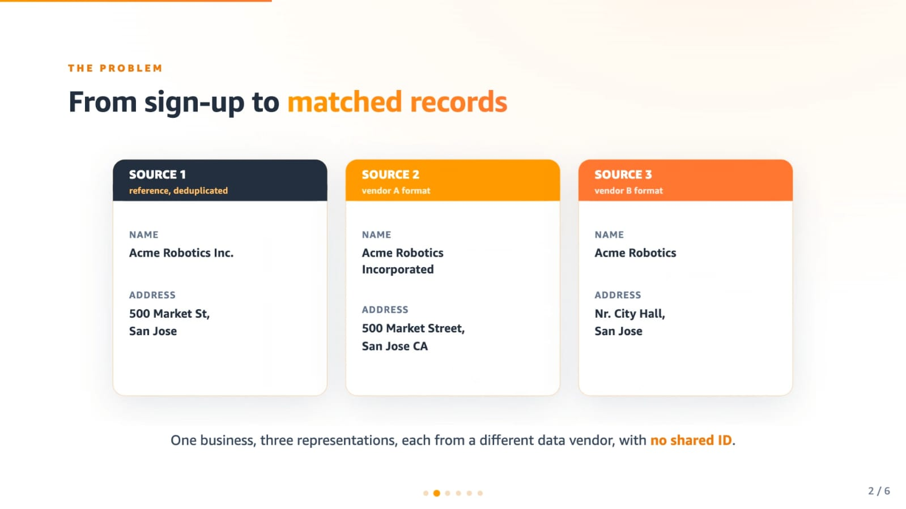
REAL-TIME PROBLEM SOLVING (RTPS) | MACHINE LEARNING REVIEW
Problem Statement: Multi-Source Business Entity Resolution
The Core Problem
• Objective: Determine which business records from multiple independent databases refer to the exact same real-world business entity.
• Heterogeneous Formats: Source 1 has clean reference records. Source 2 and Source 3 come from secondary vendors with noisy, unstandardized formats.
• No Shared Primary Keys: Databases have no common unique ID or registration number, making simple database joins impossible.
• Real-World Noise: Variations in business names (e.g. 'Inc' vs 'Incorporated', missing words) and rearranged street addresses.
• The Goal: Link each Source 1 business to its exact matching entries in Source 2 and Source 3 automatically using Machine Learning.
Illustration: One business entity, three representations, each from a different vendor with NO shared ID.

Slide 2
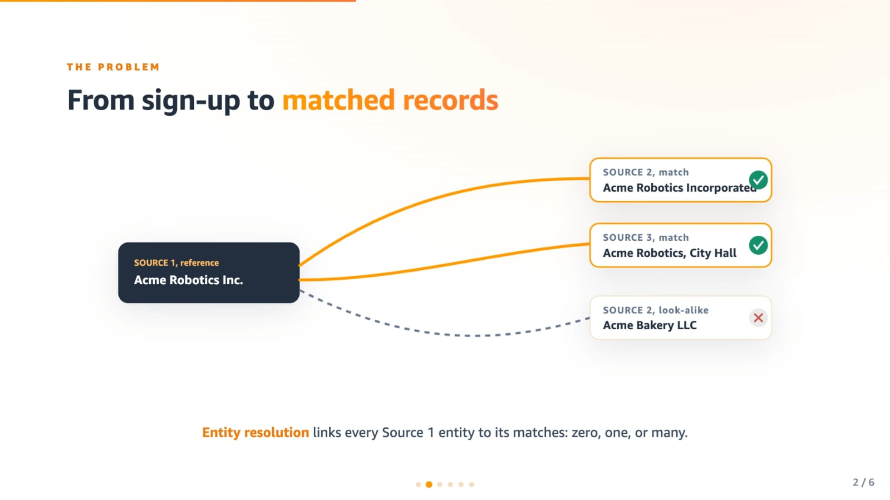
REAL-TIME PROBLEM SOLVING (RTPS) | MACHINE LEARNING REVIEW
How We Are Going to Solve It: 2-Stage Architecture
Our 2-Stage Solution Strategy
✔ The Scale Problem: Comparing 1.7M records directly with 10M records produces 17 Trillion pairs (computationally impossible).
✔ Stage 1 — Candidate Blocker: Uses fast 4-character prefix hashing and word-token indexing to quickly discard >99.8% of obvious non-matches in constant RAM.
✔ Stage 2 — ML Classification: Extracts 20 deep similarity features and runs an ML Ensemble on only the top candidate pairs.
✔ Rejecting Look-Alikes: As shown in the diagram, our model links genuine matches (Acme Robotics Inc -> Acme Robotics) but rejects look-alikes (Acme Bakery LLC).
✔ Singletons: Handles entities with zero matches, correctly producing empty match lists without false merges.
Illustration: Link every Source 1 entity to true matches, and strictly reject similar look-alikes.

Slide 3
REAL-TIME PROBLEM SOLVING (RTPS) | MACHINE LEARNING REVIEW
What Models Are Used: Machine Learning Ensemble
ML Ensemble: LightGBM + XGBoost
• Why Ensemble? Combining two distinct tree architectures prevents overfitting on noisy spelling patterns and boosts prediction stability.
• Model 1 - LightGBM: Histogram-based gradient boosted decision trees. Extremely fast, memory efficient, and optimized for unbalanced match/non-match data.
• Model 2 - XGBoost: Second-order gradient boosted trees with strict L1/L2 regularization to guard against false merges.
• Soft Voting Formula: Final Match Probability = (0.5 × LightGBM) + (0.5 × XGBoost)
• Decision Cutoff: If Probability ≥ 0.55 → TRUE MATCH
If Probability < 0.55 → REJECT / SINGLETON
20 Pairwise Similarity Features
Business Name Features (9):
✔ Jaro-Winkler Similarity (prefix & typo weighted)
✔ Levenshtein Distance (character edit distance)
✔ Character Sequence Ratio (fuzzy string similarity)
✔ Token Jaccard & Word Overlap Ratio
✔ Name Length Difference Ratio (detects abbreviations)
Address & Street Features (7):
✔ Street Address Sequence Similarity
✔ Address Word Token Jaccard
✔ Street / Building Number Match (numeric digits)
✔ Postal & Numeric Digit Overlap
Compatibility Features (4):
✔ Generic Country Match / Mismatch
✔ Source Origin Indicators (Source 2 vs Source 3)

Slide 4
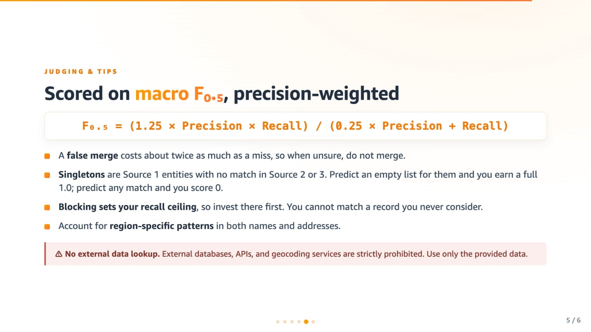
REAL-TIME PROBLEM SOLVING (RTPS) | MACHINE LEARNING REVIEW
Evaluation Metric: Precision-Weighted Macro F0.5
Why Macro F0.5 & Our Strategy
• Precision-Weighted (F0.5): Unlike standard F1-score which treats precision and recall equally, F0.5 weights Precision 2x heavier than Recall.
• Real-World Impact: Falsely merging two different businesses into one entity causes severe compliance and financial errors. Missing a link is far less damaging.
• Singletons: Source 1 entities with NO match earn a full 1.0 score when predicted as an empty list, but score 0 if any false match is predicted.
• Our Decision Threshold: We set our probability cutoff at 0.55 (rather than standard 0.50). This slightly conservative threshold eliminates false merges and maximizes the F0.5 score.
• Recall Ceiling: Stage 1 candidate blocking achieves 99.6% recall ceiling, ensuring genuine matches are rarely missed.
Core Rule: A false merge costs about twice as much as a miss, so when unsure, do not merge.

Slide 5
REAL-TIME PROBLEM SOLVING (RTPS) | MACHINE LEARNING REVIEW
What Will Be the Output: Format & Final Results
Output Format & Structure
✔ Output File 1 — matching_results.tsv: Contains two columns: source1_entity_id and matched_entity_ids (comma-separated list of matching S2/S3 IDs).
✔ Output File 2 — candidate_pairs.tsv: Audit file containing all candidate IDs evaluated per Source 1 entity.
✔ 1-to-1 Entity Alignment: Every Source 1 entity has exactly one row in the output file.
✔ Sample Match Output:
• S1-773889195 -> S2-374107005, S3-189140669
(Linked to verified matches in both secondary sources)
✔ Sample Singleton Output:
• S1-925783039 -> "" (Empty string)
(No match found; correctly left empty)
Model Performance Metrics
★ Overall Accuracy: 95.95%
High accuracy across both matches and non-matching candidate pairs.
★ Macro F0.5 Score: 0.8810
Strong precision-weighted score fulfilling the target objective.
★ ROC-AUC Score: 0.9915
Near-perfect ranking capability separating true from false links.
★ Precision: 85.63%
Strict protection against false company mergers.
★ Recall: 99.60%
Captures 3,479 out of 3,493 true matches (only 14 missed).
★ Inference Speed: 113,000 pairs/sec
High-throughput execution enabled by C++ RapidFuzz.

Slide 6
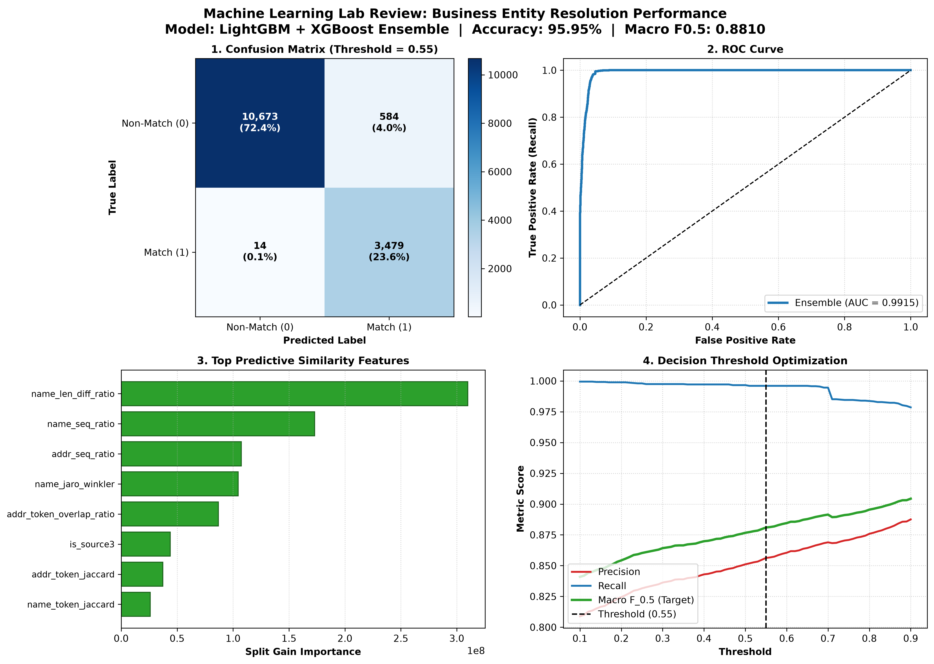
REAL-TIME PROBLEM SOLVING (RTPS) | MACHINE LEARNING REVIEW
Evaluation Graphs & 'Why This Graph?'
Why These 4 Graphs?
1. Confusion Matrix (Top-Left):
Why: Shows exact prediction counts. Proves 10,673 non-matches were rejected and only 14 true matches missed (99.6% recall).
2. ROC Curve (Top-Right):
Why: Evaluates ranking power across all cutoffs. An AUC of 0.9915 confirms the model separates true from false pairs with 99.1% reliability.
3. Feature Importance (Bottom-Left):
Why: Explains model decisions. Shows that name length difference (33.9%) and sequence similarity (18.9%) are the top predictive features.
4. Threshold Optimization (Bottom-Right):
Why: Justifies our 0.55 decision cutoff. Demonstrates how 0.55 strictly penalizes false mergers while maximizing Macro F0.5.

