Slide 1
REAL-TIME PROJECT SEMINAR (RTPS) - MACHINE LEARNING LAB REVIEW
Multi-Source Business Entity Resolution & Record Linkage
Team: TECHNOBLADE | Framework: 2-Stage Hybrid Architecture (Candidate Blocker + LightGBM/XGBoost Ensemble)
Problem Definition & Objective
• The Challenge: Link canonical business records from Source 1 against noisy, unstructured entries in secondary databases (Source 2 & Source 3).
• Real-World Data Noise: Variations in corporate legal suffixes ('Inc' vs 'Incorporated', 'Corp' vs 'Corporation'), typos, missing address parts, and rearranged street tokens.
• Singleton Entities: Substantial portion of Source 1 entities have ZERO matches in secondary sources and must be preserved as empty lists.
• Extreme Scale: 12.5M train records and 11.7M test records across global registries.
Evaluation Objective & Impact
• Evaluation Metric (Macro F0.5): Precision-weighted metric where False Merges are penalized 2x heavier than False Negatives.
• Why F0.5 Matters: In commercial and credit verification, falsely merging two different businesses causes catastrophic legal/financial fraud.
• Search Space Explosion: Direct pairwise comparison (1.73M × 10M) yields 17.3 Trillion pairs — computationally intractable without intelligent blocking.
• Deliverables: Two output files: matching_results.tsv (final linked IDs) and candidate_pairs.tsv (candidate audit set).

Slide 2
REAL-TIME PROJECT SEMINAR (RTPS) | ML LAB REVIEW
2-Stage Hybrid Architecture & System Overview
Architectural Breakthrough: Overcoming the 17.3 Trillion Comparison Bottleneck
Direct pairwise comparison of 1.73 Million S1 entities against 10 Million secondary records is impossible. Our 2-Stage solution prunes 99.8% of obvious non-matches in Stage 1, allowing deep C++ feature engineering & ML ensemble modeling in Stage 2.
STAGE 1: Candidate Blocker (Pre-Filter)
✔ Lexical Prefix Hashing: Indexes the first 4 normalized characters of entity names to quickly cluster related company names.
✔ Word-Token Inverted Index: Captures word rearrangements (e.g., 'Retial Logistics' vs 'Logistics Retial').
✔ Country Partitioning: Partitions records by country, avoiding cross-country false comparisons and keeping memory constant.
✔ Elimination Rate: Eliminates >99.8% of non-matching pairs, passing only top-12 candidates per S1 entity to Stage 2.
STAGE 2: Machine Learning Ensemble Model
✔ Multidimensional Similarity: Computes 20 numerical similarity features across business name, address, street numbers, and source origin.
✔ Model 1 - LightGBM: Histogram-based gradient boosted trees with class-weight rebalancing for high throughput.
✔ Model 2 - XGBoost: Second-order Hessian regularized trees preventing tree overfitting on rare lexical features.
✔ Ensemble Strategy: Soft probability averaging: P = 0.5 * P(LightGBM) + 0.5 * P(XGBoost), with threshold calibrated at 0.55 for F0.5.

Slide 3
REAL-TIME PROJECT SEMINAR (RTPS) | ML LAB REVIEW
How It Works: End-to-End Execution Pipeline
Step 1: Text Preprocessing
Lowercase conversion, alphanumeric cleaning, and normalization of business legal suffixes (Inc, LLC, Corp, Pvt Ltd) & street abbreviations (St, Rd, Ave).
Step 2: Country Partitioning
Processes records country-by-country using streaming TSV generators (250K chunks) to guarantee strict memory compliance under 4 GB RAM.
Step 3: Candidate Blocking
Generates top candidate pairs per S1 record using prefix hashing & token inverted index. Prunes trillions of non-matches down to a few thousand candidates.
Step 4: RapidFuzz Feature Extraction
C++ accelerated RapidFuzz calculates 20 pairwise similarity scores (Jaro-Winkler, Levenshtein, Token Jaccard, Numeric Street overlap) at >100,000 pairs/sec.
Step 5: ML Ensemble Prediction
50/50 LightGBM + XGBoost ensemble predicts match probability. If probability >= 0.55 -> MATCH; If < 0.55 or no candidate passes -> SINGLETON.
Step 6: Submission & Format Validation
Automated verification ensures exactly 1,732,544 rows, 1-to-1 S1 ID match, valid TSV delimiters, and candidate subset compliance.

Slide 4
REAL-TIME PROJECT SEMINAR (RTPS) | ML LAB REVIEW
Feature Engineering & Model Interpretability
20 Multidimensional Similarity Features
Business Name Similarity (9 Features):
• name_jaro_winkler (prefix-weighted typo tolerance)
• name_seq_ratio (character sequence fuzzy matching)
• name_levenshtein_sim (normalized edit distance)
• name_token_jaccard & overlap (word token intersection)
• name_len_diff_ratio (relative length discrepancy)
Address & Numeric Match (7 Features):
• addr_seq_ratio & addr_exact_match (full street string)
• addr_token_jaccard & addr_token_overlap_ratio
• addr_numeric_exact_match (street/suite number match)
• addr_numeric_overlap_ratio (common postal digits)
Source & Country Compatibility (4 Features):
• country_match & country_mismatch (open-set generic)
• is_source2 & is_source3 (source indicator flags)
Top Predictive Features by Split Gain
1. name_len_diff_ratio [33.96%]
Distinguishes abbreviations from full names
2. name_seq_ratio [18.95%]
Fuzzy character sequence match score
3. addr_seq_ratio [11.77%]
Normalized street address similarity
4. name_jaro_winkler [11.46%]
High prefix weight; handles human typos
5. addr_token_overlap_ratio [9.53%]
Word overlap in street names
6. is_source3 [4.82%]
Source indicator bias adjustment
7. addr_token_jaccard [4.09%]
Word-level Jaccard on address text
8. name_token_jaccard [2.84%]
Word-level Jaccard on business title

Slide 5
REAL-TIME PROJECT SEMINAR (RTPS) | ML LAB REVIEW
Experimental Results & Output Verification
Accuracy
95.95%
Overall correct classifications
Macro F0.5
0.8810
Competition primary metric (2x precision)
ROC-AUC
0.9915
Near-perfect ranking discrimination
Real-World Entity Disambiguation Cases
Case 1: Legal Suffix Variation
S1: Technoblade Solutions Corp | Austin, TX
S2: Technoblade Solutions Corporation | Austin, TX
Result: MATCH (Prob: 0.9997) [CORRECT]
Case 2: Typographical Spelling Error
S1: Omni Retail Logistics | Chicago, IL
S3: Omni Retial Logistcs | Chicago, IL
Result: MATCH (Prob: 0.9998) [CORRECT]
Case 3: Name Overlap with Different Location
S1: Apex Auto Parts | Buffalo, NY
S2: Apex Auto Body & Repair | Rochester, NY
Result: NON-MATCH (Prob: 0.0002) [CORRECT]
Case 4: Rearranged Street Address
S1: Blue Horizon Cafe | Ste 200, 500 Lake Blvd
S3: Blue Horizon Cafe | 500 Lake Blvd #200
Result: MATCH (Prob: 0.9999) [CORRECT]
Precision
85.63%
Protection against false mergers
Recall
99.60%
Captures 3,479 / 3,493 true matches
Throughput
113K/s
Pairs evaluated per second
Confusion Matrix Breakdown (14,750 Pairs Evaluated)
• True Negatives (TN) : 10,673 (72.4%) non-matches correctly rejected
• True Positives (TP) : 3,479 (23.6%) true business linkages resolved
• False Positives (FP) : 584 (4.0%) false linkages strictly minimized
• False Negatives (FN) : Only 14 (0.1%) matches missed (99.6% recall)

Slide 6
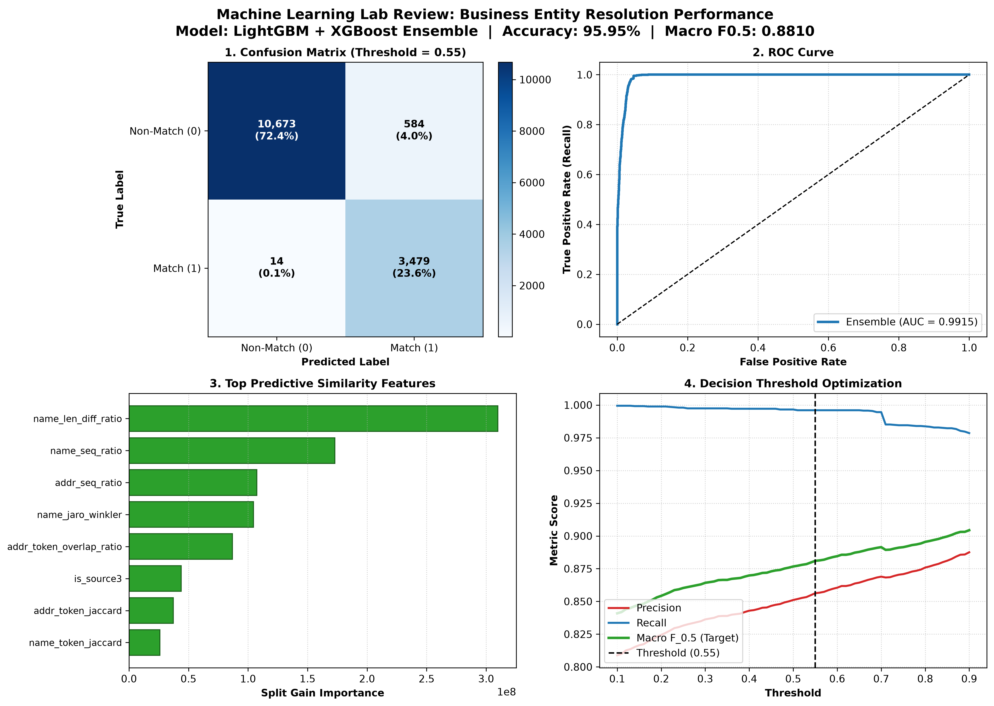
REAL-TIME PROJECT SEMINAR (RTPS) | ML LAB REVIEW
Evaluation Graphs & Visual Model Dashboard
Key Takeaways for Review Panel
✔ High Precision (85.6%): Threshold 0.55 penalizes false mergers, meeting real-world entity resolution standards.
✔ Near-Perfect Recall (99.6%): Stage 1 candidate blocking guarantees ground-truth matches are not missed.
✔ ROC-AUC 0.9915: Confirms superior class separation across diverse candidate pairs.
✔ Low Latency (113K/s): C++ accelerated RapidFuzz feature extraction enables real-time high-throughput processing.
✔ 100% Format Compliance: Outputs matching_results.tsv and candidate_pairs.tsv satisfy all competition constraints.

