Slide 1
Horizon Europe
AI-Augmented Proposal Writing for Horizon Europe
From manual drafting → structured AI orchestration
Tools: ChatGPT · NotebookLM · Claude Code
ChatGPT
NotebookLM
Claude Code
Eötvös Loránd University | 2026

Slide 2
The Problem Space
Why Horizon Europe proposals are hard
Structural complexity
  Multi-part, strict template
  Excellence / Impact / Implementation criteria
  Call specific constraints
  Requires a joint effort
Fragmented inputs
  Call documents & annexes
  Templates & compliance constraints
  Internal drafts and partner materials
  Separate budget tables
Consistency & compliance risks
  Errors accumulate across a long manual process
Key insight
  Most failures are structural, not conceptual

Slide 3
AI as a Proposal Co-Pilot
Three levels of AI support
The Three Layers
The Shift
ChatGPT — micro-task layer
  Drafting
  Summarising
  Rephrasing
NotebookLM — knowledge layer
  Document interaction
  Synthesis
Claude Code — orchestration layer
  Structured workflows
  Agents
  Quality gates & compliance checks
From: asking AI simple questions and providing basic instructions.
To: designing complex workflows
How: proposal writing become proposal engineering
Each layer is connected the previous one — use all three for maximum impact

Slide 4
Prompting LLMs
From generic prompts → structured contracts
The "Garbage In, Garbage Out" (GIGO) principle states that the quality of output from any system—computing, AI, or decision-making—is directly determined by the quality of the input.
Bad prompt:
  "Write section X"
Better — define:
Tasks (goals, boundaries)
  Roles (to do what and how)
  Inputs (concept note, WPs)
  Constraints (page limit, criteria)
  Output structure (headings, KPIs)
Structured prompt pattern
Role: Gannt designer
Task: Create a gannt chart for the work packages.
Constraints:
- measurable KPIs
- align with Expected Outcomes
- include milestones
- no WP-level detail
Input: the documents in WP folder
Output: structured text, max 600 words
Prompt = contract, not just instruction

Slide 5
Prompt Patterns & Meta-Prompting
From ad-hoc prompts → reusable patterns
Role-based prompting
  "Act as a Horizon Europe evaluator"
Verfier prompts
  "Generate a number of additional questions about X"
  "Combine the answers to the individual questions to produce Y"
Constraint-driven prompts
  Page limits · structure rules
  Forbidden content (e.g. no WP detail in section X)
Input-grounded prompts
  Provide concept note + work packages
  Follow template patterns
Refinement prompts
  "Suggest a better version of the question to use instead"
Meta-prompting example
Task: Generate a reusable prompt template for Horizon Europe proposal writing
Requirements:
Must enforce evaluator alignment (Excellence / Impact / Implementation)
Must include measurable KPIs
Must prevent WP-level detail leakage
Must define explicit input structure
Must define output format
Output:
A reusable prompt template
With placeholders for inputs (concept, WPs, call requirements)
You design standards, not just prompts

Slide 6
ChatGPT: Core Use Cases
Fast execution of atomic tasks
What ChatGPT Does Well
Best For
Help with brainstorming
Drafting & prototyping (e.g. concept notes, summaries)
Compliance checks
Refining prompts
Local transformations
Iterative refinement
Works best when:
• there are no explicit constraints
• completing repetitive tasks
• used as part a larger system
ChatGPT is the fast execution layer — best for contained, well-defined tasks

Slide 7
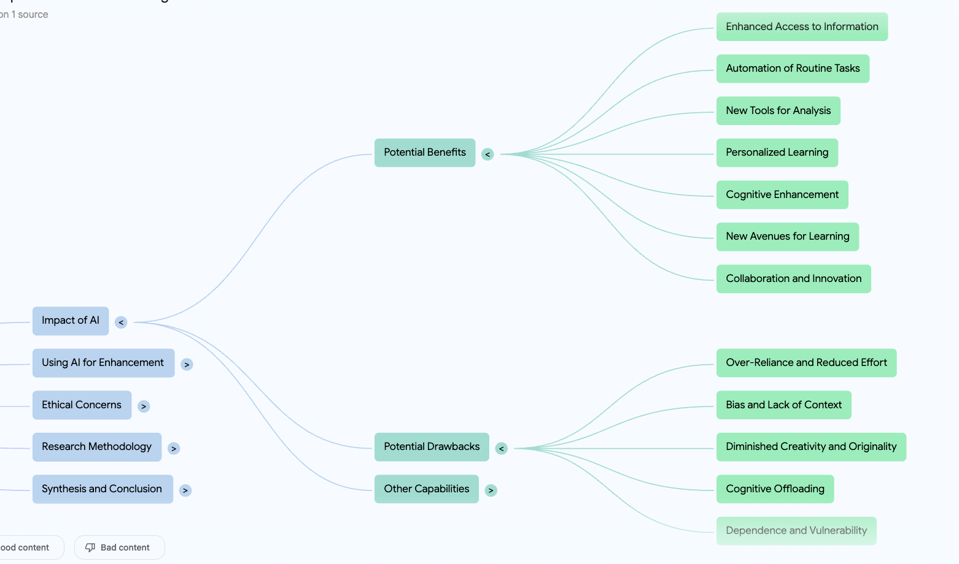
Knowledge Structuring
From documents → structured understanding
Build with NotebookLM
  Concept maps of key themes
  Requirement matrices
  Project logic flows
Example output files
  General Annexes
  Work Programme documents
Logical Framework Matrices
Key value
  Turns PDFs into structured inputs for AI workflows

Slide 8
NotebookLM: Document Intelligence
Working directly with proposal materials
Upload
Ask
Call document
Annexes & work programmes
Draft sections
Evaluation guidelines
"What are the evaluation criteria?"
"Extract Expected Outcomes"
"Summarise compliance constraints"
Functions as:
• Closed workspace
• Grounded knowledge layer
• Reducing hallucinations
• Free tier model
NotebookLM stays anchored to your documents — no fabrication from general knowledge

Slide 9
Limitations of the Chat Model Paradigm
Why chat-style AI breaks down at larger scale project
Core Constraints
Failure Modes
Single context window
  Monolithic — no structural separation between instructions, inputs, and outputs
  Each prompt = isolated reasoning step
  Everything the model “knows” at runtime is compressed into this one window.
Scaling problem
Token pressure increases
Signal-to-noise ratio drops
Reasoning degrades non-linearly
Structural limitation
  No explicit state management
  No validation or enforcement layer
  No file system integration
  No or limited workflow memory beyond chat history
Context drift
  Loss of constraints over long interactions
  e.g. page limits, evaluator criteria
Content instability
  Leakage between sections
  Increasing inconsistency as complexity grows
Key Insight
  Chat models are optimised for
  interaction, not execution
The problem is not the model — it is the architecture

Slide 10
Agent / Multi-Window Paradigm
Structured separation of context as the design principle
Core Concept
Advantages
Agents
Agents are scoped, prompt based execution units with memory, identity, capabilities, constraints and lifecycle.
Isolated contexts
  Multiple agents, each handling one task
  Coordinated through a structured workflow
  No cross-contamination between contexts
Capabilities
  Multi-step workflows (staged execution)
  Validation gates between steps
  Parallel processing of and execution
  Reusable components — agents, skills
Signal quality
  High signal-to-noise ratio per task
  Explicit state via files and artefacts
Execution model
  Deterministic pipeline
  Governance rules enforced at each step
  Auditable, reproducible outputs
Key Insight
  The advantage is not more context —
  it is structured separation of context
This is the architectural shift from prompting to proposal engineering

Slide 11
Workflow Architecture
System components of a Claude Code agentic pipeline
Context
Project Constitution
Orchestration Workflow
rules & constraints
Skills
reusable logic
Hooks
enforcement
Subagents
specialist workers
Outputs
Claude Code is a stateful, deterministic, execution lifecycle managment tool.

Slide 12
Claude Code: Agentic Workflows
From prompts → systems
Instead of
You Define
Checking compliance by hand
Formatting iteratively
Re-reading requirements each time
Agents
  WP-dependecy mapper
  Gantt-designer
  compliance-checker
  cross-document-validator
Workflow stages
  Validation gates between stages
  Deterministic execution pipeline
Skills & Hooks
  Reusable logic components
  Enforcement rules

Slide 13
Workflow Ecosystem
Documents → Agents → Governed by Memory → Structured Outputs
Source Materials
Call doc · Annexes · Templates
Concept · Action Plan · WP Matrix
Project Memory
CLAUDE.md (rules, SOs, WP structure)
Agent memory (decisions & recalls)
Pipeline Control
proposal_workflow.yaml
Settings · Skills · Hooks
✓
Call
Analysis
call_analyzer
✓
Concept
Refinement
concept
✓
WP Design
& Deps
wp_designer
wp-dep-mapper
✓
Gantt &
Milestones
gantt_designer
✓
Impact
Arch.
impact-designer
✓
Impl.
Arch.
implementation-architect
◌
Budget
Plan
budget_planner
◌
Draft &
Review
proposal_writer
reviewer
Internal outputs (output/_internal/)
call_requirements · compliance_constraints · evaluation_matrix
wp_gap · dep_map · gantt_data · governance_model · risk_register
Final outputs (output/)
concept.md · workpackages.md · gantt_chart
impact_architecture · implementation.md
Agents/Phases
Pending phase
Memory layer
Internal output
Final output
Documents transformed through agents · governed by memory · producing structured outputs across phases

Slide 14
Why This Matters
Agentic proposal pipelines outperform manual drafting and isolated chat interactions
Modular
Deterministic
Auditable
Each phase can be rerun independently
Each agent has a fixed input / output contract
Every step is captured through file-based artefacts
Consistent
Scalable
Resilient
Central memory in CLAUDE.md preserves key decisions
New agents can be inserted without redesigning the pipeline
Gating mechanisms protect the workflow at multiple points
Self-synchronizing
Updating the memory bank keeps docs and repository state continuously aligned — significantly reducing the risk of consistency errors and drift
Critical advantage: Compliance becomes systematic, not manual

Slide 15
Integrated Workflow
How the tools work together in a single pipeline
Documents
NotebookLM
Structured
Knowledge
ChatGPT /
Claude Code
Proposal
Outputs
source materials
→ extract knowledge
→ structured inputs
→ generate / refine
→ final deliverables
Call docs
Annexes
Templates
Q&A
Synthesis
Compliance check
call_requirements.md
evaluation_matrix.md
Section drafting
Agents & validators
Excellence
Impact
Implementation
Each layer feeds the next — from raw documents to a compliance-ready proposal

Slide 16
Key Takeaways
AI is not just a writing tool
Biggest Gains
Future Direction
It is a proposal
engineering system
Design the system,
not just the prompt
Consistency
Compliance
Speed
All three layers
working together
Fully automated
proposal pipelines
AI-assisted
evaluation simulation
I. The competitive edge is not using AI — it is designing how AI is used
II. AI value is not “text generation” — it is controlled transformation of grounded inputs into validated content.

