Slide 1

Credit Card Default Prediction
A machine learning approach
James King

Slide 2
Bio
Degree in Mathematics and Statistics
Training for actuarial studies and data science
Certificate in Data Science and AI

Slide 3

Overview
Business Overview and Context
Business Problem and Data Solution
Exploratory Data Analysis and Design
Model Description and Analysis
Conclusion

Slide 4


Credit Card Debt
Risk for all stakeholders
Over 13 million credit cards in circulation
28% depend on card
Exceedingly high interest rates
Average 16%
Reputation for overspending
Total credit card debt: $20 billion
Average credit card debt: $1500
Issuers and holders at risk for default
We aim our solution to the issuers as stakeholder

Slide 5


Business Problem
Can banks efficiently minimize their exposure to risk of default?
Must use only available data
Must prioritise:
Recall – the ability to detect at-risk users
Precision – the efficiency of the classification
Accuracy less important

Slide 6
Data Solution
Attribute | Meaning
LIMIT_VAL | Credit limit on card
AGE | Age of customer
SEX | Sex of customer
EDUCATION | Education level of customer
MARRIAGE | Marital Status
PAY_n | Lateness of payment n
BILL_AMTn | Amount of bill n
PAY_AMTn | Amount of payment n
Demographic and Historical Data
Data Set
Sourced from the UCI machine learning repository
Contains 30000 entries of customer data
Demographic Information:
AGE, SEX, EDUCATION, MARRIAGE
Financial Information:
LIMIT_VAL
Historical Information:
PAY_n, BILL_AMTn, PAY_AMTn

Slide 7
Proportion of Defaults
Significant proportion of defaults
6507 out of 30000 customers reported default

Slide 8

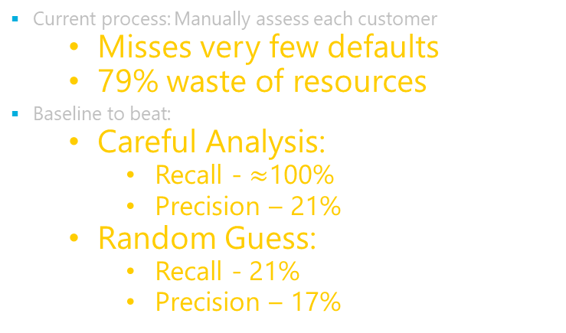
Data Question
Can we train a model to help predict a default?
Current process: Manually assess each customer
Misses very few defaults
79% waste of resources
Baseline to beat:
Careful Analysis:
Recall - $≈$100%
Precision – 21%
Random Guess:
Recall - 21%
Precision – 17%

Slide 9
Project Pipeline
Data
Solution!
Explore Data
Model and Validate
Business Question
Implement

Slide 10
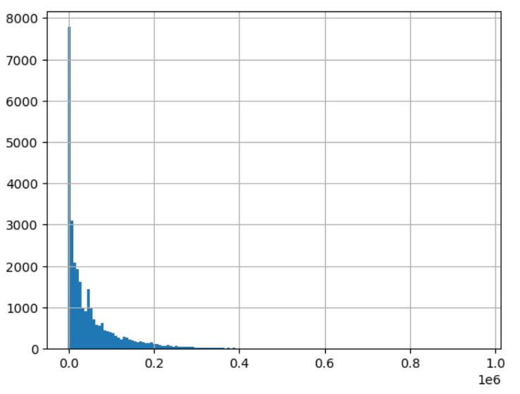
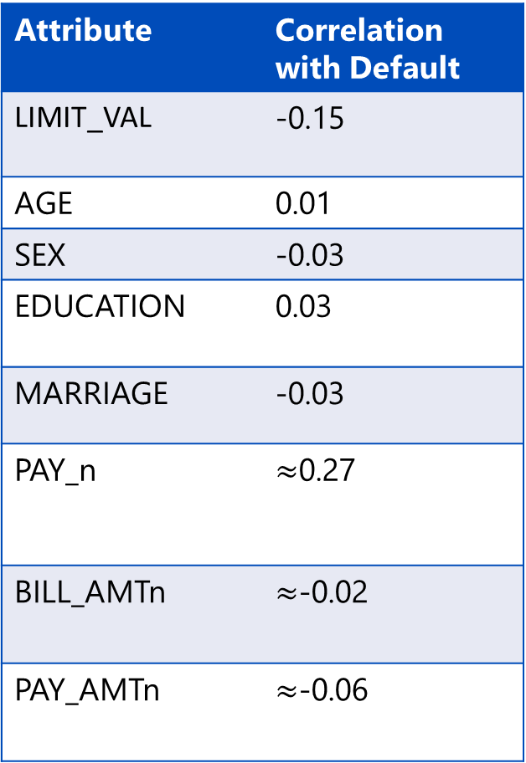

Initial Data Exploration
Attribute | Correlation with Default
LIMIT_VAL | -0.15
AGE | 0.01
SEX | -0.03
EDUCATION | 0.03
MARRIAGE | -0.03
PAY_n | $≈$0.27
BILL_AMTn | $≈$-0.02
PAY_AMTn | $≈$-0.06
Impressions on correlation and histograms
Small correlation with all variables
Many distributions close to exponential
Variables of same type highly correlated
$≈$0.8
BILL_AMT1 histogram

Slide 11
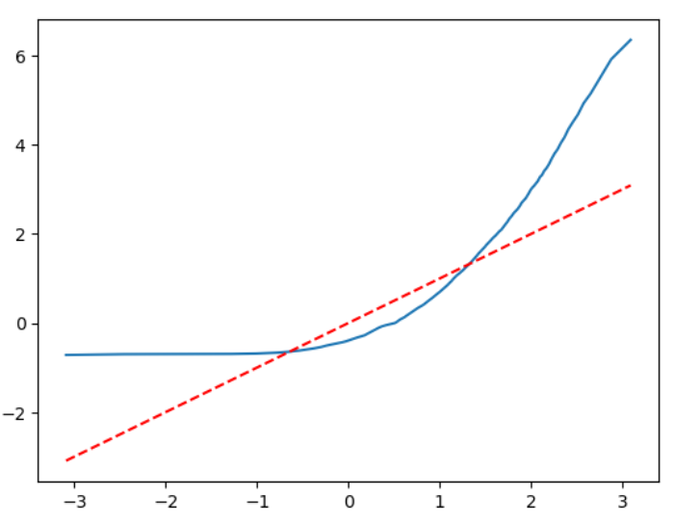
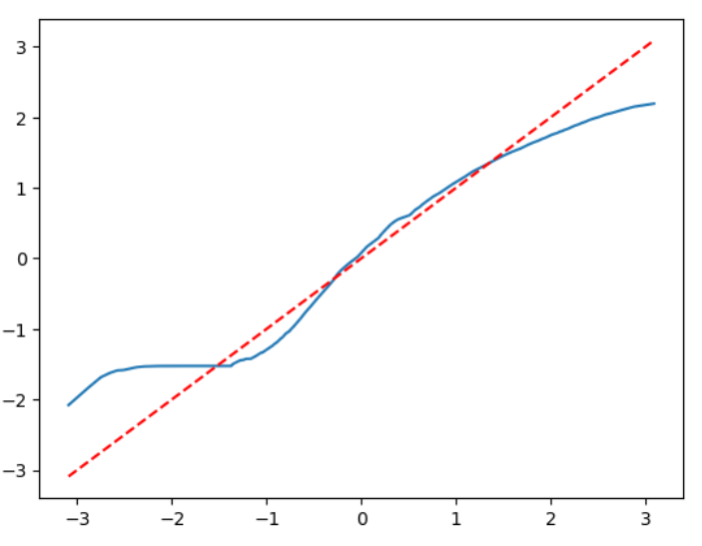
Feature Engineering
Transforms on variables for normality
Quantile Quantile Plots Before and After Transformation
Applying logarithm to data disperses it from zero
Applications on numerical data work:

Slide 12
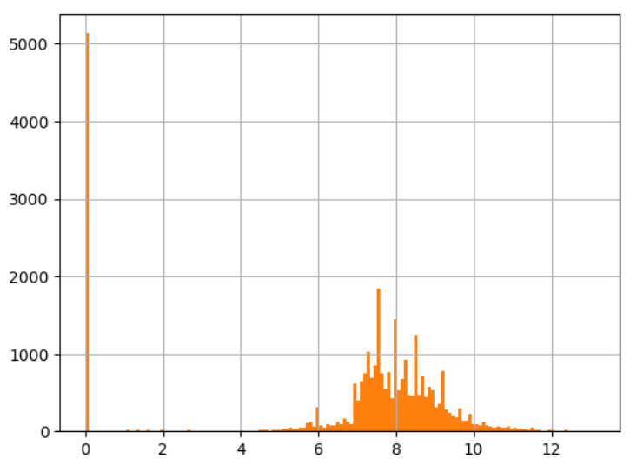
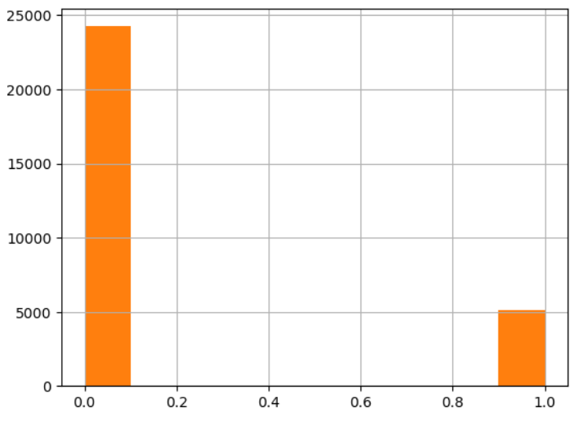
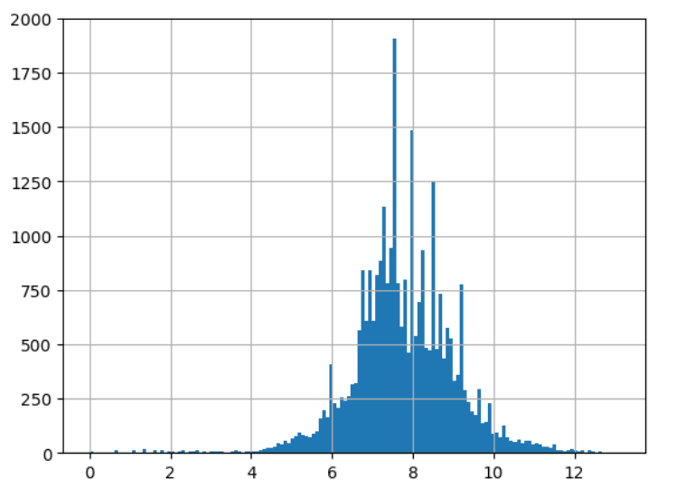
Feature Engineering Cont.
Histogram of log(PAY_AMT1+1)
Does not work for all
Applying a logarithm to the PAY_AMTn variables results in an odd distribution
Mixture of continuous normal and discrete mass at zero
Each variable is split into continuous and discrete components

Slide 13
Model Validation
Model | Precision | Recall
Logistic Regression | 0.243 | 0.729
Ridge Regression | 0.153 | 0.747
Naïve Bayes | 0.655 | 0.387
5-Nearest Neighbours | 0.364 | 0.552
Radius Neighbours | 0.013 | 0.739
Closest Centroid | 0.542 | 0.487
SVM (linear) | 0.266 | 0.711
SVM (polynomial) | 0.270 | 0.687
SVM (radial basis) | 0.358 | 0.678
SVM (sigmoid) | 0.442 | 0.436
Decision Tree | 0.434 | 0.419
MLP Classifier | 0.366 | 0.675
Single Model Results

Slide 14
Model Validation
Model | Precision | Recall
AdaBoost | 0.339 | 0.692
Bagging | 0.358 | 0.639
Gradient Boost | 0.369 | 0.686
Random Forest | 0.402 | 0.674
Stacking | 0.358 | 0.677
Voting | 0.246 | 0.728
Ensemble Model Results
Stacking and voting classifiers used logistic regression, ridge regression and radial basis support vector classification

Slide 15

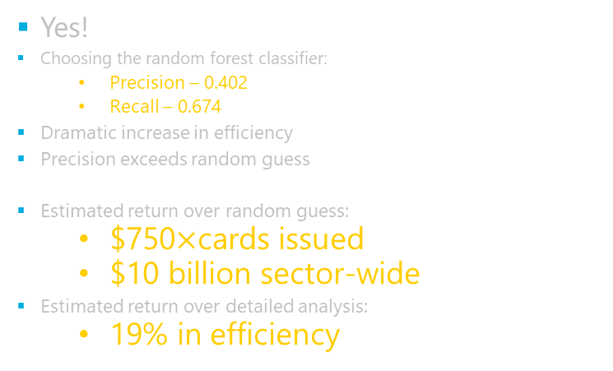
Conclusion
Can banks efficiently minimize their exposure to risk of default using customer data?
Yes!
Choosing the random forest classifier:
Precision – 0.402
Recall – 0.674
Dramatic increase in efficiency
Precision exceeds random guess
Estimated return over random guess:
$750$×$cards issued
$10 billion sector-wide
Estimated return over detailed analysis:
19% in efficiency

Slide 16
Wait!
The data does not generalize!
Data sourced from unknown Taiwanese bank in 2005
May not generalise across time
May not generalise internationally
Bank may have customer selection bias
Future sources of data:
Same structure from more relevant source
Bank identity would be known

Slide 17
References
Libraries used
References
Numpy
Pandas
Matplotlib.pyplot
Scipy.stats
Sklearn
Tensorflow
keras
https://archive.ics.uci.edu/ml/datasets/default+of+credit+card+clients
Yeh, I. C., & Lien, C. H. (2009). The comparisons of data mining techniques for the predictive accuracy of probability of default of credit card clients. Expert Systems with Applications, 36(2), 2473-2480.
https://www.wemoney.com.au/blog/what-is-the-average-credit-card-debt-in-australia#:~:text=As%20we've%20already%20seen,every%20card%20that%20is%20issued.

Slide 18

THANK YOU!
Any Questions?
jpking2614@outlook.com
+61451708278

