Slide 1

Credit Card Default Prediction
A machine learning approach
JAMES KING
August 2021

Slide 2

Bio
Bachelor of Science in Mathematics and Statistics Australian National University to be completed Dec 2021
Certificate in Data Science and Artificial Intelligence Institute of Data, UTS March 2021 – August 2021
Bachelor in Actuarial Studies Macquarie University part-time, commenced February 2020

Slide 3

Overview
Business Problem
Data and Machine Learning Solution
Exploratory Data Analysis & Design
Model Description & Analysis
Conclusion

Slide 4

Business Problem
Credit Card Debt is a risk for stakeholders
Over 13 million credit cards in circulation in Australia
28% card holders depend on the card for their daily finances
Exceedingly high interest rates
Average 16%
Reputation for overspending
Total credit card debt: $20 billion
Average credit card debt: $1500
Issuers (banks) and holders at risk for default

Slide 5


Data and Machine Learning PoC
Can a machine learning approach help banks to efficiently predict risk of credit card default?
Key Requirements:
Data for the ML model training and testing needs to sourced from the public domain
Three critical solution requirements:
Recall – the ability to detect at-risk users
Precision – the efficiency of the classification
Accuracy is less important

Slide 6
Data Set
Attribute | Meaning
LIMIT_VAL | Credit limit on card
AGE | Age of customer
SEX | Sex of customer
EDUCATION | Education level of customer
MARRIAGE | Marital Status
PAY_n | Lateness of payment n
BILL_AMTn | Amount of bill n
PAY_AMTn | Amount of payment n
Sourced from the UCI machine learning repository
30000 entries of customer data
Demographic Information: AGE, SEX, EDUCATION, MARRIAGE
Financial Information: LIMIT_VAL
Historical Information: PAY_n, BILL_AMTn, PAY_AMTn

Slide 7
Exploratory Data Analysis: Proportion of Defaults
The data set has significant level of defaults:
6507 out of 30000 (21%) customers reported default
This data set is suitable for the PoC as it has enough default cases to train and test a model

Slide 8

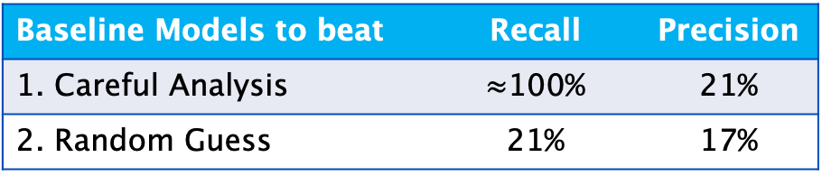
ML Model Goals
Baseline Models to beat | Recall | Precision
1. Careful Analysis | $≈$100% | 21%
2. Random Guess | 21% | 17%
The model needs to be better than
Careful analysis of each customer
Misses very few defaults
79% is a “waste of resources” and inefficient as these customers don’t default
This process is reactive – after the payment is late.
Random Guess
Finds only a 5th of defaults
Blah

Slide 9
Project Pipeline
Data
Solution!
Explore Data
Model and Validate
Business Question
Implement

Slide 10
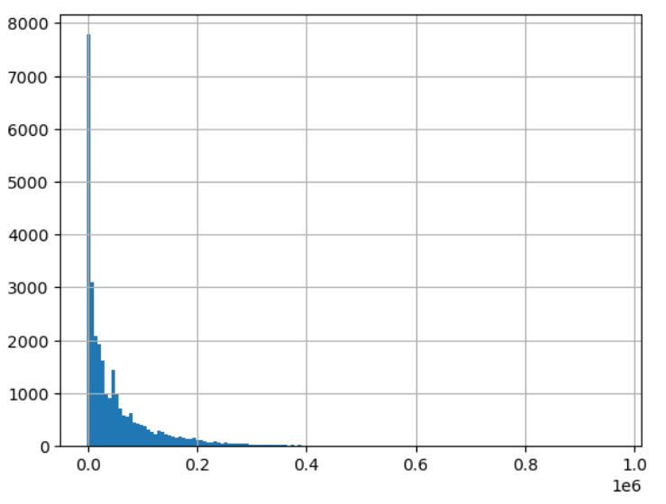
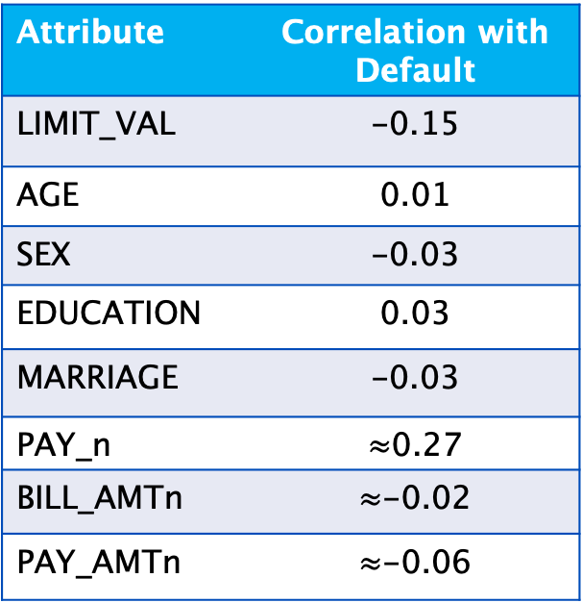

Initial Data Exploration
Impressions on correlation and histograms
Attribute | Correlation with Default
LIMIT_VAL | -0.15
AGE | 0.01
SEX | -0.03
EDUCATION | 0.03
MARRIAGE | -0.03
PAY_n | $≈$0.27
BILL_AMTn | $≈$-0.02
PAY_AMTn | $≈$-0.06
Small correlation with all variables
Many distributions close to exponential
Variables of same type highly correlated
$≈$0.8
BILL_AMT1 histogram

Slide 11
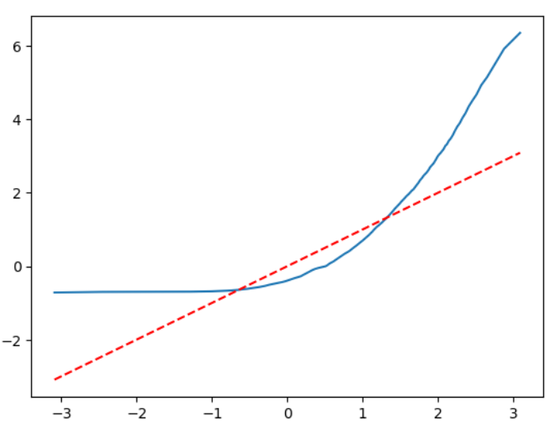
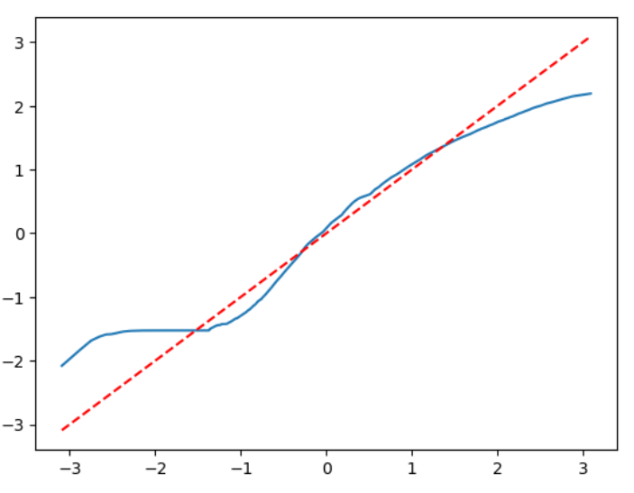
Feature Engineering
Transforms on variables for normality
Applying logarithm to data disperses it from zero
Applications on numerical data work:
Quantile Quantile Plots Before and After Transformation

Slide 12
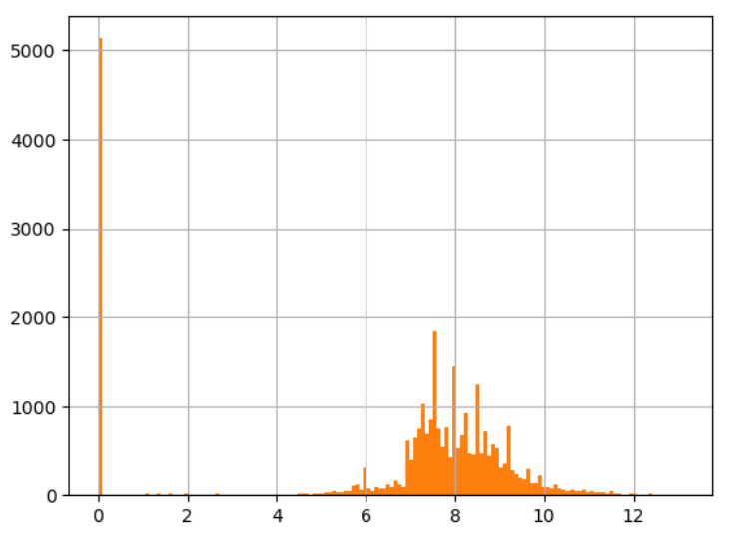
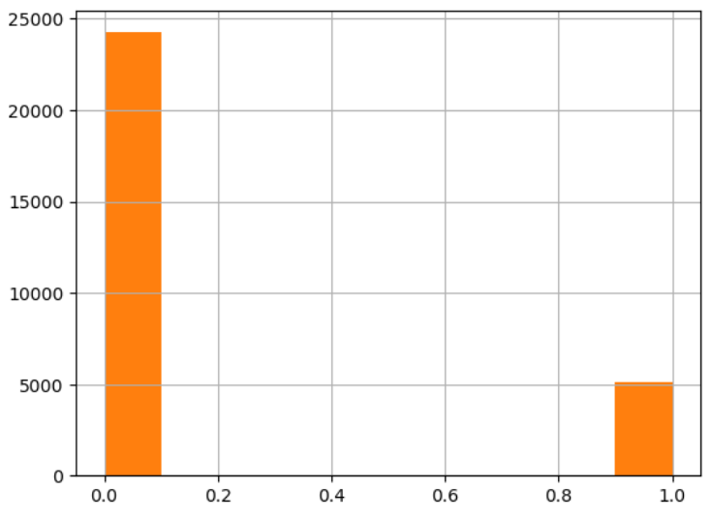
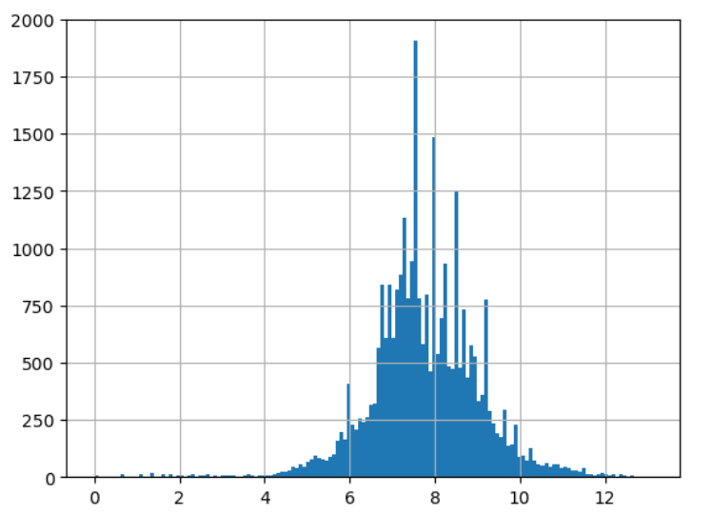
Feature Engineering(2)
Does not work for all variables
Applying a logarithm to the PAY_AMTn variables results in an odd distribution
Mixture of continuous normal and discrete mass at zero
Each variable is split into continuous and discrete components
Histogram of log(PAY_AMT1+1)

Slide 13
Model Validation
Model | Precision | Recall
Logistic Regression | 0.243 | 0.729
Ridge Regression | 0.153 | 0.747
Naïve Bayes | 0.655 | 0.387
5-Nearest Neighbours | 0.364 | 0.552
Radius Neighbours | 0.013 | 0.739
Closest Centroid | 0.542 | 0.487
SVM (linear) | 0.266 | 0.711
SVM (polynomial) | 0.270 | 0.687
SVM (radial basis) | 0.358 | 0.678
SVM (sigmoid) | 0.442 | 0.436
Decision Tree | 0.434 | 0.419
MLP Classifier | 0.366 | 0.675
Single Model Results:

Slide 14
Model Validation
Model | Precision | Recall
AdaBoost | 0.339 | 0.692
Bagging | 0.358 | 0.639
Gradient Boost | 0.369 | 0.686
Random Forest | 0.402 | 0.674
Stacking | 0.358 | 0.677
Voting | 0.246 | 0.728
Ensemble Model Results
Stacking and voting classifiers used logistic regression, ridge regression and radial basis support vector classification

Slide 15

Can a machine learning approach help banks to efficiently predict risk of credit card default?
Conclusion
Yes!
Choosing the random forest classifier:
Precision – 0.402
Recall – 0.674
Dramatic increase in efficiency
Precision exceeds random guess
Estimated return over random guess:
$750$×$cards issued
$10 billion sector-wide
Estimated return over detailed analysis:
19% in efficiency

Slide 16

Wait!
The data does not generalize!
Data sourced from unknown Taiwanese bank in 2005
May not generalise across time
May not generalise internationally
Bank may have customer selection bias
Future sources of data:
Same structure from more relevant source
Bank identity would be known

Slide 17
References
Libraries used
References
Numpy
Pandas
Matplotlib.pyplot
Scipy.stats
Sklearn
Tensorflow
keras
https://archive.ics.uci.edu/ml/datasets/default+of+credit+card+clients
Yeh, I. C., & Lien, C. H. (2009). The comparisons of data mining techniques for the predictive accuracy of probability of default of credit card clients. Expert Systems with Applications, 36(2), 2473-2480.
https://www.wemoney.com.au/blog/what-is-the-average-credit-card-debt-in-australia#:~:text=As%20we've%20already%20seen,every%20card%20that%20is%20issued

Slide 18

THANK YOU!
Any Questions?
jpking2614@outlook.com
+61451708278

