Slide 1

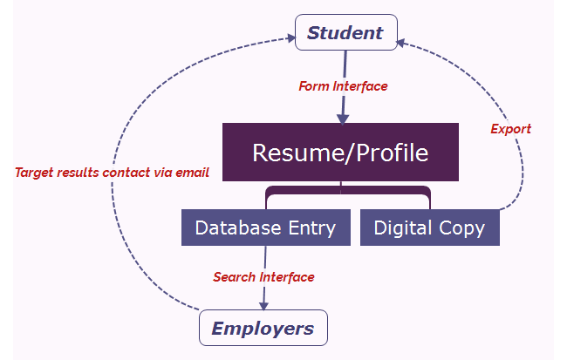
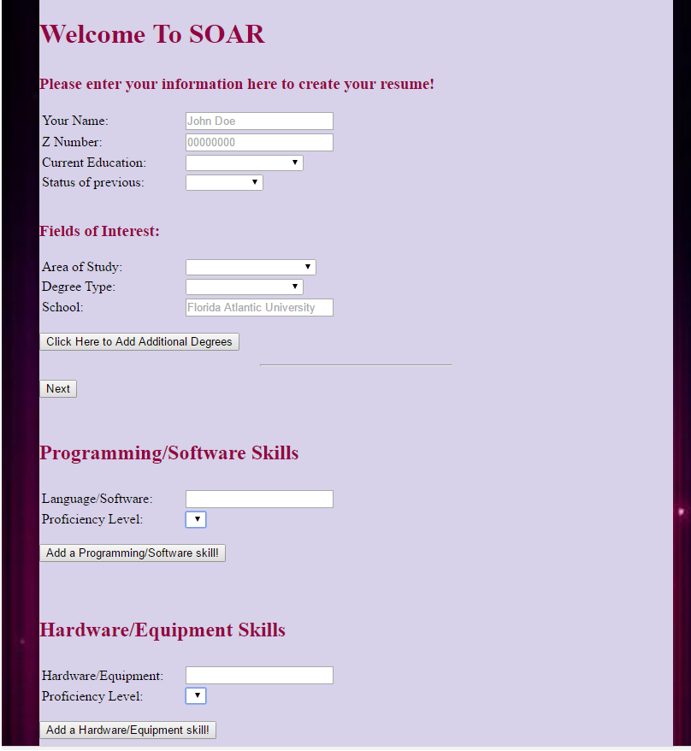
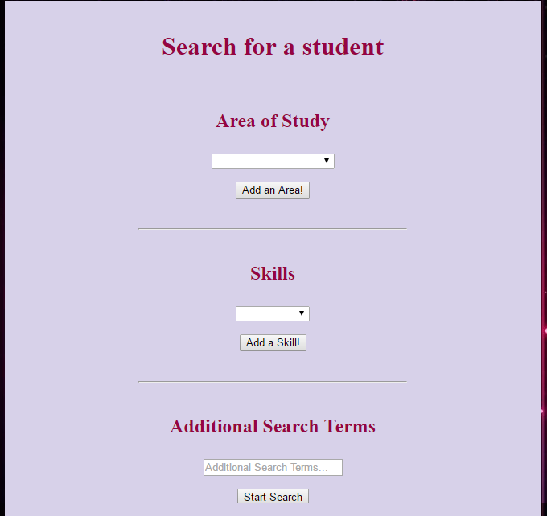



SOAR – Resume Builder & Database
Felipe Soares, Jacob Pack, Cameron Herwig,
Erik White, Jagger Thom
Dr. Shihong Huang
CEN 4010 - Principles of Software Engineering
Introduction
The SOAR Resume Builder is a web application with the aim of helping students connect with possible employers. The goal is to standardize formatting of resumes, making easier for employers and recruiters to find students with the skills they are looking for. The application also simplifies the process of creating resumes, which often appears to be a daunting task, having the information gathered in an online form and formatting it in a professional manner for the student to distribute independently.
Searching
The database structure was designed to normalize the values available in the search parameter by using reference tables for all the skills listed on the resumes. To accommodate the large variety of skills mainly on the Computer Science and Computer Engineering fields, entries are suggested via auto complete. As new skills are added for the first time, the list of suggestion grows by adding to a catalog table of skills.
Searching is also possible by doing keyword searches on the introduction and additional information field if the employer is looking for specific characteristics not present under the skills category.
SOAR
Features
The system is designed to have open access to the database, there is no sign up procedure, authentication is made through the OAUTH API, so all is needed is an FAU email account.
The search feature is also available to all the users, so any students that may also be owners or managers of businesses may also search the database.
Opening the access to the entire school maximizes exposure and possibilities for students.
Resumes can be searched by using preset values or by a text field. The preset values are aggregated into the database as users create their resumes, allowing for a continuously up to date options on the database.
Development Environment
The Team
Fighting Mongooses
Project Owner: Jagger Thom
Scrum Master: Felipe Soares
Developers: Cameron Herwig
Jacob Pack Erik White
Student Information Screen
Conceptual UML 2.0 Class Diagram
Department of Computer and Electrical Engineering and Computer Science
December 14, 2016

