Slide 1
PRISMA

Slide 2
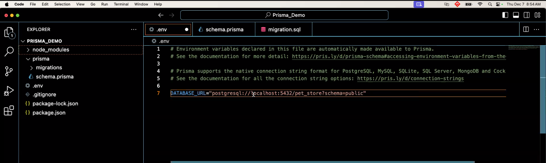
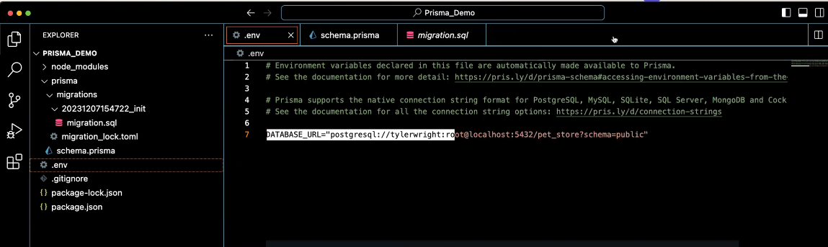
.env file
DATABASE_URL=‘POSTGRESQL:// localhost:5432/blah blah blah’
Longer if there is a password

Slide 3
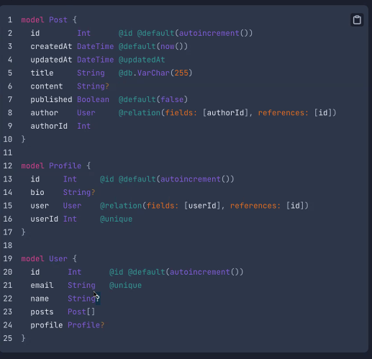
Set up the tables
Data types (from documentation)

Slide 4
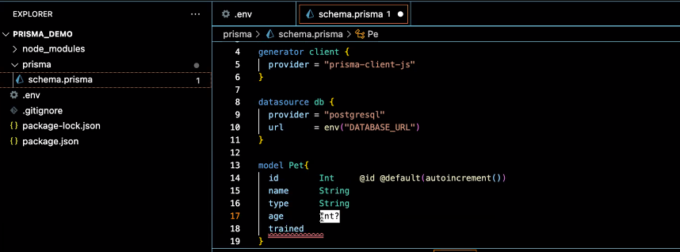
Creating a table

Slide 5
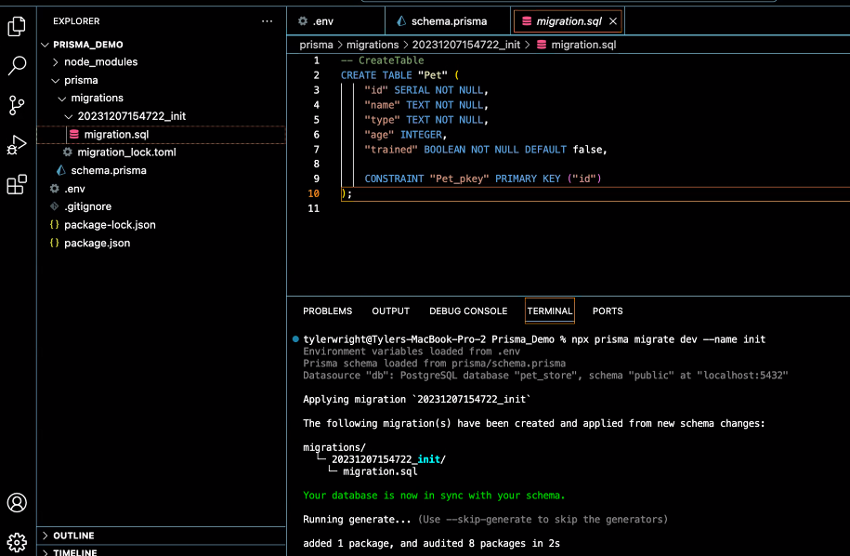
Psql
Create database dbname
Npx prisma migrate dev – name init
Creates migration folder
Then creates a sql file
The name is “init” usually done for first migration
Name in lower case use underscores not dashes

Slide 6
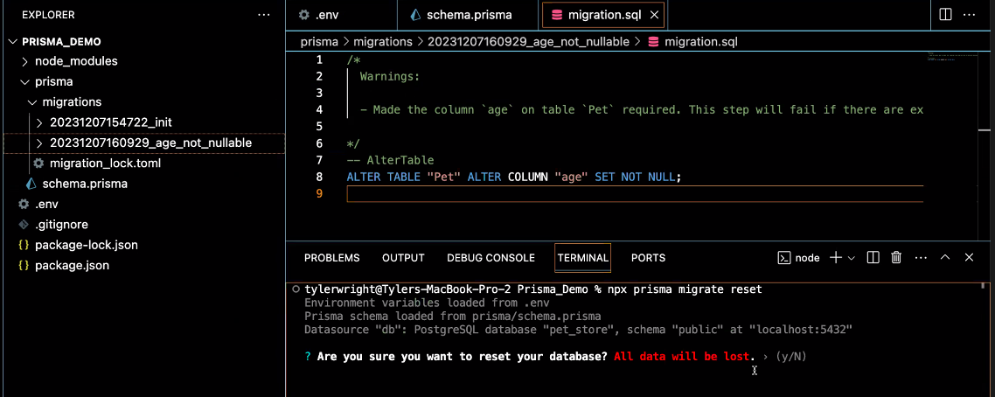
To clear all data and reset the tables:
Npx prisma migrate reset

Slide 7
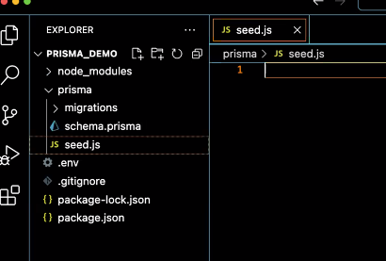
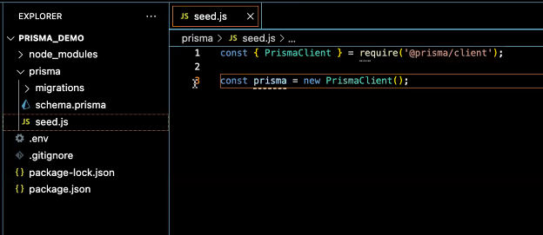
Next: install prisma client
Npm install @prisma/client
Create seed file
These two lines are required

Slide 8
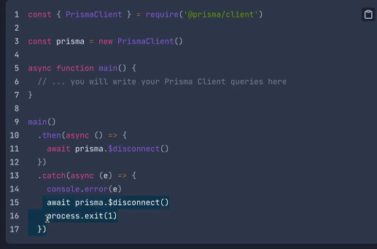
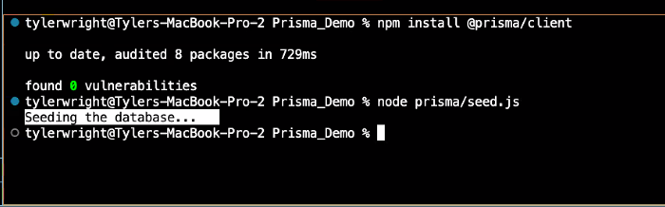
In seed file:
const { PrismaClient } = require('@prisma/client')
2
3const prisma = new PrismaClient()
4
5async function main() {
6 // ... you will write your Prisma Client queries here
Console.log(`seeding the database`)
7}
8
9main()
10 .then(async () => {
11 await prisma.$disconnect()
12 })
13 .catch(async (e) => {
14 console.error(e)
15 await prisma.$disconnect()
16 process.exit(1)
17 })
Test the connection:
Node prisma/seed.js
**can create a script for this in package.json**

Slide 9
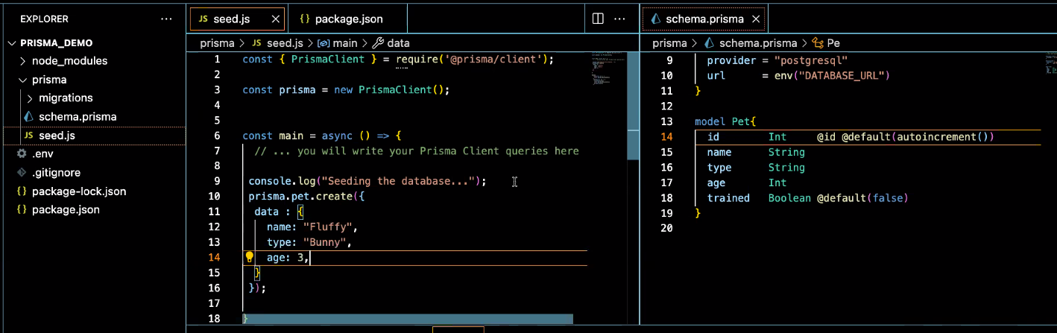
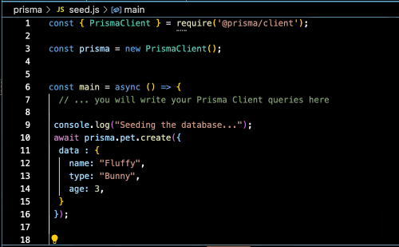
Create data:

Slide 10

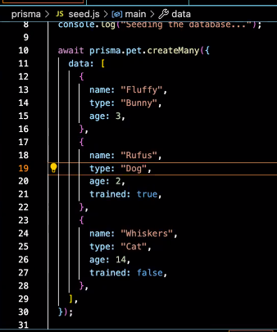
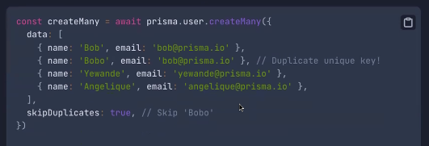
This is a reset and seed script
Copy paste and change data for quick seed fill
Or do it like this using the createMany command

Slide 11
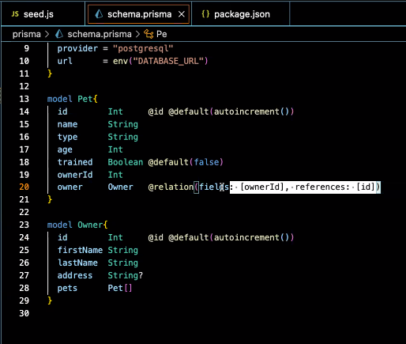
Set up relational data

Slide 12
Command “npx prisma studio”
will open a gui on the browser to view your db if you dont have pgadmin or Postico on your machine

Slide 13

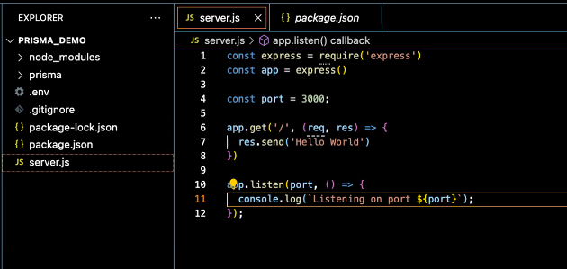

Set up server
Npm install express
Create server.js
Helpful scripts
If anyone runs into that issue of a port in use and youre not sure where it’s running you can run the command “killall node”. Wsl users may have to wait a few seconds to reconnect

Slide 14
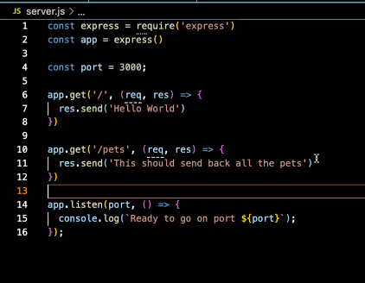
Set up server
Rest api creation

Slide 15
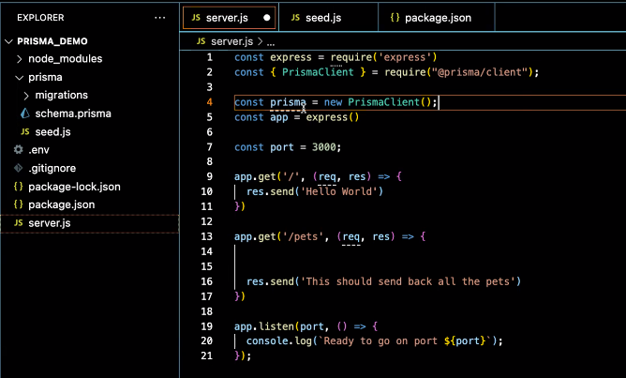
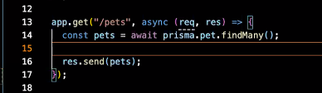
GET
Include prisma code into server.js
Get all the pets

Slide 16
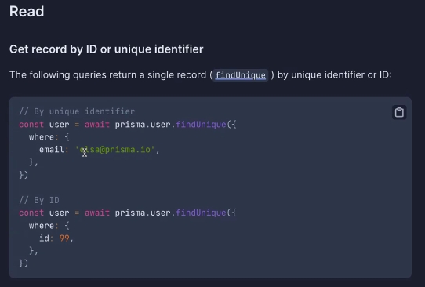
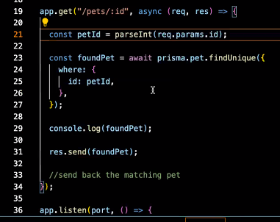
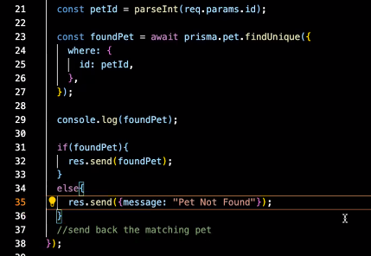
GET
Find one pet by ID
The parseInt() this converts a string to an integer.. Because the param came in as a string
If else for pet not found

Slide 17
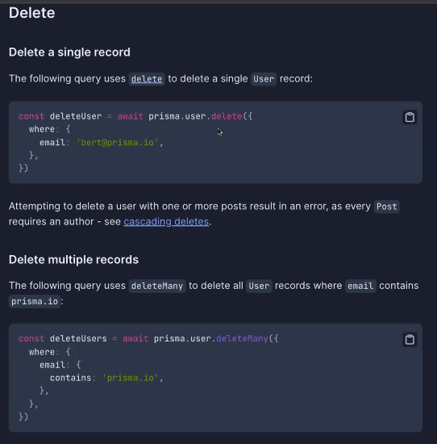
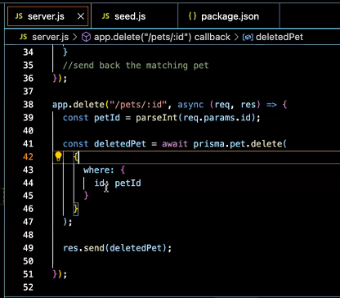
delete

Slide 18
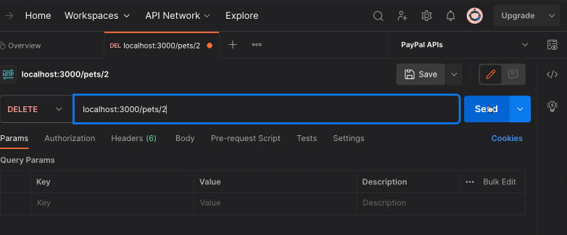
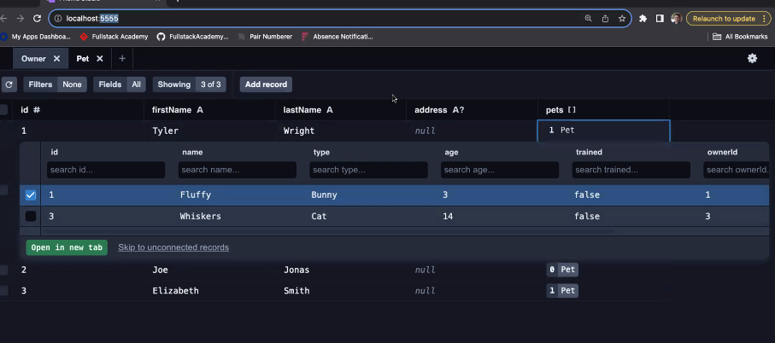
delete
Use postman to test
Use prisma studio to check

Slide 19
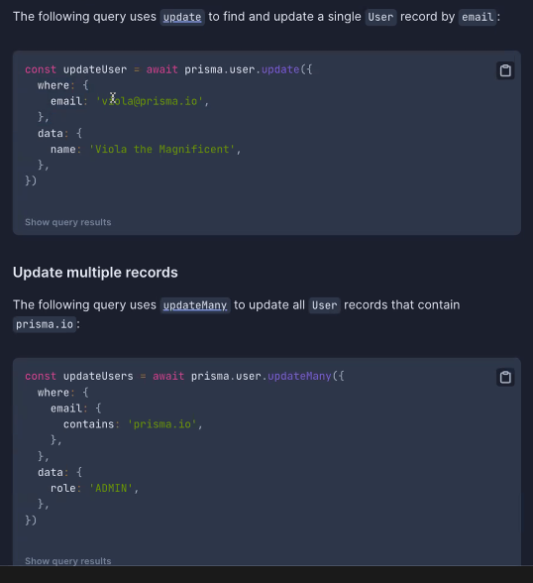
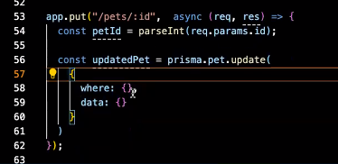
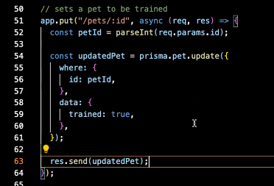
Update (put)
Normally would include information in the body
This is for a Boolean so don’t need middleware
Don’t forget to add await

Slide 20
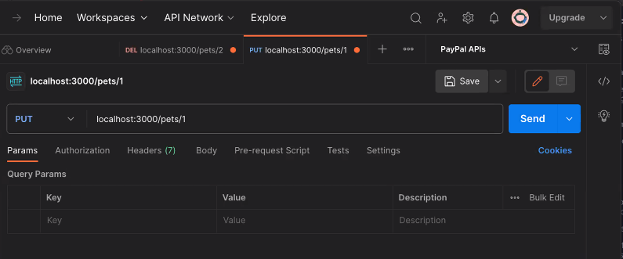
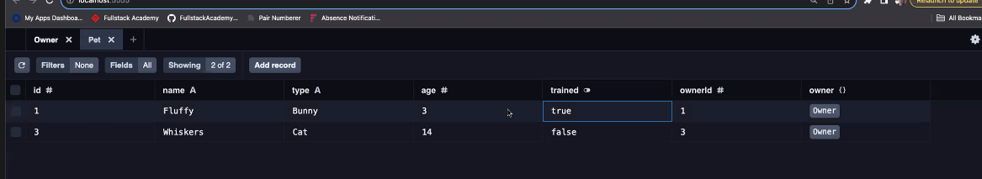
Update (put)
Use postman to test
Use prisma studio to check

