Slide 1





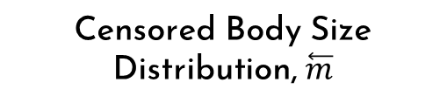




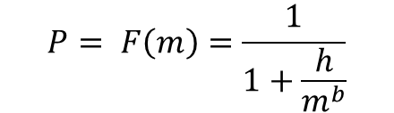


Data Simulation and bias
True Body Size Distribution, $m$
Sampling Probability
Censored Body Size Distribution, $\overset{⃖}{m}$
Frequency
Probability of being collected
Frequency
Body Size
Body Size
Body Size
$$F\left(m\right)=cm^{λ}$$
$$P= F\left(m\right)=\frac{1}{1+\frac{h}{m^{b}}}$$
$$Observed \sim Bernoulli (P)$$
$$rPLB(N, λ, m_{min}, m_{max})$$
True vs. Empirical Distributions
Continuous Frequency Distribution
Estimate λ
Frequency
Frequency
Density
Body Size
Body Size
Distribution of $λ, \overset{⃖}{λ}$
Correction Process
Estimate $m_{min}$
Censored data, $\vec{m}$
$$m_{min}$$
Censor Data
Estimate λ
Frequency
Frequency
Density
Body Size
Body Size
Distribution of $λ, \overset{⃖}{λ}$
$$estimate_xmin(\overset{⃖}{m})$$
$$\vec{m}=\overset{⃖}{m}≥ m_{min}$$

Slide 2
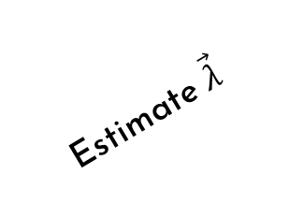



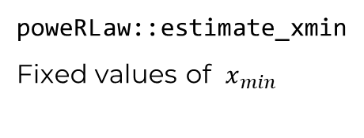






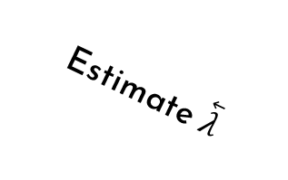


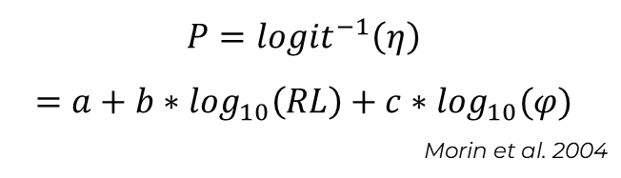


Data Sampling and Bias
True Body Size Distribution, $m$
Sampling Probability
Biased Body Size Distribution, $\overset{⃖}{m}$
Frequency
Probability of being collected
Frequency
Body Size
Body Size
Body Size
$$F\left(m\right)=cm^{λ}$$
$$P={logit}^{−1}\left(η\right)=a+b∗\log_{10}\left(RL\right)+c∗\log_{10}(φ)$$
Morin et al. 2004
$$Observed \sim Bernoulli (P)$$
sizeSpectra::rPLB$(N, λ, m_{min}, m_{max})$
True vs. Empirical Distributions
Biased data, $\overset{⃖}{m}$
Continuous Frequency Distribution
$$λ$$
Frequency
Frequency
Estimate $\overset{⃖}{λ}$
$$\vec{λ}$$
Body Size
Body Size
Density
$$\overset{⃖}{λ}$$
Censoring Process
$$x_{min}$$
Censored data, $\vec{m}$
$$x_{min}$$
Censor Data Then
Continuous Frequency Distribution
Estimate $\vec{λ}$
Estimate $x_{min}$
Distribution of $\overset{⃖}{λ}, \vec{λ}$
Fixed $x_{min}$
Frequency
Frequency
Body Size
Body Size
poweRLaw::estimate_xmin
Fixed values of $x_{min}$
$$\vec{m}=\overset{⃖}{m}≥ x_{min}$$

Slide 3
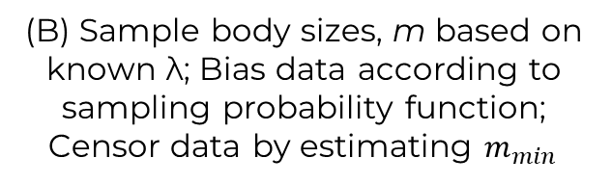
(B) Sample body sizes, m based on known λ; Bias data according to sampling probability function; Censor data by estimating $m_{min}$
(A) λ (points) varies across a hypothetical environmental variable, x, with a known relationship, β (dashed line)
λ
Environmental Variable, x
(C) Estimate relationship of λ to environmental gradient (β) from biased and censored data
(D) Compare distribution of β estimates (colors) to known value (dashed vertical line)
λ_{est.}
Density
Environmental Variable, x
Distribution of β_{est}
Notes:
Each A → one J, estimate strengths metabolic
Using strengths, calculate local STABILITY

Slide 4
