Slide 1

MUTHOOT INSTITUTE OF TECHNOLOGY AND SCIENCE · DEPARTMENT OF COMPUTER SCIENCE AND ENGINEERING
CSD 415 PROJECT WORK · PROJECT PHASE I · REVIEW 1
OneForAll
Repository Intelligence, Engineering Knowledge and Software Defect Risk Prediction
TEAM 14 · CSE 2023–2027 BATCH
ROLL NO.
FOCUS AREA (ZEROTH PLAN)
PROJECT GUIDE
Sunu Aariyan
MUT23CS140
Frontend & UI
Ms. Mithu Mary George
Jithin P R
MUT23CS084
Backend
CO-GUIDE
[PLACEHOLDER – co-guide name]
Mathew Maijo Kavalam
MUT23CS103
AI & Repository Intelligence
ACADEMIC YEAR
2026–27 · Semester VII
Sahala Sajad
MUT23CS132
Database & Documentation
REVIEW
Individual Review-1 contributions: [PLACEHOLDER – to be confirmed by each member]
Project Phase I – Review 1
Notes:
Introduce the team and guide. One line: OneForAll is a permission-aware engineering intelligence platform; this review shows the implemented foundation (workspace, requirements, repository intelligence) and the plan for engineering context, AI assistance and explainable defect-risk prediction. Fill in the co-guide and the individual contribution placeholders before presenting.

Slide 2
02 · PROJECT OVERVIEW
Project Overview
A permission-aware engineering intelligence platform, built in phases — the foundation is implemented and running.
PROBLEM
Engineering knowledge is spread across trackers, Git hosts, CI and documents; AI assistants see only fragments of a project.
Requirements
MOTIVATION
Research solves single stages — code graphs, edit planning, defect prediction, explanation — but not one connected, access-controlled context.
Feedback
Design
NEED
A project-scoped engineering context that links work items with code structure, enforced by organisation roles.
Shared Engineering Context
project-scoped, permission-aware
TARGET USERS
Developers, team leads and project managers, QA engineers, engineering organisations.
Deploy
Code
NEXT
SCOPE (PHASE I)
Multi-tenant workspace, requirements and tasks, repository snapshots and structure analysis (implemented); engineering context next.
EXPECTED IMPACT
Less manual context gathering and earlier visibility of risky changes — to be evaluated in later phases; no measured claims yet.
Test
Review
IMPLEMENTED
NEXT
FUTURE
status per SDLC stage
OneForAll · Project Phase I – Review 1 · Team 14 · Dept. of CSE, MITS
02 / 20
Notes:
Walk through problem, motivation and need. The ring shows where OneForAll sits in the SDLC: requirements and code are implemented today (requirements/tasks, repository snapshots and structure analysis). The shared engineering context in the centre is the next phase (2I). Review, test, deploy and feedback stages are future work.

Slide 3
03 · PROGRESS SINCE ZEROTH REVIEW
Progress Since Zeroth Review
What changed between the Zeroth Review (Aug 2026) and Review 1 (Oct 2026).
ASPECT
AT ZEROTH REVIEW
NOW (REVIEW 1)
Problem definition
Repository-aware, multi-agent engineering intelligence platform.
Focus refined to repository intelligence, engineering knowledge and defect-risk prediction; multi-agent AI moved to later phases. Title change subject to Department approval.
Literature survey
Broad survey: repository-level AI, SE agents, code models, documentation, defect prediction.
Five core papers selected and mapped to one pipeline: Represent → Understand → Plan → Predict → Explain.
Architecture
Proposed: Angular 20, ASP.NET Core (.NET 9), SQL Server, Redis, SignalR, Azure.
Implemented: Next.js 16 + TypeScript, Supabase (PostgreSQL, Auth, Row-Level Security), Tree-sitter.
Algorithms
Proposed: AST parsing, code graph, engineering risk score.
Implemented: Tree-sitter AST extraction of symbols and relationships (4 languages). Graph, risk and explanation still planned.
Hardware
Development laptops; Azure cloud (proposed).
Development laptops + Docker (local Supabase). No special hardware; cloud deployment deferred.
Software built
Not started.
Phase 1 and 2A–2H complete: auth, organisation hierarchy, projects, requirements/tasks, repository, snapshots, structure analysis.
COMMITTEE SUGGESTIONS → ACTION TAKEN
SUGGESTION
ACTION TAKEN
[PLACEHOLDER – committee remark from the Zeroth Review]
[PLACEHOLDER – what the team changed in response]
OneForAll · Project Phase I – Review 1 · Team 14 · Dept. of CSE, MITS
03 / 20
Notes:
Required by the Review-1 template. Highlight the stack change: the proposed .NET / Angular / SQL Server design was replaced by Next.js + Supabase, where PostgreSQL Row-Level Security enforces tenant isolation inside the database. Fill in the committee suggestions before presenting. Note that the refined title needs Department approval.

Slide 4
04 · PROBLEM STATEMENT
Problem Statement
Fragmented engineering knowledge, and AI tools that see only part of it.
TODAY: KNOWLEDGE IN SEPARATE TOOLS
PROBLEM STATEMENT
Engineering knowledge — requirements, code structure, change history and quality signals — is spread across separate tools. Developers connect these pieces by hand. General-purpose AI assistants work on pasted fragments without a persistent, permission-aware view of the project, and defect-prone changes are usually found late: in review, testing or production.
Issue tracker
requirements, tasks
Git hosting
code, history, PRs
WHO IS AFFECTED
Developers, team leads and project managers, QA engineers, organisations adopting AI-assisted engineering.
CI / CD
builds, tests
Developer
links it by hand
Docs & wiki
decisions, designs
WHY IT MATTERS
Time goes into gathering context; broad AI access to repositories risks exposing code to people who should not see it; late defects mean rework.
ENGINEERING SIGNIFICANCE
Quality reports
coverage, defects
AI chat
pasted fragments
Needs structural code analysis (ASTs), multi-tenant authorization inside the database, and data models linking work items to code.
No shared, access-controlled view of the project. Each answer starts from zero.
SDGS ADDRESSED
SDG 8 – Decent Work & Economic Growth · SDG 9 – Industry, Innovation & Infrastructure
OneForAll · Project Phase I – Review 1 · Team 14 · Dept. of CSE, MITS
04 / 20
Notes:
State the problem in one breath, then the three cards. Avoid statistics we have not measured. SDGs carried over from the Zeroth Review (8 and 9).

Slide 5
05 · EXISTING SYSTEMS
Existing Systems and Their Limitations
Each category holds one slice of engineering knowledge.
CATEGORY
EXAMPLES
WHAT IT DOES WELL
LIMITATION FOR THIS PROBLEM
IDEs and code assistants
VS Code, IntelliJ IDEA, GitHub Copilot
Editing, completion, local navigation.
Context is mostly the open workspace and session; not tied to requirements or to organisation-level access rules.
Repository hosting
GitHub, GitLab, Bitbucket
Version control, pull requests, code search.
Code-centric; requirement-to-code traceability depends on manual linking conventions; no structural risk signal.
Issue trackers
Jira, Azure Boards
Planning, workflows, reporting.
Track work items but do not understand the code that implements them.
General AI assistants
ChatGPT, Claude, Gemini
Reasoning, explanation, drafting.
Each conversation starts from pasted fragments; no persistent, access-controlled project context.
Repository-level AI research
RepoGraph [1], CGM [2], CodePlan [3], SWE-agent [8]
Code graphs, planning, issue resolution on benchmarks.
Evaluated as standalone methods; no multi-tenant access control or requirement context.
Defect-prediction research
JIT-BiCC [4], FoX [5], Kamei et al. [12]
Commit-level risk, formal explanations.
Standalone models; not part of a team's day-to-day engineering workspace.
Inference: no existing tool maintains a project-scoped, access-controlled context that links work items, code structure and change risk.
OneForAll · Project Phase I – Review 1 · Team 14 · Dept. of CSE, MITS
05 / 20
Notes:
Be fair to existing tools: each is good at its slice. The gap is the connection between slices, under access control. Product capabilities change quickly, so keep claims about tools general.

Slide 6
06 · LITERATURE REVIEW (1/2)
Literature Review — Repository Understanding
Three core papers on representing, understanding and changing whole repositories.
[1]
REPRESENT
CORE IDEA
CONTRIBUTION / FINDINGS
LIMITATION / GAP
RepoGraph: Enhancing AI Software Engineering with Repository-level Code Graph
Builds a line-level repository graph with tree-sitter: definition and reference nodes joined by invoke and contain edges. Retrieves k-hop ego-graphs around search terms.
Plug-in module for procedural and agent frameworks; improved all four tested methods on SWE-bench and generalised to CrossCodeEval.
Authors note: evaluated only with GPT-4-series models, on SWE-bench Lite (cost), and on Python. Gap for OneForAll: no access control or work-item context.
Ouyang et al. · ICLR 2025
[2]
UNDERSTAND
CORE IDEA
CONTRIBUTION / FINDINGS
LIMITATION / GAP
Code Graph Model (CGM): A Graph-Integrated LLM for Repository-Level SE Tasks
Puts a repository code graph (7 node types, 5 edge types) inside an open LLM: node text encoded by CodeT5+ through an adapter; a graph-aware attention mask limits attention to neighbouring nodes.
Agentless Graph-RAG pipeline (rewriter, retriever, reranker, reader); reports 43.00% resolved on SWE-bench Lite with Qwen2.5-72B, first among open-weight models.
Authors note: repositories larger than the context length and complex dynamic dependencies remain hard. Supports Python and Java.
Tao et al. · NeurIPS 2025
[3]
PLAN
CORE IDEA
CONTRIBUTION / FINDINGS
LIMITATION / GAP
CodePlan: Repository-level Coding using LLMs and Planning
Frames repository-level coding as planning: incremental dependency analysis and change may-impact analysis drive an adaptive plan — a chain of LLM edits.
Evaluated on C# package migration and Python temporal edits needing changes to 2–97 files; closer to ground truth than the baselines.
Gap for OneForAll: targets edit propagation; no requirement context, defect-risk signal or multi-tenant authorization.
Bairi et al. · Proc. ACM Softw. Eng. (FSE) 2024
OneForAll · Project Phase I – Review 1 · Team 14 · Dept. of CSE, MITS
06 / 20
Notes:
For each paper: one sentence of idea, one of result, one of limitation. Numbers are as reported by the authors. The stage tag shows where the paper sits in our Represent → Understand → Plan → Predict → Explain pipeline.

Slide 7
07 · LITERATURE REVIEW (2/2)
Literature Review — Defect Risk and Explanation
Two core papers on predicting and explaining risky changes, plus supporting work.
[4]
PREDICT
CORE IDEA
CONTRIBUTION / FINDINGS
LIMITATION / GAP
Just-In-Time Software Defect Prediction via Bi-modal Change Representation Learning
BiCC-BERT is pre-trained on code changes and commit messages with a Replaced Message Identification objective, learning bi-modal change representations.
JIT-BiCC fuses these representations with 14 expert change metrics in an MLP classifier; reports a 10.8% F1 improvement over eight baselines on 27,391 changes.
Gap for OneForAll: predicts per-commit risk only; explaining individual predictions and project context are outside its focus.
Jiang, Shen, Gu · J. Syst. Softw. 219, 2025
[5]
EXPLAIN
CORE IDEA
CONTRIBUTION / FINDINGS
LIMITATION / GAP
A Formal Explainer for Just-In-Time Defect Predictions (FoX)
Uses formal reasoning about a JIT model's behaviour to give provably correct explanations of why a commit is predicted defective, guaranteed to be minimal.
Explanations shown to be correct, robust and actionable where model-agnostic techniques are not; 54-practitioner survey: 86% found it useful, 74% trustworthy.
Gap for OneForAll: explains an existing JIT model; it is not a predictor and is not integrated into a team's workflow.
Yu, Fu, Ignatiev, Tantithamthavorn, Stuckey · ACM TOSEM 33(7), 2024
SUPPORTING REFERENCES (FROM THE ZEROTH REVIEW SURVEY)
[6] RepoCoder — iterative retrieval and generation for repository-level code completion (EMNLP 2023).
[7] SWE-bench — benchmark of real GitHub issues for repository-level issue resolution (ICLR 2024).
[8] SWE-agent — agent–computer interface for LLM agents working on repositories (NeurIPS 2024).
[9] CodeBERT — bimodal pre-trained model for programming and natural language (Findings of EMNLP 2020).
[10] GraphCodeBERT — pre-training code representations with data flow (ICLR 2021).
[11] Zeng et al. — empirical study of deep just-in-time defect prediction versus simpler baselines (ISSTA 2021).
[12] Kamei et al. — large-scale study of just-in-time quality assurance and change-level metrics (IEEE TSE 2013).
OneForAll · Project Phase I – Review 1 · Team 14 · Dept. of CSE, MITS
07 / 20
Notes:
JIT-BiCC predicts; FoX explains. Together they define the Predict and Explain stages we plan to adopt. Supporting references give the wider context from our Zeroth survey.

Slide 8
08 · RESEARCH GAP AND NOVELTY
Literature Insight and Research Gap
The five papers form one pipeline. Each solves one stage in isolation.
REPRESENT
UNDERSTAND
PLAN
PREDICT
EXPLAIN
RepoGraph [1]
CGM [2]
CodePlan [3]
JIT-BiCC [4]
FoX [5]
repository code graph
graph-integrated LLM
dependency-aware edit plans
change-level defect risk
provable explanations
IMPLEMENTED
FUTURE
FUTURE
FUTURE
FUTURE
OneForAll: Foundation: symbols and relationships from ASTs (2H)
OneForAll: Context-grounded AI services
OneForAll: Change planning on the code graph
OneForAll: Defect-risk estimate per change
OneForAll: Explanation shown with each risk
RESEARCH GAP
NOVELTY OF ONEFORALL
Isolated stages. Each method is evaluated on its own benchmark (SWE-bench, JIT datasets); none keeps a persistent context for a real team's project.
Missing links. Requirements and tasks are absent from repository-level methods; code structure is absent from JIT defect prediction.
No access boundary. Tenant isolation and role checks before context is used are outside their scope.
Engineering context (Phase 2I, planned). Requirements, tasks and code structure linked per project and kept across snapshots.
Authorization first. Access is enforced in the database (RLS) before any context is read — the same boundary future AI services must pass.
Integration, not reinvention. One pipeline carries the same context from representation to explained risk; published techniques are adopted and evaluated, not re-invented.
Therefore, there is a need to develop a permission-aware platform that maintains project-scoped engineering context from repositories and work items, and uses it for repository understanding and explainable defect-risk prediction.
OneForAll · Project Phase I – Review 1 · Team 14 · Dept. of CSE, MITS
08 / 20
Notes:
Key message for the rubric (research gap and novelty): we do not claim to invent code graphs or JIT prediction. The contribution is the engineering-context architecture that connects the five stages under database-enforced access control. Only the Represent stage has an implemented foundation today.

Slide 9
09 · OBJECTIVES
Objectives and Expected Outcomes
Six measurable objectives; status as of Review 1.
IMPLEMENTED
NEXT
FUTURE
OBJECTIVE
MEASURE OF SUCCESS
O1
Secure multi-tenant workspace
Cross-tenant and role tests pass (153/153 PostgREST checks).
Organisation → department → team → project, with OWNER / ADMIN / MEMBER roles enforced in the database.
IMPLEMENTED
O2
Engineering work capture
Invalid transitions rejected; regression suites pass.
Requirements and tasks per project, with lifecycle rules enforced by database triggers.
IMPLEMENTED
O3
Repository intelligence foundation
Parser tests 166/166; signed, tamper-checked persistence.
Snapshots, file manifests and AST extraction of symbols and relationships for TypeScript, JavaScript, Python and Java.
IMPLEMENTED
O4
Shared engineering context
Every work item linkable to code; links respect RLS.
Link requirements and tasks to code entities per project (Phase 2I).
NEXT
O5
Context-grounded AI assistance
Answers cite only context the user may access.
Authorization-aware orchestrator that assembles only permitted context for AI services.
FUTURE
O6
Explainable defect-risk prediction
Precision / recall / F1 against published JIT baselines.
Change-level risk estimate with an explanation, informed by JIT-BiCC [4] and FoX [5].
FUTURE
EXPECTED DELIVERABLES
Web prototype (running, partial) · Repository intelligence module · Engineering context store (next) · Risk prediction and explanation module (planned) · Project report · Conference paper (planned)
OneForAll · Project Phase I – Review 1 · Team 14 · Dept. of CSE, MITS
09 / 20
Notes:
Three objectives are implemented, one is next, two are future. Measures for future objectives are planned evaluation criteria, not results.

Slide 10
10 · SCOPE
Scope of the Project
What is built, what comes next, and what is planned — clearly separated.
IMPLEMENTED
NEXT
FUTURE
Phase 1, 2A–2H
Phase 2I and prerequisites
Later phases
Email / password authentication, sessions, protected routes
Organisations, departments, teams and memberships
Roles: OWNER, ADMIN, MEMBER
Projects (greenfield / brownfield) with lifecycle
Requirements and tasks with status rules
Repository connection record (no cloning, no credentials stored)
Snapshots and file manifests (path, language, size, SHA-256)
Structure analysis: symbols and relationships, 4 languages
Enterprise web UI (desktop, tablet, mobile)
Shared Engineering Context: link requirements and tasks to code entities
Repository source ingestion (fetch file content for analysis)
Job-based execution and recovery for long analyses
AI Orchestrator: intent, authorization check, context assembly, model routing
AI services: Q&A, review, test generation, documentation
Code graph traversal and change history
Defect-risk prediction with explanations
CI/CD integration and deployment feedback
Starts after Review 1. Source ingestion and jobs are prerequisites for analysing real repositories.
Planned for the rest of Phase I and Phase II; order may change after Phase 2I.
OUT OF SCOPE
Replacing the IDE, Git host, issue tracker or CI system · Autonomous production changes · Unrestricted AI access to repositories
OneForAll · Project Phase I – Review 1 · Team 14 · Dept. of CSE, MITS
10 / 20
Notes:
Point at the three columns: everything on the left runs today; the middle is the next phase; the right is the plan. Nothing in the right column is claimed as implemented.

Slide 11
11 · SYSTEM REQUIREMENTS
Functional and Non-Functional Requirements
Functional requirements by subsystem; non-functional requirements as design constraints.
FUNCTIONAL REQUIREMENTS
NON-FUNCTIONAL REQUIREMENTS
Identity and access
Sign up, sign in, sign out; session refresh; route protection.
IMPLEMENTED
Security. Authorization enforced in the database (RLS) and re-checked by the application; strict tenant isolation.
Integrity. Generated structure is written only through a signed server path; completed analyses are immutable.
Reliability. Explicit lifecycle states; failures recorded with a retry path; no partial results stored.
Maintainability. Strict TypeScript, modular server code, Zod validation, versioned SQL migrations.
Usability. One design system; responsive layouts; visible keyboard focus.
Bounded work. 1 MB per source file; 50,000 symbols per analysis. Performance not yet benchmarked.
Privacy. No repository credentials stored; secrets stay server-side.
Organisation hierarchy
Create organisations, departments, teams; manage memberships and roles.
IMPLEMENTED
Projects
Greenfield / brownfield projects; lifecycle DRAFT → ACTIVE → ARCHIVED.
IMPLEMENTED
Requirements and tasks
Create, prioritise and move through enforced status transitions.
IMPLEMENTED
Repository
Record one repository per project (GitHub, GitLab, Bitbucket, generic Git); disconnect.
IMPLEMENTED
Snapshots
Record commit snapshots and file manifests.
IMPLEMENTED
Structure intelligence
Extract symbols and relationships per snapshot; show file coverage.
IMPLEMENTED
Engineering context
Link work items to code entities.
NEXT
AI, risk, delivery
AI assistance; defect risk with explanation; CI/CD feedback.
FUTURE
OneForAll · Project Phase I – Review 1 · Team 14 · Dept. of CSE, MITS
11 / 20
Notes:
Functional requirements map one-to-one to implemented modules, plus the next and future rows. For non-functional requirements, we state design constraints and limits — we do not claim performance figures we have not measured.

Slide 12
12 · SYSTEM DESIGN
System Architecture
Layered target architecture. Status shows what exists today.
IMPLEMENTED
NEXT
FUTURE
ACCESS
User
Supabase Auth · session
RBAC: OWNER / ADMIN / MEMBER
PostgreSQL Row-Level Security
HIERARCHY
Organization
Department
Team
Project
WORKSPACE
Requirements
Tasks
Repository record
Snapshots · file manifest
REPOSITORY INTELLIGENCE
Tree-sitter AST parsing
Symbols
Relationships
Code graph · change history
ENGINEERING CONTEXT
Shared Engineering Context — requirements, tasks and code entities linked per project (Phase 2I)
AI LAYER
AI Orchestrator: intent → authorize → assemble context → route model
AI services: Q&A · review · tests · docs
deploy
feedback
QUALITY & DELIVERY
Defect-risk prediction
Explanation
CI/CD integration
Deployment feedback
OneForAll · Project Phase I – Review 1 · Team 14 · Dept. of CSE, MITS
12 / 20
Notes:
Read top to bottom: every request passes access control and the organisation hierarchy before it touches workspace data. The first four bands are implemented. The engineering context (amber) is next. AI, risk and delivery bands are future work; the dashed loop shows deployment feedback updating the context.

Slide 13
13 · TECHNOLOGIES USED
Current Implementation Architecture
Only technology that is in the codebase today.
BROWSER
WHY THESE TECHNOLOGIES
React 19 UI · Tailwind CSS 4 design system · custom components and icon set · command palette
Next.js + TypeScript. One typed language for UI and server; Server Actions keep every mutation on the server.
Supabase / PostgreSQL. Auth plus Row-Level Security enforce tenant isolation inside the database, not only in app code [14], [15].
Tree-sitter. Robust parsers with official grammars for many languages; runs as WASM inside Node.js [13].
Zod. Runtime validation of every input before it reaches the database.
Tailwind CSS 4. Token-based design system shared by every screen.
HTTPS · session cookie
NEXT.JS 16 APP ROUTER (NODE.JS, TYPESCRIPT)
Proxy
session refresh, route guard
Server Components
RLS-filtered reads
Server Actions
mutations, Zod validation
Repository structure engine
web-tree-sitter (WASM) adapters: TypeScript, TSX, JavaScript, Python, Java
analyzer with size, hash and symbol limits
canonical OFA-STRUCTURE-V1 message · HMAC-SHA256 signer (server-only key)
PostgREST / Auth API with the user's JWT
SUPABASE (LOCAL, DOCKER)
Auth
PostgREST
Vault (database copy of HMAC key)
NOT IN THE CURRENT BUILD
PostgreSQL: RLS policies · SECURITY DEFINER functions (search_path = '') · lifecycle and immutability triggers · versioned migrations
No LLM calls, embeddings, vector store, RAG pipeline or job queue yet. These belong to later phases and are not claimed here.
OneForAll · Project Phase I – Review 1 · Team 14 · Dept. of CSE, MITS
13 / 20
Notes:
This is the real stack. One technical advantage over the Zeroth proposal: database-level Row-Level Security keeps tenant isolation in force even if application code has a bug. Be explicit that no AI component runs today.

Slide 14
14 · METHODOLOGY
Repository Intelligence — Implementation
From a recorded repository to signed, queryable code structure. No AI, embeddings or RAG in this phase.
Phase 2F
Phase 2G
Phase 2G
Phase 2H
Phase 2H
Phase 2H
Repository
record per project
Snapshot
commit SHA, branch, status
File manifest
path, language, size, SHA-256
Structure analysis
PENDING → PROCESSING → COMPLETED / FAILED
Symbols
10 kinds: class, method, function…
Relationships
contains, imports, extends, implements
PER-FILE DECISION LOGIC (ANALYZER)
DEMO RUN (REAL OUTPUT)
10-file snapshot · 4 languages
Next file in
manifest
Parser for
language?
Size
≤ 1 MB?
SHA-256 =
manifest?
Parse
succeeds?
Extract
symbols +
relationships
42
42
4 / 10
yes
yes
yes
yes
symbols
relationships
files analysed
no
no
no
no
Unsupported 3: Markdown, CSV, no-language file
Failed 3: hash drift, over 1 MB, syntax error
Relationships: 33 contains, 5 imports, 3 extends, 1 implements
Symbol kinds: 9 methods, 9 modules, 7 classes, 4 functions, 4 variables, 3 constants, 2 interfaces, 2 constructors, 1 enum, 1 type
Unsupported
Failed
Failed (drift)
Failed
ANALYSIS LIFECYCLE (DATABASE-ENFORCED)
begin
run token issued; PROCESSING
analyse files
decision logic above
canonicalise
OFA-STRUCTURE-V1
sign
HMAC-SHA256, server key
persist
DB verifies signature + token
COMPLETED — sealed by trigger, read-only
any error → FAILED, retry via reset
Source content for this run came from an in-memory test provider. Production source ingestion is not built yet; the app shows a readiness message instead of fake analysis.
Limits: 1 MB per file, 50,000 symbols per analysis. Unsupported languages are counted, not guessed. Source content is checked against the manifest hash before parsing, so a changed file cannot be analysed as the recorded one.
OneForAll · Project Phase I – Review 1 · Team 14 · Dept. of CSE, MITS
14 / 20
Notes:
Methodology slide. Phase 2G stores file-level facts (manifest); Phase 2H extracts structure from ASTs. Explain the four decisions per file and the signed persistence. The numbers on the right are the real output of the analyzer on our 10-file demo snapshot, shown in the UI on the next slides. Calls and references are reserved in the schema but not extracted yet.

Slide 15
15 · SECURITY AND AUTHORIZATION
Security and Authorization
Authorization lives in the database; the application re-checks it but is never the only guard.
REQUEST PATH
CAPABILITY
OWNER
ADMIN
MEMBER
Browser
session cookie only; no keys
View organisation, departments, teams
✓
✓
✓
Edit organisation; manage departments, teams, memberships
✓
✓
–
Proxy
refreshes session, guards routes
Delete organisation
✓
–
–
Server Component / Action
Zod validation, role check (UI hint)
Create projects, requirements, tasks; repository, snapshots, analyses
✓
✓
–
View projects and their data
all
all
own teams
PostgREST with user JWT
every query runs as the user
KEY CONTROLS
Row-Level Security
policies call has_org_role / is_org_member
Cross-tenant isolation. Another organisation's IDs return 404 — no existence leak.
Signed persistence. Structure is written only by a definer function that verifies an HMAC-SHA256 signature and a one-time run token.
Key handling. Server key in an environment variable, database copy in Supabase Vault; never sent to the client or logged.
Least privilege. Clients cannot insert or delete symbols and relationships, or update analyses, directly.
SECURITY DEFINER functions
lifecycle and persist; search_path = ''
Triggers
status transitions, sealed COMPLETED
Green: enforced inside PostgreSQL — holds even if application code is wrong.
OneForAll · Project Phase I – Review 1 · Team 14 · Dept. of CSE, MITS
15 / 20
Notes:
Walk the request path top to bottom. The green layers run inside PostgreSQL, so a bug in application code cannot bypass them. The role matrix is enforced by RLS policies, which the next slide's tests check (153/153 PostgREST checks, including cross-tenant attempts).

Slide 16
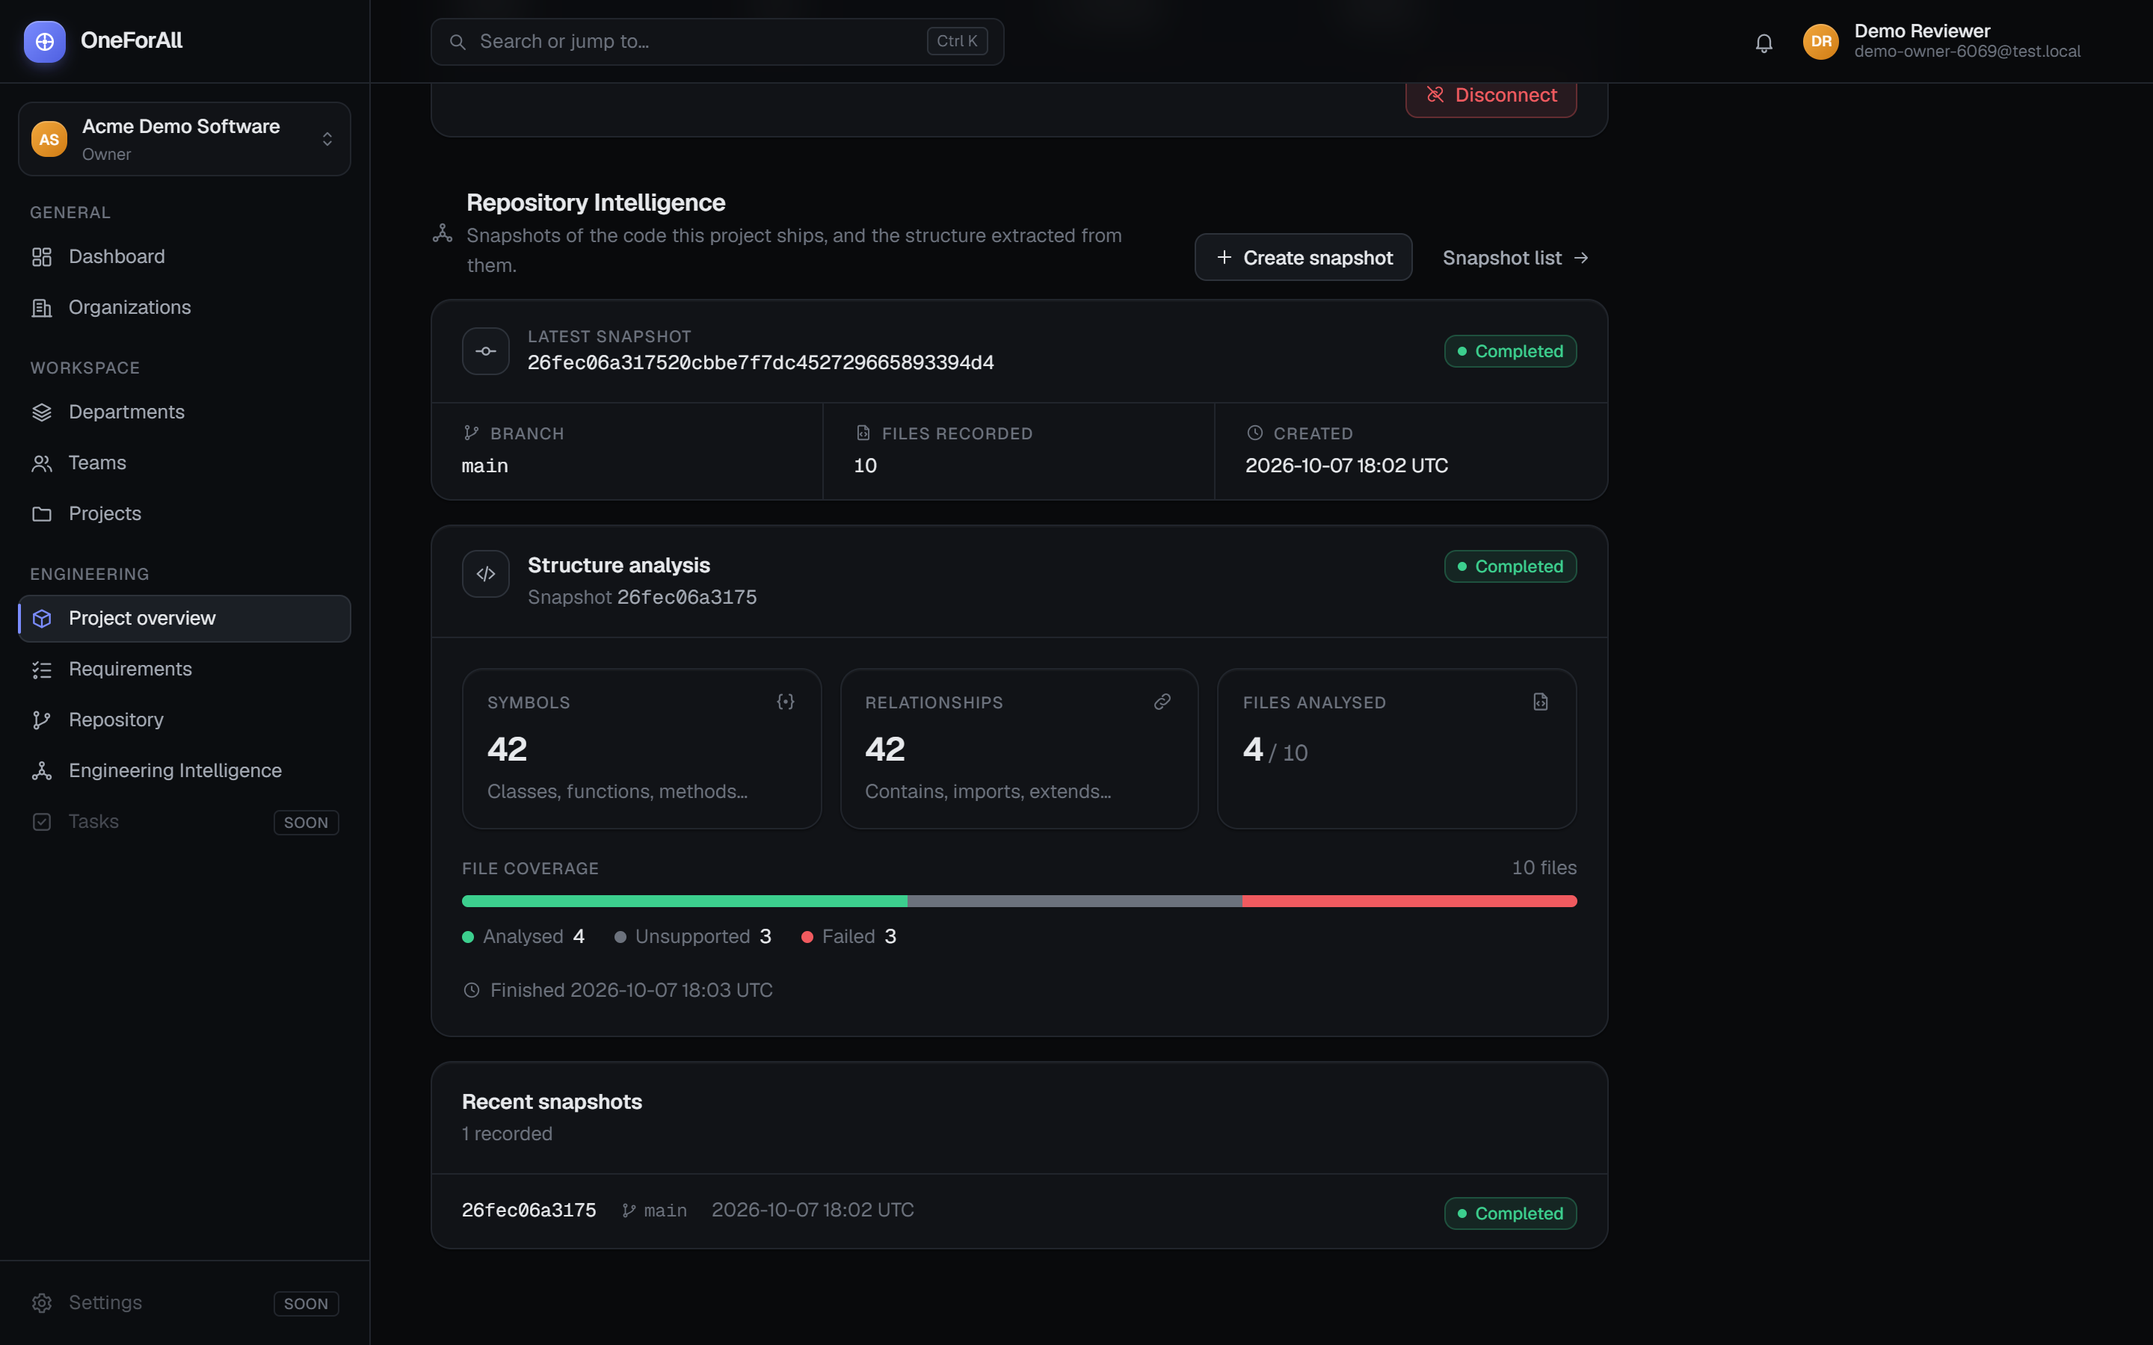
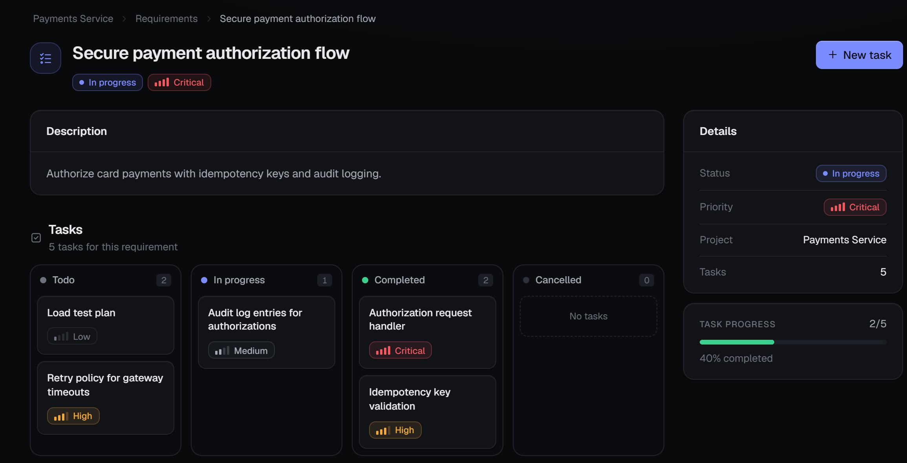
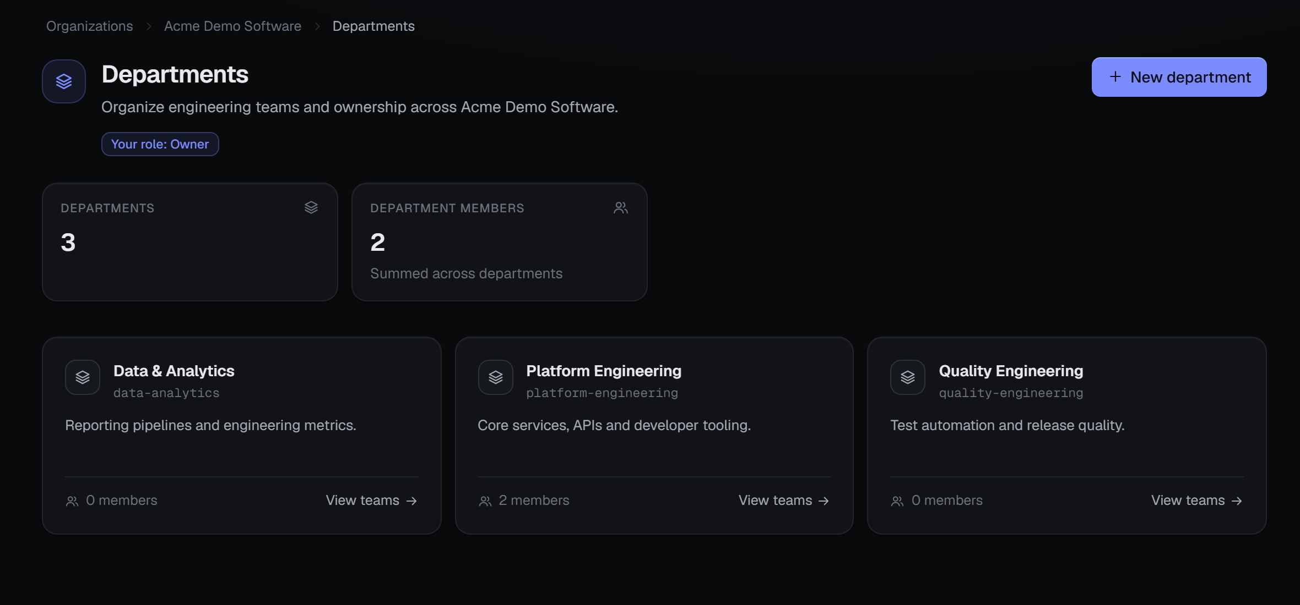
16 · DEVELOPMENT PROGRESS
Working Prototype — Real Screenshots
Running locally on Supabase with a fictional demo organisation (Acme Demo Software) and @test.local accounts.
Requirement with task board
Organisation → departments
Repository intelligence: snapshot + structure analysis (42 / 42)
Implemented screens: sign-in, dashboard, organisation / department / team / project pages, requirements and task board, repository, snapshots, structure intelligence.
Labelled honestly: Tasks and Settings show “Soon”. The analysis shown is real analyzer output on 10 fixture files supplied by a test provider (slide 14).
OneForAll · Project Phase I – Review 1 · Team 14 · Dept. of CSE, MITS
16 / 20
Notes:
Screenshots are from the running prototype (production build on localhost). The analysis numbers are the real output from the demo snapshot. Offer a live demo if time allows: sign in → open the project → requirements board → repository intelligence.

Slide 17
17 · PRELIMINARY RESULTS
Testing and Validation
Automated checks run against the local Supabase stack. No AI or performance figures — those modules are not built.
155
153 / 153
166 / 166
114 / 114
mutants generated
PostgREST checks pass
parser tests pass
manifest tests pass
Mutation testing (Phase 2H)
Phase 2H persistence over HTTP
Tree-sitter adapters
Snapshot file manifests
151 killed · 4 proven equivalent · 0 unexplained survivors
authorization, write-path and tamper checks via the real API
TypeScript, TSX, JavaScript, Python, Java
paths, languages, sizes, hashes, isolation
BUILD AND REGRESSION CHECKS
FUNCTIONAL RESULT
TypeScript type check
PASS
Demo snapshot: 42 symbols and 42 relationships extracted from 4 of 10 files; 3 unsupported, 3 failed by design (drift, size, syntax). In verification runs the extracted symbols were identical between development and production builds.
ESLint
PASS
Production build
PASS
Database schema diff vs migrations
CLEAN
Secret scan of source and client bundle
CLEAN
HOW TO READ THE MUTATION SCORE
Each of the 4 equivalent mutants was shown to behave exactly like the original code, so no test can kill it. They are excluded from the score, not counted as killed: 151 of 151 non-equivalent mutants were killed. They are not failures.
Phase 2A–2G regression suites
PASS
OneForAll · Project Phase I – Review 1 · Team 14 · Dept. of CSE, MITS
17 / 20
Notes:
All numbers come from our own test runs on the local stack. Mutation testing deliberately breaks the code (for example the HMAC check) and confirms a test fails. Equivalent mutants cannot be detected by any test by definition, so we report them separately rather than inflating the score.

Slide 18
18 · CHALLENGES FACED
Challenges and Mitigation
Real issues met during Phases 1 – 2H and how they were resolved.
CHALLENGE
IMPACT
MITIGATION
RLS recursion and authorization complexity
Policies on membership tables that query the same tables can recurse; role logic grew complex.
SECURITY DEFINER helper functions (has_org_role, is_org_member) with a fixed search_path; policies call the helpers.
Clients could alter generated structure
Symbols and relationships written from a client could be forged.
Client writes revoked; a definer function persists only payloads with a valid HMAC-SHA256 signature and run token; key in env + Vault.
Server Action .bind() rendering issue
Binding an action inside client-side rendering broke the page.
Bind in the Server Component and pass the bound action to the client form.
No repository source ingestion yet
Analysis cannot read real repository files in production.
Explicit readiness boundary: the UI says ingestion is required; no simulated results are ever shown.
Crash could leave an analysis in PROCESSING
A stuck analysis blocks reruns of that snapshot.
Lifecycle functions record failure and allow reset / retry; a durable job system is planned.
OneForAll · Project Phase I – Review 1 · Team 14 · Dept. of CSE, MITS
18 / 20
Notes:
Pick two or three of these to explain in detail, depending on time. All five happened during implementation and are visible in the code and migrations.

Slide 19
19 · UPDATED TIMELINE
Updated Timeline and Remaining Work
Project schedule Aug 2026 – Mar 2027 (as in the Zeroth plan), updated with actual progress.
Completed bars cover the period between the Zeroth Review and Review 1; start dates are approximate.
Aug
Sep
Oct
Nov
Dec
Jan
Feb
Mar
Problem definition and literature survey
Architecture and design document
Phase 1, 2A–2E: auth, hierarchy, projects, requirements
Phase 2F–2H: repository, snapshots, structure
Phase 2I: Shared Engineering Context
AI Orchestrator and AI services
Quality and defect-risk prediction + explanation
CI/CD integration and feedback
Evaluation, paper, report, final demo
IMPLEMENTED
NEXT
FUTURE
Review 1
Review 2: date TBC
REMAINING WORK
Estimated overall completion: [PLACEHOLDER – team to confirm %]
9 of 14 planned implementation phases are complete (a count of phases, not of effort). Remaining: 2I engineering context, AI orchestrator, AI services, quality / risk, CI/CD — plus evaluation and the paper.
OneForAll · Project Phase I – Review 1 · Team 14 · Dept. of CSE, MITS
19 / 20
Notes:
Completed bars cover work between the Zeroth Review (August) and Review 1 (October); the implementation phases were committed in early October. Future bars are a plan, not a commitment. The percentage of overall completion is left for the team to agree; the phase count is a fact, but phases differ in size — the AI and risk phases carry most of the research work.

Slide 20
20 · CONCLUSION AND REFERENCES
Conclusion and References
Implemented and validated: a secure multi-tenant engineering workspace and the repository-intelligence foundation (snapshots, manifests, AST-based symbols and relationships), checked by automated authorization, parser and mutation tests.
Research position: five core papers form one pipeline — Represent, Understand, Plan, Predict, Explain. OneForAll's contribution is the permission-aware engineering context that connects them.
Next: Phase 2I engineering context, then AI orchestration and explainable defect-risk prediction.
[1] S. Ouyang, W. Yu, K. Ma, Z. Xiao, Z. Zhang, M. Jia, J. Han, H. Zhang, and D. Yu, “RepoGraph: Enhancing AI software engineering with repository-level code graph,” in Proc. ICLR, 2025.
[2] H. Tao et al., “Code Graph Model (CGM): A graph-integrated large language model for repository-level software engineering tasks,” in Proc. NeurIPS, vol. 38, 2025.
[3] R. Bairi et al., “CodePlan: Repository-level coding using LLMs and planning,” Proc. ACM Softw. Eng., vol. 1, no. FSE, pp. 675–698, 2024.
[4] Y. Jiang, B. Shen, and X. Gu, “Just-in-time software defect prediction via bi-modal change representation learning,” J. Syst. Softw., vol. 219, Art. 112253, 2025.
[5] J. Yu, M. Fu, A. Ignatiev, C. Tantithamthavorn, and P. Stuckey, “A formal explainer for just-in-time defect predictions,” ACM Trans. Softw. Eng. Methodol., vol. 33, no. 7, pp. 1–31, 2024.
[6] F. Zhang et al., “RepoCoder: Repository-level code completion through iterative retrieval and generation,” in Proc. EMNLP, 2023.
[7] C. E. Jimenez et al., “SWE-bench: Can language models resolve real-world GitHub issues?,” in Proc. ICLR, 2024.
[8] J. Yang et al., “SWE-agent: Agent-computer interfaces enable automated software engineering,” in Proc. NeurIPS, 2024.
[9] Z. Feng et al., “CodeBERT: A pre-trained model for programming and natural languages,” in Findings of EMNLP, 2020.
[10] D. Guo et al., “GraphCodeBERT: Pre-training code representations with data flow,” in Proc. ICLR, 2021.
[11] Z. Zeng et al., “Deep just-in-time defect prediction: How far are we?,” in Proc. ISSTA, 2021.
[12] Y. Kamei et al., “A large-scale empirical study of just-in-time quality assurance,” IEEE Trans. Softw. Eng., vol. 39, no. 6, pp. 757–773, 2013.
[13] Tree-sitter, “Tree-sitter: An incremental parsing system,” documentation. [Online]. Available: https://tree-sitter.github.io
[14] PostgreSQL Global Development Group, “Row Security Policies,” PostgreSQL Documentation. [Online]. Available: https://www.postgresql.org/docs/
[15] Supabase, “Row Level Security” and “Vault,” Supabase Documentation. [Online]. Available: https://supabase.com/docs
Thank you · Questions
OneForAll · Project Phase I – Review 1 · Team 14 · Dept. of CSE, MITS
20 / 20
Notes:
Close with the three conclusion points, then open for questions. References [1]–[5] are the core papers; [6]–[12] are supporting literature cited on slides 5 and 7; [13]–[15] are the technical documentation behind slide 13.

