Slide 1

WHAT MAKES A GOOD GAME?
Jacob Prebys

Slide 2

MISSION
To combine video game reviews with plot summaries and gameplay information, and use natural language processing techniques to predict critical reception

Slide 3

DATA
THE REAL STUFF

Slide 4
BUILDING
OUR
DATASET
METACRITIC
Professional reviews
User reviews
ESRB Ratings
WIKIPEDIA
Plot summaries
Gameplay details
VGCHARTZ
Global/regional sales
Release dates
5100+ complete entries

Slide 5
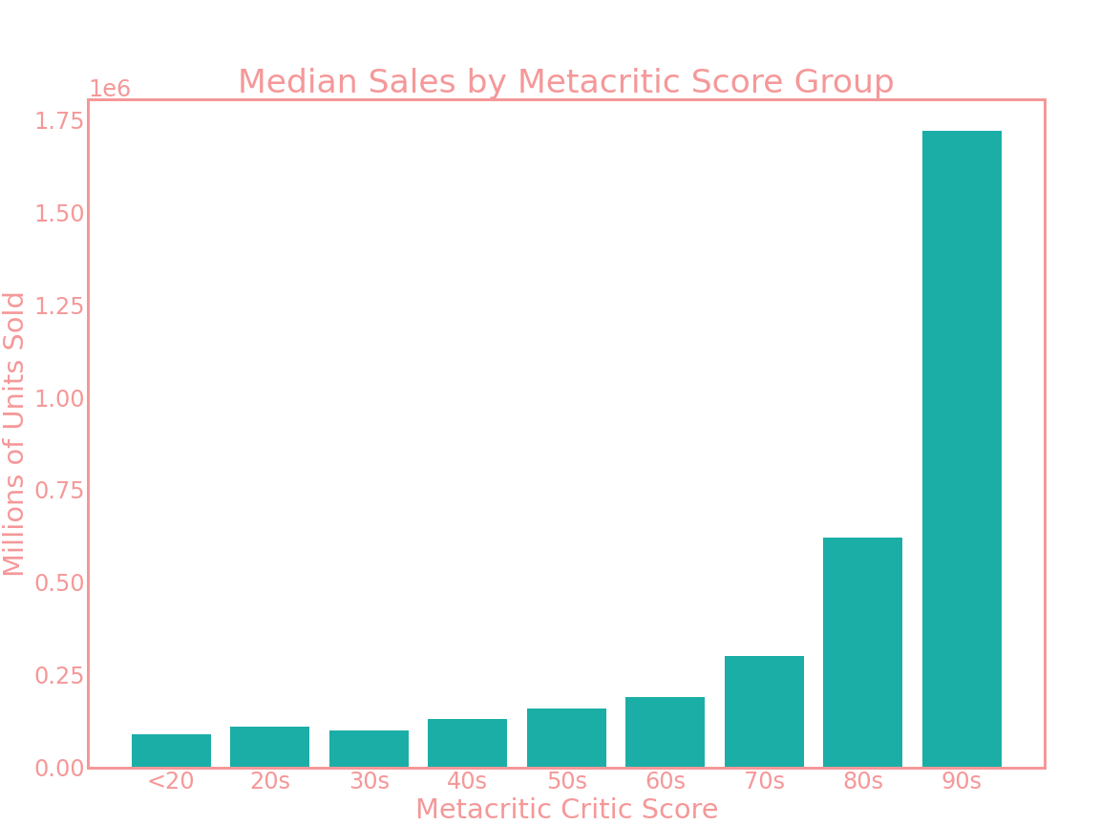
TARGETING CRITIC SCORES
WHO CARES?
You care!
Higher critic scores will raise your global sales potential

Slide 6
GAMES BY RATING CLASS
MAKING
CLASSES
>75
37.3%
60-75
37.9%
We turn our problem into a classification by binning the review scores into three classes of success
<60
24.8%

Slide 7

Text Processing
LEMMATIZATION
High TF-IDF
Reducing words to their roots
heroes
moon
empire
character
original
super
creation
legendary
combat
VECTORIZATION
Turning the game descriptions into numerical data

Slide 8
MODELING
THE GOOD STUFF

Slide 9
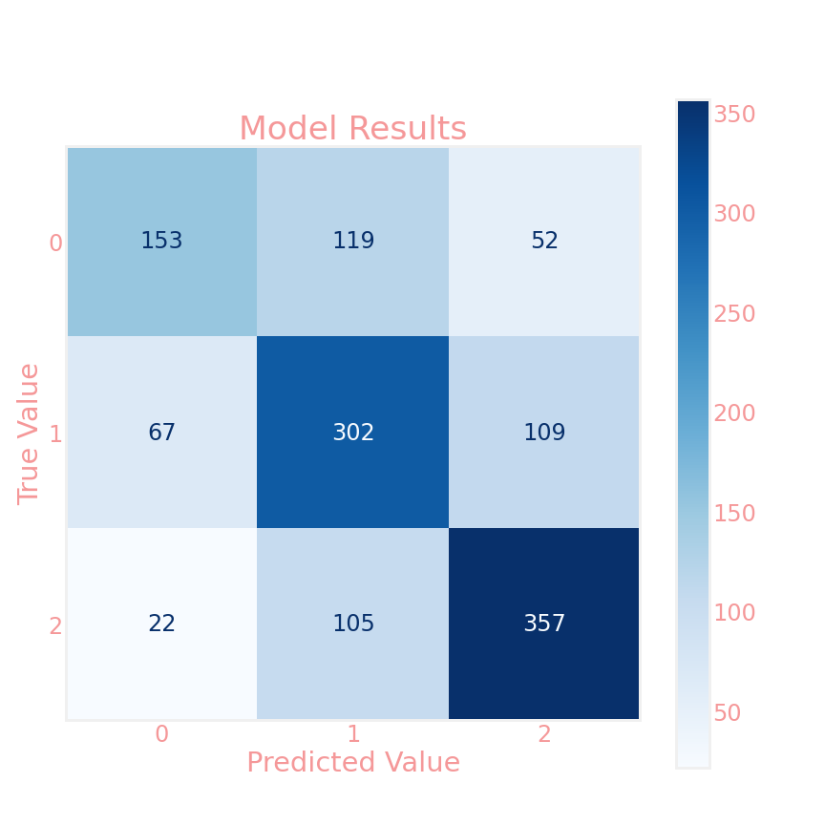
THE MODEL SO FAR
- Random Forest Classifier
- Balanced class weight
- Has high variance
65% accuracy

Slide 10
FEATURE ENGINEERING
-Better text preprocessing
-Explore document normalization
ALGORITHM CHOICE
FUTUREWORK
-Research more focused algorithms
-Make XGBoost work on my computer
DEPLOYMENT
-Develop a web application
-Design recommender system

Slide 11



Contact Info
EMAIL
GITHUB
LINKEDIN
jakers991@gmail.com
jprebys
linkedin.com/in/jprebys

