Slide 1

Current-Based Data-Retention-Time Characterization of Gain-Cell Embedded DRAMs Across the Design and Variations Space
S. Jayaprakash B151236
Department of Electronics and Communication Engineering
Rajiv Gandhi University of Knowledge Technologies
Basar, Nirmal District.

Slide 2
Overview
Abstract
Introduction
GCeDRAM
Working
DRT
EDRT
VDRT
DRT Analysis
IDRT
Comparison
Summary
Exploration
Conclusion
References

Slide 3
Abstract
Increasing demand for high-density and low-power on-chip embedded memories.
GCeDRAM offers higher density, lower leakage power, and two-ported operation.
There are several DRT measurement techniques which became unfeasible because of runtime evaluation.
IDRT methodology is compared over other DRT characterization methodologies for
1) accuracy and
2) run-time

Slide 4
Introduction
6T SRAM requires a big area on chip due to the large memory bitcell, it dissipates significant static power due to its high leakage.
It fails to operate reliably under scaled supply voltages.
1Transistor 1Capacitor DRAM is not preferred because of destructive read operation and fabrication complexity.
So, GCeDRAM is developed which has a storage node(SN), a read port and a write port.
In this paper, 3-transistor (3T) and 4T NMOS-only GCs are depicted.

Slide 5
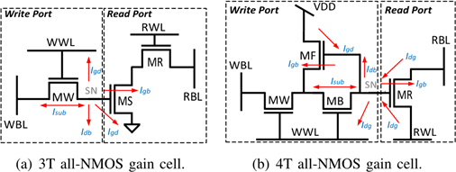
GCeDRAM

Slide 6
Working
WRITE OPERATION: When WWL line is activated, whatever the data present on WBL will get transferred to the SN.
When GC is not accessed, the data is dynamically stored on the parasitic capacitance of SN.
READ OPERATION: RBL is precharged to Vdd.
Once the read word line (RWL) is driven to GND (4T) or V_{DD} (3T), allowing the read transistors (MR and MS) to conditionally discharge the RBL depending on value (charge) stored on the SN.
As GC’s store data dynamically, it needs to be refreshed frequently. The refresh period is determined by DRT.

Slide 7
DRT
DRT is defined as the maximum time interval between a write operation and a successful read operation.
It depends on
1) stored data
2) The temperature and operating voltage
3) The amount of global process variations (GPVs) and local process variations (LPVs) and
4) The operating frequency.
The measurement of accurate DRT is needed because of the increased technology, the leakage currents also increasing which needs lower refresh rates.

Slide 8
EDRT
EDRT is a technique to measure DRT. In this method, a write operation is performed to GC’s and a read operation is performed after an idle phase.
This method is repeated for long idle phases. It is a trial and error method.
The longest idle time that still ensures the correct data to be read is known as the DRT of the cell.
This method although gives accurate DRT, it is not preferable for large memory cell arrays because of calculation time for DRT becomes high.
To reduce the DRT evaluation run-time and to avoid the need for high license costs, another method VDRT is introduced.

Slide 9
VDRT
In this method DRT is determined as the time interval after a write operation at which the voltage difference between stored ‘1’ and ‘0’ crosses a critical threshold at which its polarity can no longer be distinguished using a read operation.
It needs fewer runtime for estimation of DRT than EDRT but the accuracy of this method is lower because of the fact that DRT is not only affected by leakage of stored value.
To avoid this limitation, another current based DRT method is introduced. This method monitors current through the read port.
It takes into account the effect of LPV’s on SN deterioration and the RBL driver.

Slide 10
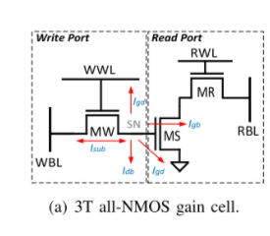
DRT ANALYSIS
The DRT is primarily affected by the leakage currents, which deteriorate the SN voltage, and the read port variation, which affects the RBL access latency during read operations.
Storage Node Leakage : When the WBL holds an opposite value to the SN, a sub-threshold leakage (I_{sub}) path is created between the drain and source of MW.
When the cell stores a ‘1’, the SN
deteriorates even further through gate
leakage (I_{gate}) to WWL.
Bulk leakage (I_{bulk}) to the substrate of MW.

Slide 11
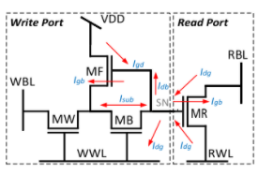
DRT ANALYSIS
Read Port Variation: SN conditionally enables a current path between the RBL and the RWL to either discharge RBL when the cell holds a ‘1’, or keep it charged at V_{DD} when it holds a ‘0’.
The RBL evaluation delay is often the
dominant portion of the total read latency of
the GC array due to the large RBL capacitance
and degraded SN voltage.
Finally, a 1T read port is also affected by
unselected transistors sharing the same
column, which cause the RBL voltage to saturate at a level close to V_{DD}-V_{T.}
In order to avoid RBL saturation, a 2T read port is incorporated in the 3T GC.

Slide 12
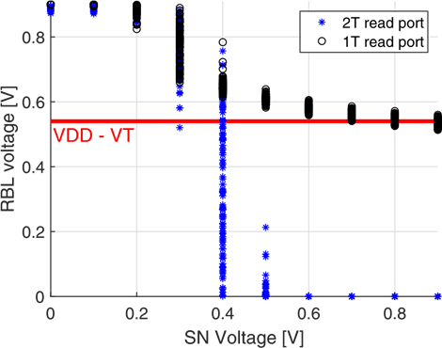
DRT ANALYSIS
The RWL is connected to the gate of MR,
decoupling MS from the RBL when the
cell is not selected.
The simulations were conducted under
worst-case biasing conditions with all
the unselected cells in the column storing
a ‘1’,causing the RBL voltage of the 1T read
port to saturate at a level close to V_{DD}-V_{T} before
completely discharging to GND.
The RBL voltage of the 2T read
port discharges close to GND when
the SN voltage is high enough in
order to completely discharge RBL
within the 1ns read access.

Slide 13
IDRT
The DRT is determined according to the maximum time interval after a write operation until the moment when the current through the active read port crosses a critical threshold.
It contains three phases. It is illustrated for 3T NMOS GC.
1) EDRT Measurement : The load of the GCs sharing the same column is added to the shared RBL and a sense amplifier is used to sense the RBL voltage.
During the idle phase, the WBL is forced to the opposite voltage of the written value in order to apply worst-case biasing conditions.
Then, a trial read operation is performed following a determined idle phase and the output is compared with the written value.
It is repeated for longer idle phases until the read operation is incorrect and the corresponding voltage of SN is noted.

Slide 14
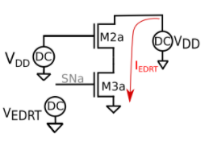
IDRT
Reference Current Acquisition : In this phase, we find critical current through the read port (I_{EDRT}) that still ensures a successful read operation.
The value of I_{EDRT} is obtained using the test-bench shown in Figure.
The previously evaluated V_{EDRT} is
applied to the storage node (SNa),
followed by the assertion of the RWL
and the pre-charge of the
RBL (e.g., to V_{DD} for an NMOS-only read port).
The I_{EDRT} is evaluated as the DC current which
dis-charges the RBL for the considered operating point.
I_{EDRT} represents the minimum/maximum read-port current that is necessary for a correct read operation.

Slide 15
IDRT
Evaluation Phase : The evaluation phase is used to evaluate the DRT distribution under LPVs.
This phase consists of a write operation to the GC (M1b–M3b), followed by an idle phase, during which the stored SNb voltage deteriorates over time as a result of the various leakage currents.
The data deterioration is reproduced on the read port replica (M2c, M3c) using an ideal voltage buffer that applies the voltage of SNb to SNc.
Using this setup, the read port replica is constantly enabled and its drive current (i_{IDRT}) is continuously monitored.
The time interval following the write operation at which the i_{IDRT} crosses the critical I_{EDRT} threshold is taken as DRT.

Slide 16
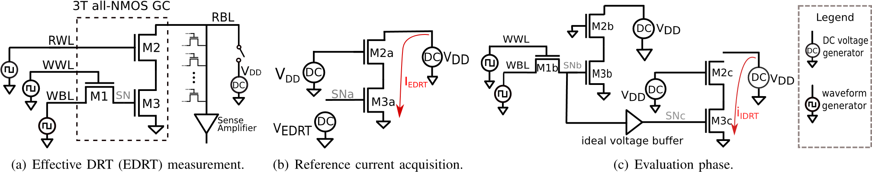
IDRT

Slide 17
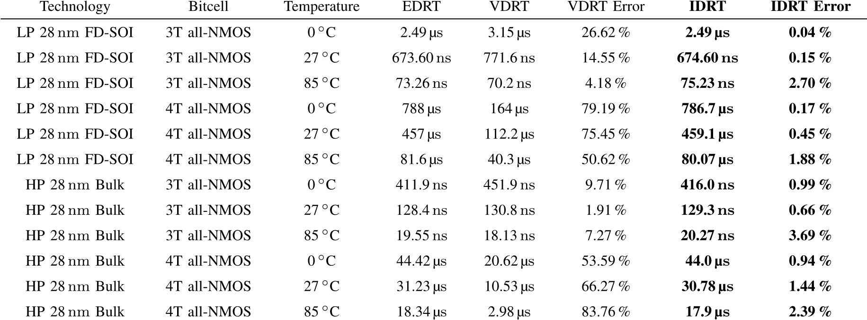
COMPARISON OF DRT CHARACTERIZATION METHODOLOGIES
Accuracy of the DRT Characterization Methodologies : The simulations were repeated in both low power (LP) 28 nm FD-SOI and high performance (HP) 28nm Bulk CMOS technologies.

Slide 18
Summary
VDRT methodology is suitable for a fast DRT evaluation in the early stage of the design phase.
For a rigorous design-space exploration as well as for corner analysis (e.g., GPVs and temperature points), the EDRT method should be preferred.
DRT MEASUREMENT OF A 3T GC AND A 4T GC IN 28 nm FD-SOI :
The following design and corner parameters are considered as a baseline:
1) 0.9V supply voltage 8) Temperature at 27◦C
2) 1.3V boosting voltage to drive the WWL
3) 0.7V reference voltage for the 4T GC-eDRAM sense amplifier
4) minimum-sized transistors
5) a load of 127 GCs on the RBL to emulate a GC-eDRAM of 128 rows
6) body biasing (BB) is not applied
7)1ns period for single-cycle write and read operations.

Slide 19
DRT MEASUREMENT OF A 3T GC IN GENERIC 25 nm TECHNOLOGY(USING TANNER EDA V16)
The IDRT measurement was carried out in Tanner EDA V16 with T-Spice and S-Edit following the different temperatures of 0, 27 and 85 degree Celsius. The following schematic layout was designed for each step of IDRT calculation of 3T NMOS gain cell. The following procedure is followed for implementation of the schematic.
1) Download and install Tanner EDA V16 preferably in windows.
2) Import the library files for generic 25nm process technology and create a new design file. The following specifications have to be followed for implementation details.
Supply voltage-0.9V
Boosting voltage for WWL-1.3V

Slide 20
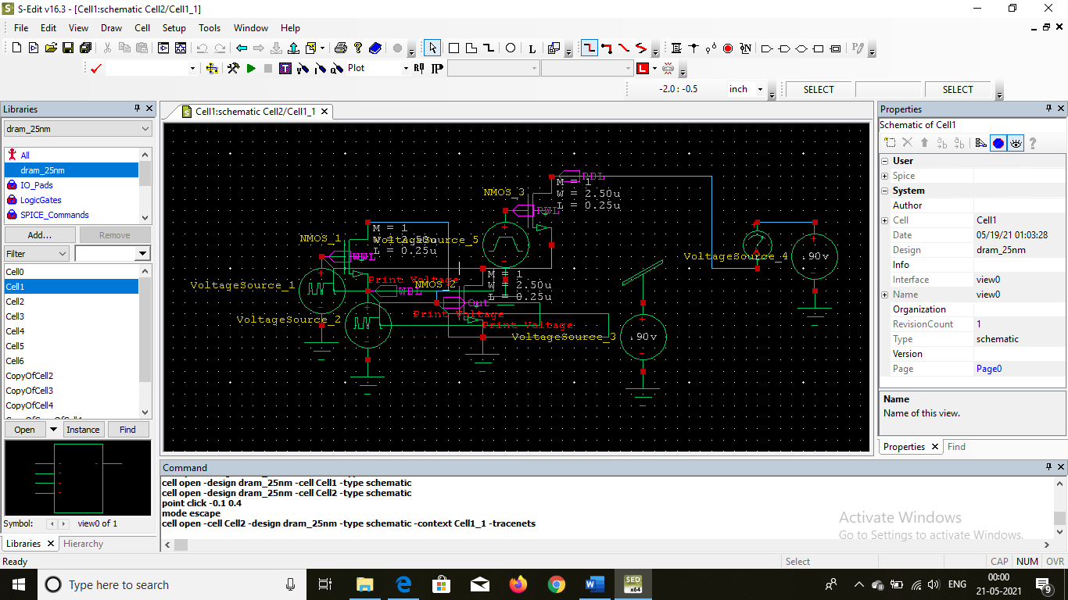
Arrange the components of the circuit as per the circuit diagram and for the first step of the IDRT methodology, write logic 1 into SN and make the MW transistor off by switching off the WWL. Refer to the schematic below for more details.

Slide 21
4) Implement the worst case biasing conditions such that WBL will be having opposite voltage as of the SN value.
5) Perform the read operation after some time which still ensures correct read operation which is written to SN.
6) The following waveform results may appear.
7) We can see that the SN value which is at 0.9V at write operation has degraded to 0V within 10ms of time for all temperatures(approximately).

Slide 22
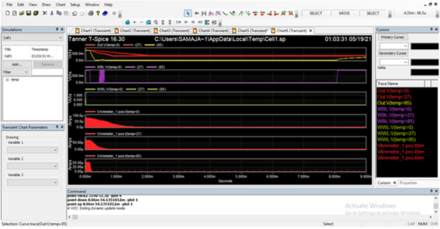

Slide 23
8) Now from this diagram, the minimum voltage required for the correct read operation is the threshold voltage of the 3T gain cell that is about 0.65V for 25nm technology LP.(Refer to ptm.asu.edu/ for latest model specifications.)
9) Now, the voltage VEDRT is 0.65V. This voltage we use it in second step for finding IEDRT i.e reference current acquisiton.
10) Create a new cell view. Connect the circuit devices as per the schematic shown below.

Slide 24
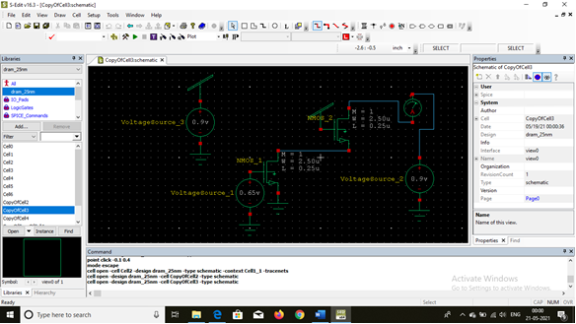

Slide 25
11) Using the setup, measure the dc current. The result obtained is shown below.
12) From the graph, we take note of the readings for further steps.
13) For the third step, again create a new cell view and connect the circuit devices as per the circuit diagram. The schematic is shown below.
14) This schematic similar to the first schematic except for the duplicate test bench setup. We perform the write operation and after some time, we read the value.
15) During reading operation, we try to measure the current reading also. The time upto which current which crosses the previously measured Iedrt current after a successful write operation, will be termed as the DRT of the cell.

Slide 26
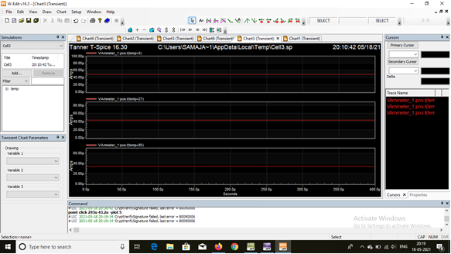

Slide 27
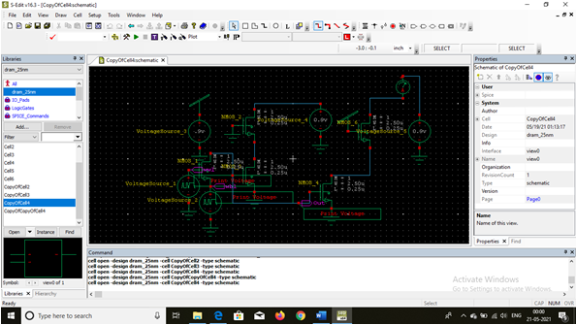

Slide 28
16) From the graph, we try to plot its simulation results which looks something like this.
17) From the graph, let us consider for 27 degree Celsius , the measured Iedrt current was 42 uA.
18) Now, from the third step simulation waveform reading, the time for crossing the 42 uA for the circuit is around 210 us.
19) This time is also consisting of the write operation time. We essentially need to subtract write operation time of 10us (from first step simulation waveform figure) which gives DRT as 200us.
20) Similarly for other temperatures, we can deduce the following observations.
0 degree- 478 us
85 degree-52us
21) As we increase the temperature, the DRT is reducing leading to more power consumption for refreshing operation.
22) That is why data centres of big tech companies, will be hosting cool temperature areas as their data centres.
Note: The waveforms applied as input are bit voltages. We can also apply pulse.

Slide 29
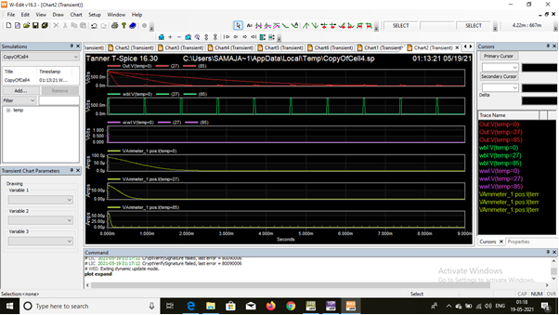

Slide 30
CONCLUSIONS
This paper presented a current-based data-retention time (IDRT) characterization methodology.
The IDRT methodology shows an accuracy deviation of less than 3.7%.
Together with the EDRT approach, the proposed methodology has been used to evaluate the DRT of GCs designed in 28nm FD-SOI and 28nm Bulk CMOS process technologies across a design and variations space.
The IDRT methodology was used to extract the high-sigma DRT and evaluate key GC-eDRAM characteristics, including retention power, memory availability, and maximum frequency, for different memory sizes.

Slide 31
REFERENCES
F. Tu, W. Wu, S. Yin, L. Liu, and S. Wei, “RANA: Towards efficient neural acceleration with refresh-optimized embedded DRAM,” in Proc. ACM/IEEE 45th Annu. Int. Symp. Comput. Archit. (ISCA), Jun. 2018, pp. 340–352.
C. Berry et al., “IBM Z14: 14 nm microprocessor for the next-generation mainframe,” in IEEE ISSCC Dig. Tech. Papers, Feb. 2018, pp. 36–38.
M. Gautschi et al., “Near-threshold RISC-V core with DSP extensions for scalable IoT endpoint devices,” IEEE Trans. Very Large Scale Integr. (VLSI) Syst., vol. 25, no. 10, pp. 2700–2713, Oct. 2017.
Y.-H. Chen, T. Krishna, J. S. Emer, and V. Sze, “Eyeriss: An energyefficient reconfigurable accelerator for deep convolutional neural networks,” IEEE J. Solid-State Circuits, vol. 52, no. 1, pp. 127–138, Jan. 2017.
M. Tikekar, V. Sze, and A. Chandrakasan, “A fully-integrated energyefficient H.265/HEVC decoder with eDRAM for wearable devices,” in Proc. Symp. VLSI Circuits, Jun. 2017, pp. C230–C231.
.

Slide 32
Thank you

