Slide 1
Computer Architecture and Operating System
TLB, Concurrency
Lecturer: Tianming Bai

Slide 2
Review
Free Space Management (Variable-Sized Allocation)
Allocation Strategies:
Basic: Best Fit, Worst Fit, First Fit, and Next Fit.
Advanced: Segregated Lists and Buddy Allocation.
Paging (Fixed-Sized Allocation)
Address Translation
The Page Table
Page Table Entry
The Overheads of Paging

Slide 3
THE CRUX
How can we speed up address translation and avoid the extra memory reference that paging seems to require?
Goal: Minimal space and time overhead while maintaining the flexibility of paging.

Slide 4
Introduction to TLB
Use Hardware support: the Translation-Lookaside Buffer (TLB).
A TLB is part of the chip’s Memory-Management Unit (MMU).It is a hardware cache of popular virtual-to-physical address translations.
Mechanism: Upon each virtual memory reference, hardware first checks the TLB. If found, translation is instant without consulting the page table.

Slide 5
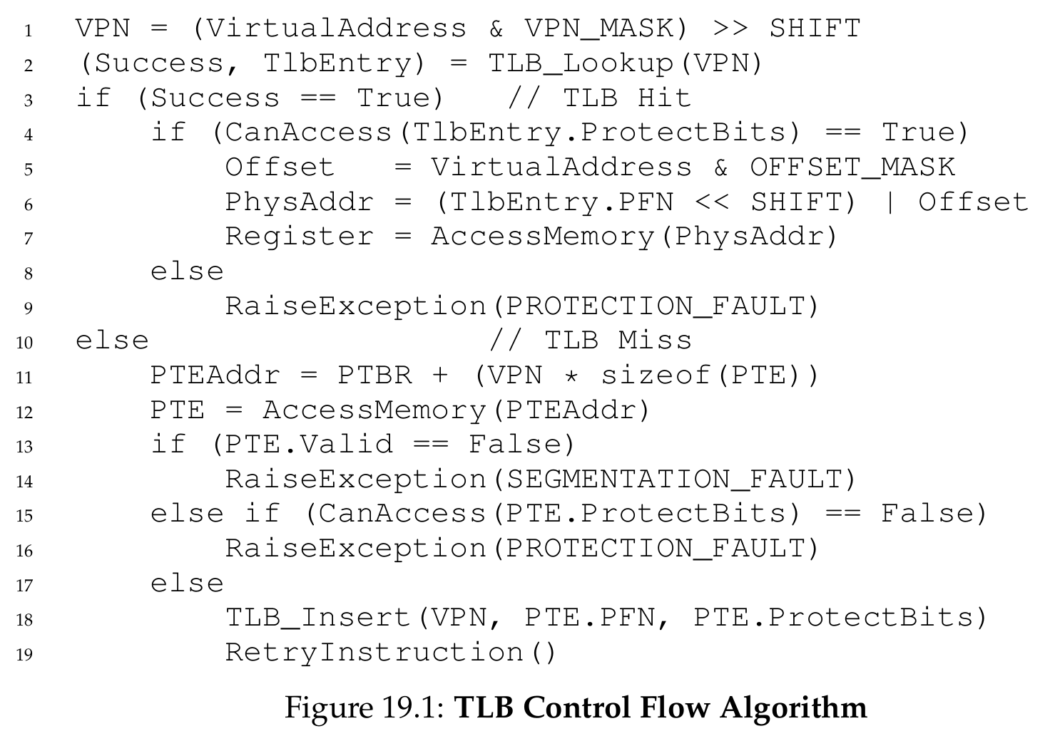
TLB Basic Algorithm
Steps:
Extract VPN from virtual address.
Check if TLB holds the translation for this VPN.
TLB Hit: Extract PFN from TLB, concatenate with offset, form Physical Address (PA).
TLB Miss: Access page table in memory, update TLB with the translation, and retry.

Slide 6
Example
Assume we have an array of 10 4-byte integers in memory, starting at virtual address 100. Assume further that we have a small 8-bit virtual address space, with 16-byte pages;
Compute:
VPN, Offset

Slide 7
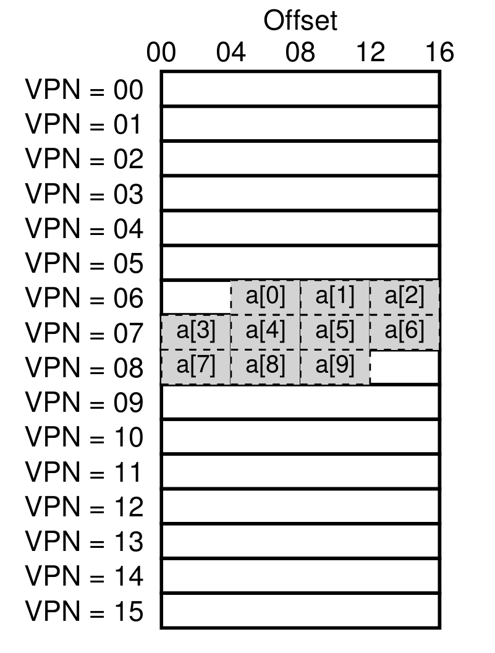
Example
Assumption: We have an array of 10 4-byte integers in memory, starting at virtual address 100. Assume further that we have a small 8-bit virtual address space, with 16-byte pages;
Compute:
VPN, Offset

Slide 8
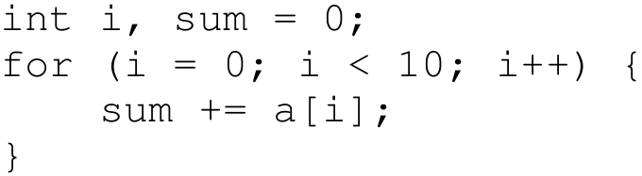
Example
Consider a simple loop:
For simplicity, pretend that the only memory accesses are to the array (ignoring the variables i and sum, as well as the instructions).

Slide 9
Example
Trace Analysis:
Access a[0] (VPN 06) -> TLB Miss (first time).
Access a[1], a[2] (same VPN 06) -> TLB Hit.
Access a[3] (VPN 07) -> TLB Miss...
Hit Rate: 70% in this tiny example (In reality, with 4KB pages, it's much higher).

Slide 10
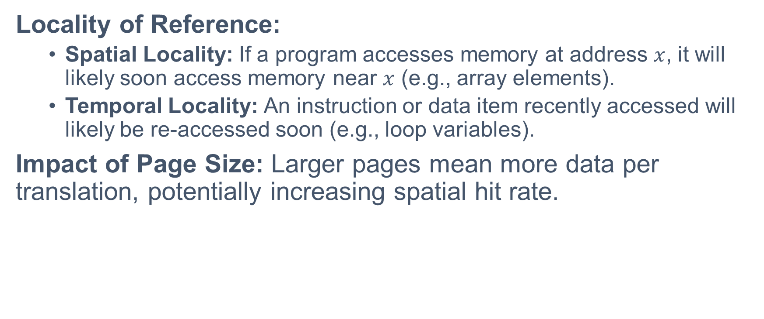
Why Does TLB Work?
Locality of Reference:
Spatial Locality: If a program accesses memory at address $x$, it will likely soon access memory near $x$ (e.g., array elements).
Temporal Locality: An instruction or data item recently accessed will likely be re-accessed soon (e.g., loop variables).
Impact of Page Size: Larger pages mean more data per translation, potentially increasing spatial hit rate.

Slide 11
Who Handles The TLB Miss?
Hardware-Managed TLB (CISC, e.g., x86):
Hardware knows exactly where page tables are (via PTBR).
Hardware "walks" the table on its own.
Software-Managed TLB (RISC, e.g., MIPS, SPARC):
Hardware raises an exception (trap handler).
OS handles the miss, updates TLB with privileged instructions.
Advantage of Software approach: Flexibility (OS can use any data structure) and simplicity in hardware.

Slide 12
TLB Contents
Structure: Typically 32, 64, or 128 entries; fully associative (searched in parallel).
Typical Entry: VPN | PFN | Other Bits
Other Bits:
Valid Bit: Is this a valid translation? (Note: Different from Page Table Valid Bit).
Protection Bits: Read/Write/Execute permissions.
ASID: Address Space Identifier (Process ID).
Dirty Bit: Has the page been written to?

Slide 13
Problem
TLB translations are only valid for the current process. For example, if Process A runs, VPN 10 points to PFN 100. If Process B runs, VPN 10 might point to PFN 170. Hardware cannot distinguish them.
How to perform process switches?

Slide 14
Context Switches
Solutions:
Flush TLB: Set all valid bits to 0 on context switch (Simple but high overhead).
ASID (Address Space Identifier): Hardware support to distinguish process translations.

Slide 15
ASID: Sharing the TLB
Adding an ASID field to the TLB entry to identify which process the translation belongs to.
Benefit: Multiple processes can keep their translations in the TLB simultaneously.
Sharing Pages: ASID allows two different VPNs from different processes to map to the same physical PFN (Shared Libraries).

Slide 16
TLB Replacement Policy
When TLB is full and a new entry is needed, which one to evict?
Common Policies:
LRU (Least-Recently-Used): Evicts the entry that hasn't been used for the longest time. Exploits locality.
Random: Evicts a random entry. Simple, avoids corner-case behaviors (like LRU failing in large loops).
Read the Chapter 22: Beyond Physical Memory: Policies and learn about these policies.

Slide 17
Break

Slide 18
From Virtual Memory to Concurrency
From Virtual Memory to Concurrency Thus far: Single point of execution per process.
Virtual Memory: The OS multiplexes physical memory to create the illusion of a large, private virtual address space for each process.
Each process behaves as if it has its own memory.
Now: Multiple points of execution.
What if a single running process needs to perform multiple tasks simultaneously?
We need a new abstraction: The Thread.

Slide 19
THE CRUX
How to provide the illusion of multiple simultaneous tasks within the same program?
How do we manage shared memory safely when scheduling is unpredictable and interrupts can happen at any time?
Goal: Reliable and deterministic execution of concurrent code.

Slide 20
Introduction to Threads
What is a Thread?
A new abstraction for a single running process.
Multiple PCs: Instead of a single point of execution, a multi-threaded program has multiple Program Counters (PCs).
Shared Address Space: Threads are like separate processes, but they share the same address space and can access the same data.
Thread Control Block (TCB): Similar to a PCB, a TCB is used to store the state of each thread (registers, PC) during a context switch.
Context Switch Difference: The address space remains the same, so there is no need to switch page tables.

Slide 21
Address Space Layout
Single-Threaded vs. Multi-Threaded
One major difference between threads and processes concerns the stack.
Single-threaded process: A single stack residing at the bottom of the address space.
Multi-threaded process: One stack per thread, resulting in multiple stacks spread throughout the address space.
Variables, parameters, and return values are placed in thread-local storage (the stack of the relevant thread).

Slide 22
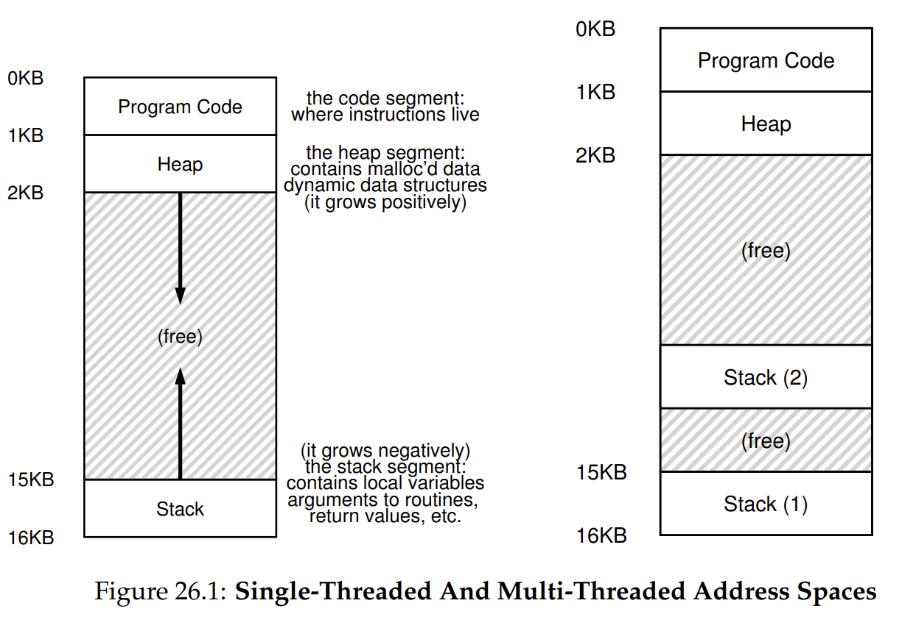
Address Space Layout

Slide 23
Why Use Threads?
Two major reasons to use threads instead of processes:
Parallelism: Transform a single-threaded program to run on multiple CPUs. Speed up tasks like operating on large arrays by dividing the work.
Avoid Blocking (Overlapping I/O): If one thread is blocked waiting for slow I/O (e.g., disk I/O, network), the scheduler can switch to other threads that are ready to do useful work.
Why not multiple processes: Threads share an address space naturally, making it much easier to share data structures than using separate processes.

Slide 24
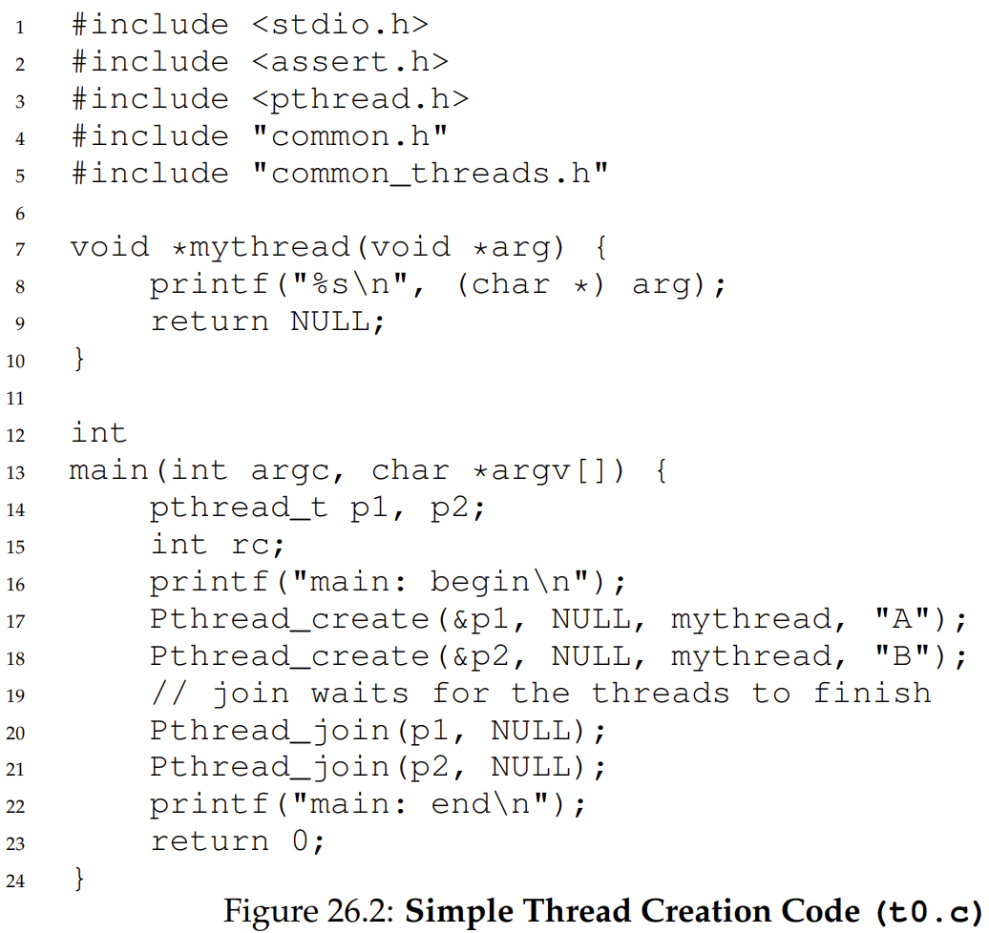
Example
Thread Creation Basics
A simple program creates two threads (T1 and T2) doing independent work (printing "A" or "B").
Main thread uses pthread_create() to launch threads.
Main thread uses pthread_join() to wait for T1 and T2 to finish before exiting.

Slide 25
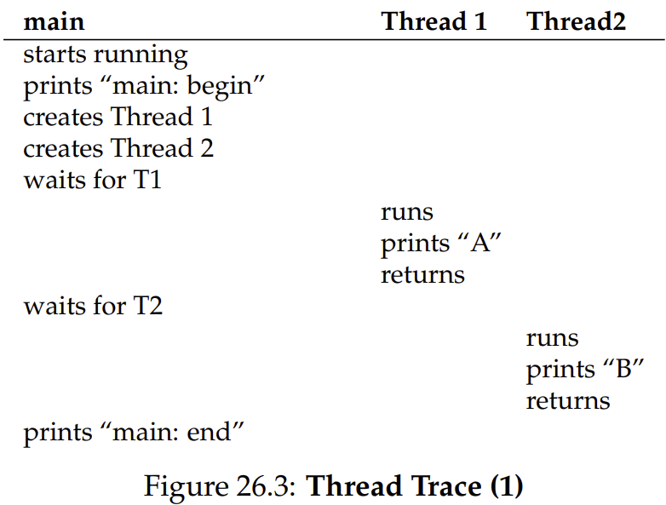
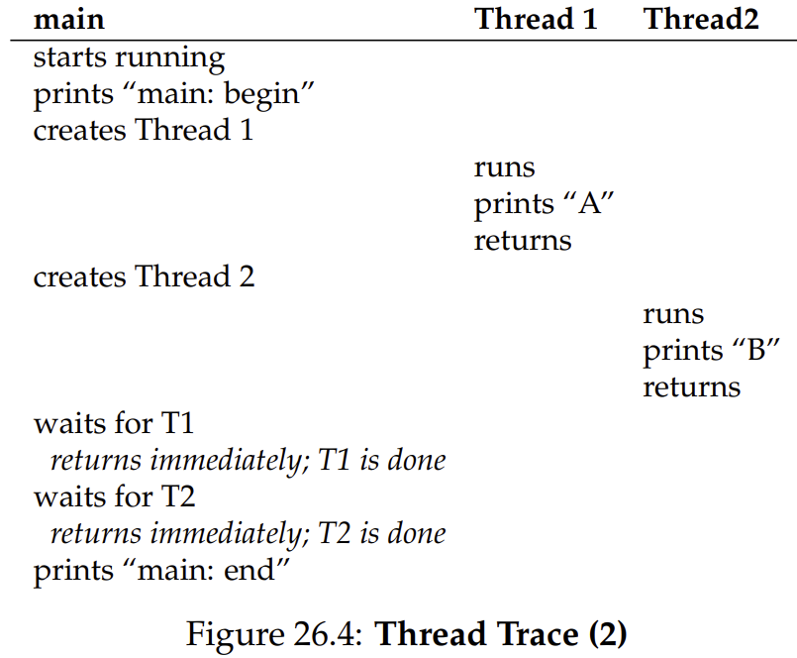
Example
Once created, a thread may run immediately, or be placed in a "ready" state.
The OS scheduler determines what runs next; it is hard to predict the execution order.

Slide 26
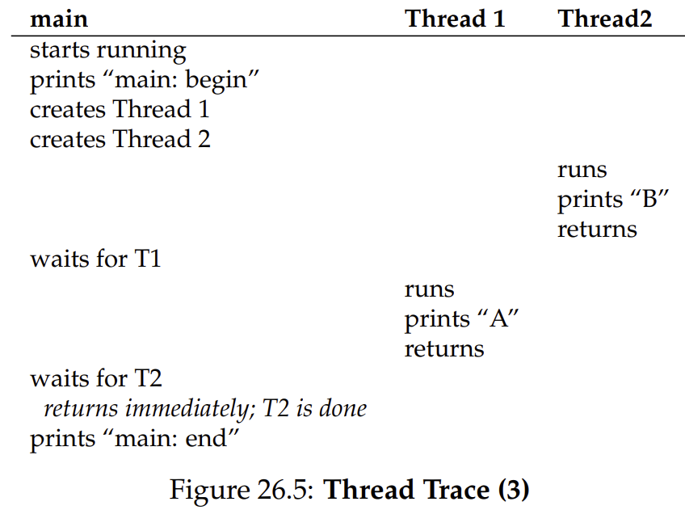
Example
"B" might print before "A" even if Thread 1 was created first.

Slide 27
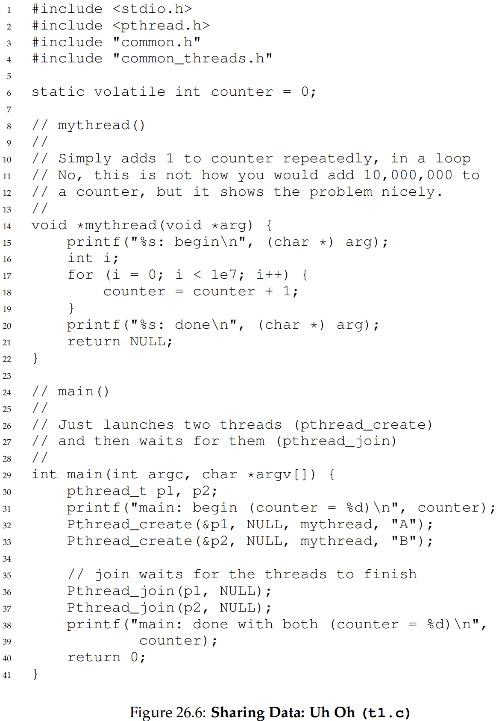
Example
Consider two threads updating a global shared variable (static volatile int counter = 0).
Each thread loops 10 million times: counter = counter + 1.
Desired final result: 20,000,000.
Actual result: Varies every run! (e.g., 19345221, or 19221041) .

Slide 28
Example
Why does the counter fail? We must look at the compiler-generated assembly code.
Load: mov 0x8049a1c, %eax (Get memory value into register).
Add: add $0x1, %eax (Add 1 to register).
Store: mov %eax, 0x8049a1c (Store register back to memory).
A timer interrupt can go off between these instructions!

Slide 29
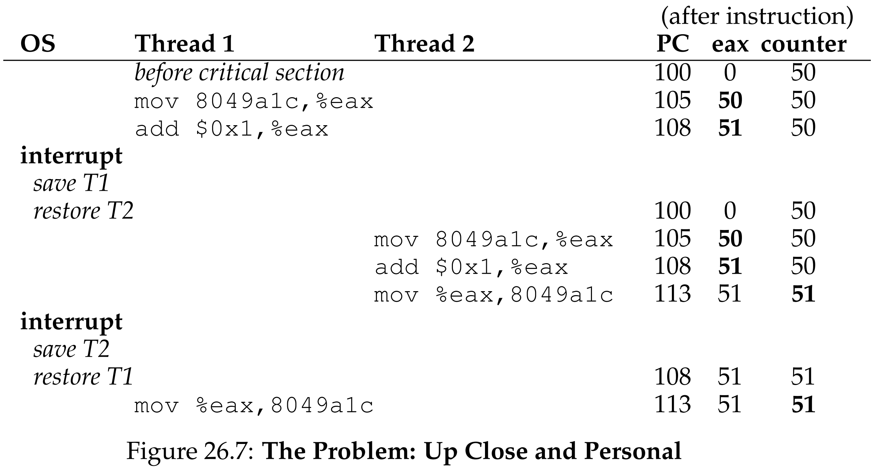
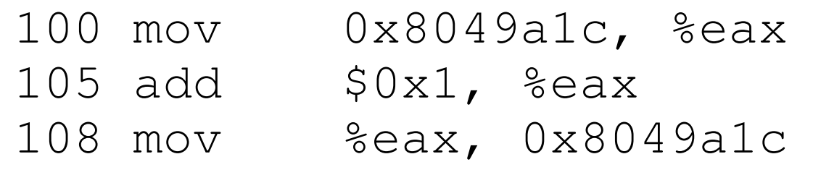
Example
Execution Trace:
Thread 1 loads counter (50), increments to 51. -> INTERRUPT!
Thread 2 loads counter (still 50), increments to 51, stores 51. -> INTERRUPT!
Thread 1 resumes, executes final store instruction (51).
Result: Code ran twice, but counter went from 50 to 51, not 52!

Slide 30
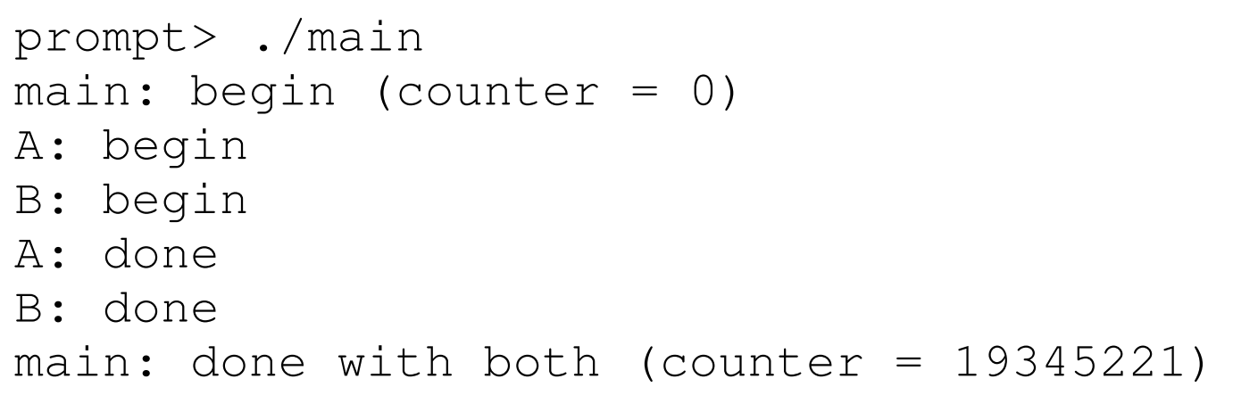
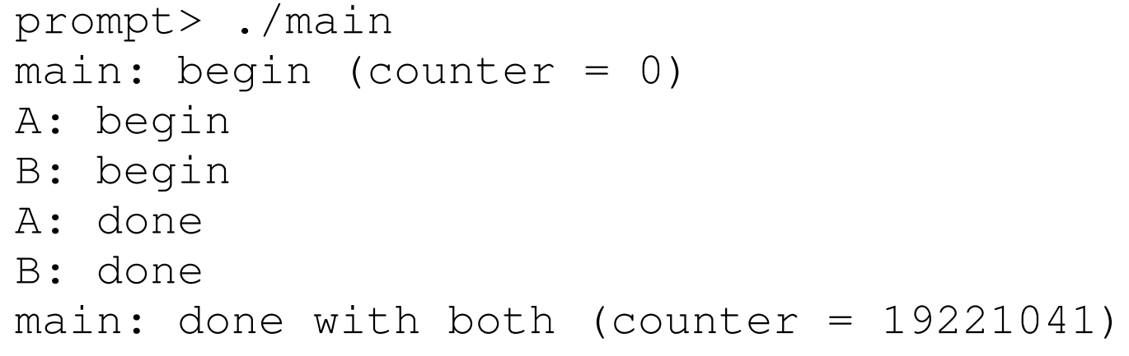
Example

Slide 31
Key Concepts
What did we just demonstrate?
Race Condition (Data Race): The results depend on the timing of the code's execution. With untimely context switches, we get the wrong result.
Indeterminate: Because of the race condition, the output is not deterministic. It is unknown what the output will be and it is likely to be different across runs.

Slide 32
Key Concepts
Where does it happen and how to fix it?
Critical Section: Because multiple threads executing this code can result in a race condition, we call this piece of code a critical section. It accesses a shared variable and must not be concurrently executed by more than one thread.
Mutual Exclusion: What we really want for this code. This property guarantees that if one thread is executing within the critical section, the others will be prevented from doing so.

Slide 33
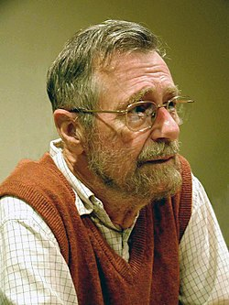
Who coined these terms?
Edsger W. Dijkstra: A pioneer in the field who coined virtually all of these core concurrency terms (Critical Section, Mutual Exclusion, etc.).
Won the Turing Award for this and other foundational work in computer science.
Authored the famous 1968 paper "Cooperating Sequential Processes", which clearly outlined the mutual exclusion problem and multi-threaded programming concepts.
Discovered many of these concurrency principles while developing the "THE" Operating System at Technische Hogeschool Eindhoven.

Slide 34
The Wish For Atomicity
Hardware Solutions
One way to solve the race condition is to have more powerful instructions that do exactly what we need in a single step.
Imagine a super instruction: memory-add 0x8049a1c, $0x1.
The hardware guarantees it executes atomically (as a unit, "all or none").

Slide 35
The Wish For Atomicity
The Limit of Hardware:
In the general case, we won't have such powerful instructions.
Imagine we were building a concurrent B-tree and wished to update it. Updating a B-tree may require:
Traversing multiple nodes
Splitting nodes
Updating parent pointers
Writing multiple memory locations
Would we really want the hardware to support a sane "atomic update of B-tree" instruction? Probably not.

Slide 36
The Wish For Atomicity
The Real Solution:
Instead, we ask the hardware for a few useful, basic instructions.
With help from the OS, we use these to build general synchronization primitives.
These primitives allow multi-threaded code to access critical sections reliably.

Slide 37
Summary
Accelerating Address Translation (TLB): The Translation-Lookaside Buffer (TLB) relies on spatial and temporal locality to make virtual memory fast.
Context switches introduce complexity (managed via ASIDs or flushing) to prevent processes from reading wrong physical frames.
Threads: Threads share the same address space but have independent execution paths (PCs, registers, stacks).
They enable parallelism on multi-core systems and prevent process blocking during slow I/O operations.
The Crux of Concurrency: Sharing memory across threads introduces race conditions due to unpredictable OS scheduling and interrupts.
Correctness requires atomicity and mutual exclusion, which we must build using new hardware instructions and OS synchronization primitives in the coming lectures.

Slide 38
Next Lecture
Locks…

