Slide 1
Computer Architecture and Operating System
Locks
Lecturer: Tianming Bai

Slide 2
Review
Accelerating Address Translation (TLB): The Translation-Lookaside Buffer (TLB) relies on spatial and temporal locality to make virtual memory fast.
Context switches introduce complexity (managed via ASIDs or flushing) to prevent processes from reading wrong physical frames.
Threads: Threads share the same address space but have independent execution paths (PCs, registers, stacks).
They enable parallelism on multi-core systems and prevent process blocking during slow I/O operations.

Slide 3
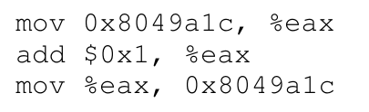
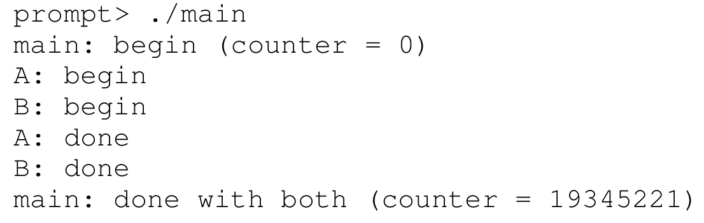
Review
The Problem: Uncontrolled Scheduling
Race Condition: Results depend on the timing of execution.
Critical Section: Code that accesses shared data and must be atomic.
Indeterminate: Output varies from run to run.

Slide 4
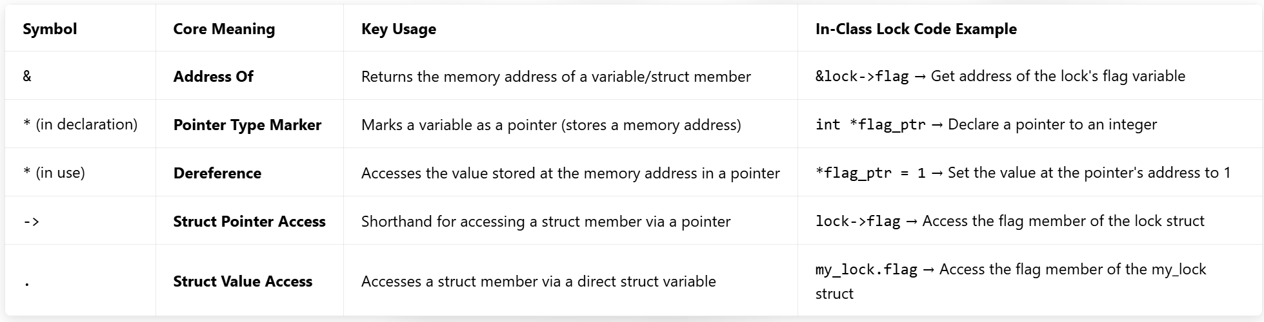
C Pointer Fundamentals

Slide 5
THE CRUX
The Goal:
We want to execute a series of instructions atomically, as if they were a single instruction.
How can we provide mutual exclusion for critical sections?
What hardware support is needed?
What OS support is required?

Slide 6
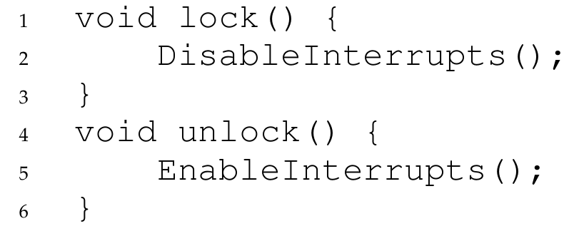
Controlling Interrupts
Disable interrupts for the duration of the critical section.
Pros:
Simple.
Cons:
Security: Allows a user program to take over the machine (if it never calls unlock).
Multi-processor: Does not work on multiple CPUs.
Efficiency: Interrupts might be lost.

Slide 7
Locks
What is a Lock?
A lock is just a variable that holds the state of the lock at any instant.
It is either:
available (unlocked or free): no thread holds the lock, or
acquired (locked or held): exactly one thread holds the lock and presumably is in a critical section.
We could store other information in the data type as well, such as which thread holds the lock, or a queue for ordering lock acquisition, but information like that is hidden from the user of the lock.

Slide 8
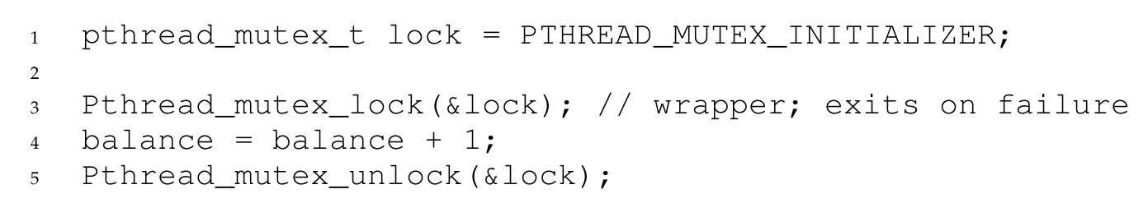
Locks
Calling the lock() tries to acquire the lock;
If no other thread holds the lock (it is free), the thread will acquire the lock and enter the critical section.
If another thread then calls lock() on that same lock variable, it will not return while the lock is held by another thread.
Once the owner of the lock calls unlock(), the lock is available again.
If no threads are waiting: change state to free.
If threads are waiting: one of them will acquire the lock and enter the critical section.

Slide 9
Evaluating Locks
How do we judge a lock implementation?
Mutual Exclusion: Does it actually prevent multiple threads from entering the critical section?
Fairness: Does each thread contending for the lock have a fair chance at acquiring it? Does any thread starve?
Performance: What are the time overheads?
Single CPU, no contention.
Single CPU, multiple threads contending.
Multiple CPUs, multiple threads contending.

Slide 10
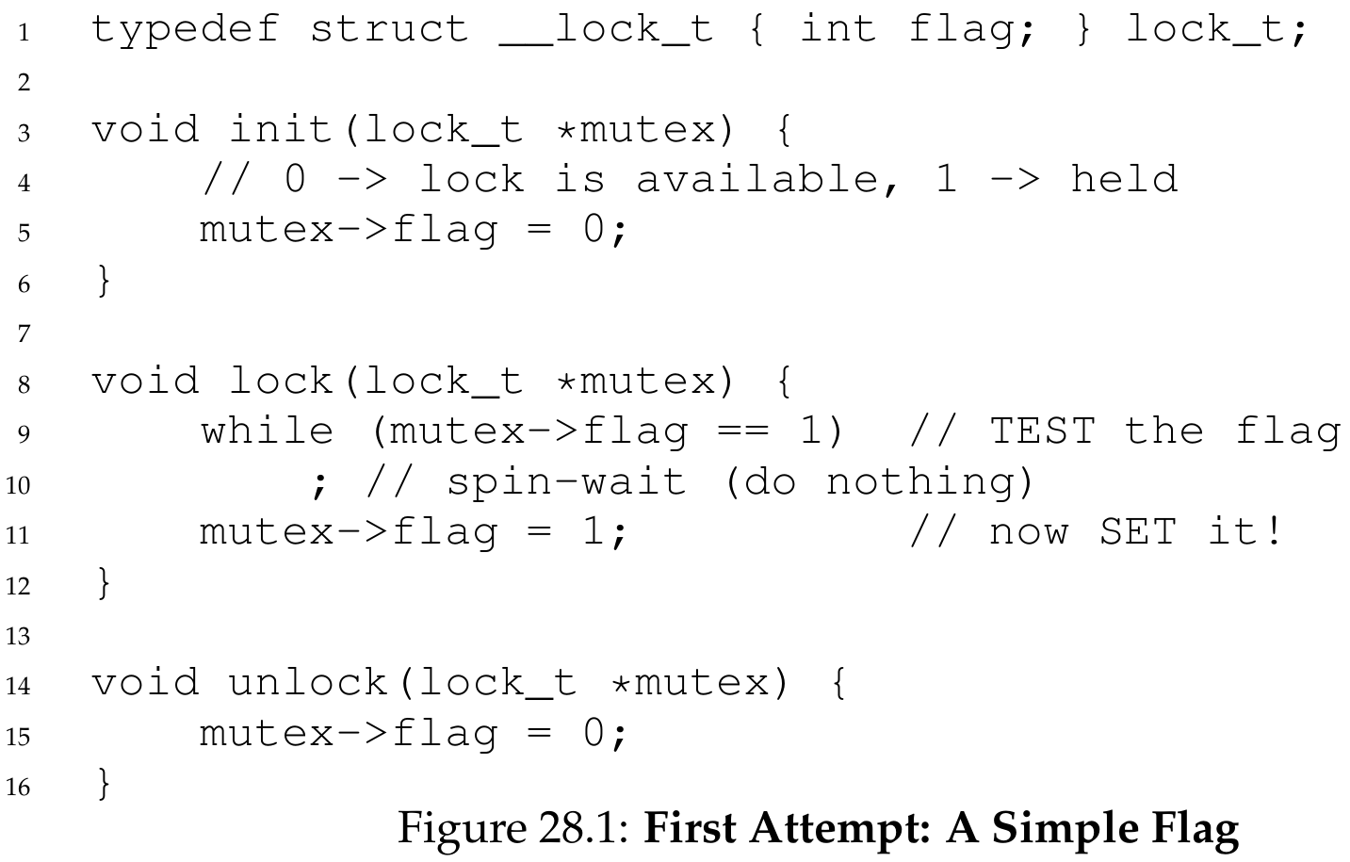
1 Simple Flag
flag = 0 (available)
flag = 1 (held)

Slide 11
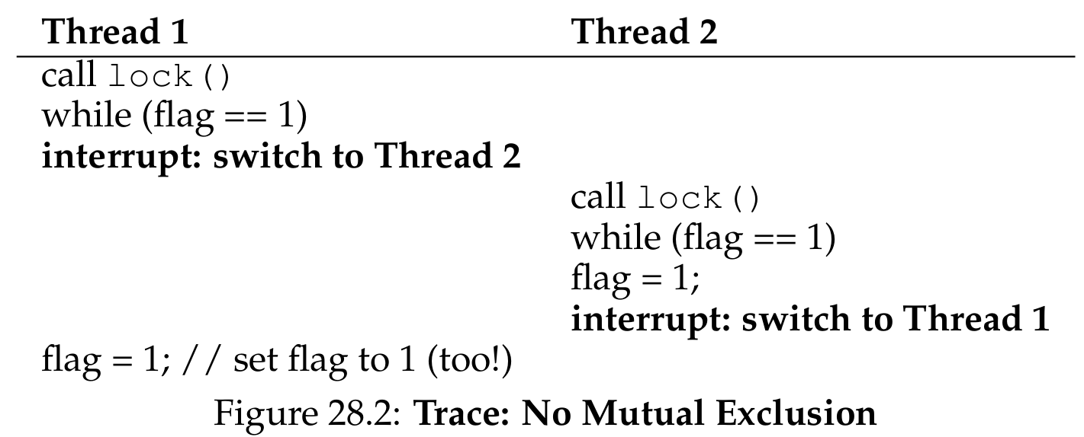
1 Simple Flag
Thread 1 calls lock(), checks flag == 1 (false).
Interrupt switches to Thread 2.
Thread 2 also checks flag == 1 (false), sets flag to 1.
Switches back to Thread 1, sets flag to 1.
Both threads are in the critical section!
This fails the most basic requirement: mutual exclusion.

Slide 12
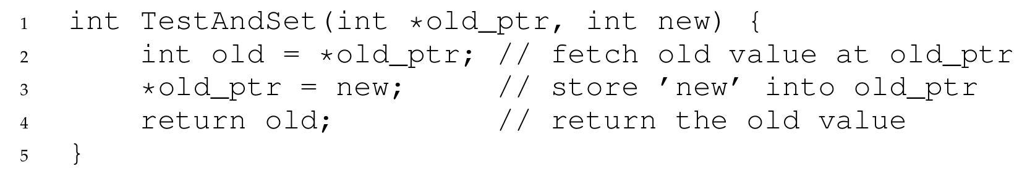
2 Test-And-Set
Hardware Support: Atomic Exchange
We need an instruction that tests a value and sets it to something else atomically.
Building a Spin Lock:
The thread "spins" in a while-loop until the lock is available.

Slide 13
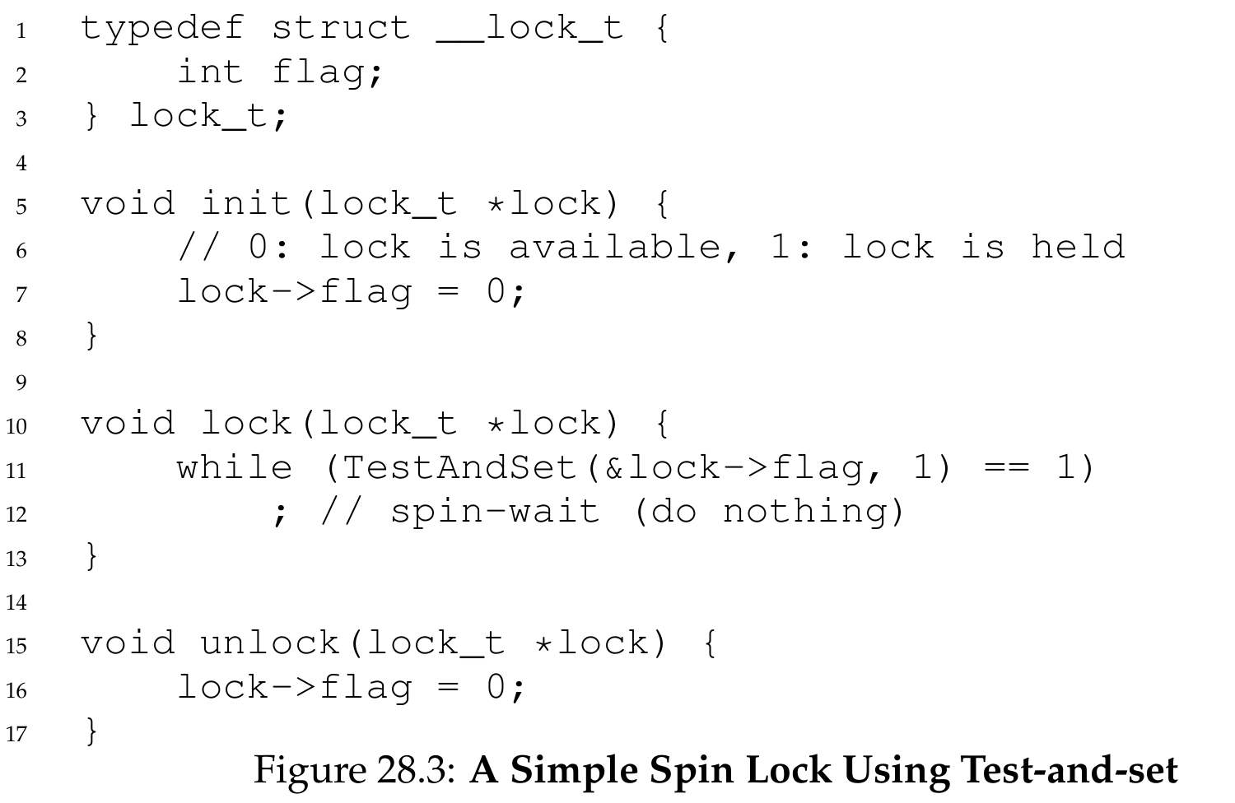
2 Test-And-Set (TAS)
Case 1: Lock is free (flag=0).
TestAndSet returns 0, thread exits loop, sets flag to 1 atomically.

Slide 14
2 Test-And-Set
Case 2: Lock is held (flag=1).
TestAndSet returns 1 every time, thread spins until lock is released.
Because test and set are atomic, only one thread can acquire the lock at a time.
This lock is called a spin lock because it spins using CPU cycles until the lock becomes available.

Slide 15
Evaluating Spin Locks
Correctness: Yes, provides mutual exclusion.
Fairness: No guarantees. May lead to starvation.
Performance:
Single CPU: Very bad if lock holder is preempted. Other threads spin for entire time slices.
Multiple CPUs: Reasonable, if critical sections are short. Spinning on one CPU while another CPU releases the lock is efficient.

Slide 16
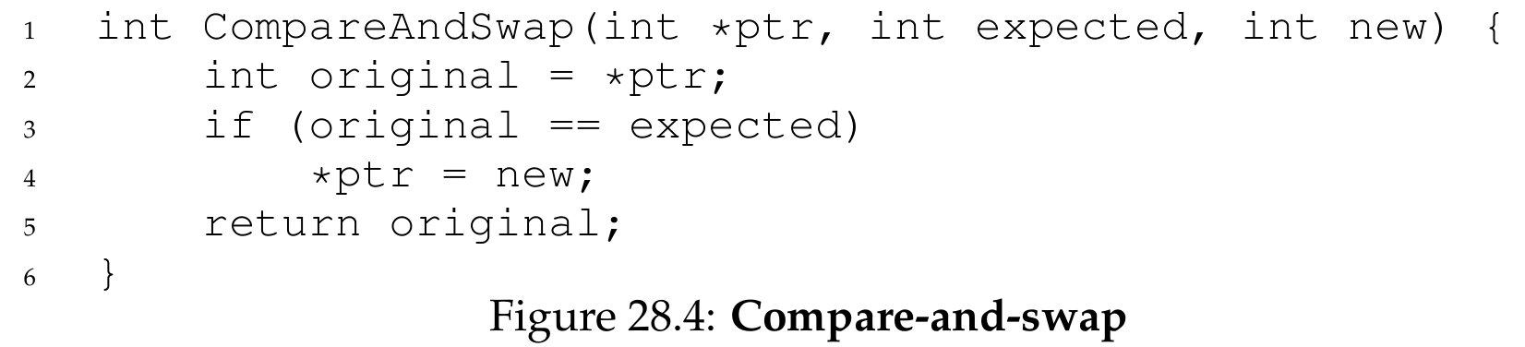
3 Compare-And-Swap (CAS)
Another Hardware Primitive:
Test if the value at an address is equal to an expected value; if so, update it to a new value.
More powerful than Test-And-Set; used in many lock-free synchronization.

Slide 17
What is Lock-Free?
Definition: Lock-free (or non-blocking) synchronization means threads can complete operations without using locks (no mutex, no spin locks, no waiting).
Threads make progress independently; no thread blocks another indefinitely.
Relies only on atomic hardware instructions (CAS, LL/SC).
Key Property
Even if some threads are delayed or preempted, other threads can still finish their operations.
No deadlock, no starvation, no priority inversion from locks.
Classic Use Case: Atomic updates to shared variables or data structures (e.g., atomic increment, linked-list insertion).

Slide 18
Why CAS Is More Powerful
Recap: Test-And-Set (TAS)
Only forces a write; overwrites the value unconditionally.
Can only implement simple spin locks (binary state: 0 or 1).

Slide 19
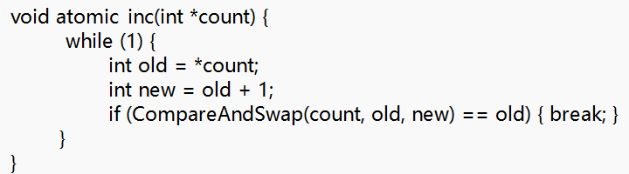
Why CAS Is More Powerful
Compare-And-Swap (CAS)
Conditional write: updates only if the value matches expected.
Can atomically update any value to any new value.
Enables arbitrary lock-free operations (impossible with TAS).

Slide 20
Break

Slide 21
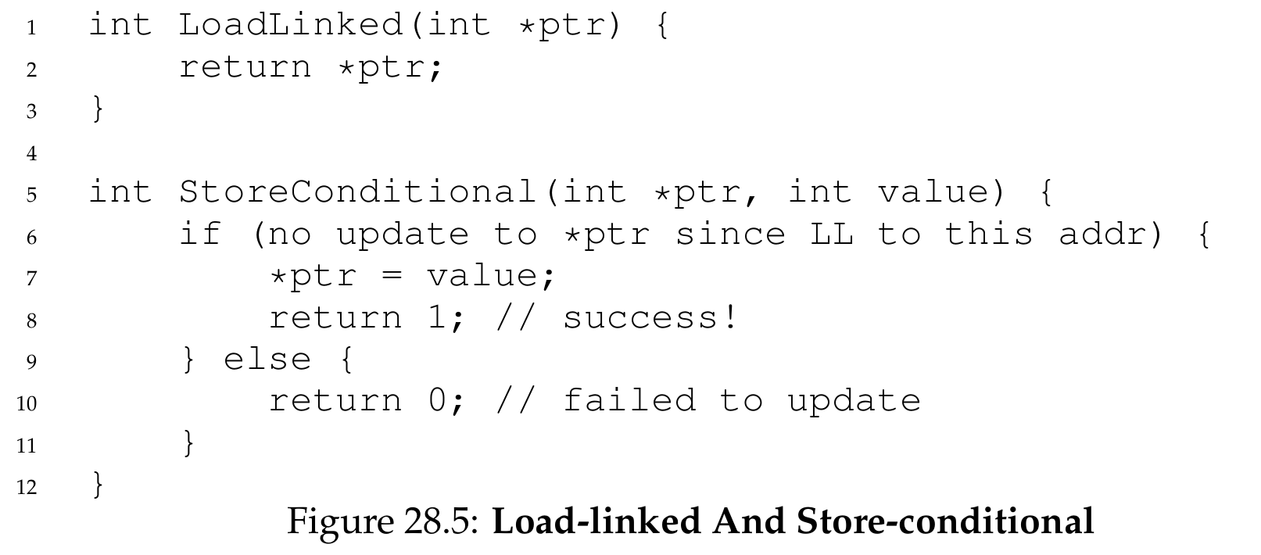
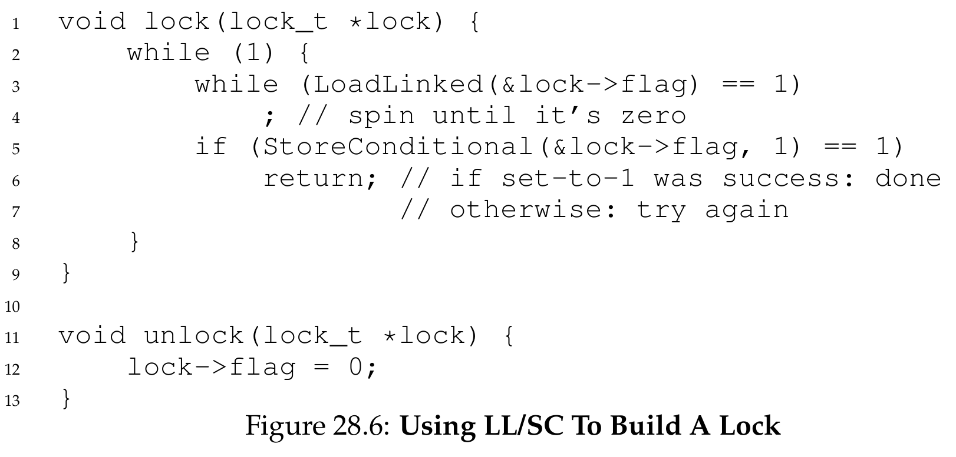
4 Load-Linked and Store-Conditional
The RISC Approach (MIPS, Alpha, ARM):
Load-Linked: Fetches a value and "monitors" the address.
Store-Conditional: Only succeeds if no other thread has updated that address since the Load-Linked.

Slide 22
4 Load-Linked and Store-Conditional
Case A: LL/SC Succeeds (No Contention)
Thread executes LoadLinked(&flag) → reads 0, marks the address.
No other thread modifies flag.
Thread executes StoreConditional(&flag, 1) → succeeds.
Return value = 1; atomic update complete.

Slide 23
4 Load-Linked and Store-Conditional
Case B: LL/SC Fails (With Contention)
Thread 1 executes LoadLinked(&flag) → reads 0, marks the address.
Thread 2 interrupts and modifies flag (e.g., sets to 1).
Thread 1 executes StoreConditional(&flag, 1) → hardware detects the change.
Store fails; return value = 0; Thread 1 retries.

Slide 24
Is LL/SC Better? -> ABA Problem
What Is the ABA Problem?
Core Definition: The ABA problem is a critical bug in lock-free synchronization using Test-And-Set (TAS) or Compare-And-Swap (CAS).
A thread observes a memory value = A
Another thread changes the value: A → B → A
The first thread checks again: still A
The thread incorrectly assumes: “nothing changed” and proceeds
But the value was modified twice, the state is NOT the same as before! What if the address is reused?

Slide 25
ABA Problem Example
Which Instructions Suffer From ABA?
Test-And-Set (TAS): YES
Compare-And-Swap (CAS): YES
Load-Linked / Store-Conditional (LL/SC): NO (hardware tracks changes, not just values)

Slide 26
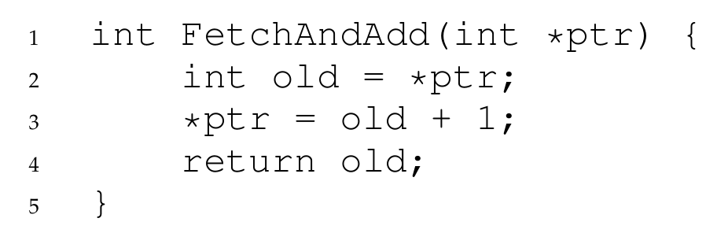
5 Fetch-And-Add & Ticket Locks
Fetch-And-Add atomically increments a value and returns the old value.

Slide 27
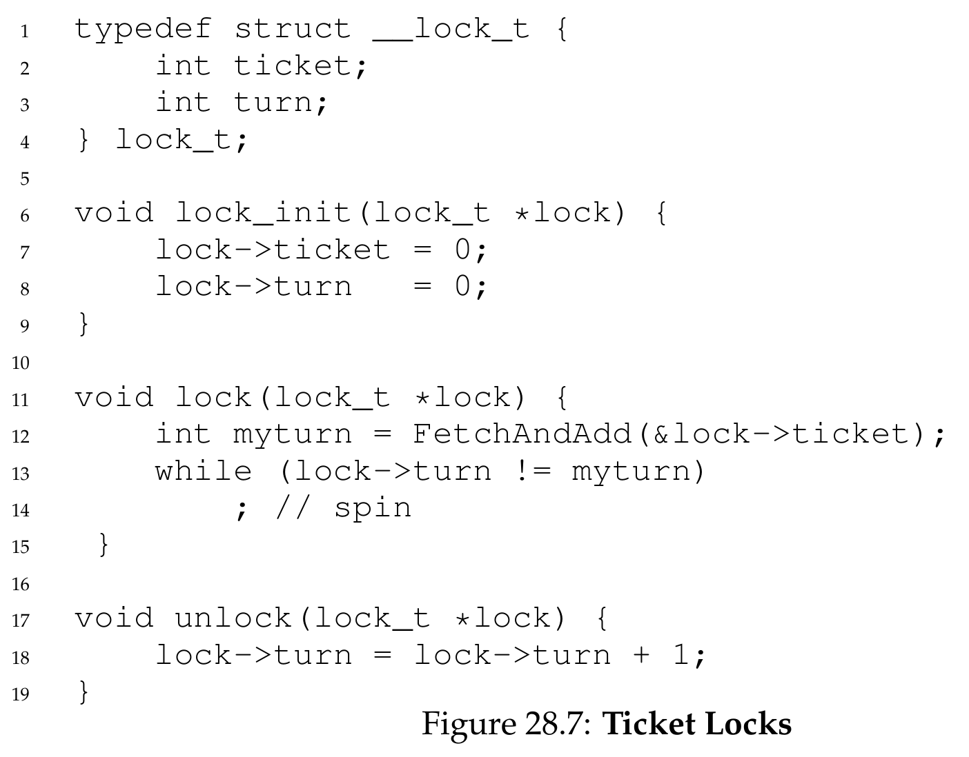
5 Fetch-And-Add & Ticket Locks
We use this to build a ticket lock: the first lock that guarantees fairness (no starvation).
Each thread gets a ticket in order.
Lock is acquired when turn == myturn.
Guaranteed fairness: no starvation, first-come-first-served order.

Slide 28
Ticket Lock Example (3 Threads)
Step 1: Initialize the Lock
ticket = 0, turn = 0 (no threads waiting, lock is free)
Step 2: Threads Arrive One By One (In Order: T1 → T2 → T3)
Thread 1 arrives first
myturn = FetchAndAdd(&ticket) → returns 0
ticket becomes 1
Checks: myturn (0) == turn (0) → acquires lock immediately
Thread 2 arrives second
myturn = FetchAndAdd(&ticket) → returns 1
ticket becomes 2
Checks: 1 != 0 → spins and waits
Thread 3 arrives third
myturn = FetchAndAdd(&ticket) → returns 2
ticket becomes 3
Checks: 2 != 0 → spins and waits

Slide 29
Ticket Lock Example (3 Threads)
Step 3: Thread 1 Finishes and Calls Unlock()
turn becomes 1
Thread 2 sees myturn (1) == turn (1) → acquires lock
Step 4: Thread 2 Finishes and Calls Unlock()
turn becomes 2
Thread 3 sees myturn (2) == turn (2) → acquires lock
Final Execution Order
T1 → T2 → T3 (exactly the order they arrived)

Slide 30
Why Ticket Locks Guarantee Fairness
Ticket locks enforce strict First-Come-First-Served (FCFS) order.
Every thread gets a unique, ordered ticket
No thread can “cut in line”
No thread will starve (wait forever)
For Simple Spin Lock (TAS/CAS)
Unfair: A later thread can accidentally acquire the lock before an earlier thread
Starvation possible: A thread might wait forever
Why This Works
Fetch-and-Add is atomic: No two threads get the same ticket number
Turn-based serving: The lock only grants access to the next ticket in line
No preemption in line: Threads must wait their turn

Slide 31
Too Much Spinning: The Problem
Spin locks are inefficient on a single CPU:
If a thread holding the lock is preempted, all other threads spin wastefully for full time slices.
THE CRUX: HOW TO AVOID SPINNING
How can we develop a lock that doesn’t needlessly waste time spinning on the CPU?
Hardware alone cannot solve this. We need OS support.

Slide 32
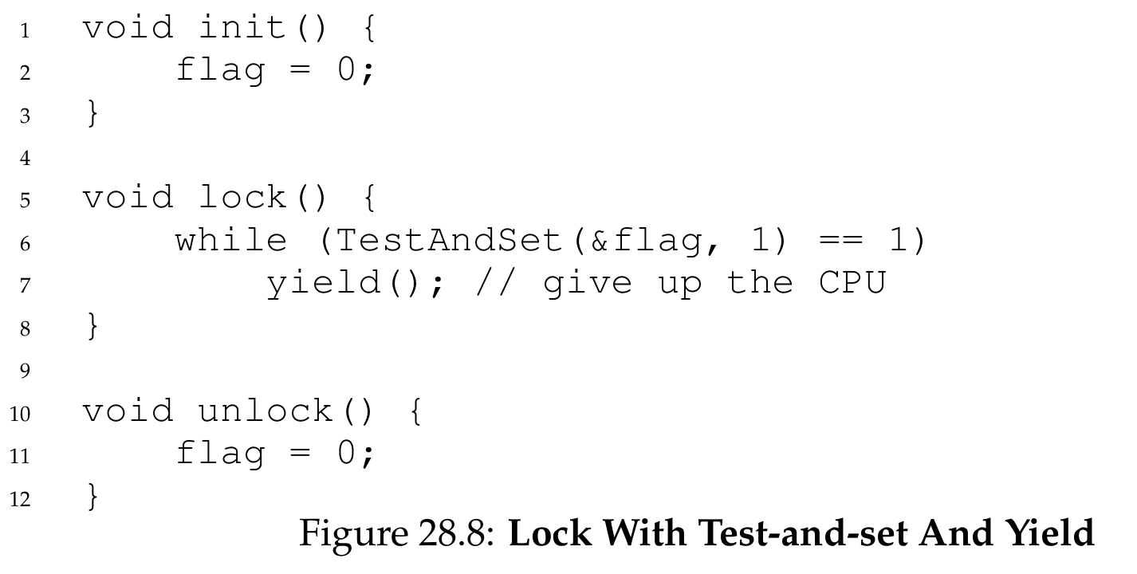
Simple Approach: Just Yield
When a thread can’t acquire the lock, instead of spinning, it yields the CPU.
Yield() moves the thread from Running to Ready, letting another thread run.
But still inefficient with many threads, and does not prevent starvation.

Slide 33
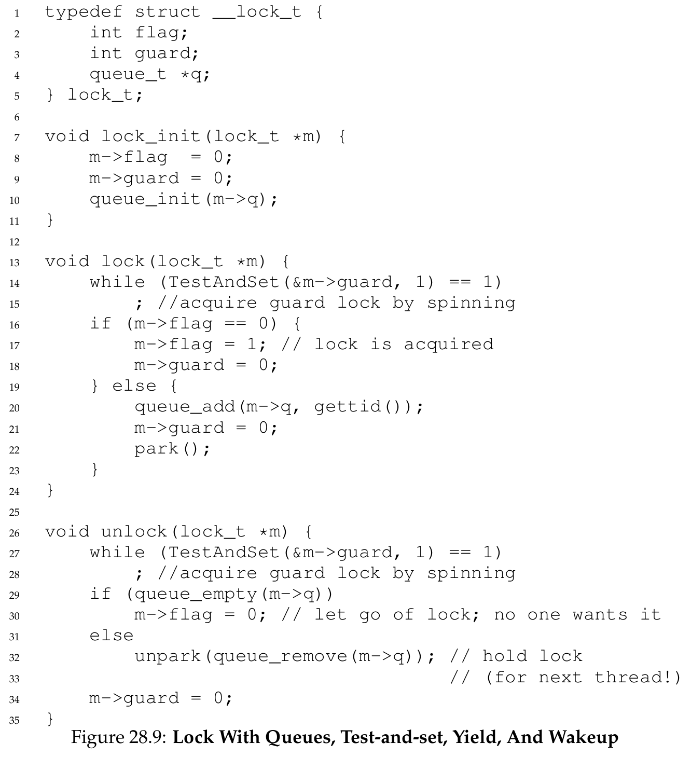
Better Approach: Using Queues
To eliminate spinning and guarantee fairness, we use a queue to track waiting threads and put them to sleep instead of spinning.
We use OS primitives:
park(): put thread to sleep
unpark(threadID): wake a specific thread

Slide 34
Queue-Based Lock Logic
When lock() is called and lock is held:
Add thread to waiting queue.
Put thread to sleep (park()).
When unlock() is called:
If threads are waiting, remove one from queue.
Wake it up (unpark()).
This eliminates spinning completely. No more wasted time slices.
Also provides fairness (FIFO order).

Slide 35
Linux Futex (Fast User-Space Mutex)
Linux uses a futex, which is a hybrid: fast in the common case, sleeps only under contention.
Futex key ideas:
Atomic operations in user space (fast path).
Only enters the kernel and sleeps when there is contention.
Uses a single integer to track lock state and waiter count.

Slide 36
Two-Phase Locks
Many real-world locks (including Linux futex) are two-phase locks:
Phase 1: Spin briefly, hoping the lock will be released soon.
Phase 2: If lock not acquired, sleep to save CPU.
This combines the best of both worlds:
Low latency if lock is free soon.
No CPU waste if wait is long.

Slide 37
Summary
A lock provides mutual exclusion for critical sections.
Early solutions (interrupt disabling) are unsafe and not multiprocessor-safe.
Simple flag fails because test and set are not atomic.
Hardware atomic instructions (Test-And-Set, Compare-And-Swap, LL/Sc, Fetch-And-Add) enable correct spin locks.

Slide 38
Summary
Spin locks are simple but inefficient on single CPU and can starve threads.
Ticket locks add fairness via ticket/turn ordering.
Yielding reduces waste but not enough.
Queue-based sleeping locks (using park/unpark or futex) eliminate spinning, ensure fairness, and maximize efficiency.
Modern real-world locks (Linux futex) are hybrid two-phase designs.

Slide 39
Next Lecture
I/O …

