Slide 1
Computer Architecture and Operating System
Data Format
Lecturer: Tianming Bai

Slide 2
Introduction
Computer uses binary numbers.
The most basic unit of information: bit
8bits = 1byte (Why?)

Slide 3
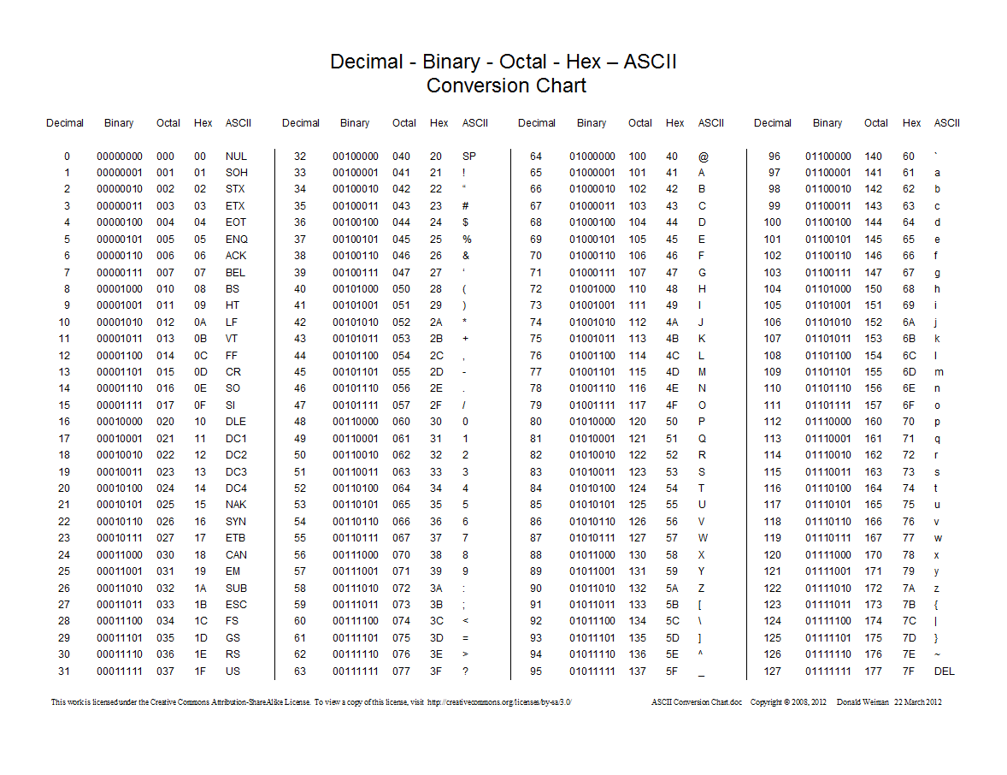

Slide 4

Positional Numbering System
We use decimal numbers
Try：
Convert ${1011}_{2}$ to decimal
Convert $6_{10}$ to binary
Convert ${147}_{10}$ to binary

Slide 5
Integer Representation
Unsigned (e.g. uint8)
Signed (e.g. int8)
Signed Magnitude
One’s complement
Two’s complement

Slide 6
Integer Arithmetic
When doing calculation, what do we care?
Addition
Subtraction
Multiplication
Division

Slide 7
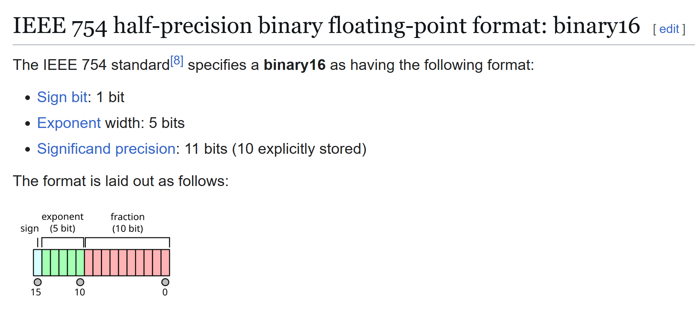
Floating Point Representation

Slide 8
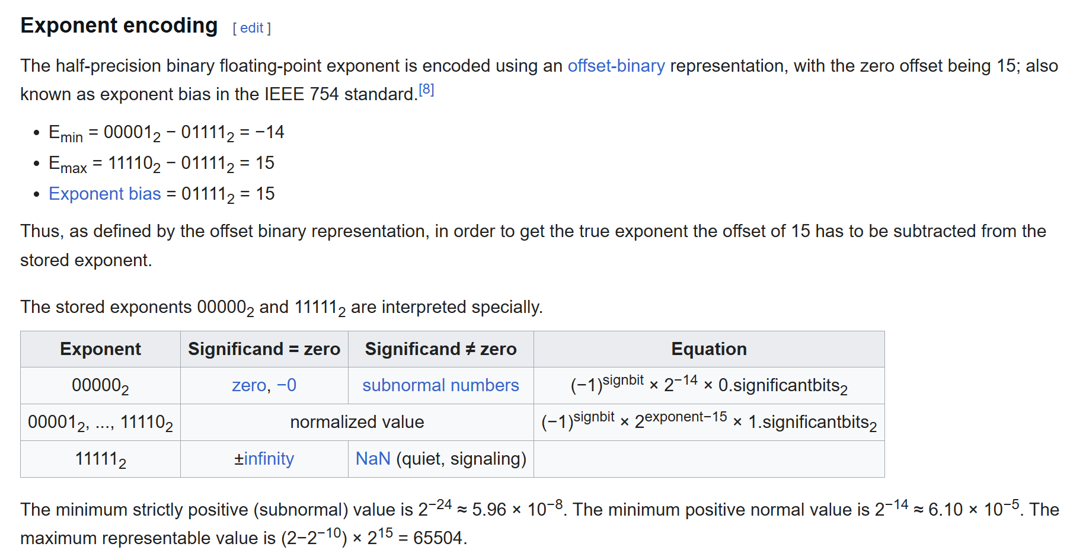
Floating Point Representation

Slide 9
Floating Point Representation
Convert to decimal:
0 00000 0000000001
0 00001 0000000000
0 01111 0000000001

Slide 10
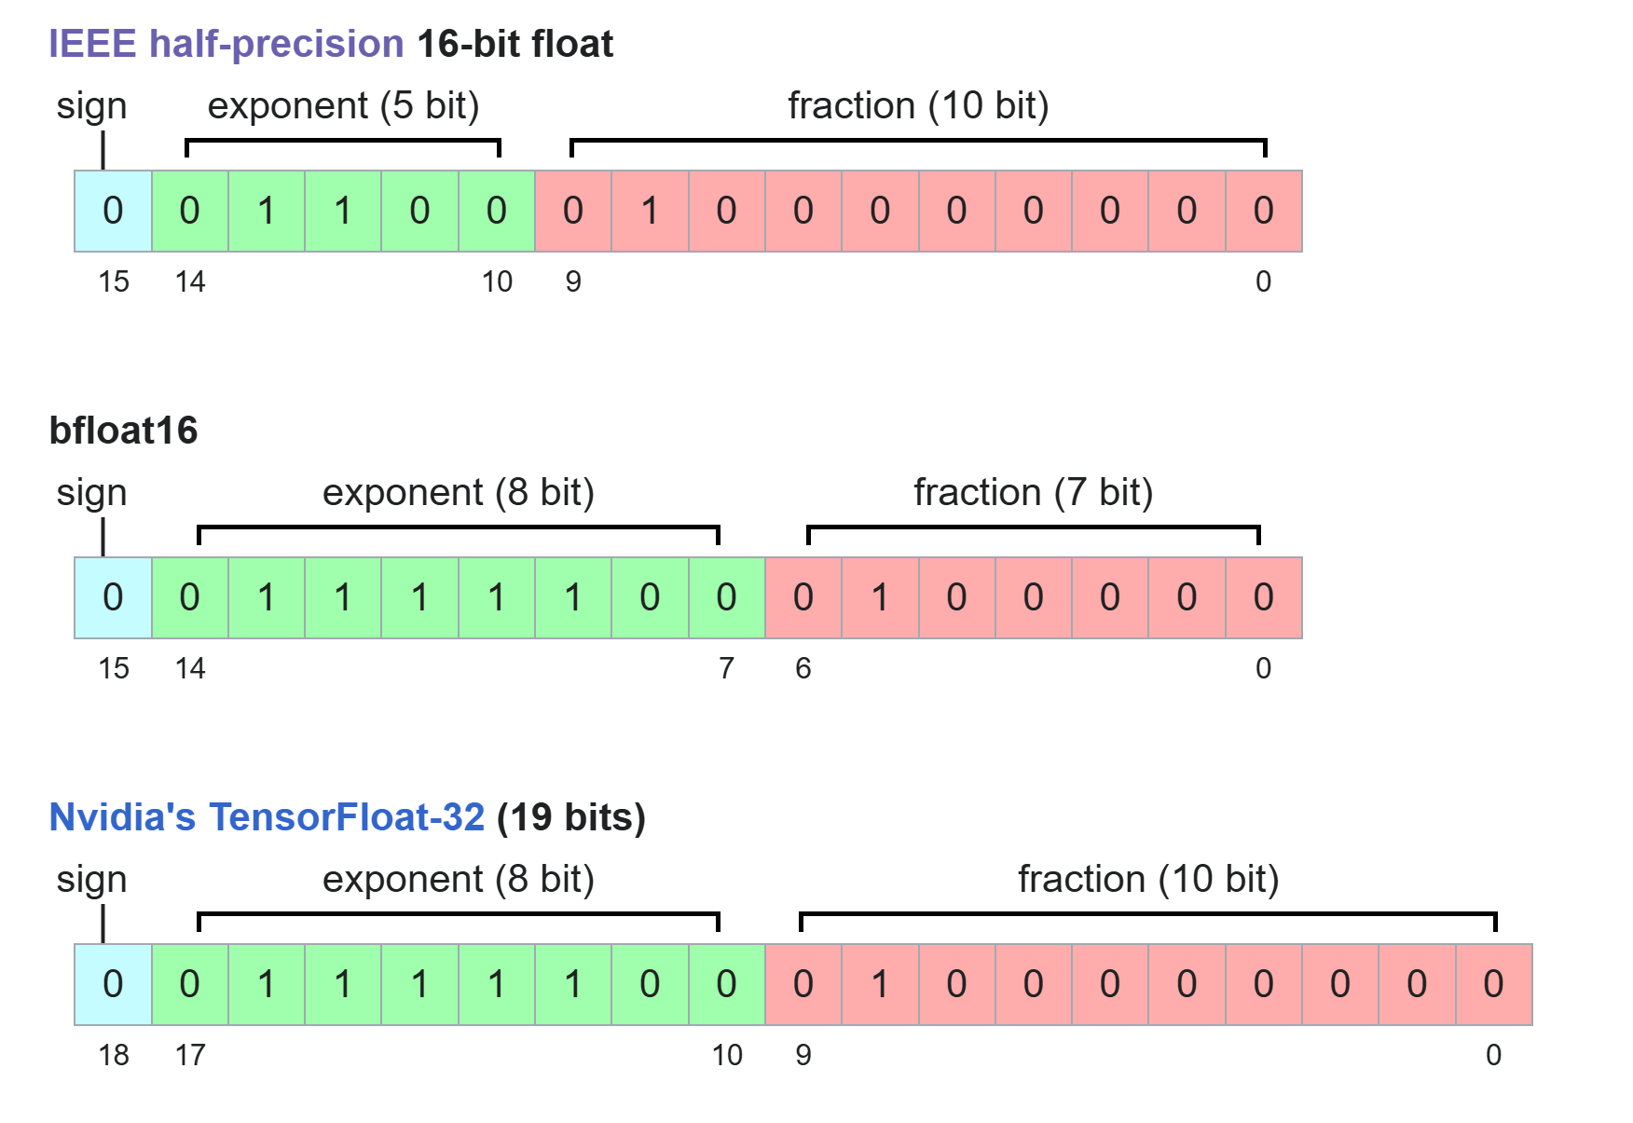
Floating Point Representation
What are we balancing?

Slide 11
Floating Point Arithmetic
When doing calculation, what do we care?
Addition
Alignment
Summation
Normalization
Round Up
Detection
Example:
A = 0 00000 0000000001
B = 0 00001 0000000000
Try compute:
A + A
A + B

Slide 12
Floating Point Arithmetic
When doing calculation, what do we care?
Multiplication
Sign
Exponential：summation
Mantissa：multiplication
Normalize
Round Up
Detection
Example:
B = 0 00001 0000000000
C = 0 00000 0111111110
Try compute:
B * B
C * C

Slide 13
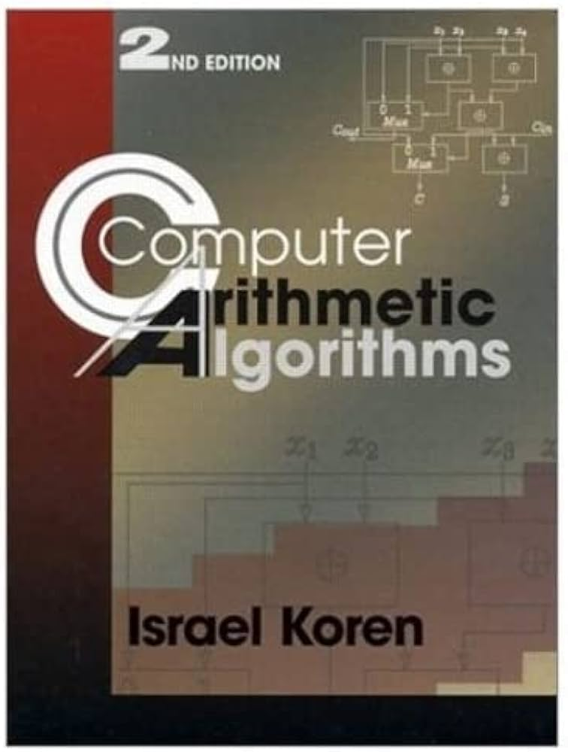
Computer Arithmetic Book

Slide 14
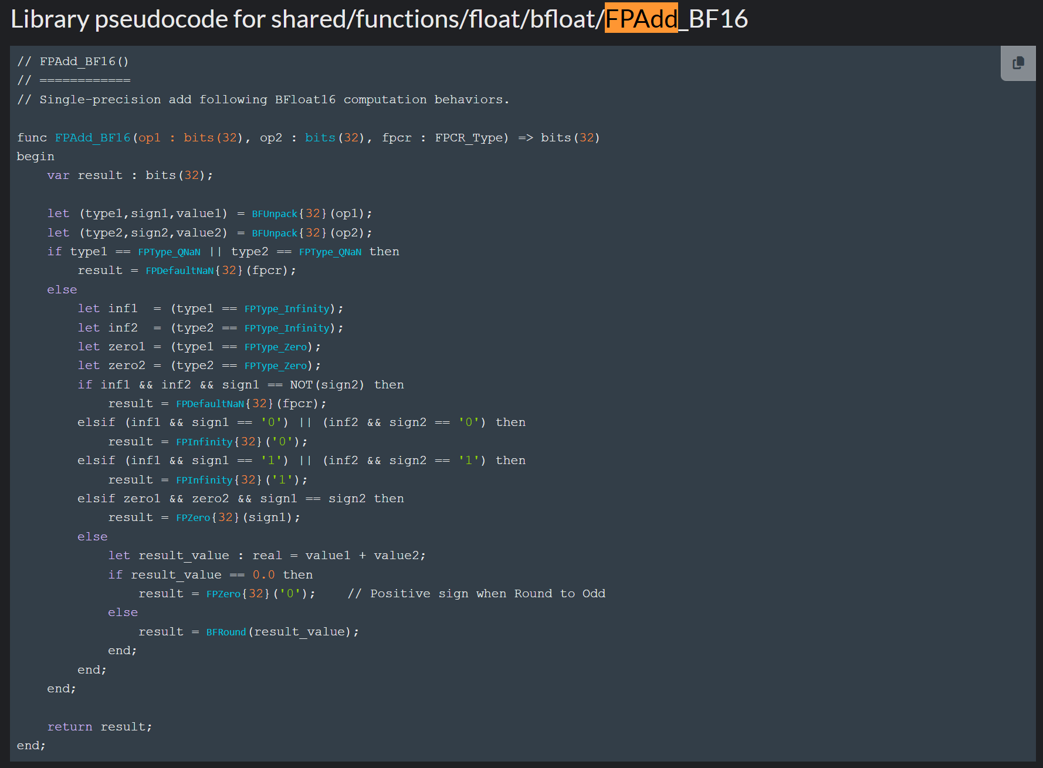
Modern Design - ARM
https://developer.arm.com/documentation/ddi0602/2025-12/?lang=en
https://developer.arm.com/documentation/ddi0602/2025-12/Shared-Pseudocode/shared-functions-float?lang=en#func_FPAdd_4

Slide 15
Next Lecture
Instruction Set Architecture

