Slide 1
Computer Architecture and Operating System
Process
Lecturer: Tianming Bai

Slide 2
Review
Cache memory
Introduction to OS: CPU Virtualization, Memory Virtualization, Concurrency, and Persistence

Slide 3
Content
How the OS virtualizes the CPU
What is a process?

Slide 4
Recall
In MARIE, we can run only one program at a time.
Fetch -> Decode -> Execution
In real life, we often wants to run more than one program at once

Slide 5
How to Provide the Illusion of Many CPUs
The OS creates this illusion by virtualizing the CPU.
By running one process, then stopping it and running another, and so forth.
Definition: A process is simply a running program.
A program itself is lifeless: static bytes (instructions + static data) stored on disk
The OS transforms this static program into an active, running process
It is the most fundamental abstraction the OS provides to users

Slide 6
How a Process Is Created
From a static program on disk to a running process:
Load the program into memory
OS reads the program code and static data from disk into the process’s address space
Modern OSes do this lazily: load code/data only when it is needed during execution
Allocate & initialize the run-time stack
OS allocates memory for the process’s stack
Initializes the stack with argc and argv parameters for the main() function
Allocate the heap
OS sets up initial heap space for dynamic memory allocation (malloc()/free())
Initialize I/O setup
By default, UNIX systems open 3 file descriptors: standard input, output, and error
Start execution at the entry point
OS jumps to the main() function, transferring CPU control to the new process

Slide 7
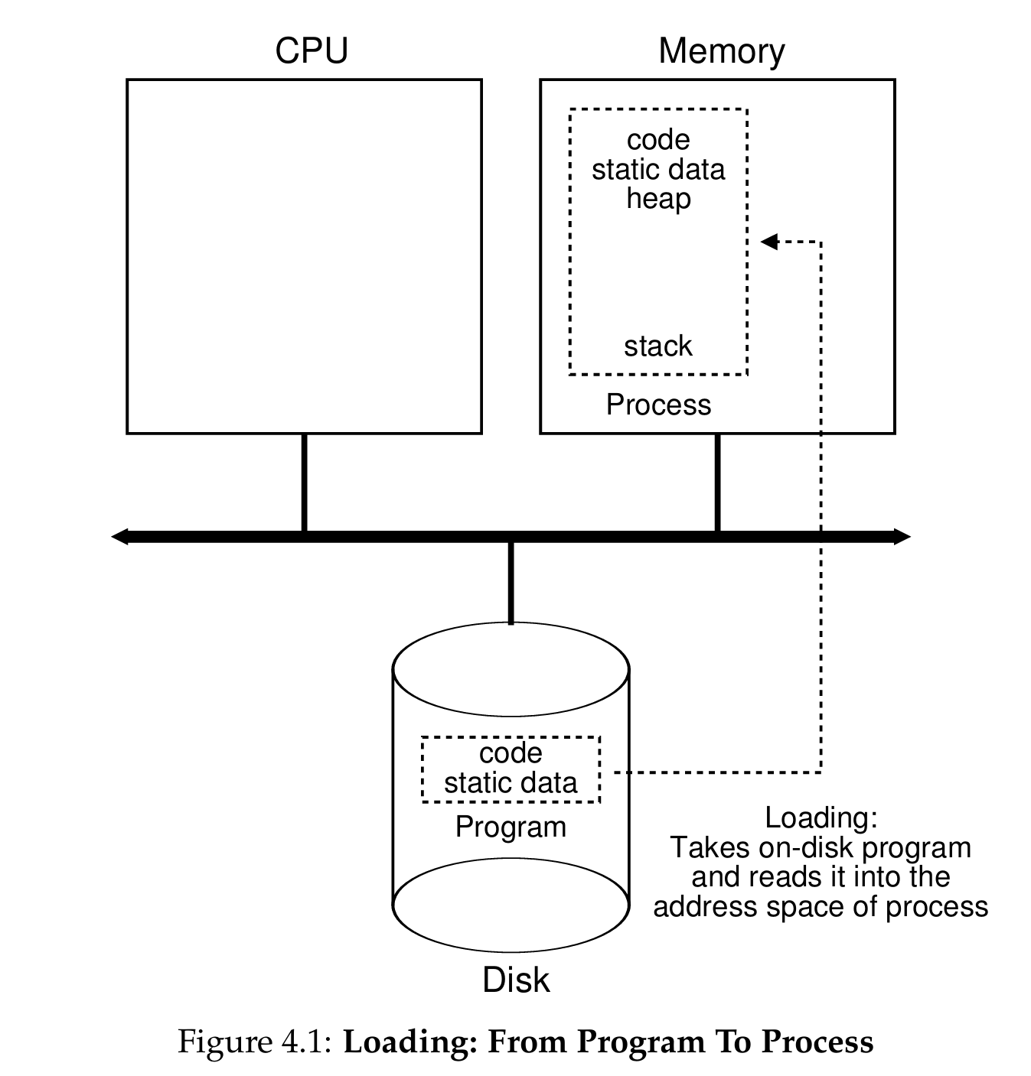
How a Process Is Created

Slide 8
Process Machine State
What defines a process at any moment?
Its machine state: all parts of the system the process accesses or affects during execution.
Core Components of the Machine State：
Address Space: The memory the process can access
Program instructions, static data, heap (dynamic data), stack (local variables/function calls)
CPU Registers
Program Counter (PC) / Instruction Pointer (IP): which instruction to run next
Stack Pointer & Frame Pointer: manage the function call stack
General-purpose registers for computation
I/O Information
List of open files the process is accessing
Standard input/output/error file descriptors (UNIX systems)

Slide 9
Time Sharing
The basic technique the OS uses to share the CPU:
Run one process for a short time slice
Stop it, save its state, and switch to another process
Repeat, creating the illusion that all processes are running simultaneously
Counterpart: Space Sharing
Resource is divided in space among users
Example: Disk space — once a block is assigned to a file, it stays assigned until the file is deleted
Tradeoff
Benefit: Makes the system easy to use, enables concurrent program execution
Cost: Performance reduction, each process runs slower when the CPU is shared

Slide 10
Mechanism vs. Policy
To implement virtualization of the CPU, the OS will need both some low-level machinery and some high-level intelligence.
low-level machinery: Mechanism
How does an operating system perform a context switch?
high-level intelligence: Policy
Which process should the operating system run right now?

Slide 11
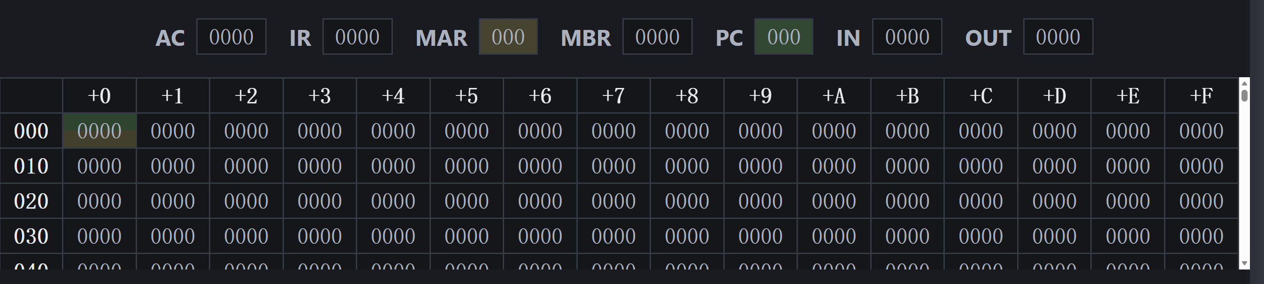
Example

Slide 12
Process States
A process can be in one of three fundamental states at any time:
State | Definition
Running | The process is actively executing instructions on a CPU core
Ready | The process is ready to run, but the OS has chosen not to schedule it at this moment
Blocked | The process cannot run until an external event completes (e.g., an I/O request to disk finishes)
OS moves processes between Ready and Running via scheduling and descheduling
A process moves to Blocked when it initiates an I/O operation, and back to Ready when the I/O completes

Slide 13
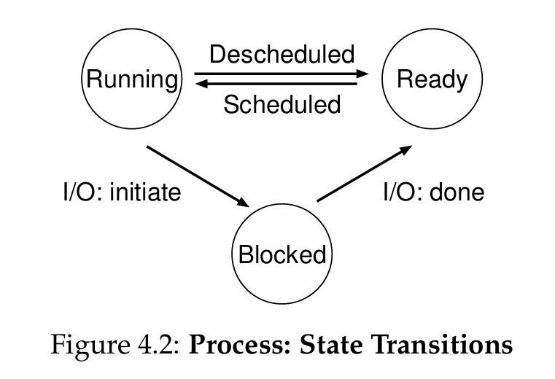
Process State Transitions
Key Transitions:
Running → Ready: Process is descheduled by the OS (time slice ends)
Ready → Running: Process is scheduled by the OS to use the CPU
Running → Blocked: Process initiates an I/O operation, cannot continue until it completes
Blocked → Ready: I/O operation completes, process is now eligible to run again

Slide 14
Process State Trace Examples
Example 1: CPU-Only Workloads (No I/O)
Two processes, both only use the CPU (no I/O requests)
Time | Process 0 | Process 1
1 | Running | Ready
2 | Running | Ready
3 | Running | Ready
4 | Running | Ready
5 | Done | Running
6 | Done | Running
7 | Done | Running
8 | Done | Done

Slide 15
Process State Trace Examples
Example 2: Workload with I/O
Process 0 initiates an I/O after 3 time units
Time | Process 0 | Process 1 | Key Note
1 | Running | Ready
2 | Running | Ready
3 | Running | Ready | Process 0 initiates I/O
4 | Blocked | Running | OS runs Process 1 to keep CPU busy
5 | Blocked | Running
6 | Ready | Running | I/O completes, Process 0 moves to Ready
7 | Ready | Running | Process 1 finishes
8 | Running | Done
9 | Running | Done | Process 0 finishes

Slide 16
Standard Process API
All modern OSes provide these core interfaces for process management:
API Call | Core Function
Create | Create a new process (e.g., when you run a program in the terminal)
Destroy | Forcefully terminate a running process
Wait | Wait for a process to finish execution
Misc Control | Suspend a process (pause) or resume it later
Status | Get runtime information about a process (run time, state, etc.)

Slide 18
Question
How can the OS virtualize the CPU efficiently, while retaining full control over the system?
Performance: Implement virtualization without excessive system overhead
Control: Run user processes efficiently, while preventing them from taking over the machine or accessing restricted resources
Solution: Hardware + OS collaboration via the Limited Direct Execution (LDE) protocol

Slide 19
Direct Execution
The core idea is simple: run the program directly on the physical CPU.
OS creates a process entry in the process list
Allocates memory for the process, loads program code from disk into memory
Jumps to the program’s entry point (main()) and runs user code directly on the CPU

Slide 20
Why "Limited"?
Unlimited direct execution creates two fatal problems:
No control over restricted operations: A user process could issue privileged I/O requests, access all system memory, or take over the machine entirely
No way to switch processes: Once a process starts running on the CPU, the OS is not running, it cannot stop the process to switch to another

Slide 21
Limited Direct Execution
We add limits to direct execution, using hardware support to:
Restrict what user processes can do
Let the OS safely regain control of the CPU at any time

Slide 22
User Mode vs. Kernel Mode
Hardware-Enforced Privilege Modes
All modern CPUs support two core execution modes:
Mode | Privilege Level | Capabilities
User Mode | Restricted | Code can only perform safe, non-privileged operations (e.g., arithmetic, in-memory operations). Cannot issue I/O requests, modify system configuration, or access restricted memory.
Kernel Mode | Full | Code runs with complete access to all hardware resources. Can execute privileged instructions (e.g., I/O setup, timer configuration, memory management) and modify critical system state.

Slide 23
Question
What if a user process needs to perform privileged operations?
We cannot let it run in kernel mode directly.
Solution: System calls via the trap mechanism.

Slide 24
System Calls
System calls let user processes safely request privileged operations from the OS, via a controlled hardware trap.
Stage 1: Boot Time Setup (Kernel Mode Only)
OS initializes the trap table at system boot
Tells the hardware the memory location of trap handlers for:
System calls
Hardware interrupts (e.g., timer, keyboard)
Illegal operations (e.g., division by zero)
Setting the trap table is a privileged operation — user code cannot modify it.

Slide 25
System Calls
Stage 2 - The User Request (User Mode)
Your program calls a standard library function, like read(). It enters the C Standard Library (libc).
The library code places the System Call Number (e.g., 63 for read) and arguments into agreed-upon general-purpose registers (e.g., a7, a0).
The library executes a special trap instruction (e.g., ecall in RISC-V, or syscall in x86).
Up to this exact microsecond, the CPU is still operating under strict User Mode restrictions.

Slide 26
System Calls
Stage 3 - The Hardware Trap
The CPU hardware decoder sees the ecall instruction and instantly intervenes.
The hardware forcefully flips the Mode Bit in the status register from User Mode -> Kernel Mode.
The hardware automatically saves the current Program Counter (PC) and registers so the program doesn't lose its place.
The hardware reads the Trap Table address (set in Stage 1) and forces the PC to jump to the OS's pre-defined entry point.

Slide 27
System Calls
Stage 4 - Kernel Execution & Return
The OS wakes up in Kernel Mode. It reads the System Call Number (e.g., 63), verifies the permissions, and performs the actual hardware I/O (e.g., reading the disk).
Once finished, the OS executes a special return-from-trap instruction (e.g., sret).
The CPU hardware sees sret. It automatically flips the Mode Bit back to User Mode and restores the saved PC.
The user program resumes execution exactly where it left off, now with the requested data available.

Slide 28
Switching Between Processes
If a process is running on the CPU, the OS is NOT running. If the OS is not running, how can it do anything?
Once a user process starts executing, the OS has no way to stop it or switch to another process, unless the process voluntarily gives up control.
The Two Approaches to Regain Control
Cooperative Approach: Trust processes to hand control back to the OS voluntarily
Non-Cooperative Approach: Use hardware support to force control back to the OS, even with uncooperative/rogue processes

Slide 29
Cooperative Approach
The OS trusts user processes to behave reasonably:
Processes hand control back to the OS frequently via system calls (e.g., I/O requests)
Explicit yield() system call: Does nothing except transfer control to the OS
Control is also returned when a process triggers an illegal operation (e.g., invalid memory access, division by zero), which generates a trap to the kernel
Limitations
No protection against rogue/buggy processes: A process stuck in an infinite loop will never make a system call, and never hand control back to the OS
The only fix is to reboot the machine
Used in early systems (e.g., early Mac OS, Xerox Alto), but not suitable for modern general-purpose operating systems

Slide 30
Non-Cooperative Approach
The Hardware Solution: Timer Interrupt
The only way to guarantee the OS can regain control, even with uncooperative processes.
How It Works
Boot Time Setup: OS programs a hardware timer device to raise an interrupt every X milliseconds (privileged operation)
Runtime: When the timer interrupt fires:
The currently running process is halted
Hardware saves the process’s registers to its kernel stack
CPU jumps to the OS’s pre-configured timer interrupt handler (kernel mode)
The OS now has full control of the CPU!

Slide 31
Summary
The Process Abstraction
The Core Illusion: The OS virtualizes the CPU using time sharing, running one process for a short time slice and switching to another, creating the illusion of many CPUs.
The Process: A process is a running program. It is defined by its machine state: Address Space (memory), CPU Registers (PC, SP, FP), and I/O Information.
State Transitions: A process actively moves between three fundamental states: Running (executing on CPU), Ready (waiting to be scheduled), and Blocked (waiting for an external event like I/O).
The Process API: Modern OSes provide standard interfaces to Create, Destroy, Wait, Suspend/Resume, and check the Status of processes.

Slide 32
Summary
Control & Mechanisms
Limited Direct Execution (LDE): The OS achieves high performance by running user code directly on the CPU, but maintains control by applying hardware-enforced limits.
Privilege Modes: Hardware strictly separates User Mode (restricted capabilities) from Kernel Mode (full hardware access).
System Calls (The Trap): User processes must use a controlled hardware trap mechanism (via a pre-configured Trap Table) to safely request privileged operations from the OS.
Regaining Control: To prevent rogue processes from taking over, the OS relies on the Non-Cooperative Approach: using a hardware Timer Interrupt to forcefully halt the current process and switch execution back to the kernel.

Slide 33
Next Lecture
Scheduling…

