Slide 1
Computer Architecture and Operating System
Scheduling
Lecturer: Tianming Bai

Slide 2
Review
Process
Process States
Low-level machinery: Mechanism
Limited Direct Execution: User Mode vs. Kernel Mode

Slide 3
Content
Scheduling Policies:
Scheduling Metrics
First In, First Out (FIFO)
Shortest Job First (SJF)
Shortest Time-to-Completion First (STCF)
Round-Robin (RR)
The Multi-Level Feedback Queue (MLFQ)

Slide 4
Recall
To implement virtualization of the CPU, the OS will need both some low-level machinery and some high-level intelligence.
How should we develop a basic framework for thinking about scheduling policies?
What are the key assumptions?
What metrics are important?

Slide 5
Assumptions
We start with 5 simplifying (and mostly unrealistic) assumptions about the processes (jobs) running on our system:
Each job runs for the exact same amount of time.
All jobs arrive in the system at the exact same time.
Once started, each job runs to completion (no preemption).
All jobs only use the CPU (they perform no I/O operations).
The run-time of every job is known in advance (the scheduler is "omniscient").
We will relax these one by one, and evolve our scheduling algorithms to match the new, more realistic constraints.

Slide 6
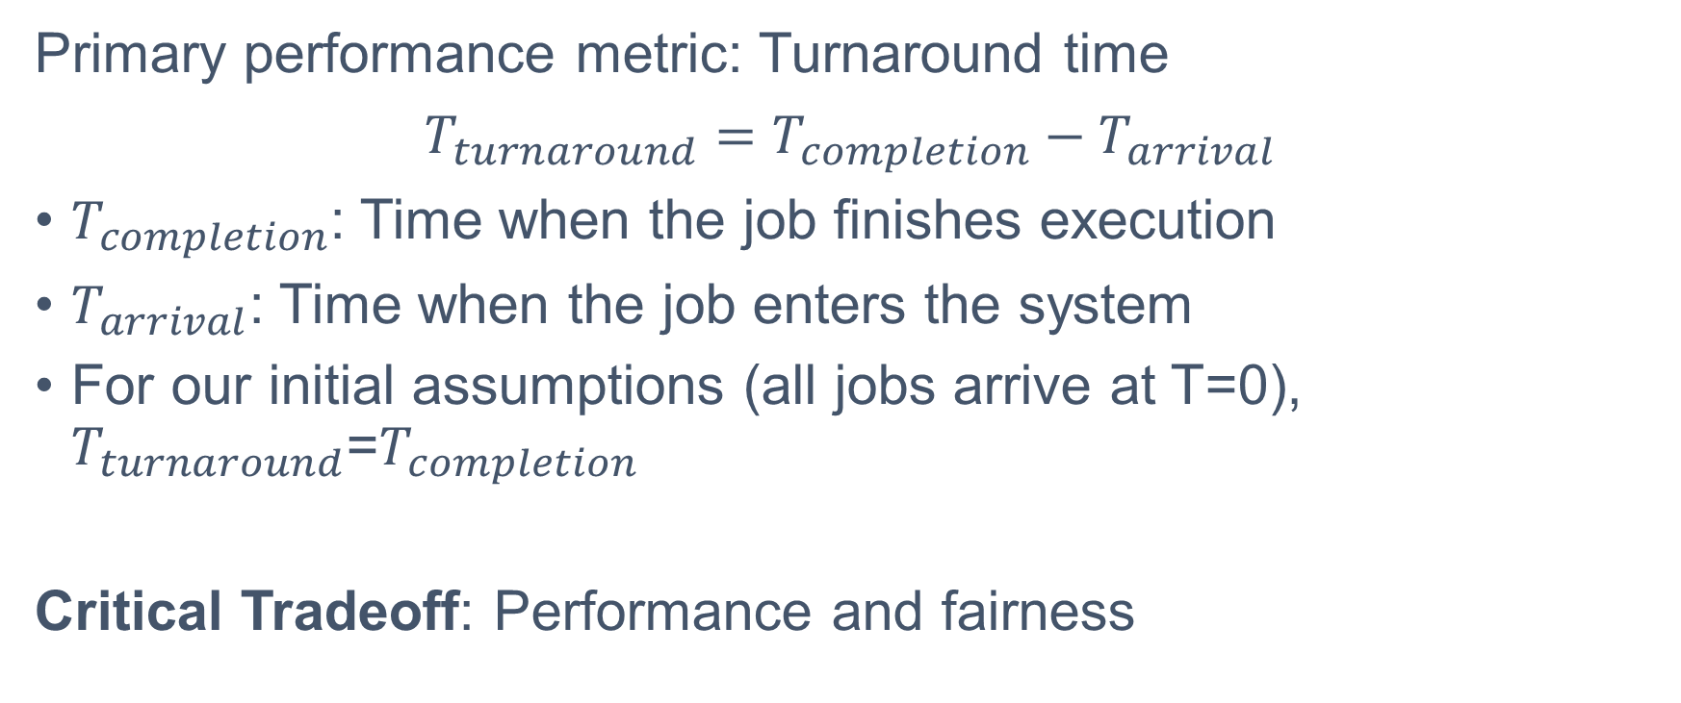
Scheduling Metric
Primary performance metric: Turnaround time
$T_{turnaround}​=T_{completion}​−T_{arrival}$​
$T_{completion}$​: Time when the job finishes execution
$T_{arrival}$​: Time when the job enters the system
For our initial assumptions (all jobs arrive at T=0), $T_{turnaround}$​=$T_{completion}$​
Critical Tradeoff: Performance and fairness

Slide 7
First-In, First-Out (FIFO)
Jobs run in the exact order they arrive in the system. Also called First-Come, First-Served (FCFS).
Example 1: 3 jobs: A, B, C
All arrive at T=0, each runs for 10 seconds
Compute:
Turnaround Time
Average Turnaround Time

Slide 8
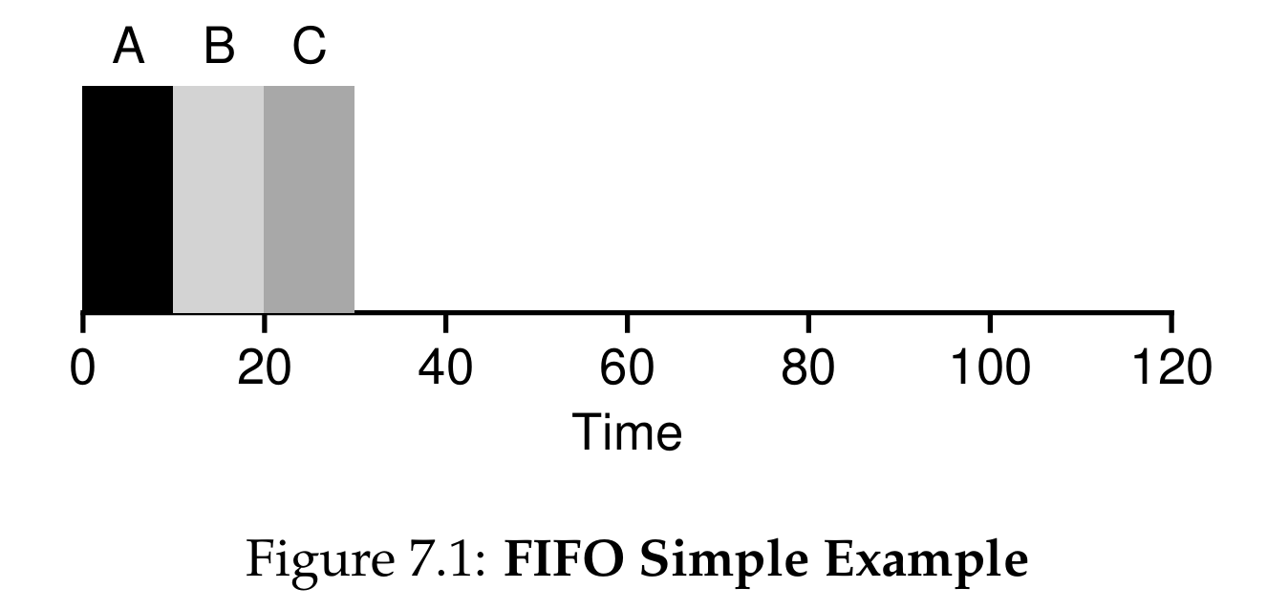
First-In, First-Out (FIFO)
Example 1: 3 jobs: A, B, C
All arrive at T=0, each runs for 10 seconds
Turnaround Time: A=10, B=20, C=30
Average Turnaround Time: (10+20+30)/3 ​= 20 seconds
Gantt Chart:

Slide 9
First-In, First-Out (FIFO)
Relax Assumption 1: Jobs Have Different Runtimes
Example 2: 3 jobs: A, B, C
All arrive at T=0
A runs for 80 seconds, B and C run for 5 seconds each.
Calculate:
Turnaround Time:
Average Turnaround Time:

Slide 10
First-In, First-Out (FIFO)
Example 2: 3 jobs: A, B, C
All arrive at T=0
A runs for 80 seconds, B and C run for 5 seconds each.
Turnaround Time: A = 80, B = 85, C = 90
Average Turnaround Time: (80 + 85 + 90)/3 = 85
This problem is generally referred to as the convoy effect, where a number of relatively-short weight resource consumers get queued behind a heavy weight resource consumer.
Advantages: simple to implement
Limitations: performs poorly when job runtimes vary

Slide 11
Shortest Job First (SJF)
Run the job with the shortest total runtime first, then the next shortest, and so on. Non-preemptive: once a job starts, it runs to completion.
Example:
3 jobs: A (80s), B (5s), C (5s), all arrive at T=0
Calculations
Turnaround Time
Average Turnaround Time

Slide 12
Shortest Job First (SJF)
Run the job with the shortest total runtime first, then the next shortest, and so on. Non-preemptive: once a job starts, it runs to completion.
Example:
3 jobs: A (80s), B (5s), C (5s), all arrive at T=0
Calculations
Turnaround Time: B=5, C=10, A=90
Average Turnaround Time: (5 + 10 + 90)/3 = 35 seconds
85 / 35 = ~ 2.4x performance improvement!

Slide 13
Shortest Job First (SJF)
Relax Assumption 2: Jobs Arrive At Different Times
Example:
Job A arrives at T=0, runs for 80 seconds
Jobs B and C arrive at T=10, each runs for 5 seconds
Calculation:
Turnaround Time
Average Turnaround Time

Slide 14
Shortest Job First (SJF)
Example:
Average Turnaround Time: (80+75+80)/3 = ~78.33 seconds
Even though B and C are short jobs, they are forced to wait the full 100 seconds for A to finish. We are back to the convoy effect!
Advantages: Provably optimal for average turnaround time when all jobs arrive simultaneously
Limitations: Still suffers from convoy effects when jobs arrive over time

Slide 15
Relax Assumption 3: Preemptive Scheduling
Non-preemptive: Once a job starts running, it runs to completion (FIFO, SJF)
Preemptive: The OS can pause (preempt) a running job at any time, and switch to another job
Enabled by the timer interrupt and context switch mechanisms we learned previously
Virtually all modern operating systems use preemptive scheduling
We need a scheduler that can preempt a long-running job when a new, shorter job arrives.

Slide 16
Shortest Time-to-Completion First (STCF)
Also called Preemptive Shortest Job First (PSJF). At any time (when a new job arrives, or a job finishes), the scheduler runs the job with the shortest remaining time left to complete.
Example
Job A arrives at T=0, runs for 80 seconds
Jobs B and C arrive at T=10, each runs for 5 seconds

Slide 17
Shortest Time-to-Completion First (STCF)
Example:
Job A arrives at T=0, runs for 80 seconds
Jobs B and C arrive at T=10, each runs for 5 seconds
Calculations:
Turnaround Time: A=90, B=15-10=5, C=20-10=10
Average Turnaround Time: (90+5+10)/3​=35 seconds
78.33/35 = ~ 2.2x performance improvement!

Slide 18
Next Metric
Any limitation to STCF?
Still requires knowing job runtimes in advance (Assumption 5 still holds)
Terrible for interactive performance
The rise of time-shared and interactive systems (terminals, modern PCs) created a new requirement: responsiveness
Users sitting at a terminal need to see a response immediately when they type, not wait 10+ seconds for a long job to finish

Slide 19

Response Time
The time from when a job arrives in the system to the first time it is scheduled to run on the CPU.
$$T_{response}​=T_{first run}​−T_{arrival}​$$

Slide 20
Shortest Time-to-Completion First (STCF)
Example: 3 jobs: A, B, C
All arrive at T=0, each runs for 5 seconds total
Response Time: A=0, B=5, C=10
Average Response Time: (0+5+10​)/3 = 5 seconds

Slide 21
Round Robin (RR)
Also called time-slicing. The scheduler runs each job for a fixed time slice (scheduling quantum), then switches to the next job in the ready queue. It repeats this cycle until all jobs are complete.
The time slice must be a multiple of the timer interrupt period
Example: 10ms timer interrupt → time slice can be 10ms, 20ms, 100ms, etc.

Slide 22
Round Robin (RR)
Example: 3 jobs: A, B, C
All arrive at T=0, each runs for 5 seconds total
Time slice = 1 second
Response Time Calculations
Response Time: A=0, B=1, C=2
Average Response Time: 30+1+2​=1 second
5x improvement over SJF!

Slide 23
RR Tradeoffs
Time Slice Length
Shorter time slice: Better (lower) response time
Longer time slice: Better (lower) turnaround time, less overhead
Context Switch Cost
Context switching has a fixed cost: saving/restoring registers, flushing CPU caches/TLBs/branch predictors
Amortization Principle: Increase the time slice to amortize the fixed cost of context switching
Example:
1ms context switch cost, 10ms time slice → 10% of time wasted on switching
1ms context switch cost, 100ms time slice → <1% of time wasted on switching
Key Takeaway: RR is the worst policy for turnaround time, but the best policy for response time. This is the fundamental scheduling tradeoff: you cannot optimize for both turnaround time and response time at the same time.

Slide 24
Assumption 4: Jobs Perform I/O
When a job initiates an I/O request (e.g., to disk, network), it becomes blocked waiting for the I/O to complete.
The CPU sits idle during this time.
We are wasting precious CPU resources!
The Solution: Treat Each CPU Burst As A Separate Job
A job that performs I/O is split into multiple short "sub-jobs", each corresponding to a single CPU burst between I/O operations
The scheduler treats each CPU burst as an independent job
When a job blocks for I/O, the scheduler runs another job on the CPU
When the I/O completes, the job is moved back to the ready queue

Slide 25
Assumption 4: Jobs Perform I/O
Example: Overlap CPU and I/O
2 jobs: A and B, each need 50ms of total CPU time
Job A: 10ms CPU burst → 10ms I/O → repeat (5 total bursts)
Job B: 50ms continuous CPU burst, no I/O
STCF scheduler: Runs A’s 10ms bursts, preempts B when A’s I/O completes
Result: CPU is never idle! We overlap A’s I/O with B’s CPU execution, doubling system utilization.

Slide 26
Relax Assumption 5
The Final, Most Unrealistic Assumption
All of our optimal algorithms (SJF, STCF) require the scheduler to know the total runtime of every job in advance.
In real general-purpose operating systems, this is impossible
The OS has no way to see into the future and know how long a job will run, or how long its next CPU burst will be
How can we build a scheduler that behaves like SJF/STCF (optimizes turnaround time) without knowing job runtimes in advance? How can we also incorporate the responsiveness of RR for interactive workloads?

Slide 27
Multi-Level Feedback Queue (MLFQ)
The Multi-Level Feedback Queue (MLFQ) has a number of distinct queues, each assigned a different priority level.
At any given time, a job that is ready to run is on a single queue.
MLFQ uses priorities to decide which job should run at a given time: a job with higher priority is chosen to run.
Basic Rules:
Rule 1: If Priority(A) > Priority(B), A runs (B doesn’t).
Rule 2: If Priority(A) = Priority(B), A & B run in Round-Robin (RR) scheduling.
MLFQ varies the priority of a job based on its observed behavior.

Slide 28
How To Change Priority
We define a job's allotment as the amount of time a job can spend at a given priority level before the scheduler reduces its priority.
Our first attempt at a priority-adjustment algorithm:
Rule 3: When a job enters the system, it is placed at the highest priority (the topmost queue).
Rule 4a: If a job uses up its allotment while running, its priority is reduced (i.e., it moves down one queue).
Rule 4b: If a job gives up the CPU (for example, by performing an I/O operation) before the allotment is up, it stays at the same priority level (i.e., its allotment is reset).
This approach assumes an unknown job might be short, giving it high priority first to approximate SJF.

Slide 29
Next
What’s the potential issue?
Starvation: If there are "too many" interactive jobs in the system, they will combine to consume all CPU time. Long-running jobs will never receive any CPU time (they starve).
Gaming the Scheduler: A smart user could do something sneaky to trick the scheduler into giving them more than their fair share of the resource. By issuing an I/O operation before the allotment is used, a job can relinquish the CPU and stay in the same queue indefinitely.
Program Phase Changes: A program may change its behavior over time. A CPU-bound job that transitions to a phase of interactivity would be out of luck and stuck at the lowest priority.

Slide 30
Priority Boost
To solve starvation, we need to guarantee that CPU-bound jobs will make some progress.
Rule 5: After some time period S, move all the jobs in the system to the topmost queue.
Benefits:
Processes are guaranteed not to starve.
If a CPU-bound job has become interactive, the scheduler treats it properly once it has received the priority boost.
Challenge (Ousterhout's Law): What should the time period S be set to? It acts as a "voo-doo constant". If set too high, long jobs starve; if too low, interactive jobs suffer.

Slide 31
Gaming the Scheduler
To prevent gaming the scheduler, we must perform better accounting of CPU time at each level.
Instead of forgetting how much of its allotment a process used when it performs I/O, the scheduler should keep track.
We combine and rewrite Rules 4a and 4b:
Rule 4: Once a job uses up its time allotment at a given level (regardless of how many times it has given up the CPU), its priority is reduced (i.e., it moves down one queue).
With better accounting, regardless of I/O behavior, a job slowly moves down the queues and cannot gain an unfair share of the CPU.

Slide 32
Tuning MLFQ
Configuring an MLFQ requires answering several parameterization questions.
How many queues should there be?
How big should the time slice and allotment be?
How often should priority be boosted?
Varying Time Slices: Most MLFQ variants allow for varying time-slice lengths across different queues.
High-priority queues are usually given short time slices (e.g., 10 or fewer milliseconds) for interactive jobs.
Low-priority queues contain long-running CPU-bound jobs, so longer time slices work well (e.g., 100s of ms).

Slide 33
MLFQ Rules Summary
The MLFQ Rules:
Rule 1: If Priority(A) > Priority(B), A runs (B doesn’t).
Rule 2: If Priority(A) = Priority(B), A & B run in round-robin fashion using the time slice (quantum length) of the given queue.
Rule 3: When a job enters the system, it is placed at the highest priority (the topmost queue).
Rule 4: Once a job uses up its time allotment at a given level (regardless of how many times it has given up the CPU), its priority is reduced (i.e., it moves down one queue).
Rule 5: After some time period S, move all the jobs in the system to the topmost queue.

Slide 34
Conclusion
Scheduling Trade-offs: CPU scheduling fundamentally balances conflicting metrics: Turnaround Time (optimized by running shortest jobs first) versus Response Time (optimized by frequent context switching/time-slicing).
FIFO and SJF minimize turnaround time but suffer from the convoy effect when jobs arrive dynamically. Round Robin (RR) delivers excellent responsiveness for interactive users but performs poorly for turnaround time.
The Multi-Level Feedback Queue (MLFQ) approximates SJF without a priori knowledge of job runtimes. It achieves this by learning from a job's history.
Dynamic Adaptation: By utilizing multiple queues, penalizing long CPU bursts (priority reduction), rewarding I/O behaviors, and periodically boosting all priorities, MLFQ prevents starvation, prevents gaming, and perfectly balances both responsiveness and turnaround time.

Slide 35
Next Lecture
A deeper look into memory virtualization.

