Slide 1
Computer Architecture and Operating System
Virtual Memory
Lecturer: Tianming Bai

Slide 2
Review
In early time, the physical memory contained just the OS routines and one running program. Multiprogramming and Time Sharing were introduced to increase CPU utilization and interactivity.

Slide 3
Review - CPU Virtualization
How the OS provides the illusion of many CPUs?
Mechanism: Limited Direct Execution (LDE). The OS runs programs directly on the CPU but maintains control through hardware-enforced User/Kernel modes and Trap mechanisms (System Calls).
Policy: Scheduling. We discussed how to optimize Turnaround Time (SJF, STCF) and Response Time (RR, MLFQ).
We successfully virtualized the CPU through time-sharing. Now, what about memory? Saving the entire contents of memory to disk when switching processes is brutally slow.
The Solution: Leave multiple processes in memory simultaneously and switch the CPU between them.

Slide 4
Recall - Introduction to VM
Limitations of physical-only memory: A program’s size is strictly capped by physical RAM, and multiple running programs can overwrite each other’s data.
The Goal: Extend memory capacity, provide isolation/protection, and simplify programming.

Slide 5
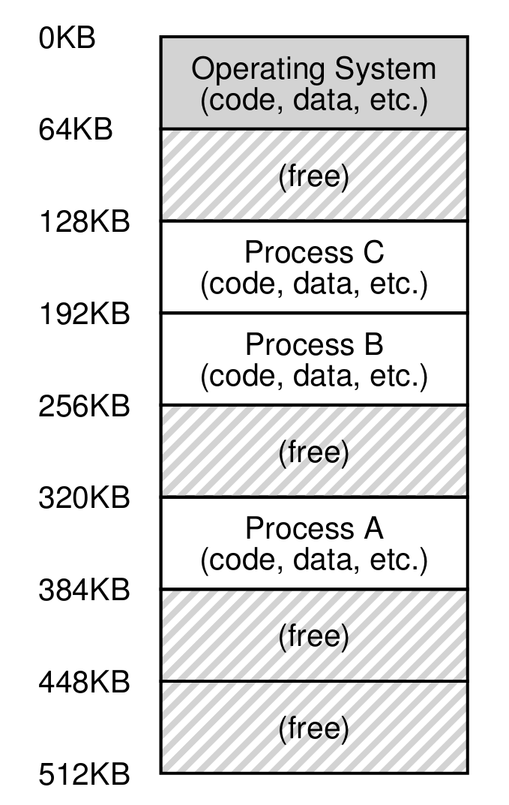
How To Virtualize Memory?
How can the OS build this abstraction of a private, potentially large address space for multiple running processes (all sharing memory) on top of a single, physical memory?

Slide 6
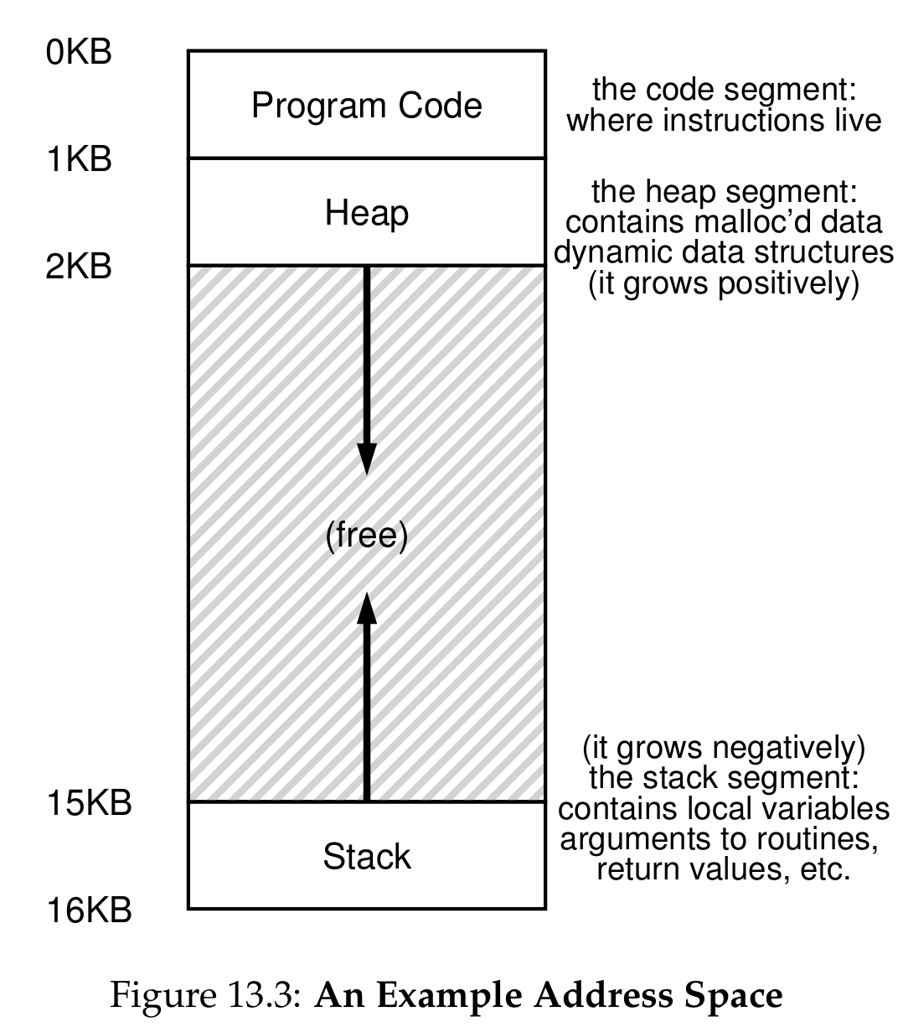
Address Spaces
Doing so requires the OS to create an easy to use abstraction of physical memory.
We call this abstraction the address space, and it is the running program's view of memory in the system.
The address space of a process contains all of the memory state of the running program.
The program thinks it is loaded into memory at a particular address (say 0), but the reality is quite different.

Slide 7
Address Spaces
Program Code: Where instructions live. Placed at the top of the address space because it is static and won't need more space.
Heap: Used for dynamically-allocated, user-managed memory (e.g., malloc()). It starts just after the code and grows downward.
Stack: Used to keep track of function calls, local variables, and return values. It starts at the bottom and grows upward.
Note: Any address you can see as a programmer (e.g., printing a pointer) is a virtual address, not the physical truth.

Slide 8
Virtualize Memory

Slide 9
Goals of Virtual Memory
Transparency: The OS should implement virtual memory in a way that is invisible to the running program.
Efficiency: Make virtualization time-efficient (relying on hardware support) and space-efficient (not using too much memory for OS structures).
Protection (Isolation): Protect processes from one another and the OS itself from processes. A process should only be able to access its own address space.

Slide 10
Example
C code:
int x = 3000;
x = x + 3;
Assembly (x86):
128: movl 0x0(%ebx), %eax ; load value of x into register eax.
132: addl $0x03, %eax ; add 3 to eax register.
135: movl %eax, 0x0(%ebx) ; store eax back to memory.

Slide 11
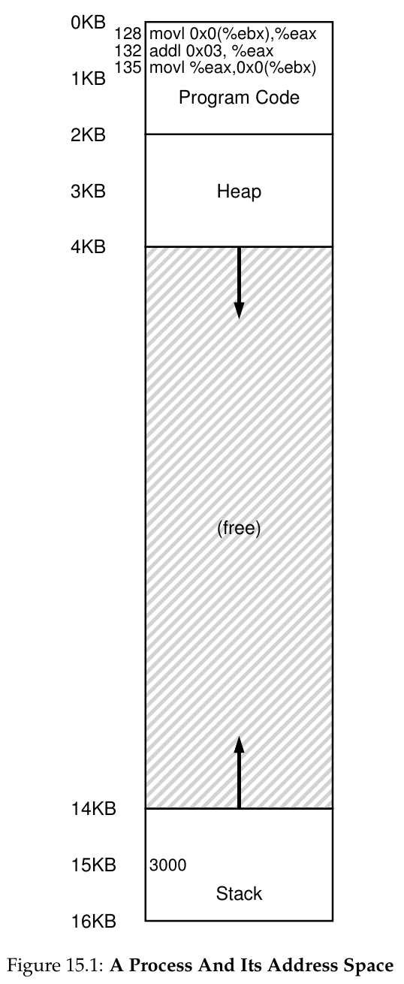
Example
From the program's perspective, its address space starts at address 0 and grows to 16 KB.
When these instructions run, the following memory accesses take place:
Fetch instruction at address 128.
Execute this instruction (load from address 15 KB).
Fetch instruction at address 132 (no memory reference).
Fetch the instruction at address 135.
Execute this instruction (store to address 15 KB).

Slide 12
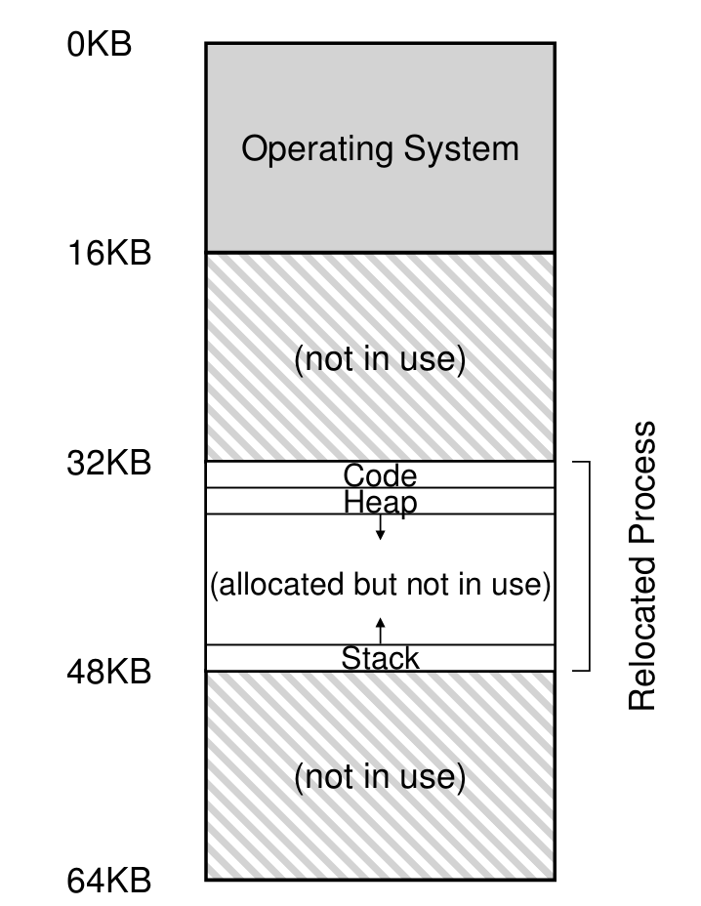
Example
The OS wants to place the process somewhere else in physical memory, not necessarily at address 0.
In this example, the OS uses the first slot for itself, and has relocated the process into the slot starting at physical address 32 KB.
The Problem: How can we relocate this process in memory in a way that is transparent to the process? How can we provide the illusion of a virtual address space starting at 0?

Slide 13
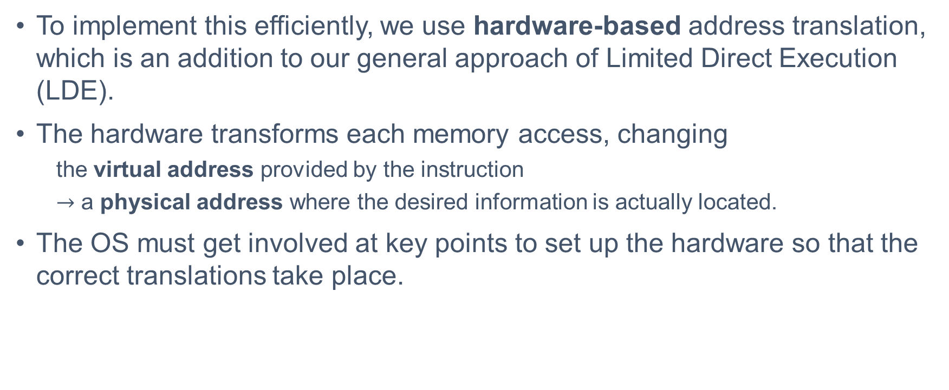
Address Translation
To implement this efficiently, we use hardware-based address translation, which is an addition to our general approach of Limited Direct Execution (LDE).
The hardware transforms each memory access, changing
the virtual address provided by the instruction
$→$ a physical address where the desired information is actually located.
The OS must get involved at key points to set up the hardware so that the correct translations take place.

Slide 14
Assumptions
Before building a complex mechanism, we start with three simple assumptions about the user's address space:
The user's address space must be placed contiguously in physical memory.
The size of the address space is not too big (less than the size of physical memory).
Each address space is exactly the same size.

Slide 15
Attempt #1: Dynamic Relocation
Introduced in the late 1950s, this technique requires two hardware registers within each CPU:
a base register
a bounds (limit) register
When a program starts running, the OS decides where in physical memory it should be loaded and sets the base register to that value.
The Translation Formula: physical address = virtual address + base.

Slide 16
Protection via the Bounds Register
Bounds register: help with protection. The processor will first check that the memory reference is within bounds to make sure it is legal.
If a process generates a virtual address that is greater than (or equal to) the bounds, or one that is negative, the CPU will raise an exception.
The OS exception handler will then likely terminate the misbehaving process.

Slide 17
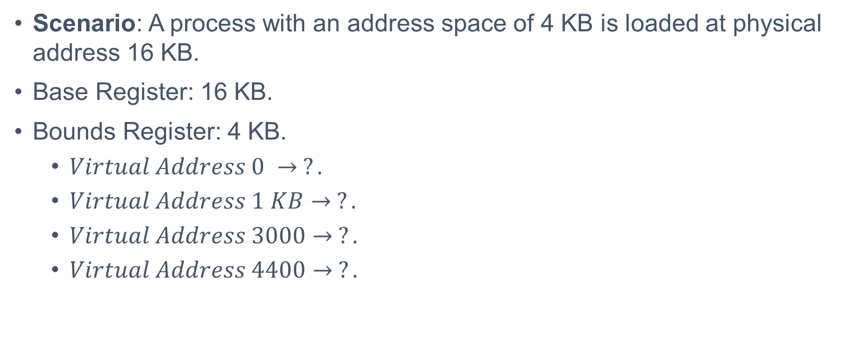
Address Translation Example
Scenario: A process with an address space of 4 KB is loaded at physical address 16 KB.
Base Register: 16 KB.
Bounds Register: 4 KB.
$Virtual Address 0 → ?.$
$Virtual Address 1 KB→ ?.$
$Virtual Address 3000→ ?.$
$Virtual Address 4400→ ?.$

Slide 18
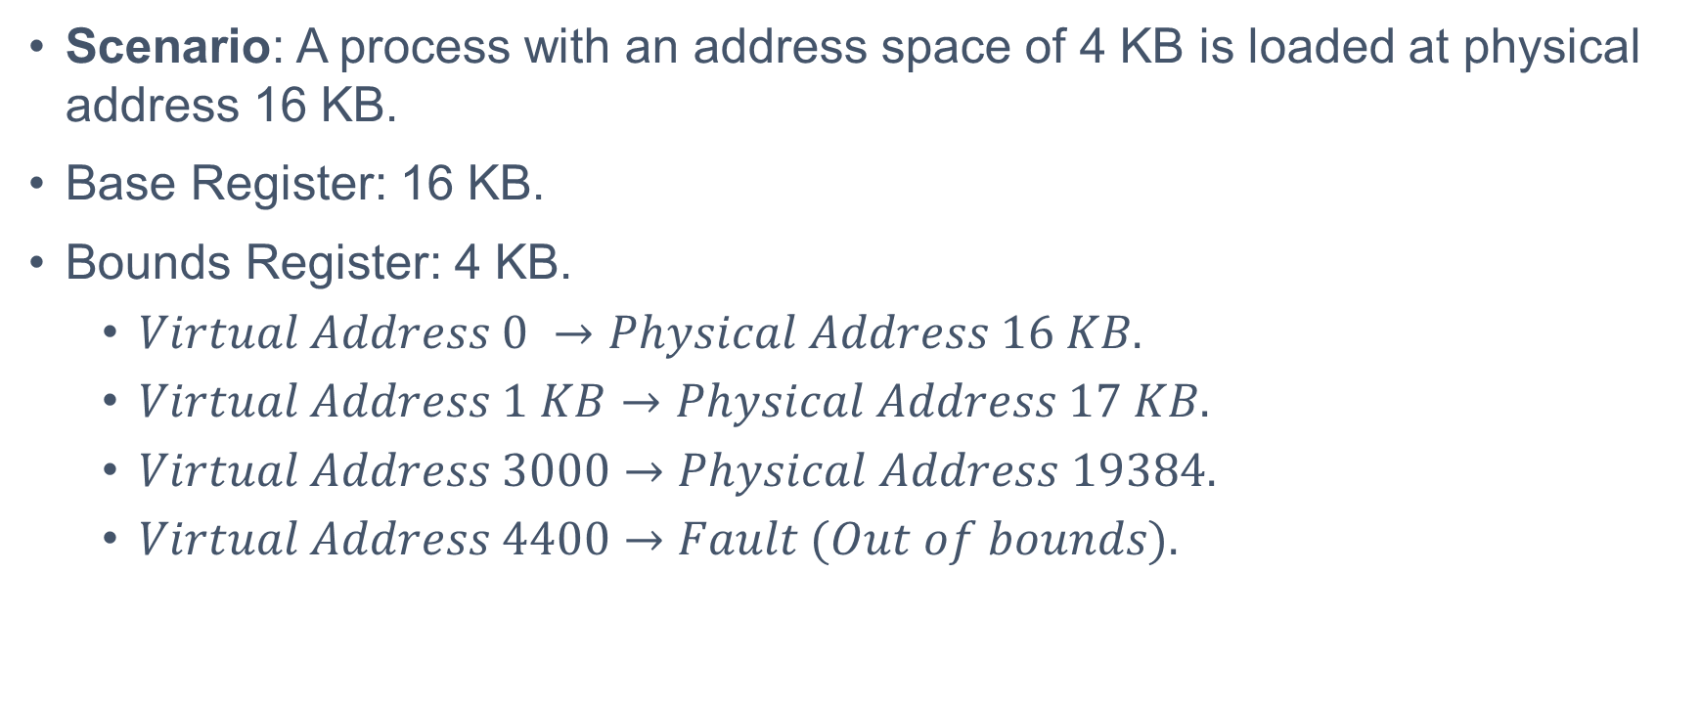
Address Translation Example
Scenario: A process with an address space of 4 KB is loaded at physical address 16 KB.
Base Register: 16 KB.
Bounds Register: 4 KB.
$Virtual Address 0 →Physical Address 16 KB.$
$Virtual Address 1 KB→Physical Address 17 KB.$
$Virtual Address 3000→Physical Address 19384.$
$Virtual Address 4400→Fault (Out of bounds).$

Slide 19
Hardware Support
Privileged Mode: A kernel mode to prevent user processes from executing privileged operations.
Base/Bounds Registers: One pair per CPU, located in the Memory Management Unit (MMU).
Translation Circuitry: Hardware to translate virtual addresses and check limits efficiently on every memory access.
Exceptions: Ability to raise exceptions for out-of-bounds access or attempts to modify privileged registers.

Slide 20
Operating System Responsibilities
Memory Management:
When a process is created, the OS searches a data structure (often called a free list) to find room for the new address space and marks it used.
Upon termination of a process, the OS puts its memory back on the free list and cleans up associated data structures.
Exception Handling: The OS must install handlers at boot time to take action (usually termination) when a process tries to access memory outside its bounds.

Slide 21
Operating System Responsibilities
Context Switching: There is only one base and bounds register pair on each CPU.
When switching, the OS must save the base/bounds values to a per-process structure (Process Control Block (PCB)).
When resuming, it must set the CPU registers to the correct values for the new process.
Relocation: When a process is stopped, the OS can copy its address space to a new location, update the saved base register, and resume it without the program noticing.

Slide 22
Problems
While Base-and-Bounds is efficient and provides protection, it has significant inefficiencies.
The relocated process uses a fixed-size slot of physical memory. Because the stack and heap are not too big, all of the space between the two is simply wasted.
This type of waste is called Internal Fragmentation: the space inside the allocated unit is not all used (i.e., is fragmented) and thus wasted.

Slide 23
Break

Slide 24
How To Support A Large Address Space?
The simple approach of using a single base and bounds register pair makes it quite hard to run a program when the entire address space doesn't fit into memory.
Imagine a 32-bit address space (4 GB in size); a typical program will only use megabytes of memory, but still would demand that the entire 4 GB address space be resident in physical memory.
How do we support a large address space with (potentially) a lot of free space between the stack and the heap?

Slide 25
The Solution: Segmentation
To solve this problem, an idea from the early 1960s was born: Segmentation.
Instead of having just one base and bounds pair in our MMU, why not have a base and bounds pair per logical segment of the address space?
A segment is just a contiguous portion of the address space of a particular length.
In our canonical address space, we have three logically-different segments: code, stack, and heap.

Slide 26
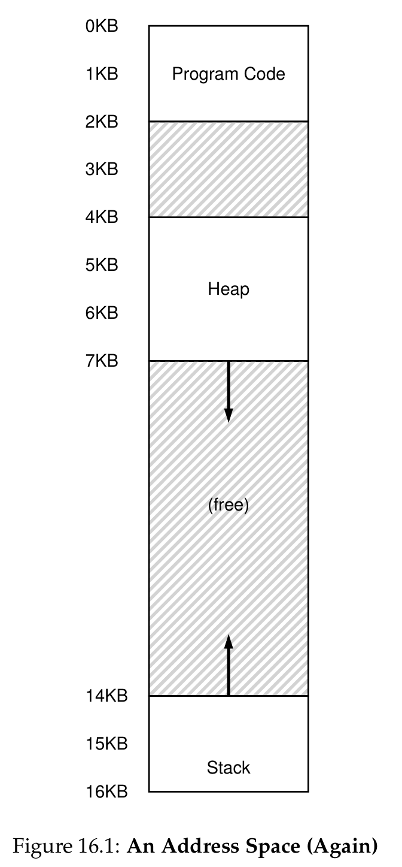
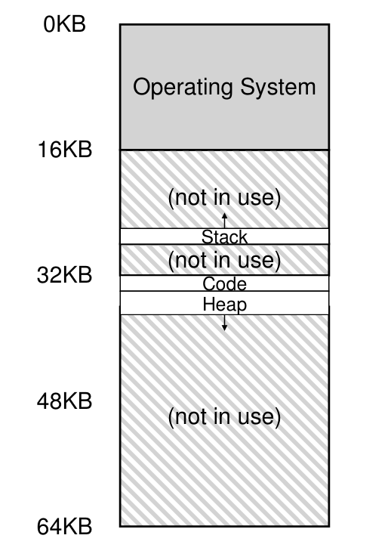
Placing Segments In Physical Memory
Segmentation allows the OS to place each one of those segments in different parts of physical memory.
Only used memory is allocated space in physical memory.
Thus, large address spaces with large amounts of unused virtual space (sparse address spaces) can be accommodated, entirely avoiding the waste of internal fragmentation.

Slide 27
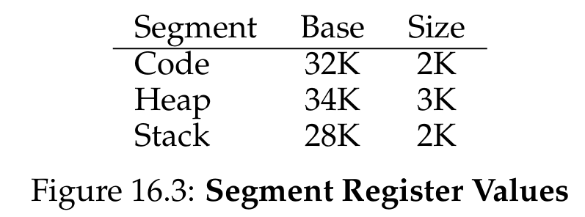
Hardware Support
The hardware structure in our MMU required to support segmentation is a set of three base and bounds register pairs.
Each bounds (size) register holds the exact size of a segment.
It tells the hardware exactly how many bytes are valid in this segment, enabling the hardware to determine when a program makes an illegal access outside of those bounds.

Slide 28

Example
Compute
$Virtual Address 100 →Physical Address ?.$
$Virtual Address 4200→Physical Address ?.$

Slide 29
Example
Assume a reference is made to virtual address 100 (which is in the code segment).
Hardware retrieves the Base (32KB) and Bounds (2KB) for the Code Segment.
The hardware adds the base value to the offset: 100 + 32KB = 32868.
It checks that the address is within bounds (100 is less than 2KB) and issues the reference to physical memory address 32868.

Slide 30
Example
Now consider virtual address 4200 (in the heap segment).
If we just add 4200 to the heap base (34KB), we get 39016, which is incorrect.
We must first extract the offset into the heap. Because the heap starts at virtual address 4KB (4096), the offset is 4200 - 4096 = 104.
We add this offset (104) to the base register (34KB) to get the correct physical address: 34920.

Slide 31
Segmentation Fault
What if we tried to refer to an illegal address (e.g., virtual address 7KB), which is in the free space beyond the end of the heap?
The hardware detects that the offset is greater than the bounds of the heap segment.
The hardware traps into the OS, likely leading to the termination of the offending process.
This is the origin of the famous error all C programmers dread: the segmentation violation or segmentation fault.

Slide 32
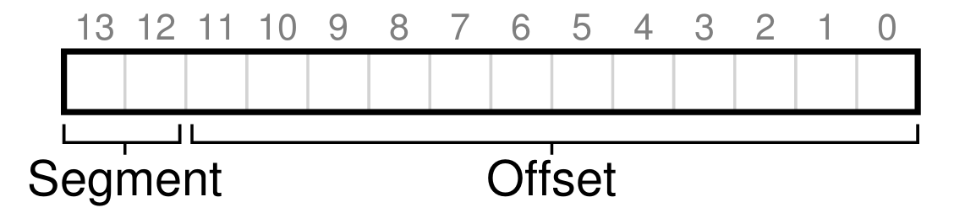
Which Segment Are We Referring To?
How does the hardware know which segment a virtual address refers to?
Explicit Approach: Chop up the address space into segments based on the top few bits of the virtual address.
In our example with 3 segments, we need 2 bits. A 14-bit virtual address is split:
Top 2 bits (Bits 13-12): Segment Selector (00=Code, 01=Heap, 11=Stack).
Bottom 12 bits (Bits 11-0): Offset into the segment.

Slide 33
What About The Stack?
Thus far, we've ignored the stack. The stack has a critical difference: it grows backwards (towards lower addresses).
We need a little extra hardware support. Instead of just base and bounds, the hardware needs to know which way the segment grows.
We add a Grows Positive? bit (1 for positive growth, 0 for negative growth) to the segment registers.

Slide 34
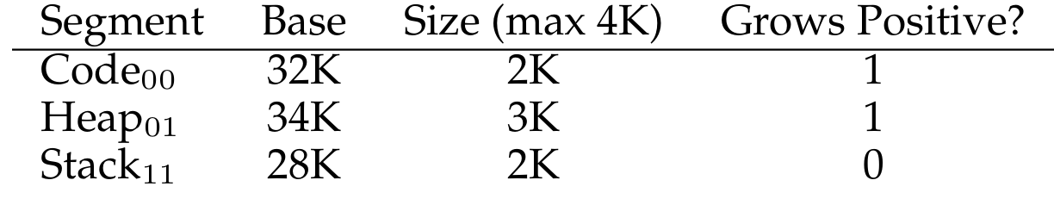
Hardware Support
To translate a stack virtual address (e.g., 15KB), the hardware sees the top two bits (11) and identifies the stack segment.
It calculates the offset (3KB). Since the stack grows negatively, we subtract the maximum segment size (4KB) from 3KB to get a negative offset: -1KB.
Add the negative offset (-1KB) to the Base (28KB) to arrive at the correct physical address: 27KB.

Slide 35
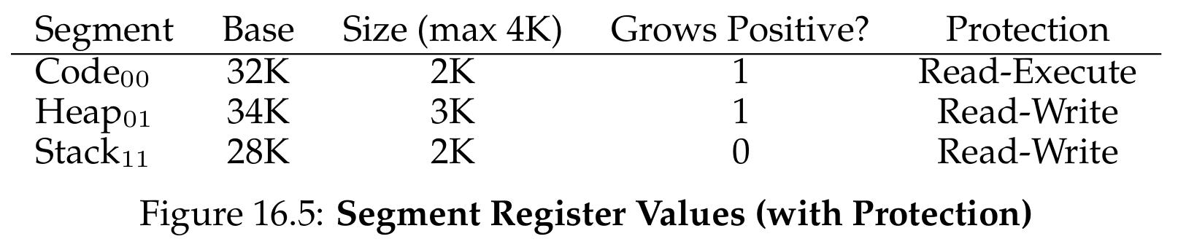
Support for Sharing
To save memory, it is useful to share certain memory segments between address spaces (e.g., code sharing).
We need more hardware support: Protection bits.
These bits indicate whether a program can read, write, or execute a segment.
By setting a code segment to read-only, the same physical segment can be safely mapped into multiple virtual address spaces without harming isolation.

Slide 36
Fine-grained vs. Coarse-grained
Coarse-grained: Systems with just a few large segments (code, stack, heap), like our examples so far.
Fine-grained: Systems that allow address spaces to consist of a large number of smaller segments (thousands of segments).
Supporting fine-grained segmentation requires a segment table stored in memory, allowing the OS to utilize main memory more effectively.

Slide 37
Context Switches and Segment Growth
Segmentation raises new issues for the Operating System:
Context Switch: The OS must save and restore the multiple segment registers (base, bounds, protection bits) for each process during a switch.
Segment Growth: When a program calls malloc() and the heap segment needs to grow, the OS must allocate more physical memory, update the segment size register, and inform the library of success (or reject it if memory is full).

Slide 38
Managing Free Space
When segments are different sizes, physical memory quickly becomes full of little holes of free space.
This makes it difficult to allocate new segments or grow existing ones, even if there is enough total free memory.
We call this fundamental new problem External Fragmentation.

Slide 39
Attempting to Solve Fragmentation
Compaction: The OS stops running processes, copies their data to one contiguous region, and updates segment registers. However, this is extremely expensive and memory-intensive.
Free-list Algorithms: The OS can use algorithms like best-fit, worst-fit, first-fit, or buddy algorithm to try to keep large extents of memory available.
No matter how smart the algorithm, external fragmentation will still exist.

Slide 40
Summary
The Abstraction: The OS creates the illusion of a private Address Space to provide transparency, efficiency, and protection.
Base and Bounds: Uses hardware (MMU) for efficient dynamic relocation, but suffers from massive Internal Fragmentation due to forced contiguous memory allocation.
Segmentation: Solves internal fragmentation by providing independent base and bounds pairs for logical segments (Code, Heap, Stack).
Benefits: Allows for sparse memory allocation, accommodates stack's negative growth, and enables memory sharing via protection bits.
The New Challenge: Allocating variable-sized segments creates holes in physical memory, leading to External Fragmentation, which is difficult to solve entirely.

Slide 41
Next Lecture
Paging …

