Slide 1
Computer Architecture and Operating System
Paging
Lecturer: Tianming Bai

Slide 2
Review
Address Space
Base and Bounds: Uses hardware (MMU) for efficient dynamic relocation, but suffers from massive Internal Fragmentation due to forced contiguous memory allocation.
Segmentation: Solves internal fragmentation by providing independent base and bounds pairs for logical segments (Code, Heap, Stack).
Allocating variable-sized segments creates holes in physical memory, leading to External Fragmentation, which is difficult to solve entirely.

Slide 3
The Crux
How should we manage free space when the requests are for variable-sized blocks?
What strategies can we use to minimize fragmentation, and what are the time and space overheads?

Slide 4
Assumptions
We assume a basic interface provided by the library:
void *malloc(size_t size)
void free(void *ptr)
We focus primarily on external fragmentation and simplify the issue of internal fragmentation (waste inside an allocated block).
Once memory is allocated, it cannot be relocated or compacted.
The allocator initially manages a continuous, fixed-size heap region.

Slide 5
Low-Level Mechanisms
Splitting & Coalescing
Tracking Size
Embedded Free List
Growing The Heap

Slide 6
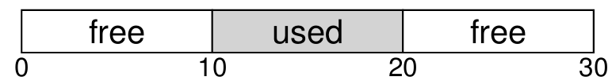
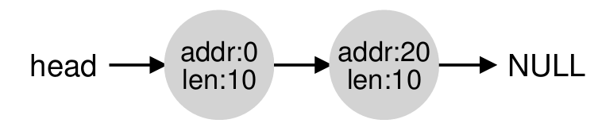
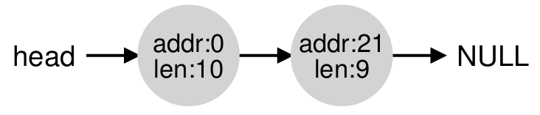
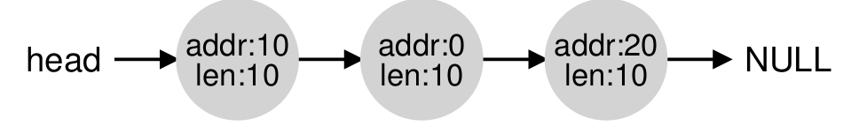
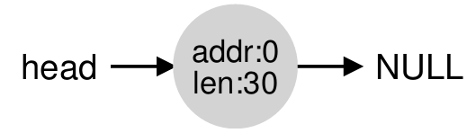
Low-Level Mechanisms
Splitting: Occurs when a request is smaller than the available free chunk.
The allocator splits the free chunk into two: the allocated block (returned to the user) and the remaining free block (kept in the free list).
Coalescing: Occurs during memory release.
The allocator checks adjacent free blocks and merges them into a larger continuous block.
Failing to coalesce results in a free list filled with tiny fragments unable to satisfy large requests.

Slide 7
Low-Level Mechanisms
Tracking Size
Because free(ptr) lacks a size parameter, the allocator uses a header to track block sizes.
The header is stored in memory immediately before the allocated block's starting address.
It contains the block size and a magic number (for integrity checking).
Actual allocated size = User requested size + Header size.

Slide 8
Low-Level Mechanisms
Embedded Free List
The allocation library cannot call malloc() to create linked list nodes for its own management.
Instead, list nodes are stored directly inside the free space itself.
Initialization: Uses mmap to request heap space; the head node is placed at the start, recording the size and the next pointer.
After Allocation: The free block is split, and the node's size and pointers are updated dynamically.

Slide 9
Low-Level Mechanisms
Growing the Heap
What happens when the heap completely runs out of space?
The allocator makes system calls like sbrk or mmap to request more physical memory from the Operating System.
The OS expands the heap space, allowing the allocator to continue serving allocation requests.

Slide 10
Allocation Strategies
The core goal of these classic strategies is to balance speed and minimal fragmentation.
Basic Allocation Strategies：
Best Fit
Worst Fit
First Fit
Next Fit
Advanced Optimization：
Segregated Lists
Buddy Allocation

Slide 11
Best Fit
Best Fit Logic: Traverse the entire free list to find the smallest free block that satisfies the request.
Pros: Minimizes space waste by perfectly matching request sizes.
Cons: Requires a full list traversal, resulting in high performance overhead.

Slide 12
Worst Fit
Worst Fit Logic: Traverse the entire free list to find the largest available free block, split it, and allocate.
Pros: Theoretically preserves large free blocks and avoids leaving behind tiny slivers.
Cons: Also requires a full list traversal. In practice, it suffers from terrible performance and severe fragmentation.

Slide 13
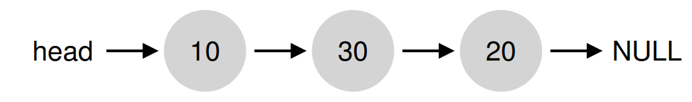
Example
Envision a free list with three elements on it, of sizes 10, 30, and 20 (ignore headers and other details here).
Best fit
Worst fit

Slide 14
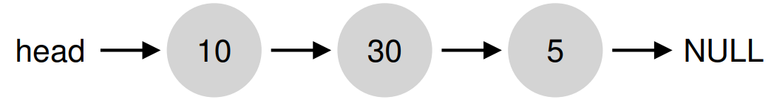
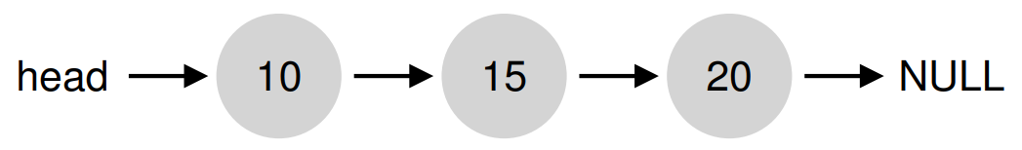
Example
Envision a free list with three elements on it, of sizes 10, 30, and 20 (ignore headers and other details here).
Best fit
Worst fit

Slide 15
First Fit
First Fit Logic: Find the very first free block that is large enough and allocate it immediately.
Pros: Extremely fast, as it avoids exhaustive searches.
Cons: Tends to accumulate numerous small fragments at the beginning of the free list.
Optimization: Address-based sorting of the free list simplifies coalescing and reduces fragmentation.

Slide 16
Next Fit
Next Fit Logic: Based on First Fit, but keeps an extra pointer to the location where the last search ended, resuming the search from there instead of the beginning.
Pros: Spreads allocations more uniformly across the free space, preventing fragmentation build-up at the front.
Performance is generally comparable to First Fit.

Slide 17
Segregated Lists
Core Idea: Maintain separate free lists specifically for frequently requested, fixed-size objects. Other requests use the general allocator.
The Slab Allocator (Solaris Kernel):
Creates dedicated object caches for frequently used kernel objects (e.g., locks, file-system inodes).
When a cache is empty, it requests page-aligned slabs from the general allocator.
Freed objects remain in an initialized state, eliminating repeated initialization/destruction overheads.

Slide 18
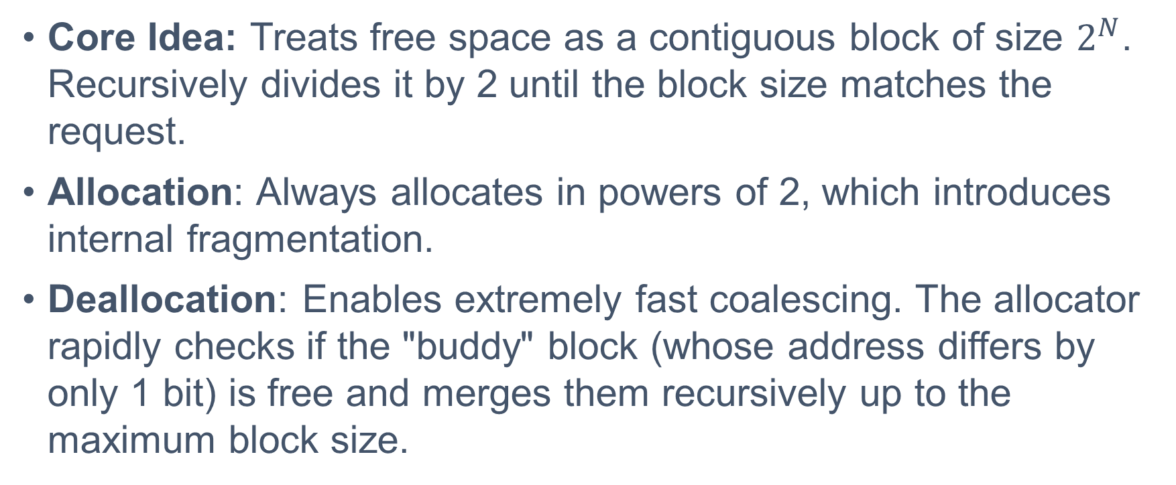
Buddy Allocation
Core Idea: Treats free space as a contiguous block of size $2^{N}$. Recursively divides it by 2 until the block size matches the request.
Allocation: Always allocates in powers of 2, which introduces internal fragmentation.
Deallocation: Enables extremely fast coalescing. The allocator rapidly checks if the "buddy" block (whose address differs by only 1 bit) is free and merges them recursively up to the maximum block size.

Slide 19
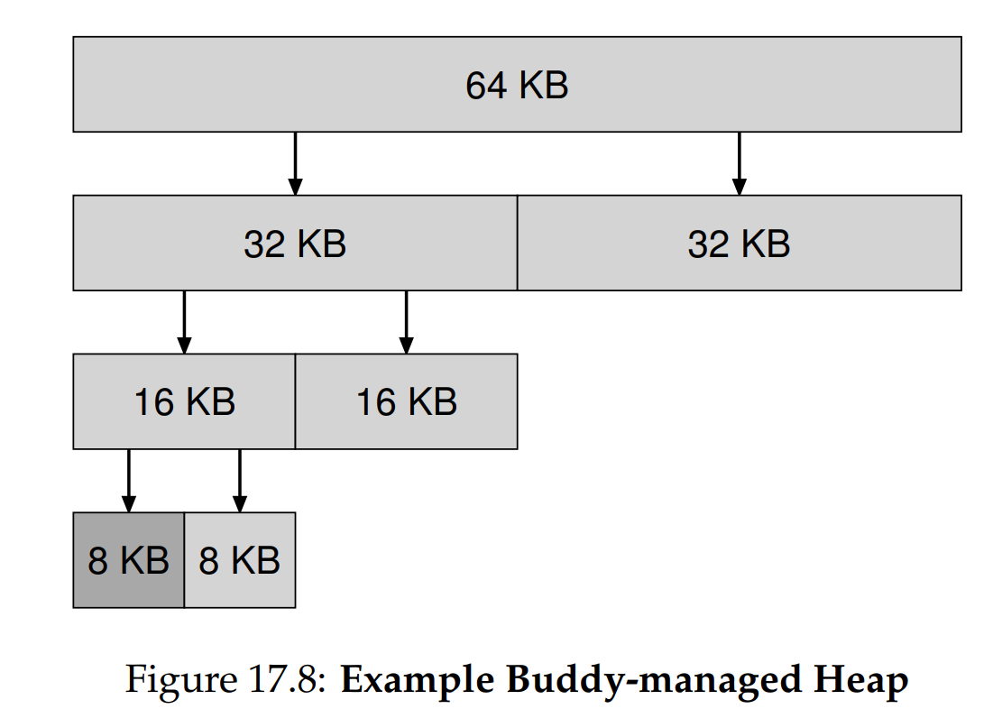
Buddy Allocation

Slide 20
Other Optimization Ideas
Complex Data Structures: Replacing simple linked lists with more sophisticated structures like balanced binary trees or splay trees to significantly reduce search times.
Multiprocessor Support: Designing concurrent allocators tailored for modern multi-core, multi-threaded environments.
Examples of modern optimized allocators include Hoard and jemalloc.

Slide 21
Break

Slide 22
Paging
To solve space-management problems.
Approach 1: Variable-sized pieces. As we saw with segmentation, chopping space into different-size chunks leads to inherent difficulties.
Approach 2: Fixed-sized pieces. We chop up the space into identically sized pieces.
In virtual memory, we call this idea paging.

Slide 23
THE CRUX
How can we virtualize memory with pages, so as to avoid the problems of segmentation?
What are the basic techniques?
How do we make those techniques work well, with minimal space and time overheads?

Slide 24
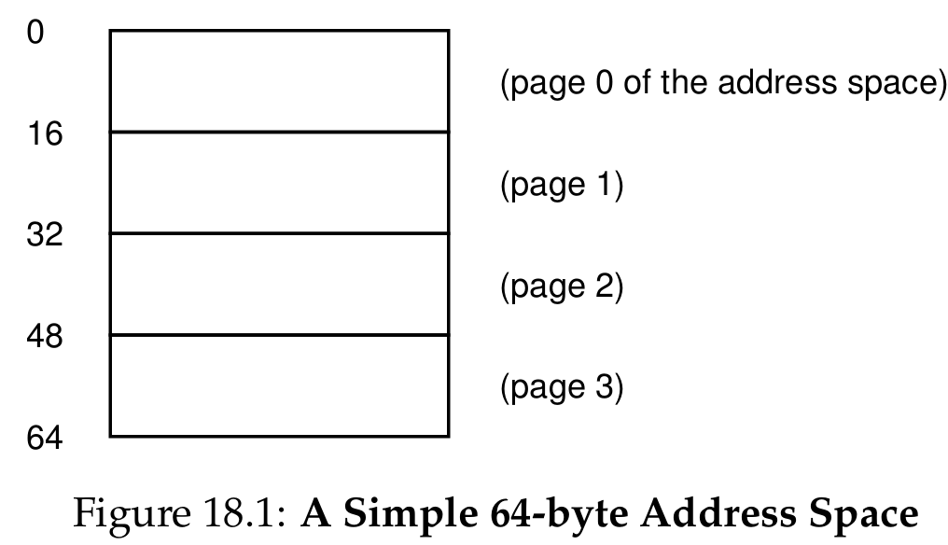
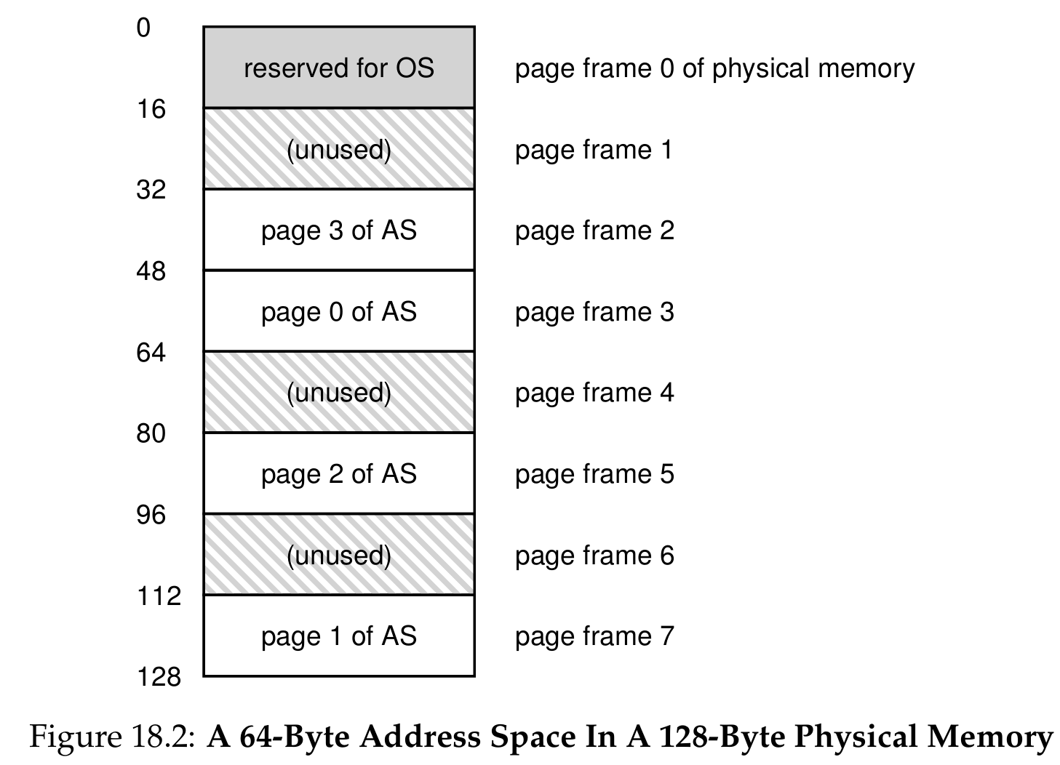
Pages and Page Frames
Pages: We divide the virtual address space of a process into fixed-sized units called pages.
Page Frames: Correspondingly, we view physical memory as an array of fixed-sized slots called page frames.
Each of these frames can contain a single virtual-memory page.
For example, a 64-byte virtual address space can be divided into 4 pages of 16 bytes each, placed into a 128-byte physical memory (8 frames).

Slide 25
The Advantages of Paging
Flexibility: With a fully developed paging approach, the OS can build the abstraction of an address space effectively, regardless of how a process uses the space (e.g., how the heap and stack grow).
Simplicity: Free-space management becomes incredibly easy.
To allocate memory, the OS just keeps a free list of all available page frames and grabs the required number of frames.
There is absolutely no external fragmentation because all frames are the exact same size.

Slide 26
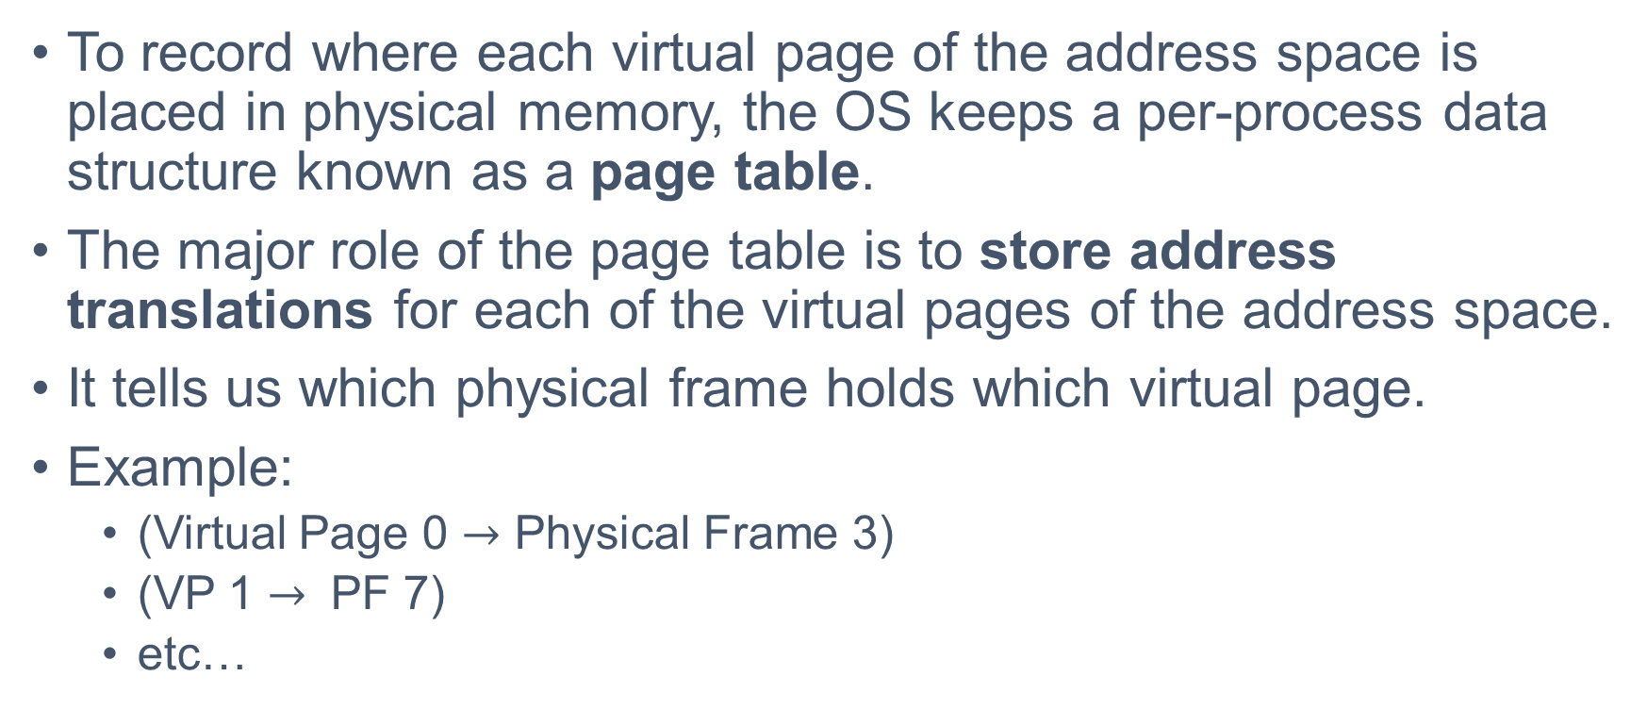
Mechanism: The Page Table
To record where each virtual page of the address space is placed in physical memory, the OS keeps a per-process data structure known as a page table.
The major role of the page table is to store address translations for each of the virtual pages of the address space.
It tells us which physical frame holds which virtual page.
Example:
(Virtual Page 0 $→$ Physical Frame 3)
(VP 1 $→$ PF 7)
etc…

Slide 27
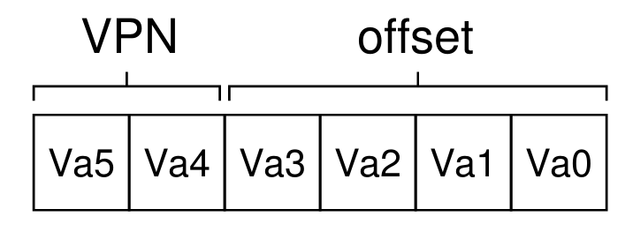
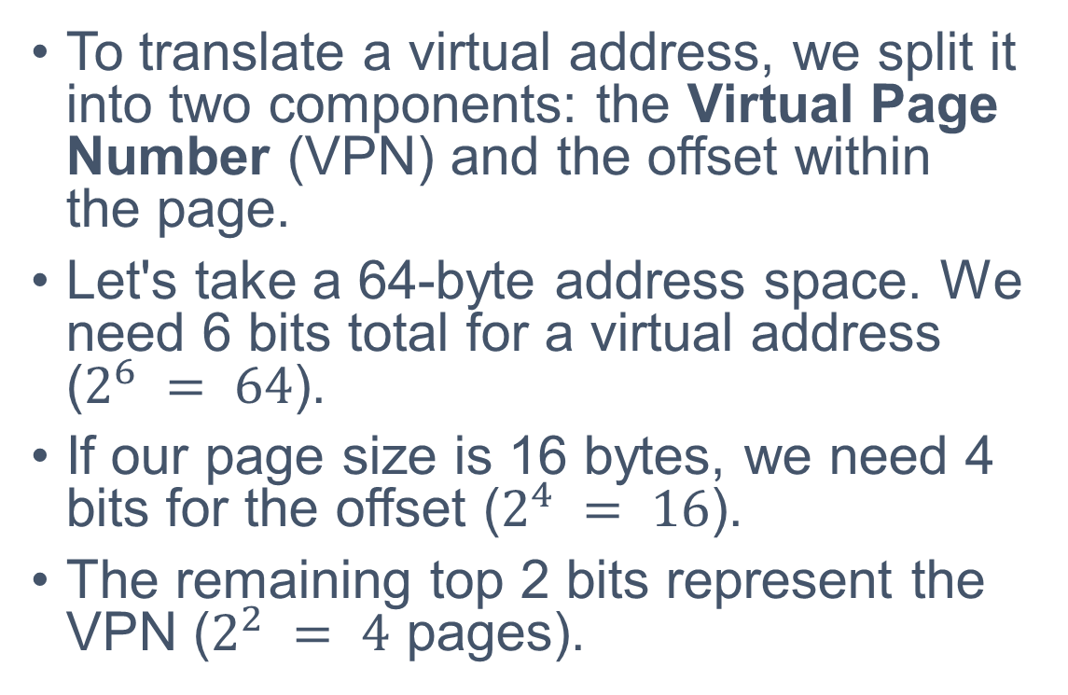
Translating Addresses
To translate a virtual address, we split it into two components: the Virtual Page Number (VPN) and the offset within the page.
Let's take a 64-byte address space. We need 6 bits total for a virtual address ($2^{6} = 64$).
If our page size is 16 bytes, we need 4 bits for the offset ($2^{4} = 16$).
The remaining top 2 bits represent the VPN ($2^{2} = 4$ pages).

Slide 28
Address Translation Example
Assume a process generates virtual address 21. What is the physical address?

Slide 29
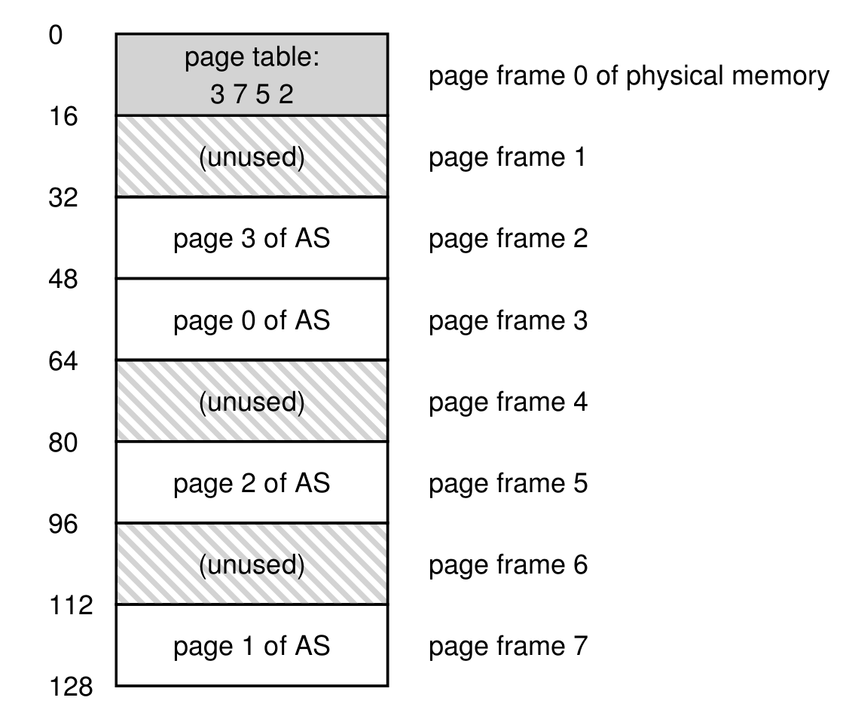
Address Translation Example
Assume a process generates virtual address 21. In 6-bit binary, this is 010101.
Step 1: The hardware splits the address.
VPN = 01 (Virtual Page 1).
Offset = 0101 (5th byte of the page).
Step 2: The hardware looks up the page table and finds that VPN 01 maps to Physical Frame Number (PFN) 111 (Frame 7).

Slide 30
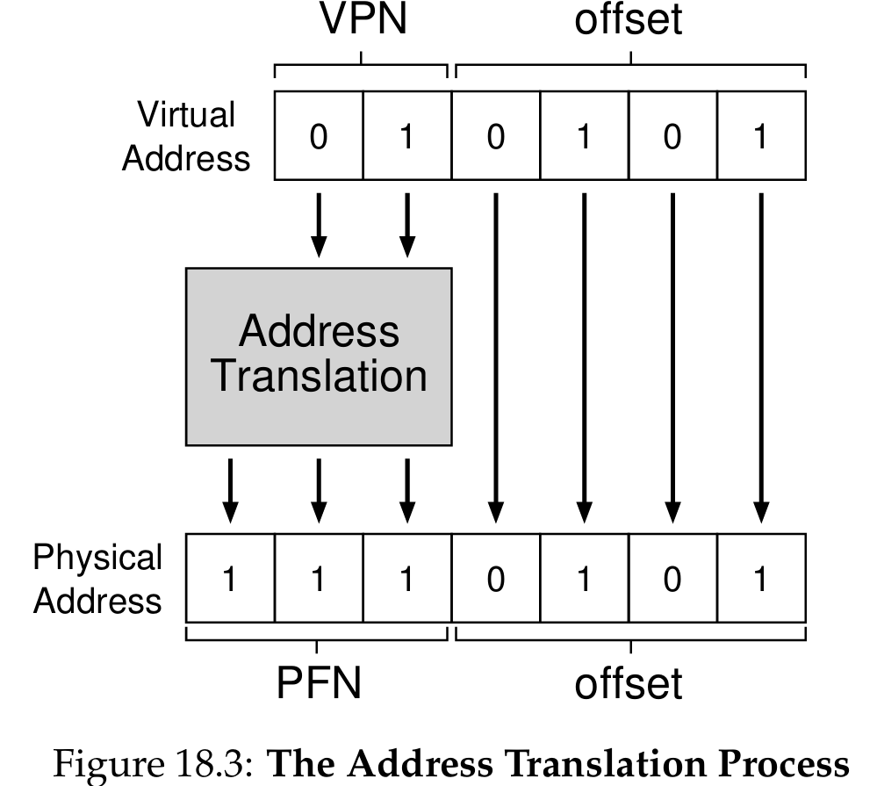
Address Translation Example
Step 3: The hardware replaces the VPN with the PFN.
The offset remains exactly the same, because the offset within the virtual page is the exact same offset within the physical frame.
PFN (111) + Offset (0101) = 1110101. In decimal, physical address 1110101 is 117.
The translation is complete!

Slide 31
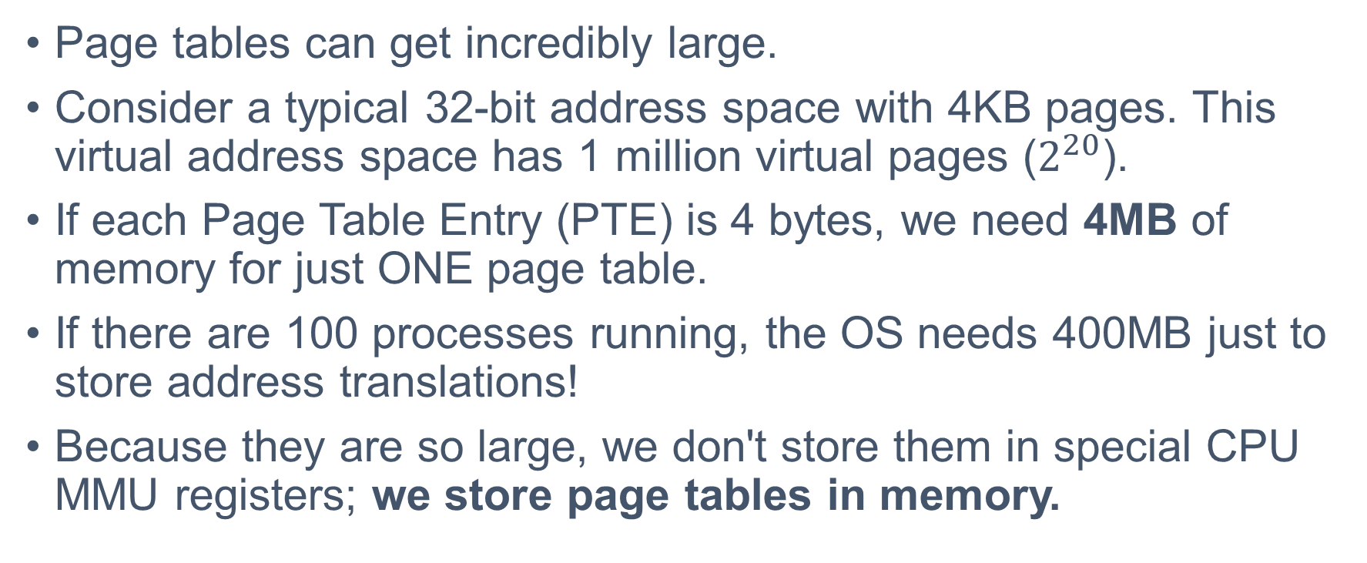
Where Are Page Tables Stored?
Page tables can get incredibly large.
Consider a typical 32-bit address space with 4KB pages. This virtual address space has 1 million virtual pages ($2^{20}$).
If each Page Table Entry (PTE) is 4 bytes, we need 4MB of memory for just ONE page table.
If there are 100 processes running, the OS needs 400MB just to store address translations!
Because they are so large, we don't store them in special CPU MMU registers; we store page tables in memory.

Slide 32
What’s Actually In A Page Table?
The page table is essentially an array (a linear page table). The OS indexes the array by the VPN to find the Page Table Entry (PTE).
A PTE contains the PFN (Physical Frame Number) and various status bits:
Valid bit: Indicates if the translation is valid (used to represent unused space between heap and stack). Accessing an invalid page generates a trap to the OS.
Protection bits: Indicate whether the page can be read, written, or executed.

Slide 33
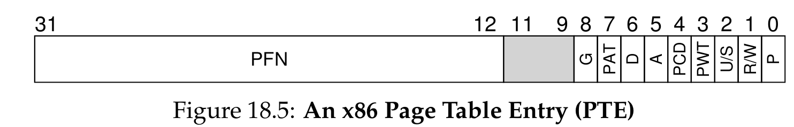
Other Important PTE Bits
Present bit: Indicates whether this page is currently in physical memory or if it has been swapped out to disk.
Dirty bit: Indicates whether the page has been modified since it was brought into memory.
Reference bit: Used to track whether a page has been accessed recently. This helps the OS decide which pages to swap out when memory is full.

Slide 34
Paging is Too Slow
With page tables stored in physical memory, address translation becomes a two-step process for the hardware.
Memory Access 1 (Translation): To fetch an instruction or data, the hardware must first fetch the PTE from the page table in memory.
Memory Access 2 (Execution): Once the PFN is retrieved, the hardware can finally issue the memory request to fetch the actual instruction or data.
Paging requires one extra memory reference for every single instruction fetch and every single data load/store.

Slide 35
A Simple Memory Trace
Let's look at a simple C program initializing an array to see the true cost:
int array[1000];
for (i = 0; i < 1000; i++) array[i] = 0;
The assembly code for the inner loop looks like this:
1024 movl $0x0,(%edi,%eax,4) ; store 0 into array[i]
1028 incl %eax ; increment i
1032 cmpl $0x03e8,%eax ; compare i to 1000
1036 jne 0x1024 ; loop if not equal

Slide 36
The Reality of Memory Accesses
Just to execute the first instruction movl $0x0,(%edi,%eax,4) (which zeroes an array element), the system does the following:
Access memory to fetch the PTE for the instruction's address.
Access memory to fetch the instruction itself.
Access memory to fetch the PTE for the array element's address.
Access memory to store the value 0 into the array.
Four physical memory accesses for one single assembly instruction!

Slide 37
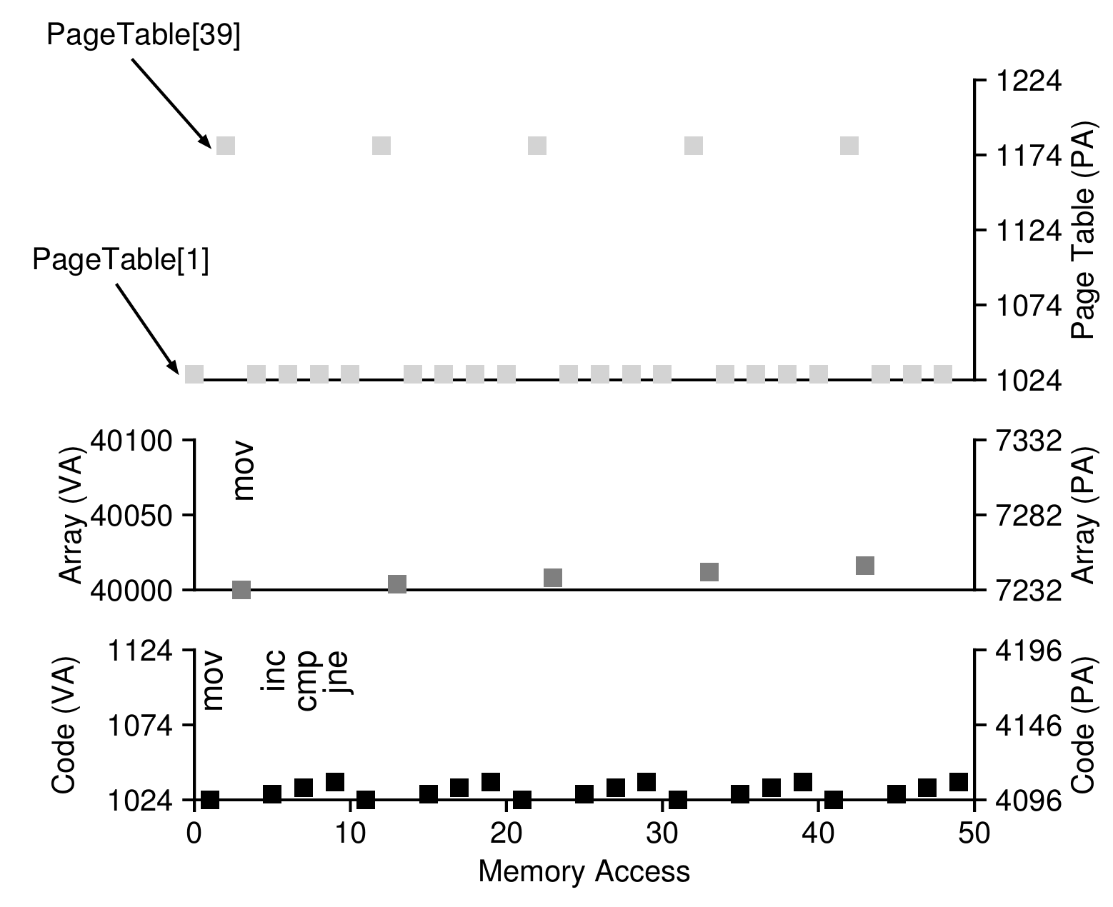
Visualizing
The graph plots memory accesses over time for the loop.
You can clearly see the pattern: for every single instruction or data access, the hardware must first jump to the page table (located at physical address 1KB in this example) to fetch the translation.
Without careful hardware and OS design, paging would bring the system to a crawl.

Slide 38
Summary
Free Space Management (Variable-Sized Allocation)
Managing variable-sized memory requests while minimizing external fragmentation.Low-Level Mechanisms: Utilizes block splitting, coalescing, embedded free lists, and headers to track sizes.
Allocation Strategies:
Basic: Best Fit, Worst Fit, First Fit, and Next Fit.
Advanced: Segregated Lists (for frequently used objects) and Buddy Allocation (powers of 2 for fast coalescing).
Paging (Fixed-Sized Allocation)
Divides virtual memory into fixed-sized "Pages" and physical memory into "Page Frames," which completely eliminates external fragmentation.
Address Translation: The hardware splits a virtual address into a Virtual Page Number (VPN) and an offset, translating the VPN into a Physical Frame Number (PFN).
The Page Table: An in-memory data structure used by the OS to store these VPN-to-PFN translations.
Page Table Entry (PTE): Contains the PFN alongside status bits (Valid, Protection, Present, Dirty, Reference).
The Overheads of Paging:
Space Overhead: Page tables can become massive, consuming megabytes of memory per process.
Time Overhead: Requires extra memory accesses just to fetch translations before instructions or data can be executed, significantly slowing down the system without optimization.

Slide 39
Next Lecture
TLB, Threads…

