Slide 1
Week 4 Lab
Lecturer: Tianming Bai

Slide 2
TO DO
Based on the feedback received during the lecture and through our recent quiz, I know many of you have been struggling to connect the foundational concepts from Week 2 with the more advanced RISC-V and pipeline topics we’ve covered since.
This lab will be a structured review session designed to help you:
Diagnose exactly where your knowledge gaps are,
Re-master the core MARIE and Von Neumann architecture concepts you need to move forward,
Build confidence with the Ripes simulator and assembly logic,
Get clear, step-by-step answers to the questions you’ve been asking.
We’ll start with a quick self-check to help you identify what you need to review, then walk through every key concept, tool, and experiment from the past weeks together. Next week, we will finish the Computer Architecture part and have a transition to the Operating System. This is your chance to catch up, ask questions, and make sure you’re fully prepared for the rest of the course.

Slide 3
Self-Check Instructions
This self-check is designed to help you assess your current mastery of core concepts from our previous lectures and labs, identify knowledge gaps, and confirm you are fully prepared for this week’s lab activities.
We have split the self-check into 3 sections, for each section:
Please complete all questions independently to get an accurate view of your learning progress.
The correct answers for all questions in this self-check are provided on the page 20 - 22 of this lab PPT. You can check and grade your answers after you finish the full self-check.

Slide 4
Section 1: Week 2 Lecture Check
What is the core idea of the Von Neumann Architecture?
A. Instructions and data are stored in the same memory
B. The CPU uses a pipeline to speed up execution
C. The CPU has multiple general-purpose registers
D. Programs can only run on a single specific processor

Slide 5
Section 1: Week 2 Lecture Check
What is an ISA (Instruction Set Architecture)?
A. The physical circuit design of the CPU
B. The contract between software and hardware, defining what the CPU can do
C. The assembly language syntax for a specific processor
D. The cache design of a CPU

Slide 6
Section 1: Week 2 Lecture Check
Which MARIE register holds the address of the next instruction to be executed?
A. AC (Accumulator)
B. IR (Instruction Register)
C. PC (Program Counter)
D. MBR (Memory Buffer Register)

Slide 7
Section 1: Week 2 Lecture Check
What happens during the Fetch phase of the instruction cycle?
A. The CPU performs the math operation defined by the instruction
B. The CPU retrieves the next instruction from memory and updates the PC
C. The Control Unit decodes the opcode of the instruction
D. The result is stored back to memory

Slide 8
Section 1: Week 2 Lecture Check
Which CPU component is responsible for mathematical operations like addition and subtraction?
A. Control Unit (CU)
B. Arithmetic Logic Unit (ALU)
C. Program Counter (PC)
D. Memory Address Register (MAR)

Slide 9
Section 1 Review Guide
If you got 2 or more questions wrong in this section:
Before proceed, please go back to review the Week 2 Lecture slides, focusing on:
Von Neumann Architecture core rules
ISA definition and purpose
CPU core components and their functions
MARIE register roles
Fetch-Decode-Execute instruction cycle

Slide 10
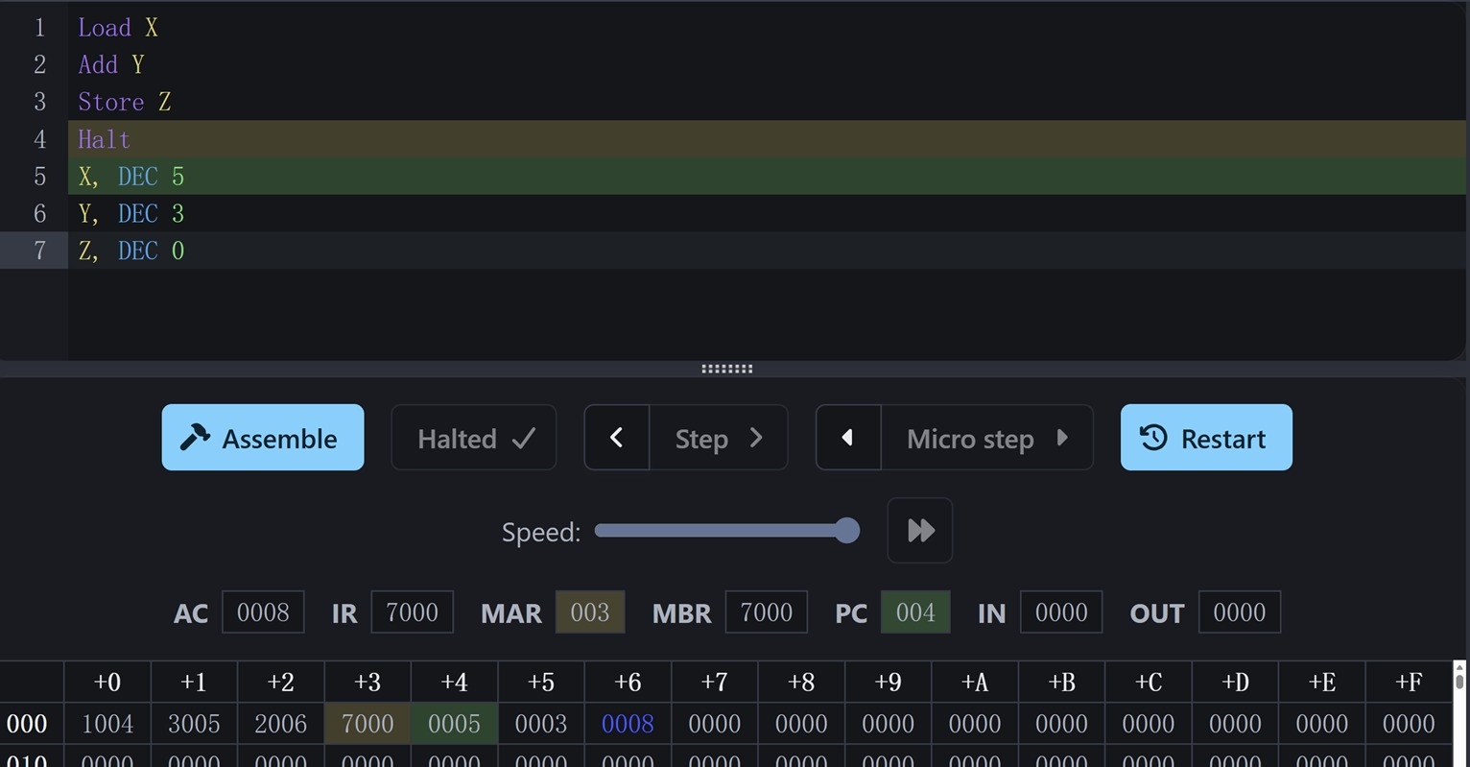
Section 2: Week 2 Lab Check
Read the screenshot and answer the questions

Slide 11
Section 2: Week 2 Lab Check
What is the memory address of the Halt instruction?
What data value is stored at memory address 005 (the location of variable Y)?
The instruction at address 002 is Store Z. What is the memory address of variable Z?
What is the value of the Program Counter (PC) register after the program has halted?
What is the opcode for the Add instruction in MARIE?

Slide 12
Section 2 Review Guide
If you got 2 or more questions wrong in this section. Please go back to review the Week 2 Lab slides and MARIE simulator experiment materials, with focused study on these core practical concepts:
The Fetch-Decode-Execute cycle (step-by-step hardware execution and register interactions for each phase)
How instructions and data are stored in memory
Basic RTL (Register-Transfer Level) logic for MARIE instructions

Slide 13
Section 3: Week 3 Lecture & Lab
Tests your mastery of Week 3 Lecture and Lab content, including the differences between RISC-V GPR and MARIE Accumulator architectures, single-cycle vs pipelined processor design, CPI and pipeline speedup calculations, endianness rules, RISC-V instruction categories, the impact of pipeline hazards on performance, and navigation of the Ripes simulator. If you struggle with this section, please review the Week 3 Lecture and Lab slides together.
If you cannot copy paste the assembly code into Ripes simulator’s website, check Week1 Lab Slides and download the software (remember to download the correct OS versions, i.e. Windows/Mac).

Slide 14
Section 3: Week 3 Lecture & Lab
What is the key difference between the RISC-V (GPR Architecture) and MARIE (Accumulator Architecture) when performing an addition operation?
A. RISC-V requires all math operations to use a single dedicated Accumulator register
B. RISC-V can perform addition directly between multiple general-purpose registers, no need to load every value into a single accumulator
C. MARIE can store intermediate results in multiple general-purpose registers
D. MARIE uses 3-address instructions for addition, while RISC-V uses 1-address instructions

Slide 15
Section 3: Week 3 Lecture & Lab
For a single-cycle processor, the CPI (Cycles Per Instruction) is always 1.0. What is the core reason for this?
A. The processor uses pipelining to overlap instruction execution
B. The processor never has cache misses
C. The processor can execute multiple instructions at the same time
D. The processor executes one full instruction from start to finish in a single clock cycle

Slide 16
Section 3: Week 3 Lecture & Lab
We store the 32-bit hex value 0x12345678 in memory. If we observe the byte at the lowest memory address is 0x78, what endianness is this processor using?
A. Big-Endian
B. Little-Endian

Slide 17
Section 3: Week 3 Lecture & Lab
In a 5-stage pipeline, when a branch instruction decides to jump, the pre-fetched instructions after the branch are flushed (discarded). What is the direct impact of this flush?
A. It reduces the total number of instructions executed
B. It makes the CPI (Cycles Per Instruction) greater than 1.0
C. It increases the speedup of the pipeline
D. It eliminates all data dependencies between instructions

Slide 18
Section 3: Week 3 Lecture & Lab
Which of the following RISC-V instructions belongs to the Control Flow category (changes the Program Counter to create loops/branches)?
A. lw x5, 0(x10)
B. add x7, x7, x6
C. blt x6, x5, loop
D. sw x7, 0(x11)

Slide 19
Section 3: Week 3 Lecture & Lab
What is the theoretical maximum speedup of a 5-stage pipelined processor, compared to a non-pipelined single-cycle processor?
A. 2x
B. 5x
C. 10x
D. 1x (no speedup)

Slide 20
Answers
Section 1: A,B,C,B,B

Slide 21
Answers
Section 2:
003 (or 0003, 0x003)
0003 (or 3)
006 (or 0006, 0x006)
004 (or 0004, 0x004)
3

Slide 22
Answers
Section 3:B,D,B,B,C,B

Slide 23
Great Work!
If you’ve successfully completed all three sections of the self-check and confirmed your understanding of the core concepts, congratulations!
You’ve built a rock-solid foundation in processor architecture fundamentals — from the Fetch-Decode-Execute cycle and MARIE’s accumulator design, to RISC-V’s GPR architecture, pipelined processor behavior, and the core rules of ISA design.

Slide 24
Week 4 Exercises
These exercises will help you master core cache mapping calculations, including:
Main memory block count calculation
Memory address field splitting (Tag / Block / Set / Word)
Cache block mapping for given memory addresses
Direct Mapped, Fully Associative, and Set Associative cache schemes

Slide 25
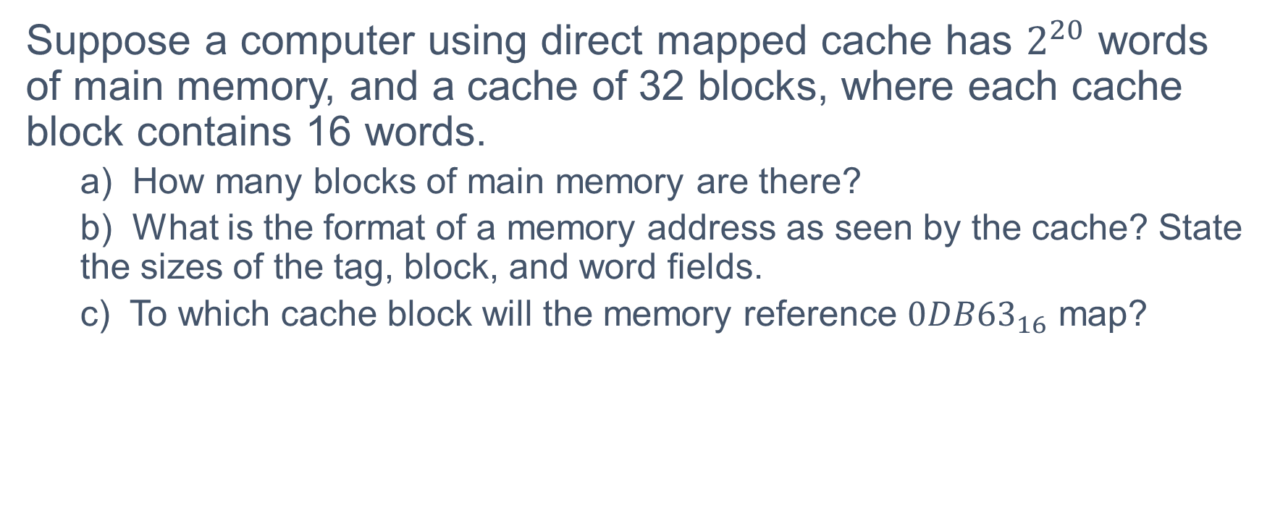
Exercise 1: Direct Mapped
Suppose a computer using direct mapped cache has $2^{20}$ words of main memory, and a cache of 32 blocks, where each cache block contains 16 words.
a) How many blocks of main memory are there?
b) What is the format of a memory address as seen by the cache? State the sizes of the tag, block, and word fields.
c) To which cache block will the memory reference $0DB{63}_{16}$​ map?

Slide 26
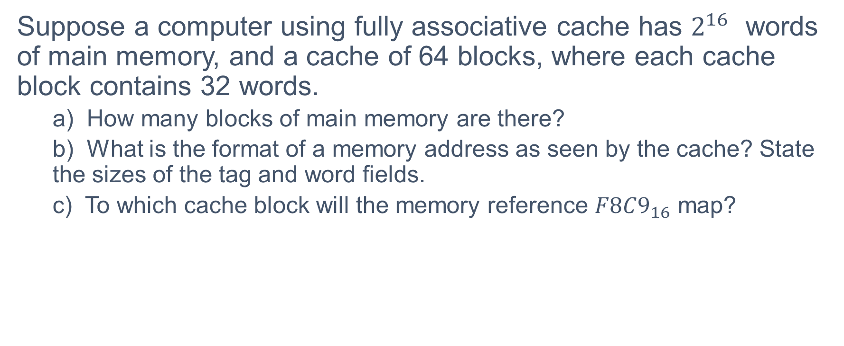
Exercise 2: Fully Associative
Suppose a computer using fully associative cache has $2^{16}$ words of main memory, and a cache of 64 blocks, where each cache block contains 32 words.
a) How many blocks of main memory are there?
b) What is the format of a memory address as seen by the cache? State the sizes of the tag and word fields.
c) To which cache block will the memory reference $F8C9_{16}$​ map?

Slide 27
Exercise 3: 2-Way Set Associative
Assume a system’s memory has 128M words. Blocks are 64 words in length and the cache consists of 32K blocks.
Show the format for a main memory address assuming a 2-way set associative cache mapping scheme. Be sure to include the fields as well as their sizes.

