Slide 1
Week 5 Lab
Lecturer: Tianming Bai

Slide 2
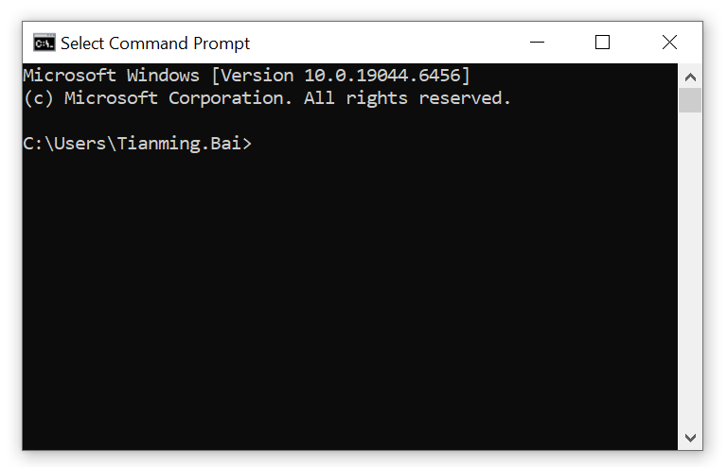
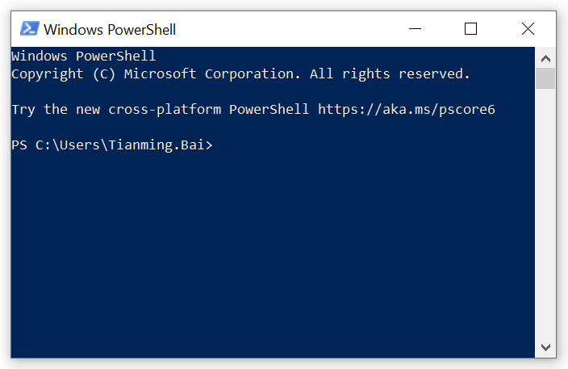
OSTEP
Welcome to the second half of the course!
Today, we officially transition into the Operating System (OS). For the rest of the semester, we will be using assignments designed by the authors of our textbook, Operating Systems: Three Easy Pieces (OSTEP).
The authors have built brilliant Python Simulators. These Python scripts simulate how an OS schedules tasks, manages memory, and handles disks. Your job will be to run these simulators, observe the outputs, and analyze the algorithms.
To run these simulators, we need to learn Command Line Interface.

Slide 3
GUI vs. CLI
What is GUI and CLI?
GUI (Graphical User Interface)
Interacting with the computer using visual elements (windows, icons, buttons) and a mouse.
Examples: Your Windows Desktop, Google Chrome, Mac Finder.
Pros: Highly intuitive, easy to learn, great for everyday browsing or editing.
Cons: Hard to automate, consumes a lot of memory and graphics power.
CLI (Command Line Interface)
Interacting with the Operating System purely through text. You type a command, hit Enter, and the OS obeys.
Examples: Windows Command Prompt (cmd), PowerShell, Mac/Linux Terminal.
Pros: Extremely fast, uses almost zero memory, and is perfectly designed for automation and scripts.
Cons: Hard to learn :) (actually not hard, just kidding).

Slide 4
CLI
As future AI and Big Data professionals, the massive models you train and the datasets you process will run on remote Linux servers, cloud instances (AWS/Google Cloud), or supercomputer clusters. These servers do not have screens or mice. The Command Line is the absolute universal language for instructing computers to do heavy lifting. Today, we take the first step.

Slide 5

CLI
How to Open Your Terminal?
For Windows Users:
Method 1 (Search): Press the Windows Key, type PowerShell (or cmd), and press Enter.
Method 2 (The Run Shortcut):
Press Win + R on your keyboard to open the "Run" dialog.
Type powershell (or cmd).
Press Enter.
For Mac Users:
The Spotlight Shortcut:
Press Cmd + Space to open Spotlight Search.
Type Terminal.
Press Enter.

Slide 6
CLI
Open your terminal.
Here are the only 4 commands you need to survive:
Where am I?
Command: pwd (Mac/Linux/PowerShell) or echo %cd% (Windows CMD)
Tells you your current folder path.
What is inside here?
Command: ls (Mac/Linux/PowerShell) or dir (Windows CMD)
Lists all files and folders in your current directory.
How do I move?
Command: cd <Folder_Name> (e.g., cd Desktop or cd Downloads)
Command to go back one folder: cd ..
Moves your terminal into the folder where your Python scripts are saved.
How do I run a script with "Flags"?
Command: python script_name.py -flag value
Flags (arguments) tell the Python script exactly how you want it to behave before it even starts running.

Slide 7
VS Code Integrated Terminal
Open Visual Studio Code and open your project folder.
Click Terminal in the very top menu bar -> Select New Terminal.
Or you can use shortcuts:
Windows: Press Ctrl + ` (The backtick key, usually located just below the Esc key).
Mac: Press Cmd + `.
A terminal panel will pop up at the bottom of your screen, ready for your commands!

Slide 8
Task 1
Go to Learning Mall and download this week's lab files (codes.zip).
Move the .zip file to a proper location (e.g., your Desktop or a dedicated OS course folder).
Extract/unzip the folder.
Open Visual Studio Code.
Go to the top menu: File -> Open Folder... (Choose the unzipped folder you just created).
Open the Integrated Terminal.

Slide 9
Task 1
Let's practice talking to your OS using the Command Line. In your VS Code terminal, try the answer the following questions:
Where am I?
What is inside?
Create a new file via CLI.
Type the following command to create a text file:
echo "Hello OS!" > my_test.txt
Type ls again. You should now see my_test.txt in your list. You just commanded the OS to write data to the disk.

Slide 10
Task 2
Now, let's test the "Illusions" of the OS. We will run a multi-threaded program to see what happens when the OS is forced to switch contexts at the worst possible moment.
Run the Script:
Type python concurrency.py and press Enter.
Observe the Results.
Use Up Arrow:
Do not re-type the command. Press the Up Arrow (↑) key on your keyboard once. The terminal remembers your last command!
Press Enter to run it again. Do this 3-4 times.
Think: Why is the final number different every single time? Open the concurrency.py file in VS Code and read the comments about the Python GIL!

Slide 11
Task 3
For our upcoming homework assignments, we will use Python simulators designed by the OSTEP authors. Let's make sure your environment can run them properly.
Run the Simulator with Flags:
Type the following command exactly as shown and press Enter:
python process-run.py -l 5:100,5:100 -c
You should see a timeline printed on your screen showing Process 0 and Process 1 running.
Note: You do not need to understand the output numbers yet! If it runs without a Python error, you are ready for next week's CPU Scheduling lecture.

Slide 12
Task 4
Run the script: python cpu_hog.py.
Open Windows Task Manager (Ctrl+Shift+Esc) or Activity Monitor (Mac), go to the Details tab, and find python.exe.
Question 1: What is the PID (Process ID)? ________
Question 2: What percentage (%) of the CPU is it using? ________
Open 3 more separate terminal windows and run python cpu_hog.py in all of them.
Look at Task Manager again.
Question 3: Did your computer crash? How did the OS distribute the CPU % among the 4 identical processes?
Press Ctrl + C in your terminals to kill the programs

Slide 13
Task 5
If you did not finish last week's lab, please use this time to review and complete them. Ask the TA or instructor for help if you are stuck
If you have successfully completed all tasks today, go to the official OSTEP website (https://pages.cs.wisc.edu/~remzi/OSTEP/) . Overview the textbook and preview Processes.

