Slide 1
Localization & Repair of Software Fault
Presentation 2022.03.15
Ni Mu

Slide 2
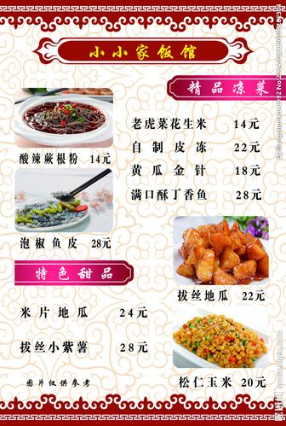



1. A bug I have fixed
Background: deliveries vs. recipes
Code:
for delivery in deliveries:
for recipe in recipes:
if recipe == delivery:
recipes.remove(recipe)
deliveries.remove(delivery)
Bug: repeated recipe, repeated “remove(delivery)”

Slide 3
2. How did I localize & fix it
for delivery in deliveries:
for recipe in recipes:
if recipe == delivery:
recipes.remove(recipe)
deliveries.remove(delivery)
Localize: through error message (delivery not in deliveries)
Fix: add a break after remove(delivery) …?
Not so easy!

Slide 4
2. How did I localize & fix it
Something weird about Python’s list:
lst = [0, 1, 2, 3, 4]
for i in lst:
lst.remove(i) # lst = [1, 3]
The correct code:
records = []
for delivery in deliveries:
for recipe in recipes:
if recipe == delivery:
recipes.remove(recipe)
records.append(recipe)
break
for record in records:
deliveries.remove(record)
0 1 2 3 4
recipes:
deliveries:
records:

Slide 5
3. How to localize it automatically
Using static rule: modify the “loop” list when using “for xxx in list” is dangerous

