Slide 1

GuRU99 Insurance PRoject

Slide 2
IntrODUCTION
The Guru99 Insurance project aims to provide insurance agents with facility to generate and store Insurance Quotes for Cars. Over a period of time , new and new functionalities will be added to the site.
Region – UK
The software must meet UK standards.

Slide 3
Software REQUIREMENTS SPECIFICATION
Guru99 Insurance Site has following modules
Broker Registration
Request Quotation
Retrieve Quotation
Edit Profile

Slide 4
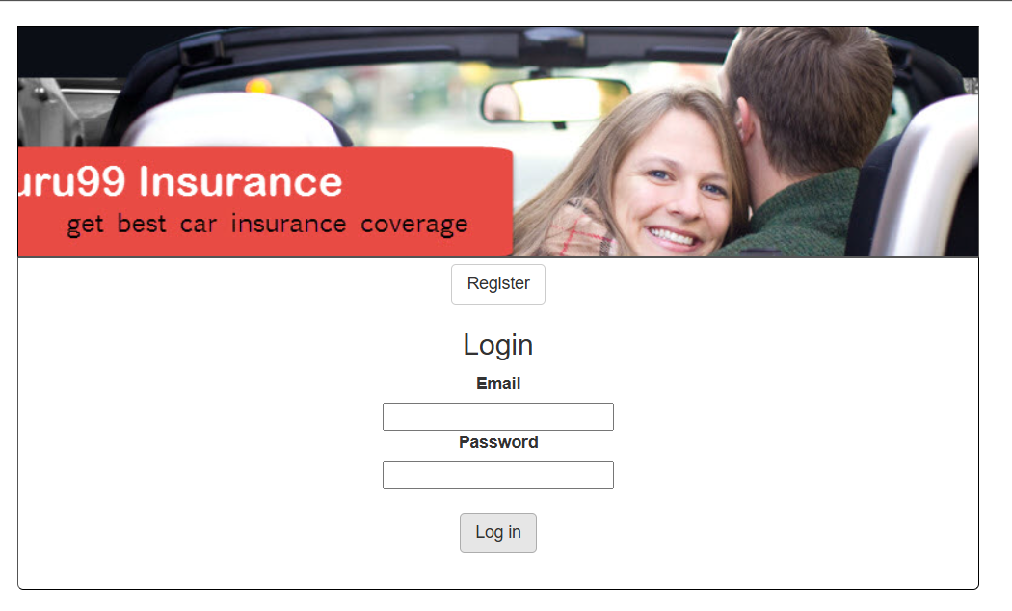
BROKER REGISTRATION

Slide 5
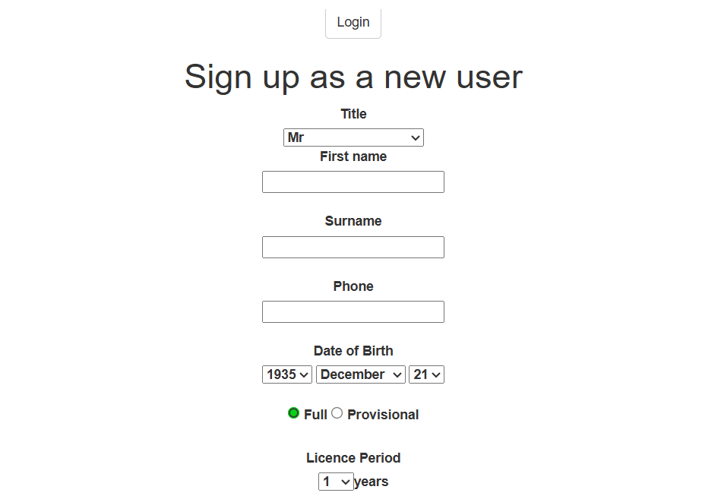
BROKER REGISTRATION

Slide 6
RETRIEVE QUOTATION

Slide 7
REQUEST QUOTATION

Slide 8
EDIT PROFILE

