Slide 1
Introduction
With a focus on the white population within GA, we wanted to analyze the rates of child morality (2023) between counties that are considered rural vs those considered urban. With this case problem, we will take a deeper dive into how child mortality rate among the white population vary across urban and rural counties in Georgia, and what factors might contribute to these differences.
Notes:
With a focus on the white population within GA, Moriam and I wanted to analyze the rates of child morality (2023) between counties that are considered rural vs those considered urban. With this case problem, we will take a deeper dive and understand factors associated with high and low health outcomes that may be associted with urban and rural counties.
In Georgia, there were 60 deaths per 100,000 children under age 18. This ranged from 20 to 170 deaths per 100,000 children across counties in the state.

Slide 2
Data Overview
Our analysis is supported by data from the "Georgia | County Health Rankings & Roadmaps," provided by the University of Wisconsin Population Health Institute. This comprehensive dataset, updated with information for 2023, is crucial for assessing health disparities across Georgia's counties. It encompasses 11 vital variables, including County Name, Number of Deaths, County Value (mortality rate), Error Margin, and demographic breakdowns by race (Asian, Black, Hispanic, White), we further classified it into Rural or Urban categories. This dataset serves as a foundational resource for addressing our research question and illuminating potential areas for targeted health interventions. The number of death is per 100,000 children under 18 in each county.

Slide 3
Methodology
Tools Used: Analysis conducted using Excel for data manipulation and for statistical analysis.
Analysis Steps: Data was cleaned for any inconsistencies or missing values, relevant variables were selected focusing on child mortality rates among the white population, and comparative analysis between rural and urban settings was conducted.

Slide 4

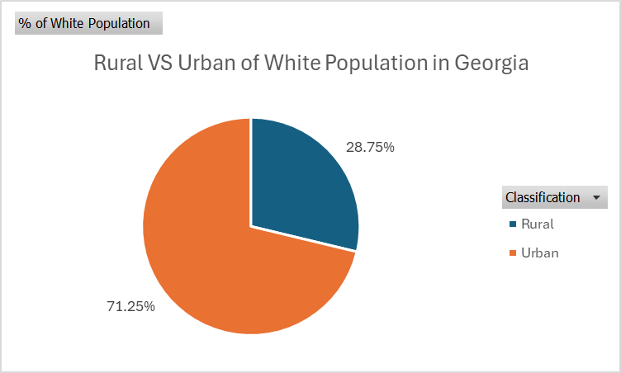
White Population in Georgia
Urban areas in Georgia house the majority of the non-Hispanic white population with 71.25%.
Rural regions account for 28.75% of the non-Hispanic white residents.
The data encompass the total distribution of the white population across Georgia, adding up to 100%.
Notes:
This pie chart is represents the sum of non-Hispanic white in rural vs. urban counties – gives you an idea of totality when comparing overall numbers -- despite urban having a higher rate in numbers, it critical to note there is higher population amount with urban communities. With rural communities, the rate of mortality is significantly higher.

Slide 5
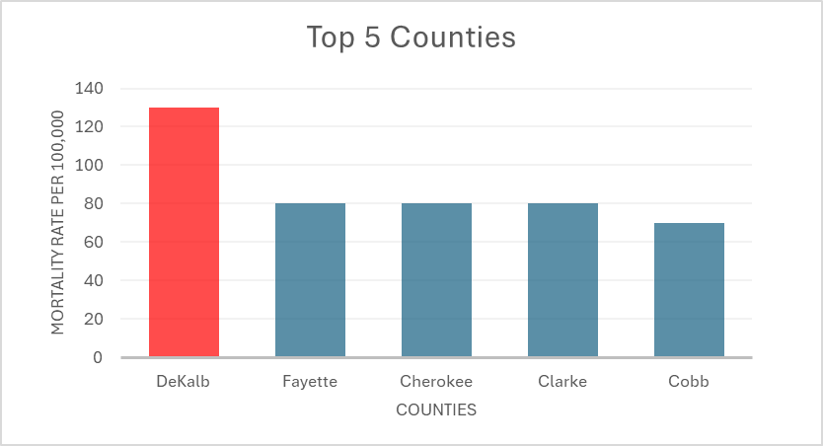
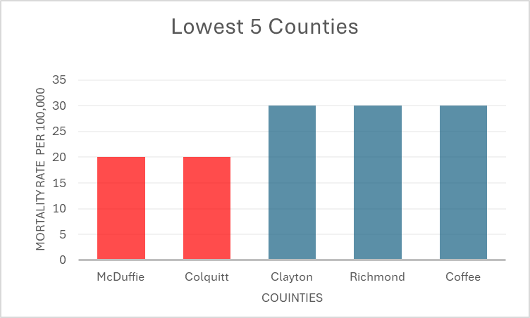
Mortality Rate for Top 5 Counties VS Lowest 5 Counties
Notes:
Distribution of Mortality Rates Across County Classifications: When comparing mortality rates within the same classification, rural counties have lower mortality rates (20 and 30) compared to urban counties where the rates range from 70 to 130. This points to significant health disparities based on geographic classification.

Slide 6
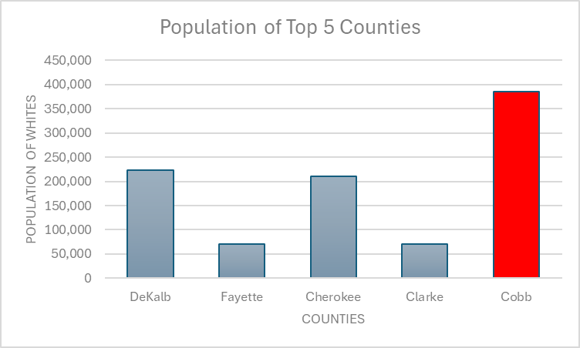
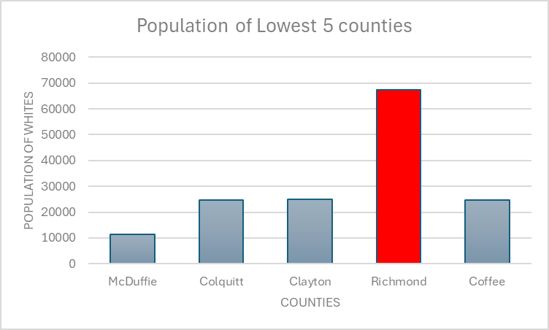
Population of Top 5 Counties VS lowest 5 Counties
Notes:
Urban-Rural Divide in Mortality Rates: The data indicates that urban counties have both higher mortality rates and larger white populations. For instance, DeKalb, an urban county with the highest mortality rate of 130, has a significantly larger white population of 223,448. In contrast, the rural counties with the lowest mortality rates, McDuffie and Colquitt, have much smaller white populations of 11,445 and 24,794 respectively.
Population and Mortality Correlation: There appears to be a correlation between the size of the white population and the mortality rate. The urban counties with higher mortality rates also have substantially larger white populations. This might suggest that factors associated with urban living, such as lifestyle, environmental issues, or healthcare system strains, could be influencing mortality rates.

Slide 7
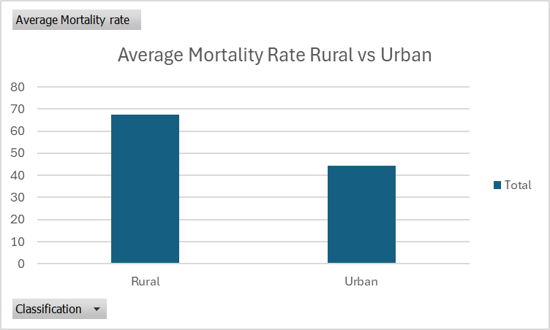
Average Mortality Rate Rural vs Urban
Rural areas exhibit a higher average mortality rate of 67.5, suggesting that certain rural counties not shown may experience significantly elevated mortality rates.
Urban areas have a lower average mortality rate of approximately 44.29, indicating variability and potential pockets of lower mortality rates within urban counties.
Notes:
Rural Areas: The average mortality rate for rural areas is significantly higher at 67.5. This contrasts with individual rural counties' rates, which were some of the lowest at 20 and 30, indicating that other rural counties not listed must have considerably higher rates to increase the average to this extent.
Urban Areas: Urban areas show an average mortality rate of approximately 44.29. Despite having counties with very high individual mortality rates, such as DeKalb with 130, the overall average for urban areas is brought down by counties with lower rates. This suggests a wide variation in mortality rates across different urban counties.

Slide 8
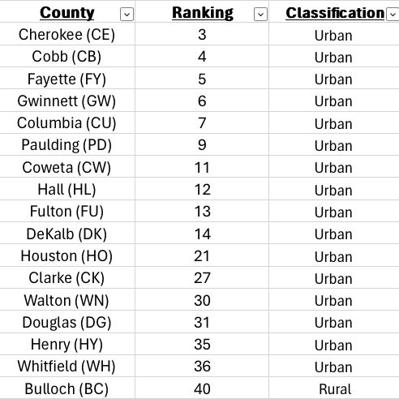
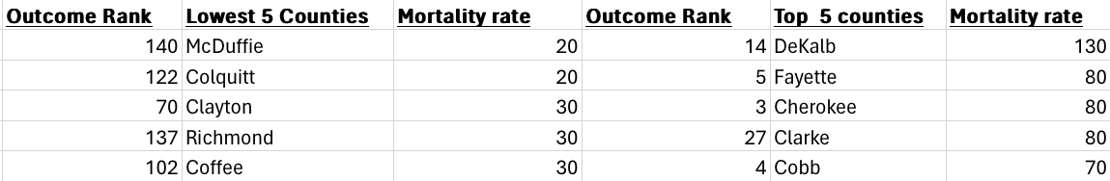
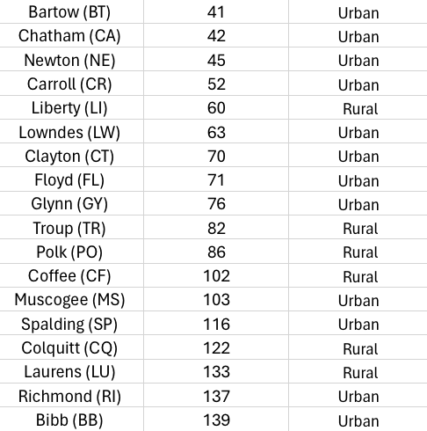
Comparative Data
Health Outcomes tell us how long people live on average within a community, and how much physical and mental health people experience in a community while they are alive.
Conclusion: Rural Areas are ranked lower compared to those considered Urban
Notes:
Now that we know about the averages and the highest and lowest counties – Moriam and I want to be able to see if there is a correlation with our results and the data behind health outcomes within Georgian counties.
Urban counties have a higher health outcome than rural – this correlates to child mortality rate results

Slide 9
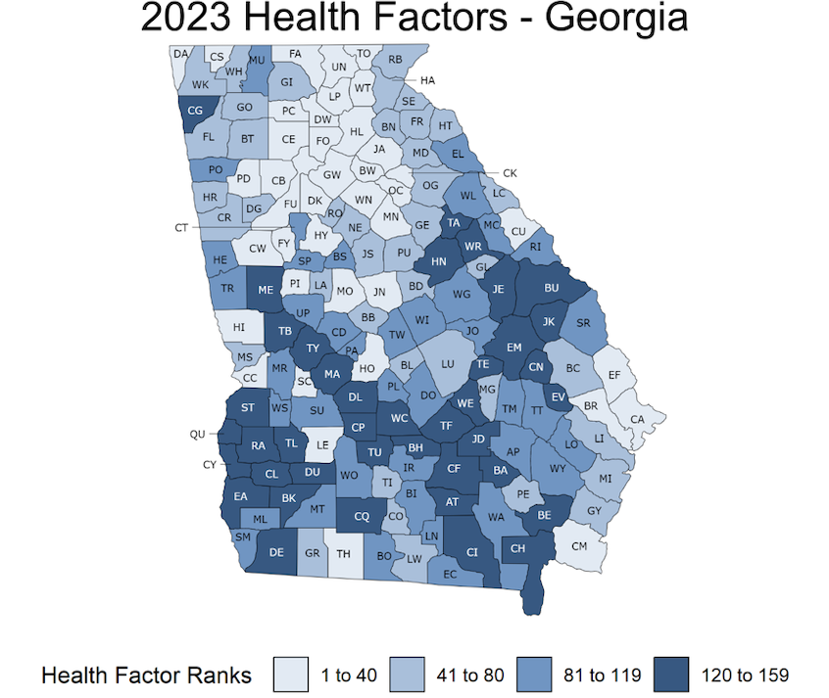

Slide 10
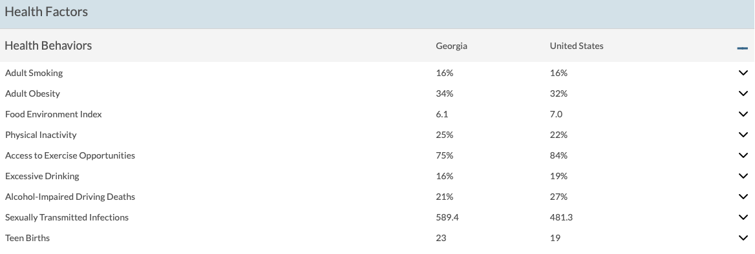
Health Factors Regarding Health Outcomes
Notes:
Factors that can effect the health outcomes – based on the results, you can assume rural areas have higher rates of these factors.

Slide 11
Conclusion
In conclusion, rural counties exhibit a notably higher average white mortality rate when mixed with urban counterparts. This trend prompts an exploration into the multifaceted factors at play. Disparities in healthcare accessibility, socioeconomic status, environmental conditions, and lifestyle choices emerge as potential contributors, highlighting the urgent need for targeted interventions and policy measures to address these disparities and safeguard the health and well-being of all communities, regardless of their geographic location.

