Slide 1

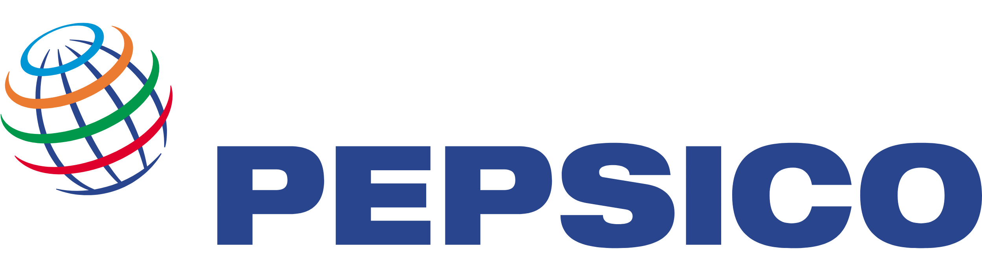
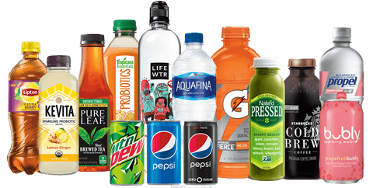
A Global Leader in Food and Beverages
Name: Jannatur Raihan
Batch No: 041
Department: Chemistry
Date: 07 December 2024

Slide 2

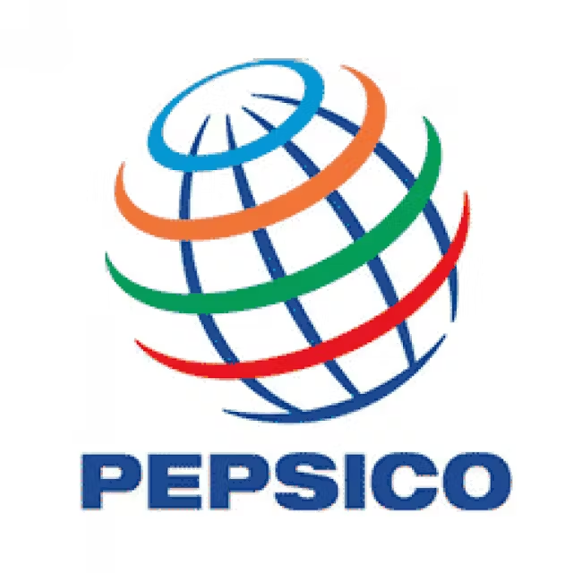
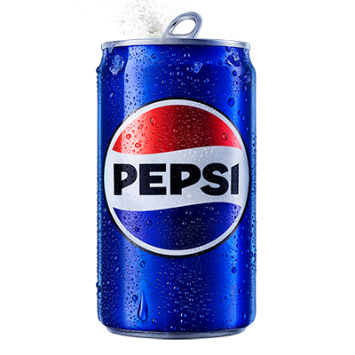
PepsiCo Overview
Founded: 1965, through the merger of Pepsi-Cola and Frito-Lay.
Headquarters: Purchase, New York, USA.
Core Business: PepsiCo is a global leader in food and beverages, with a diverse portfolio of popular brands in the beverage and snack sectors.
Mission: "Create more smiles with every sip and every bite."
Global Reach: Operates in over 200 countries and territories.
Employee Base: Over 290,000 employees worldwide.

Slide 3

Products/Services
Beverages:
Pepsi: Carbonated soft drink.
Mountain Dew: Citrus-flavored soda.
Gatorade: Leading sports drink.
Aquafina: Bottled water.
Lipton: Tea (joint venture with Unilever).
Tropicana: Fruit juices and beverages.
Snacks:
Lay's: Potato chips and snacks.
Doritos: Tortilla chips.
Cheetos: Cheese-flavored snacks.
Quaker Oats: Breakfast cereals and healthy snacks.
Tostitos: Tortilla chips and salsa

Slide 4

Analysis
PepsiCo’s Revenue Breakdown by Product Category
Product Category | Revenue
Beverages | 55%
Snacks | 35%
Other | 10%

Slide 5
PepsiCo’s Market Share vs. Competitors
Coca-Colaleads with 45%
PepsiCo holds 25%
Other 30%

Slide 6
Conclusion
PepsiCo continues to dominate the global food and beverage industry through its strong brand portfolio and innovative products.
Sustainability and health-conscious products are driving future growth.
The company faces challenges from rising costs and health trends, but it is adapting with product innovations and sustainability practices.

