Slide 1

CERTIPRO
Certified professionals to meet your technology needs!
Anthony Segovia
Juan Raigosa
Oscar Lopez

Slide 2
CONTENT
Objective
Institutions
Students
CertiPro
Conclusion

Slide 3
OBJECTIVE:
The objective of this project is to create an application called CertiPro where professionals can upload their resume as well as any tokens and NFTs that represent certifications, awards and degrees given by schools and universities. Clients would also be able to find professionals from a list of candidates and hire them.

Slide 4
INSTITUTION:
Institutions will create non-fungible tokens for each student graduating from their programs in their stremlite app.
Once the student graduates, the institutions creates the NFT, then will award the certificate in the streamlite app, then the certificate will get printed, and a QR code will be created for the certificate.
Lastly, the institutions will send the tokens representing the certifications directly to the student’s wallets and will send the printed certificates via mail.

Slide 5

INSTITUTION
CERTIFICATE
QR CODE

Slide 6
STUDENT:
Students will send the institutions their wallet addresses that will hold the tokens for their certificates.
Once the students pay and graduate from the program, the institutions will send him the token, after, the student will import the token using the contract address and keep it on his Metamask wallet address.
The student as a professional will create a profile on CertiPro with their personal information including their resume and certifications to be displayed.

Slide 7
CERTIPRO:
CertiPro is a streamlite application that allows professionals to create a profile where costumers can find professionals from among a list of candidates and hire them.
Each profile can upload a photo, add Ethereum wallet, resume and certificates that will be displayed on the app, as well as the address where the certificates are stored and view the certificates on the app.

Slide 8
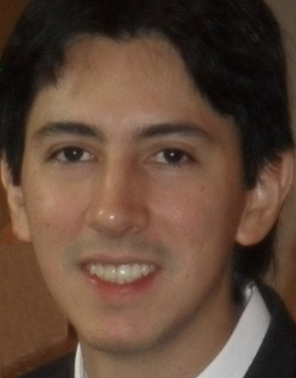
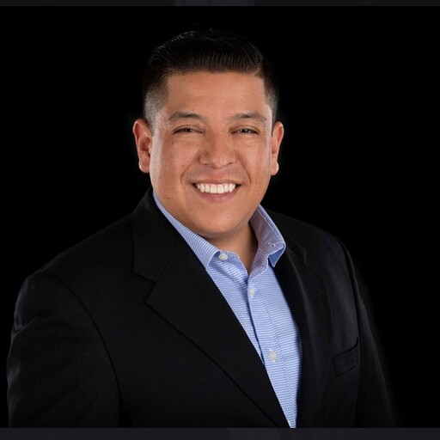

PROFILES IN CERTIPRO
Anthony Segovia
Juan Raigosa
Oscar Lopez
Blockchain Developer
FinTech Professional
Data Analysist

Slide 9
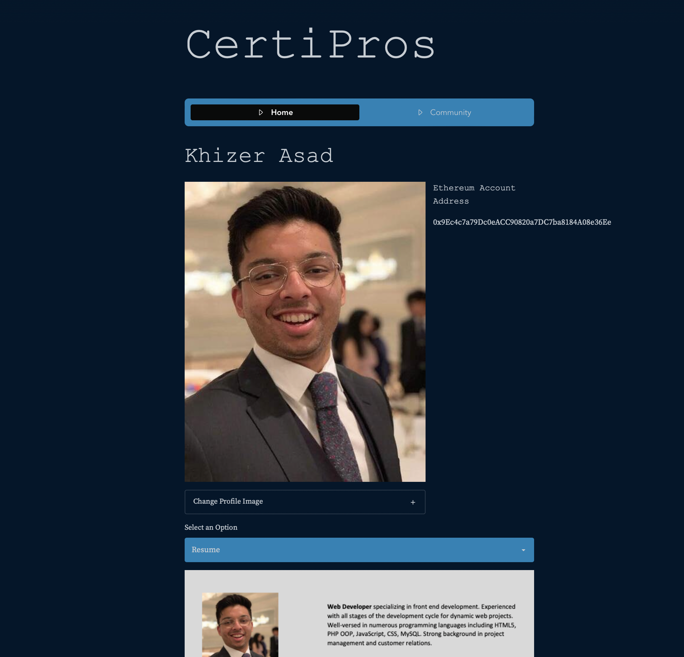
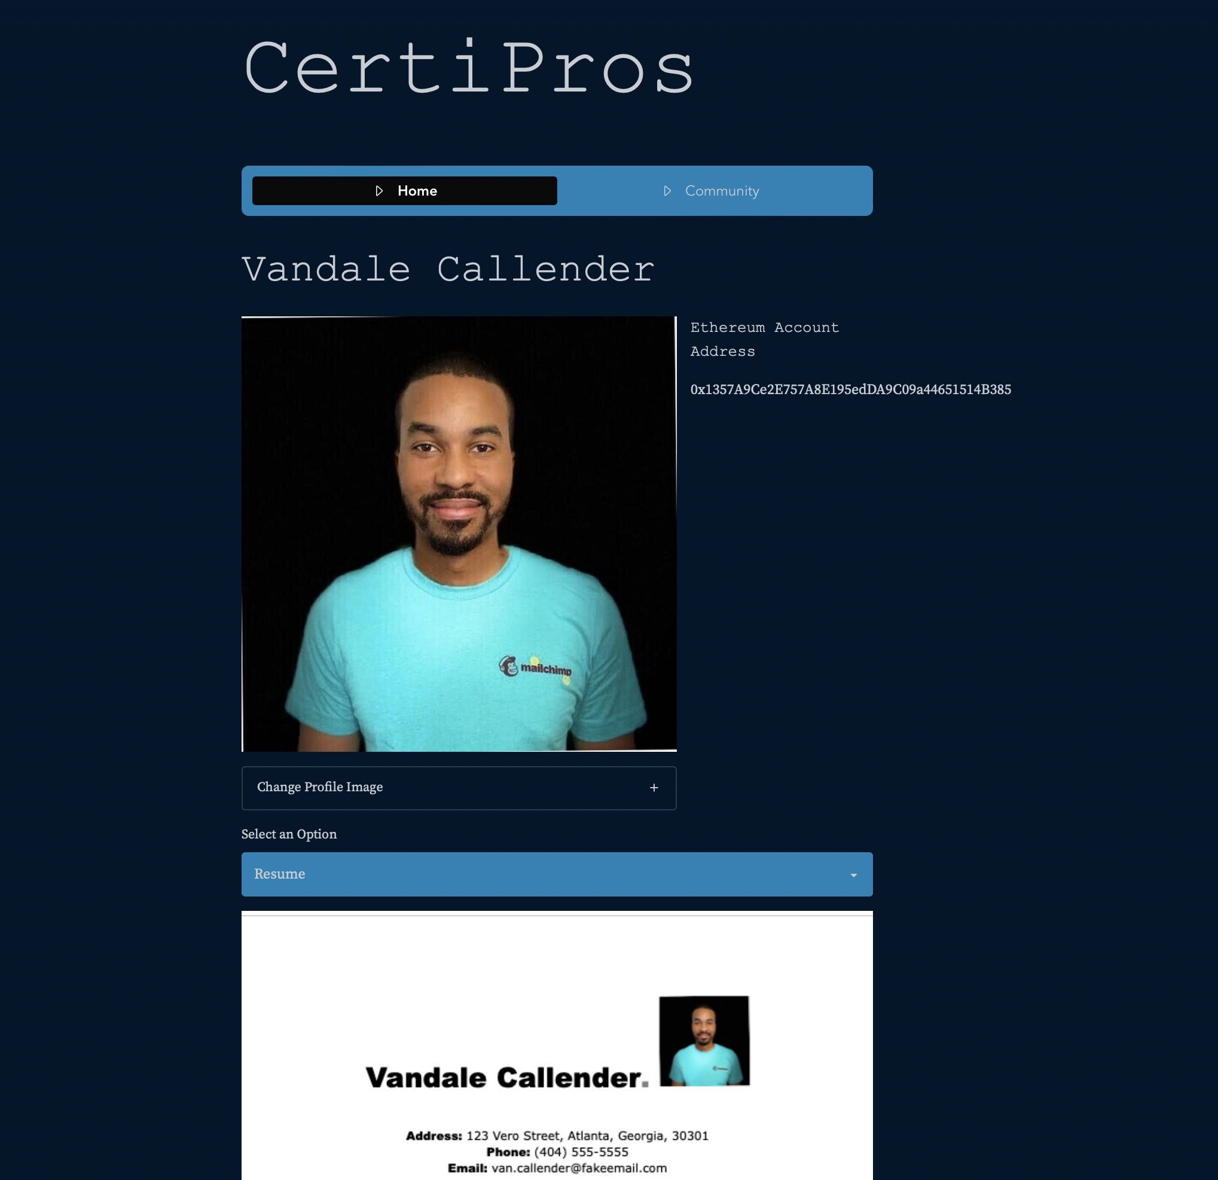
PROFILES IN CERTIPRO
Vandale Calender
Khizer Azad
Web Developer
Data Analysist

Slide 10
CONCLUSION:
The CertiPro app is a great source for professionals to integrate, upload and upgrade their resumes, diplomas, certifications and awards as it will help them develop a presence within the field.
It will also be a great source for recruiters to find certified professionals to meet the technology needs of their costumers and different companies.

