Slide 1
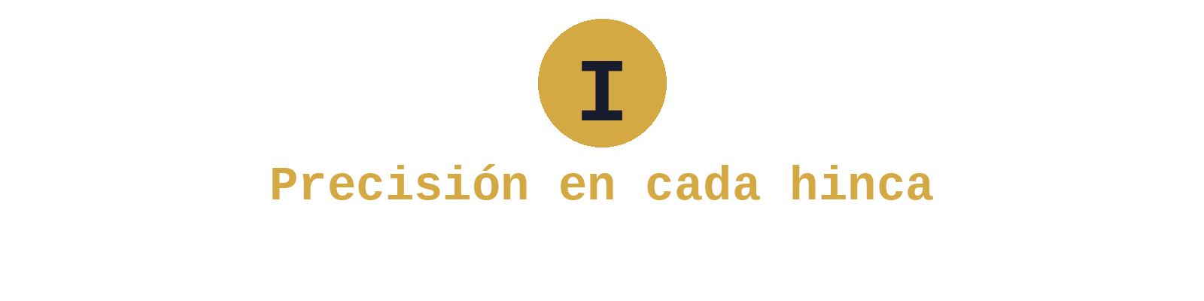
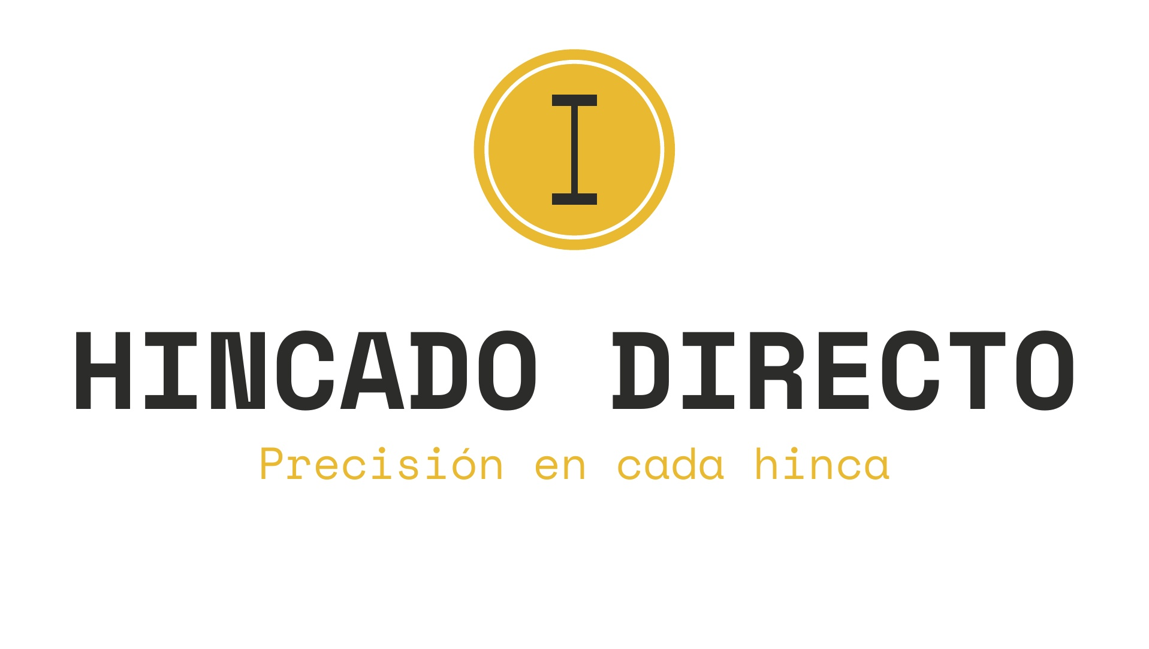
PRECISION IN EVERY PILE
Foundation, assembly and services
for energy and infrastructure
Corporate Presentation 2025

Slide 2

HINCADO DIRECTO AT A GLANCE
Experience measured on site
+3,800
MW INSTALLED
+55
PROJECTS COMPLETED
4
COUNTRIES · ES · FR · PT · IT
9
FIELD TEAMS
+20
YEARS OF TEAM EXPERIENCE
15
PROFESSIONALS

Slide 3
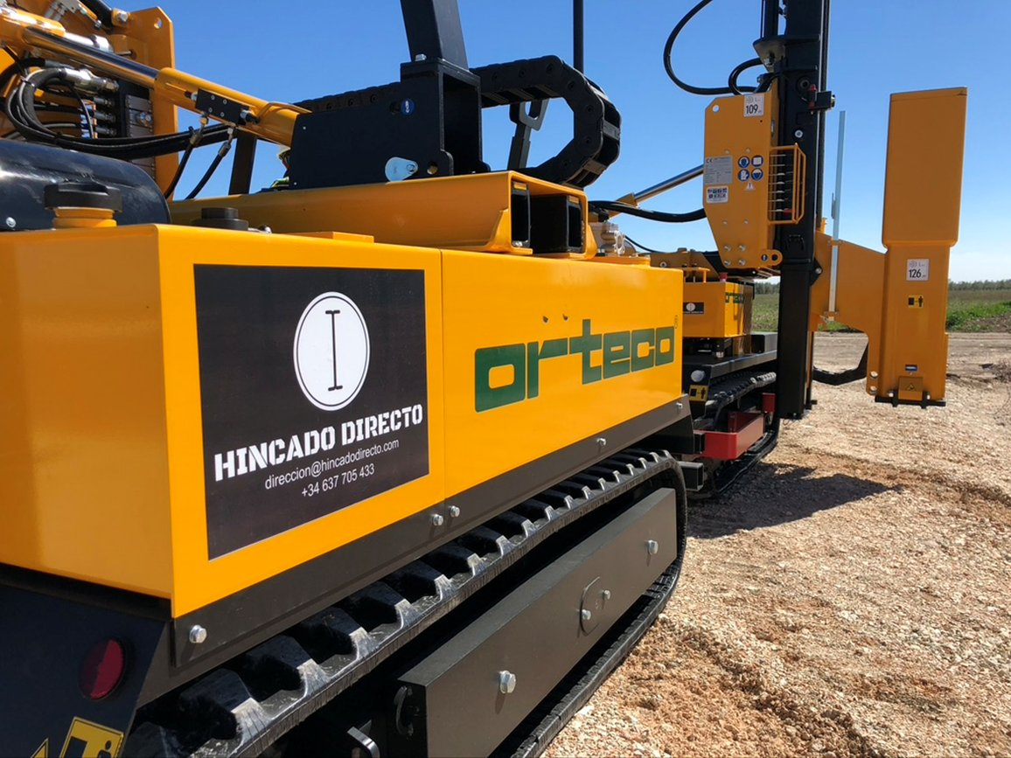
ABOUT US
The job gets done. And it gets done right.
Founded in 2019, Hincado Directo started as a company specializing in pile driving for solar photovoltaic plants. Today we operate across the entire foundation and assembly chain: pile driving, drilling, POT testing, machining and quality control, in both solar energy and civil works. A team of 15 professionals with over 20 years of combined industry experience, operating in 4 European countries with our own fleet of 9 machines.
Operating since 2019
Own fleet of 9 machines
Spain · France · Portugal · Italy

Slide 4
OUR SERVICES
Everything we do
From soil testing to full execution. A single point of contact, an uncompromising quality standard.
01
02
03
04
Surveying
POT Testing
Drilling
Pile Driving
On-site staking and topographic surveys with in-house equipment and millimetric precision.
Pull Out Test: tension, compression and lateral load tests to dimension foundations precisely.
Pre-drilling and boring for high-resistance terrain or rock where direct driving is not viable.
Direct pile driving of steel profiles for all terrain types and project scales.
05
06
07
Machining
Quality Control
Distribution & Assembly
Cutting driven profiles to the exact height required by the structure design.
Alignment, verticality and depth verification. Detailed site reports.
On-site material logistics and assembly of structures on top of the driven profiles.

Slide 5
CORE SERVICE
Pile driving and drilling
Direct pile driving
Installation of steel profiles by impact. Maximum speed in favorable terrain.
Pre-drilling
Prior boring for high-resistance terrain, rock or hard strata.
Full drilling
For terrain where pile driving is not viable. Boring and profile fixation.
9 simultaneous operational teams
Capacity for parallel projects across Spain, France, Portugal and Italy
All terrain
Clay, sand, rock, mixed terrain and slopes. Soil heterogeneity is not a problem.

Slide 6
TESTING & VALIDATION
Pull Out Test: reliable data before execution
Pile driving tests and POT trials with predefined load cycles. Real data to dimension foundations precisely.
Tension
Pull-out tests to verify the anchoring capacity of the driven profile in actual project soil.
Compression
Vertical load tests to verify the bearing capacity of the profile under structural load.
Lateral load
Lateral push tests to simulate wind actions on the photovoltaic or civil structure.
Why does it matter?
A well-executed POT test prevents costly over-dimensioning and detects soil problems before committing to mass driving.

Slide 7
COMPLEMENTARY SERVICES
Machining and quality control on site
Machining
Profile cutting to grade
Once driven, profiles may end up at uneven heights. Machining consists of precision-cutting each profile to the exact elevation required by the structure design.
Millimetric precision
We ensure every profile sits at the specified height, enabling correct assembly and preventing mechanical stress.
Quality control
Comprehensive verification
Systematic review of all driven profiles: alignment, verticality, depth and position against the design.
Site reports
Detailed documentation: how many profiles meet specs, which require rework or re-driving. Full traceability.

Slide 8
SECTORS
Beyond solar energy
Our pile driving and drilling expertise applies to multiple sectors where steel profile foundations are key.
Solar Photovoltaic Energy
Our core sector. +3,800 MW installed across solar plants of all sizes.
→ Utility-scale plants (>50 MW)
→ Medium and distributed plants
→ Fixed structures and trackers
→ Driving, drilling, POT, machining and QC
Civil Works & Infrastructure
The same pile driving technique applied to civil infrastructure.
→ Road safety barriers (guardrails)
→ Driven supports and posts
→ Industrial fencing and enclosures
→ Steel profile foundation projects

Slide 9
EQUIPMENT
Own fleet, real capacity
Two industry-reference models, compliant with the latest European environmental regulations.
Pile Drivers
7× Orteco 1000 HD
Drill-Rammers
2× Faga MHPW 1000
→ High-performance hydraulic pile driver
→ Dual: drilling + driving integrated
→ All-terrain driving capability
→ Ideal for rock or high-resistance soil
→ High-precision positioning system
→ Maximum versatility in one machine
→ EU environmental compliance
→ Professional operator included
Always rented with professional operator · Optional assistant · Coverage: Spain, France, Portugal & Italy

Slide 10
INTERNATIONAL PRESENCE
Where we operate
Spain
HEADQUARTERS
Main base of operations. Most of our +55 projects across the country.
France
ACTIVE PROJECTS
Projects in southern France: Sillans la Cascade, Châteauvert, among others.
Portugal
ACTIVE PROJECTS
Presence in Alentejo: PV Morgavel, São Teotonio and additional projects.
Italy
EXPANDING
Mobilization capacity from our base. Market under development.

Slide 11
TRACK RECORD
+3,800 MW installed with top-tier EPCs
Project | MW | Country | EPC / Client | Structure
Mula Solar | 342 | Spain | TSK | PVH
Ceclavín | 330 | Spain | Elecnor / Engie | Trina
La Nava | 300 | Spain | Engie / Sacyr | Nextracker
Algibyo + Girasoles | 182 | Spain | GES | PVH
Manzanares | 155 | Spain | FCC | PVH
Escatrón I | 153 | Spain | Prodiel | PVH
Garoña + La Muela | 126 | Spain | Axial | Nextracker
Talayuela II | 100 | Spain | FCC | PVH
Sillans la Cascade | 85 | France | Cobra / Engie | PVH
PV Morgavel | 52 | Portugal | GES | PVH
Other (+45 projects) | +1,975 | ES/FR/PT | Various EPCs | Various
Total: +3,800 MW · +55 projects · 4 countries · +15 different EPCs

Slide 12
THEY TRUST US
Companies working with Hincado Directo
+15 EPCs, developers and structure manufacturers have trusted us with their projects.
GRUPO COBRA
ENGIE
SACYR
FCC
TSK
ELECNOR
PRODIEL
GES
AXIAL
GRUPO ORTIZ
ZELESTRA
SUNCRAFT
ARESOL
PVH
NEXTRACKER
TRINA
AJ BRAND
TCI GECOMP
IBÉRICA RENOV.
TILSECO
+ CRC · OSMOS · and other partners

Slide 13
Let's talk about your next project
Over 3,800 MW back us up. We are ready for your next challenge.
Address
Duque de Sevilla 3, Ground Floor 28002 Madrid, Spain
Phone
+34 641 43 81 26
Web
www.hincadodirecto.com
info@hincadodirecto.com

