Slide 1
TAJ
Data Consulting Services

Slide 2
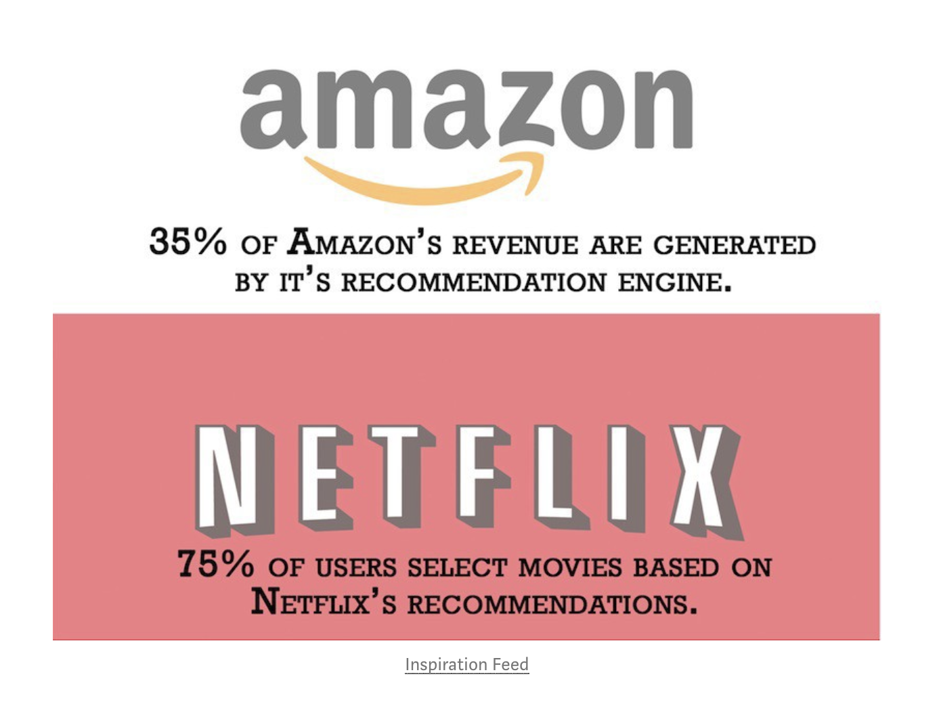
The Model - FPGrowth
Why is it important?
How it works?
TRADE UP
X-SELLING

