Slide 1
Weigh once. Honour it everywhere.
KIFARU PORTOS
RCS v2 port-anchored clearance for heavy trucks on the Mombasa - Northern Corridor route
Proposal to the judging panel | 5 November 2026
Live platform: kifaru-portos-1-0.vercel.app
Notes:
Open with the one-line idea: every heavy truck is weighed once at its first trusted point and later weighbridges honour a signed token instead of weighing again. The platform already exists and is live.

Slide 2
The project in one minute
Problem
Innovation
Almost every truck is compliant, yet every truck is weighed again at every station; port dwell and corridor transit run far above target.
Weigh once at the first trusted point, honour a signed token downstream, and roll doubtful trucks through a lane instead of stopping them.
Proof it works
Impact (modelled)
Built, tested with 177 automated tests and live on a hosted database, with every agency workflow from port gate to delivery.
Port-truck road stops 23.2 % to 5.3 %; port dwell 6.8 h to 4.0 h; about 143 truck-hours a day freed at one station.
Notes:
Give the judges the whole case in four sentences before the detail: the problem, the idea, the fact that it is already built and live, and the modelled impact.

Slide 3
Compliant trucks stop too often; overloads are caught late
1
2
3
Weight is measured last
Every station repeats the work
High-speed WIM is not enough
Identity, cargo and releases are checked repeatedly at the port, yet the first weighing happens on the highway, far from cranes, customs and yard space.
Paper certificates and release orders travel with the driver; Mariakani, Mtwapa and Athi River each weigh the same truck again.
It estimates axle loads only. Dimensions, lifted axles, per-wheel balance, permits and certificates are still checked by hand at static bridges.
23.2 %
8 000
2 990 USD
of port trucks sent to a static scale at 85 % loading, road-only screening (modelled)
trucks a day at Mariakani; one percentage point of stops is 8 truck-hours a day
indicative fee for 5 000 kg over the gross limit, tripled on a repeat in the same journey
Notes:
The gap: the port chain verifies everything except weight, and the road weighs everything again. Numbers are from the chain model and the 2018 Regulations fee table, both to be confirmed.

Slide 4
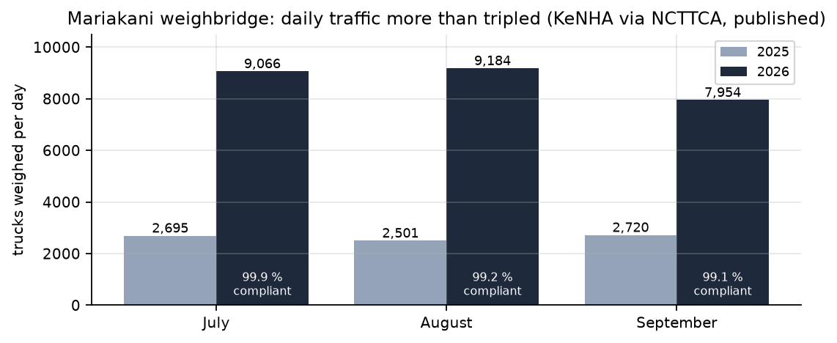
What the published data shows
87 h
import container dwell at Mombasa, Jul-Sep 2026 (target 60 h)
66 h
Mombasa to Nairobi transit for 482 km in 2025 (target 29 h)
Mariakani weighed 7,954-9,184 trucks a day in Jul-Sep 2026, over three times a year earlier, and 99 % of them were compliant. Source: KeNHA via NCTTCA quarterly report, Oct 2026.
6.7 h
average truck turnaround inside the port, KPA 2023
Notes:
These are published figures, not model outputs: NCTTCA Transport Observatory (21st edition and the July-September 2026 quarterly), KeNHA, and KPA's annual bulletin. Compliance is already near 99 %, so the waste is in re-checking compliant trucks.

Slide 5
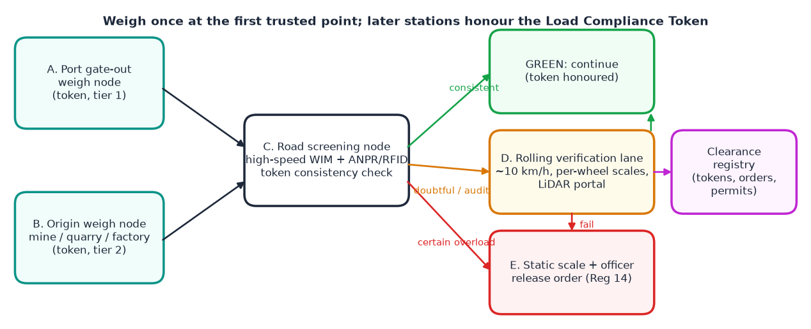
Weigh at the first trusted point, honour it downstream
One rule for all streams
A signed Load Compliance Token is issued at the first verified weighing: port exit, approved origin scale, or first road station.
Later stations only check that identity and weight are unchanged, so compliant trucks keep moving.
Doubtful trucks roll through a verification lane at about 10 km/h.
Red cases still go to the static scale and an authorised officer: the legal reference never moves.
Legal hook: Reg 10(2) of the EAC Vehicle Load Control (Enforcement Measures) Regulations, 2018 excuses vehicles previously confirmed compliant by screening devices from producing the paper certificate.
Notes:
Walk the diagram left to right: port and origin nodes issue tokens; the road node checks consistency; green continues, doubtful goes to the lane, certain overloads go to the static scale and the officer. The registry links everything.

Slide 6
Three truck streams, one token
A
Port trucks
B
Industrial origin
C
Untokened trucks
Containers from Mombasa
Mines, quarries, cement, sugar, fuel depots, farms, factories
Spot loads, traders, small fleets, first-time users
First weight at the port gate-out node, beside the i-Gate: plate, tag, container OCR, e-seal and releases captured once.
An approved loading-site scale sends a signed ticket; trust is earned by comparing origin readings with road and lane readings.
The first road station or the rolling verification lane issues the token; more uncertainty, so more go through the lane.
Trust tier 1 | audit 2 %
Trust tier 2 | audit 4 %, falling with a clean record
Trust tier 3 | audit 3 %
Notes:
Enforcement effort follows risk: audit rates rise with demerit points and fall for fleets with a clean record. On-board records (tier 4) inform the risk score but never issue a token.

Slide 7
The token and the rolling verification lane
Rolling Verification Lane
What the token carries
10 km/h
20-30 s
Tractor and trailer plates, RFID tag, container number (check digit) and e-seal
Axle-group loads, gross weight, expected weight and the variance between them
Issuing node, time stamp and validity window; snapshot of customs, shipping-line and KPA release status
Route, destination, declared driver; dimensions, axle configuration, permit reference
Source and trust tier, which set the audit rate; Ed25519 signature so it cannot be altered
doubtful trucks roll through per-wheel scales and a LiDAR portal, no stop
to capture the full static-bridge parameter set
~370 / h
~25 x
one lane at 27 m headway; a static lane does about 15
static lanes replaced by one rolling lane
Layout: 100-150 m approach, flat 15 m measuring zone, 50 m exit. Legal grade only after weights-and-measures approval (Reg 5).
Notes:
The token makes the road check a consistency test rather than an accuracy test; the lane supplies everything high-speed WIM lacks without stopping the truck.

Slide 8
Everything KeNHA checks at a static bridge, covered
Gross and axle-group loads
Axle count and lifted axles
Height, width, length
Per-wheel scales in the lane, error target 1 %; static scale remains legal proof for red cases
Side LiDAR and camera classification matched to the registered configuration
Overhead LiDAR portal and light curtain; checked against special-load permits
Left-right imbalance
Certificates, release orders, seals
Fee, signature, calibration
Per-wheel scales; wheel-track position from the WIM rows
Held in the registry and shown to every station; e-seal status from KRA; customs alerted on a transit overload
Fee computed from the schedule and allowance policy; officer e-signs; quarterly calibration register
Notes:
Two limits from the regulations: screening never replaces static weighing as proof of overload, and fees and release orders come from an authorised officer. The system prepares; the officer approves.

Slide 9
Decision rules at the road screening node
GREEN
Continue
AMBER
Divert to lane
RED
Static + officer
Valid token, identity match, weight within tolerance of the token (8 % port or origin, 11 % road)
Dimensions inside limits, axle count matches registration
Or no token but weight below the limit by the full margin: a road token is issued
No token and weight inside the margin band
Weight inconsistent with the token (cargo changed)
Dimension or axle-count mismatch, unreadable identity, or random audit
Lane pass issues or renews the token
Over the limit beyond the margin on any node
Dimension or permit breach, or inconclusive lane result
Officer e-signs the release order (Reg 14); hazardous and perishable flags change the handling
For a tokened truck the road no longer judges weight against the limit: it only confirms the weight is unchanged since the first trusted weighing.
Notes:
For loads in the margin band the road reading no longer has to be accurate against the limit; it only has to confirm the weight is unchanged since the first trusted weighing.

Slide 10
SmartPort: one record per truck, booking to delivery
1
2
3
4
5
6
Pre-arrival booking
Customs and permits
Arrival and ID
Gate-in
Yard allocation
Verification and loading
Transporter
KRA, KenTrade, KEBS
KPA
KPA
KPA
KPA
7
8
9
10
11
Automated weighing
Final clearance
Gate-out
Inland transport
Delivery
KPA, KeNHA
KPA, KRA
KPA
Transporter, KeNHA
Cargo owner
Stage 7 is the port gate-out weigh node: the weighing fills the record and issues the token automatically. Each stage must carry its required data before the next opens.
Notes:
This is the port-side layer from the SmartPort design. Agencies keep their own systems; SmartPort shares release, weighing and location status through authorised adapters and one dashboard.

Slide 11
Anchored in the 2018 Enforcement Regulations
Reg 10(2)
Reg 4(6) and 18(3)
Reg 3(4) and 11(3)
Vehicles previously confirmed within limits by screening devices need not produce the paper certificate.
A vehicle found in breach by surveillance is weighed on a static scale.
Tickets and release orders for overloaded vehicles come from authorised officers.
The legal basis for a digital green status.
Screening decides who needs a static weighing; it never replaces it as proof.
The platform prepares the red case; the officer e-signs with MFA.
Reg 5, 6 and 8
Reg 14 and 18
Second and Third Schedules
Scales need weights-and-measures approval; calibration every three months; annual audit.
Release orders travel with the journey; a repeat overload triples the fee; transit overloads wait for customs.
Discretion allowance below 5 %; legal weights and the fee table.
Legal-grade flag per lane; quarterly calibration register; expired calibration blocks green.
Digital release-order registry with repeat detection and automatic customs alert.
Allowance is a policy value to agree with KeNHA; it changes the stop share materially.
Notes:
Open legal questions for Phase 0-1: whether Reg 10(2) covers a digital token, who approves the devices, whether an officer may e-sign remotely, and whether low-speed in-motion weighing can be approved as legal-grade.

Slide 12
Not a blank sheet: the platform is built, tested and live
Clearance engine 2.0
Clearance registry
Deterministic rules: token consistency, dimensions, lifted axles, permits, allowance, tiered audits, routes; evidence hash per decision
Tokens with public verification, Reg 14 release orders with officer e-signature, permits, trust-tier policy, stream and route statistics
Web platform
Roadside gateway and hardware
Control centre, weighbridge console, registry, model explorer, transporter, driver, cargo owner, warehouse, admin, 3D digital twin
Store-and-forward gateway (built); STM32 acquisition firmware, analog front end, lane and port-node layouts (designed, not fabricated)
Simulation package
Cloud and security
RCS v2 chain Monte Carlo, experiments with replications and gate, SimPy station model with tokens and lane, SUMO adapter
Live on Vercel (Dublin) with Supabase PostgreSQL; RBAC, MFA, signed records, hash-chained ledger, PII encryption, DPIA
177 automated tests passing | live at kifaru-portos-1-0.vercel.app | every record carries live / simulated / replay and simulated data is never shown as live
Notes:
78 API tests, 32 simulation, 22 gateway, 24 DSP, 8 agents. Hardware is designed, not built; regulators have not reviewed the design. These are stated plainly in the proposal.

Slide 13
Port trucks: road stops fall, near-limit checks move to the port
23.2 % to 5.3 %
road static stops at 85 % loading (modelled)
~143
road truck-hours saved a day at 8 000 trucks and 6 minutes per stop
Honest reading: total re-weighs stay similar (5.3 % road + 14.8 % port vs 23.2 % road); the gain is relieving road queues and fixing overloads where it is cheap. A 5 % allowance or a legal-grade port scale cuts port re-weighs to about 1 %.
Notes:
Assumptions: 1.5 % overloaded, load spread 12 % of the limit capped at the limit, port error 1 %, road error 2.5 %, 90 % token coverage, 3 % audits. All to be replaced with measured data in Phase 0-2.

Slide 14
Mixed traffic: token coverage is the lever that matters
10.0 % to 1.5 %
first-station static visits as coverage rises from 30 % to 90 % (baseline 20.8 %)
0.04 %
static visits at later stations once every truck carries a token: repeat stops disappear
Lane capacity: modelled peak 116 trucks an hour against about 370 per lane, so one lane per station is enough. Fleet and loader enrolment is therefore a core workstream.
Notes:
Untokened trucks alone: the lane trims static visits only from about 21 % to 14 % of those trucks; the rest sit inside the 2 % margin and need a legal-grade lane reading or the discretion allowance.

Slide 15
What moves the result, and the go/no-go gate
Go/no-go gate (Section 10.9)
ok
Road stop share cut by 10+ points
17.9 points
ok
False-clear rate at most 1 %
0.00 %
ok
Port re-weigh practical (at most 20 %)
14.8 %
ok
Lane peak within capacity
116 of 370 trucks/h
All checks met in the model. The gate is re-applied to the validated model on measured baseline data before any hardware spend.
Notes:
Token coverage swings the road stop share by about 10 points; audit rate about 4; loading about 2.6. Port error and the allowance move the port re-weigh share instead.

Slide 16
Station model: the lane absorbs doubtful trucks without stops
44.3 min
mean time in system when every truck stops (static scale saturated)
2.3 min
with RCS v2 at 90 % token coverage; static utilisation 8 %
The station model uses a heavier synthetic population (15 % overloaded) than the chain model, so shares differ; it is used for queues, lane capacity and closures. A two-hour lane closure sends doubtful trucks back to the static scale, as designed.
Notes:
Decisions in the station model come from the production clearance engine, so the simulation and the live platform cannot disagree on policy.

Slide 17
Port visit: dwell falls by about 40 % with SmartPort
6.8 h to 4.0 h
mean port dwell; the existing case is calibrated to KPA's published 6.7 h
-70 %
weighbridge service time at the port gate-out node versus a static stop
Assumed: RFID/ANPR gates (1 min vs 4), pre-cleared documents (5 % holds vs 15 %), appointments aligned with container readiness. To be measured in the shadow pilot.
Notes:
The existing-operations case reproduces KPA's published 2023 truck turnaround, which anchors the model in real data. The SmartPort gains come from stated design assumptions, all listed in the proposal.

Slide 18
Roadmap: a gate before any hardware spend
Phase 0-1
Phase 2
Phase 3
Phase 4
Phase 5
Access and legal
Baseline and design
Bench prototype
Shadow pilot
Live pilot
Months 0-3
Months 3-7
Months 6-11
Months 10-16
Months 16-24
Agencies, loaders, data requests, legal opinion on Reg 10(2), 5, 3(4)
Time-and-motion at the port exit and Mariakani; classification counts; validated simulation; token and API spec
Scale-model rig, token service, OCR, LiDAR portal, per-wheel scales, mock agency APIs
Port exit lane, one origin site, one lane at Mariakani; tokens issued and compared, not acted on
Volunteer fleets use the green lane; approved signs; static audits continue; lane scale approval
Exit gate
Exit gate
Exit gate
Exit gate
Exit gate
MoUs, data access, legal route clear
Simulation meets the gate
Latency and repeatability met
Accuracy and false-clear targets met
Agency approval, then scale out
Notes:
The 16-week simulation sits inside Phase 2: weeks 1-2 baseline plan and data requests, 3-4 sensor model, 5-8 process model, 9-10 road traffic, 11-14 token service and hardware-in-the-loop, 15-16 validation and committee report.

Slide 19
Main risks and how they are handled
KPA may not allow a weigh node in the exit lane
Scales lack legal-grade approval
Start the port node as advisory; the first road station can be the first trusted point
Seek weights-and-measures approval early; model both cases; apply the allowance where KeNHA agrees
Private origin scales under-report
Token fraud: plate swaps, cargo added later
Approve and audit each scale; compare origin readings with road and lane; suspend tokens on drift
Bind token to plate, tag and seal; weight consistency on the road; audits and demerits
Land and civil works for the lane (about 250 m)
Model assumptions differ from reality
Confirm availability per station early; approved signs for speed discipline
Validate against measured baselines before any claim; tornado analysis; gate re-applied
Notes:
Also: legitimate weight changes (partial offloads, fuel) handled with a validity window and lane renewal; data-sharing delays covered by a two-week provisional study; officers must still sign (e-signature workflow with MFA).

Slide 20
Decisions requested
NEXT STEPS
1
Approve the redesign around the port gate-out node and the Load Compliance Token
2
Approve Phases 0-2: simulation and baseline study, gated before hardware spend
3
Authorise approaches to KPA, KRA, KeNHA, NTSA and the weights-and-measures body
4
Nominate an executive sponsor and a legal adviser
Full proposal: docs/07-proposal/KIFARU-PORTOS-Project-Proposal.pdf | kifaru-portos-1-0.vercel.app
Notes:
Close on the four decisions. Everything modelled is labelled modelled; the first spend is the baseline study and the legal opinion, not hardware.

