Slide 1
Emoji Prediction
Prepared by
Justin Keeling & Alex Harry

Slide 2
Emoji Prediction: Introduction
The Problem
Its
Importance
Human-based
Solution?
Who cares?
Notes:
Just a transition slide to for the introduction and the points we will cover within the intro.

Slide 3
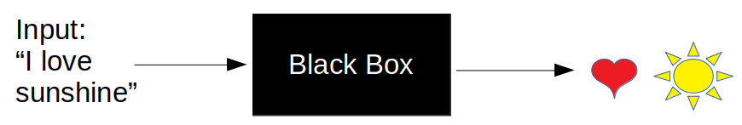
Problem to be Solved?
Given…
  Training Data
  Test Data
Predict
Notes:
The problem we are trying to solve is :… predicting an emoji from given text.
As seen, text will be given as input and outputted is emojis that best resemble that text.

Slide 4

Why is it important?
Emojis usage
  When and why?
Brain perception
Goal Perhaps?
  More we can predict…
  … More we know?
Notes:
This is an important task because…
More data to use for text mining
From research, emojis are used when text becomes too much to explain emotions.
Sentiment can be gathered from emojis.
Depending on application uses, would this specific purpose be irrelevant? Is this task more for researchers.

Slide 5
Feasible Human-Based Solution
Why not?
  Time
  Employees?
  Stream-line data
Notes:
Computers are systematically faster than what humans can do.
For instance, we have ?# of data and realistically, it would be too much time for even two of us to determine the data without bias…
Who would want this job?
Being able to use social media outlets, data can be constantly processed.

Slide 6
Who Cares?
Applications
  Economics/Finances
  Politics
  Customer Satisfaction
So… Who cares?
Notes:
The audience that cares most about this typically revolve around politics, economics/finances, companies for customer satisfaction.
Especially emojis being a great resource for gathering sentiment, anything relating to media and a companies product.

Slide 7
Background:
Relevant Work
A Similar
Experiment
Their
Approach

Slide 8
Relevant Work

Slide 9
Similar Study: Experiment

Slide 10
Similar Study: Approach

Slide 11
Methods
Data and Setup
Our High-level
Approach
Time-Line

Slide 12
Data & Setup

Slide 13
High-level Approach

Slide 14
Timeline

