Slide 1
Emoji Prediction
Prepared by
Justin Keeling & Alex Harry
Group 2

Slide 2
Emoji Prediction: Introduction
The Problem
Its
Importance
Human-based
Solution?
Who cares?
Notes:
Problems: Emoji Prediction, Given a tweet, predict emojis that will resemble the tweet
It is important because…
Emojis are becoming a norm:
- 95% of users on the internet have sent an emoji
- The use of emojis has increased drastically.
- It is another dimension in terms of data.
Serkan Ayvaz Mohammed O. Shiha. 2017. The Effects of Emoji in SentimentAnalysis. (2017).
A human based solution is not optimal due to time constraints (computers are fast)
- Computers are instructional: Meaning that humans may not approach each text input the same every time (not a bad thing though)
- Who would want the job?
Who cares?
Buisnes, researchers, politics(polls/ elections), software companies, users.

Slide 3
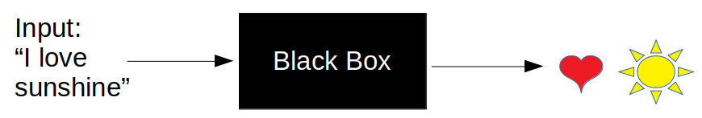
Black-box
Input
Outputs (Prediction)

Slide 4
Background:
Relevant Work
A Similar
Experiment
Their
Approach
Notes:
Relevant Work
Psychology: How users perceive emojis
Competition: In terms of this project
Sentiment Analysis
Texting: Emoji Prediction
Similar Experiment
Competition (exactly the same as our project; other than the fact that we will not do it in Spanish too)
Many different Approaches: The best F1 score is from a SVM (Support Vector Machine) Classifier with a Bag of N grams…
And also, a LSTM Networks.
- Uses F1: 35.99 Shows the precision, recall and accuracy as well.
- Their Base line is based from “FastText” which uses a negative log likelihood model

Slide 5
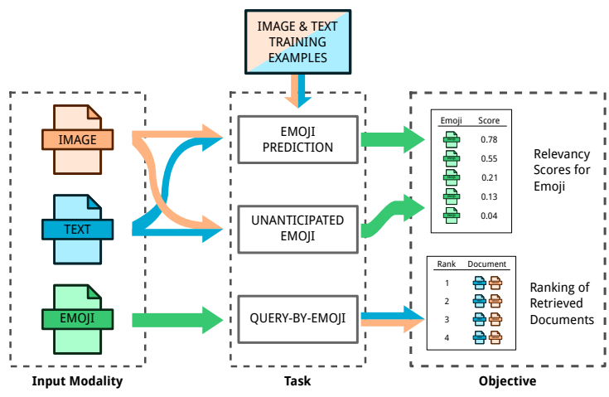
Similar Experiment (Pipeline)
Spencer Cappallo, Stacey Svetlichnaya, Pierre Garrigues, Thomas Mensink, andCees G. M. Snoek. 2018. The New Modality: Emoji Challenges in Prediction,Anticipation, and Retrieval. (2018)

Slide 6
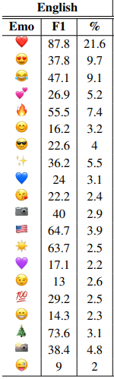
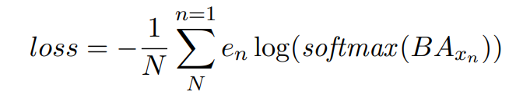
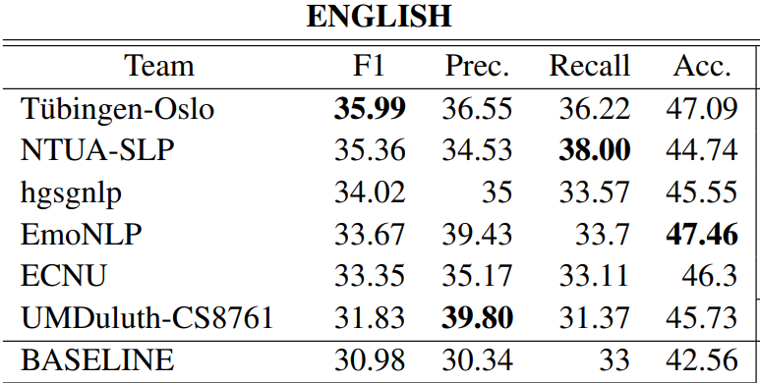
Competition: Scores
Spencer Cappallo, Stacey Svetlichnaya, Pierre Garrigues, Thomas Mensink, andCees G. M. Snoek. 2018. The New Modality: Emoji Challenges in Prediction,Anticipation, and Retrieval. (2018)

Slide 7
Methods
Data and Setup
Our High-level
Approach
Time-Line
Notes:
Data Setup:
Consisted of getting access to the Tweets from Twitter Developers API
File of the data to the tweet: Date, replying, posting, symbols, content… etc.
Approach:
Baseline: Naive Bayes Performance
Performance Measures/ Validation: F1 (Micro/Macro), recall, precision, accuracy… K-fold
Processing: Tokens, Stems, Lemmas, exclude Stopwords, Sentiment analysis to emojis
Other ML Algorithms such as KNN and SVM.

Slide 8
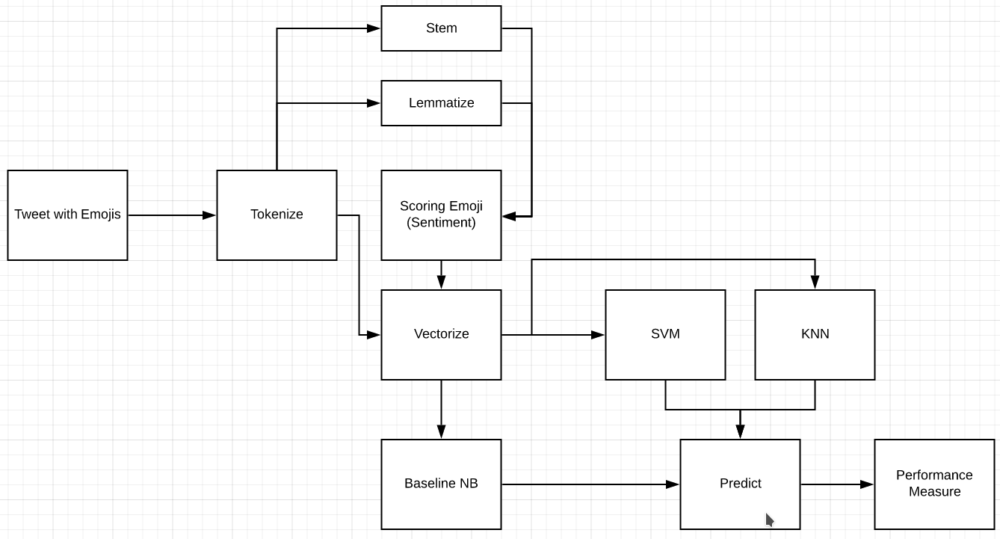
High-level Pipeline
Notes:
Tweets have: Dates , content, urls, hashtags, symbols, and booleans for “replying” and more.
Had to email the developers and be approved to use the tweets.
Ran a script that essentially holds the specific tweet but no content. This is used to create the actual data. (for both training and test)

Slide 9
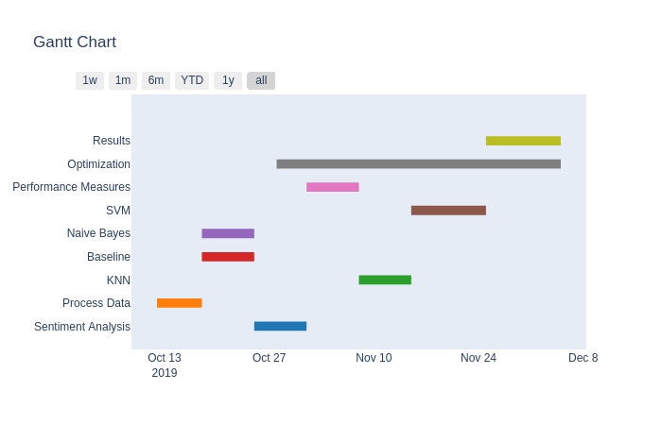
Timeline

Slide 10
Reference
Serkan Ayvaz Mohammed O. Shiha. 2017. The Effects of Emoji in SentimentAnalysis. (2017).
Nicholls M. Thiessen M. Kohler M. Keage H. Churches, O. 2014. Emoticons inmind: an event-related potential study. (2014)
Spencer Cappallo, Stacey Svetlichnaya, Pierre Garrigues, Thomas Mensink, andCees G. M. Snoek. 2018. The New Modality: Emoji Challenges in Prediction,Anticipation, and Retrieval. (2018)
Francesco Barbieri, Jose Camacho-Collados, Francesco Ronzano, Luis Espinosa-Anke, Miguel Ballesteros, Valerio Basile, Viviana Patti, and Horacio Saggion. 2018.SemEval-2018 Task 2: Multilingual Emoji Prediction. InProceedings of the 12thInternational Workshop on Semantic Evaluation (SemEval-2018). Association forComputational Linguistics, New Orleans, LA, United States

