Slide 1
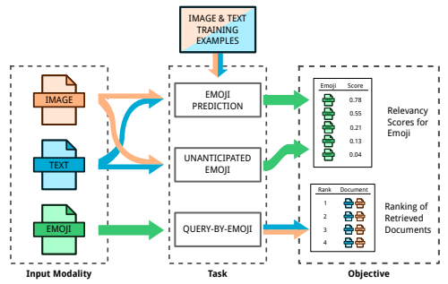
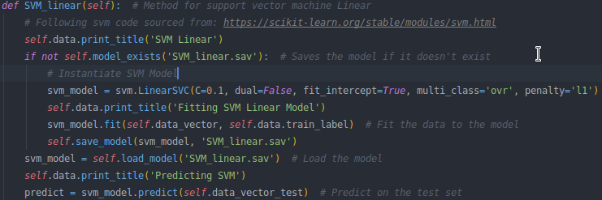
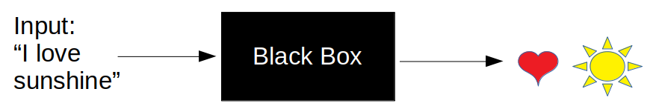

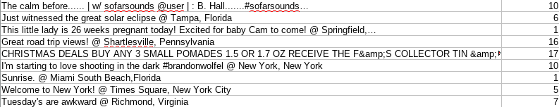
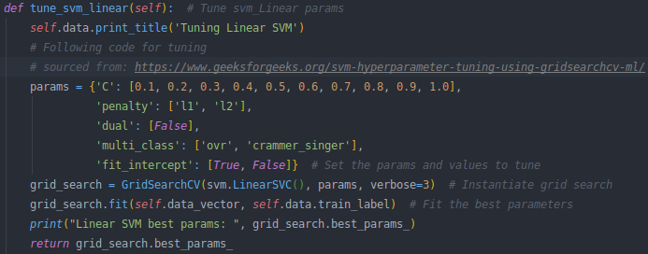
Emoji Prediction
Justin Keeling & Alex Harry
What Problem We Worked on?
High level Approach
High level Solution
The problem we worked on is Emoji prediction. By using natural language processing techniques alongside machine learning algorithms, we created models to predict emojis based off text. The application in which this can be used for is user experience regarding text-based applications.
Using the train data provided, which includes tweet content, labels, and ids, is pre-processed using natural language processing techniques. This converts the data into a vector which is then used to fit to a machine learning model.
As for the test data, the trained model makes emoji predictions for each example in the test data.
Scoring the model involves using the labels affiliated with the test data. Using accuracy, precision, recall, and f1, scores are created which are analyzed to see the model's performance.
The best performing model is the linear SVM. This model includes lemmatizing, sentiment analysis and removing stop words.
A similar pipeline to our problem. Source: Fig. 2 from: Spencer Cappallo, Stacey Svetlichnaya, Pierre Garrigues, Thomas Mensink, and
Cees G. M. Snoek. 2018. The New Modality: Emoji Challenges in Prediction,
Anticipation, and Retrieval. (2018).
Data used
Baseline, Preprocessing & Models used
Results and Discussion
The data provided to us is from a social media platform, more specifically Twitter. The process in which the data is received requires approval from Twitter Developers. Once the approval process is finished, the scripts provided earlier are to be run in which a file containing the data is created. This results in 291,021 tweets for training and 50,000 for testing. The data gathered from twitter contains the actual text from the tweet, and two other files are also created which include the emoji labels (which are numerical values), and the text ids.
The baseline we use to compare other models against is Naïve Bayes without using any preprocessing. Naïve Bayes is a basic model within machine learning is the primary reason to why it is chosen to be our baseline.
Preprocessing techniques such as lemmatizing, sentiment analysis and ‘English stop words’, were used in order to find the best model.
Using variations of the preprocessing techniques mentioned above, multiple machine learning models are implemented in search of the best performing include: K nearest neighbors, Naïve Bayes, linear support vector machine (SVM). Parameters were tuned using sklearn's Grid Search.
The linear support vector machine provided the top performing results with an accuracy of 34% and a F1 score of 0.20916. The K-Nearest neighbor algorithm provided the the lowest accuracy score and a similar recall and F1 score of Naïve Bayes.
The intuition to be gained from this is that we can accurately predict emoji's from analyzing tweets approximately 34% of the time. However, it may not be ready to deploy to a real-life situation. It may be possible to improve these results with the utilization of more advanced techniques in language processing.

