Slide 1

PHOTON
Indian Institute of Technology Roorkee
Department of Computer Science & Engineering · Computer Networks (CSC-303)
Live Photo Sync for Groups over Unreliable Mobile Networks
A verified, resumable and ephemeral photo-sharing system on HTTP/3, WebSocket and Redis Streams
Group No. 13
Akshat Srivastava · Shubham Singla · Yash Jain · Pushkar Jain · Aditya Yadav · Divyanshu Meena
Submitted to Prof. Sandeep Kumar · 3 November, 2026

Slide 2




Every group photo is stuck on one phone
Sharing is manual and late
Someone has to pick photos and send them after the event, so most are never shared.
PROBLEM STATEMENT
How can phones on unreliable, changing networks share every photo of a live session with every member automatically, so that each photo is uploaded once, verified before anyone is told, delivered without gaps or duplicates, and deleted from the server within a bounded time?
Cloud albums keep everything
Shared albums store photos indefinitely, recompress them or tie the group to one vendor.
Mobile networks break uploads
Handovers, dead zones and suspended apps restart big uploads and drop notifications.
A client's hash is only a claim
If the server trusts it, one member can upload other bytes and hide someone's real photo.

Slide 3



PHOTON: join, shoot, and everyone has the photo
1. Join
2. Shoot
3. Receive
Members join a live session with an 8-character code, an invite link or a QR code.
Any camera app. PHOTON notices the new photo in the background and uploads it once.
Every member gets a thumbnail at once, then the preview, then the original in the gallery.
~2 s
1 upload
3,060
30 min
capture to stored on a real phone, app in the background
per photo per session: SHA-256 content address, verified by the server
of 3,060 events delivered to 153 open sockets, none lost
server copy lifetime, then deleted by two sweepers

Slide 4








Computer networks concepts at work
HTTP/3 and QUIC
Alt-Svc fallback
WebSocket
TLS 1.3 everywhere
Photo bytes over UDP 443: no head-of-line blocking, survives Wi-Fi to LTE
Clients drop to HTTP/2 over TCP when a network blocks UDP
Full-duplex event channel, binary frames, close codes 4001 to 4410
Edge, service to service, and Redis; JWT in the first frame, not the URL
OAuth 2.0 + PKCE
Selective repeat
Pub/sub over a log
Port forwarding, LAN
Google and GitHub sign-in without a secret on the phone; EdDSA JWTs
1 MiB chunks with CRC32C; only lost chunks are sent again
Redis Streams: one cursor for backlog and live events
adb reverse over USB, or the laptop's LAN address over Wi-Fi

Slide 5
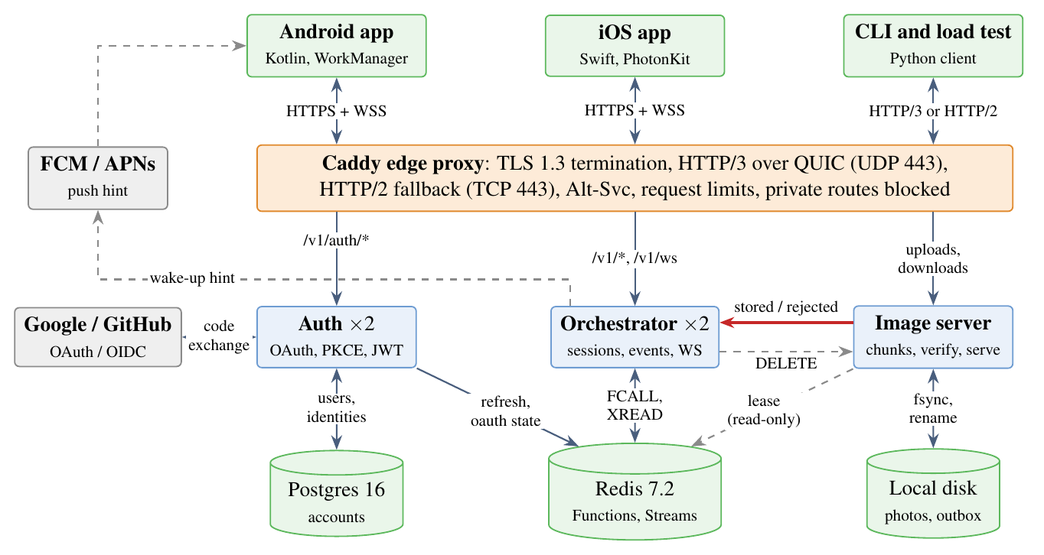
Architecture: one writer for each kind of state
Orchestrator owns sessions, photo status and events; never touches bytes
Image server owns the bytes and their deletion; reports only to the orchestrator (red arrow)
Auth issues JWTs; other services verify them locally
Caddy edge terminates TLS 1.3, serves HTTP/3 and HTTP/2
Redis for short-lived state, Postgres for accounts

Slide 6
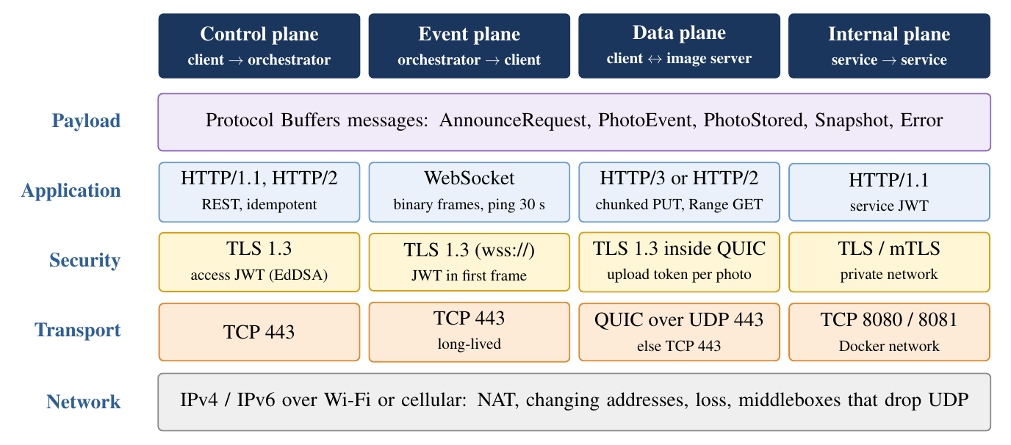
Four planes, four protocol choices
Why not one raw TCP protocol? HTTP already gives framing, status codes, auth headers and proxy support, and standard HTTP/3 clients fall back to HTTP/2 on their own. Each plane uses the protocol that suits its traffic.

Slide 7
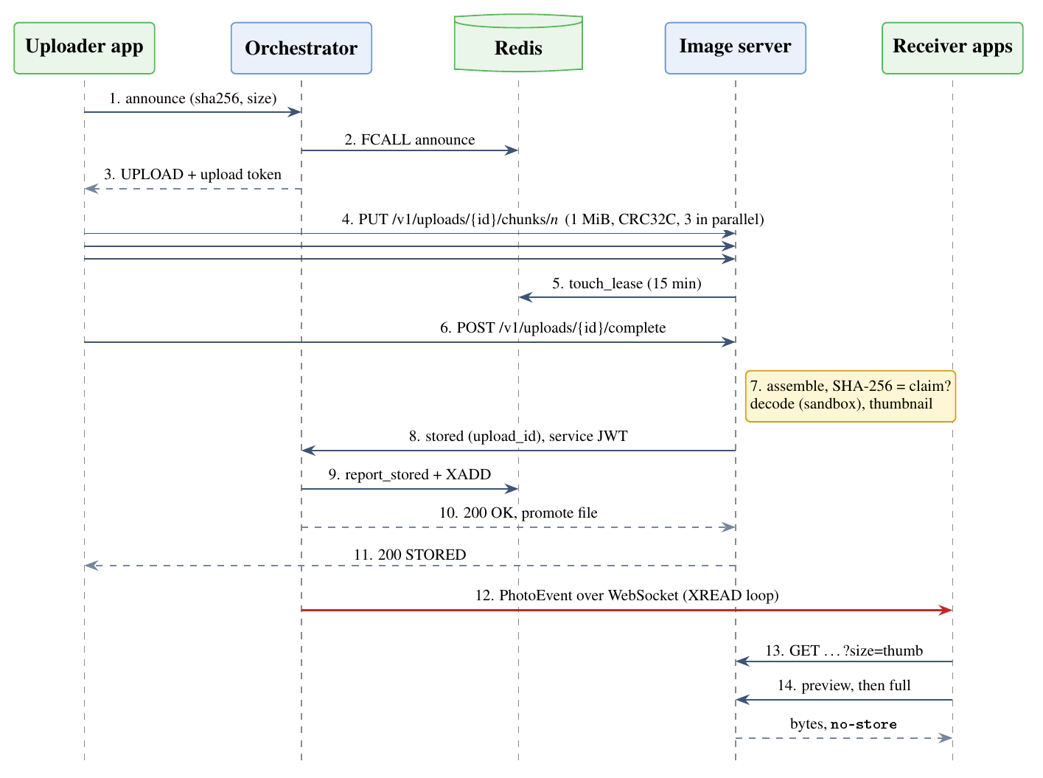
Life of a photo
Control (1 to 3)
Announce the SHA-256; one atomic Lua call answers UPLOAD, ALREADY_UPLOADED or IN_PROGRESS
Data (4 to 7)
Chunks with CRC32C, three in parallel; complete; the server recomputes SHA-256 and decodes in a sandbox
Internal (8 to 10)
Fenced stored report; status and event change in one step; file promoted
Event (12 to 14)
WebSocket frame to every member; thumbnail, then preview, then original

Slide 8



What is new: six ideas
N1 Verify before announce
N2 Fencing tokens
N3 One read loop
The server recomputes SHA-256; a photo exists for others only after that check
Every report names its upload_id; late messages from stalled uploads are rejected
Backlog and live events from one XREAD loop, so no event falls in a gap
N4 Transport-aware data plane
N5 Ephemeral by design
N6 Background capture
HTTP/3 with fallback, CRC32C chunks, chunk size from measured throughput
No shareable links; exact 30-minute expiry; two independent sweepers
Foreground service + content-URI trigger; five checks stop echo uploads

Slide 9
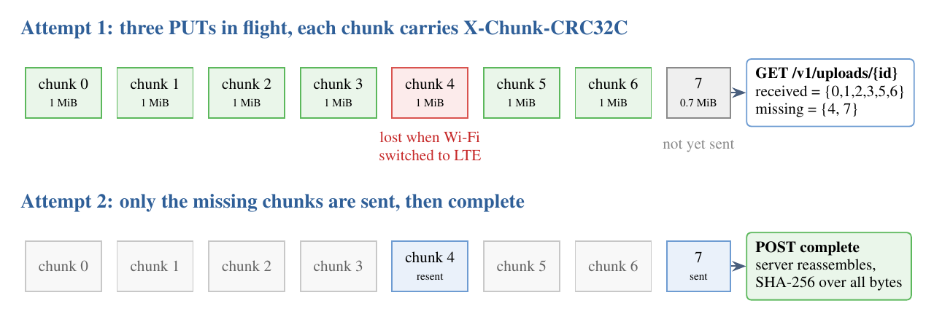
Data plane: selective repeat over HTTP/3
Chunk size from measured throughput
c = clamp(B̂ × 2 s, 256 KiB, 8 MiB), at least S / 4096
Retry with exponential backoff and jitter
dₖ = ½ sₖ + U(0, ½ sₖ), sₖ = min(60 s, 1 s · 2ᵏ)
QUIC: a lost packet stalls one stream, not all; the connection ID survives an address change
Alt-Svc: HTTP/2 over TCP when UDP is blocked, chosen by the client
Idempotent PUT per chunk: a repeat overwrites itself; the server's bitmap says what is missing

Slide 10
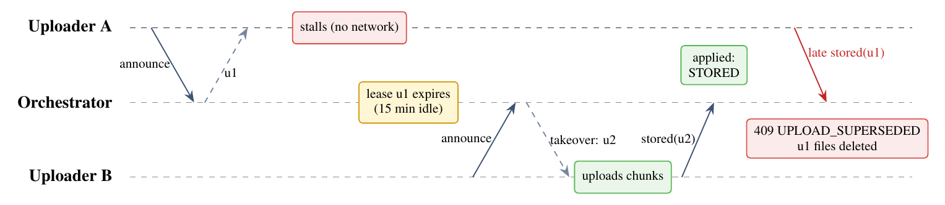
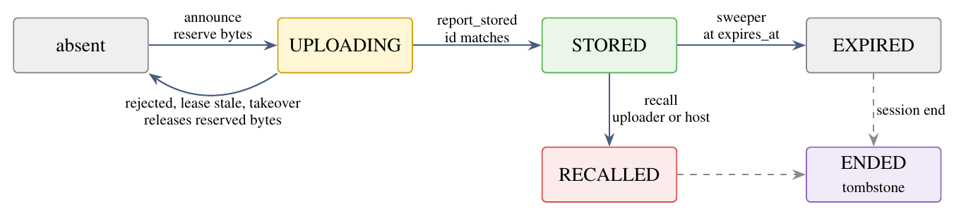
Consistency: atomic announce and fencing tokens
Announce is one Redis function: session ACTIVE? member? live-upload limits? quota? then HSETNX
Two members, same photo, same instant: one gets UPLOAD, the other IN_PROGRESS
Quota invariant: stored + reserved ≤ 1 GB per session; bytes released exactly once
Every report names its upload_id: a stale one gets 409 UPLOAD_SUPERSEDED and only its own files are deleted

Slide 11
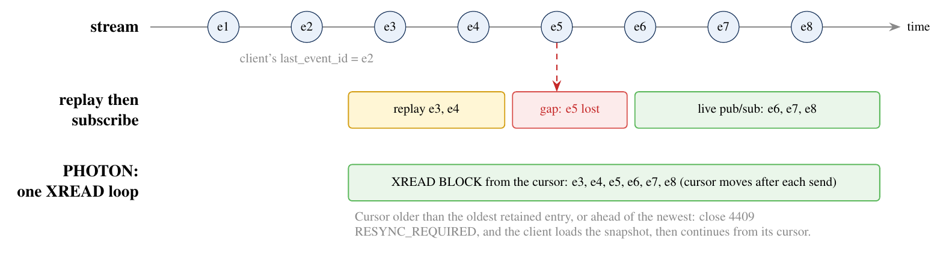
Event plane: no gaps, no duplicates
One XREAD BLOCK loop per socket, starting after the client's cursor
Cursor outside the retained range: close 4409, load the snapshot, continue
At-least-once + dedupe by event id and hash = exactly-once effect
Push (FCM, APNs) is only a hint that triggers the same catch-up
1,200
2.6 ms
events, once and in order, across random reconnects
stream to socket, p50, 10-member session

Slide 12
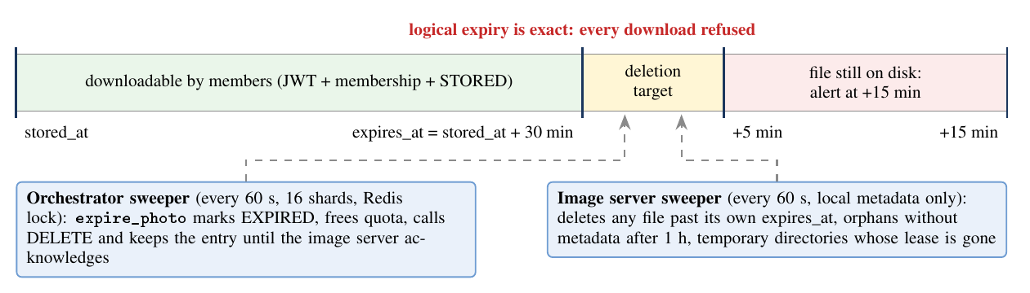



Security and the 30-minute lifetime
TLS 1.3 on every hop, Redis included
Server recomputes SHA-256; 3 mismatches block uploads
PKCE, single-use state and nonce, exact redirect URIs
Images decoded in a sandboxed process with CPU and memory limits
Refresh tokens rotate; reuse after 30 s revokes the family
No links: every download re-checks JWT, membership, status and expiry

Slide 13
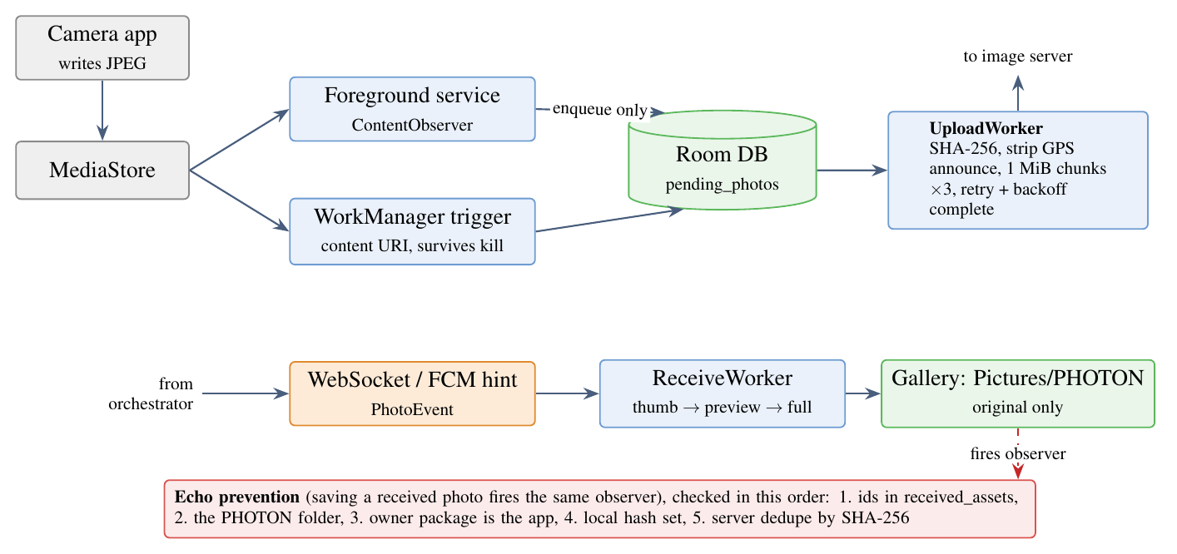
Android: syncing in the background
Motorola edge 70 fusion, Android 16
2.1 s
test photo stored, PHOTON in the background
1.8 s
after the app's process was killed
14 s
camera app photo, including the camera finishing its write
Android stops ordinary background services, so a foreground service watches the gallery and a WorkManager content-URI trigger fires even after the process is killed.

Slide 14
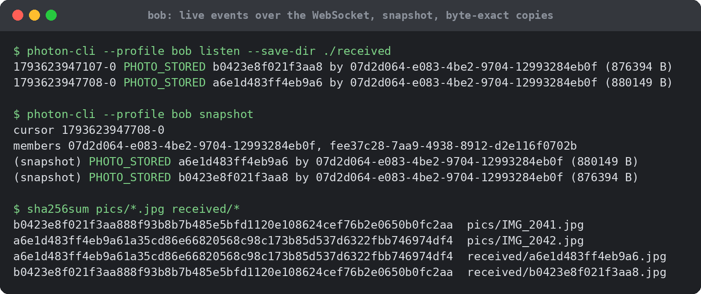
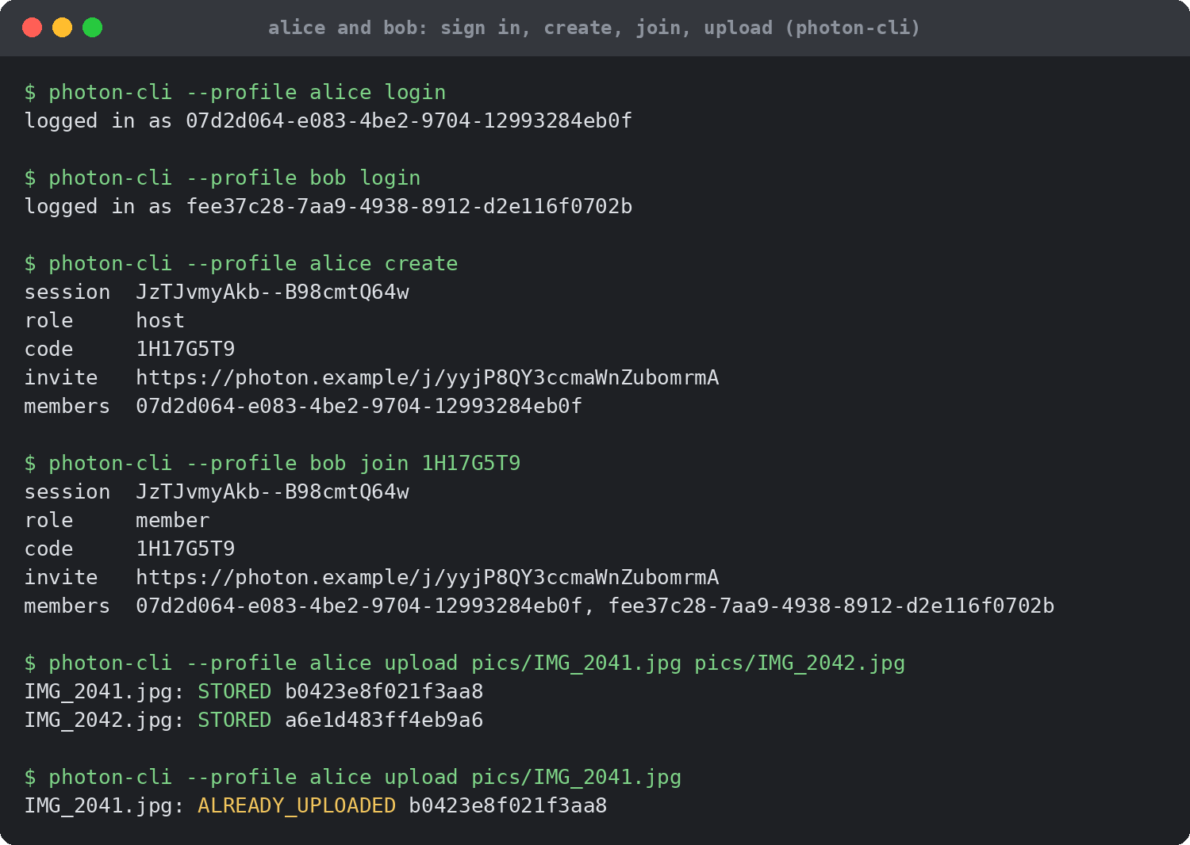
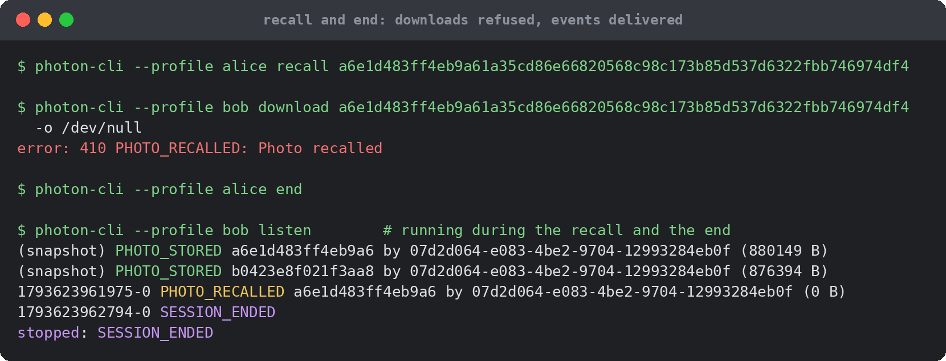
Demo run: two users, one session
Real output of the development stack: Alice uploads two photos, a repeat is ALREADY_UPLOADED, Bob's copies have the same SHA-256, and a recalled photo answers 410.

Slide 15
Testing, and the bugs only measurement found
155
Symptom | Cause | Fix
Phone's WebSocket closed with 1011 every few seconds | Redis client's 5 s socket timeout cut XREAD BLOCK 15000 | No socket timeout on the blocking pool, TCP keepalive
150 sockets at once: 50 closed | Default pool fails the 101st concurrent command | Blocking pools of 500 and 200; callers wait
Phone on Wi-Fi could not reach the server | App built for 127.0.0.1, which is the phone itself | Build for the laptop's LAN address
Uploads only while the app was open | Background service stopped by Android | Foreground service + content-URI trigger
server tests: unit, integration, end to end, against real Redis and Postgres
135 + 90
Android unit tests and iOS PhotonKit tests
24k lines
Python, Lua, Kotlin, Swift and deployment config

Slide 16
Performance on one laptop
~700 req/s
0.08 ms
24.8 / s
159 ms
announce saturates; latency then grows as Little's law predicts
one atomic state transition inside Redis (p50)
photos stored per second with 8 members uploading at once
upload start to the last of 10 members

Slide 17
Comparison with existing tools
Feature | PHOTON | Google Photos | iCloud SPL | AirDrop | Quick Share | WhatsApp
Shares new camera photos automatically | ✓ | Partial | ✓ | ✗ | ✗ | ✗
Android and iOS in one group | ✓ | ✓ | ✗ | ✗ | ✗ | ✓
Members need not be nearby | ✓ | ✓ | ✓ | ✗ | ✗ | ✓
No long-lived server copy | ✓ | ✗ | ✗ | ✓ | ✓ | Partial
Original quality by default | ✓ | Partial | ✓ | ✓ | ✓ | ✗
Thumbnail first, original later | ✓ | ✓ | ✓ | ✗ | ✗ | ✓
Uploader can recall a photo | ✓ | ✓ | ✓ | ✗ | ✗ | ✓
Time-boxed group, code or QR | ✓ | ✗ | ✗ | ✗ | ✗ | ✗
Open source, self-hostable | ✓ | ✗ | ✗ | ✗ | ✗ | ✗
Score / 9 | 9 | 5 | 5 | 2 | 2 | 4.5
Based on each product's documented default behaviour. Existing tools are ahead on end-to-end encryption, long-term albums, video and offline transfer.

Slide 18
Limitations and future work
Limitations
Future work
No end-to-end encryption: the server can read photos during their 30 minutes
HTTP/3 is configured at the edge but was not measured on a phone
iOS core library is built and tested; the app needs Xcode to compile
Benchmarks ran on one laptop; Docker deployment written, not run
Per-session keys for end-to-end encryption; thumbnails made on the phone
Measure HTTP/3 against HTTP/2 across a real Wi-Fi to LTE handover
Peer-to-peer delivery on the same Wi-Fi (WebRTC), server for verification
Object storage and Redis Cluster; the keys already carry {sid} hash tags
Video and Live Photos

Slide 19
Team and contributions
Name | Enroll. No. | Email | Contribution
Akshat Srivastava | 24114010 | akshat_s@cs.iitr.ac.in | System design; Redis Functions library (sessions, announce, fencing, quota); orchestrator service
Shubham Singla | 24114093 | shubham_s@cs.iitr.ac.in | Image server: resumable chunked upload with CRC32C, SHA-256 verification, sandboxed decoder, outbox
Yash Jain | 24114108 | yash_j2@cs.iitr.ac.in | Network edge (Caddy, TLS 1.3, HTTP/3), WebSocket event plane, Redis Streams catch-up and resync
Pushkar Jain | 24114071 | pushkar_j@cs.iitr.ac.in | Auth service: OAuth 2.0 with PKCE (Google, GitHub), EdDSA JWTs, refresh rotation; Redis ACLs
Aditya Yadav | 24114007 | aditya_y@cs.iitr.ac.in | Android app (Kotlin): UI, MediaStore observer, foreground service, WorkManager upload, receive pipeline
Divyanshu Meena | 24114034 | divyanshu_m@cs.iitr.ac.in | iOS PhotonKit, push (FCM/APNs), Docker deployment, tests and benchmarks, project report and slides

Slide 20
Thank you
Questions?
Every hard part of a “simple” sharing feature was the network between the phones. Each was solved with a standard mechanism: QUIC, selective retransmission, idempotent requests, leases, fencing tokens and a durable event log.
Group 13 · IIT Roorkee · Computer Networks (CSC-303)

