Slide 1
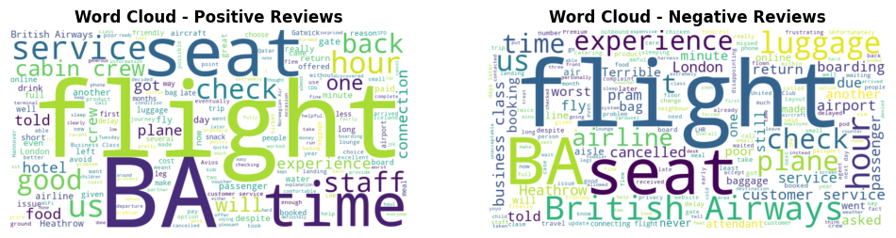
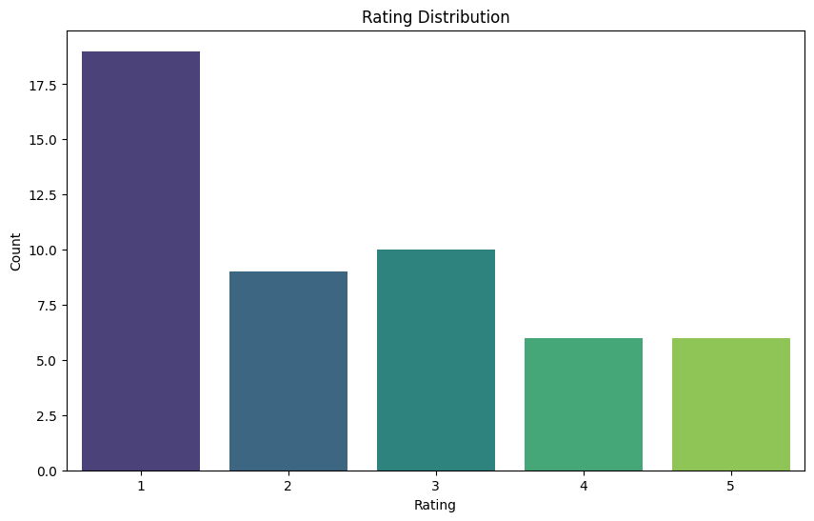
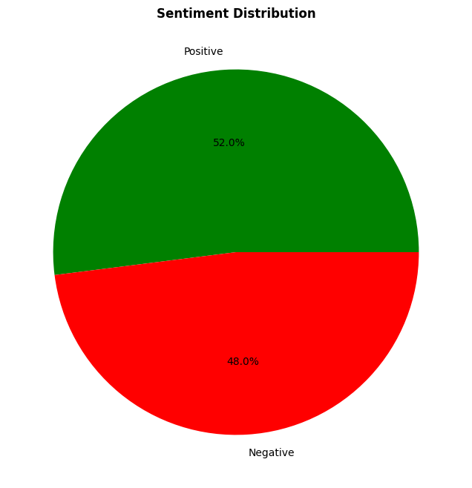
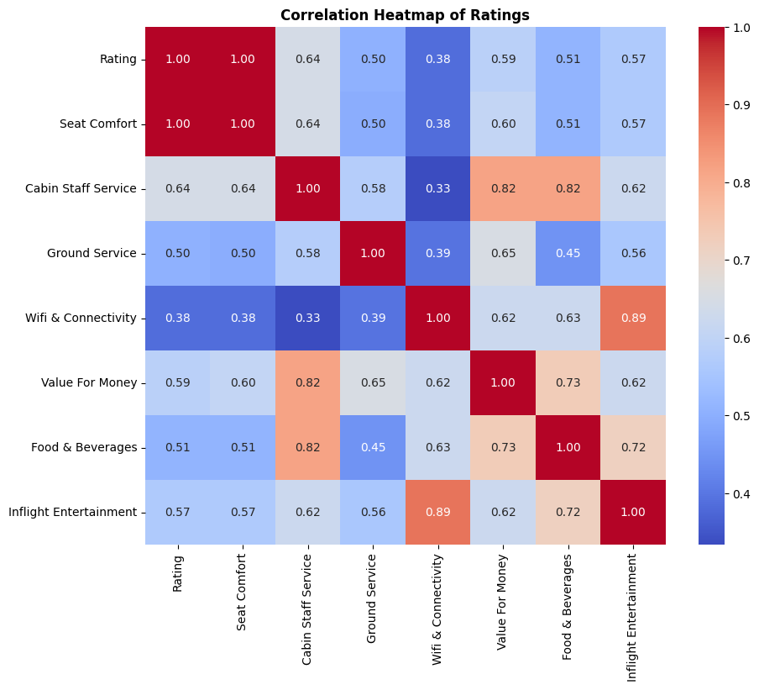
British Airways Customer Feedback Analysis Overview of Customer Satisfaction
Overall Rating
48%
Sentiments
Negative
52%
Sentiments
Positive
26%
Recommended
No
74%
Recommended
Yes
Sentiments Distribution

Slide 2
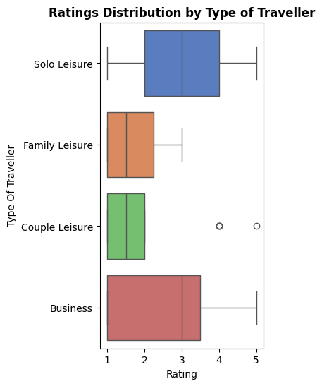
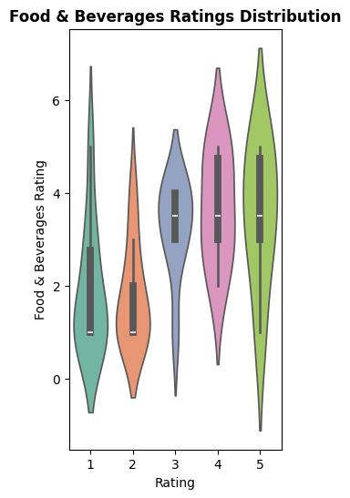
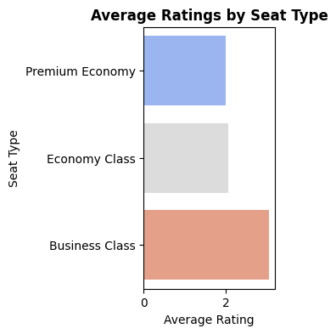
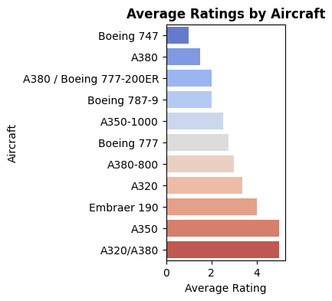
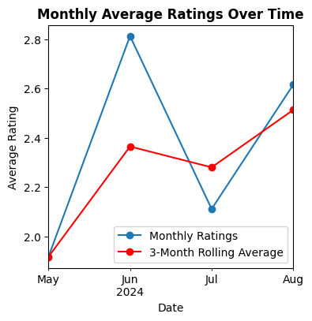
Detailed Analysis and Areas for Improvement
Overall Average Rating: 2.42
Average Seat Comfort Rating: 2.48
Average Cabin Staff Service Rating: 2.87
Average Food & Beverages Rating: 2.67
Average Ground Service Rating: 2.14
Average Wifi & Connectivity Rating: 1.83
Average Value For Money Rating: 2.10
Average Inflight Entertainment Rating: 2.73

