Slide 1

Breast cancer classification using FCNN
Master's Program in Mechatronics
Department of Automation
Name : Kazi Abdul Jamil
Academic Year : 2024-25
Matriculation No. : 550131

Slide 2
Content
Motivation
Data Representation
Preprocessing
Model Architecture
Training
Evaluation
Discussion
Limitation & Future Work
Conclusions

Slide 3
Title: Breast cancer classification using FCNN
Motivation :
Breast cancer is one of the most common cancer in women.
Early and accurate detection is crucial to improve survival
Malignant
Classify
Benign
Why it is important?
Early diagnosis, prevent over treatment or under treatment
Objective : Build a neural network model that classifies tumors based on the features extracted.
Dataset resource : WDBC Dataset from UCI ML repository (Link: )

Slide 4
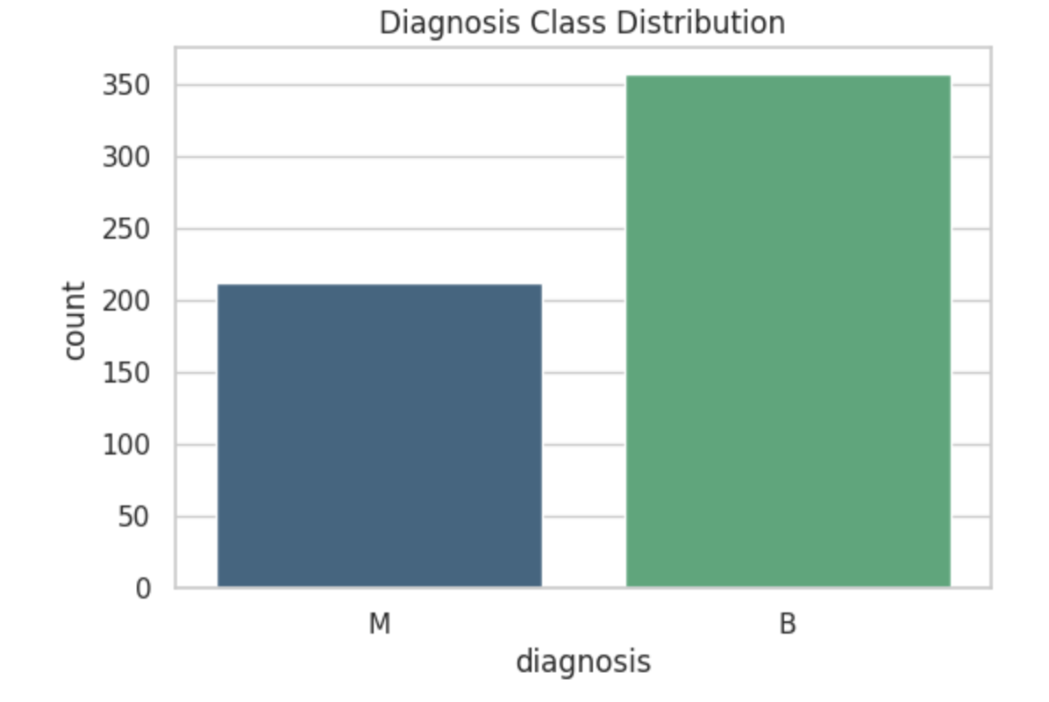
Data Representation :
Wisconsin Diagnostic Breast Cancer Dataset consist of 569 samples (in rows) and 30 Features (In columns)
Features
1 | 2 | .. | 30
1 | - | - | -
…. | - | - | -
569 | - | - | -
Diagnosis label:
Malignant(M) = 1
Samples
Benign(B) = 0

Slide 5
Preprocessing:
Dropped the ID colum
Encoded diagnosis using LabelEncoder
Scaled features using StandardScaler
Train – test split
Validation split from train
Balance the distribution

Slide 6
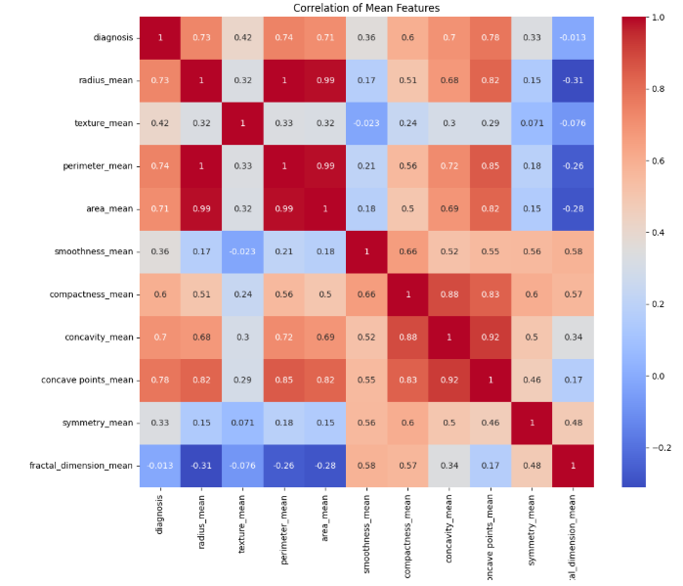
Correlation of mean Features (M=1 , B=0)

Slide 7
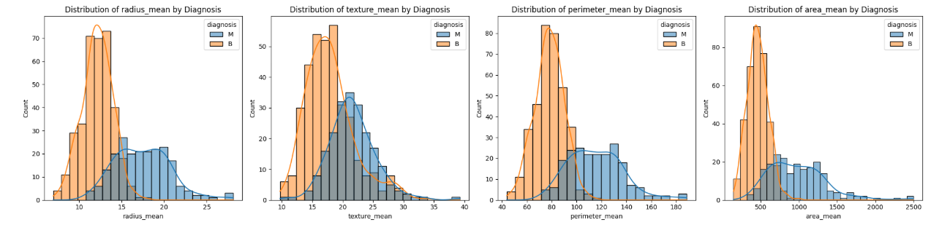
Distribution of texture_mean by Diagnosis
Distribution of area_mean by Diagnosis
Distribution of radius_mean by Diagnosis
Distribution of perimeter_mean by Diagnosis

Slide 8
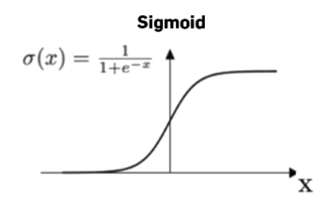
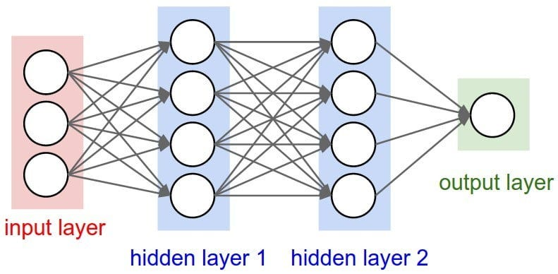
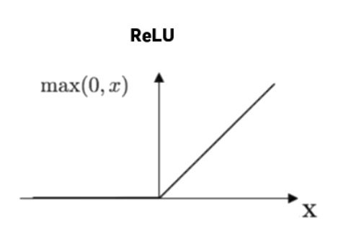
Model Architecture :
Dropout=30%
Dropout=20%
Dense layer 1
Dense layer 2
ReLU
ReLU
Sigmoid
Loss Function: Binary Cross-entropy
Optimizer: Adam
Evaluation Matric : Accuracy
Activation Function

Slide 9
Training Setup:
Multiple Seeds
Robust, Reproducable, avoids randomness bias
K-Fold Cross validation
Accuracy
Use to average out randomness in training
Reliable, less overfitting
Best suits for small dataset and more stable results
Simple clear metric
Classes are balanced, focused on quick comparision

Slide 10
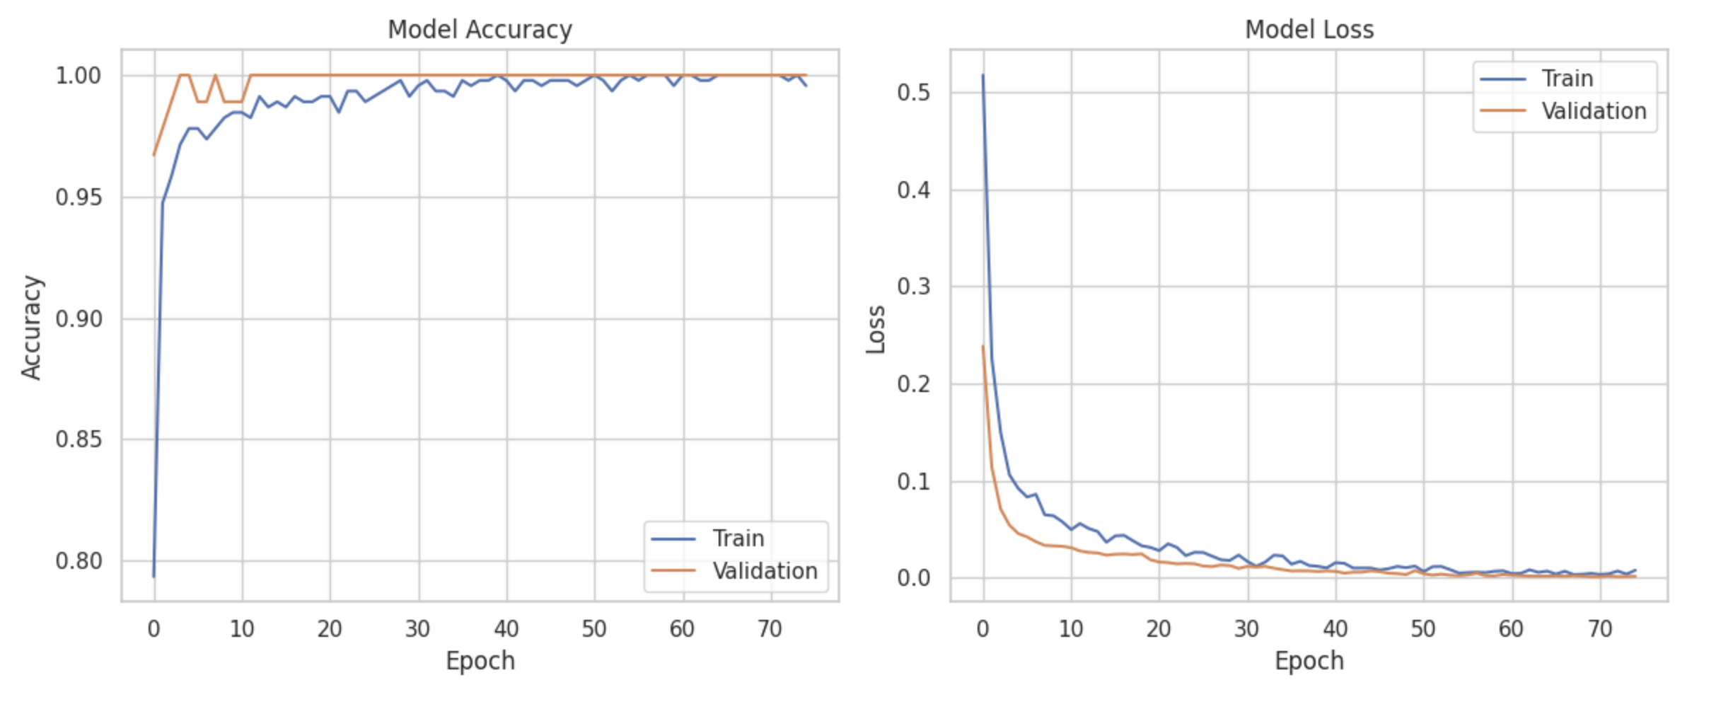
Training :
Model | Type | Category | Strength
Logistic Regression | Linear Classifier | Classical ML | Simple, interpretable baseline
Random Forest | Ensemble of decision tree | Classical ML | Reduce overfitting, robust
Gradient Boosting | Ensemble(Boosting) | Classical ML | High accuracy with tunning
FCNN | Neural Network | Deep Learning | Flexible, good for complex data
Evaluation:

Slide 11
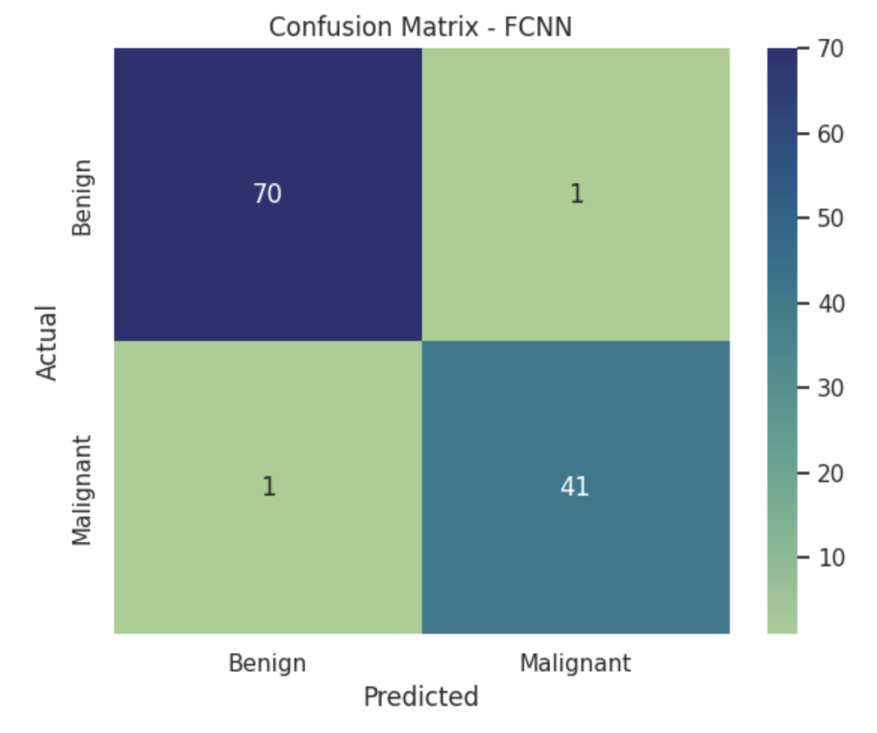
Evaluation:

Slide 12
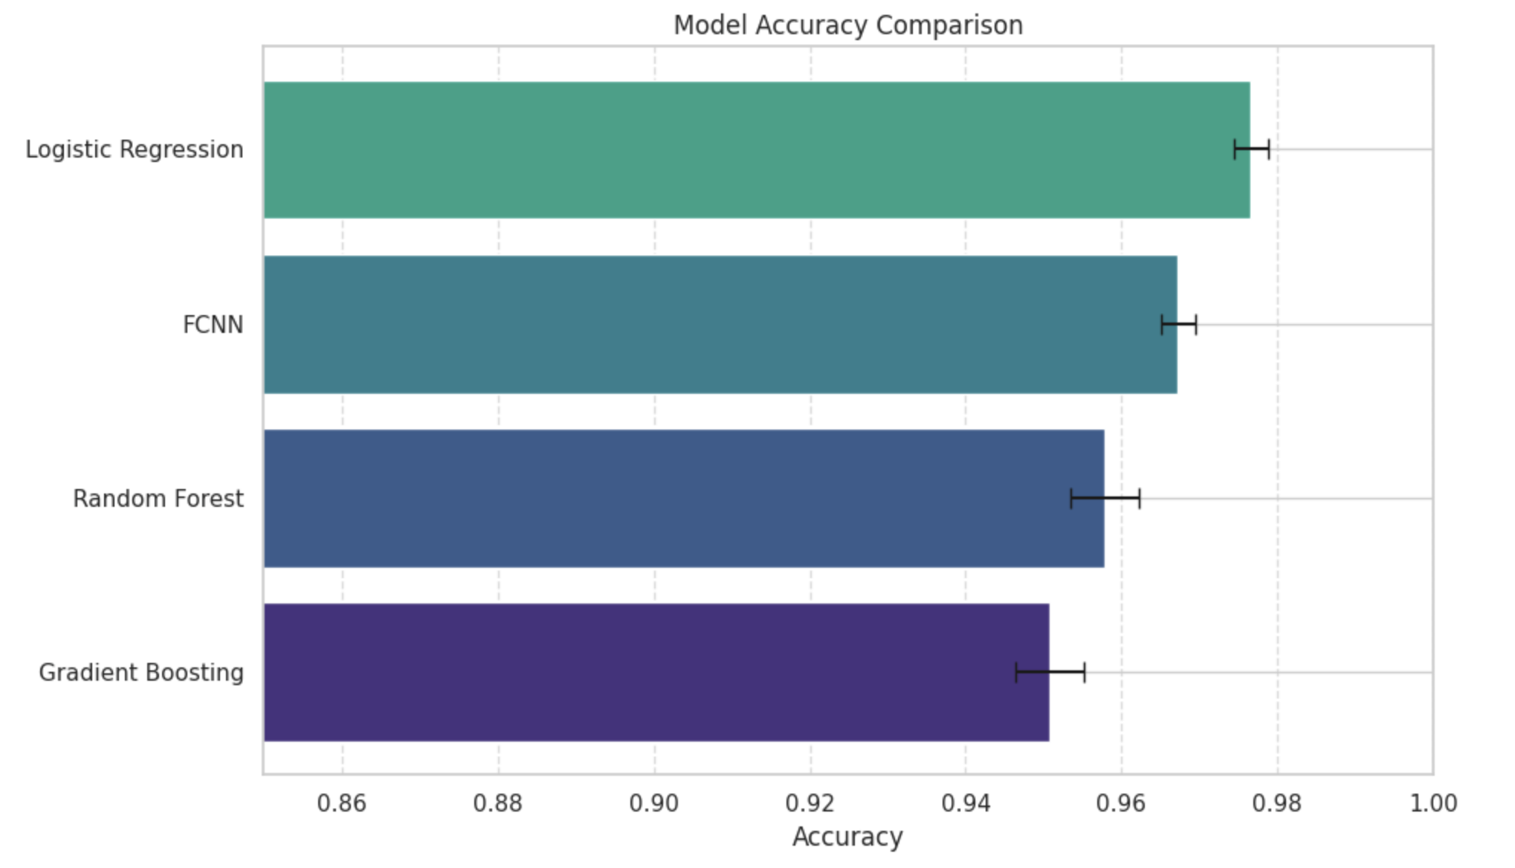
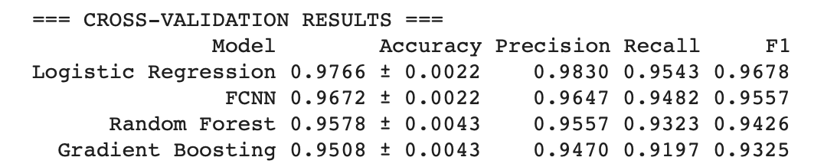
Results :

Slide 13
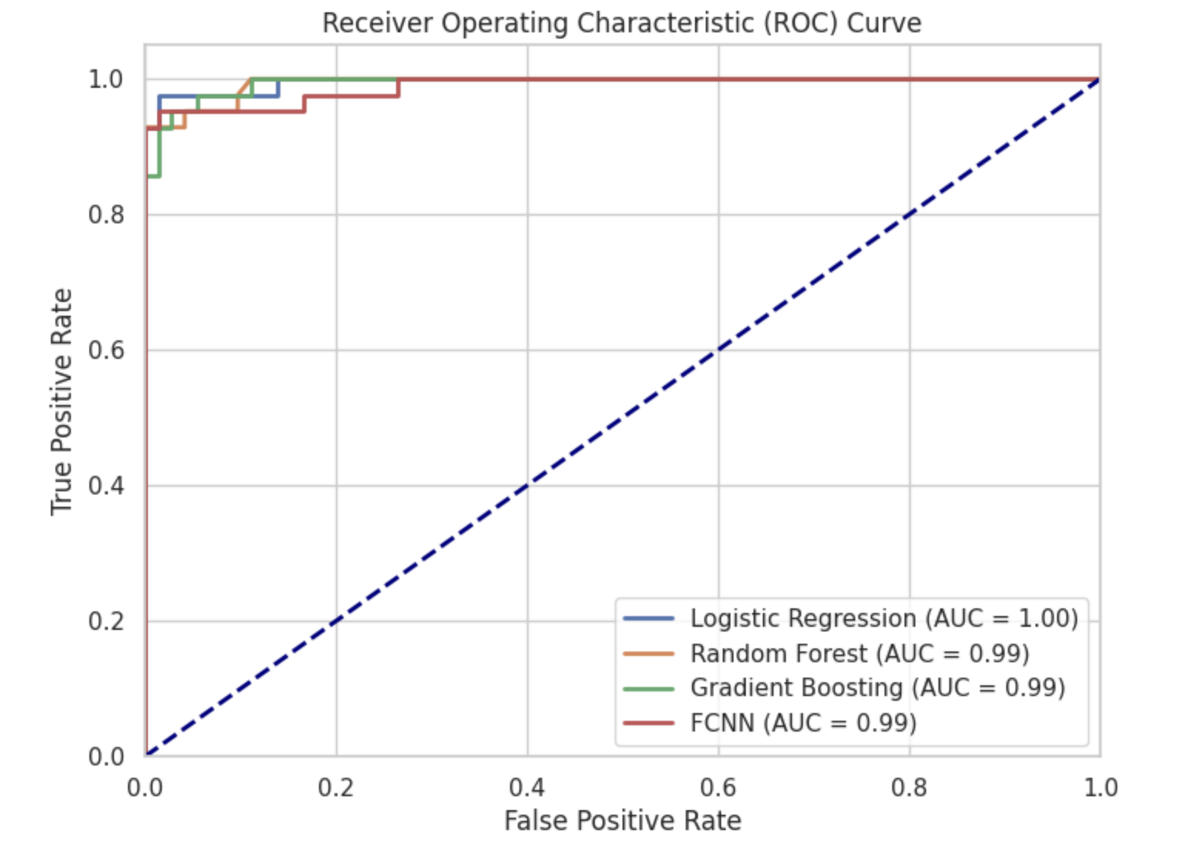

Slide 14
Limitation Future Work
Dataset Size
Limited number of samples may restrict deep learning model performance (e.g., FCNN).
Binary Classification Only
Models are tailored to benign vs. malignant only — not applicable to multi-class scenarios.
Feature Simplicity
Dataset features are all numeric and pre-extracted — lacks raw image or time-series data.
Basic Hyperparameter Tuning
Classical models used mostly default settings; tuning could improve results.
No External Validation
Evaluation only on internal CV folds — no test on unseen real-world data.
Expand Dataset
Use larger, more diverse datasets to improve generalization.
Hyperparameter Optimization
Apply grid search or Bayesian optimization for all models.
Model Explainability
Use SHAP or LIME to explain predictions, especially in medical contexts.
Multi-Class or Multi-Label Models
Extend to more complex classification problems if labels allow.
Incorporate Deep Learning on Raw Data
Apply CNNs on raw histopathology images for end-to-end learning.

Slide 15
Conclusion :
Logistic Regression achieved the best overall performance – simple, effective, and highly accurate.
FCNN showed strong results, especially in terms of recall and flexibility for nonlinear data.
Ensemble models were consistent but not significantly better than simpler models in this dataset.
Model selection should be task-specific, balancing accuracy, interpretability, and complexity.
This study confirms that well-preprocessed data and simple models can deliver state-of-the-art performance in binary classification.

Slide 16
Question & Answer

Slide 17
Discussion:
Logistic Regression
Achieved the highest accuracy: 97.66%
Lowest standard deviation (±0.22%) — highly stable
Suggests that the data is nearly linearly separable
Outperformed complex models despite being simple
Excellent choice as a baseline classifier
Fully Connected Neural Network (FCNN)
Second-highest accuracy: 96.72%
Handles non-linear relationships effectively
Performs well even without large dataset size
Promising for more complex future expansions
Random Forest
Accuracy: 95.78%
Stable results across cross-validation (±0.43%)
Robust to overfitting, handles feature interactions
Could benefit from additional tuning or feature selection
Useful for feature importance analysis
Gradient Boosting
Accuracy: 95.08%
Similar variability to FCNN (±0.43%)
Sensitive to hyperparameters Underperformed compared to simpler models
Requires tuning to fully exploit its potential

