Slide 1
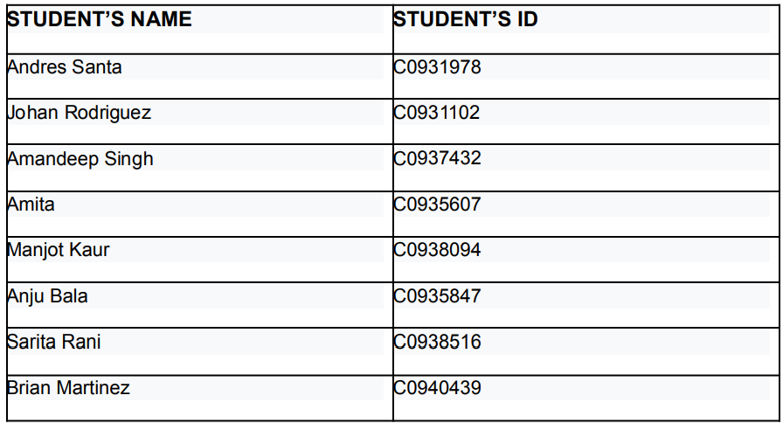
AI in Predictive Toxicology

Slide 2

Project Overview
Objective:
Predict chemical toxicity to improve early-stage drug development and reduce resource costs.
Significance:
Supports pharmaceutical innovation by identifying toxic compounds earlier.
Scope:
Two predictive models for chemical toxicity:
  Model 1: Toxic vs. Non-Toxic classification.
  Model 2: Toxicity Level Prediction.

Slide 3
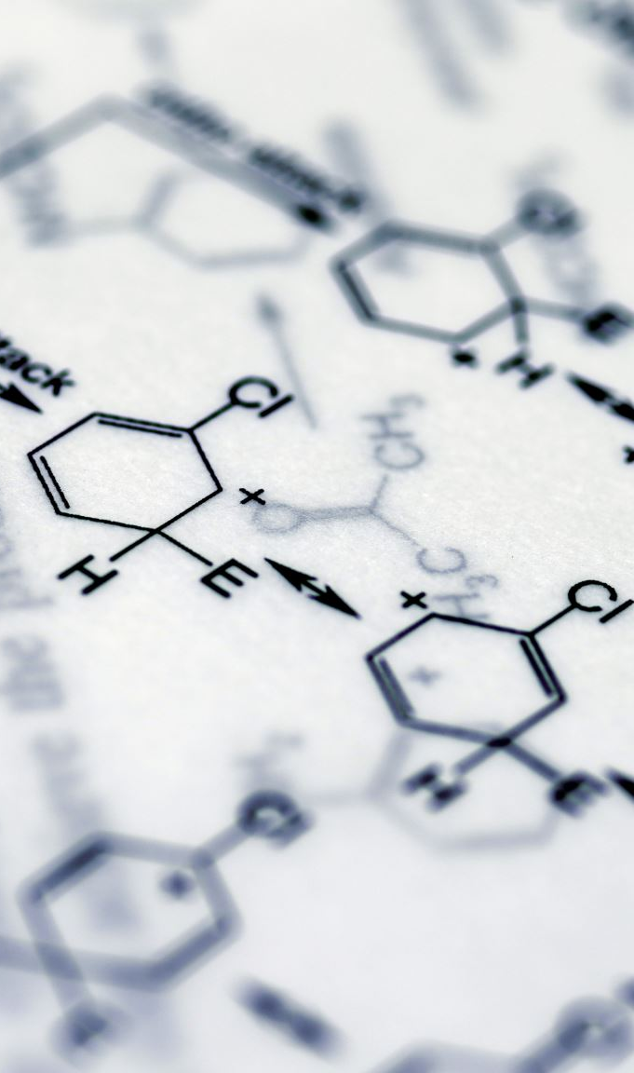
Data and Methodology
Dataset:
PubChem Compound Dataset with features like molecular weight, polar surface area, and hydrogen bond donors.
Steps:
Data Preprocessing:
  Handled missing values with imputation.
  Dropped irrelevant features (e.g., synonyms, annotations).
Feature Engineering:
  Label encoding for categorical variables.
  Feature selection based on correlation analysis.
Model Training:
  Random Forest for classification and regression tasks.
  Evaluated using train-test split (80%-20%).

Slide 4
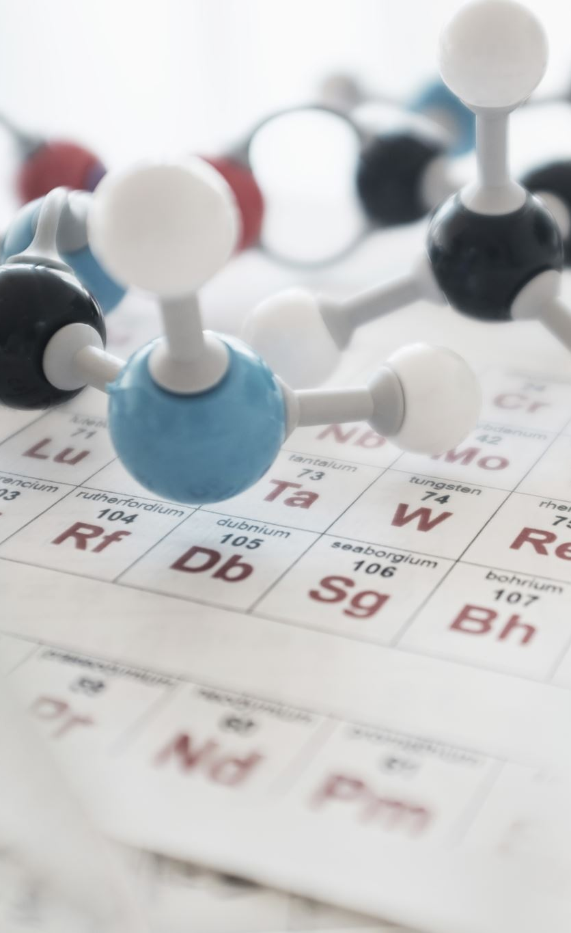
Model 1 - Binary Classification
Goal:
Classify chemicals as toxic or non-toxic.
Key Features:
Molecular weight, complexity, polar area, xlogP, etc.
Results:
  Accuracy: 91.9%
  Precision (Toxic): 97.3%
  Precision (Non-Toxic): 68.7%
Insights:
  High precision for toxic chemicals.
  Performance challenges with non-toxic due to class imbalance.

Slide 5
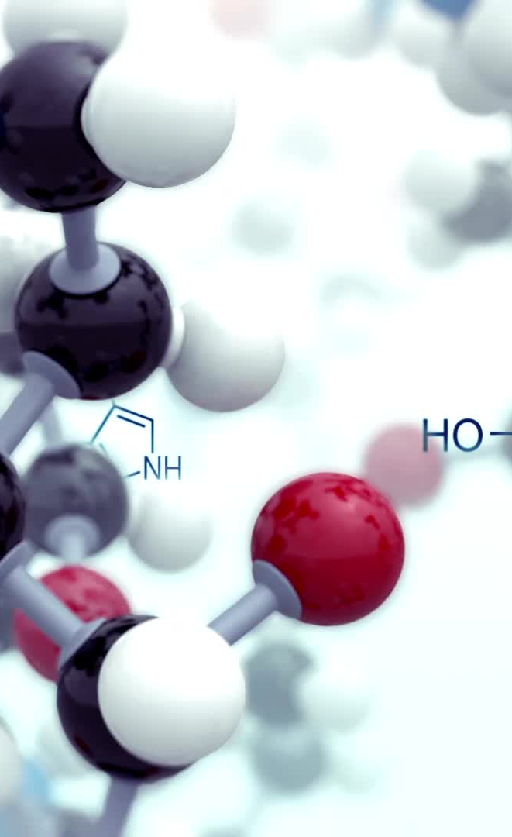
Model 2 - Toxicity Level Prediction
Goal:
Predict toxicity levels of compounds.
Key Features:
Similar to Model 1.
Results:
  Mean Absolute Error (MAE): 0.006
  R² Score: 99.9% (on validation data)
Insights:
Accurate for toxicity level prediction but needs refinement for specific toxicity thresholds.

Slide 6
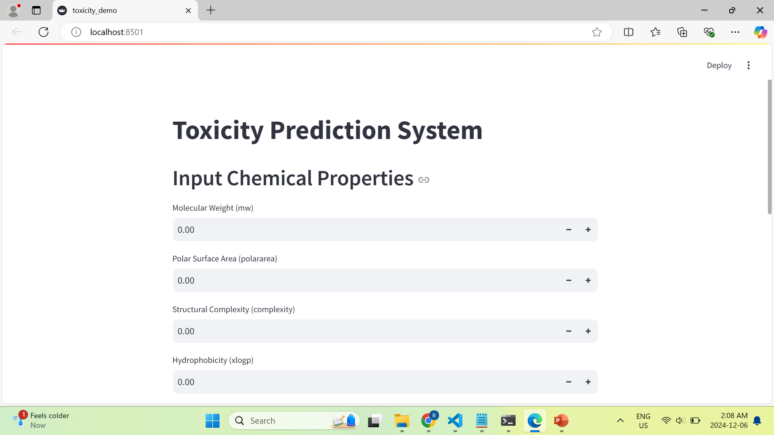
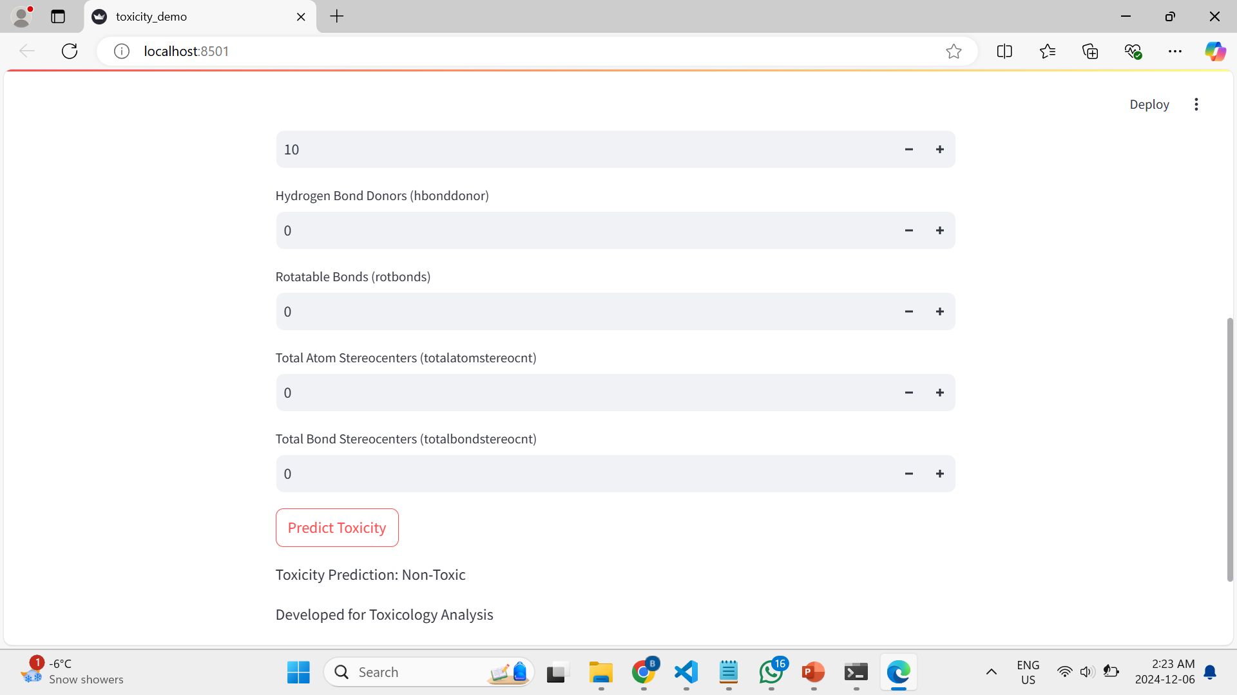
Deployment
Process:
Model Saving: Trained models saved as .pkl files for reproducibility.
Interactive UI: Built using Streamlit for user-friendly access.
How It Works:
  Users input chemical properties.
  Outputs predicted toxicity (binary) and toxicity levels.
Demo Highlight:
Accessible via local execution: streamlit run toxicity_demo.py.

Slide 7
Key Insights and Learnings
Strengths:
High accuracy and scalability for binary classification.
Easy deployment with an interactive Streamlit app.
Limitations:
Imbalance in class distribution affects non-toxic predictions.
Complex toxicity level predictions require further tuning.
Proposed Improvements:
Use oversampling techniques like SMOTE to balance data.
Simplify toxicity levels for clarity and better predictions.
Explore interpretability with SHAP for feature importance.

Slide 8
Conclusion
Achievements:
Demonstrated AI’s potential in predictive toxicology.
Validated models with high precision and R² scores.
Deployed a user-friendly application for chemical safety predictions.
Future Steps:
Refine models with more diverse datasets.
Deploy cloud-based services (e.g., AWS SageMaker) for broader accessibility.
Integrate additional features for enhanced toxicity prediction.

Slide 9
Final Remarks
Why It Matters:
Reduces costs and time in drug development.
Enhances chemical safety for human health and the environment.
Your Role:
Collaborated on model building, data analysis, and deployment.
Applied cutting-edge AI techniques to address a real-world challenge.

