Slide 1


Career Search
Group 404 Fernando Alvarado, Chris Hill, Kristi Kacaj, Jessica Rubio Lachira, Sierra Portlock, Sunitha Pillai
Notes:
Web page demo
Include:
Overall concept
Motivation for development
Design process

Slide 2
APIs
AJAX
const token = "4+0CUzMzAuJK0eSUvLwwqUgrm5Lb2JhAVKGlttonnKTHtxhmnAk1h1FqAOsR1ZY0nVmNTqMh3ZFyEg745ofzuA=="; var wqueryURL = "https://api.careeronestop.org/v1/occupation/YVWz2wiZiFxhjWG/" + searchPosition + "/" + searchLocation + "?training=false&interest=true&videos=true&tasks=true&dwas=false&wages=true&alternateOnetTitles=false&projectedEmployment=true&ooh=true&stateLMILinks=true&relatedOnetTitles=true&skills=true&knowledge=true&ability=true&trainingPrograms=true"; console.log(wqueryURL); $.ajax({ url: wqueryURL, method: "GET", async: false, headers: { Authorization: "Bearer " + token }, error: function(err) { console.log(err); alert("Jobs requested could not be returned"); }, }).then(function(response) {
JobAPI
careerOneStop
NewsAPI
Notes:
Description of API and its purpose (how it works)
How we used API for our webpage

Slide 3
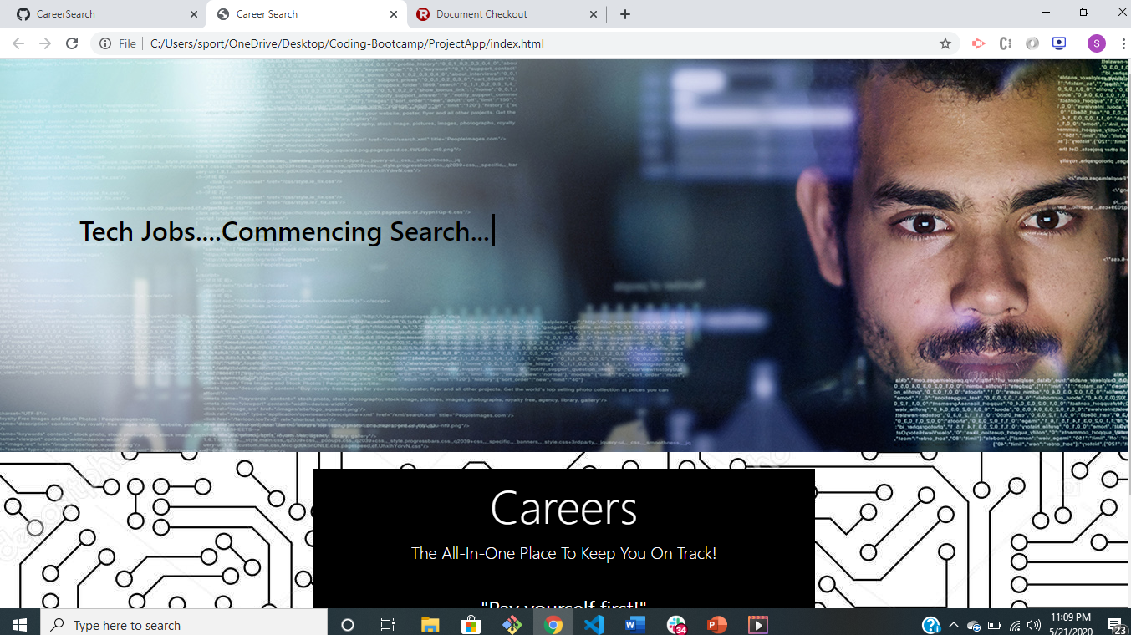
Technology Not Learned In Class: Animation
h2 { animation: type 4s steps(36); overflow: hidden; white-space: nowrap; width: 36ch; color: black; margin-left: -65px; height: 100px; } span{ animation: blink 1s linear infinite; } @keyframes blink{ 0%{opacity: 0;} 100%{opacity: 1;} } @keyframes type { 0% { width: 0ch; } 100% { width: 36ch; } }
Notes:
Description of function
What feature/code was used
Purpose of the feature? (brief description of how technology works)
How did you learn about this feature

Slide 4

Highlight Specific link Fernando
<head> <title>Career Search</title>
<meta charset="UTF-8"> <meta name="viewport" content="width=device-width, initial-scale=1, shrink-to-fit=no">
<script src="https://ajax.googleapis.com/ajax/libs/jquery/3.3.1/jquery.min.js"></script>
<link rel="stylesheet" href="https://stackpath.bootstrapcdn.com/bootstrap/4.4.1/css/bootstrap.min.css"integrity="sha384-Vkoo8x4CGsO3+Hhxv8T/Q5PaXtkKtu6ug5TOeNV6gBiFeWPGFN9MuhOf23Q9Ifjh" crossorigin="anonymous">
<link rel="stylesheet" type="text/css" href="./assets/css/style.css">
<script src="https://stackpath.bootstrapcdn.com/bootstrap/4.4.1/js/bootstrap.min.js" integrity="sha384-wfSDF2E50Y2D1uUdj0O3uMBJnjuUD4Ih7YwaYd1iqfktj0Uod8GCExl3Og8ifwB6" crossorigin="anonymous"></script>
<script src="./assets/javascript/app.js"></script> <script src="https://cdnjs.cloudflare.com/ajax/libs/popper.js/1.12.9/umd/popper.min.js"></script>
<!-- <script src="https://maxcdn.bootstrapcdn.com/bootstrap/4.0.0/js/bootstrap.min.js"></script> -->
<script src="https://use.fontawesome.com/releases/v5.0.8/js/all.js"></script>
</head>
Notes:
Situation- would not display properly (What specifically)
Behavior- used book as resource, watched tutorials, 3rd day reached out to Jim
Result- Discovered script tag was in wrong place
Impact: learned to start with the basics when resolving problem

Slide 5

Problems Encountered
1. Initial API had limits
2. Upload resume and send to recruiters
3. Bootstrap restrained us from editing with CSS
Notes:
Situation: Editing navbar and upload resume
-
Behavior: online research functions to accomplish tags. Partnered with Kristi
- Abandoned ship and produced alternative.
What I learned: Sometimes its best to keep it simple and its always important to stay on time schedule to complete project
Spent 2 classes on previous concept (budget tracker)
API did not work the way we wanted. Want: help us build budget. API built budget on THEIR website.
We could not input information only pull information

Slide 6

Q & A
?

