Slide 1
AFS-200 Object-Oriented Programming & the Web
Week 5 – Python Web Frameworks: Flask and Django

Slide 2
Week 5 - Topics
Object Oriented Programming
Inheritance
Class Attributes and Methods
Composition
Magic Methods
Modules
Request
Frameworks
Introduction
Flask and Django

Slide 3
Instance Methods and Attributes
Functions created inside of a class are referred to as methods. The are used to define the behaviors of an object.
Every instance method take an object as the first parameter. This object represents the instance of the class and is usually called “self”.
It is usually a good idea to define "getters and setters" when creating a class.
A "getter" is a method that returns the value of a class attribute
A "setter" is a method that sets the value of a class attribute

Slide 4
Class Attributes and Methods
Class Attributes and Methods are shared at the class level across all instances of that class.
Class Attributes are typically named using all capital letters.
Class Attributes are defined outside of the __init__() method.
Class Attributes can be accessed via the Class or via an instance of the class.

Slide 5
Inheritance: Class Attributes and Methods
Inheritance allows a new class to extend an existing class.
The new class inherits the members of the class it extends.
Inheritance involves a superclass and a subclass.
The superclass, also called a base class, is the general class and the subclass, also called a derive class, is the specialized class.
Must call the initializer of the superclass inside the initializer of the subclass before any unique attributes are defined for the subclass.
Polymorphism allows subclasses to have methods with the same names as methods in their superclasses.

Slide 6

Magic 8-Ball
The Magic 8-Ball is a plastic sphere, made to look like an oversized eight-ball, that is used for fortune-telling or seeking advice.
Inside the ball, a cylindrical reservoir contains a white plastic 20 faced die floating in alcohol dyed dark blue.
Each of the die's 20 faces has an affirmative, negative, or non-committal statement printed on it.
These messages are read through a window on the ball's bottom.

Slide 7
Magic Methods
Magic methods in Python are the special methods that start and end with the double underscores. They are also called dunder methods.
Magic methods are invoked internally from the class or the interpreter.
Magic methods allow the developer to control how the class object will behave to standard Python operations such as print, arithmetic operators and comparison operators.

Slide 8
Important Magic Methods
Magic Method | Description
__str__(self) | Returns a string representation of a type.
__repr__(self) | Returns a machine-readable representation of a type
__add__(self, other) | Called when the add operation (+) is used.
__sub__(self, other) | Called when the subtraction operation (-) is used.
__mul__(self, other) | Called when the multiplication operation (*) is used.
__lt__(self, other) | Called on the comparison using < operator.
__le__(self, other) | Called on the comparison using <= operator.
__eq__(self, other) | Called on the comparison using == operator.
__ne__(self, other) | Called on the comparison using != operator.
__ge__(self, other) | Called on the comparison using > operator.
__del__(self) | Destructor method. Called when the type is destroyed.
__format__(self, formatstr) | Called by built-int unicode() method to return an unicode string of a type.

Slide 9
Python Requests Module
Requests is an elegant and simple HTTP library for Python
https://docs.python-requests.org/en/latest/
Need to install the requests module before using it!
pip install requests
or
python -m pip install requests
The Request object supports multiple HTTP request types including: GET, POST, PUT, DELETE, HEAD

Slide 10

Python Web Frameworks

Slide 11
Python Web Frameworks
vs | Django | Flask
Type | Macro Web Framework | Micro Web Framework
API Support | Does Not Have API Support | Provides API Support
Visual Debugging | Not-supported | Supported
Dynamic HTML Pages | Supported | Not-supported
Flexibility | Low Flexibility | High Flexibility
Learning Curve | High Learning Curve | Low Learning Curve
Development Control | Less Control Over Components | More Control Over Components

Slide 12
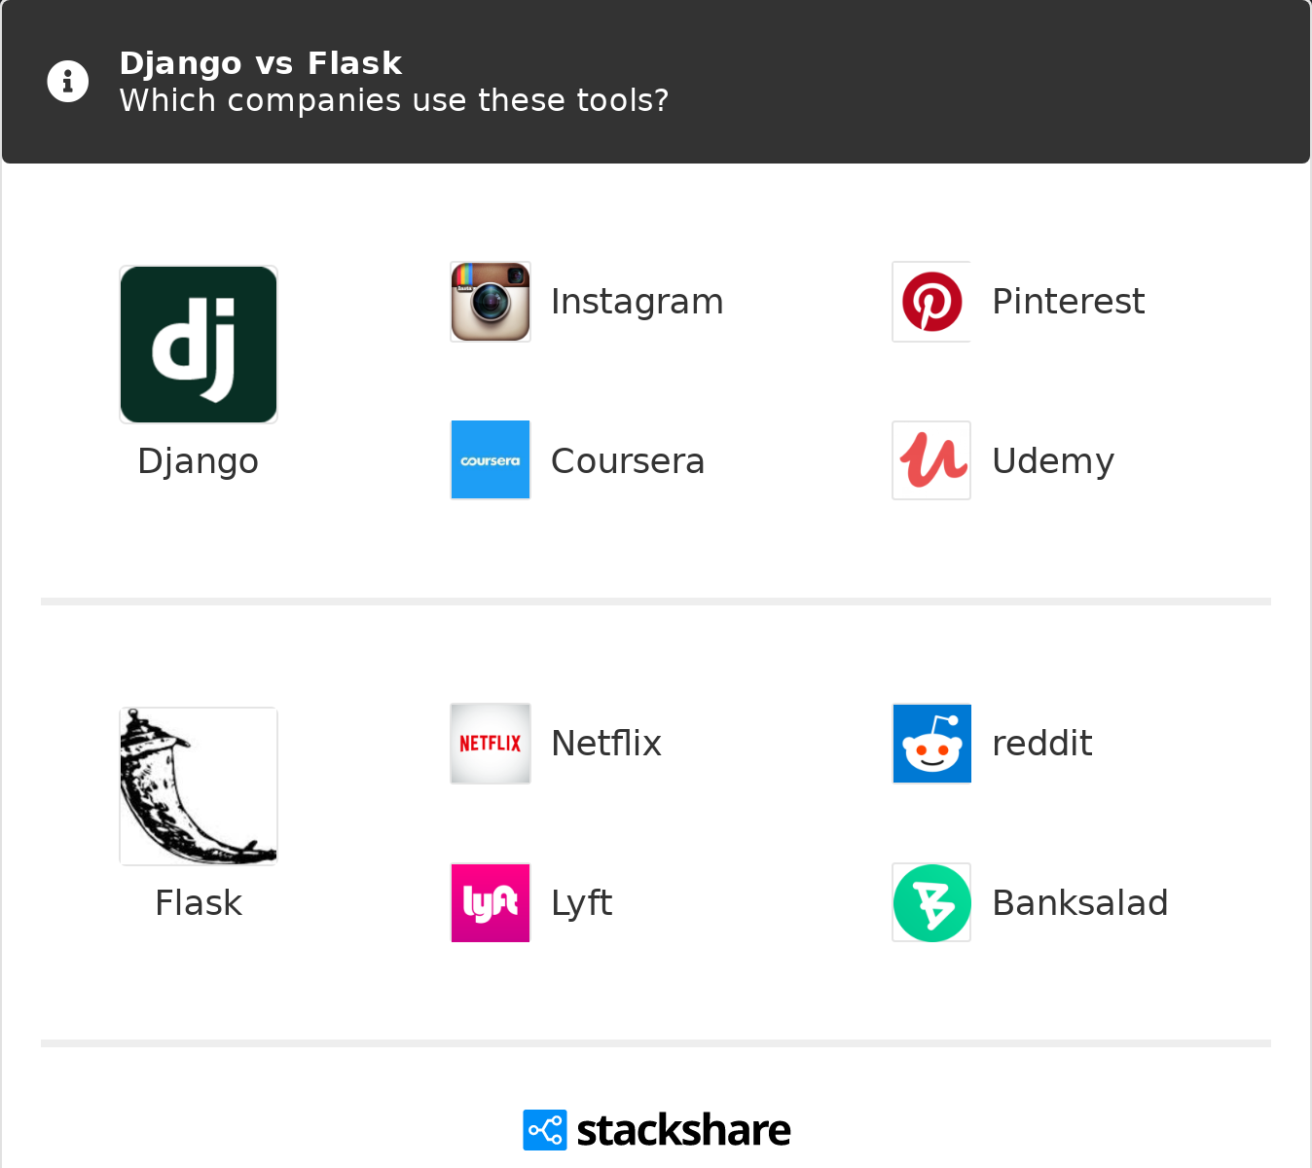
Full Stack Python
https://www.fullstackpython.com/

Slide 13
Python: Flask Web Frameworks
Flask is a WSGI (Web Server Gateway Interface) framework used for lightweight web applications where high speed is required.
Flask lets the developer extend the framework.
Flask follows the MVC (Model-View-Controller) architecture.
A Flask Project is a single application where you can add countless views and models.
Flask uses SQLAlchemy for database connectivity.
Flask is more suitable if you are using NoSQL.
Flask is lightweight and comes with very few features. This makes it very flexible allowing developers to extend it with various add-on tools and libraries. Making it easier to learn.

Slide 14
Python: Django Web Frameworks
Django is a full-stack web framework designed for full-scale powerful web apps.
Django is a batteries-included framework which comes with most of the features pre-installed.
Django follows MVT (Model-View-Template) architecture.
A Django project is a collection of smaller applications.
Django provides native support for popular databases like PostgreSQL, MySQL, etc.
Django is a feature-packed framework, but it is not easy to change these features. Developers must use the tools provided by Django.

Slide 15
Flask Installation
Start a new project with virtualenv
python -m venv <project name>
Create a new virtual environment
$ virtualenv <project name>
Activate the virtualenv
# Activate the virtualenv (OS X & Linux)
$ source <project name>/bin/activate
# Activate the virtualenv (Windows)
$ <project name>\Scripts\activate
# Activate the virtual environment (GitBash Shell)
$ source <project name>/Scripts/activate
Change working directory to project folder.

Slide 16
Flask Installation - Continued
Use pip to install the Flask libraries
pip install flask
Create a simple Flask application
create a file called "app.py“
from flask import Flask
app = Flask(__name__)
@app.route("/")
def hello():
return "Hello World!"
if __name__ == "__main__":
app.run()
Start Flask
“flask run” or “python -m flask run”

Slide 17
Week 5 & 6 Assignment Overviews

