Slide 1





TRƯỜNG ĐẠI HỌC CÔNG NGHỆ ĐỒNG NAI
KHOA CÔNG NGHỆ THÔNG TIN
ASP.NET CORE Web API
Chapter 5:
API Security Basic
Lecturer: Phạm Đình Sắc
phamdinhsac@dntu.edu.vn
Section: Software Engineering
MH: 0370094
Buổi 8 - Chương 5 - C05_API_Security.pptx - 15/08/2024

Slide 2

Subject Objectives
Understand API security basic
Understanding how to protect data effectively
Understanding how to Prevent Unauthorized Access
Building practices for API Security
Skills
Knowledge of HTTPS and SSL/TLS
Authentication and Authorization
Cross-Origin Resource Sharing (CROS)
Cross-Site Scripting (XSS)
Notes:
Effectively : 1 cách hiệu quả

Slide 3


Content
Why is API security necessary?
API Security Solutions
2.1. Input Validation and CORS
2.2. Data Encryption
2.3. Authentication and Authorization
2.4. Rate Limiting
2.5. Prevent XSS (Cross-Site Scripting)
2.6. Prevent CSRF (Cross-Site Request Forgery)
2.7. Using an API Firewall (API Gateway)

Slide 4


1
API Security Basic
Why is API security necessary?
Lecturer: Phạm Đình Sắc
phamdinhsac@dntu.edu.vn
Section: Software Engineering

Slide 5
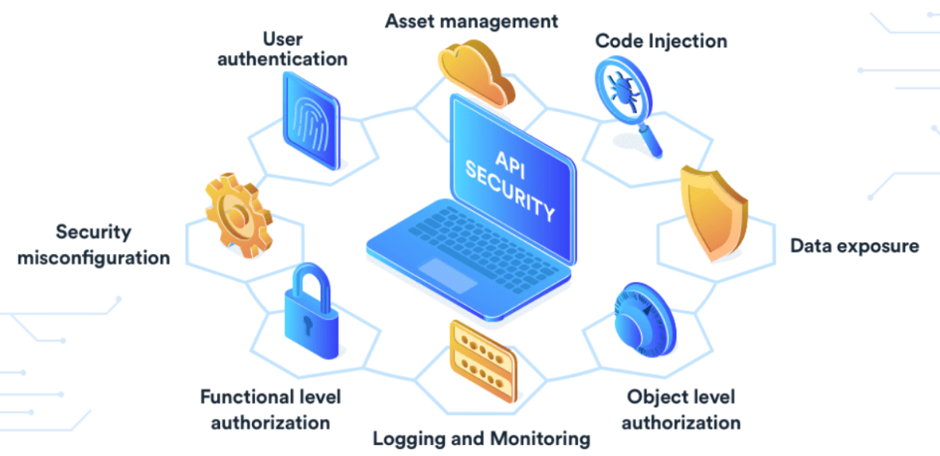

1. Why is API security necessary?
APIs, essential for software development, allow different systems to communicate.
However, their internet-based nature makes them prime targets for attacks. Thus, API security is paramount (very important)
Notes:
internet-based nature : Bản chất dựa trên internet
Paramount : tối quan trọng
Prime ; Chính, chủ yếu. Xuất sắc
Essential: thiết yếu
Thus; Do đó

Slide 6
1. Why is API security necessary?
API security helps protect sensitive data and prevents potential attacks such as:
SQL Injection: Hackers insert malicious SQL code to access unwanted data.
Denial of Service (DoS): An attack that overloads the system with numerous requests, causing the service to become inoperable.
Cross-Site Scripting (XSS): Hacker injects malicious code into websites (usually javascript)
CSRF (Cross-Site Request Forgery): Hacker injects malicious code or link to a website where the user has been authenticated.
…..
Notes:
Inoperable : Không hoạt động
intercept and steal ; chặn và đánh cắp

Slide 7

2. API Security Solutions
2.1. Input Validation and CORS (Cross-Origin Requests) 2.2. Data Encryption 2.3. Authentication and Authorization 2.4. Rate Limiting
2.5. Prevent XSS (Cross-Site Scripting)
2.6. Prevent CSRF (Cross-Site Request Forgery) 2.7. Using an API Firewall (API Gateway)

Slide 8
2.1.1. Input Validation helps Prevent:
Prevent attackers from injecting malicious code into SQL, NoSQL queries
Prevent denial of service (DoS) attacks by limiting the size and number of requests.
Prevent malicious code (XSS) from being injected into web pages to steal user information.
Prevent invalid data from causing application-layer errors
Prevent error messages about sensitive information

Slide 9
2.1.1. Data Annotations
System.ComponentModel.DataAnnotations
Data Annotations are attributes you can apply directly to your model properties.
These attributes specify validation rules that ASP.NET Core automatically enforces.
Common data annotation attributes include:
[Required]
[MaxLength] , [StringLength]
[Range]
[EmailAddress]
[RegularExpression]
Notes:
Data Annotations (chú thích, notes)

Slide 10
2.1.1. Data Annotations
Keyword | Validation
Required | The field is not empty
MaxLength | The maximum length for a string field
StringLength | The maximum, MinimumLength for a string field
Range | Value falls within a specified range
EmailAddress | The input is a valid email address
DataType | The input is a valid DataType specified
RegularExpression | Input matches a regular expression pattern
Notes:
Data Annotations (chú thích, notes)

Slide 11
Symbol | Regular Expressions (Regex) Explanation | Notes
^ | Start string character
\d | Any digit from 0 to 9
\w | Any letter, number or underscore (_) | \W negative of \w
\s | any white spcace (space, tab, newline) | \S negative of \s
$ | Represents the end of a string
? | 0 or 1 any character before it
* | 0 or more any characters before it
+ | 1 or more any characters before it
{n} | Ensure the string length = n
{n,} | Ensure minimum string length = n
{n,m} | Ensure string length min = n and max = m
[ ] | Set of characters | [abc]
[^ ] | Negation of a set | [^xyz]
( ) | Group characters together | ([a-z]) or (abc)
(?=.*[ ]) | Must at least one character in [ ] | (?=.*[a-z])

Slide 12
2.1.1. Input Validation
public class Acount
{
[Required(ErrorMessage = "*")]
[RegularExpression(@"^[a-zA-Z0-9_]{3,10}$", ErrorMessage = "**")]
public string userName { get; set; }
[Required(ErrorMessage = "*")] [RegularExpression(@"^\d[10}$", ErrorMessage = "**")]
public string phone { get; set; }
[Required(ErrorMessage = "*")] [EmailAddress(ErrorMessage = "**")]
public string email { get; set; }
Required(ErrorMessage = "*")] [RegularExpression(@"^(?=.*[a-z]) (?=.*[A-Z]) (?=.*\d) (?=.*[\W]) [\S]{8,}$", ErrorMessage = “*")]
public string password { get; set; }
}

Slide 13
2.1.1. Input Validation
public class LoginModel
{
[Required(ErrorMessage = "*")] [RegularExpression(@"^[a-zA-Z0-9_]{3,10}$", ErrorMessage = "**")]
public string userName { get; set; }
Required(ErrorMessage = "*")] [RegularExpression(@"^(?=.*[a-z]) (?=.*[A-Z]) (?=.*\d) (?=.*[\W]) [\S]{8,}$", ErrorMessage = “*")]
public string password { get; set; }
}

Slide 14
2.1.2. Check Validation
Use [FromBody] and ModelState
[HttpPost]
public IActionResult LoginAPI([FromBody] LoginModel model)
{
if (ModelState.IsValid) return Unauthorized(); //Invalid Model
if (model.UserName == "admin" && model.Password == "noP@ss$123")
{
return Ok(new
{
success = true,
message = "Login successful",
});
}
return Unauthorized(new
{
success = false,
message = "Invalid username or password"
});
}
Note: By default POST, PUT, and PATCH data is retrieved from body

Slide 15
2.1.2. Check Validation
Use [FromBody] and ModelState
[HttpPut]
public async Task<ActionResult<EmployeeDTO>> Update([FromBody] EmployeeDTO model)
{
if (ModelState.IsValid)
{
var entity = await _EmployeeRepository.GetAsync(model.Id);
if (entity != null)
{
_mapper.Map(model, entity);
if (await _EmployeeRepository.UpdateAsync(entity) != null)
return Ok(model);
}
}
return NoContent();
}

Slide 16
2.1.3. CORS (Cross-Origin Requests)
in Program.cs, use AddPolicy have name
builder.Services.AddCors(options =>
{
options.AddPolicy(“Policy1", policy =>
{
policy.WithOrigins("https://dntu.edu.vn", "https://localhost:44386")
.AllowAnyHeader()
.AllowAnyMethod();
});
});
app.UseCors("Policy1"); // Place above app.UseAuthentication()

Slide 17
2.1.3. CORS (Cross-Origin Requests)
in Program.cs, use AddDefaultPolicy
builder.Services.AddCors(options =>
{
options.AddDefaultPolicy(
policy =>
{
policy.WithOrigins("https://dntu.edu.vn", "https://localhost:44386")
.AllowAnyHeader()
.AllowAnyMethod();
});
});
app.UseCors(); // Plase above app.UseAuthentication()

Slide 18
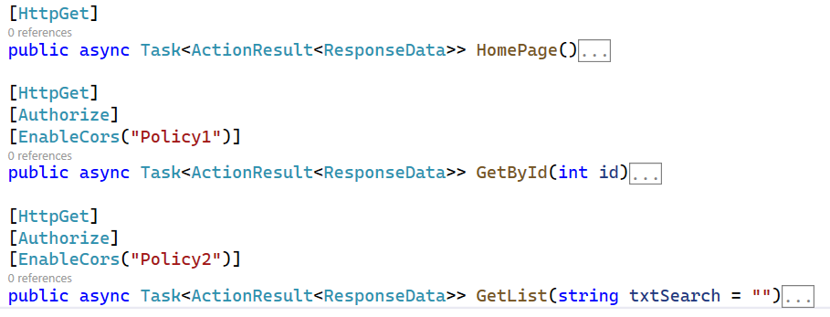
2.1.3. CORS (Cross-Origin Requests)
Enable CORS with attributes: enables CORS for selected endpoints
// Policy1, Policy2 is name of AddPolicy in Program.cs
Notes:
Policy1, Policy2 is name when AddPolicy in Program.cs

Slide 19
2. API Security Solutions
2.1. Input Validation and CORS (Cross-Origin Requests) 2.2. Data Encryption 2.3. Authentication and Authorization 2.4. Rate Limiting
2.5. Prevent XSS (Cross-Site Scripting)
2.6. Prevent CSRF (Cross-Site Request Forgery) 2.7. Using an API Firewall (API Gateway)

Slide 20
2.2. Data Encryption
HTTPS/TLS to encrypt all data transmitted between client and server, helping to prevent Man-in-the-Middle attacks. //in Program.cs
app.UseHttpsRedirection(); app.UseHsts(); // Browser only uses https
In the launchSettings.json file, make sure the configuration has https enabled
"iisSettings": {
"iisExpress": {
"sslPort": 44382
}
}
Write code that handles properties encryption with sensitive data
Ex: username, password, connection string, secret key, client Id, client secret… in appsetting.json

Slide 21
2.2. Data Encryption
using System.Security.Cryptography;
public string Encrypt(string plainText, string key)
{
using (Aes aesAlg = Aes.Create())
{
var keyBytes = Encoding.UTF8.GetBytes(key.PadRight(32)); // length key 32 byte
aesAlg.Key = keyBytes;
aesAlg.IV = new byte[16]; // (Initialization Vector)
ICryptoTransform encryptor = aesAlg.CreateEncryptor(aesAlg.Key, aesAlg.IV);
using (var msEncrypt = new MemoryStream())
{
using (var csEncrypt = new CryptoStream(msEncrypt, encryptor, CryptoStreamMode.Write))
using (var swEncrypt = new StreamWriter(csEncrypt))
{
swEncrypt.Write(plainText);
}
var encrypted = msEncrypt.ToArray();
return Convert.ToBase64String(encrypted);
}
}
}

Slide 22
2.2. Data Encryption
public string Decrypt(string cipherText, string key)
using (Aes aesAlg = Aes.Create())
{
var keyBytes = Encoding.UTF8.GetBytes(key.PadRight(32));
aesAlg.Key = keyBytes;
aesAlg.IV = new byte[16];
ICryptoTransform decryptor = aesAlg.CreateDecryptor(aesAlg.Key, aesAlg.IV);
var cipherBytes = Convert.FromBase64String(cipherText);
using (var msDecrypt = new MemoryStream(cipherBytes))
{
using (var csDecrypt = new CryptoStream(msDecrypt, decryptor, CryptoStreamMode.Read))
using (var srDecrypt = new StreamReader(csDecrypt))
{
return srDecrypt.ReadToEnd();
}
}
}
}

Slide 23
Homework 1
Write a library to encrypt and decrypt sensitive data like: contents in appstting.jon (connection string, authentication…) and other content you want implement.
Methods with write functionality (Post, Put, Delete, Attach…) placing [FromBody] keyword before the model parameter and check the ModelState.IsValid property
Configure Input Validation and CORS (Cross-Origin Requests) to protect APIs

Slide 24
2. API Security Solutions
2.1. Input Validation and CORS (Cross-Origin Requests) 2.2. Data Encryption 2.3. Authentication and Authorization 2.4. Rate Limiting
2.5. Prevent XSS (Cross-Site Scripting)
2.6. Prevent CSRF (Cross-Site Request Forgery) 2.7. Using an API Firewall (API Gateway)

Slide 25
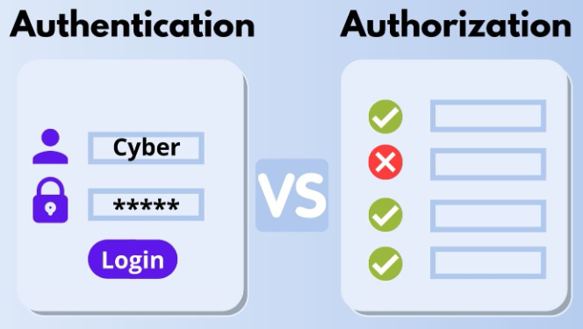
2.2. Authentication and Authorization
Step 1. Install the Microsoft.AspNetCore.Authentication.JwtBearer package
Step 2. Configure JWT for your API (appsettings.json, Program.cs…)
Step 3. Create GenerateAccessToken (GenerateJwtToken) method
Step 4. Create Login/Logout (Singin/Signout) methods
Step 5. Grant endpoint access (Endpoints protection)
Step 6. Option Methods:
RefreshToken,
GenerateRefreshToken,
ValidateAccessToken,
ValidateRefreshToken,
ChangePassword
………………
Who are you? Can you do that?
Notes:
Who are you? Can you do that?

Slide 26
Step 2. Configure JWT for your API
appsettings.json
{
"Logging": {
"LogLevel": {"Default": "Information", "Microsoft.AspNetCore": "Warning"}
},
"AllowedHosts": "*",
"ConnectionStrings": {
"myConnect": "nZC6cm+QZj2CGVOkwBsCI81PrZK1eINozvOAGyuVpMXF1SCUp0Q"
},
"GoogleSettings": {
"ClientId": "657718689565-v3hhi6.apps.googleusercontent.com",
"ClientSecret": "GOCGDFGGFSPX-9SoUx4TlaXFDFKJLKDSFuq62jZd__JMO8fNu_H"
},
"JwtSettings": {
"Secretkey": "70b254816bf0fa3e4a81f5d400ccbb3c0de63f73gghfsdg1sdfsdjfa4",
"Issuer": "JwtIssuer",
"Audience": "JwtAudience"
}
}

Slide 27
Step 2. Configure JWT for your API
Program.cs
var secretkey = builder.Configuration["JwtSettings:Secretkey"];
var secretKeyBytes = Encoding.UTF8.GetBytes(secretkey);
builder.Services.AddAuthentication(options =>
{
options.DefaultAuthenticateScheme = JwtBearerDefaults.AuthenticationScheme;
options.DefaultChallengeScheme = JwtBearerDefaults.AuthenticationScheme;
options.DefaultScheme = JwtBearerDefaults.AuthenticationScheme;
}).AddJwtBearer(option =>
{ option.TokenValidationParameters = new TokenValidationParameters
{
ValidateIssuer = true,
ValidIssuer = builder.Configuration["JwtSettings:Issuer"],
ValidateLifetime = true,
ValidateAudience = true,
ValidAudience = builder.Configuration["JwtSettings:Audience"],
ValidateIssuerSigningKey = true,
IssuerSigningKey = new SymmetricSecurityKey(secretKeyBytes),
ClockSkew = TimeSpan.Zero,
};
});
app.UseAuthentication();
app.UseAuthorization();

Slide 28
Step 3. Generate Access Token
In Controller or Service
private string GenerateAccessToken(Account user)
{
var guid = Guid.NewGuid().ToString();
var authoClaims = new List<Claim>
{
new Claim("Id", user.Id.ToString()),
new Claim("UserName", user.UserName),
new Claim(ClaimTypes.Name, user.FullName),
new Claim(ClaimTypes.Role,"RoleName"), // option role name
new Claim(JwtRegisteredClaimNames.Jti, guid),
new Claim(JwtRegisteredClaimNames.Email, user.Email)
};
// Continue at next slide

Slide 29
Step 3. Generate Access Token
In Controller or Service // Continue
var jwtSettings = _configuration.GetSection("JwtSettings");
var secretKeyBytes = Encoding.UTF8.GetBytes(jwtSettings["SecretKey"]);
var securityKey = new SymmetricSecurityKey(secretKeyBytes); var credentials = new SigningCredentials(securityKey,SecurityAlgorithms.HmacSha512Signature);
var token = new JwtSecurityToken(
issuer: jwtSettings["Issuer"],
audience: jwtSettings["Audience"],
claims: authoClaims,
expires: DateTime.UtcNow.AddMinutes(60),
signingCredentials: credentials
);
return new JwtSecurityTokenHandler().WriteToken(token); //accessToken
}

Slide 30
Step 3. Generate Access Token
In Controller or Service
private string GenerateAccessToken(Account user)
{
var authoClaims = new List<Claim>
{
new Claim("Id", user.Id.ToString()),
new Claim("UserName", user.UserName),
new Claim(ClaimTypes.Name, user.FullName),
new Claim(JwtRegisteredClaimNames.Jti, Guid.NewGuid().ToString()),
new Claim(JwtRegisteredClaimNames.Email, user.Email),
};
var jwtSettings = _configuration.GetSection("JwtSettings");
var secretKeyBytes = Encoding.UTF8.GetBytes(jwtSettings["SecretKey"]);
var securityKey = new SymmetricSecurityKey(secretKeyBytes);
var credentials = new SigningCredentials(securityKey,SecurityAlgorithms.HmacSha512Signature);
var token = new JwtSecurityToken(
issuer: jwtSettings["Issuer"],
audience: jwtSettings["Audience"],
claims: authoClaims,
expires: DateTime.UtcNow.AddMinutes(60),
signingCredentials: credentials
);
return new JwtSecurityTokenHandler().WriteToken(token); //accessToken
}

Slide 31
Step 4. Login method
In Controller or Service
private string GenerateAccessToken(Account user)
{
var authoClaims = new List<Claim>
{
new Claim("Id", user.Id.ToString()),
new Claim("UserName", user.UserName),
new Claim(ClaimTypes.Name, user.FullName),
new Claim(JwtRegisteredClaimNames.Jti, Guid.NewGuid().ToString()),
new Claim(JwtRegisteredClaimNames.Email, user.Email),
};
var jwtSettings = _configuration.GetSection("JwtSettings");
var secretKeyBytes = Encoding.UTF8.GetBytes(jwtSettings["SecretKey"]);
var securityKey = new SymmetricSecurityKey(secretKeyBytes);
var credentials = new SigningCredentials(securityKey,SecurityAlgorithms.HmacSha512Signature);
var token = new JwtSecurityToken(
issuer: jwtSettings["Issuer"],
audience: jwtSettings["Audience"],
claims: authoClaims,
expires: DateTime.UtcNow.AddMinutes(60),
signingCredentials: credentials
);
return new JwtSecurityTokenHandler().WriteToken(token); //accessToken
}

Slide 32
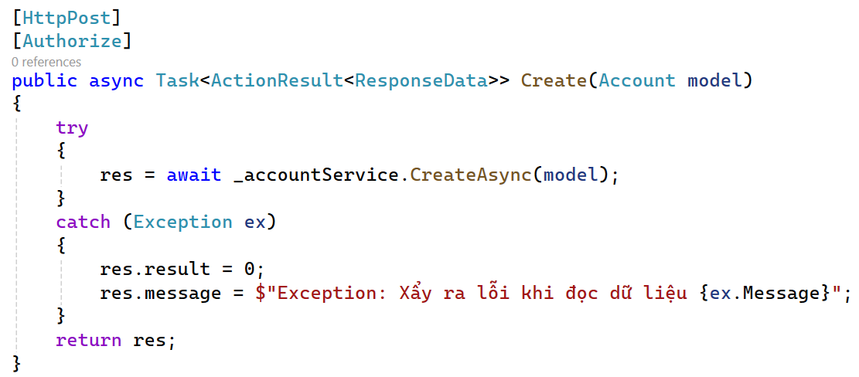
Step 5. Grant endpoint access
Place the [Authorize] keyword above the action you want to protect

Slide 33
Homework 2
Authentication and Authorization
Use Microsoft.AspNetCore.Authentication.JwtBearer library to write login/logout mothods in account class (use database at Repoditory lecture)
Research [Authorize] and Roles, Policy to Implement users or uers group permissions. (Roles get from )
Create RefreshTokenAsync method to apply when accesToken expires. (Step 6 - Go to Slide)
Use the Microsoft.AspNetCore.Authentication.Google library to do as exercise 1, naming the methods signin/signout.
https://learn.microsoft.com/en-us/aspnet/core/security/authorization/roles
https://learn.microsoft.com/en-us/aspnet/core/security/authorization/claims
Notes:
https://learn.microsoft.com/en-us/aspnet/core/security/authorization/roles?view=aspnetcore-8.0
https://learn.microsoft.com/en-us/aspnet/core/security/authorization/claims?view=aspnetcore-8.0

Slide 34
2. API Security Solutions
2.1. Input Validation and CORS (Cross-Origin Requests) 2.2. Data Encryption 2.3. Authentication and Authorization 2.4. Rate Limiting
2.5. Prevent XSS (Cross-Site Scripting)
2.6. Prevent CSRF (Cross-Site Request Forgery) 2.7. Using an API Firewall (API Gateway)

Slide 35
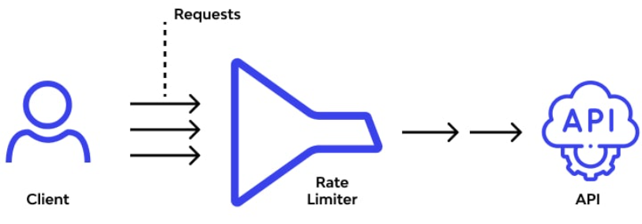
2.3. Rate Limiting
Rate Limiting is a control technique that restricts the number of requests a user can make to a system within a specific time period.
How it works: By setting limits, it prevents system overload and ensures balance resource allocation.
Applications of Rate Limiting: Common applications include mitigating DoS or DDoS attacks, anomaly detection and protecting APIs.
Notes:
Allocation : Phân bổ (distribute)
Mitigate : giảm thiểu

Slide 36
2
2.4. Rate Limiting
using Microsoft.AspNetCore.RateLimiting
+ Active for all Controlls
+ Enable on specified endpoints
+ Enable on specified endpoints
using AspNetCoreRateLimit
Homework (Students research and do it)

Slide 37
2.4. Rate Limiting
Way 1. Microsoft.AspNetCore.RateLimiting
in Program.cs
builder.Services.AddMemoryCache();
builder.Services.AddRateLimiter(options =>
{
options.AddFixedWindowLimiter(policyName: "Fixed", opt =>
{
opt.PermitLimit = 5; // limite 5 requests
opt.Window = TimeSpan.FromMinutes(1); //Within 1 minute
opt.QueueProcessingOrder = QueueProcessingOrder.OldestFirst;
opt.QueueLimit = 2; // Limit number of requests in queue
opt.QueueTimeout = TimeSpan.FromSeconds(10);//Wait 10 seconds to reject
});
});
app.UseRateLimiter(); //above app.UseAuthentication() & app.UseAuthorization()
app.MapControllers().RequireRateLimiting("Fixed"); //Enable all Controllers
Notes:
https://learn.microsoft.com/en-us/aspnet/core/performance/rate-limit?view=aspnetcore-8.0

Slide 38
2.4. Rate Limiting
Way 1. Microsoft.AspNetCore.RateLimiting
in Program.cs
Must be specified at which endpoint or controller needs Rate Limiting.
builder.Services.AddMemoryCache();
builder.Services.AddRateLimiter(options =>
{
options.AddFixedWindowLimiter(policyName: "Fixed", opt =>
{
opt.PermitLimit = 5; // limite 5 requests
opt.Window = TimeSpan.FromMinutes(1); //Within 1 minute
opt.QueueProcessingOrder = QueueProcessingOrder.OldestFirst;
opt.QueueLimit = 2; // Limit number of requests in queue
opt.QueueTimeout = TimeSpan.FromSeconds(10);//Wait 10 seconds to reject
});
});
app.UseRateLimiter(); //above app.UseAuthentication() & app.UseAuthorization()
app.MapControllers();
Notes:
https://learn.microsoft.com/en-us/aspnet/core/performance/rate-limit?view=aspnetcore-8.0

Slide 39
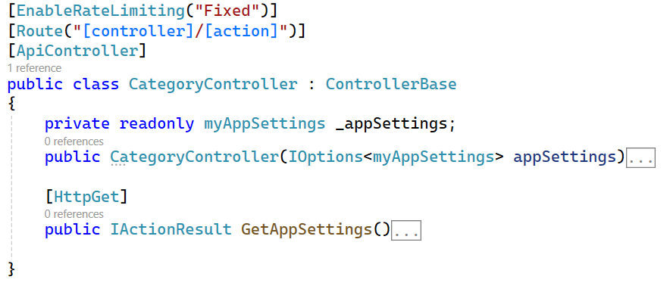
2.4. Rate Limiting
Way 1. Microsoft.AspNetCore.RateLimiting
//Enable all Endpoints in Controller
Notes:
https://blog.maartenballiauw.be/post/2022/09/26/aspnet-core-rate-limiting-middleware.html

Slide 40
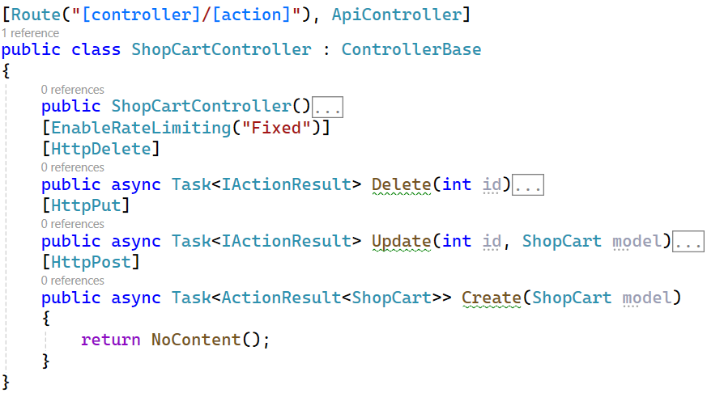
2.4. Rate Limiting
Way 1. Microsoft.AspNetCore.RateLimiting
// Enable this Endpoint
Notes:
https://blog.maartenballiauw.be/post/2022/09/26/aspnet-core-rate-limiting-middleware.html

Slide 41
2.4. Rate Limiting
Way 1. Microsoft.AspNetCore.RateLimiting
in Program.cs
builder.Services.AddMemoryCache();
builder.Services.AddRateLimiter(options =>
{
options.RejectionStatusCode = 429; //Set StatusCode = 429
options.GlobalLimiter = PartitionedRateLimiter.Create<HttpContext, string> (httpContext =>RateLimitPartition.GetFixedWindowLimiter(partitionKey: httpContext.Request.Headers.Host.ToString(),
factory: partition => new FixedWindowRateLimiterOptions
{
AutoReplenishment = true,
PermitLimit = 10, // Limite 10 requests
QueueLimit = 0, // Within 1 minute
Window =TimeSpan.FromMinutes(1)//Limit number of requests in queue
}));
});
app.UseRateLimiter(); //above app.UseAuthentication() & app.UseAuthorization()
//Enable Application
Notes:
https://blog.maartenballiauw.be/post/2022/09/26/aspnet-core-rate-limiting-middleware.html

Slide 42
2.4. Rate Limiting
Way 2. using AspNetCoreRateLimit
Key features of AspNetCoreRateLimit:
IP-based rate limiting: Restrict requests based on the client’s IP address.
Client-based rate limiting: Apply rate limits based on client identifiers (e.g., API keys).
Flexible configuration: You can define global, client-specific, or endpoint-specific rate limits.
Support for distributed caches: The library supports Redis, SQL Server, and other distributed caches for rate-limiting data storage.
Ease of integration: It integrates easily with the middleware pipeline.

Slide 43
2. API Security Solutions
2.1. Input Validation and CORS (Cross-Origin Requests) 2.2. Data Encryption 2.3. Authentication and Authorization 2.4. Rate Limiting
2.5. Prevent XSS (Cross-Site Scripting)
2.6. Prevent CSRF (Cross-Site Request Forgery) 2.7. Using an API Firewall (API Gateway)

Slide 44
2.5.1. XSS (Cross-Site Scripting)
XSS is a type of security attack where attackers inject malicious code (usually JavaScript) into a website. Example:
<input type="text" value="<script> Script contains malicious code </script>" />
When another user accesses the site, the malicious code executes in their browser, potentially leading to account hijacking, data theft, or unauthorized actions.
XSS occurs when a web application improperly input data, allowing attackers to embed harmful code into the website content accessed by user.
https://learn.microsoft.com/en-us/aspnet/core/security/cross-site-scripting?view=aspnetcore-8.0
Notes:
Potentially : Có khả năng
Leading : dẫn đến
Harmful: Có hại

Slide 45
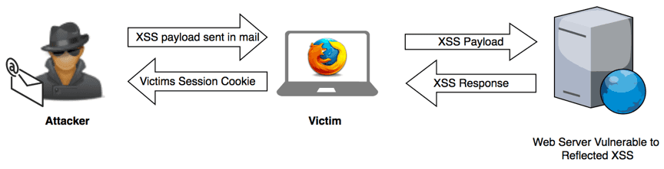
2.5.2 How to Prevent XSS Attack
Access Control or Authorization, Be careful when clicking strange links
Input Validation: Always validate and sanitize all user inputs. This includes data from forms, URLs, or any source where users can enter data.
Use Security Libraries and Tools: Use security libraries like AntiXSS of MS or XSS filtering tools provided by frameworks to sanitize
Avoid embedding user data directly in HTML, especially inside <script> or <style> tags. Use JavaScript to handle user data safely.
Write Middleware code to prevent XSS attacks
Notes:
Sanitize : Khử trùng
Avoid : tránh

Slide 46
Example
Input Validation and Encoding
HTML input encoding: Convert <script> thành &lt;script&gt; to intercept excute script code (If if necessary)
HTML encoding in Razor view, Ex: @Html.Encode(userInput)
Check and clean output data
Using @Html.Raw(Model.UserComment) ensures clean data
Configure Content Security Policy (CSP)
// only javascripts belonging to the domain are executed.
app.Use(async (context, next) =>
{
context.Response.Headers.Add("Content-Security-Policy", "default-src 'self'; script-src 'self';");
await next();
});
Use Middleware (next slide)

Slide 47
ASP.NET Core Middleware
Middleware is a software component that's inserted into the application's request pipeline. It's a mechanism that intercepts HTTP requests and responses, enabling developers to process it.
Types of middleware: authentication, authorization… (program.cs)
How it works: When a request arrives, it passes through each middleware in the pipeline:
Process the request
Invoke the next middleware
Produce a response and terminate the pipeline
https://learn.microsoft.com/en-us/aspnet/core/fundamentals/middleware/?view=aspnetcore-8.0
Notes:
Mechanism cơ chế
Intercept : ngăn chặn

Slide 48
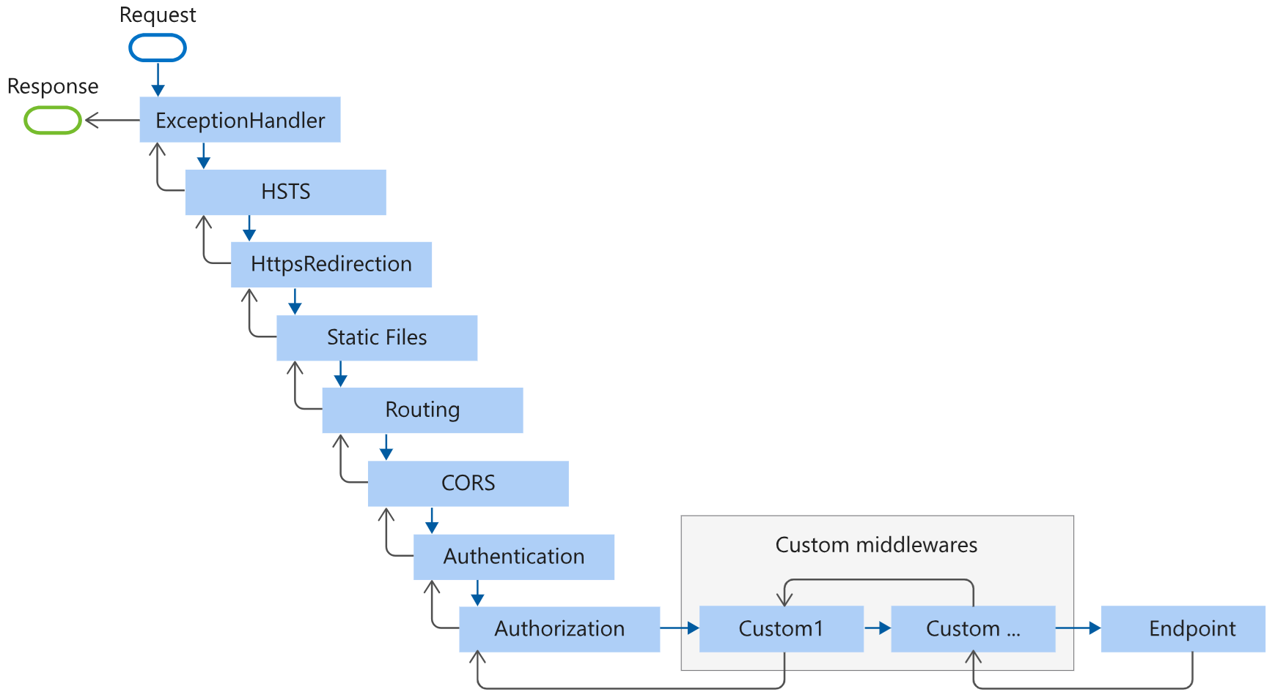
Middleware order

Slide 49
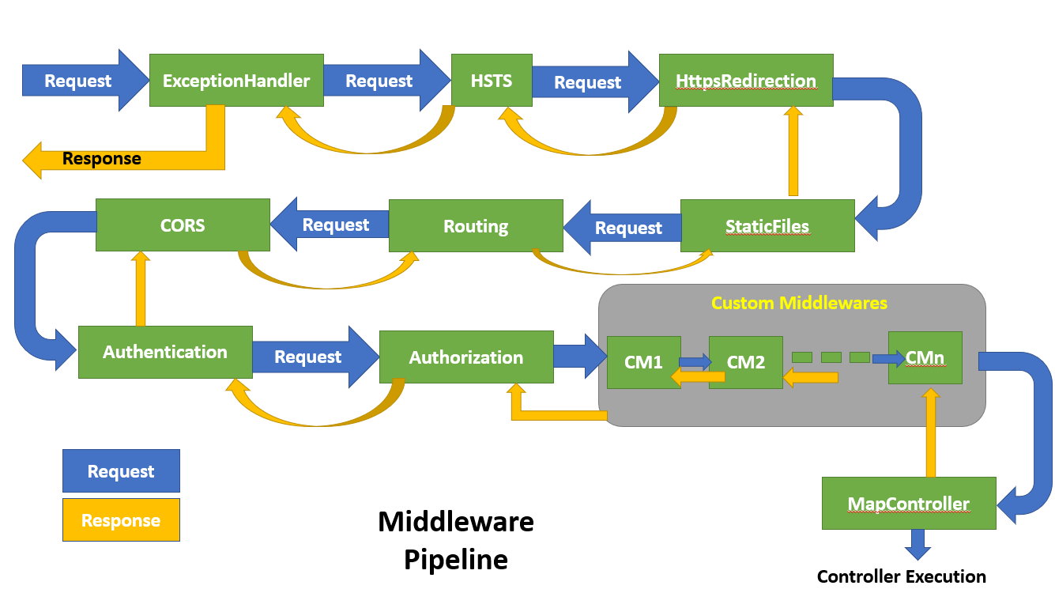
Middleware order
https://learn.microsoft.com/en-us/aspnet/core/fundamentals/middleware/?view=aspnetcore-8.0

Slide 50
Create a Middleware
Step 1: Create a class in Middleware Folder
public class MyMiddleware
{
private readonly RequestDelegate _next; // Obligatory (must)
public MyMiddleware(RequestDelegate next)
{
_next = next;
}
public async Task InvokeAsync(HttpContext context)
{
//Code at here --> Logical processing before forwarding requests.
await _next(context); // next middleware in pipeline
}
}
Step 2: in Program.cs
app.UseMiddleware<MyMiddleware>();

Slide 51
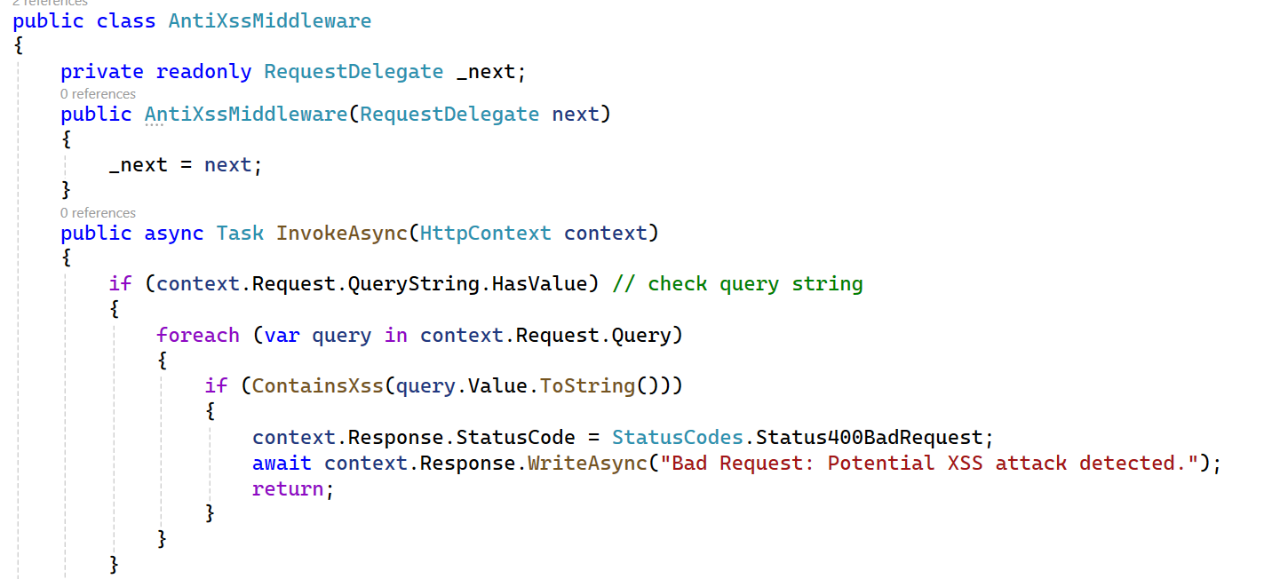
Create a AntiXssMiddleware class
//Code in Program.cs
app.UseMiddleware<AntiXssMiddleware>();

Slide 52
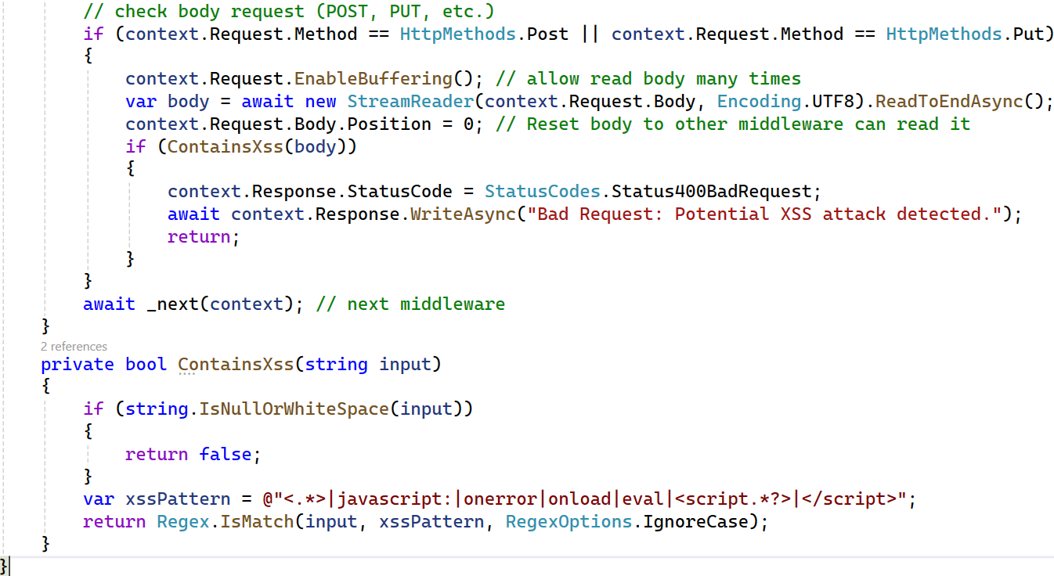
//In Program.cs
app.UseMiddleware<AntiXssMiddleware>();

Slide 53
Homework 4
Prevent XSS
Create and Apply a Middleware prevent XSS attack as lecture
Study and Optimize Exercise 1

Slide 54
2. API Security Solutions
2.1. Input Validation and CORS (Cross-Origin Requests) 2.2. Data Encryption 2.3. Authentication and Authorization 2.4. Rate Limiting
2.5. Prevent XSS (Cross-Site Scripting)
2.6. Prevent CSRF (Cross-Site Request Forgery) 2.7. Using an API Firewall (API Gateway)

Slide 55
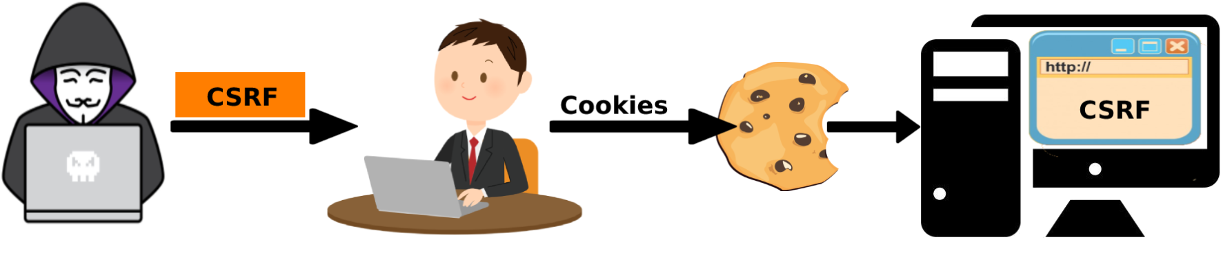
2.5. CSRF (Cross-Site Request Forgery)
CSRF is a type of network attack in which a hacker tricks an authenticated user into performing unwanted actions on a website they are logged.
This tool is commonly used in web applications that have a session management mechanism or cookies to authenticate users.
But, APIs are not configured to prevent CSRF attacks when using OAuth2 authentication such as JWT Bearer, Google ...
Notes:
exploits : khai thác
induce : gây ra

Slide 56
2.5.1. Prevent CSRF attack for Client
CSRF token: Add a unique token to each form on the website. This token is compared to a token stored on the server. If they don't match, the request is rejected.
Check the request origin (Referer header): Check if the request came from a trusted domain.
Use HTTP-only cookies: Prevent JavaScript from accessing cookies, reducing the attacker's ability to steal cookies.
Use SameSite cookies: Restrict the browser from sending cookies along with cross-site requests.
Implement two-factor authentication.
https://learn.microsoft.com/en-us/aspnet/web-api/overview/security/preventing-cross-site-request-forgery-csrf-attacks
Notes:
https://learn.microsoft.com/en-us/aspnet/web-api/overview/security/preventing-cross-site-request-forgery-csrf-attacks

Slide 57
2.5.2. Prevent CSRF attack
a. Only allow cookies to be sent within the same domain (origin)
builder.Services.Configure<CookiePolicyOptions>(options =>
{
options.MinimumSameSitePolicy = SameSiteMode.Strict;
});
builder.Services.AddControllersWithViews(options =>
{
options.Filters.Add(new AutoValidateAntiforgeryTokenAttribute());
});
builder.Services.AddAntiforgery(options =>
{
options.HeaderName = "X-CSRF-TOKEN"; //Client must using this name
});
Notes:
https://learn.microsoft.com/en-us/aspnet/core/security/anti-request-forgery?view=aspnetcore-8.0

Slide 58
2.5.2. Prevent CSRF attack
b. Use [ValidateAntiForgeryToken] in controllers
[Route("[controller]/[action]"), ApiController]
[ValidateAntiForgeryToken]
public class AuthController : ControllerBase
{
private readonly IAuthService _authService;
public AuthController(IAuthService authService)
{
_authService = authService;
}
}
public class MyController : Controller
{
[HttpPost] [ValidateAntiForgeryToken]
public IActionResult Create([FromBody] Account model)
{
return Ok(model);
}
}
Notes:
https://learn.microsoft.com/en-us/aspnet/core/security/anti-request-forgery?view=aspnetcore-8.0

Slide 59
2.5.2. Prevent CSRF attack
c. Use in Post Forms
<form method="post" asp-controller="Account" asp-action="TransferMoney">
<!-- Add CSRF Token into form -->
@Html.AntiForgeryToken()
<input type="text" name="amount" />
<button type="submit">Transfer</button>
</form>
$.ajax({
url: "/api/account/transfer",
type: "POST",
headers: {
'Content-Type': 'application/json',
// get CSRF token from form
"X-CSRF-TOKEN": $('input[name="__RequestVerificationToken"]').val()
},
data: { amount: 100 },
success: function (response) {
console.log(response);
}
});
X-CSRF-TOKEN" is HeaderName
Notes:
https://learn.microsoft.com/en-us/aspnet/core/security/anti-request-forgery?view=aspnetcore-8.0

Slide 60
2.5.2. Prevent CSRF attack
d. Generate CSRF token
public class MyController : Controller
{
private readonly IAntiforgery _antiforgery;
public MyController(IAntiforgery antiforgery)
{
_antiforgery = antiforgery;
}
[HttpGet]
public IActionResult GetForm()
{
// Generate CSRF token and save it to cookie
var tokens = _antiforgery.GetAndStoreTokens(HttpContext);
ViewData["CSRFToken"] = tokens.RequestToken;
return View();
}
}
Notes:
https://learn.microsoft.com/en-us/aspnet/core/security/anti-request-forgery?view=aspnetcore-8.0

Slide 61
2. API Security Solutions
2.1. Input Validation and CORS (Cross-Origin Requests) 2.2. Data Encryption 2.3. Authentication and Authorization 2.4. Rate Limiting
2.5. Prevent XSS (Cross-Site Scripting)
2.6. Prevent CSRF (Cross-Site Request Forgery) 2.7. Using an API Firewall (API Gateway)

Slide 62
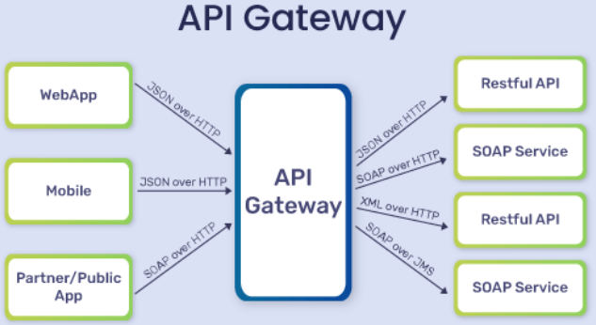
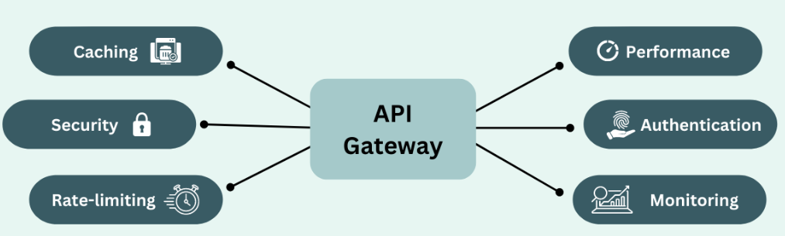
2.7. Using an API Firewall (API Gateway)
API Firewall, also known as API Gateway, is a software that acts as a middleman between applications and external services. It serves as a security layer, controlling and managing all incoming and outgoing API requests.

Slide 63
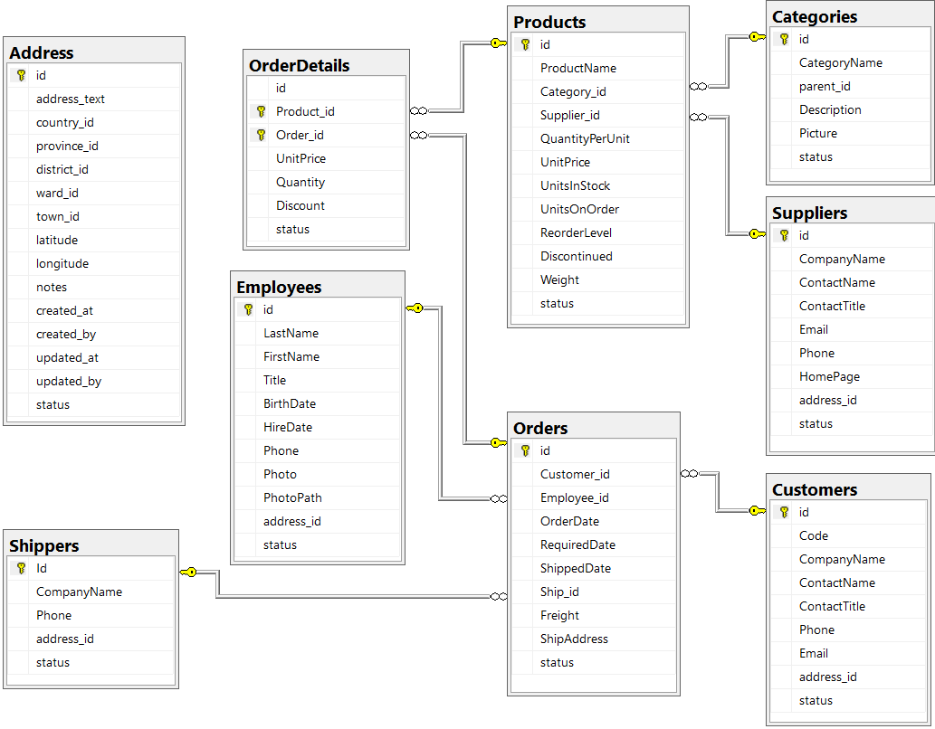
Database for Subject
Product Diagram
Link download Database

Slide 64
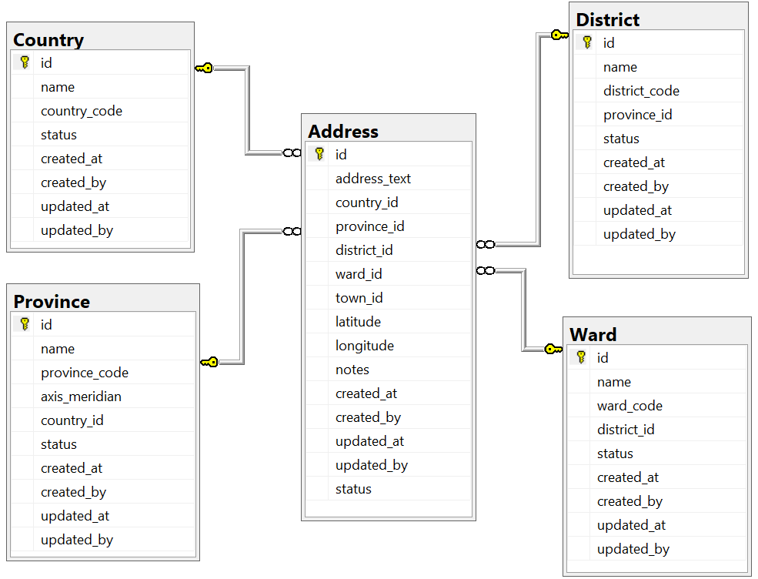
Database for Subject (cont)
Link download Database
Address Diagram

Slide 65
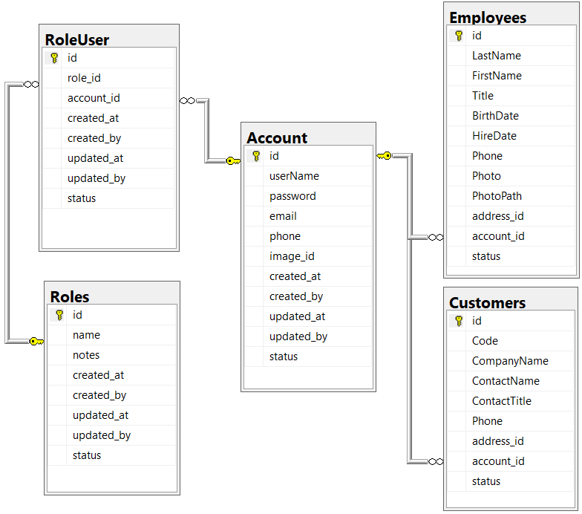
Database for Subject (cont)
Link download Database
Account Diagram

Slide 66

THANK YOU
Q & a
Next time: Consume API
Lecturer: Phạm Đình Sắc
phamdinhsac@dntu.edu.vn
Section: Software Engineering

