Slide 1


CS 600: Artificial Intelligence Foundations
Foundations of Artificial Intelligence
Notes:
Welcome to CS 600: Artificial Intelligence Foundations. This learning module will focus on an introduction to Artificial Intelligence.

Slide 2
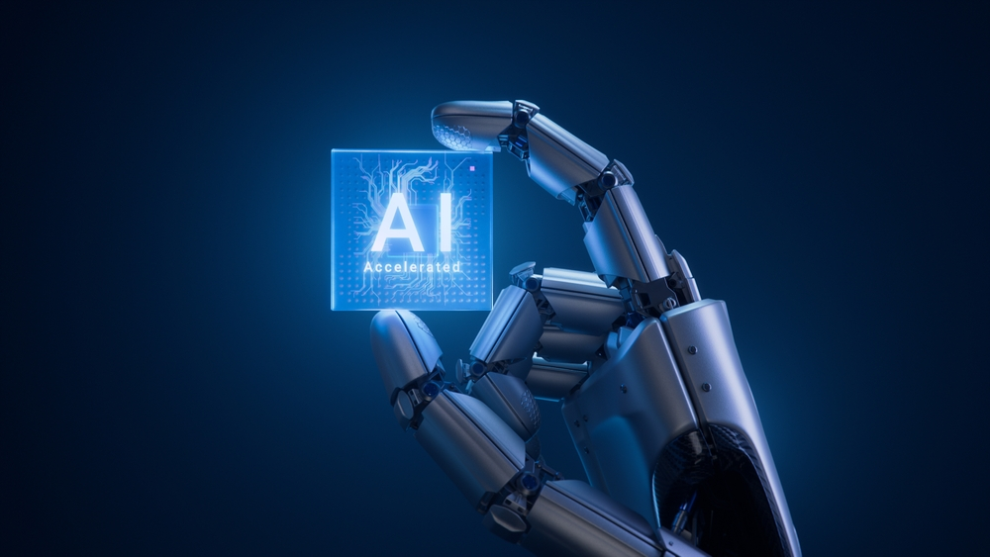
What Is Artificial Intelligence?
Artificial Intelligence (AI) is a branch of computer science
Focuses on creating systems that can perform tasks that normally require human intelligence
Examples:
Voice assistants (Siri, Alexa)
Recommendation systems (Netflix, Amazon)
Spam filters and navigation apps
Notes:
Artificial Intelligence, often called AI, is a branch of computer science focused on creating systems that can perform tasks that normally require human intelligence. These tasks include things like recognizing speech, understanding images, making decisions, and solving problems.
You already interact with AI more often than you might realize. Examples include voice assistants like Siri or Alexa, recommendation systems on Netflix or Amazon, spam filters in your email, and even navigation apps that suggest the fastest route home.

Slide 3
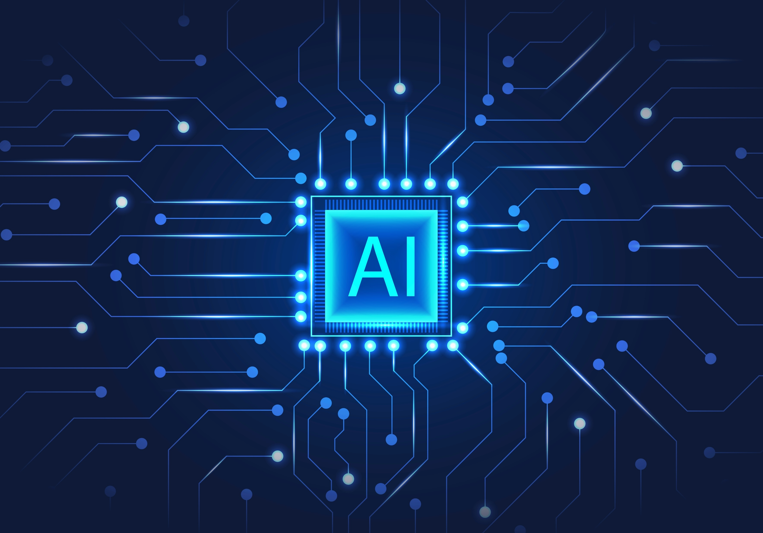
Why AI Matters?
Helps analyze large amounts of data
Automates tasks
Supports decision-making
Used in everyday technology, often without us noticing it
Notes:
AI matters because it allows computers to analyze large amounts of information, automate tasks, and support decision-making in ways that would be difficult or impossible for humans to do alone.

Slide 4
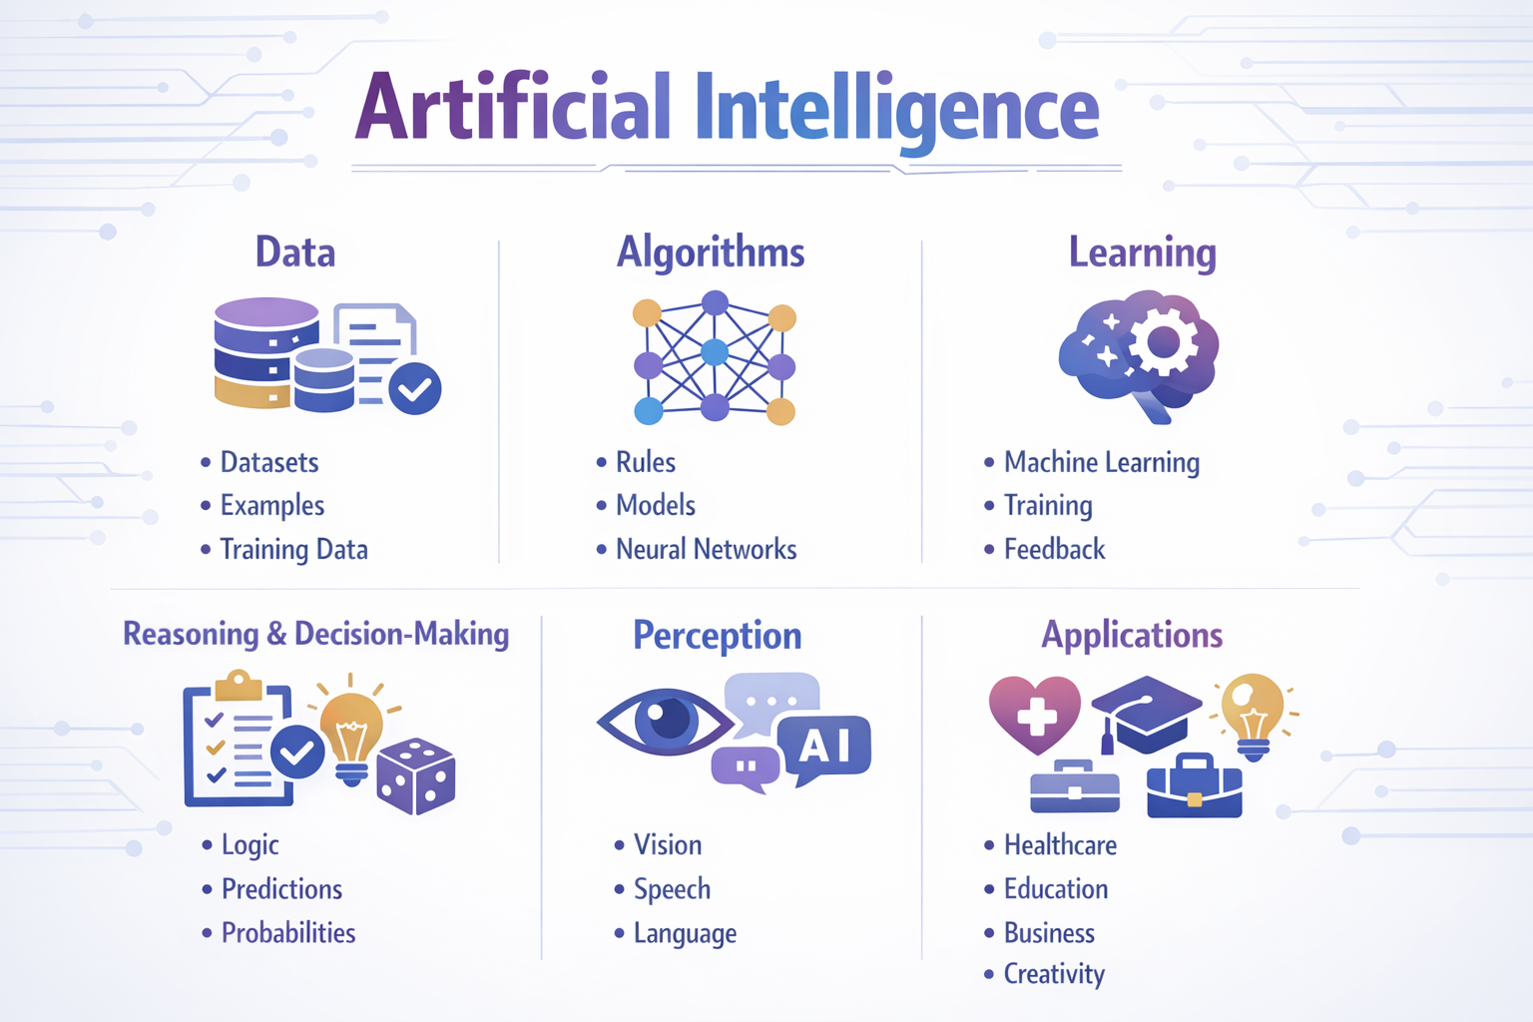
Core Ideas Behind AI
AI systems are built around a few key concepts:
Intelligent agents
Data and knowledge
Learning and adaptation
Reasoning and decision-making
Image created using ChatGPT
Notes:
To understand how AI works, it helps to look at a few key ideas that form the foundation of the field. Concepts such as Intelligent Agents, Data and Knowledge, Learning and Adaptation, and Reasoning and Decision-making. Let’s explore these further.

Slide 5
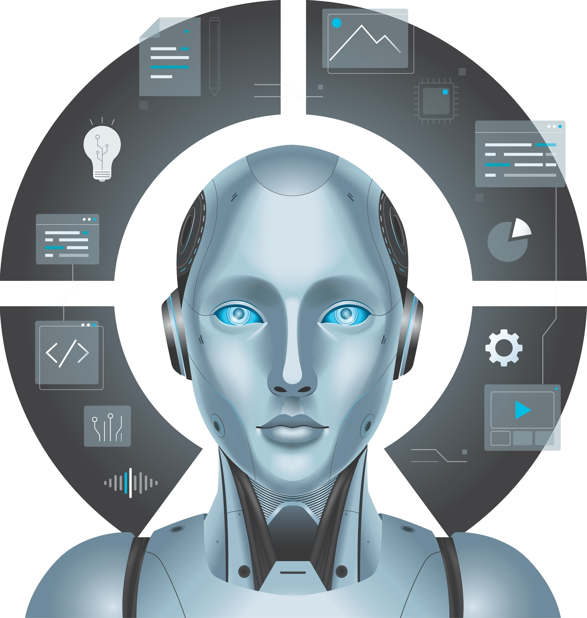
Intelligent Agents
An intelligent agent:
Observes its environment
Makes decisions
Takes actions to achieve a goal
Examples:
Self-driving car
Chess-playing program
Recommendation system
Notes:
In AI, many systems are described as intelligent agents. An intelligent agent is something that:
Observes its environment
Makes decisions based on what it observes
Takes actions to achieve a goal
For example, a chess-playing program looks at the board, decides on the best move, and then makes that move. A self-driving car observes the road, traffic, and signs, and then decides how to steer, brake, or accelerate.

Slide 6

Data and Knowledge
AI systems rely on:
Data (examples, information, experiences)
Knowledge (rules, relationships, patterns)
Two common approaches:
Rule-based systems (written by humans)
Data-driven systems (machine learning)
Notes:
AI systems depend heavily on data and knowledge.
Data is information, such as images, text, numbers, or examples of past behavior.
Knowledge is what the system learns or is told about how things relate to each other.
Some AI systems use rules that are written by humans. Others use machine learning, where the system learns patterns from data instead of being told exactly what to do in every situation.

Slide 7

Learning and Adaptation
Many AI systems can learn over time
Learning means:
Improving performance with experience
Finding patterns in data
Example:
Streaming services are learning your preferences
Notes:
One of the most powerful ideas in AI is learning. When an AI system learns, it improves its performance over time by studying examples and experiences.
For instance, a movie recommendation system learns what you like by paying attention to what you watch and rate. Over time, its suggestions usually become more accurate because it has learned your preferences.

Slide 8

Reasoning and Decision-Making
AI systems must choose the best action
This may involve:
Logic and rules
Comparing options
Using probabilities
Goal: Make the best possible decision with available information
Notes:
AI systems also need to reason and make decisions. This can involve:
Following logical rules
Comparing different options
Estimating probabilities
Choosing the best action based on available information
The goal is not just to act, but to act in a way that makes sense for the situation and moves the system closer to its goal.

Slide 9
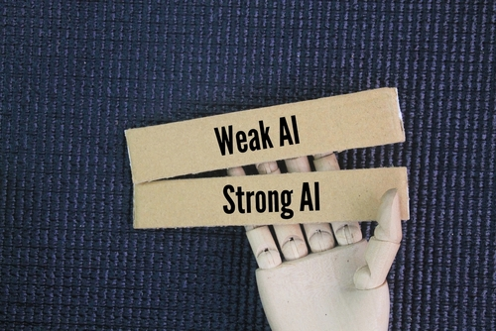
Types of Artificial Intelligence
Two major categories:
Narrow (Weak) AI
General (Strong) AI

Slide 10

Narrow (Weak) AI
Designed to perform a specific task
Examples:
Voice assistants
Facial recognition
Spam filters
Recommendation systems
All AI in use today is Narrow AI
Notes:
Not all AI is the same. There are two major categories you should know about.
Narrow (Weak) AI
Narrow AI is designed to do one specific task or a small set of tasks. Examples include:
Voice assistants
Face recognition systems
Spam filters
Recommendation systems
All AI systems in use today fall into this category.

Slide 11

General (Strong) AI
Would be able to perform any intellectual task a human can
Could learn and reason across many areas
Does not currently exist
Remains a long-term research goal
Notes:
General AI refers to a system that could perform any intellectual task that a human can do. This type of AI would be able to learn, reason, and solve problems across many different areas, just like a person.
At this time, General AI does not exist. It is a long-term goal of AI research, not something we currently have.

Slide 12

Why These Foundations Matter
Helps us:
Understand how AI really works
Recognize its limits
Use AI responsibly
AI is not magic:
Built by humans
Trained on data
Guided by algorithms
Notes:
Understanding the foundations of AI helps you:
Better understand how modern technology works
Think critically about what AI can and cannot do
Recognize the limits and risks of AI systems
Use AI tools more responsibly and effectively
Remember, AI is not magic. It is built by people, trained on data, and guided by rules and algorithms. This means it can be powerful, but it can also make mistakes or reflect the biases in its data.

Slide 13

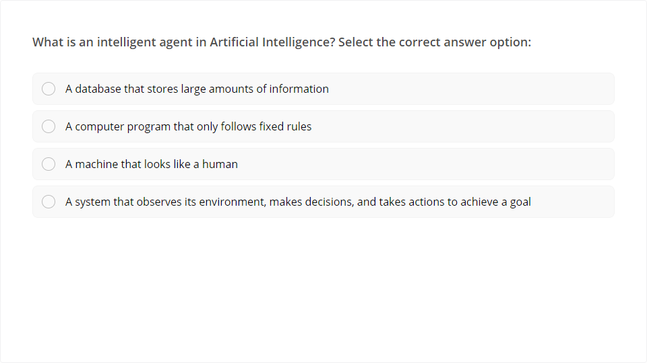
Knowledge Check
Quiz
Click the Quiz button to edit this object
Notes:
Quick Knowledge Check

Slide 14

Summary
AI systems can:
Observe
Learn
Reason
Act
Foundations of AI prepare us for:
Machine learning
Neural networks
Ethical considerations in AI
Notes:
In this lesson, you learned that Artificial Intelligence is about building systems that can:
Observe the world
Learn from data
Make decisions
Take actions to achieve goals
These foundations will help you better understand more advanced topics later in the course, such as machine learning, neural networks, and ethical issues in AI.

Slide 15
Closing
Next up: We’ll build on these foundations by exploring how machines learn and how data drives modern AI systems.
Notes:
Next up: We’ll build on these foundations by exploring how machines learn and how data drives modern AI systems.

