Slide 1

Technology Value Stream

Slide 2
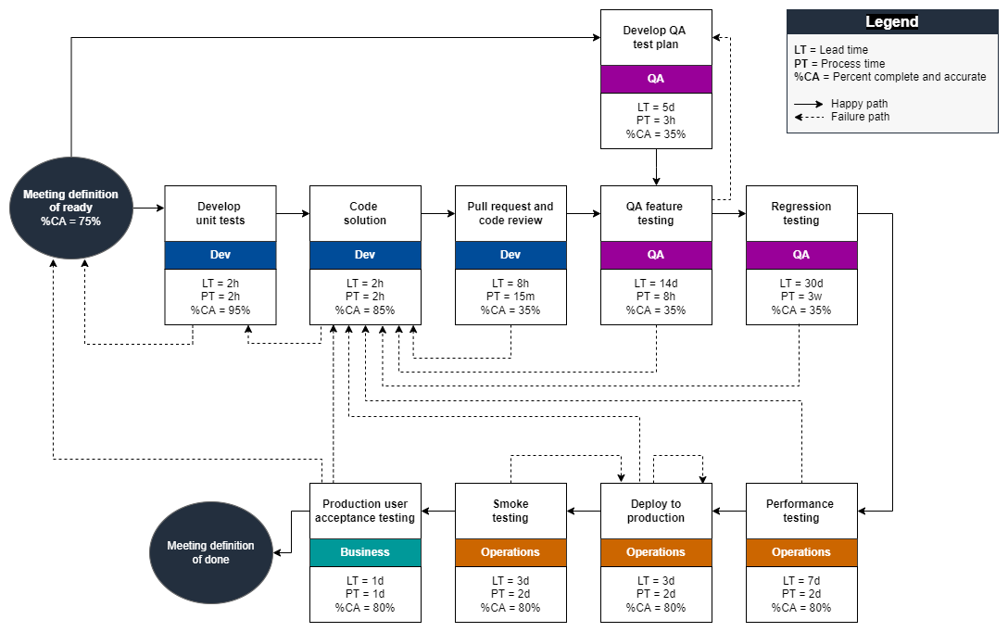
What is the value stream
Minimizing processes to achieve the same result
Eliminate waste by finding creative solutions to what processes are necessary to deliver the end product

Slide 3
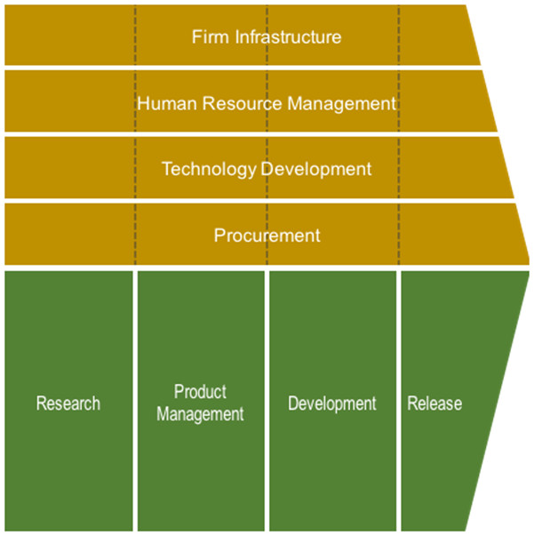
Value Creation
Creating activities that provide value to the end user
Encompasses all activities that go into creating the product

Slide 4
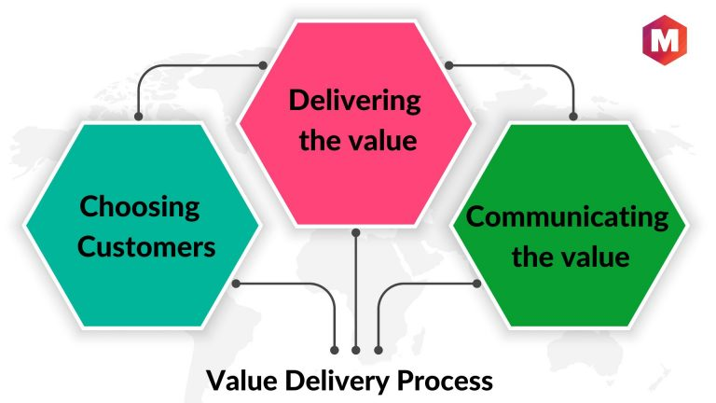
Value Delivery
Activities that deliver value to your customers
Examples
Deploying code
advertising/sales

Slide 5
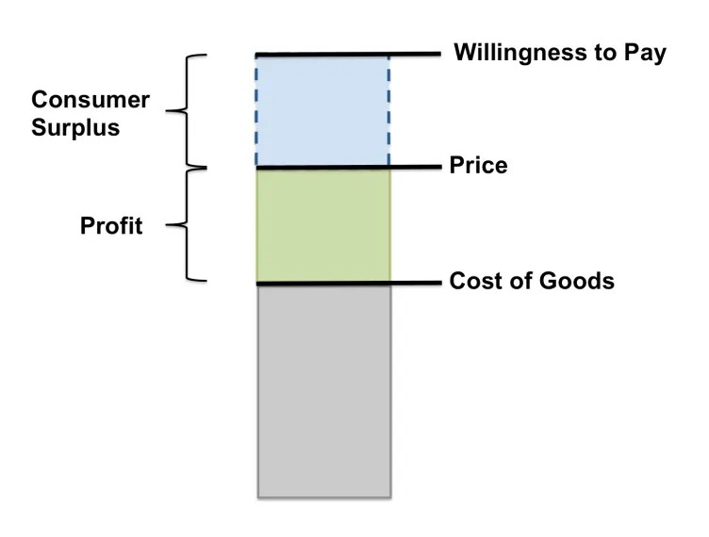
Value Capture
Determining profitability by setting price

Slide 6
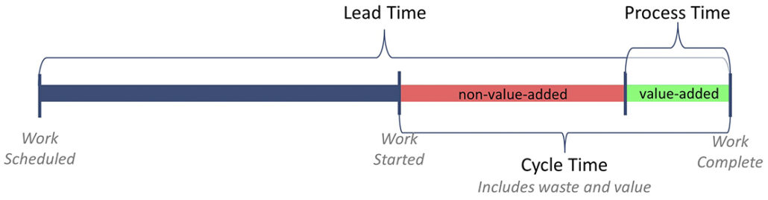
Lead Time VS Process Time

Slide 7
Lead time – time from customer request to them receiving something
Cycle time – time it takes from the team starting to work to delivering on the request
Process time – portion of the cycle time where value is being added

Slide 8
Common scenario: months long lead times
Long lead times limit ability to deliver value to customers
Customers likely to seek competitor's product if time between updates or release is too long
Potential sign of development issues like bottlenecks

Slide 9
The Ideal: Hours long lead times
Quick response to customer feedback
Pace set innovation for the industry

