Slide 1
Counting

Slide 2
Counting xor
movl $0, %eax
xorl %eax, %eax

Slide 3
Counting xor
movl $0, %eax
xorl %eax, %eax
e.g. EAX = 10100010101010010101101100101010

Slide 4
Counting xor
movl $0, %eax
xorl %eax, %eax
10100010101010010101101100101010 10100010101010010101101100101010
00000000000000000000000000000000
e.g. EAX = 10100010101010010101101100101010
XOR

Slide 5
Counting xor
movl $0, %eax
xorl %eax, %eax
10100010101010010101101100101010 10100010101010010101101100101010
00000000000000000000000000000000
e.g. EAX = 10100010101010010101101100101010
XOR
= EAX

Slide 6
Counting shift
movl %ebx, %eax # copy info into EAX so we don’t lose the original data
shrl $1, %eax # shift EAX one position to the right
andl $0b00000000000000000000000000000001, %eax # mask
cmpl $0b00000000000000000000000000000001, %eax # is the result 1 or 0?
je yes_he_likes_dressy_clothes
jmp no_he_doesnt_like_dressy_clothes
EBX = 1011
Dad’s preferences:
Food: 1
Heavy Metal Music: 0
Wearing Dressy Clothes: 1
Football: 1

Slide 7
Counting shift
movl %ebx, %eax # copy info into EAX so we don’t lose the original data
shrl $1, %eax # shift EAX one position to the right
andl $0b00000000000000000000000000000001, %eax # mask
cmpl $0b00000000000000000000000000000001, %eax # is the result 1 or 0?
je yes_he_likes_dressy_clothes
jmp no_he_doesnt_like_dressy_clothes
EBX = 1011
EAX = 1011

Slide 8

Counting shift
movl %ebx, %eax # copy info into EAX so we don’t lose the original data
shrl $1, %eax # shift EAX one position to the right
andl $0b00000000000000000000000000000001, %eax # mask
cmpl $0b00000000000000000000000000000001, %eax # is the result 1 or 0?
je yes_he_likes_dressy_clothes
jmp no_he_doesnt_like_dressy_clothes
1 0 1 1
0 1 0 1 1
EBX = 1011
EAX = 1011 $→$ 0101

Slide 9
Counting shift
movl %ebx, %eax # copy info into EAX so we don’t lose the original data
shrl $1, %eax # shift EAX one position to the right
andl $0b00000000000000000000000000000001, %eax # mask
cmpl $0b00000000000000000000000000000001, %eax # is the result 1 or 0?
je yes_he_likes_dressy_clothes
jmp no_he_doesnt_like_dressy_clothes
1 0 1 1
0 1 0 1 1
EBX = 1011
EAX = 0101

Slide 10
Counting mask
movl %ebx, %eax # copy info into EAX so we don’t lose the original data
shrl $1, %eax # shift EAX one position to the right
andl $0b00000000000000000000000000000001, %eax # mask
cmpl $0b00000000000000000000000000000001, %eax # is the result 1 or 0?
je yes_he_likes_dressy_clothes
jmp no_he_doesnt_like_dressy_clothes
Masking is the process of eliminating everything you don’t want.
EBX = 1011
EAX = 0101

Slide 11
Counting mask
movl %ebx, %eax # copy info into EAX so we don’t lose the original data
shrl $1, %eax # shift EAX one position to the right
andl $0b00000000000000000000000000000001, %eax # mask
cmpl $0b00000000000000000000000000000001, %eax # is the result 1 or 0?
je yes_he_likes_dressy_clothes
jmp no_he_doesnt_like_dressy_clothes
Masking is the process of eliminating everything you don’t want.
It is done by doing an AND with a number that has the bits we are interested in set to 1.
EBX = 1011
EAX = 0101

Slide 12
Counting mask
movl %ebx, %eax # copy info into EAX so we don’t lose the original data
shrl $1, %eax # shift EAX one position to the right
andl $0b00000000000000000000000000000001, %eax # mask
cmpl $0b00000000000000000000000000000001, %eax # is the result 1 or 0?
je yes_he_likes_dressy_clothes
jmp no_he_doesnt_like_dressy_clothes
Masking is the process of eliminating everything you don’t want.
It is done by doing an AND with a number that has the bits we are interested in set to 1.
EBX = 1011
EAX = 0101
Dad’s preferences:
Food: 1
Heavy Metal Music: 0
Wearing Dressy Clothes: 1
Football: 1
dressy clothes ?

Slide 13
Counting mask
movl %ebx, %eax # copy info into EAX so we don’t lose the original data
shrl $1, %eax # shift EAX one position to the right
andl $0b00000000000000000000000000000001, %eax # mask
cmpl $0b00000000000000000000000000000001, %eax # is the result 1 or 0?
je yes_he_likes_dressy_clothes
jmp no_he_doesnt_like_dressy_clothes
Masking is the process of eliminating everything you don’t want.
It is done by doing an AND with a number that has the bits we are interested in set to 1.
EBX = 1011
EAX = 0101
Dad’s preferences:
Food: 1
Heavy Metal Music: 0
Wearing Dressy Clothes: 1
Football: 1
dressy clothes ?

Slide 14
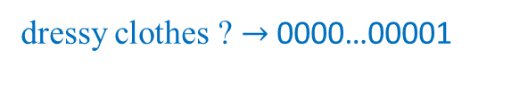
Counting mask
movl %ebx, %eax # copy info into EAX so we don’t lose the original data
shrl $1, %eax # shift EAX one position to the right
andl $0b00000000000000000000000000000001, %eax # mask
cmpl $0b00000000000000000000000000000001, %eax # is the result 1 or 0?
je yes_he_likes_dressy_clothes
jmp no_he_doesnt_like_dressy_clothes
Masking is the process of eliminating everything you don’t want.
It is done by doing an AND with a number that has the bits we are interested in set to 1.
EBX = 1011
EAX = 0101
Dad’s preferences:
Food: 1
Heavy Metal Music: 0
Wearing Dressy Clothes: 1
Football: 1
dressy clothes ? $→$ 0000…00001

Slide 15
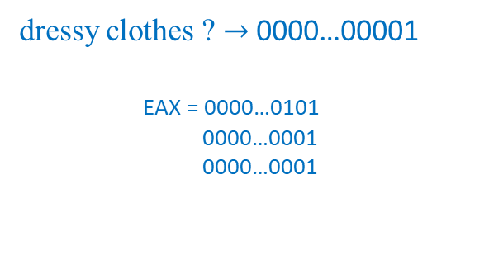
Counting mask
movl %ebx, %eax # copy info into EAX so we don’t lose the original data
shrl $1, %eax # shift EAX one position to the right
andl $0b00000000000000000000000000000001, %eax # mask
cmpl $0b00000000000000000000000000000001, %eax # is the result 1 or 0?
je yes_he_likes_dressy_clothes
jmp no_he_doesnt_like_dressy_clothes
Masking is the process of eliminating everything you don’t want.
It is done by doing an AND with a number that has the bits we are interested in set to 1.
EBX = 1011
EAX = 0101
Dad’s preferences:
Food: 1
Heavy Metal Music: 0
Wearing Dressy Clothes: 1
Football: 1
dressy clothes ? $→$ 0000…00001
EAX = 0000…0101
0000…0001
0000…0001
AND

Slide 16
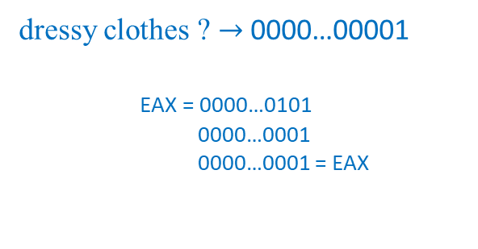
Counting mask
movl %ebx, %eax # copy info into EAX so we don’t lose the original data
shrl $1, %eax # shift EAX one position to the right
andl $0b00000000000000000000000000000001, %eax # mask
cmpl $0b00000000000000000000000000000001, %eax # is the result 1 or 0?
je yes_he_likes_dressy_clothes
jmp no_he_doesnt_like_dressy_clothes
Masking is the process of eliminating everything you don’t want.
It is done by doing an AND with a number that has the bits we are interested in set to 1.
EBX = 1011
EAX = 0001
Dad’s preferences:
Food: 1
Heavy Metal Music: 0
Wearing Dressy Clothes: 1
Football: 1
dressy clothes ? $→$ 0000…00001
EAX = 0000…0101
0000…0001
0000…0001 = EAX
AND

Slide 17

Counting shift and mask
movl %ebx, %eax # copy info into EAX so we don’t lose the original data
shrl $1, %eax # shift EAX one position to the right
andl $0b00000000000000000000000000000001, %eax # mask
cmpl $0b00000000000000000000000000000001, %eax # is the result 1 or 0?
je yes_he_likes_dressy_clothes
jmp no_he_doesnt_like_dressy_clothes
EBX = 1011
EAX = 0001 = 0001 ? $→$ true
Dad’s preferences:
Food: 1
Heavy Metal Music: 0
Wearing Dressy Clothes: 1
Football: 1
dressy clothes ?
EAX = 0000…0001
0000…0001
true
CMP

Slide 18
Counting shift and mask
movl %ebx, %eax # copy info into EAX so we don’t lose the original data
shrl $1, %eax # shift EAX one position to the right
andl $0b00000000000000000000000000000001, %eax # mask
cmpl $0b00000000000000000000000000000001, %eax # is the result 1 or 0?
je yes_he_likes_dressy_clothes
jmp no_he_doesnt_like_dressy_clothes
EBX = 1011
EAX = 0001 = 0001 ? $→$ true
Dad’s preferences:
Food: 1
Heavy Metal Music: 0
Wearing Dressy Clothes: 1
Football: 1
dressy clothes ?
EAX = 0000…0001
0000…0001
true
CMP

Slide 19
Counting rotate
Rotate left 10010111 = 00101111

Slide 20
Counting rotate
Rotate left 10010111 = 00101111

Slide 21
Counting flags
Flag | Permission | Binary | Octal
O_WRONLY | open the file in write-only mode | 0b00000000000000000000000000000001 | 01
O_RDWR | open the file for both reading and writing | 0b00000000000000000000000000000010 | 02
O_CREAT | create the file if it doesn’t already exist | 0b00000000000000000000000001000000 | 0100
O_TRUNC | erase the contents of the file if the file already exists | 0b00000000000000000000001000000000 | 01000
O_APPEND | start writing at the end of the file rather than at the beginning. | 0b00000000000000000000010000000000 | 02000

Slide 22
Counting flags
Flag | Permission | Binary | Octal
O_WRONLY | open the file in write-only mode | 0b00000000000000000000000000000001 | 01
O_RDWR | open the file for both reading and writing | 0b00000000000000000000000000000010 | 02
O_CREAT | create the file if it doesn’t already exist | 0b00000000000000000000000001000000 | 0100
O_TRUNC | erase the contents of the file if the file already exists | 0b00000000000000000000001000000000 | 01000
O_APPEND | start writing at the end of the file rather than at the beginning. | 0b00000000000000000000010000000000 | 02000
To use these flags, you OR them together in the combination that you want.

Slide 23
Counting flags
Flag | Permission | Binary | Octal
O_WRONLY | open the file in write-only mode | 0b00000000000000000000000000000001 | 01
O_RDWR | open the file for both reading and writing | 0b00000000000000000000000000000010 | 02
O_CREAT | create the file if it doesn’t already exist | 0b00000000000000000000000001000000 | 0100
O_TRUNC | erase the contents of the file if the file already exists | 0b00000000000000000000001000000000 | 01000
O_APPEND | start writing at the end of the file rather than at the beginning. | 0b00000000000000000000010000000000 | 02000
To use these flags, you OR them together in the combination that you want.
E.g. open a file in write-only mode and create the file if it doesn’t exist
O_WRONLY OR O_CREAT

Slide 24
Counting flags
Flag | Permission | Binary | Octal
O_WRONLY | open the file in write-only mode | 0b00000000000000000000000000000001 | 01
O_RDWR | open the file for both reading and writing | 0b00000000000000000000000000000010 | 02
O_CREAT | create the file if it doesn’t already exist | 0b00000000000000000000000001000000 | 0100
O_TRUNC | erase the contents of the file if the file already exists | 0b00000000000000000000001000000000 | 01000
O_APPEND | start writing at the end of the file rather than at the beginning. | 0b00000000000000000000010000000000 | 02000
To use these flags, you OR them together in the combination that you want.
E.g. open a file in write-only mode and create the file if it doesn’t exist
O_WRONLY OR O_CREAT
0001 0100 = 0101

Slide 25
Counting flags
Flag | Permission | Binary | Octal
O_WRONLY | open the file in write-only mode | 0b00000000000000000000000000000001 | 01
O_RDWR | open the file for both reading and writing | 0b00000000000000000000000000000010 | 02
O_CREAT | create the file if it doesn’t already exist | 0b00000000000000000000000001000000 | 0100
O_TRUNC | erase the contents of the file if the file already exists | 0b00000000000000000000001000000000 | 01000
O_APPEND | start writing at the end of the file rather than at the beginning. | 0b00000000000000000000010000000000 | 02000
To use these flags, you OR them together in the combination that you want.
E.g. open a file in write-only mode and create the file if it doesn’t exist
O_WRONLY OR O_CREAT
0001
0100
0101
OR
0001 0100 = 0101

Slide 26
Counting flags
Flag | Permission | Binary | Octal
O_WRONLY | open the file in write-only mode | 0b00000000000000000000000000000001 | 01
O_RDWR | open the file for both reading and writing | 0b00000000000000000000000000000010 | 02
O_CREAT | create the file if it doesn’t already exist | 0b00000000000000000000000001000000 | 0100
O_TRUNC | erase the contents of the file if the file already exists | 0b00000000000000000000001000000000 | 01000
O_APPEND | start writing at the end of the file rather than at the beginning. | 0b00000000000000000000010000000000 | 02000
Note that if you don’t set either O_WRONLY or O_RDWR, then the file is automatically opened in read-only mode (O_RDONLY, except that it isn’t really a flag since it’s zero).

Slide 27
Counting program status register
What would happen if you added two numbers and the result was larger than would fit in a register?

Slide 28
Counting program status register
What would happen if you added two numbers and the result was larger than would fit in a register?
32 bits
2,147,483,648 … etc … 128 64 32 16 8 4 2 1
1 1 1 1 1 1 1 1 1 1 1 1 1 1 1 1 1 1 1 1 1 1 1 1 1 1 1 1 1 1 1 1 = 4,294,967,295 (= 2³² – 1)

Slide 29
Counting program status register
What would happen if you added two numbers and the result was larger than would fit in a register?
32 bits
2,147,483,648 … etc … 128 64 32 16 8 4 2 1
1 1 1 1 1 1 1 1 1 1 1 1 1 1 1 1 1 1 1 1 1 1 1 1 1 1 1 1 1 1 1 1 = 4,294,967,295 (= 2³² – 1)

Slide 30
Counting program status register
What would happen if you added two numbers and the result was larger than would fit in a register?
32 bits
2,147,483,648 … etc … 128 64 32 16 8 4 2 1
1 1 1 1 1 1 1 1 1 1 1 1 1 1 1 1 1 1 1 1 1 1 1 1 1 1 1 1 1 1 1 1 = 4,294,967,295 (= 2³² – 1)

Slide 31
Counting program status register
What would happen if you added two numbers and the result was larger than would fit in a register?
2,147,483,648 … etc … 128 64 32 16 8 4 2 1
1 1 1 1 1 1 1 1 1 1 1 1 1 1 1 1 1 1 1 1 1 1 1 1 1 1 1 1 1 1 1 1 = 4,294,967,295 (= 2³² – 1)
0 0 0 0 0 0 0 0 0 0 0 0 0 0 0 0 0 0 0 0 0 0 0 0 0 0 0 0 0 0 0 1 = 1

Slide 32
Counting program status register
What would happen if you added two numbers and the result was larger than would fit in a register?
2,147,483,648 … etc … 128 64 32 16 8 4 2 1
1 1 1 1 1 1 1 1 1 1 1 1 1 1 1 1 1 1 1 1 1 1 1 1 1 1 1 1 1 1 1 1 = 4,294,967,295 (= 2³² – 1)
0 0 0 0 0 0 0 0 0 0 0 0 0 0 0 0 0 0 0 0 0 0 0 0 0 0 0 0 0 0 0 1 = 1
0 0 0 0 0 0 0 0 0 0 0 0 0 0 0 0 0 0 0 0 0 0 0 0 0 0 0 0 0 0 0 1
1 1 1 1 1 1 1 1 1 1 1 1 1 1 1 1 1 1 1 1 1 1 1 1 1 1 1 1 1 1 1 1 = 4,294,967,296

Slide 33
Counting program status register
What would happen if you added two numbers and the result was larger than would fit in a register?
2,147,483,648 … etc … 128 64 32 16 8 4 2 1
1 1 1 1 1 1 1 1 1 1 1 1 1 1 1 1 1 1 1 1 1 1 1 1 1 1 1 1 1 1 1 1 = 4,294,967,295 (= 2³² – 1)
0 0 0 0 0 0 0 0 0 0 0 0 0 0 0 0 0 0 0 0 0 0 0 0 0 0 0 0 0 0 0 1 = 1
0 0 0 0 0 0 0 0 0 0 0 0 0 0 0 0 0 0 0 0 0 0 0 0 0 0 0 0 0 0 0 1
1 1 1 1 1 1 1 1 1 1 1 1 1 1 1 1 1 1 1 1 1 1 1 1 1 1 1 1 1 1 1 1 = 4,294,967,296
The program status register has a flag called the carry flag. You can test it to see if the last computation overflowed the register.
PROGRAM STATUS REGISTER = 0 0 0 0 0 0 0 0 0 0 0 0 0 0 0 0 0 0 0 0 0 0 0 0 0 0 0 0 0 0 0 0

Slide 34
Counting program status register
What would happen if you added two numbers and the result was larger than would fit in a register?
2,147,483,648 … etc … 128 64 32 16 8 4 2 1
1 1 1 1 1 1 1 1 1 1 1 1 1 1 1 1 1 1 1 1 1 1 1 1 1 1 1 1 1 1 1 1 = 4,294,967,295 (= 2³² – 1)
0 0 0 0 0 0 0 0 0 0 0 0 0 0 0 0 0 0 0 0 0 0 0 0 0 0 0 0 0 0 0 1 = 1
0 0 0 0 0 0 0 0 0 0 0 0 0 0 0 0 0 0 0 0 0 0 0 0 0 0 0 0 0 0 0 1
1 1 1 1 1 1 1 1 1 1 1 1 1 1 1 1 1 1 1 1 1 1 1 1 1 1 1 1 1 1 1 1 = 4,294,967,296
The program status register has a flag called the carry flag. You can test it to see if the last computation overflowed the register.
carry flag
PROGRAM STATUS REGISTER = 0 0 0 0 0 0 0 0 0 0 0 0 0 0 0 0 0 0 0 0 0 0 0 0 0 0 0 0 0 0 0 0

Slide 35
Counting program status register
What would happen if you added two numbers and the result was larger than would fit in a register?
2,147,483,648 … etc … 128 64 32 16 8 4 2 1
1 1 1 1 1 1 1 1 1 1 1 1 1 1 1 1 1 1 1 1 1 1 1 1 1 1 1 1 1 1 1 1 = 4,294,967,295 (= 2³² – 1)
0 0 0 0 0 0 0 0 0 0 0 0 0 0 0 0 0 0 0 0 0 0 0 0 0 0 0 0 0 0 0 1 = 1
0 0 0 0 0 0 0 0 0 0 0 0 0 0 0 0 0 0 0 0 0 0 0 0 0 0 0 0 0 0 0 1
1 1 1 1 1 1 1 1 1 1 1 1 1 1 1 1 1 1 1 1 1 1 1 1 1 1 1 1 1 1 1 1 = 4,294,967,296
The program status register has a flag called the carry flag. You can test it to see if the last computation overflowed the register.
carry flag
PROGRAM STATUS REGISTER = 0 0 0 0 0 0 0 0 0 0 0 0 0 0 0 0 0 0 0 1 0 0 0 0 0 0 0 0 0 0 0 0

Slide 36
Counting program status register
What would happen if you added two numbers and the result was larger than would fit in a register?
2,147,483,648 … etc … 128 64 32 16 8 4 2 1
1 1 1 1 1 1 1 1 1 1 1 1 1 1 1 1 1 1 1 1 1 1 1 1 1 1 1 1 1 1 1 1 = 4,294,967,295 (= 2³² – 1)
0 0 0 0 0 0 0 0 0 0 0 0 0 0 0 0 0 0 0 0 0 0 0 0 0 0 0 0 0 0 0 1 = 1
0 0 0 0 0 0 0 0 0 0 0 0 0 0 0 0 0 0 0 0 0 0 0 0 0 0 0 0 0 0 0 1
1 1 1 1 1 1 1 1 1 1 1 1 1 1 1 1 1 1 1 1 1 1 1 1 1 1 1 1 1 1 1 1 = 4,294,967,296

Slide 37
Counting program status register
What would happen if you added two numbers and the result was larger than would fit in a register?
2,147,483,648 … etc … 128 64 32 16 8 4 2 1
1 1 1 1 1 1 1 1 1 1 1 1 1 1 1 1 1 1 1 1 1 1 1 1 1 1 1 1 1 1 1 1 = 4,294,967,295 (= 2³² – 1)
0 0 0 0 0 0 0 0 0 0 0 0 0 0 0 0 0 0 0 0 0 0 0 0 0 0 0 0 0 0 0 1 = 1
0 0 0 0 0 0 0 0 0 0 0 0 0 0 0 0 0 0 0 0 0 0 0 0 0 0 0 0 0 0 0 1
1 1 1 1 1 1 1 1 1 1 1 1 1 1 1 1 1 1 1 1 1 1 1 1 1 1 1 1 1 1 1 1 = 4,294,967,296
2nd 32-bit register
1st 32-bit register

Slide 38
Counting program status register
What would happen if you added two numbers and the result was larger than would fit in a register?
2,147,483,648 … etc … 128 64 32 16 8 4 2 1
1 1 1 1 1 1 1 1 1 1 1 1 1 1 1 1 1 1 1 1 1 1 1 1 1 1 1 1 1 1 1 1 = 4,294,967,295 (= 2³² – 1)
0 0 0 0 0 0 0 0 0 0 0 0 0 0 0 0 0 0 0 0 0 0 0 0 0 0 0 0 0 0 0 1 = 1
0 0 0 0 0 0 0 0 0 0 0 0 0 0 0 0 0 0 0 0 0 0 0 0 0 0 0 0 0 0 0 1
1 1 1 1 1 1 1 1 1 1 1 1 1 1 1 1 1 1 1 1 1 1 1 1 1 1 1 1 1 1 1 1 = 4,294,967,296
2nd 32-bit register
1st 32-bit register
64-bit register

Slide 39
Counting program status register
What would happen if you added two numbers and the result was larger than would fit in a register?
2,147,483,648 … etc … 128 64 32 16 8 4 2 1
1 1 1 1 1 1 1 1 1 1 1 1 1 1 1 1 1 1 1 1 1 1 1 1 1 1 1 1 1 1 1 1 = 4,294,967,295 (= 2³² – 1)
0 0 0 0 0 0 0 0 0 0 0 0 0 0 0 0 0 0 0 0 0 0 0 0 0 0 0 0 0 0 0 1 = 1
0 0 0 0 0 0 0 0 0 0 0 0 0 0 0 0 0 0 0 0 0 0 0 0 0 0 0 0 0 0 0 1
1 1 1 1 1 1 1 1 1 1 1 1 1 1 1 1 1 1 1 1 1 1 1 1 1 1 1 1 1 1 1 1 = 4,294,967,296
2nd 32-bit register
Most Significant Byte (MSB)
1st 32-bit register
Least Significant Byte (LSB)
64-bit register

Slide 40
Counting program status register
There are flags for a number of different statuses.
carry flag
PROGRAM STATUS REGISTER = 0 0 0 0 0 0 0 0 0 0 0 0 0 0 0 0 0 0 0 0 0 0 0 0 0 0 0 0 0 0 0 0

Slide 41
Counting program status register
There are flags for a number of different statuses.
E.g.
When you do a compare (cmpl) instruction, the result is stored in this register.
compare flag
carry flag
PROGRAM STATUS REGISTER = 0 0 0 0 0 0 0 0 0 0 0 0 0 0 0 0 0 0 0 0 0 0 0 0 0 0 0 0 0 0 0 0

Slide 42
Counting program status register
There are flags for a number of different statuses.
E.g.
When you do a compare (cmpl) instruction, the result is stored in this register.
The conditional jump instructions (jge, jne, etc) use these results to tell whether or not they should jump.
conditional jumps flag
compare flag
carry flag
PROGRAM STATUS REGISTER = 0 0 0 0 0 0 0 0 0 0 0 0 0 0 0 0 0 0 0 0 0 0 0 0 0 0 0 0 0 0 0 0

Slide 43
Counting program status register
There are flags for a number of different statuses.
E.g.
When you do a compare (cmpl) instruction, the result is stored in this register.
The conditional jump instructions (jge, jne, etc) use these results to tell whether or not they should jump.
jmp, the unconditional jump, doesn’t care what is in the status register, since it is
unconditional.
conditional jumps flag
compare flag
carry flag
PROGRAM STATUS REGISTER = 0 0 0 0 0 0 0 0 0 0 0 0 0 0 0 0 0 0 0 0 0 0 0 0 0 0 0 0 0 0 0 0

Slide 44
Counting floating-point numbers
Computers have a general problem with numbers with decimal points, because computers can only store fixed-size, finite values.

Slide 45
Counting floating-point numbers
Computers have a general problem with numbers with decimal points, because computers can only store fixed-size, finite values. Decimal numbers can be any length, including infinite length.
E.g. 1/3 = 0.33333333333333333333333333...

Slide 46
Counting floating-point numbers
Computers have a general problem with numbers with decimal points, because computers can only store fixed-size, finite values. Decimal numbers can be any length, including infinite length.
E.g. 1/3 = 0.33333333333333333333333333...
A computer handles decimals by storing them at a fixed precision (number of significant bits).

Slide 47
Counting floating-point numbers
Computers have a general problem with numbers with decimal points, because computers can only store fixed-size, finite values. Decimal numbers can be any length, including infinite length.
E.g. 1/3 = 0.33333333333333333333333333...
A computer handles decimals by storing them at a fixed precision (number of significant bits).
A computer stores decimal numbers in two parts - the exponent and the mantissa.

Slide 48
Counting floating-point numbers
Computers have a general problem with numbers with decimal points, because computers can only store fixed-size, finite values. Decimal numbers can be any length, including infinite length.
E.g. 1/3 = 0.33333333333333333333333333...
A computer handles decimals by storing them at a fixed precision (number of significant bits).
A computer stores decimal numbers in two parts - the exponent and the mantissa.
X.XXXXX * 10^XXXX
mantissa exponent

Slide 49
Counting floating-point numbers
Computers have a general problem with numbers with decimal points, because computers can only store fixed-size, finite values. Decimal numbers can be any length, including infinite length.
E.g. 1/3 = 0.33333333333333333333333333...
A computer handles decimals by storing them at a fixed precision (number of significant bits).
A computer stores decimal numbers in two parts - the exponent and the mantissa.
X.XXXXX * 10^XXXX
E.g. 12345.2 = 1.23452 * 10^4
1 = 1.00000 * 10^0
mantissa exponent

Slide 50
Counting floating-point numbers
Computers have a general problem with numbers with decimal points, because computers can only store fixed-size, finite values. Decimal numbers can be any length, including infinite length.
E.g. 1/3 = 0.33333333333333333333333333...
A computer handles decimals by storing them at a fixed precision (number of significant bits).
A computer stores decimal numbers in two parts - the exponent and the mantissa.
X.XXXXX * 10^XXXX
The mantissa and the exponent are only so long → problems
E.g. 5.234 * 10^5000 + 1 = 5.234 * 10^5000 adding 1 might not even register in the mantissa
E.g. 12345.2 = 1.23452 * 10^4
1 = 1.00000 * 10^0
mantissa exponent

Slide 51
Counting floating-point numbers
Computers have a general problem with numbers with decimal points, because computers can only store fixed-size, finite values. Decimal numbers can be any length, including infinite length.
E.g. 1/3 = 0.33333333333333333333333333...
A computer handles decimals by storing them at a fixed precision (number of significant bits).
A computer stores decimal numbers in two parts - the exponent and the mantissa.
X.XXXXX * 10^XXXX
The mantissa and the exponent are only so long → problems
E.g. 5.234 * 10^5000 + 1 = 5.234 * 10^5000 adding 1 might not even register in the mantissa
It takes most computers a lot longer to do floating-point arithmetic than it does integer arithmetic. So, for programs that really need speed, integers are mostly used.
E.g. 12345.2 = 1.23452 * 10^4
1 = 1.00000 * 10^0
mantissa exponent

Slide 52
Counting negative numbers: first digit
Option 1: first digit = sign
E.g. 00000000000000000000000000000001 = 1
10000000000000000000000000000001 = -1

Slide 53
Counting negative numbers: first digit
Option 1: first digit = sign
E.g. 00000000000000000000000000000001 = 1
10000000000000000000000000000001 = -1
Problems:
It takes a lot more circuitry to add and subtract signed numbers represented this way.
ambiguity +0/-0 00000000000000000000000000000000 = 0
10000000000000000000000000000000 = -0

Slide 54
Counting negative numbers: two’s complement
Option 2: two’s complement
1. Perform a NOT operation on the number
2. Add one to the resulting number

Slide 55
Counting negative numbers: two’s complement
Option 2: two’s complement
1. Perform a NOT operation on the number
2. Add one to the resulting number
    E.g. To get -1
    00000000000000000000000000000001 = 1
    11111111111111111111111111111110
11111111111111111111111111111111 = -1
NOT
1

Slide 56
Counting negative numbers: two’s complement
Option 2: two’s complement
1. Perform a NOT operation on the number
2. Add one to the resulting number
    E.g. To get -1
    00000000000000000000000000000001 = 1
    11111111111111111111111111111110
11111111111111111111111111111111 = -1
    E.g. To get -2
    00000000000000000000000000000010 = 2
    11111111111111111111111111111101
11111111111111111111111111111110 = -2
NOT
1
NOT
1

Slide 57
Counting negative numbers: two’s complement
Option 2: two’s complement
You can add them regularly
E.g. 1 + (-1) = 0
00000000000000000000000000000001
11111111111111111111111111111111
00000000000000000000000000000000

Slide 58
Counting negative numbers: two’s complement
Option 2: two’s complement
You can add them regularly
E.g. 1 + (-1) = 0
00000000000000000000000000000001
11111111111111111111111111111111
00000000000000000000000000000000
First digit still carries the sign bit → simple to determine positive or negative (negative numbers always have a 1 in leftmost bit)

Slide 59
Counting negative numbers: two’s complement
Problems
You get half the values for a certain number of bits

Slide 60
Counting negative numbers: two’s complement
Problems
You get half the values for a certain number of bits (e.g. 8 bits)
Unsigned bytes: 0 – 255 Signed bytes: -128 – 127
128 | 64 | 32 | 16 | 8 | 4 | 2 | 1 | Decimal
0 | 0 | 0 | 0 | 0 | 0 | 0 | 0 | 0
0 | 0 | 0 | 0 | 0 | 0 | 0 | 1 | 1
0 | 0 | 0 | 0 | 0 | 0 | 1 | 0 | 2
0 | 0 | 0 | 0 | 0 | 0 | 1 | 1 | 3
 |  |  |  | …
1 | 1 | 1 | 1 | 1 | 1 | 0 | 1 | 253
1 | 1 | 1 | 1 | 1 | 1 | 1 | 0 | 254
1 | 1 | 1 | 1 | 1 | 1 | 1 | 1 | 255
128 | 64 | 32 | 16 | 8 | 4 | 2 | 1 | Decimal
0 | 0 | 0 | 0 | 0 | 0 | 0 | 0 | 0
0 | 0 | 0 | 0 | 0 | 0 | 0 | 1 | 1
 |  |  |  | …
0 | 1 | 1 | 1 | 1 | 1 | 1 | 1 | 127
1 | 0 | 0 | 0 | 0 | 0 | 0 | 0 | -128
 |  |  |  | …
1 | 1 | 1 | 1 | 1 | 1 | 1 | 0 | -2
1 | 1 | 1 | 1 | 1 | 1 | 1 | 1 | -1

Slide 61
Counting negative numbers: two’s complement
Problems
You get half the values for a certain number of bits (e.g. 8 bits)
Unsigned bytes: 0 – 255 Signed bytes: -128 – 127
Sign extension when changing register sizes
128 | 64 | 32 | 16 | 8 | 4 | 2 | 1 | Decimal
0 | 0 | 0 | 0 | 0 | 0 | 0 | 0 | 0
0 | 0 | 0 | 0 | 0 | 0 | 0 | 1 | 1
0 | 0 | 0 | 0 | 0 | 0 | 1 | 0 | 2
0 | 0 | 0 | 0 | 0 | 0 | 1 | 1 | 3
 |  |  |  | …
1 | 1 | 1 | 1 | 1 | 1 | 0 | 1 | 253
1 | 1 | 1 | 1 | 1 | 1 | 1 | 0 | 254
1 | 1 | 1 | 1 | 1 | 1 | 1 | 1 | 255
128 | 64 | 32 | 16 | 8 | 4 | 2 | 1 | Decimal
0 | 0 | 0 | 0 | 0 | 0 | 0 | 0 | 0
0 | 0 | 0 | 0 | 0 | 0 | 0 | 1 | 1
 |  |  |  | …
0 | 1 | 1 | 1 | 1 | 1 | 1 | 1 | 127
1 | 0 | 0 | 0 | 0 | 0 | 0 | 0 | -128
 |  |  |  | …
1 | 1 | 1 | 1 | 1 | 1 | 1 | 0 | -2
1 | 1 | 1 | 1 | 1 | 1 | 1 | 1 | -1

Slide 62
Counting negative numbers: two’s complement
Problems
You get half the values for a certain number of bits (e.g. 8 bits)
Unsigned bytes: 0 – 255 Signed bytes: -128 – 127
Sign extension when changing register sizes (e.g. 4 → 8 bits)
4 bits: 1101 = -3 1101 = -3
8 bits 00001101 = 13 11111101 = -3
128 | 64 | 32 | 16 | 8 | 4 | 2 | 1 | Decimal
0 | 0 | 0 | 0 | 0 | 0 | 0 | 0 | 0
0 | 0 | 0 | 0 | 0 | 0 | 0 | 1 | 1
0 | 0 | 0 | 0 | 0 | 0 | 1 | 0 | 2
0 | 0 | 0 | 0 | 0 | 0 | 1 | 1 | 3
 |  |  |  | …
1 | 1 | 1 | 1 | 1 | 1 | 0 | 1 | 253
1 | 1 | 1 | 1 | 1 | 1 | 1 | 0 | 254
1 | 1 | 1 | 1 | 1 | 1 | 1 | 1 | 255
128 | 64 | 32 | 16 | 8 | 4 | 2 | 1 | Decimal
0 | 0 | 0 | 0 | 0 | 0 | 0 | 0 | 0
0 | 0 | 0 | 0 | 0 | 0 | 0 | 1 | 1
 |  |  |  | …
0 | 1 | 1 | 1 | 1 | 1 | 1 | 1 | 127
1 | 0 | 0 | 0 | 0 | 0 | 0 | 0 | -128
 |  |  |  | …
1 | 1 | 1 | 1 | 1 | 1 | 1 | 0 | -2
1 | 1 | 1 | 1 | 1 | 1 | 1 | 1 | -1
WRONG
CORRECT

Slide 63
Counting negative numbers: two’s complement
Problems
You get half the values for a certain number of bits (e.g. 8 bits)
Unsigned bytes: 0 – 255 Signed bytes: -128 – 127
Sign extension when changing register sizes (e.g. 4 → 8 bits)
4 bits: 1101 = -3 1101 = -3
8 bits 00001101 = 13 11111101 = -3
The x86 processor has different versions of several instructions depending on whether they expect signed or unsigned.
E.g. shift-right sarl (sign-preserving) vs. shrl (non sign-preserving)
128 | 64 | 32 | 16 | 8 | 4 | 2 | 1 | Decimal
0 | 0 | 0 | 0 | 0 | 0 | 0 | 0 | 0
0 | 0 | 0 | 0 | 0 | 0 | 0 | 1 | 1
0 | 0 | 0 | 0 | 0 | 0 | 1 | 0 | 2
0 | 0 | 0 | 0 | 0 | 0 | 1 | 1 | 3
 |  |  |  | …
1 | 1 | 1 | 1 | 1 | 1 | 0 | 1 | 253
1 | 1 | 1 | 1 | 1 | 1 | 1 | 0 | 254
1 | 1 | 1 | 1 | 1 | 1 | 1 | 1 | 255
128 | 64 | 32 | 16 | 8 | 4 | 2 | 1 | Decimal
0 | 0 | 0 | 0 | 0 | 0 | 0 | 0 | 0
0 | 0 | 0 | 0 | 0 | 0 | 0 | 1 | 1
 |  |  |  | …
0 | 1 | 1 | 1 | 1 | 1 | 1 | 1 | 127
1 | 0 | 0 | 0 | 0 | 0 | 0 | 0 | -128
 |  |  |  | …
1 | 1 | 1 | 1 | 1 | 1 | 1 | 0 | -2
1 | 1 | 1 | 1 | 1 | 1 | 1 | 1 | -1
WRONG
CORRECT

Slide 64
Counting octal
Base of 8 and numbers 0 – 7
E.g.
8² = 64 | 8¹ = 8 | 8⁰ = 1 | Decimal
0 | 1 | 0 | 8
1 | 2 | 1 | 81

Slide 65
Counting octal
Base of 8 and numbers 0 – 7
E.g.
8² = 64 | 8¹ = 8 | 8⁰ = 1 | Decimal
0 | 1 | 0 | 8
1 | 2 | 1 | 81

Slide 66
Counting octal
Base of 8 and numbers 0 – 7
E.g.
Every 3 binary digits make one octal digit
8² = 64 | 8¹ = 8 | 8⁰ = 1 | Decimal
0 | 1 | 0 | 8
1 | 2 | 1 | 81
Binary | Octal | Binary | Octal
000 | 0 | 100 | 4
001 | 1 | 101 | 5
010 | 2 | 110 | 6
011 | 3 | 111 | 7

Slide 67
Counting octal
Base of 8 and numbers 0 – 7
E.g.
Every 3 binary digits make one octal digit
Permissions in Linux: read, write, execute
8² = 64 | 8¹ = 8 | 8⁰ = 1 | Decimal
0 | 1 | 0 | 8
1 | 2 | 1 | 81
Binary | Octal | Binary | Octal
000 | 0 | 100 | 4
001 | 1 | 101 | 5
010 | 2 | 110 | 6
011 | 3 | 111 | 7

Slide 68
Counting octal
Base of 8 and numbers 0 – 7
E.g.
Every 3 binary digits make one octal digit
Permissions in Linux: read, write, execute
E.g. R W X
0 = 0 0 0 no permissions
4 = 1 0 0 read only
6 = 1 1 0 read and write
5 = 1 0 1 read and execute
7 = 1 1 1 read, write, execute
8² = 64 | 8¹ = 8 | 8⁰ = 1 | Decimal
0 | 1 | 0 | 8
1 | 2 | 1 | 81
Binary | Octal | Binary | Octal
000 | 0 | 100 | 4
001 | 1 | 101 | 5
010 | 2 | 110 | 6
011 | 3 | 111 | 7

Slide 69
Counting octal
Base of 8 and numbers 0 – 7
E.g.
Every 3 binary digits make one octal digit
Permissions in Linux: read, write, execute
E.g. R W X
0 = 0 0 0 no permissions
4 = 1 0 0 read only
6 = 1 1 0 read and write
5 = 1 0 1 read and execute
7 = 1 1 1 read, write, execute
8² = 64 | 8¹ = 8 | 8⁰ = 1 | Decimal
0 | 1 | 0 | 8
1 | 2 | 1 | 81
Binary | Octal | Binary | Octal
000 | 0 | 100 | 4
001 | 1 | 101 | 5
010 | 2 | 110 | 6
011 | 3 | 111 | 7

Slide 70
Counting octal
Base of 8 and numbers 0 – 7
E.g.
Every 3 binary digits make one octal digit
Permissions in Linux: read, write, execute Users: owner, group, everyone else
E.g. R W X
0 = 0 0 0 no permissions
4 = 1 0 0 read only
6 = 1 1 0 read and write
5 = 1 0 1 read and execute
7 = 1 1 1 read, write, execute
These numbers are then used for the three different sets of permissions - the owner, the group, and everyone else. The number 0644 means read and write for the first permission set, and read-only for the second and third set. The first permission set is for the owner of the file. The third permission set is for the group owner of the file. The last permission set is for everyone else. So, 0751 means that the owner of the file can read, write, and execute the file, the group members can read and execute the file, and everyone else can only execute the file.
8² = 64 | 8¹ = 8 | 8⁰ = 1 | Decimal
0 | 1 | 0 | 8
1 | 2 | 1 | 81
Binary | Octal | Binary | Octal
000 | 0 | 100 | 4
001 | 1 | 101 | 5
010 | 2 | 110 | 6
011 | 3 | 111 | 7

Slide 71
Counting octal
Base of 8 and numbers 0 – 7
E.g.
Every 3 binary digits make one octal digit
Permissions in Linux: read, write, execute Users: owner, group, everyone else
E.g. R W X 0751 means octal number
0 = 0 0 0 no permissions owner can read, write, execute
4 = 1 0 0 read only group can read and execute
6 = 1 1 0 read and write everyone else can only execute
5 = 1 0 1 read and execute
7 = 1 1 1 read, write, execute
These numbers are then used for the three different sets of permissions - the owner, the group, and everyone else. The number 0644 means read and write for the first permission set, and read-only for the second and third set. The first permission set is for the owner of the file. The third permission set is for the group owner of the file. The last permission set is for everyone else. So, 0751 means that the owner of the file can read, write, and execute the file, the group members can read and execute the file, and everyone else can only execute the file.
8² = 64 | 8¹ = 8 | 8⁰ = 1 | Decimal
0 | 1 | 0 | 8
1 | 2 | 1 | 81
Binary | Octal | Binary | Octal
000 | 0 | 100 | 4
001 | 1 | 101 | 5
010 | 2 | 110 | 6
011 | 3 | 111 | 7

Slide 72
Counting octal
Base of 8 and numbers 0 – 7
E.g.
Every 3 binary digits make one octal digit
Permissions in Linux: read, write, execute Users: owner, group, everyone else
E.g. R W X 0751 means octal number
0 = 0 0 0 no permissions owner can read, write, execute
4 = 1 0 0 read only group can read and execute
6 = 1 1 0 read and write everyone else can only execute
5 = 1 0 1 read and execute
7 = 1 1 1 read, write, execute
These numbers are then used for the three different sets of permissions - the owner, the group, and everyone else. The number 0644 means read and write for the first permission set, and read-only for the second and third set. The first permission set is for the owner of the file. The third permission set is for the group owner of the file. The last permission set is for everyone else. So, 0751 means that the owner of the file can read, write, and execute the file, the group members can read and execute the file, and everyone else can only execute the file.
8² = 64 | 8¹ = 8 | 8⁰ = 1 | Decimal
0 | 1 | 0 | 8
1 | 2 | 1 | 81
Binary | Octal | Binary | Octal
000 | 0 | 100 | 4
001 | 1 | 101 | 5
010 | 2 | 110 | 6
011 | 3 | 111 | 7
Careful not to put any leading zeroes in front of decimal numbers, or they will be interpreted as octal numbers!

Slide 73
Counting octal
Base of 8 and numbers 0 – 7
E.g.
Every 3 binary digits make one octal digit
Permissions in Linux: read, write, execute Users: owner, group, everyone else
E.g. R W X 0751 means octal number
0 = 0 0 0 no permissions owner can read, write, execute
4 = 1 0 0 read only group can read and execute
6 = 1 1 0 read and write everyone else can only execute
5 = 1 0 1 read and execute
7 = 1 1 1 read, write, execute
These numbers are then used for the three different sets of permissions - the owner, the group, and everyone else. The number 0644 means read and write for the first permission set, and read-only for the second and third set. The first permission set is for the owner of the file. The third permission set is for the group owner of the file. The last permission set is for everyone else. So, 0751 means that the owner of the file can read, write, and execute the file, the group members can read and execute the file, and everyone else can only execute the file.
8² = 64 | 8¹ = 8 | 8⁰ = 1 | Decimal
0 | 1 | 0 | 8
1 | 2 | 1 | 81
Binary | Octal | Binary | Octal
000 | 0 | 100 | 4
001 | 1 | 101 | 5
010 | 2 | 110 | 6
011 | 3 | 111 | 7

Slide 74
Counting octal
Base of 8 and numbers 0 – 7
E.g.
Every 3 binary digits make one octal digit
Permissions in Linux: read, write, execute Users: owner, group, everyone else
E.g. R W X 0751 means octal number
0 = 0 0 0 no permissions owner can read, write, execute
4 = 1 0 0 read only group can read and execute
6 = 1 1 0 read and write everyone else can only execute
5 = 1 0 1 read and execute
7 = 1 1 1 read, write, execute
These numbers are then used for the three different sets of permissions - the owner, the group, and everyone else. The number 0644 means read and write for the first permission set, and read-only for the second and third set. The first permission set is for the owner of the file. The third permission set is for the group owner of the file. The last permission set is for everyone else. So, 0751 means that the owner of the file can read, write, and execute the file, the group members can read and execute the file, and everyone else can only execute the file.
8² = 64 | 8¹ = 8 | 8⁰ = 1 | Decimal
0 | 1 | 0 | 8
1 | 2 | 1 | 81
Binary | Octal | Binary | Octal
000 | 0 | 100 | 4
001 | 1 | 101 | 5
010 | 2 | 110 | 6
011 | 3 | 111 | 7

Slide 75
Counting octal
Base of 8 and numbers 0 – 7
E.g.
Every 3 binary digits make one octal digit
Permissions in Linux: read, write, execute Users: owner, group, everyone else
E.g. R W X 0751 means octal number
0 = 0 0 0 no permissions owner can read, write, execute
4 = 1 0 0 read only group can read and execute
6 = 1 1 0 read and write everyone else can only execute
5 = 1 0 1 read and execute
7 = 1 1 1 read, write, execute
These numbers are then used for the three different sets of permissions - the owner, the group, and everyone else. The number 0644 means read and write for the first permission set, and read-only for the second and third set. The first permission set is for the owner of the file. The third permission set is for the group owner of the file. The last permission set is for everyone else. So, 0751 means that the owner of the file can read, write, and execute the file, the group members can read and execute the file, and everyone else can only execute the file.
8² = 64 | 8¹ = 8 | 8⁰ = 1 | Decimal
0 | 1 | 0 | 8
1 | 2 | 1 | 81
Binary | Octal | Binary | Octal
000 | 0 | 100 | 4
001 | 1 | 101 | 5
010 | 2 | 110 | 6
011 | 3 | 111 | 7

Slide 76
Counting octal
Base of 8 and numbers 0 – 7
E.g.
Every 3 binary digits make one octal digit
Permissions in Linux: read, write, execute Users: owner, group, everyone else
E.g. R W X 0751 means octal number
0 = 0 0 0 no permissions owner can read, write, execute
4 = 1 0 0 read only group can read and execute
6 = 1 1 0 read and write everyone else can only execute
5 = 1 0 1 read and execute
7 = 1 1 1 read, write, execute 0644 owner rw, group and else r only
8² = 64 | 8¹ = 8 | 8⁰ = 1 | Decimal
0 | 1 | 0 | 8
1 | 2 | 1 | 81
Binary | Octal | Binary | Octal
000 | 0 | 100 | 4
001 | 1 | 101 | 5
010 | 2 | 110 | 6
011 | 3 | 111 | 7

Slide 77
Counting hex
Numbers 1 – 9 and letters a – f
Every 4 binary digits make one hexadecimal digit
E.g.
Decimal | Hex
0 | 0
1 | 1
2 | 2
3 | 3
4 | 4
5 | 5
6 | 6
7 | 7
8 | 8
9 | 9
10 | a
11 | b
12 | c
13 | d
14 | e
15 | f

Slide 78
Counting hex
Numbers 1 – 9 and letters a – f
Every 4 binary digits make 1 hexadecimal digit
E.g.
Decimal | Hex | Binary
0 | 0 | 0000
1 | 1 | 0001
2 | 2 | 0010
3 | 3 | 0011
4 | 4 | 0100
5 | 5 | 0101
6 | 6 | 0110
7 | 7 | 0111
8 | 8 | 1000
9 | 9 | 1001
10 | a | 1010
11 | b | 1011
12 | c | 1100
13 | d | 1101
14 | e | 1110
15 | f | 1111

Slide 79
Counting hex
Numbers 1 – 9 and letters a – f
Every 4 binary digits make 1 hexadecimal digit
E.g.
Decimal | Hex | Binary
0 | 0 | 0000
1 | 1 | 0001
2 | 2 | 0010
3 | 3 | 0011
4 | 4 | 0100
5 | 5 | 0101
6 | 6 | 0110
7 | 7 | 0111
8 | 8 | 1000
9 | 9 | 1001
10 | a | 1010
11 | b | 1011
12 | c | 1100
13 | d | 1101
14 | e | 1110
15 | f | 1111
01001010111011001000101101011010
0100 1010 1110 1100 1000 1011 0101 1010
4 a e c 8 b 5 4
0x4aec8b54

Slide 80
Counting hex
Numbers 1 – 9 and letters a – f
Every 4 binary digits make 1 hexadecimal digit
E.g.
Decimal | Hex | Binary
0 | 0 | 0000
1 | 1 | 0001
2 | 2 | 0010
3 | 3 | 0011
4 | 4 | 0100
5 | 5 | 0101
6 | 6 | 0110
7 | 7 | 0111
8 | 8 | 1000
9 | 9 | 1001
10 | a | 1010
11 | b | 1011
12 | c | 1100
13 | d | 1101
14 | e | 1110
15 | f | 1111
01001010111011001000101101011010
0100 1010 1110 1100 1000 1011 0101 1010
4 a e c 8 b 5 4
0x4aec8b54

Slide 81
Counting hex
Numbers 1 – 9 and letters a – f
Every 4 binary digits make 1 hexadecimal digit
E.g.
Decimal | Hex | Binary
0 | 0 | 0000
1 | 1 | 0001
2 | 2 | 0010
3 | 3 | 0011
4 | 4 | 0100
5 | 5 | 0101
6 | 6 | 0110
7 | 7 | 0111
8 | 8 | 1000
9 | 9 | 1001
10 | a | 1010
11 | b | 1011
12 | c | 1100
13 | d | 1101
14 | e | 1110
15 | f | 1111
01001010111011001000101101011010
0100 1010 1110 1100 1000 1011 0101 1010
4 a e c 8 b 5 4
0x4aec8b54

Slide 82
Counting hex
Numbers 1 – 9 and letters a – f
Every 4 binary digits make 1 hexadecimal digit
E.g.
Decimal | Hex | Binary
0 | 0 | 0000
1 | 1 | 0001
2 | 2 | 0010
3 | 3 | 0011
4 | 4 | 0100
5 | 5 | 0101
6 | 6 | 0110
7 | 7 | 0111
8 | 8 | 1000
9 | 9 | 1001
10 | a | 1010
11 | b | 1011
12 | c | 1100
13 | d | 1101
14 | e | 1110
15 | f | 1111
01001010111011001000101101011010
0100 1010 1110 1100 1000 1011 0101 1010
4 a e c 8 b 5 4
0x4aec8b54

Slide 83
Counting hex
Numbers 1 – 9 and letters a – f
Every 4 binary digits make 1 hexadecimal digit
E.g.
Decimal | Hex | Binary
0 | 0 | 0000
1 | 1 | 0001
2 | 2 | 0010
3 | 3 | 0011
4 | 4 | 0100
5 | 5 | 0101
6 | 6 | 0110
7 | 7 | 0111
8 | 8 | 1000
9 | 9 | 1001
10 | a | 1010
11 | b | 1011
12 | c | 1100
13 | d | 1101
14 | e | 1110
15 | f | 1111
01001010111011001000101101011010
0100 1010 1110 1100 1000 1011 0101 1010
4 a e c 8 b 5 4
0x4aec8b54

Slide 84
Counting hex
Numbers 1 – 9 and letters a – f
Every 4 binary digits make 1 hexadecimal digit
E.g.
Decimal | Hex | Binary
0 | 0 | 0000
1 | 1 | 0001
2 | 2 | 0010
3 | 3 | 0011
4 | 4 | 0100
5 | 5 | 0101
6 | 6 | 0110
7 | 7 | 0111
8 | 8 | 1000
9 | 9 | 1001
10 | a | 1010
11 | b | 1011
12 | c | 1100
13 | d | 1101
14 | e | 1110
15 | f | 1111
01001010111011001000101101011010
0100 1010 1110 1100 1000 1011 0101 1010
4 a e c 8 b 5 4
0x4aec8b54

Slide 85
Counting hex
Numbers 1 – 9 and letters a – f
Every 4 binary digits make 1 hexadecimal digit
E.g.
Decimal | Hex | Binary
0 | 0 | 0000
1 | 1 | 0001
2 | 2 | 0010
3 | 3 | 0011
4 | 4 | 0100
5 | 5 | 0101
6 | 6 | 0110
7 | 7 | 0111
8 | 8 | 1000
9 | 9 | 1001
10 | a | 1010
11 | b | 1011
12 | c | 1100
13 | d | 1101
14 | e | 1110
15 | f | 1111
01001010111011001000101101011010
0100 1010 1110 1100 1000 1011 0101 1010
4 a e c 8 b 5 4
0x4aec8b54
byte
byte
byte

Slide 86
Counting hex
Numbers 1 – 9 and letters a – f
Every 4 binary digits make 1 hexadecimal digit
E.g.
Decimal | Hex | Binary
0 | 0 | 0000
1 | 1 | 0001
2 | 2 | 0010
3 | 3 | 0011
4 | 4 | 0100
5 | 5 | 0101
6 | 6 | 0110
7 | 7 | 0111
8 | 8 | 1000
9 | 9 | 1001
10 | a | 1010
11 | b | 1011
12 | c | 1100
13 | d | 1101
14 | e | 1110
15 | f | 1111
01001010111011001000101101011010
0100 1010 1110 1100 1000 1011 0101 1010
4 a e c 8 b 5 4
0x4aec8b54
byte
32-bit word
byte
32-bit word
byte
32-bit word

Slide 87
Counting hex
Numbers 1 – 9 and letters a – f .
Every 4 binary digits make 1 hexadecimal digit
E.g.
Decimal | Hex | Binary
0 | 0 | 0000
1 | 1 | 0001
2 | 2 | 0010
3 | 3 | 0011
4 | 4 | 0100
5 | 5 | 0101
6 | 6 | 0110
7 | 7 | 0111
8 | 8 | 1000
9 | 9 | 1001
10 | a | 1010
11 | b | 1011
12 | c | 1100
13 | d | 1101
14 | e | 1110
15 | f | 1111
01001010111011001000101101011010
0100 1010 1110 1100 1000 1011 0101 1010
4 a e c 8 b 5 4
0x4aec8b54
byte
32-bit word
byte
32-bit word
byte
32-bit word
0x4AEC8B54 = 0b01001010111011001000101101011010
0x00000000 = 0b00000000000000000000000000000000
0xFFFFFFFF = 0b11111111111111111111111111111111

Slide 88
Counting hex
Numbers 1 – 9 and letters a – f
Every 4 binary digits make 1 hexadecimal digit
E.g.
Decimal | Hex | Binary
0 | 0 | 0000
1 | 1 | 0001
2 | 2 | 0010
3 | 3 | 0011
4 | 4 | 0100
5 | 5 | 0101
6 | 6 | 0110
7 | 7 | 0111
8 | 8 | 1000
9 | 9 | 1001
10 | a | 1010
11 | b | 1011
12 | c | 1100
13 | d | 1101
14 | e | 1110
15 | f | 1111
01001010111011001000101101011010
0100 1010 1110 1100 1000 1011 0101 1010
4 a e c 8 b 5 4
0x4aec8b54
byte
32-bit word
byte
32-bit word
byte
32-bit word
0x4AEC8B54 = 0b01001010111011001000101101011010
0x00000000 = 0b00000000000000000000000000000000
0xFFFFFFFF = 0b11111111111111111111111111111111
Easier and less error-prone
movl $0xFFFFFFFF, %eax movl $0b11111111111111111111111111111111, %eax # set all bits of register to 1
int $0x80 int $0b00000000000000000000000010000000 # interrupt number 128
16¹ = 16 | 16⁰ = 1 | Decimal
8 | 0 | 128

Slide 89
Counting order in a word
Little-endian: Bytes are written from registers to memory least-significant-portion-first

Slide 90
Counting order in a word
Little-endian: Bytes are written from registers to memory least-significant-portion-first E.g. x64 processors

Slide 91
Counting order in a word
Little-endian: Bytes are written from registers to memory least-significant-portion-first E.g. x64 processors
E.g. 0x5d 23 ef ee in a register → 0xee ef 23 5d in memory

Slide 92
Counting order in a word
Little-endian: Bytes are written from registers to memory least-significant-portion-first E.g. x64 processors
E.g. 0x5d 23 ef ee in a register → 0xee ef 23 5d in memory
register
byte 0 | byte 1 | byte 2 | byte 3
5d | 23 | ef | ee

Slide 93
Counting order in a word
Little-endian: Bytes are written from registers to memory least-significant-portion-first E.g. x64 processors
E.g. 0x5d 23 ef ee in a register → 0xee ef 23 5d in memory
register
memory
byte 0 | byte 1 | byte 2 | byte 3
5d | 23 | ef | ee
byte 0 | byte 1 | byte 2 | byte 3

Slide 94
Counting order in a word
Little-endian: Bytes are written from registers to memory least-significant-portion-first E.g. x64 processors
E.g. 0x5d 23 ef ee in a register → 0xee ef 23 5d in memory
register stores the “little end” / least-significant byte first
memory
byte 0 | byte 1 | byte 2 | byte 3
5d | 23 | ef | ee
ee
byte 0 | byte 1 | byte 2 | byte 3

Slide 95
Counting order in a word
Little-endian: Bytes are written from registers to memory least-significant-portion-first E.g. x64 processors
E.g. 0x5d 23 ef ee in a register → 0xee ef 23 5d in memory
register stores the “little end” / least-significant byte first
memory
byte 0 | byte 1 | byte 2 | byte 3
5d | 23 | ef | ee
ee | ef
byte 0 | byte 1 | byte 2 | byte 3

Slide 96
Counting order in a word
Little-endian: Bytes are written from registers to memory least-significant-portion-first E.g. x64 processors
E.g. 0x5d 23 ef ee in a register → 0xee ef 23 5d in memory
register stores the “little end” / least-significant byte first
memory
byte 0 | byte 1 | byte 2 | byte 3
5d | 23 | ef | ee
ee | ef | 23
byte 0 | byte 1 | byte 2 | byte 3

Slide 97
Counting order in a word
Little-endian: Bytes are written from registers to memory least-significant-portion-first E.g. x64 processors
E.g. 0x5d 23 ef ee in a register → 0xee ef 23 5d in memory
register stores the “little end” / least-significant byte first
memory
byte 0 | byte 1 | byte 2 | byte 3
5d | 23 | ef | ee
ee | ef | 23 | 5d
byte 0 | byte 1 | byte 2 | byte 3

Slide 98
Counting order in a word
Little-endian: Bytes are written from registers to memory least-significant-portion-first E.g. x64 processors
E.g. 0x5d 23 ef ee in a register → 0xee ef 23 5d in memory
register stores the “little end” / least-significant byte first
memory
Big-endian: Bytes are written from registers to memory most-significant-portion-first
byte 0 | byte 1 | byte 2 | byte 3
5d | 23 | ef | ee
ee | ef | 23 | 5d
byte 0 | byte 1 | byte 2 | byte 3

Slide 99
Counting order in a word
Little-endian: Bytes are written from registers to memory least-significant-portion-first E.g. x64 processors
E.g. 0x5d 23 ef ee in a register → 0xee ef 23 5d in memory
register stores the “little end” / least-significant byte first
memory
Big-endian: Bytes are written from registers to memory most-significant-portion-first
register stores the “big end” / most-significant byte first
memory
byte 0 | byte 1 | byte 2 | byte 3
5d | 23 | ef | ee
ee | ef | 23 | 5d
byte 0 | byte 1 | byte 2 | byte 3
byte 0 | byte 1 | byte 2 | byte 3
5d | 23 | ef | ee
5d | 23 | ef | ee
byte 0 | byte 1 | byte 2 | byte 3

Slide 100
Counting order in a word
Little-endian: Bytes are written from registers to memory least-significant-portion-first E.g. x64 processors
E.g. 0x5d 23 ef ee in a register → 0xee ef 23 5d in memory
register stores the “little end” / least-significant byte first
memory
Big-endian: Bytes are written from registers to memory most-significant-portion-first
register stores the “big end” / most-significant byte first
memory
byte 0 | byte 1 | byte 2 | byte 3
5d | 23 | ef | ee
ee | ef | 23 | 5d
byte 0 | byte 1 | byte 2 | byte 3
bits within the bytes
are ordered normally
byte 0 | byte 1 | byte 2 | byte 3
5d | 23 | ef | ee
5d | 23 | ef | ee
byte 0 | byte 1 | byte 2 | byte 3

Slide 101
Counting order in a word
Little-endian: Bytes are written from registers to memory least-significant-portion-first E.g. x64 processors
E.g. 0x5d 23 ef ee in a register → 0xee ef 23 5d in memory
register stores the “little end” / least-significant byte first
memory
  Bytes are reversed again when read back into a register.
byte 0 | byte 1 | byte 2 | byte 3
5d | 23 | ef | ee
ee | ef | 23 | 5d
byte 0 | byte 1 | byte 2 | byte 3
bits within the bytes
are ordered normally

Slide 102
Counting order in a word
Little-endian: Bytes are written from registers to memory least-significant-portion-first E.g. x64 processors
E.g. 0x5d 23 ef ee in a register → 0xee ef 23 5d in memory
register stores the “little end” / least-significant byte first
memory
  Bytes are reversed again when read back into a register.
  However, the byte order can cause problems in several instances:
byte 0 | byte 1 | byte 2 | byte 3
5d | 23 | ef | ee
ee | ef | 23 | 5d
byte 0 | byte 1 | byte 2 | byte 3
bits within the bytes
are ordered normally

Slide 103
Counting order in a word
Little-endian: Bytes are written from registers to memory least-significant-portion-first E.g. x64 processors
E.g. 0x5d 23 ef ee in a register → 0xee ef 23 5d in memory
register stores the “little end” / least-significant byte first
memory
  Bytes are reversed again when read back into a register.
  However, the byte order can cause problems in several instances:
• If you read in several bytes at a time using movl but deal with them on a byte-by-byte basis using the least significant byte
(e.g. by using %al and/or shifting of the register), this will be in a different order than they appear in memory
byte 0 | byte 1 | byte 2 | byte 3
5d | 23 | ef | ee
ee | ef | 23 | 5d
byte 0 | byte 1 | byte 2 | byte 3
bits within the bytes
are ordered normally

Slide 104
Counting order in a word
Little-endian: Bytes are written from registers to memory least-significant-portion-first E.g. x64 processors
E.g. 0x5d 23 ef ee in a register → 0xee ef 23 5d in memory
register stores the “little end” / least-significant byte first
memory
  Bytes are reversed again when read back into a register.
  However, the byte order can cause problems in several instances:
• If you read in several bytes at a time using movl but deal with them on a byte-by-byte basis using the least significant byte
(e.g. by using %al and/or shifting of the register), this will be in a different order than they appear in memory
• If you read or write files written for different architectures, you may have to account for whatever order they write their bytes in
byte 0 | byte 1 | byte 2 | byte 3
5d | 23 | ef | ee
ee | ef | 23 | 5d
byte 0 | byte 1 | byte 2 | byte 3
bits within the bytes
are ordered normally

Slide 105
Counting order in a word
Little-endian: Bytes are written from registers to memory least-significant-portion-first E.g. x64 processors
E.g. 0x5d 23 ef ee in a register → 0xee ef 23 5d in memory
register stores the “little end” / least-significant byte first
memory
  Bytes are reversed again when read back into a register.
  However, the byte order can cause problems in several instances:
• If you read in several bytes at a time using movl but deal with them on a byte-by-byte basis using the least significant byte
(e.g. by using %al and/or shifting of the register), this will be in a different order than they appear in memory.
• If you read or write files written for different architectures, you may have to account for whatever order they write their bytes in.
• If you read or write to network sockets, you may have to account for a different byte order in the protocol.
byte 0 | byte 1 | byte 2 | byte 3
5d | 23 | ef | ee
ee | ef | 23 | 5d
byte 0 | byte 1 | byte 2 | byte 3
bits within the bytes
are ordered normally

Slide 106
Counting conversion-program.s
  .include "linux.s"
  .section .data
  # This is where it will be stored
tmp_buffer:
  .ascii "\0\0\0\0\0\0\0\0\0\0\0" # 11 null bytes
  .section .text
  .globl _start
_start:
  movl %esp, %ebp
  pushl $tmp_buffer # storage for the result
  pushl $824 # number to convert
  call integer2string
  addl $8, %esp
  pushl $tmp_buffer # get the character count for our system call
  call count_chars
  addl $4, %esp
  movl %eax, %edx # the count goes in %edx for SYS_WRITE
  # Make the system call
  movl $SYS_WRITE, %eax
  movl $STDOUT, %ebx
  movl $tmp_buffer, %ecx
  int $LINUX_SYSCALL
  # Write a carriage return
  pushl $STDOUT
  call write_newline
  # Exit
  movl $SYS_EXIT, %eax
  movl $0, %ebx
  int $LINUX_SYSCALL

Slide 107
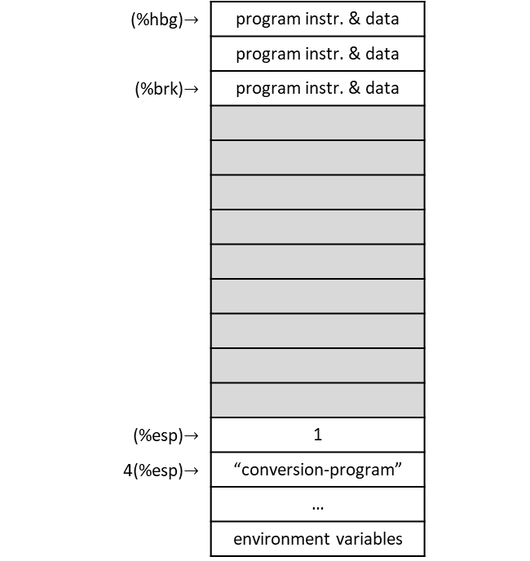
Counting conversion-program.s
  .include "linux.s"
  .section .data
  # This is where it will be stored
tmp_buffer:
  .ascii "\0\0\0\0\0\0\0\0\0\0\0" # 11 null bytes
  .section .text
  .globl _start
_start:
  movl %esp, %ebp
  pushl $tmp_buffer # storage for the result
  pushl $824 # number to convert
  call integer2string
  addl $8, %esp
  pushl $tmp_buffer # get the character count for our system call
  call count_chars
  addl $4, %esp
  movl %eax, %edx # the count goes in %edx for SYS_WRITE
  # Make the system call
  movl $SYS_WRITE, %eax
  movl $STDOUT, %ebx
  movl $tmp_buffer, %ecx
  int $LINUX_SYSCALL
  # Write a carriage return
  pushl $STDOUT
  call write_newline
  # Exit
  movl $SYS_EXIT, %eax
  movl $0, %ebx
  int $LINUX_SYSCALL
(%hbg)$→$ | program instr. & data
 | program instr. & data
(%brk)$→$ | program instr. & data
(%esp)$→$ | 1
4(%esp)$→$ | “conversion-program”
 | …
 | environment variables
heap
unmapped /
inaccesible
memory
stack

Slide 108

Counting conversion-program.s
  .include "linux.s"
  .section .data
  # This is where it will be stored
tmp_buffer:
  .ascii "\0\0\0\0\0\0\0\0\0\0\0" # 11 null bytes
  .section .text
  .globl _start
_start:
  movl %esp, %ebp
  pushl $tmp_buffer # storage for the result
  pushl $824 # number to convert
  call integer2string
  addl $8, %esp
  pushl $tmp_buffer # get the character count for our system call
  call count_chars
  addl $4, %esp
  movl %eax, %edx # the count goes in %edx for SYS_WRITE
  # Make the system call
  movl $SYS_WRITE, %eax
  movl $STDOUT, %ebx
  movl $tmp_buffer, %ecx
  int $LINUX_SYSCALL
  # Write a carriage return
  pushl $STDOUT
  call write_newline
  # Exit
  movl $SYS_EXIT, %eax
  movl $0, %ebx
  int $LINUX_SYSCALL
(%hbg)$→$ | program instr. & data
 | program instr. & data
(%brk)$→$ | program instr. & data
(%ebp) & (%esp)$→$ | 1
4(%esp)$→$ | “conversion-program”
 | …
 | environment variables
heap
unmapped /
inaccesible
memory
stack

Slide 109
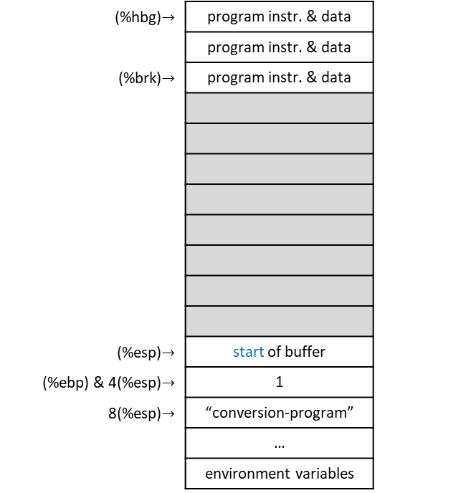
Counting conversion-program.s
  .include "linux.s"
  .section .data
  # This is where it will be stored
tmp_buffer:
  .ascii "\0\0\0\0\0\0\0\0\0\0\0" # 11 null bytes
  .section .text
  .globl _start
_start:
  movl %esp, %ebp
  pushl $tmp_buffer # storage for the result
  pushl $824 # number to convert
  call integer2string
  addl $8, %esp
  pushl $tmp_buffer # get the character count for our system call
  call count_chars
  addl $4, %esp
  movl %eax, %edx # the count goes in %edx for SYS_WRITE
  # Make the system call
  movl $SYS_WRITE, %eax
  movl $STDOUT, %ebx
  movl $tmp_buffer, %ecx
  int $LINUX_SYSCALL
  # Write a carriage return
  pushl $STDOUT
  call write_newline
  # Exit
  movl $SYS_EXIT, %eax
  movl $0, %ebx
  int $LINUX_SYSCALL
(%hbg)$→$ | program instr. & data
 | program instr. & data
(%brk)$→$ | program instr. & data
(%esp)$→$ | start of buffer
(%ebp) & 4(%esp)$→$ | 1
8(%esp)$→$ | “conversion-program”
 | …
 | environment variables
heap
stack

Slide 110
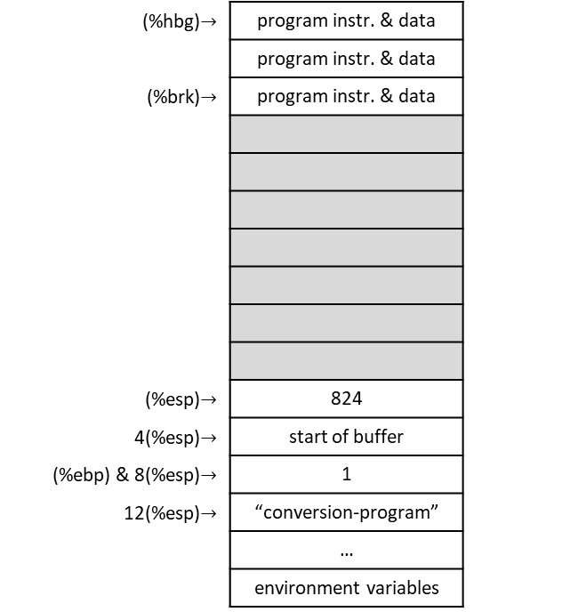
Counting conversion-program.s
  .include "linux.s"
  .section .data
  # This is where it will be stored
tmp_buffer:
  .ascii "\0\0\0\0\0\0\0\0\0\0\0" # 11 null bytes
  .section .text
  .globl _start
_start:
  movl %esp, %ebp
  pushl $tmp_buffer # storage for the result
  pushl $824 # number to convert
  call integer2string
  addl $8, %esp
  pushl $tmp_buffer # get the character count for our system call
  call count_chars
  addl $4, %esp
  movl %eax, %edx # the count goes in %edx for SYS_WRITE
  # Make the system call
  movl $SYS_WRITE, %eax
  movl $STDOUT, %ebx
  movl $tmp_buffer, %ecx
  int $LINUX_SYSCALL
  # Write a carriage return
  pushl $STDOUT
  call write_newline
  # Exit
  movl $SYS_EXIT, %eax
  movl $0, %ebx
  int $LINUX_SYSCALL
(%hbg)$→$ | program instr. & data
 | program instr. & data
(%brk)$→$ | program instr. & data
(%esp)$→$ | 824
4(%esp)$→$ | start of buffer
(%ebp) & 8(%esp)$→$ | 1
12(%esp)$→$ | “conversion-program”
 | …
 | environment variables
heap
stack

Slide 111
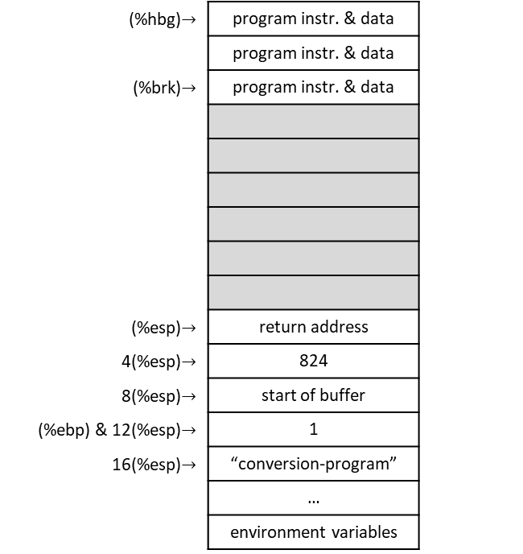
Counting conversion-program.s
  .include "linux.s"
  .section .data
  # This is where it will be stored
tmp_buffer:
  .ascii "\0\0\0\0\0\0\0\0\0\0\0" # 11 null bytes
  .section .text
  .globl _start
_start:
  movl %esp, %ebp
  pushl $tmp_buffer # storage for the result
  pushl $824 # number to convert
  call integer2string
  addl $8, %esp
  pushl $tmp_buffer # get the character count for our system call
  call count_chars
  addl $4, %esp
  movl %eax, %edx # the count goes in %edx for SYS_WRITE
  # Make the system call
  movl $SYS_WRITE, %eax
  movl $STDOUT, %ebx
  movl $tmp_buffer, %ecx
  int $LINUX_SYSCALL
  # Write a carriage return
  pushl $STDOUT
  call write_newline
  # Exit
  movl $SYS_EXIT, %eax
  movl $0, %ebx
  int $LINUX_SYSCALL
(%hbg)$→$ | program instr. & data
 | program instr. & data
(%brk)$→$ | program instr. & data
(%esp)$→$ | return address
4(%esp)$→$ | 824
8(%esp)$→$ | start of buffer
(%ebp) & 12(%esp)$→$ | 1
16(%esp)$→$ | “conversion-program”
 | …
 | environment variables
heap
stack

Slide 112
Counting conversion-program.s: integer-to-string.s
  # %ecx will hold the count of characters processed
  # %eax will hold the current value
  # %edi will hold the base (10)
  .equ ST_VALUE, 8
  .equ ST_BUFFER, 12
  .globl integer2string
  .type integer2string, @function
integer2string:
  # Normal function beginning
  pushl %ebp
  movl %esp, %ebp
  movl $0, %ecx # current character count
  movl ST_VALUE(%ebp), %eax # move the value into position
  movl $10, %edi # to divide by 10, the 10 must be in a # register or memory location
(%hbg)$→$ | program instr. & data
 | program instr. & data
(%brk)$→$ | program instr. & data
(%esp)$→$ | return address
4(%esp)$→$ | 824
8(%esp)$→$ | start of buffer
(%ebp) & 12(%esp)$→$ | 1
16(%esp)$→$ | “conversion-program”
 | …
 | environment variables
heap
stack

Slide 113
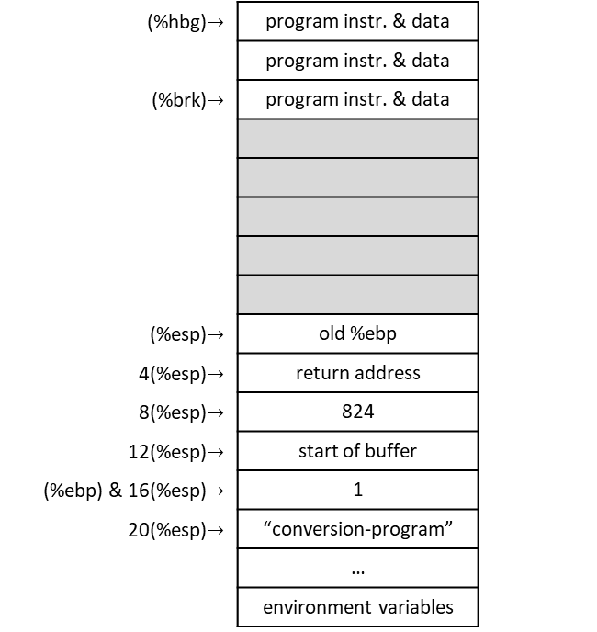
Counting conversion-program.s: integer-to-string.s
  # %ecx will hold the count of characters processed
  # %eax will hold the current value
  # %edi will hold the base (10)
  .equ ST_VALUE, 8
  .equ ST_BUFFER, 12
  .globl integer2string
  .type integer2string, @function
integer2string:
  # Normal function beginning
  pushl %ebp
  movl %esp, %ebp
  movl $0, %ecx # current character count
  movl ST_VALUE(%ebp), %eax # move the value into position
  movl $10, %edi # to divide by 10, the 10 must be in a # register or memory location
(%hbg)$→$ | program instr. & data
 | program instr. & data
(%brk)$→$ | program instr. & data
(%esp)$→$ | old %ebp
4(%esp)$→$ | return address
8(%esp)$→$ | 824
12(%esp)$→$ | start of buffer
(%ebp) & 16(%esp)$→$ | 1
20(%esp)$→$ | “conversion-program”
 | …
 | environment variables
heap
stack

Slide 114

Counting conversion-program.s: integer-to-string.s
  # %ecx will hold the count of characters processed
  # %eax will hold the current value
  # %edi will hold the base (10)
  .equ ST_VALUE, 8
  .equ ST_BUFFER, 12
  .globl integer2string
  .type integer2string, @function
integer2string:
  # Normal function beginning
  pushl %ebp
  movl %esp, %ebp
  movl $0, %ecx # current character count
  movl ST_VALUE(%ebp), %eax # move the value into position
  movl $10, %edi # to divide by 10, the 10 must be in a # register or memory location
(%hbg)$→$ | program instr. & data
 | program instr. & data
(%brk)$→$ | program instr. & data
(%ebp) & (%esp)$→$ | old %ebp
4(%esp)$→$ | return address
8(%esp)$→$ | 824
12(%esp)$→$ | start of buffer
16(%esp)$→$ | 1
20(%esp)$→$ | “conversion-program”
 | …
 | environment variables
heap
stack

Slide 115
Counting conversion-program.s: integer-to-string.s
  # %ecx will hold the count of characters processed
  # %eax will hold the current value
  # %edi will hold the base (10)
  .equ ST_VALUE, 8
  .equ ST_BUFFER, 12
  .globl integer2string
  .type integer2string, @function
integer2string:
  # Normal function beginning
  pushl %ebp
  movl %esp, %ebp
  movl $0, %ecx # current character count
  movl ST_VALUE(%ebp), %eax # move the value into position
  movl $10, %edi # to divide by 10, the 10 must be in a # register or memory location
(%hbg)$→$ | program instr. & data
 | program instr. & data
(%brk)$→$ | program instr. & data
(%ebp) & (%esp)$→$ | old %ebp
4(%esp)$→$ | return address
8(%esp)$→$ | 824
12(%esp)$→$ | start of buffer
16(%esp)$→$ | 1
20(%esp)$→$ | “conversion-program”
 | …
 | environment variables
heap
stack
ECX = 0

Slide 116
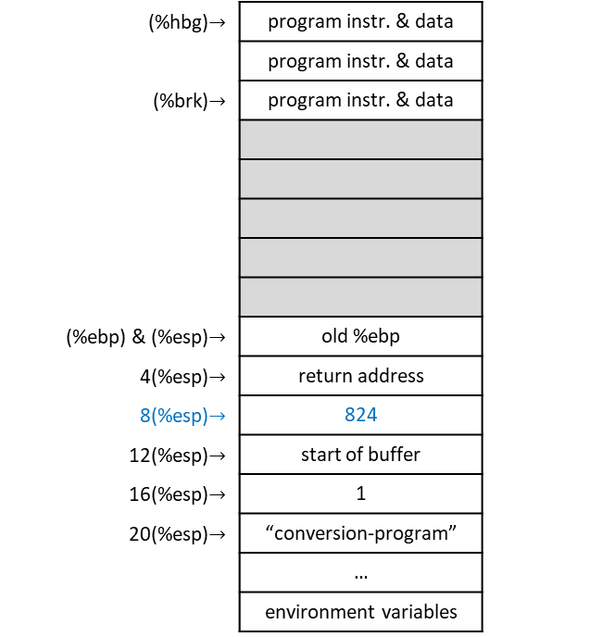
Counting conversion-program.s: integer-to-string.s
  # %ecx will hold the count of characters processed
  # %eax will hold the current value
  # %edi will hold the base (10)
  .equ ST_VALUE, 8
  .equ ST_BUFFER, 12
  .globl integer2string
  .type integer2string, @function
integer2string:
  # Normal function beginning
  pushl %ebp
  movl %esp, %ebp
  movl $0, %ecx # current character count
  movl ST_VALUE(%ebp), %eax # move the value into position
  movl $10, %edi # to divide by 10, the 10 must be in a # register or memory location
(%hbg)$→$ | program instr. & data
 | program instr. & data
(%brk)$→$ | program instr. & data
(%ebp) & (%esp)$→$ | old %ebp
4(%esp)$→$ | return address
8(%esp)$→$ | 824
12(%esp)$→$ | start of buffer
16(%esp)$→$ | 1
20(%esp)$→$ | “conversion-program”
 | …
 | environment variables
heap
stack
ECX = 0
EAX = 824

Slide 117
Counting conversion-program.s: integer-to-string.s
  # %ecx will hold the count of characters processed
  # %eax will hold the current value
  # %edi will hold the base (10)
  .equ ST_VALUE, 8
  .equ ST_BUFFER, 12
  .globl integer2string
  .type integer2string, @function
integer2string:
  # Normal function beginning
  pushl %ebp
  movl %esp, %ebp
  movl $0, %ecx # current character count
  movl ST_VALUE(%ebp), %eax # move the value into position
  movl $10, %edi # to divide by 10, the 10 must be in a # register or memory location
(%hbg)$→$ | program instr. & data
 | program instr. & data
(%brk)$→$ | program instr. & data
(%ebp) & (%esp)$→$ | old %ebp
4(%esp)$→$ | return address
8(%esp)$→$ | 824
12(%esp)$→$ | start of buffer
16(%esp)$→$ | 1
20(%esp)$→$ | “conversion-program”
 | …
 | environment variables
heap
stack
ECX = 0
EAX = 824
EDI = 10

Slide 118
Counting conversion-program.s: integer-to-string.s
conversion_loop:
  # Division is performed on the combined %edx:%eax register,
  movl $0, %edx # so first clear out %edx
  # Store the quotient in %eax, remainder in %edx (both are implied)
  divl %edi # divide %edx:%eax (which are implied) by 10
  # Quotient is in %eax
  # Remainder in %edx, which now needs to be converted into a number.
  # So, %edx has a number 0 – 9, an index on the ASCII table
  # e.g. ascii '0' + integer 0 = ascii '0'
  # e.g. ascii '0' + integer 1 = ascii '1'
  addl $'0', %edx # gives us character for the number stored in %edx
  # Push this value on the stack. When we are done, we can pop off the characters one-by-
  # one and they will be in the right order.
  # Note: We are pushing the whole register, but we only need the byte in %dl (the last
  # byte of the %edx register) for the character.
  pushl %edx
  incl %ecx # increment the digit count
  cmpl $0, %eax # check if %eax is zero yet, go to next step if so.
  je end_conversion_loop
  # %eax already has its new value.
  jmp conversion_loop
end_conversion_loop:
  # The string is now on the stack, if we pop it off a character at a time we can copy it # into the buffer and be done.
  movl ST_BUFFER(%ebp), %edx # get the pointer to the buffer in %edx
(%hbg)$→$ | program instr. & data
 | program instr. & data
(%brk)$→$ | program instr. & data
(%ebp) & (%esp)$→$ | old %ebp
4(%esp)$→$ | return address
8(%esp)$→$ | 824
12(%esp)$→$ | start of buffer
16(%esp)$→$ | 1
20(%esp)$→$ | “conversion-program”
 | …
 | environment variables
heap
stack
ECX = 0
EAX = 824
EDI = 10

Slide 119
Counting conversion-program.s: integer-to-string.s
conversion_loop:
  # Division is performed on the combined %edx:%eax register,
  movl $0, %edx # so first clear out %edx
  # Store the quotient in %eax, remainder in %edx (both are implied)
  divl %edi # divide %edx:%eax (which are implied) by 10
  # Quotient is in %eax
  # Remainder in %edx, which now needs to be converted into a number.
  # So, %edx has a number 0 – 9, an index on the ASCII table
  # e.g. ascii '0' + integer 0 = ascii '0'
  # e.g. ascii '0' + integer 1 = ascii '1'
  addl $'0', %edx # gives us character for the number stored in %edx
  # Push this value on the stack. When we are done, we can pop off the characters one-by-
  # one and they will be in the right order.
  # Note: We are pushing the whole register, but we only need the byte in %dl (the last
  # byte of the %edx register) for the character.
  pushl %edx
  incl %ecx # increment the digit count
  cmpl $0, %eax # check if %eax is zero yet, go to next step if so.
  je end_conversion_loop
  # %eax already has its new value.
  jmp conversion_loop
end_conversion_loop:
  # The string is now on the stack, if we pop it off a character at a time we can copy it # into the buffer and be done.
  movl ST_BUFFER(%ebp), %edx # get the pointer to the buffer in %edx
(%hbg)$→$ | program instr. & data
 | program instr. & data
(%brk)$→$ | program instr. & data
(%ebp) & (%esp)$→$ | old %ebp
4(%esp)$→$ | return address
8(%esp)$→$ | 824
12(%esp)$→$ | start of buffer
16(%esp)$→$ | 1
20(%esp)$→$ | “conversion-program”
 | …
 | environment variables
heap
stack
ECX = 0
EAX = 824
EDI = 10
EDX = 0

Slide 120
Counting conversion-program.s: integer-to-string.s
conversion_loop:
  # Division is performed on the combined %edx:%eax register,
  movl $0, %edx # so first clear out %edx
  # Store the quotient in %eax, remainder in %edx (both are implied)
  divl %edi # divide %edx:%eax (which are implied) by 10
  # Quotient is in %eax
  # Remainder in %edx, which now needs to be converted into a number.
  # So, %edx has a number 0 – 9, an index on the ASCII table
  # e.g. ascii '0' + integer 0 = ascii '0'
  # e.g. ascii '0' + integer 1 = ascii '1'
  addl $'0', %edx # gives us character for the number stored in %edx
  # Push this value on the stack. When we are done, we can pop off the characters one-by-
  # one and they will be in the right order.
  # Note: We are pushing the whole register, but we only need the byte in %dl (the last
  # byte of the %edx register) for the character.
  pushl %edx
  incl %ecx # increment the digit count
  cmpl $0, %eax # check if %eax is zero yet, go to next step if so.
  je end_conversion_loop
  # %eax already has its new value.
  jmp conversion_loop
end_conversion_loop:
  # The string is now on the stack, if we pop it off a character at a time we can copy it # into the buffer and be done.
  movl ST_BUFFER(%ebp), %edx # get the pointer to the buffer in %edx
(%hbg)$→$ | program instr. & data
 | program instr. & data
(%brk)$→$ | program instr. & data
(%ebp) & (%esp)$→$ | old %ebp
4(%esp)$→$ | return address
8(%esp)$→$ | 824
12(%esp)$→$ | start of buffer
16(%esp)$→$ | 1
20(%esp)$→$ | “conversion-program”
 | …
 | environment variables
heap
stack
ECX = 0
EAX = 824
EDI = 10
EDX = 0

Slide 121
Counting conversion-program.s: integer-to-string.s
conversion_loop:
  # Division is performed on the combined %edx:%eax register,
  movl $0, %edx # so first clear out %edx
  # Store the quotient in %eax, remainder in %edx (both are implied)
  divl %edi # divide %edx:%eax (which are implied) by 10
  # Quotient is in %eax
  # Remainder in %edx, which now needs to be converted into a number.
  # So, %edx has a number 0 – 9, an index on the ASCII table
  # e.g. ascii '0' + integer 0 = ascii '0'
  # e.g. ascii '0' + integer 1 = ascii '1'
  addl $'0', %edx # gives us character for the number stored in %edx
  # Push this value on the stack. When we are done, we can pop off the characters one-by-
  # one and they will be in the right order.
  # Note: We are pushing the whole register, but we only need the byte in %dl (the last
  # byte of the %edx register) for the character.
  pushl %edx
  incl %ecx # increment the digit count
  cmpl $0, %eax # check if %eax is zero yet, go to next step if so.
  je end_conversion_loop
  # %eax already has its new value.
  jmp conversion_loop
end_conversion_loop:
  # The string is now on the stack, if we pop it off a character at a time we can copy it # into the buffer and be done.
  movl ST_BUFFER(%ebp), %edx # get the pointer to the buffer in %edx
(%hbg)$→$ | program instr. & data
 | program instr. & data
(%brk)$→$ | program instr. & data
(%ebp) & (%esp)$→$ | old %ebp
4(%esp)$→$ | return address
8(%esp)$→$ | 824
12(%esp)$→$ | start of buffer
16(%esp)$→$ | 1
20(%esp)$→$ | “conversion-program”
 | …
 | environment variables
heap
stack
ECX = 0
EAX = 82
EDI = 10
EDX = 4

Slide 122
Counting conversion-program.s: integer-to-string.s
conversion_loop:
  # Division is performed on the combined %edx:%eax register,
  movl $0, %edx # so first clear out %edx
  # Store the quotient in %eax, remainder in %edx (both are implied)
  divl %edi # divide %edx:%eax (which are implied) by 10
  # Quotient is in %eax
  # Remainder in %edx, which now needs to be converted into a number.
  # So, %edx has a number 0 – 9, an index on the ASCII table
  # e.g. ascii '0' + integer 0 = ascii '0'
  # e.g. ascii '0' + integer 1 = ascii '1'
  addl $'0', %edx # gives us character for the number stored in %edx
  # Push this value on the stack. When we are done, we can pop off the characters one-by-
  # one and they will be in the right order.
  # Note: We are pushing the whole register, but we only need the byte in %dl (the last
  # byte of the %edx register) for the character.
  pushl %edx
  incl %ecx # increment the digit count
  cmpl $0, %eax # check if %eax is zero yet, go to next step if so.
  je end_conversion_loop
  # %eax already has its new value.
  jmp conversion_loop
end_conversion_loop:
  # The string is now on the stack, if we pop it off a character at a time we can copy it # into the buffer and be done.
  movl ST_BUFFER(%ebp), %edx # get the pointer to the buffer in %edx
(%hbg)$→$ | program instr. & data
 | program instr. & data
(%brk)$→$ | program instr. & data
(%ebp) & (%esp)$→$ | old %ebp
4(%esp)$→$ | return address
8(%esp)$→$ | 824
12(%esp)$→$ | start of buffer
16(%esp)$→$ | 1
20(%esp)$→$ | “conversion-program”
 | …
 | environment variables
heap
stack
ECX = 0
EAX = 82
EDI = 10
EDX = 4

Slide 123
Counting conversion-program.s: integer-to-string.s
conversion_loop:
  # Division is performed on the combined %edx:%eax register,
  movl $0, %edx # so first clear out %edx
  # Store the quotient in %eax, remainder in %edx (both are implied)
  divl %edi # divide %edx:%eax (which are implied) by 10
  # Quotient is in %eax
  # Remainder in %edx, which now needs to be converted into a number.
  # So, %edx has a number 0 – 9, an index on the ASCII table
  # e.g. ascii '0' + integer 0 = ascii '0'
  # e.g. ascii '0' + integer 1 = ascii '1'
  addl $'0', %edx # gives us character for the number stored in %edx
  # Push this value on the stack. When we are done, we can pop off the characters one-by-
  # one and they will be in the right order.
  # Note: We are pushing the whole register, but we only need the byte in %dl (the last
  # byte of the %edx register) for the character.
  pushl %edx
  incl %ecx # increment the digit count
  cmpl $0, %eax # check if %eax is zero yet, go to next step if so.
  je end_conversion_loop
  # %eax already has its new value.
  jmp conversion_loop
end_conversion_loop:
  # The string is now on the stack, if we pop it off a character at a time we can copy it # into the buffer and be done.
  movl ST_BUFFER(%ebp), %edx # get the pointer to the buffer in %edx
(%hbg)$→$ | program instr. & data
 | program instr. & data
(%brk)$→$ | program instr. & data
(%ebp) & (%esp)$→$ | old %ebp
4(%esp)$→$ | return address
8(%esp)$→$ | 824
12(%esp)$→$ | start of buffer
16(%esp)$→$ | 1
20(%esp)$→$ | “conversion-program”
 | …
 | environment variables
heap
stack
ECX = 0
EAX = 82
EDI = 10
EDX = 4

Slide 124
Counting conversion-program.s: integer-to-string.s
conversion_loop:
  # Division is performed on the combined %edx:%eax register,
  movl $0, %edx # so first clear out %edx
  # Store the quotient in %eax, remainder in %edx (both are implied)
  divl %edi # divide %edx:%eax (which are implied) by 10
  # Quotient is in %eax
  # Remainder in %edx, which now needs to be converted into a number.
  # So, %edx has a number 0 – 9, an index on the ASCII table
  # e.g. ascii '0' + integer 0 = ascii '0'
  # e.g. ascii '0' + integer 1 = ascii '1'
  addl $'0', %edx # gives us character for the number stored in %edx
  # Push this value on the stack. When we are done, we can pop off the characters one-by-
  # one and they will be in the right order.
  # Note: We are pushing the whole register, but we only need the byte in %dl (the last
  # byte of the %edx register) for the character.
  pushl %edx
  incl %ecx # increment the digit count
  cmpl $0, %eax # check if %eax is zero yet, go to next step if so.
  je end_conversion_loop
  # %eax already has its new value.
  jmp conversion_loop
end_conversion_loop:
  # The string is now on the stack, if we pop it off a character at a time we can copy it # into the buffer and be done.
  movl ST_BUFFER(%ebp), %edx # get the pointer to the buffer in %edx
(%hbg)$→$ | program instr. & data
 | program instr. & data
(%brk)$→$ | program instr. & data
(%ebp) & (%esp)$→$ | old %ebp
4(%esp)$→$ | return address
8(%esp)$→$ | 824
12(%esp)$→$ | start of buffer
16(%esp)$→$ | 1
20(%esp)$→$ | “conversion-program”
 | …
 | environment variables
heap
stack
ECX = 0
EAX = 82
EDI = 10
EDX = 4

Slide 125

Counting conversion-program.s: integer-to-string.s
conversion_loop:
  # Division is performed on the combined %edx:%eax register,
  movl $0, %edx # so first clear out %edx
  # Store the quotient in %eax, remainder in %edx (both are implied)
  divl %edi # divide %edx:%eax (which are implied) by 10
  # Quotient is in %eax
  # Remainder in %edx, which now needs to be converted into a number.
  # So, %edx has a number 0 – 9, an index on the ASCII table
  # e.g. ascii '0' + integer 0 = ascii '0'
  # e.g. ascii '0' + integer 1 = ascii '1'
  addl $'0', %edx # gives us character for the number stored in %edx
  # Push this value on the stack. When we are done, we can pop off the characters one-by-
  # one and they will be in the right order.
  # Note: We are pushing the whole register, but we only need the byte in %dl (the last
  # byte of the %edx register) for the character.
  pushl %edx
  incl %ecx # increment the digit count
  cmpl $0, %eax # check if %eax is zero yet, go to next step if so.
  je end_conversion_loop
  # %eax already has its new value.
  jmp conversion_loop
end_conversion_loop:
  # The string is now on the stack, if we pop it off a character at a time we can copy it # into the buffer and be done.
  movl ST_BUFFER(%ebp), %edx # get the pointer to the buffer in %edx
(%hbg)$→$ | program instr. & data
 | program instr. & data
(%brk)$→$ | program instr. & data
(%ebp) & (%esp)$→$ | old %ebp
4(%esp)$→$ | return address
8(%esp)$→$ | 824
12(%esp)$→$ | start of buffer
(%ebp) & 16(%esp)$→$ | 1
20(%esp)$→$ | “conversion-program”
 | …
 | environment variables
heap
stack
ECX = 0
EAX = 82
EDI = 10
EDX = ‘0’ + 4 = ‘4’

Slide 126
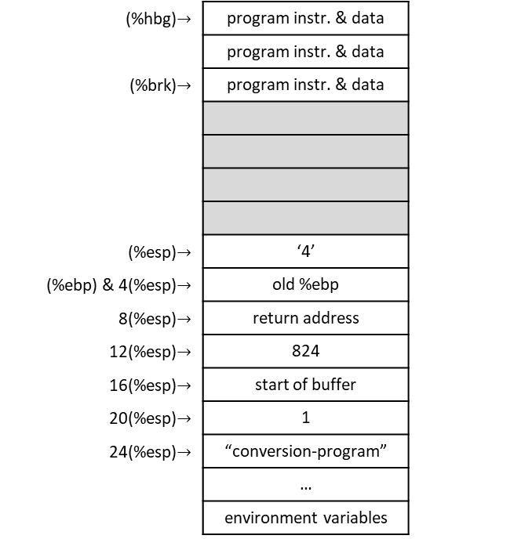
Counting conversion-program.s: integer-to-string.s
conversion_loop:
  # Division is performed on the combined %edx:%eax register,
  movl $0, %edx # so first clear out %edx
  # Store the quotient in %eax, remainder in %edx (both are implied)
  divl %edi # divide %edx:%eax (which are implied) by 10
  # Quotient is in %eax
  # Remainder in %edx, which now needs to be converted into a number.
  # So, %edx has a number 0 – 9, an index on the ASCII table
  # e.g. ascii '0' + integer 0 = ascii '0'
  # e.g. ascii '0' + integer 1 = ascii '1'
  addl $'0', %edx # gives us character for the number stored in %edx
  # Push this value on the stack. When we are done, we can pop off the characters one-by-
  # one and they will be in the right order.
  # Note: We are pushing the whole register, but we only need the byte in %dl (the last
  # byte of the %edx register) for the character.
  pushl %edx
  incl %ecx # increment the digit count
  cmpl $0, %eax # check if %eax is zero yet, go to next step if so.
  je end_conversion_loop
  # %eax already has its new value.
  jmp conversion_loop
end_conversion_loop:
  # The string is now on the stack, if we pop it off a character at a time we can copy it # into the buffer and be done.
  movl ST_BUFFER(%ebp), %edx # get the pointer to the buffer in %edx
(%hbg)$→$ | program instr. & data
 | program instr. & data
(%brk)$→$ | program instr. & data
(%esp)$→$ | ‘4’
(%ebp) & 4(%esp)$→$ | old %ebp
8(%esp)$→$ | return address
12(%esp)$→$ | 824
16(%esp)$→$ | start of buffer
20(%esp)$→$ | 1
24(%esp)$→$ | “conversion-program”
 | …
 | environment variables
heap
stack
ECX = 0
EAX = 82
EDI = 10
EDX = ‘4’

Slide 127
Counting conversion-program.s: integer-to-string.s
conversion_loop:
  # Division is performed on the combined %edx:%eax register,
  movl $0, %edx # so first clear out %edx
  # Store the quotient in %eax, remainder in %edx (both are implied)
  divl %edi # divide %edx:%eax (which are implied) by 10
  # Quotient is in %eax
  # Remainder in %edx, which now needs to be converted into a number.
  # So, %edx has a number 0 – 9, an index on the ASCII table
  # e.g. ascii '0' + integer 0 = ascii '0'
  # e.g. ascii '0' + integer 1 = ascii '1'
  addl $'0', %edx # gives us character for the number stored in %edx
  # Push this value on the stack. When we are done, we can pop off the characters one-by-
  # one and they will be in the right order.
  # Note: We are pushing the whole register, but we only need the byte in %dl (the last
  # byte of the %edx register) for the character.
  pushl %edx
  incl %ecx # increment the digit count
  cmpl $0, %eax # check if %eax is zero yet, go to next step if so.
  je end_conversion_loop
  # %eax already has its new value.
  jmp conversion_loop
end_conversion_loop:
  # The string is now on the stack, if we pop it off a character at a time we can copy it # into the buffer and be done.
  movl ST_BUFFER(%ebp), %edx # get the pointer to the buffer in %edx
(%hbg)$→$ | program instr. & data
 | program instr. & data
(%brk)$→$ | program instr. & data
(%esp)$→$ | ‘4’
(%ebp) & 4(%esp)$→$ | old %ebp
8(%esp)$→$ | return address
12(%esp)$→$ | 824
16(%esp)$→$ | start of buffer
20(%esp)$→$ | 1
24(%esp)$→$ | “conversion-program”
 | …
 | environment variables
heap
stack
ECX = 1
EAX = 82
EDI = 10
EDX = ‘4’

Slide 128
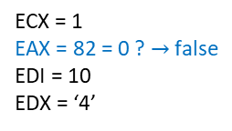
Counting conversion-program.s: integer-to-string.s
conversion_loop:
  # Division is performed on the combined %edx:%eax register,
  movl $0, %edx # so first clear out %edx
  # Store the quotient in %eax, remainder in %edx (both are implied)
  divl %edi # divide %edx:%eax (which are implied) by 10
  # Quotient is in %eax
  # Remainder in %edx, which now needs to be converted into a number.
  # So, %edx has a number 0 – 9, an index on the ASCII table
  # e.g. ascii '0' + integer 0 = ascii '0'
  # e.g. ascii '0' + integer 1 = ascii '1'
  addl $'0', %edx # gives us character for the number stored in %edx
  # Push this value on the stack. When we are done, we can pop off the characters one-by-
  # one and they will be in the right order.
  # Note: We are pushing the whole register, but we only need the byte in %dl (the last
  # byte of the %edx register) for the character.
  pushl %edx
  incl %ecx # increment the digit count
  cmpl $0, %eax # check if %eax is zero yet, go to next step if so.
  je end_conversion_loop
  # %eax already has its new value.
  jmp conversion_loop
end_conversion_loop:
  # The string is now on the stack, if we pop it off a character at a time we can copy it # into the buffer and be done.
  movl ST_BUFFER(%ebp), %edx # get the pointer to the buffer in %edx
(%hbg)$→$ | program instr. & data
 | program instr. & data
(%brk)$→$ | program instr. & data
(%esp)$→$ | ‘4’
(%ebp) & 4(%esp)$→$ | old %ebp
8(%esp)$→$ | return address
12(%esp)$→$ | 824
16(%esp)$→$ | start of buffer
20(%esp)$→$ | 1
24(%esp)$→$ | “conversion-program”
 | …
 | environment variables
heap
stack
ECX = 1
EAX = 82 = 0 ? $→$ false
EDI = 10
EDX = ‘4’

Slide 129
Counting conversion-program.s: integer-to-string.s
conversion_loop:
  # Division is performed on the combined %edx:%eax register,
  movl $0, %edx # so first clear out %edx
  # Store the quotient in %eax, remainder in %edx (both are implied)
  divl %edi # divide %edx:%eax (which are implied) by 10
  # Quotient is in %eax
  # Remainder in %edx, which now needs to be converted into a number.
  # So, %edx has a number 0 – 9, an index on the ASCII table
  # e.g. ascii '0' + integer 0 = ascii '0'
  # e.g. ascii '0' + integer 1 = ascii '1'
  addl $'0', %edx # gives us character for the number stored in %edx
  # Push this value on the stack. When we are done, we can pop off the characters one-by-
  # one and they will be in the right order.
  # Note: We are pushing the whole register, but we only need the byte in %dl (the last
  # byte of the %edx register) for the character.
  pushl %edx
  incl %ecx # increment the digit count
  cmpl $0, %eax # check if %eax is zero yet, go to next step if so.
  je end_conversion_loop
  # %eax already has its new value.
  jmp conversion_loop
end_conversion_loop:
  # The string is now on the stack, if we pop it off a character at a time we can copy it # into the buffer and be done.
  movl ST_BUFFER(%ebp), %edx # get the pointer to the buffer in %edx
(%hbg)$→$ | program instr. & data
 | program instr. & data
(%brk)$→$ | program instr. & data
(%esp)$→$ | ‘4’
(%ebp) & 4(%esp)$→$ | old %ebp
8(%esp)$→$ | return address
12(%esp)$→$ | 824
16(%esp)$→$ | start of buffer
20(%esp)$→$ | 1
24(%esp)$→$ | “conversion-program”
 | …
 | environment variables
heap
stack
ECX = 1
EAX = 82
EDI = 10
EDX = ‘4’

Slide 130
Counting conversion-program.s: integer-to-string.s
conversion_loop:
  # Division is performed on the combined %edx:%eax register,
  movl $0, %edx # so first clear out %edx
  # Store the quotient in %eax, remainder in %edx (both are implied)
  divl %edi # divide %edx:%eax (which are implied) by 10
  # Quotient is in %eax
  # Remainder in %edx, which now needs to be converted into a number.
  # So, %edx has a number 0 – 9, an index on the ASCII table
  # e.g. ascii '0' + integer 0 = ascii '0'
  # e.g. ascii '0' + integer 1 = ascii '1'
  addl $'0', %edx # gives us character for the number stored in %edx
  # Push this value on the stack. When we are done, we can pop off the characters one-by-
  # one and they will be in the right order.
  # Note: We are pushing the whole register, but we only need the byte in %dl (the last
  # byte of the %edx register) for the character.
  pushl %edx
  incl %ecx # increment the digit count
  cmpl $0, %eax # check if %eax is zero yet, go to next step if so.
  je end_conversion_loop
  # %eax already has its new value.
  jmp conversion_loop
end_conversion_loop:
  # The string is now on the stack, if we pop it off a character at a time we can copy it # into the buffer and be done.
  movl ST_BUFFER(%ebp), %edx # get the pointer to the buffer in %edx
(%hbg)$→$ | program instr. & data
 | program instr. & data
(%brk)$→$ | program instr. & data
(%esp)$→$ | ‘4’
(%ebp) & 4(%esp)$→$ | old %ebp
8(%esp)$→$ | return address
12(%esp)$→$ | 824
16(%esp)$→$ | start of buffer
20(%esp)$→$ | 1
24(%esp)$→$ | “conversion-program”
 | …
 | environment variables
heap
stack
ECX = 1
EAX = 82
EDI = 10
EDX = ‘4’

Slide 131
Counting conversion-program.s: integer-to-string.s
conversion_loop:
  # Division is performed on the combined %edx:%eax register,
  movl $0, %edx # so first clear out %edx
  # Store the quotient in %eax, remainder in %edx (both are implied)
  divl %edi # divide %edx:%eax (which are implied) by 10
  # Quotient is in %eax
  # Remainder in %edx, which now needs to be converted into a number.
  # So, %edx has a number 0 – 9, an index on the ASCII table
  # e.g. ascii '0' + integer 0 = ascii '0'
  # e.g. ascii '0' + integer 1 = ascii '1'
  addl $'0', %edx # gives us character for the number stored in %edx
  # Push this value on the stack. When we are done, we can pop off the characters one-by-
  # one and they will be in the right order.
  # Note: We are pushing the whole register, but we only need the byte in %dl (the last
  # byte of the %edx register) for the character.
  pushl %edx
  incl %ecx # increment the digit count
  cmpl $0, %eax # check if %eax is zero yet, go to next step if so.
  je end_conversion_loop
  # %eax already has its new value.
  jmp conversion_loop
end_conversion_loop:
  # The string is now on the stack, if we pop it off a character at a time we can copy it # into the buffer and be done.
  movl ST_BUFFER(%ebp), %edx # get the pointer to the buffer in %edx
(%hbg)$→$ | program instr. & data
 | program instr. & data
(%brk)$→$ | program instr. & data
(%esp)$→$ | ‘4’
(%ebp) & 4(%esp)$→$ | old %ebp
8(%esp)$→$ | return address
12(%esp)$→$ | 824
16(%esp)$→$ | start of buffer
20(%esp)$→$ | 1
24(%esp)$→$ | “conversion-program”
 | …
 | environment variables
heap
stack
ECX = 1
EAX = 82
EDI = 10
EDX = ‘4’

Slide 132
Counting conversion-program.s: integer-to-string.s
conversion_loop:
  # Division is performed on the combined %edx:%eax register,
  movl $0, %edx # so first clear out %edx
  # Store the quotient in %eax, remainder in %edx (both are implied)
  divl %edi # divide %edx:%eax (which are implied) by 10
  # Quotient is in %eax
  # Remainder in %edx, which now needs to be converted into a number.
  # So, %edx has a number 0 – 9, an index on the ASCII table
  # e.g. ascii '0' + integer 0 = ascii '0'
  # e.g. ascii '0' + integer 1 = ascii '1'
  addl $'0', %edx # gives us character for the number stored in %edx
  # Push this value on the stack. When we are done, we can pop off the characters one-by-
  # one and they will be in the right order.
  # Note: We are pushing the whole register, but we only need the byte in %dl (the last
  # byte of the %edx register) for the character.
  pushl %edx
  incl %ecx # increment the digit count
  cmpl $0, %eax # check if %eax is zero yet, go to next step if so.
  je end_conversion_loop
  # %eax already has its new value.
  jmp conversion_loop
end_conversion_loop:
  # The string is now on the stack, if we pop it off a character at a time we can copy it # into the buffer and be done.
  movl ST_BUFFER(%ebp), %edx # get the pointer to the buffer in %edx
(%hbg)$→$ | program instr. & data
 | program instr. & data
(%brk)$→$ | program instr. & data
(%esp)$→$ | ‘4’
(%ebp) & 4(%esp)$→$ | old %ebp
8(%esp)$→$ | return address
12(%esp)$→$ | 824
16(%esp)$→$ | start of buffer
20(%esp)$→$ | 1
24(%esp)$→$ | “conversion-program”
 | …
 | environment variables
heap
stack
ECX = 1
EAX = 82
EDI = 10
EDX = 0

Slide 133
Counting conversion-program.s: integer-to-string.s
conversion_loop:
  # Division is performed on the combined %edx:%eax register,
  movl $0, %edx # so first clear out %edx
  # Store the quotient in %eax, remainder in %edx (both are implied)
  divl %edi # divide %edx:%eax (which are implied) by 10
  # Quotient is in %eax
  # Remainder in %edx, which now needs to be converted into a number.
  # So, %edx has a number 0 – 9, an index on the ASCII table
  # e.g. ascii '0' + integer 0 = ascii '0'
  # e.g. ascii '0' + integer 1 = ascii '1'
  addl $'0', %edx # gives us character for the number stored in %edx
  # Push this value on the stack. When we are done, we can pop off the characters one-by-
  # one and they will be in the right order.
  # Note: We are pushing the whole register, but we only need the byte in %dl (the last
  # byte of the %edx register) for the character.
  pushl %edx
  incl %ecx # increment the digit count
  cmpl $0, %eax # check if %eax is zero yet, go to next step if so.
  je end_conversion_loop
  # %eax already has its new value.
  jmp conversion_loop
end_conversion_loop:
  # The string is now on the stack, if we pop it off a character at a time we can copy it # into the buffer and be done.
  movl ST_BUFFER(%ebp), %edx # get the pointer to the buffer in %edx
(%hbg)$→$ | program instr. & data
 | program instr. & data
(%brk)$→$ | program instr. & data
(%esp)$→$ | ‘4’
(%ebp) & 4(%esp)$→$ | old %ebp
8(%esp)$→$ | return address
12(%esp)$→$ | 824
16(%esp)$→$ | start of buffer
20(%esp)$→$ | 1
24(%esp)$→$ | “conversion-program”
 | …
 | environment variables
heap
stack
ECX = 1
EAX = 8
EDI = 10
EDX = 2

Slide 134
Counting conversion-program.s: integer-to-string.s
conversion_loop:
  # Division is performed on the combined %edx:%eax register,
  movl $0, %edx # so first clear out %edx
  # Store the quotient in %eax, remainder in %edx (both are implied)
  divl %edi # divide %edx:%eax (which are implied) by 10
  # Quotient is in %eax
  # Remainder in %edx, which now needs to be converted into a number.
  # So, %edx has a number 0 – 9, an index on the ASCII table
  # e.g. ascii '0' + integer 0 = ascii '0'
  # e.g. ascii '0' + integer 1 = ascii '1'
  addl $'0', %edx # gives us character for the number stored in %edx
  # Push this value on the stack. When we are done, we can pop off the characters one-by-
  # one and they will be in the right order.
  # Note: We are pushing the whole register, but we only need the byte in %dl (the last
  # byte of the %edx register) for the character.
  pushl %edx
  incl %ecx # increment the digit count
  cmpl $0, %eax # check if %eax is zero yet, go to next step if so.
  je end_conversion_loop
  # %eax already has its new value.
  jmp conversion_loop
end_conversion_loop:
  # The string is now on the stack, if we pop it off a character at a time we can copy it # into the buffer and be done.
  movl ST_BUFFER(%ebp), %edx # get the pointer to the buffer in %edx
(%hbg)$→$ | program instr. & data
 | program instr. & data
(%brk)$→$ | program instr. & data
(%esp)$→$ | ‘4’
(%ebp) & 4(%esp)$→$ | old %ebp
8(%esp)$→$ | return address
12(%esp)$→$ | 824
16(%esp)$→$ | start of buffer
20(%esp)$→$ | 1
24(%esp)$→$ | “conversion-program”
 | …
 | environment variables
heap
stack
ECX = 1
EAX = 8
EDI = 10
EDX = 2 + ‘0’ = ‘2’

Slide 135
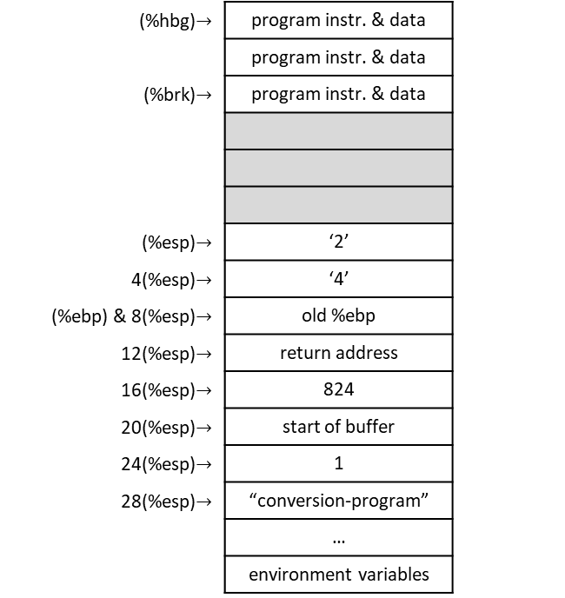
Counting conversion-program.s: integer-to-string.s
conversion_loop:
  # Division is performed on the combined %edx:%eax register,
  movl $0, %edx # so first clear out %edx
  # Store the quotient in %eax, remainder in %edx (both are implied)
  divl %edi # divide %edx:%eax (which are implied) by 10
  # Quotient is in %eax
  # Remainder in %edx, which now needs to be converted into a number.
  # So, %edx has a number 0 – 9, an index on the ASCII table
  # e.g. ascii '0' + integer 0 = ascii '0'
  # e.g. ascii '0' + integer 1 = ascii '1'
  addl $'0', %edx # gives us character for the number stored in %edx
  # Push this value on the stack. When we are done, we can pop off the characters one-by-
  # one and they will be in the right order.
  # Note: We are pushing the whole register, but we only need the byte in %dl (the last
  # byte of the %edx register) for the character.
  pushl %edx
  incl %ecx # increment the digit count
  cmpl $0, %eax # check if %eax is zero yet, go to next step if so.
  je end_conversion_loop
  # %eax already has its new value.
  jmp conversion_loop
end_conversion_loop:
  # The string is now on the stack, if we pop it off a character at a time we can copy it # into the buffer and be done.
  movl ST_BUFFER(%ebp), %edx # get the pointer to the buffer in %edx
(%hbg)$→$ | program instr. & data
 | program instr. & data
(%brk)$→$ | program instr. & data
(%esp)$→$ | ‘2’
4(%esp)$→$ | ‘4’
(%ebp) & 8(%esp)$→$ | old %ebp
12(%esp)$→$ | return address
16(%esp)$→$ | 824
20(%esp)$→$ | start of buffer
24(%esp)$→$ | 1
28(%esp)$→$ | “conversion-program”
 | …
 | environment variables
heap
stack
ECX = 1
EAX = 8
EDI = 10
EDX = ‘2’

Slide 136
Counting conversion-program.s: integer-to-string.s
conversion_loop:
  # Division is performed on the combined %edx:%eax register,
  movl $0, %edx # so first clear out %edx
  # Store the quotient in %eax, remainder in %edx (both are implied)
  divl %edi # divide %edx:%eax (which are implied) by 10
  # Quotient is in %eax
  # Remainder in %edx, which now needs to be converted into a number.
  # So, %edx has a number 0 – 9, an index on the ASCII table
  # e.g. ascii '0' + integer 0 = ascii '0'
  # e.g. ascii '0' + integer 1 = ascii '1'
  addl $'0', %edx # gives us character for the number stored in %edx
  # Push this value on the stack. When we are done, we can pop off the characters one-by-
  # one and they will be in the right order.
  # Note: We are pushing the whole register, but we only need the byte in %dl (the last
  # byte of the %edx register) for the character.
  pushl %edx
  incl %ecx # increment the digit count
  cmpl $0, %eax # check if %eax is zero yet, go to next step if so.
  je end_conversion_loop
  # %eax already has its new value.
  jmp conversion_loop
end_conversion_loop:
  # The string is now on the stack, if we pop it off a character at a time we can copy it # into the buffer and be done.
  movl ST_BUFFER(%ebp), %edx # get the pointer to the buffer in %edx
(%hbg)$→$ | program instr. & data
 | program instr. & data
(%brk)$→$ | program instr. & data
(%esp)$→$ | ‘2’
4(%esp)$→$ | ‘4’
(%ebp) & 8(%esp)$→$ | old %ebp
12(%esp)$→$ | return address
16(%esp)$→$ | 824
20(%esp)$→$ | start of buffer
24(%esp)$→$ | 1
28(%esp)$→$ | “conversion-program”
 | …
 | environment variables
heap
stack
ECX = 2
EAX = 8
EDI = 10
EDX = ‘2’

Slide 137
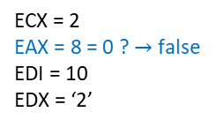
Counting conversion-program.s: integer-to-string.s
conversion_loop:
  # Division is performed on the combined %edx:%eax register,
  movl $0, %edx # so first clear out %edx
  # Store the quotient in %eax, remainder in %edx (both are implied)
  divl %edi # divide %edx:%eax (which are implied) by 10
  # Quotient is in %eax
  # Remainder in %edx, which now needs to be converted into a number.
  # So, %edx has a number 0 – 9, an index on the ASCII table
  # e.g. ascii '0' + integer 0 = ascii '0'
  # e.g. ascii '0' + integer 1 = ascii '1'
  addl $'0', %edx # gives us character for the number stored in %edx
  # Push this value on the stack. When we are done, we can pop off the characters one-by-
  # one and they will be in the right order.
  # Note: We are pushing the whole register, but we only need the byte in %dl (the last
  # byte of the %edx register) for the character.
  pushl %edx
  incl %ecx # increment the digit count
  cmpl $0, %eax # check if %eax is zero yet, go to next step if so.
  je end_conversion_loop
  # %eax already has its new value.
  jmp conversion_loop
end_conversion_loop:
  # The string is now on the stack, if we pop it off a character at a time we can copy it # into the buffer and be done.
  movl ST_BUFFER(%ebp), %edx # get the pointer to the buffer in %edx
(%hbg)$→$ | program instr. & data
 | program instr. & data
(%brk)$→$ | program instr. & data
(%esp)$→$ | ‘2’
4(%esp)$→$ | ‘4’
(%ebp) & 8(%esp)$→$ | old %ebp
12(%esp)$→$ | return address
16(%esp)$→$ | 824
20(%esp)$→$ | start of buffer
24(%esp)$→$ | 1
28(%esp)$→$ | “conversion-program”
 | …
 | environment variables
heap
stack
ECX = 2
EAX = 8 = 0 ? $→$ false
EDI = 10
EDX = ‘2’

Slide 138
Counting conversion-program.s: integer-to-string.s
conversion_loop:
  # Division is performed on the combined %edx:%eax register,
  movl $0, %edx # so first clear out %edx
  # Store the quotient in %eax, remainder in %edx (both are implied)
  divl %edi # divide %edx:%eax (which are implied) by 10
  # Quotient is in %eax
  # Remainder in %edx, which now needs to be converted into a number.
  # So, %edx has a number 0 – 9, an index on the ASCII table
  # e.g. ascii '0' + integer 0 = ascii '0'
  # e.g. ascii '0' + integer 1 = ascii '1'
  addl $'0', %edx # gives us character for the number stored in %edx
  # Push this value on the stack. When we are done, we can pop off the characters one-by-
  # one and they will be in the right order.
  # Note: We are pushing the whole register, but we only need the byte in %dl (the last
  # byte of the %edx register) for the character.
  pushl %edx
  incl %ecx # increment the digit count
  cmpl $0, %eax # check if %eax is zero yet, go to next step if so.
  je end_conversion_loop
  # %eax already has its new value.
  jmp conversion_loop
end_conversion_loop:
  # The string is now on the stack, if we pop it off a character at a time we can copy it # into the buffer and be done.
  movl ST_BUFFER(%ebp), %edx # get the pointer to the buffer in %edx
(%hbg)$→$ | program instr. & data
 | program instr. & data
(%brk)$→$ | program instr. & data
(%esp)$→$ | ‘2’
4(%esp)$→$ | ‘4’
(%ebp) & 8(%esp)$→$ | old %ebp
12(%esp)$→$ | return address
16(%esp)$→$ | 824
20(%esp)$→$ | start of buffer
24(%esp)$→$ | 1
28(%esp)$→$ | “conversion-program”
 | …
 | environment variables
heap
stack
ECX = 2
EAX = 8
EDI = 10
EDX = ‘2’

Slide 139
Counting conversion-program.s: integer-to-string.s
conversion_loop:
  # Division is performed on the combined %edx:%eax register,
  movl $0, %edx # so first clear out %edx
  # Store the quotient in %eax, remainder in %edx (both are implied)
  divl %edi # divide %edx:%eax (which are implied) by 10
  # Quotient is in %eax
  # Remainder in %edx, which now needs to be converted into a number.
  # So, %edx has a number 0 – 9, an index on the ASCII table
  # e.g. ascii '0' + integer 0 = ascii '0'
  # e.g. ascii '0' + integer 1 = ascii '1'
  addl $'0', %edx # gives us character for the number stored in %edx
  # Push this value on the stack. When we are done, we can pop off the characters one-by-
  # one and they will be in the right order.
  # Note: We are pushing the whole register, but we only need the byte in %dl (the last
  # byte of the %edx register) for the character.
  pushl %edx
  incl %ecx # increment the digit count
  cmpl $0, %eax # check if %eax is zero yet, go to next step if so.
  je end_conversion_loop
  # %eax already has its new value.
  jmp conversion_loop
end_conversion_loop:
  # The string is now on the stack, if we pop it off a character at a time we can copy it # into the buffer and be done.
  movl ST_BUFFER(%ebp), %edx # get the pointer to the buffer in %edx
(%hbg)$→$ | program instr. & data
 | program instr. & data
(%brk)$→$ | program instr. & data
(%esp)$→$ | ‘2’
4(%esp)$→$ | ‘4’
(%ebp) & 8(%esp)$→$ | old %ebp
12(%esp)$→$ | return address
16(%esp)$→$ | 824
20(%esp)$→$ | start of buffer
24(%esp)$→$ | 1
28(%esp)$→$ | “conversion-program”
 | …
 | environment variables
heap
stack
ECX = 2
EAX = 8
EDI = 10
EDX = ‘2’

Slide 140
Counting conversion-program.s: integer-to-string.s
conversion_loop:
  # Division is performed on the combined %edx:%eax register,
  movl $0, %edx # so first clear out %edx
  # Store the quotient in %eax, remainder in %edx (both are implied)
  divl %edi # divide %edx:%eax (which are implied) by 10
  # Quotient is in %eax
  # Remainder in %edx, which now needs to be converted into a number.
  # So, %edx has a number 0 – 9, an index on the ASCII table
  # e.g. ascii '0' + integer 0 = ascii '0'
  # e.g. ascii '0' + integer 1 = ascii '1'
  addl $'0', %edx # gives us character for the number stored in %edx
  # Push this value on the stack. When we are done, we can pop off the characters one-by-
  # one and they will be in the right order.
  # Note: We are pushing the whole register, but we only need the byte in %dl (the last
  # byte of the %edx register) for the character.
  pushl %edx
  incl %ecx # increment the digit count
  cmpl $0, %eax # check if %eax is zero yet, go to next step if so.
  je end_conversion_loop
  # %eax already has its new value.
  jmp conversion_loop
end_conversion_loop:
  # The string is now on the stack, if we pop it off a character at a time we can copy it # into the buffer and be done.
  movl ST_BUFFER(%ebp), %edx # get the pointer to the buffer in %edx
(%hbg)$→$ | program instr. & data
 | program instr. & data
(%brk)$→$ | program instr. & data
(%esp)$→$ | ‘2’
4(%esp)$→$ | ‘4’
(%ebp) & 8(%esp)$→$ | old %ebp
12(%esp)$→$ | return address
16(%esp)$→$ | 824
20(%esp)$→$ | start of buffer
24(%esp)$→$ | 1
28(%esp)$→$ | “conversion-program”
 | …
 | environment variables
heap
stack
ECX = 2
EAX = 8
EDI = 10
EDX = 0

Slide 141
Counting conversion-program.s: integer-to-string.s
conversion_loop:
  # Division is performed on the combined %edx:%eax register,
  movl $0, %edx # so first clear out %edx
  # Store the quotient in %eax, remainder in %edx (both are implied)
  divl %edi # divide %edx:%eax (which are implied) by 10
  # Quotient is in %eax
  # Remainder in %edx, which now needs to be converted into a number.
  # So, %edx has a number 0 – 9, an index on the ASCII table
  # e.g. ascii '0' + integer 0 = ascii '0'
  # e.g. ascii '0' + integer 1 = ascii '1'
  addl $'0', %edx # gives us character for the number stored in %edx
  # Push this value on the stack. When we are done, we can pop off the characters one-by-
  # one and they will be in the right order.
  # Note: We are pushing the whole register, but we only need the byte in %dl (the last
  # byte of the %edx register) for the character.
  pushl %edx
  incl %ecx # increment the digit count
  cmpl $0, %eax # check if %eax is zero yet, go to next step if so.
  je end_conversion_loop
  # %eax already has its new value.
  jmp conversion_loop
end_conversion_loop:
  # The string is now on the stack, if we pop it off a character at a time we can copy it # into the buffer and be done.
  movl ST_BUFFER(%ebp), %edx # get the pointer to the buffer in %edx
(%hbg)$→$ | program instr. & data
 | program instr. & data
(%brk)$→$ | program instr. & data
(%esp)$→$ | ‘2’
4(%esp)$→$ | ‘4’
(%ebp) & 8(%esp)$→$ | old %ebp
12(%esp)$→$ | return address
16(%esp)$→$ | 824
20(%esp)$→$ | start of buffer
24(%esp)$→$ | 1
28(%esp)$→$ | “conversion-program”
 | …
 | environment variables
heap
stack
ECX = 2
EAX = 0
EDI = 10
EDX = 8

Slide 142
Counting conversion-program.s: integer-to-string.s
conversion_loop:
  # Division is performed on the combined %edx:%eax register,
  movl $0, %edx # so first clear out %edx
  # Store the quotient in %eax, remainder in %edx (both are implied)
  divl %edi # divide %edx:%eax (which are implied) by 10
  # Quotient is in %eax
  # Remainder in %edx, which now needs to be converted into a number.
  # So, %edx has a number 0 – 9, an index on the ASCII table
  # e.g. ascii '0' + integer 0 = ascii '0'
  # e.g. ascii '0' + integer 1 = ascii '1'
  addl $'0', %edx # gives us character for the number stored in %edx
  # Push this value on the stack. When we are done, we can pop off the characters one-by-
  # one and they will be in the right order.
  # Note: We are pushing the whole register, but we only need the byte in %dl (the last
  # byte of the %edx register) for the character.
  pushl %edx
  incl %ecx # increment the digit count
  cmpl $0, %eax # check if %eax is zero yet, go to next step if so.
  je end_conversion_loop
  # %eax already has its new value.
  jmp conversion_loop
end_conversion_loop:
  # The string is now on the stack, if we pop it off a character at a time we can copy it # into the buffer and be done.
  movl ST_BUFFER(%ebp), %edx # get the pointer to the buffer in %edx
(%hbg)$→$ | program instr. & data
 | program instr. & data
(%brk)$→$ | program instr. & data
(%esp)$→$ | ‘2’
4(%esp)$→$ | ‘4’
(%ebp) & 8(%esp)$→$ | old %ebp
12(%esp)$→$ | return address
16(%esp)$→$ | 824
20(%esp)$→$ | start of buffer
24(%esp)$→$ | 1
28(%esp)$→$ | “conversion-program”
 | …
 | environment variables
heap
stack
ECX = 2
EAX = 0
EDI = 10
EDX = 8 + ‘0’ = ‘8’

Slide 143
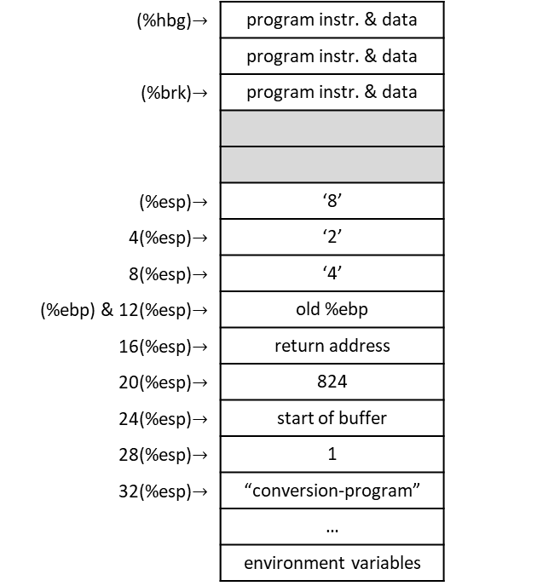
Counting conversion-program.s: integer-to-string.s
conversion_loop:
  # Division is performed on the combined %edx:%eax register,
  movl $0, %edx # so first clear out %edx
  # Store the quotient in %eax, remainder in %edx (both are implied)
  divl %edi # divide %edx:%eax (which are implied) by 10
  # Quotient is in %eax
  # Remainder in %edx, which now needs to be converted into a number.
  # So, %edx has a number 0 – 9, an index on the ASCII table
  # e.g. ascii '0' + integer 0 = ascii '0'
  # e.g. ascii '0' + integer 1 = ascii '1'
  addl $'0', %edx # gives us character for the number stored in %edx
  # Push this value on the stack. When we are done, we can pop off the characters one-by-
  # one and they will be in the right order.
  # Note: We are pushing the whole register, but we only need the byte in %dl (the last
  # byte of the %edx register) for the character.
  pushl %edx
  incl %ecx # increment the digit count
  cmpl $0, %eax # check if %eax is zero yet, go to next step if so.
  je end_conversion_loop
  # %eax already has its new value.
  jmp conversion_loop
end_conversion_loop:
  # The string is now on the stack, if we pop it off a character at a time we can copy it # into the buffer and be done.
  movl ST_BUFFER(%ebp), %edx # get the pointer to the buffer in %edx
(%hbg)$→$ | program instr. & data
 | program instr. & data
(%brk)$→$ | program instr. & data
(%esp)$→$ | ‘8’
4(%esp)$→$ | ‘2’
8(%esp)$→$ | ‘4’
(%ebp) & 12(%esp)$→$ | old %ebp
16(%esp)$→$ | return address
20(%esp)$→$ | 824
24(%esp)$→$ | start of buffer
28(%esp)$→$ | 1
32(%esp)$→$ | “conversion-program”
 | …
 | environment variables
heap
stack
ECX = 2
EAX = 0
EDI = 10
EDX = ‘8’

Slide 144
Counting conversion-program.s: integer-to-string.s
conversion_loop:
  # Division is performed on the combined %edx:%eax register,
  movl $0, %edx # so first clear out %edx
  # Store the quotient in %eax, remainder in %edx (both are implied)
  divl %edi # divide %edx:%eax (which are implied) by 10
  # Quotient is in %eax
  # Remainder in %edx, which now needs to be converted into a number.
  # So, %edx has a number 0 – 9, an index on the ASCII table
  # e.g. ascii '0' + integer 0 = ascii '0'
  # e.g. ascii '0' + integer 1 = ascii '1'
  addl $'0', %edx # gives us character for the number stored in %edx
  # Push this value on the stack. When we are done, we can pop off the characters one-by-
  # one and they will be in the right order.
  # Note: We are pushing the whole register, but we only need the byte in %dl (the last
  # byte of the %edx register) for the character.
  pushl %edx
  incl %ecx # increment the digit count
  cmpl $0, %eax # check if %eax is zero yet, go to next step if so.
  je end_conversion_loop
  # %eax already has its new value.
  jmp conversion_loop
end_conversion_loop:
  # The string is now on the stack, if we pop it off a character at a time we can copy it # into the buffer and be done.
  movl ST_BUFFER(%ebp), %edx # get the pointer to the buffer in %edx
(%hbg)$→$ | program instr. & data
 | program instr. & data
(%brk)$→$ | program instr. & data
(%esp)$→$ | ‘8’
4(%esp)$→$ | ‘2’
8(%esp)$→$ | ‘4’
(%ebp) & 12(%esp)$→$ | old %ebp
16(%esp)$→$ | return address
20(%esp)$→$ | 824
24(%esp)$→$ | start of buffer
28(%esp)$→$ | 1
32(%esp)$→$ | “conversion-program”
 | …
 | environment variables
heap
stack
ECX = 3
EAX = 0
EDI = 10
EDX = ‘8’

Slide 145
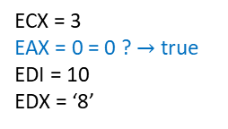
Counting conversion-program.s: integer-to-string.s
conversion_loop:
  # Division is performed on the combined %edx:%eax register,
  movl $0, %edx # so first clear out %edx
  # Store the quotient in %eax, remainder in %edx (both are implied)
  divl %edi # divide %edx:%eax (which are implied) by 10
  # Quotient is in %eax
  # Remainder in %edx, which now needs to be converted into a number.
  # So, %edx has a number 0 – 9, an index on the ASCII table
  # e.g. ascii '0' + integer 0 = ascii '0'
  # e.g. ascii '0' + integer 1 = ascii '1'
  addl $'0', %edx # gives us character for the number stored in %edx
  # Push this value on the stack. When we are done, we can pop off the characters one-by-
  # one and they will be in the right order.
  # Note: We are pushing the whole register, but we only need the byte in %dl (the last
  # byte of the %edx register) for the character.
  pushl %edx
  incl %ecx # increment the digit count
  cmpl $0, %eax # check if %eax is zero yet, go to next step if so.
  je end_conversion_loop
  # %eax already has its new value.
  jmp conversion_loop
end_conversion_loop:
  # The string is now on the stack, if we pop it off a character at a time we can copy it # into the buffer and be done.
  movl ST_BUFFER(%ebp), %edx # get the pointer to the buffer in %edx
(%hbg)$→$ | program instr. & data
 | program instr. & data
(%brk)$→$ | program instr. & data
(%esp)$→$ | ‘8’
4(%esp)$→$ | ‘2’
8(%esp)$→$ | ‘4’
(%ebp) & 12(%esp)$→$ | old %ebp
16(%esp)$→$ | return address
20(%esp)$→$ | 824
24(%esp)$→$ | start of buffer
28(%esp)$→$ | 1
32(%esp)$→$ | “conversion-program”
 | …
 | environment variables
heap
stack
ECX = 3
EAX = 0 = 0 ? $→$ true
EDI = 10
EDX = ‘8’

Slide 146
Counting conversion-program.s: integer-to-string.s
conversion_loop:
  # Division is performed on the combined %edx:%eax register,
  movl $0, %edx # so first clear out %edx
  # Store the quotient in %eax, remainder in %edx (both are implied)
  divl %edi # divide %edx:%eax (which are implied) by 10
  # Quotient is in %eax
  # Remainder in %edx, which now needs to be converted into a number.
  # So, %edx has a number 0 – 9, an index on the ASCII table
  # e.g. ascii '0' + integer 0 = ascii '0'
  # e.g. ascii '0' + integer 1 = ascii '1'
  addl $'0', %edx # gives us character for the number stored in %edx
  # Push this value on the stack. When we are done, we can pop off the characters one-by-
  # one and they will be in the right order.
  # Note: We are pushing the whole register, but we only need the byte in %dl (the last
  # byte of the %edx register) for the character.
  pushl %edx
  incl %ecx # increment the digit count
  cmpl $0, %eax # check if %eax is zero yet, go to next step if so.
  je end_conversion_loop
  # %eax already has its new value.
  jmp conversion_loop
end_conversion_loop:
  # The string is now on the stack, if we pop it off a character at a time we can copy it # into the buffer and be done.
  movl ST_BUFFER(%ebp), %edx # get the pointer to the buffer in %edx
(%hbg)$→$ | program instr. & data
 | program instr. & data
(%brk)$→$ | program instr. & data
(%esp)$→$ | ‘8’
4(%esp)$→$ | ‘2’
8(%esp)$→$ | ‘4’
(%ebp) & 12(%esp)$→$ | old %ebp
16(%esp)$→$ | return address
20(%esp)$→$ | 824
24(%esp)$→$ | start of buffer
28(%esp)$→$ | 1
32(%esp)$→$ | “conversion-program”
 | …
 | environment variables
heap
stack
ECX = 3
EAX = 0
EDI = 10
EDX = ‘8’

Slide 147
Counting conversion-program.s: integer-to-string.s
conversion_loop:
  # Division is performed on the combined %edx:%eax register,
  movl $0, %edx # so first clear out %edx
  # Store the quotient in %eax, remainder in %edx (both are implied)
  divl %edi # divide %edx:%eax (which are implied) by 10
  # Quotient is in %eax
  # Remainder in %edx, which now needs to be converted into a number.
  # So, %edx has a number 0 – 9, an index on the ASCII table
  # e.g. ascii '0' + integer 0 = ascii '0'
  # e.g. ascii '0' + integer 1 = ascii '1'
  addl $'0', %edx # gives us character for the number stored in %edx
  # Push this value on the stack. When we are done, we can pop off the characters one-by-
  # one and they will be in the right order.
  # Note: We are pushing the whole register, but we only need the byte in %dl (the last
  # byte of the %edx register) for the character.
  pushl %edx
  incl %ecx # increment the digit count
  cmpl $0, %eax # check if %eax is zero yet, go to next step if so.
  je end_conversion_loop
  # %eax already has its new value.
  jmp conversion_loop
end_conversion_loop:
  # The string is now on the stack, if we pop it off a character at a time we can copy it # into the buffer and be done.
  movl ST_BUFFER(%ebp), %edx # get the pointer to the buffer in %edx
(%hbg)$→$ | program instr. & data
 | program instr. & data
(%brk)$→$ | program instr. & data
(%esp)$→$ | ‘8’
4(%esp)$→$ | ‘2’
8(%esp)$→$ | ‘4’
(%ebp) & 12(%esp)$→$ | old %ebp
16(%esp)$→$ | return address
20(%esp)$→$ | 824
24(%esp)$→$ | start of buffer
28(%esp)$→$ | 1
32(%esp)$→$ | “conversion-program”
 | …
 | environment variables
heap
stack
ECX = 3
EAX = 0
EDI = 10
EDX = ‘8’

Slide 148
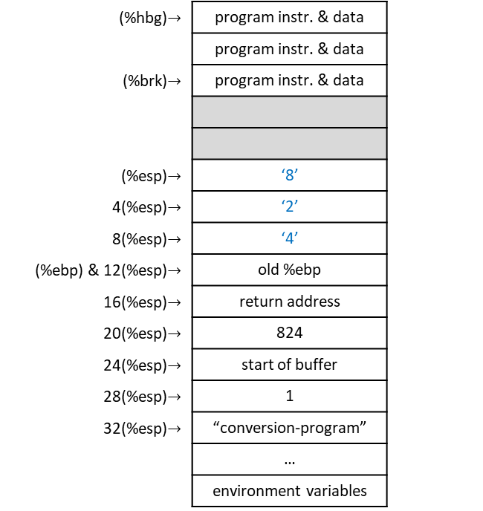
Counting conversion-program.s: integer-to-string.s
conversion_loop:
  # Division is performed on the combined %edx:%eax register,
  movl $0, %edx # so first clear out %edx
  # Store the quotient in %eax, remainder in %edx (both are implied)
  divl %edi # divide %edx:%eax (which are implied) by 10
  # Quotient is in %eax
  # Remainder in %edx, which now needs to be converted into a number.
  # So, %edx has a number 0 – 9, an index on the ASCII table
  # e.g. ascii '0' + integer 0 = ascii '0'
  # e.g. ascii '0' + integer 1 = ascii '1'
  addl $'0', %edx # gives us character for the number stored in %edx
  # Push this value on the stack. When we are done, we can pop off the characters one-by-
  # one and they will be in the right order.
  # Note: We are pushing the whole register, but we only need the byte in %dl (the last
  # byte of the %edx register) for the character.
  pushl %edx
  incl %ecx # increment the digit count
  cmpl $0, %eax # check if %eax is zero yet, go to next step if so.
  je end_conversion_loop
  # %eax already has its new value.
  jmp conversion_loop
end_conversion_loop:
  # The string is now on the stack, if we pop it off a character at a time we can copy it # into the buffer and be done.
  movl ST_BUFFER(%ebp), %edx # get the pointer to the buffer in %edx
(%hbg)$→$ | program instr. & data
 | program instr. & data
(%brk)$→$ | program instr. & data
(%esp)$→$ | ‘8’
4(%esp)$→$ | ‘2’
8(%esp)$→$ | ‘4’
(%ebp) & 12(%esp)$→$ | old %ebp
16(%esp)$→$ | return address
20(%esp)$→$ | 824
24(%esp)$→$ | start of buffer
28(%esp)$→$ | 1
32(%esp)$→$ | “conversion-program”
 | …
 | environment variables
heap
stack
ECX = 3
EAX = 0
EDI = 10
EDX = ‘8’

Slide 149
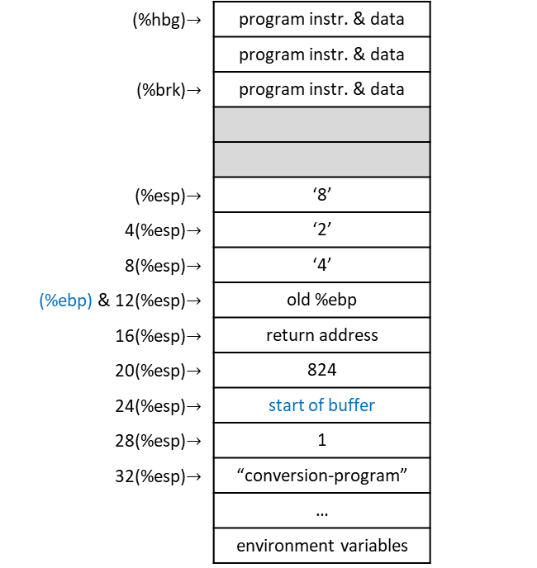
Counting conversion-program.s: integer-to-string.s
conversion_loop:
  # Division is performed on the combined %edx:%eax register,
  movl $0, %edx # so first clear out %edx
  # Store the quotient in %eax, remainder in %edx (both are implied)
  divl %edi # divide %edx:%eax (which are implied) by 10
  # Quotient is in %eax
  # Remainder in %edx, which now needs to be converted into a number.
  # So, %edx has a number 0 – 9, an index on the ASCII table
  # e.g. ascii '0' + integer 0 = ascii '0'
  # e.g. ascii '0' + integer 1 = ascii '1'
  addl $'0', %edx # gives us character for the number stored in %edx
  # Push this value on the stack. When we are done, we can pop off the characters one-by-
  # one and they will be in the right order.
  # Note: We are pushing the whole register, but we only need the byte in %dl (the last
  # byte of the %edx register) for the character.
  pushl %edx
  incl %ecx # increment the digit count
  cmpl $0, %eax # check if %eax is zero yet, go to next step if so.
  je end_conversion_loop
  # %eax already has its new value.
  jmp conversion_loop
end_conversion_loop:
  # The string is now on the stack, if we pop it off a character at a time we can copy it # into the buffer and be done.
  movl ST_BUFFER(%ebp), %edx # get the pointer to the buffer in %edx
(%hbg)$→$ | program instr. & data
 | program instr. & data
(%brk)$→$ | program instr. & data
(%esp)$→$ | ‘8’
4(%esp)$→$ | ‘2’
8(%esp)$→$ | ‘4’
(%ebp) & 12(%esp)$→$ | old %ebp
16(%esp)$→$ | return address
20(%esp)$→$ | 824
24(%esp)$→$ | start of buffer
28(%esp)$→$ | 1
32(%esp)$→$ | “conversion-program”
 | …
 | environment variables
heap
stack
ECX = 3
EAX = 0
EDI = 10
EDX = start of buffer

Slide 150
Counting conversion-program.s: integer-to-string.s
copy_reversing_loop:
  # We pushed a whole register, but we only need the last byte. So we will pop off to the
  # entire %eax register, but then only move the small part (%al) into the character string.
  popl %eax
  movb %al, (%edx)
  decl %ecx # decreasing %ecx so we know when we are finished
  incl %edx # increasing %edx so that it will be pointing to the next byte
  cmpl $0, %ecx # check to see if we are finished
  je end_copy_reversing_loop # if so, jump to the end of the function
  jmp copy_reversing_loop # otherwise, repeat the loop
end_copy_reversing_loop:
  # Done copying
  movb $0, (%edx) # now write a null byte and return
  # Normal function end
  movl %ebp, %esp
  popl %ebp
  ret
(%hbg)$→$ | program instr. & data
 | program instr. & data
(%brk)$→$ | program instr. & data
(%esp)$→$ | ‘8’
4(%esp)$→$ | ‘2’
8(%esp)$→$ | ‘4’
(%ebp) & 12(%esp)$→$ | old %ebp
16(%esp)$→$ | return address
20(%esp)$→$ | 824
24(%esp)$→$ | start of buffer
28(%esp)$→$ | 1
32(%esp)$→$ | “conversion-program”
 | …
 | environment variables
heap
stack
ECX = 3
EAX = 0
EDI = 10
EDX = start of buffer

Slide 151
Counting conversion-program.s: integer-to-string.s
copy_reversing_loop:
  # We pushed a whole register, but we only need the last byte. So we will pop off to the
  # entire %eax register, but then only move the small part (%al) into the character string.
  popl %eax
  movb %al, (%edx)
  decl %ecx # decreasing %ecx so we know when we are finished
  incl %edx # increasing %edx so that it will be pointing to the next byte
  cmpl $0, %ecx # check to see if we are finished
  je end_copy_reversing_loop # if so, jump to the end of the function
  jmp copy_reversing_loop # otherwise, repeat the loop
end_copy_reversing_loop:
  # Done copying
  movb $0, (%edx) # now write a null byte and return
  # Normal function end
  movl %ebp, %esp
  popl %ebp
  ret
(%hbg)$→$ | program instr. & data
 | program instr. & data
(%brk)$→$ | program instr. & data
(%esp)$→$ | ‘8’
4(%esp)$→$ | ‘2’
8(%esp)$→$ | ‘4’
(%ebp) & 12(%esp)$→$ | old %ebp
16(%esp)$→$ | return address
20(%esp)$→$ | 824
24(%esp)$→$ | start of buffer
28(%esp)$→$ | 1
32(%esp)$→$ | “conversion-program”
 | …
 | environment variables
heap
stack
%eax
%ax
byte 0 | byte 1 | byte 2 | byte 3
0 | 0 | 0 | 0
EAX =
ECX = 3
EAX = 0
EDI = 10
EDX = start of buffer
%al

Slide 152

Counting conversion-program.s: integer-to-string.s
copy_reversing_loop:
  # We pushed a whole register, but we only need the last byte. So we will pop off to the
  # entire %eax register, but then only move the small part (%al) into the character string.
  popl %eax
  movb %al, (%edx)
  decl %ecx # decreasing %ecx so we know when we are finished
  incl %edx # increasing %edx so that it will be pointing to the next byte
  cmpl $0, %ecx # check to see if we are finished
  je end_copy_reversing_loop # if so, jump to the end of the function
  jmp copy_reversing_loop # otherwise, repeat the loop
end_copy_reversing_loop:
  # Done copying
  movb $0, (%edx) # now write a null byte and return
  # Normal function end
  movl %ebp, %esp
  popl %ebp
  ret
(%hbg)$→$ | program instr. & data
 | program instr. & data
(%brk)$→$ | program instr. & data
(%esp)$→$ | ‘2’
4(%esp)$→$ | ‘4’
(%ebp) & 8(%esp)$→$ | old %ebp
12(%esp)$→$ | return address
16(%esp)$→$ | 824
20(%esp)$→$ | start of buffer
24(%esp)$→$ | 1
28(%esp)$→$ | “conversion-program”
 | …
 | environment variables
heap
stack
%eax
%ax
byte 0 | byte 1 | byte 2 | byte 3
0 | 0 | 0 | ‘8’
EAX =
ECX = 3
EAX = ‘8’
EDI = 10
EDX = start of buffer
%al

Slide 153
Counting conversion-program.s: integer-to-string.s
copy_reversing_loop:
  # We pushed a whole register, but we only need the last byte. So we will pop off to the
  # entire %eax register, but then only move the small part (%al) into the character string.
  popl %eax
  movb %al, (%edx)
  decl %ecx # decreasing %ecx so we know when we are finished
  incl %edx # increasing %edx so that it will be pointing to the next byte
  cmpl $0, %ecx # check to see if we are finished
  je end_copy_reversing_loop # if so, jump to the end of the function
  jmp copy_reversing_loop # otherwise, repeat the loop
end_copy_reversing_loop:
  # Done copying
  movb $0, (%edx) # now write a null byte and return
  # Normal function end
  movl %ebp, %esp
  popl %ebp
  ret
(%hbg)$→$ | program instr. & data
 | program instr. & data
(%brk)$→$ | program instr. & data
(%esp)$→$ | ‘2’
4(%esp)$→$ | ‘4’
(%ebp) & 8(%esp)$→$ | old %ebp
12(%esp)$→$ | return address
16(%esp)$→$ | 824
20(%esp)$→$ | start of buffer
24(%esp)$→$ | 1
28(%esp)$→$ | “conversion-program”
 | …
 | environment variables
heap
stack
%eax
%ax
byte 0 | byte 1 | byte 2 | byte 3
0 | 0 | 0 | ‘8’
EAX =
ECX = 3
EAX = ‘8’
EDI = 10
EDX = start of buffer
%al

Slide 154
Counting conversion-program.s: integer-to-string.s
copy_reversing_loop:
  # We pushed a whole register, but we only need the last byte. So we will pop off to the
  # entire %eax register, but then only move the small part (%al) into the character string.
  popl %eax
  movb %al, (%edx)
  decl %ecx # decreasing %ecx so we know when we are finished
  incl %edx # increasing %edx so that it will be pointing to the next byte
  cmpl $0, %ecx # check to see if we are finished
  je end_copy_reversing_loop # if so, jump to the end of the function
  jmp copy_reversing_loop # otherwise, repeat the loop
end_copy_reversing_loop:
  # Done copying
  movb $0, (%edx) # now write a null byte and return
  # Normal function end
  movl %ebp, %esp
  popl %ebp
  ret
(%hbg)$→$ | program instr. & data
 | program instr. & data
(%brk)$→$ | program instr. & data
(%esp)$→$ | ‘2’
4(%esp)$→$ | ‘4’
(%ebp) & 8(%esp)$→$ | old %ebp
12(%esp)$→$ | return address
16(%esp)$→$ | 824
20(%esp)$→$ | start of buffer
24(%esp)$→$ | 1
28(%esp)$→$ | “conversion-program”
 | …
 | environment variables
heap
stack
%eax
byte 0 | byte 1 | byte 2 | byte 3
0 | 0 | 0 | ‘8’
EAX =
ECX = 3
EAX = ‘8’
EDI = 10
EDX = start of buffer

Slide 155
Counting conversion-program.s: integer-to-string.s
copy_reversing_loop:
  # We pushed a whole register, but we only need the last byte. So we will pop off to the
  # entire %eax register, but then only move the small part (%al) into the character string.
  popl %eax
  movb %al, (%edx)
  decl %ecx # decreasing %ecx so we know when we are finished
  incl %edx # increasing %edx so that it will be pointing to the next byte
  cmpl $0, %ecx # check to see if we are finished
  je end_copy_reversing_loop # if so, jump to the end of the function
  jmp copy_reversing_loop # otherwise, repeat the loop
end_copy_reversing_loop:
  # Done copying
  movb $0, (%edx) # now write a null byte and return
  # Normal function end
  movl %ebp, %esp
  popl %ebp
  ret
(%hbg)$→$ | program instr. & data
 | program instr. & data
(%brk)$→$ | program instr. & data
(%esp)$→$ | ‘2’
4(%esp)$→$ | ‘4’
(%ebp) & 8(%esp)$→$ | old %ebp
12(%esp)$→$ | return address
16(%esp)$→$ | 824
20(%esp)$→$ | start of buffer
24(%esp)$→$ | 1
28(%esp)$→$ | “conversion-program”
 | …
 | environment variables
heap
stack
%eax
%ax
byte 0 | byte 1 | byte 2 | byte 3
0 | 0 | 0 | ‘8’
EAX =
ECX = 3
EAX = ‘8’
EDI = 10
EDX = start of buffer

Slide 156
Counting conversion-program.s: integer-to-string.s
copy_reversing_loop:
  # We pushed a whole register, but we only need the last byte. So we will pop off to the
  # entire %eax register, but then only move the small part (%al) into the character string.
  popl %eax
  movb %al, (%edx)
  decl %ecx # decreasing %ecx so we know when we are finished
  incl %edx # increasing %edx so that it will be pointing to the next byte
  cmpl $0, %ecx # check to see if we are finished
  je end_copy_reversing_loop # if so, jump to the end of the function
  jmp copy_reversing_loop # otherwise, repeat the loop
end_copy_reversing_loop:
  # Done copying
  movb $0, (%edx) # now write a null byte and return
  # Normal function end
  movl %ebp, %esp
  popl %ebp
  ret
(%hbg)$→$ | program instr. & data
 | program instr. & data
(%brk)$→$ | program instr. & data
(%esp)$→$ | ‘2’
4(%esp)$→$ | ‘4’
(%ebp) & 8(%esp)$→$ | old %ebp
12(%esp)$→$ | return address
16(%esp)$→$ | 824
20(%esp)$→$ | start of buffer
24(%esp)$→$ | 1
28(%esp)$→$ | “conversion-program”
 | …
 | environment variables
heap
stack
%eax
%ax
byte 0 | byte 1 | byte 2 | byte 3
0 | 0 | 0 | ‘8’
EAX =
ECX = 3
EAX = ‘8’
EDI = 10
EDX = start of buffer
%al

Slide 157
Counting conversion-program.s: integer-to-string.s
copy_reversing_loop:
  # We pushed a whole register, but we only need the last byte. So we will pop off to the
  # entire %eax register, but then only move the small part (%al) into the character string.
  popl %eax
  movb %al, (%edx)
  decl %ecx # decreasing %ecx so we know when we are finished
  incl %edx # increasing %edx so that it will be pointing to the next byte
  cmpl $0, %ecx # check to see if we are finished
  je end_copy_reversing_loop # if so, jump to the end of the function
  jmp copy_reversing_loop # otherwise, repeat the loop
end_copy_reversing_loop:
  # Done copying
  movb $0, (%edx) # now write a null byte and return
  # Normal function end
  movl %ebp, %esp
  popl %ebp
  ret
(%hbg)$→$ | program instr. & data
 | program instr. & data
(%brk)$→$ | program instr. & data
(%esp)$→$ | ‘2’
4(%esp)$→$ | ‘4’
(%ebp) & 8(%esp)$→$ | old %ebp
12(%esp)$→$ | return address
16(%esp)$→$ | 824
20(%esp)$→$ | start of buffer
24(%esp)$→$ | 1
28(%esp)$→$ | “conversion-program”
 | …
 | environment variables
heap
stack
%eax
%ax
byte 0 | byte 1 | byte 2 | byte 3
0 | 0 | 0 | ‘8’
EAX =
ECX = 3
EAX = ‘8’
EDI = 10
EDX = start of buffer = Ø
EDX
%al
byte 0 | byte 1 | byte 2 | byte 3 | byte 4 | byte 5 | byte 6 | byte 7 | byte 8 | byte 9 | byte 10
Ø | Ø | Ø | Ø | Ø | Ø | Ø | Ø | Ø | Ø | Ø
buffer =

Slide 158
Counting conversion-program.s: integer-to-string.s
copy_reversing_loop:
  # We pushed a whole register, but we only need the last byte. So we will pop off to the
  # entire %eax register, but then only move the small part (%al) into the character string.
  popl %eax
  movb %al, (%edx)
  decl %ecx # decreasing %ecx so we know when we are finished
  incl %edx # increasing %edx so that it will be pointing to the next byte
  cmpl $0, %ecx # check to see if we are finished
  je end_copy_reversing_loop # if so, jump to the end of the function
  jmp copy_reversing_loop # otherwise, repeat the loop
end_copy_reversing_loop:
  # Done copying
  movb $0, (%edx) # now write a null byte and return
  # Normal function end
  movl %ebp, %esp
  popl %ebp
  ret
(%hbg)$→$ | program instr. & data
 | program instr. & data
(%brk)$→$ | program instr. & data
(%esp)$→$ | ‘2’
4(%esp)$→$ | ‘4’
(%ebp) & 8(%esp)$→$ | old %ebp
12(%esp)$→$ | return address
16(%esp)$→$ | 824
20(%esp)$→$ | start of buffer
24(%esp)$→$ | 1
28(%esp)$→$ | “conversion-program”
 | …
 | environment variables
heap
stack
%eax
%ax
byte 0 | byte 1 | byte 2 | byte 3
0 | 0 | 0 | ‘8’
EAX =
ECX = 3
EAX = ‘8’
EDI = 10
EDX = start of buffer = ‘8’
EDX
%al
byte 0 | byte 1 | byte 2 | byte 3 | byte 4 | byte 5 | byte 6 | byte 7 | byte 8 | byte 9 | byte 10
‘8’ | Ø | Ø | Ø | Ø | Ø | Ø | Ø | Ø | Ø | Ø
buffer =

Slide 159
Counting conversion-program.s: integer-to-string.s
copy_reversing_loop:
  # We pushed a whole register, but we only need the last byte. So we will pop off to the
  # entire %eax register, but then only move the small part (%al) into the character string.
  popl %eax
  movb %al, (%edx)
  decl %ecx # decreasing %ecx so we know when we are finished
  incl %edx # increasing %edx so that it will be pointing to the next byte
  cmpl $0, %ecx # check to see if we are finished
  je end_copy_reversing_loop # if so, jump to the end of the function
  jmp copy_reversing_loop # otherwise, repeat the loop
end_copy_reversing_loop:
  # Done copying
  movb $0, (%edx) # now write a null byte and return
  # Normal function end
  movl %ebp, %esp
  popl %ebp
  ret
(%hbg)$→$ | program instr. & data
 | program instr. & data
(%brk)$→$ | program instr. & data
(%esp)$→$ | ‘2’
4(%esp)$→$ | ‘4’
(%ebp) & 8(%esp)$→$ | old %ebp
12(%esp)$→$ | return address
16(%esp)$→$ | 824
20(%esp)$→$ | start of buffer
24(%esp)$→$ | 1
28(%esp)$→$ | “conversion-program”
 | …
 | environment variables
heap
stack
%eax
%ax
byte 0 | byte 1 | byte 2 | byte 3
0 | 0 | 0 | ‘8’
EAX =
ECX = 3
EAX = ‘8’
EDI = 10
EDX = start of buffer = ‘8’
EDX
%al
byte 0 | byte 1 | byte 2 | byte 3 | byte 4 | byte 5 | byte 6 | byte 7 | byte 8 | byte 9 | byte 10
‘8’ | Ø | Ø | Ø | Ø | Ø | Ø | Ø | Ø | Ø | Ø
buffer =

Slide 160
Counting conversion-program.s: integer-to-string.s
copy_reversing_loop:
  # We pushed a whole register, but we only need the last byte. So we will pop off to the
  # entire %eax register, but then only move the small part (%al) into the character string.
  popl %eax
  movb %al, (%edx)
  decl %ecx # decreasing %ecx so we know when we are finished
  incl %edx # increasing %edx so that it will be pointing to the next byte
  cmpl $0, %ecx # check to see if we are finished
  je end_copy_reversing_loop # if so, jump to the end of the function
  jmp copy_reversing_loop # otherwise, repeat the loop
end_copy_reversing_loop:
  # Done copying
  movb $0, (%edx) # now write a null byte and return
  # Normal function end
  movl %ebp, %esp
  popl %ebp
  ret
(%hbg)$→$ | program instr. & data
 | program instr. & data
(%brk)$→$ | program instr. & data
(%esp)$→$ | ‘2’
4(%esp)$→$ | ‘4’
(%ebp) & 8(%esp)$→$ | old %ebp
12(%esp)$→$ | return address
16(%esp)$→$ | 824
20(%esp)$→$ | start of buffer
24(%esp)$→$ | 1
28(%esp)$→$ | “conversion-program”
 | …
 | environment variables
heap
stack
%eax
%ax
byte 0 | byte 1 | byte 2 | byte 3
0 | 0 | 0 | ‘8’
EAX =
ECX = 2
EAX = ‘8’
EDI = 10
EDX = start of buffer = ‘8’
EDX
%al
byte 0 | byte 1 | byte 2 | byte 3 | byte 4 | byte 5 | byte 6 | byte 7 | byte 8 | byte 9 | byte 10
‘8’ | Ø | Ø | Ø | Ø | Ø | Ø | Ø | Ø | Ø | Ø
buffer =

Slide 161
Counting conversion-program.s: integer-to-string.s
copy_reversing_loop:
  # We pushed a whole register, but we only need the last byte. So we will pop off to the
  # entire %eax register, but then only move the small part (%al) into the character string.
  popl %eax
  movb %al, (%edx)
  decl %ecx # decreasing %ecx so we know when we are finished
  incl %edx # increasing %edx so that it will be pointing to the next byte
  cmpl $0, %ecx # check to see if we are finished
  je end_copy_reversing_loop # if so, jump to the end of the function
  jmp copy_reversing_loop # otherwise, repeat the loop
end_copy_reversing_loop:
  # Done copying
  movb $0, (%edx) # now write a null byte and return
  # Normal function end
  movl %ebp, %esp
  popl %ebp
  ret
(%hbg)$→$ | program instr. & data
 | program instr. & data
(%brk)$→$ | program instr. & data
(%esp)$→$ | ‘2’
4(%esp)$→$ | ‘4’
(%ebp) & 8(%esp)$→$ | old %ebp
12(%esp)$→$ | return address
16(%esp)$→$ | 824
20(%esp)$→$ | start of buffer
24(%esp)$→$ | 1
28(%esp)$→$ | “conversion-program”
 | …
 | environment variables
heap
stack
%eax
%ax
byte 0 | byte 1 | byte 2 | byte 3
0 | 0 | 0 | ‘8’
EAX =
ECX = 2
EAX = ‘8’
EDI = 10
EDX = start of buffer + 1 = Ø
EDX
%al
byte 0 | byte 1 | byte 2 | byte 3 | byte 4 | byte 5 | byte 6 | byte 7 | byte 8 | byte 9 | byte 10
‘8’ | Ø | Ø | Ø | Ø | Ø | Ø | Ø | Ø | Ø | Ø
buffer =

Slide 162
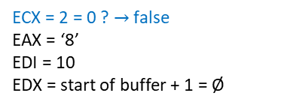
Counting conversion-program.s: integer-to-string.s
copy_reversing_loop:
  # We pushed a whole register, but we only need the last byte. So we will pop off to the
  # entire %eax register, but then only move the small part (%al) into the character string.
  popl %eax
  movb %al, (%edx)
  decl %ecx # decreasing %ecx so we know when we are finished
  incl %edx # increasing %edx so that it will be pointing to the next byte
  cmpl $0, %ecx # check to see if we are finished
  je end_copy_reversing_loop # if so, jump to the end of the function
  jmp copy_reversing_loop # otherwise, repeat the loop
end_copy_reversing_loop:
  # Done copying
  movb $0, (%edx) # now write a null byte and return
  # Normal function end
  movl %ebp, %esp
  popl %ebp
  ret
(%hbg)$→$ | program instr. & data
 | program instr. & data
(%brk)$→$ | program instr. & data
(%esp)$→$ | ‘2’
4(%esp)$→$ | ‘4’
(%ebp) & 8(%esp)$→$ | old %ebp
12(%esp)$→$ | return address
16(%esp)$→$ | 824
20(%esp)$→$ | start of buffer
24(%esp)$→$ | 1
28(%esp)$→$ | “conversion-program”
 | …
 | environment variables
heap
stack
%eax
%ax
byte 0 | byte 1 | byte 2 | byte 3
0 | 0 | 0 | ‘8’
EAX =
ECX = 2 = 0 ? $→$ false
EAX = ‘8’
EDI = 10
EDX = start of buffer + 1 = Ø
EDX
%al
byte 0 | byte 1 | byte 2 | byte 3 | byte 4 | byte 5 | byte 6 | byte 7 | byte 8 | byte 9 | byte 10
‘8’ | Ø | Ø | Ø | Ø | Ø | Ø | Ø | Ø | Ø | Ø
buffer =

Slide 163
Counting conversion-program.s: integer-to-string.s
copy_reversing_loop:
  # We pushed a whole register, but we only need the last byte. So we will pop off to the
  # entire %eax register, but then only move the small part (%al) into the character string.
  popl %eax
  movb %al, (%edx)
  decl %ecx # decreasing %ecx so we know when we are finished
  incl %edx # increasing %edx so that it will be pointing to the next byte
  cmpl $0, %ecx # check to see if we are finished
  je end_copy_reversing_loop # if so, jump to the end of the function
  jmp copy_reversing_loop # otherwise, repeat the loop
end_copy_reversing_loop:
  # Done copying
  movb $0, (%edx) # now write a null byte and return
  # Normal function end
  movl %ebp, %esp
  popl %ebp
  ret
(%hbg)$→$ | program instr. & data
 | program instr. & data
(%brk)$→$ | program instr. & data
(%esp)$→$ | ‘2’
4(%esp)$→$ | ‘4’
(%ebp) & 8(%esp)$→$ | old %ebp
12(%esp)$→$ | return address
16(%esp)$→$ | 824
20(%esp)$→$ | start of buffer
24(%esp)$→$ | 1
28(%esp)$→$ | “conversion-program”
 | …
 | environment variables
heap
stack
%eax
%ax
byte 0 | byte 1 | byte 2 | byte 3
0 | 0 | 0 | ‘8’
EAX =
ECX = 2
EAX = ‘8’
EDI = 10
EDX = start of buffer + 1 = Ø
EDX
%al
byte 0 | byte 1 | byte 2 | byte 3 | byte 4 | byte 5 | byte 6 | byte 7 | byte 8 | byte 9 | byte 10
‘8’ | Ø | Ø | Ø | Ø | Ø | Ø | Ø | Ø | Ø | Ø
buffer =

Slide 164

Counting conversion-program.s: integer-to-string.s
copy_reversing_loop:
  # We pushed a whole register, but we only need the last byte. So we will pop off to the
  # entire %eax register, but then only move the small part (%al) into the character string.
  popl %eax
  movb %al, (%edx)
  decl %ecx # decreasing %ecx so we know when we are finished
  incl %edx # increasing %edx so that it will be pointing to the next byte
  cmpl $0, %ecx # check to see if we are finished
  je end_copy_reversing_loop # if so, jump to the end of the function
  jmp copy_reversing_loop # otherwise, repeat the loop
end_copy_reversing_loop:
  # Done copying
  movb $0, (%edx) # now write a null byte and return
  # Normal function end
  movl %ebp, %esp
  popl %ebp
  ret
(%hbg)$→$ | program instr. & data
 | program instr. & data
(%brk)$→$ | program instr. & data
(%esp)$→$ | ‘4’
(%ebp) & 4(%esp)$→$ | old %ebp
8(%esp)$→$ | return address
12(%esp)$→$ | 824
16(%esp)$→$ | start of buffer
20(%esp)$→$ | 1
24(%esp)$→$ | “conversion-program”
 | …
 | environment variables
heap
stack
%eax
%ax
byte 0 | byte 1 | byte 2 | byte 3
0 | 0 | 0 | ‘2’
EAX =
ECX = 2
EAX = ‘2’
EDI = 10
EDX = start of buffer + 1 = Ø
EDX
%al
byte 0 | byte 1 | byte 2 | byte 3 | byte 4 | byte 5 | byte 6 | byte 7 | byte 8 | byte 9 | byte 10
‘8’ | Ø | Ø | Ø | Ø | Ø | Ø | Ø | Ø | Ø | Ø
buffer =

Slide 165
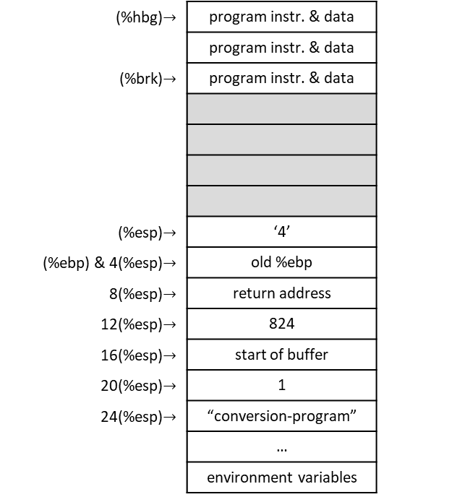
Counting conversion-program.s: integer-to-string.s
copy_reversing_loop:
  # We pushed a whole register, but we only need the last byte. So we will pop off to the
  # entire %eax register, but then only move the small part (%al) into the character string.
  popl %eax
  movb %al, (%edx)
  decl %ecx # decreasing %ecx so we know when we are finished
  incl %edx # increasing %edx so that it will be pointing to the next byte
  cmpl $0, %ecx # check to see if we are finished
  je end_copy_reversing_loop # if so, jump to the end of the function
  jmp copy_reversing_loop # otherwise, repeat the loop
end_copy_reversing_loop:
  # Done copying
  movb $0, (%edx) # now write a null byte and return
  # Normal function end
  movl %ebp, %esp
  popl %ebp
  ret
(%hbg)$→$ | program instr. & data
 | program instr. & data
(%brk)$→$ | program instr. & data
(%esp)$→$ | ‘4’
(%ebp) & 4(%esp)$→$ | old %ebp
8(%esp)$→$ | return address
12(%esp)$→$ | 824
16(%esp)$→$ | start of buffer
20(%esp)$→$ | 1
24(%esp)$→$ | “conversion-program”
 | …
 | environment variables
heap
stack
%eax
%ax
byte 0 | byte 1 | byte 2 | byte 3
0 | 0 | 0 | ‘2’
EAX =
ECX = 2
EAX = ‘2’
EDI = 10
EDX = start of buffer + 1 = ‘2’
EDX
%al
byte 0 | byte 1 | byte 2 | byte 3 | byte 4 | byte 5 | byte 6 | byte 7 | byte 8 | byte 9 | byte 10
‘8’ | ‘2’ | Ø | Ø | Ø | Ø | Ø | Ø | Ø | Ø | Ø
buffer =

Slide 166
Counting conversion-program.s: integer-to-string.s
copy_reversing_loop:
  # We pushed a whole register, but we only need the last byte. So we will pop off to the
  # entire %eax register, but then only move the small part (%al) into the character string.
  popl %eax
  movb %al, (%edx)
  decl %ecx # decreasing %ecx so we know when we are finished
  incl %edx # increasing %edx so that it will be pointing to the next byte
  cmpl $0, %ecx # check to see if we are finished
  je end_copy_reversing_loop # if so, jump to the end of the function
  jmp copy_reversing_loop # otherwise, repeat the loop
end_copy_reversing_loop:
  # Done copying
  movb $0, (%edx) # now write a null byte and return
  # Normal function end
  movl %ebp, %esp
  popl %ebp
  ret
(%hbg)$→$ | program instr. & data
 | program instr. & data
(%brk)$→$ | program instr. & data
(%esp)$→$ | ‘4’
(%ebp) & 4(%esp)$→$ | old %ebp
8(%esp)$→$ | return address
12(%esp)$→$ | 824
16(%esp)$→$ | start of buffer
20(%esp)$→$ | 1
24(%esp)$→$ | “conversion-program”
 | …
 | environment variables
heap
stack
%eax
%ax
byte 0 | byte 1 | byte 2 | byte 3
0 | 0 | 0 | ‘2’
EAX =
ECX = 1
EAX = ‘2’
EDI = 10
EDX = start of buffer + 1 = ‘2’
EDX
%al
byte 0 | byte 1 | byte 2 | byte 3 | byte 4 | byte 5 | byte 6 | byte 7 | byte 8 | byte 9 | byte 10
‘8’ | ‘2’ | Ø | Ø | Ø | Ø | Ø | Ø | Ø | Ø | Ø
buffer =

Slide 167
Counting conversion-program.s: integer-to-string.s
copy_reversing_loop:
  # We pushed a whole register, but we only need the last byte. So we will pop off to the
  # entire %eax register, but then only move the small part (%al) into the character string.
  popl %eax
  movb %al, (%edx)
  decl %ecx # decreasing %ecx so we know when we are finished
  incl %edx # increasing %edx so that it will be pointing to the next byte
  cmpl $0, %ecx # check to see if we are finished
  je end_copy_reversing_loop # if so, jump to the end of the function
  jmp copy_reversing_loop # otherwise, repeat the loop
end_copy_reversing_loop:
  # Done copying
  movb $0, (%edx) # now write a null byte and return
  # Normal function end
  movl %ebp, %esp
  popl %ebp
  ret
(%hbg)$→$ | program instr. & data
 | program instr. & data
(%brk)$→$ | program instr. & data
(%esp)$→$ | ‘4’
(%ebp) & 4(%esp)$→$ | old %ebp
8(%esp)$→$ | return address
12(%esp)$→$ | 824
16(%esp)$→$ | start of buffer
20(%esp)$→$ | 1
24(%esp)$→$ | “conversion-program”
 | …
 | environment variables
heap
stack
%eax
%ax
byte 0 | byte 1 | byte 2 | byte 3
0 | 0 | 0 | ‘2’
EAX =
ECX = 1
EAX = ‘2’
EDI = 10
EDX = start of buffer + 2 = Ø
EDX
%al
byte 0 | byte 1 | byte 2 | byte 3 | byte 4 | byte 5 | byte 6 | byte 7 | byte 8 | byte 9 | byte 10
‘8’ | ‘2’ | Ø | Ø | Ø | Ø | Ø | Ø | Ø | Ø | Ø
buffer =

Slide 168
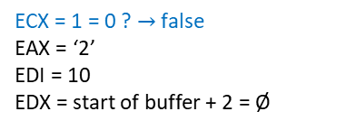
Counting conversion-program.s: integer-to-string.s
copy_reversing_loop:
  # We pushed a whole register, but we only need the last byte. So we will pop off to the
  # entire %eax register, but then only move the small part (%al) into the character string.
  popl %eax
  movb %al, (%edx)
  decl %ecx # decreasing %ecx so we know when we are finished
  incl %edx # increasing %edx so that it will be pointing to the next byte
  cmpl $0, %ecx # check to see if we are finished
  je end_copy_reversing_loop # if so, jump to the end of the function
  jmp copy_reversing_loop # otherwise, repeat the loop
end_copy_reversing_loop:
  # Done copying
  movb $0, (%edx) # now write a null byte and return
  # Normal function end
  movl %ebp, %esp
  popl %ebp
  ret
(%hbg)$→$ | program instr. & data
 | program instr. & data
(%brk)$→$ | program instr. & data
(%esp)$→$ | ‘4’
(%ebp) & 4(%esp)$→$ | old %ebp
8(%esp)$→$ | return address
12(%esp)$→$ | 824
16(%esp)$→$ | start of buffer
20(%esp)$→$ | 1
24(%esp)$→$ | “conversion-program”
 | …
 | environment variables
heap
stack
%eax
%ax
byte 0 | byte 1 | byte 2 | byte 3
0 | 0 | 0 | ‘2’
EAX =
ECX = 1 = 0 ? $→$ false
EAX = ‘2’
EDI = 10
EDX = start of buffer + 2 = Ø
EDX
%al
byte 0 | byte 1 | byte 2 | byte 3 | byte 4 | byte 5 | byte 6 | byte 7 | byte 8 | byte 9 | byte 10
‘8’ | ‘2’ | Ø | Ø | Ø | Ø | Ø | Ø | Ø | Ø | Ø
buffer =

Slide 169
Counting conversion-program.s: integer-to-string.s
copy_reversing_loop:
  # We pushed a whole register, but we only need the last byte. So we will pop off to the
  # entire %eax register, but then only move the small part (%al) into the character string.
  popl %eax
  movb %al, (%edx)
  decl %ecx # decreasing %ecx so we know when we are finished
  incl %edx # increasing %edx so that it will be pointing to the next byte
  cmpl $0, %ecx # check to see if we are finished
  je end_copy_reversing_loop # if so, jump to the end of the function
  jmp copy_reversing_loop # otherwise, repeat the loop
end_copy_reversing_loop:
  # Done copying
  movb $0, (%edx) # now write a null byte and return
  # Normal function end
  movl %ebp, %esp
  popl %ebp
  ret
(%hbg)$→$ | program instr. & data
 | program instr. & data
(%brk)$→$ | program instr. & data
(%esp)$→$ | ‘4’
(%ebp) & 4(%esp)$→$ | old %ebp
8(%esp)$→$ | return address
12(%esp)$→$ | 824
16(%esp)$→$ | start of buffer
20(%esp)$→$ | 1
24(%esp)$→$ | “conversion-program”
 | …
 | environment variables
heap
stack
%eax
%ax
byte 0 | byte 1 | byte 2 | byte 3
0 | 0 | 0 | ‘2’
EAX =
ECX = 1
EAX = ‘2’
EDI = 10
EDX = start of buffer + 2 = Ø
EDX
%al
byte 0 | byte 1 | byte 2 | byte 3 | byte 4 | byte 5 | byte 6 | byte 7 | byte 8 | byte 9 | byte 10
‘8’ | ‘2’ | Ø | Ø | Ø | Ø | Ø | Ø | Ø | Ø | Ø
buffer =

Slide 170
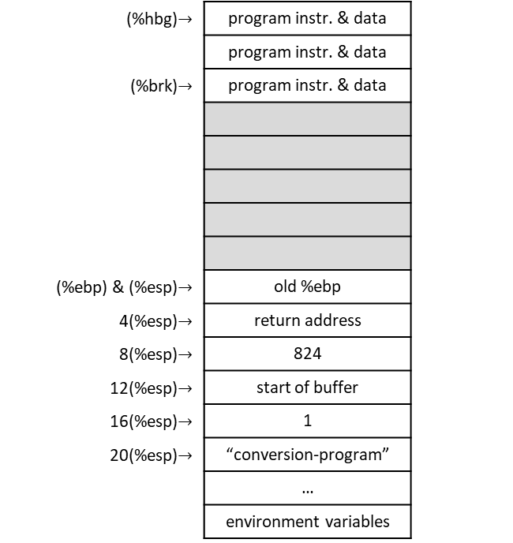
Counting conversion-program.s: integer-to-string.s
copy_reversing_loop:
  # We pushed a whole register, but we only need the last byte. So we will pop off to the
  # entire %eax register, but then only move the small part (%al) into the character string.
  popl %eax
  movb %al, (%edx)
  decl %ecx # decreasing %ecx so we know when we are finished
  incl %edx # increasing %edx so that it will be pointing to the next byte
  cmpl $0, %ecx # check to see if we are finished
  je end_copy_reversing_loop # if so, jump to the end of the function
  jmp copy_reversing_loop # otherwise, repeat the loop
end_copy_reversing_loop:
  # Done copying
  movb $0, (%edx) # now write a null byte and return
  # Normal function end
  movl %ebp, %esp
  popl %ebp
  ret
(%hbg)$→$ | program instr. & data
 | program instr. & data
(%brk)$→$ | program instr. & data
(%ebp) & (%esp)$→$ | old %ebp
4(%esp)$→$ | return address
8(%esp)$→$ | 824
12(%esp)$→$ | start of buffer
16(%esp)$→$ | 1
20(%esp)$→$ | “conversion-program”
 | …
 | environment variables
heap
stack
%eax
%ax
byte 0 | byte 1 | byte 2 | byte 3
0 | 0 | 0 | ‘4’
EAX =
ECX = 1
EAX = ‘4’
EDI = 10
EDX = start of buffer + 2 = Ø
EDX
%al
byte 0 | byte 1 | byte 2 | byte 3 | byte 4 | byte 5 | byte 6 | byte 7 | byte 8 | byte 9 | byte 10
‘8’ | ‘2’ | Ø | Ø | Ø | Ø | Ø | Ø | Ø | Ø | Ø
buffer =

Slide 171

Counting conversion-program.s: integer-to-string.s
copy_reversing_loop:
  # We pushed a whole register, but we only need the last byte. So we will pop off to the
  # entire %eax register, but then only move the small part (%al) into the character string.
  popl %eax
  movb %al, (%edx)
  decl %ecx # decreasing %ecx so we know when we are finished
  incl %edx # increasing %edx so that it will be pointing to the next byte
  cmpl $0, %ecx # check to see if we are finished
  je end_copy_reversing_loop # if so, jump to the end of the function
  jmp copy_reversing_loop # otherwise, repeat the loop
end_copy_reversing_loop:
  # Done copying
  movb $0, (%edx) # now write a null byte and return
  # Normal function end
  movl %ebp, %esp
  popl %ebp
  ret
(%hbg)$→$ | program instr. & data
 | program instr. & data
(%brk)$→$ | program instr. & data
(%ebp) & (%esp)$→$ | old %ebp
4(%esp)$→$ | return address
8(%esp)$→$ | 824
12(%esp)$→$ | start of buffer
16(%esp)$→$ | 1
20(%esp)$→$ | “conversion-program”
 | …
 | environment variables
heap
stack
%eax
%ax
byte 0 | byte 1 | byte 2 | byte 3
0 | 0 | 0 | ‘4’
EAX =
ECX = 1
EAX = ‘4’
EDI = 10
EDX = start of buffer + 2 = ‘4’
EDX
%al
byte 0 | byte 1 | byte 2 | byte 3 | byte 4 | byte 5 | byte 6 | byte 7 | byte 8 | byte 9 | byte 10
‘8’ | ‘2’ | ‘4’ | Ø | Ø | Ø | Ø | Ø | Ø | Ø | Ø
buffer =

Slide 172
Counting conversion-program.s: integer-to-string.s
copy_reversing_loop:
  # We pushed a whole register, but we only need the last byte. So we will pop off to the
  # entire %eax register, but then only move the small part (%al) into the character string.
  popl %eax
  movb %al, (%edx)
  decl %ecx # decreasing %ecx so we know when we are finished
  incl %edx # increasing %edx so that it will be pointing to the next byte
  cmpl $0, %ecx # check to see if we are finished
  je end_copy_reversing_loop # if so, jump to the end of the function
  jmp copy_reversing_loop # otherwise, repeat the loop
end_copy_reversing_loop:
  # Done copying
  movb $0, (%edx) # now write a null byte and return
  # Normal function end
  movl %ebp, %esp
  popl %ebp
  ret
(%hbg)$→$ | program instr. & data
 | program instr. & data
(%brk)$→$ | program instr. & data
(%ebp) & (%esp)$→$ | old %ebp
4(%esp)$→$ | return address
8(%esp)$→$ | 824
12(%esp)$→$ | start of buffer
16(%esp)$→$ | 1
20(%esp)$→$ | “conversion-program”
 | …
 | environment variables
heap
stack
%eax
%ax
byte 0 | byte 1 | byte 2 | byte 3
0 | 0 | 0 | ‘4’
EAX =
ECX = 0
EAX = ‘4’
EDI = 10
EDX = start of buffer + 2 = ‘4’
EDX
%al
byte 0 | byte 1 | byte 2 | byte 3 | byte 4 | byte 5 | byte 6 | byte 7 | byte 8 | byte 9 | byte 10
‘8’ | ‘2’ | ‘4’ | Ø | Ø | Ø | Ø | Ø | Ø | Ø | Ø
buffer =

Slide 173
Counting conversion-program.s: integer-to-string.s
copy_reversing_loop:
  # We pushed a whole register, but we only need the last byte. So we will pop off to the
  # entire %eax register, but then only move the small part (%al) into the character string.
  popl %eax
  movb %al, (%edx)
  decl %ecx # decreasing %ecx so we know when we are finished
  incl %edx # increasing %edx so that it will be pointing to the next byte
  cmpl $0, %ecx # check to see if we are finished
  je end_copy_reversing_loop # if so, jump to the end of the function
  jmp copy_reversing_loop # otherwise, repeat the loop
end_copy_reversing_loop:
  # Done copying
  movb $0, (%edx) # now write a null byte and return
  # Normal function end
  movl %ebp, %esp
  popl %ebp
  ret
(%hbg)$→$ | program instr. & data
 | program instr. & data
(%brk)$→$ | program instr. & data
(%ebp) & (%esp)$→$ | old %ebp
4(%esp)$→$ | return address
8(%esp)$→$ | 824
12(%esp)$→$ | start of buffer
16(%esp)$→$ | 1
20(%esp)$→$ | “conversion-program”
 | …
 | environment variables
heap
stack
%eax
%ax
byte 0 | byte 1 | byte 2 | byte 3
0 | 0 | 0 | ‘4’
EAX =
ECX = 0
EAX = ‘4’
EDI = 10
EDX = start of buffer + 3 = Ø
EDX
%al
byte 0 | byte 1 | byte 2 | byte 3 | byte 4 | byte 5 | byte 6 | byte 7 | byte 8 | byte 9 | byte 10
‘8’ | ‘2’ | ‘4’ | Ø | Ø | Ø | Ø | Ø | Ø | Ø | Ø
buffer =

Slide 174
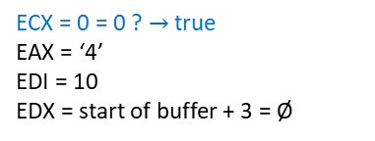
Counting conversion-program.s: integer-to-string.s
copy_reversing_loop:
  # We pushed a whole register, but we only need the last byte. So we will pop off to the
  # entire %eax register, but then only move the small part (%al) into the character string.
  popl %eax
  movb %al, (%edx)
  decl %ecx # decreasing %ecx so we know when we are finished
  incl %edx # increasing %edx so that it will be pointing to the next byte
  cmpl $0, %ecx # check to see if we are finished
  je end_copy_reversing_loop # if so, jump to the end of the function
  jmp copy_reversing_loop # otherwise, repeat the loop
end_copy_reversing_loop:
  # Done copying
  movb $0, (%edx) # now write a null byte and return
  # Normal function end
  movl %ebp, %esp
  popl %ebp
  ret
(%hbg)$→$ | program instr. & data
 | program instr. & data
(%brk)$→$ | program instr. & data
(%ebp) & (%esp)$→$ | old %ebp
4(%esp)$→$ | return address
8(%esp)$→$ | 824
12(%esp)$→$ | start of buffer
16(%esp)$→$ | 1
20(%esp)$→$ | “conversion-program”
 | …
 | environment variables
heap
stack
%eax
%ax
byte 0 | byte 1 | byte 2 | byte 3
0 | 0 | 0 | ‘4’
EAX =
ECX = 0 = 0 ? $→$ true
EAX = ‘4’
EDI = 10
EDX = start of buffer + 3 = Ø
EDX
%al
byte 0 | byte 1 | byte 2 | byte 3 | byte 4 | byte 5 | byte 6 | byte 7 | byte 8 | byte 9 | byte 10
‘8’ | ‘2’ | ‘4’ | Ø | Ø | Ø | Ø | Ø | Ø | Ø | Ø
buffer =

Slide 175
Counting conversion-program.s: integer-to-string.s
copy_reversing_loop:
  # We pushed a whole register, but we only need the last byte. So we will pop off to the
  # entire %eax register, but then only move the small part (%al) into the character string.
  popl %eax
  movb %al, (%edx)
  decl %ecx # decreasing %ecx so we know when we are finished
  incl %edx # increasing %edx so that it will be pointing to the next byte
  cmpl $0, %ecx # check to see if we are finished
  je end_copy_reversing_loop # if so, jump to the end of the function
  jmp copy_reversing_loop # otherwise, repeat the loop
end_copy_reversing_loop:
  # Done copying
  movb $0, (%edx) # now write a null byte and return
  # Normal function end
  movl %ebp, %esp
  popl %ebp
  ret
(%hbg)$→$ | program instr. & data
 | program instr. & data
(%brk)$→$ | program instr. & data
(%ebp) & (%esp)$→$ | old %ebp
4(%esp)$→$ | return address
8(%esp)$→$ | 824
12(%esp)$→$ | start of buffer
16(%esp)$→$ | 1
20(%esp)$→$ | “conversion-program”
 | …
 | environment variables
heap
stack
%eax
%ax
byte 0 | byte 1 | byte 2 | byte 3
0 | 0 | 0 | ‘4’
EAX =
ECX = 0
EAX = ‘4’
EDI = 10
EDX = start of buffer + 3 = Ø
EDX
%al
byte 0 | byte 1 | byte 2 | byte 3 | byte 4 | byte 5 | byte 6 | byte 7 | byte 8 | byte 9 | byte 10
‘8’ | ‘2’ | ‘4’ | Ø | Ø | Ø | Ø | Ø | Ø | Ø | Ø
buffer =

Slide 176
Counting conversion-program.s: integer-to-string.s
copy_reversing_loop:
  # We pushed a whole register, but we only need the last byte. So we will pop off to the
  # entire %eax register, but then only move the small part (%al) into the character string.
  popl %eax
  movb %al, (%edx)
  decl %ecx # decreasing %ecx so we know when we are finished
  incl %edx # increasing %edx so that it will be pointing to the next byte
  cmpl $0, %ecx # check to see if we are finished
  je end_copy_reversing_loop # if so, jump to the end of the function
  jmp copy_reversing_loop # otherwise, repeat the loop
end_copy_reversing_loop:
  # Done copying
  movb $0, (%edx) # now write a null byte and return
  # Normal function end
  movl %ebp, %esp
  popl %ebp
  ret
(%hbg)$→$ | program instr. & data
 | program instr. & data
(%brk)$→$ | program instr. & data
(%ebp) & (%esp)$→$ | old %ebp
4(%esp)$→$ | return address
8(%esp)$→$ | 824
12(%esp)$→$ | start of buffer
16(%esp)$→$ | 1
20(%esp)$→$ | “conversion-program”
 | …
 | environment variables
heap
stack
%eax
%ax
byte 0 | byte 1 | byte 2 | byte 3
0 | 0 | 0 | ‘4’
EAX =
ECX = 0
EAX = ‘4’
EDI = 10
EDX = start of buffer + 3 = Ø
EDX
%al
byte 0 | byte 1 | byte 2 | byte 3 | byte 4 | byte 5 | byte 6 | byte 7 | byte 8 | byte 9 | byte 10
‘8’ | ‘2’ | ‘4’ | Ø | Ø | Ø | Ø | Ø | Ø | Ø | Ø
buffer =

Slide 177
Counting conversion-program.s: integer-to-string.s
copy_reversing_loop:
  # We pushed a whole register, but we only need the last byte. So we will pop off to the
  # entire %eax register, but then only move the small part (%al) into the character string.
  popl %eax
  movb %al, (%edx)
  decl %ecx # decreasing %ecx so we know when we are finished
  incl %edx # increasing %edx so that it will be pointing to the next byte
  cmpl $0, %ecx # check to see if we are finished
  je end_copy_reversing_loop # if so, jump to the end of the function
  jmp copy_reversing_loop # otherwise, repeat the loop
end_copy_reversing_loop:
  # Done copying
  movb $0, (%edx) # now write a null byte and return
  # Normal function end
  movl %ebp, %esp
  popl %ebp
  ret
(%hbg)$→$ | program instr. & data
 | program instr. & data
(%brk)$→$ | program instr. & data
(%ebp) & (%esp)$→$ | old %ebp
4(%esp)$→$ | return address
8(%esp)$→$ | 824
12(%esp)$→$ | start of buffer
16(%esp)$→$ | 1
20(%esp)$→$ | “conversion-program”
 | …
 | environment variables
heap
stack
%eax
%ax
byte 0 | byte 1 | byte 2 | byte 3
0 | 0 | 0 | ‘4’
EAX =
ECX = 0
EAX = ‘4’
EDI = 10
EDX = start of buffer + 3 = Ø
EDX
%al
byte 0 | byte 1 | byte 2 | byte 3 | byte 4 | byte 5 | byte 6 | byte 7 | byte 8 | byte 9 | byte 10
‘8’ | ‘2’ | ‘4’ | Ø | Ø | Ø | Ø | Ø | Ø | Ø | Ø
buffer =

Slide 178
Counting conversion-program.s: integer-to-string.s
copy_reversing_loop:
  # We pushed a whole register, but we only need the last byte. So we will pop off to the
  # entire %eax register, but then only move the small part (%al) into the character string.
  popl %eax
  movb %al, (%edx)
  decl %ecx # decreasing %ecx so we know when we are finished
  incl %edx # increasing %edx so that it will be pointing to the next byte
  cmpl $0, %ecx # check to see if we are finished
  je end_copy_reversing_loop # if so, jump to the end of the function
  jmp copy_reversing_loop # otherwise, repeat the loop
end_copy_reversing_loop:
  # Done copying
  movb $0, (%edx) # now write a null byte and return
  # Normal function end
  movl %ebp, %esp
  popl %ebp
  ret
(%hbg)$→$ | program instr. & data
 | program instr. & data
(%brk)$→$ | program instr. & data
(%ebp) & (%esp)$→$ | old %ebp
4(%esp)$→$ | return address
8(%esp)$→$ | 824
12(%esp)$→$ | start of buffer
16(%esp)$→$ | 1
20(%esp)$→$ | “conversion-program”
 | …
 | environment variables
heap
stack
%eax
%ax
byte 0 | byte 1 | byte 2 | byte 3
0 | 0 | 0 | ‘4’
EAX =
ECX = 0
EAX = ‘4’
EDI = 10
EDX = start of buffer + 3 = Ø
EDX
%al
byte 0 | byte 1 | byte 2 | byte 3 | byte 4 | byte 5 | byte 6 | byte 7 | byte 8 | byte 9 | byte 10
‘8’ | ‘2’ | ‘4’ | Ø | Ø | Ø | Ø | Ø | Ø | Ø | Ø
buffer =

Slide 179

Counting conversion-program.s: integer-to-string.s
copy_reversing_loop:
  # We pushed a whole register, but we only need the last byte. So we will pop off to the
  # entire %eax register, but then only move the small part (%al) into the character string.
  popl %eax
  movb %al, (%edx)
  decl %ecx # decreasing %ecx so we know when we are finished
  incl %edx # increasing %edx so that it will be pointing to the next byte
  cmpl $0, %ecx # check to see if we are finished
  je end_copy_reversing_loop # if so, jump to the end of the function
  jmp copy_reversing_loop # otherwise, repeat the loop
end_copy_reversing_loop:
  # Done copying
  movb $0, (%edx) # now write a null byte and return
  # Normal function end
  movl %ebp, %esp
  popl %ebp
  ret
(%hbg)$→$ | program instr. & data
 | program instr. & data
(%brk)$→$ | program instr. & data
(%esp)$→$ | return address
4(%esp)$→$ | 824
8(%esp)$→$ | start of buffer
12(%esp)$→$ | 1
16(%esp)$→$ | “conversion-program”
 | …
 | environment variables
heap
stack
%eax
%ax
byte 0 | byte 1 | byte 2 | byte 3
0 | 0 | 0 | ‘4’
EAX =
ECX = 0
EAX = ‘4’
EDI = 10
EDX = start of buffer + 3 = Ø
EDX
%al
byte 0 | byte 1 | byte 2 | byte 3 | byte 4 | byte 5 | byte 6 | byte 7 | byte 8 | byte 9 | byte 10
‘8’ | ‘2’ | ‘4’ | Ø | Ø | Ø | Ø | Ø | Ø | Ø | Ø
buffer =

Slide 180

Counting conversion-program.s: integer-to-string.s
copy_reversing_loop:
  # We pushed a whole register, but we only need the last byte. So we will pop off to the
  # entire %eax register, but then only move the small part (%al) into the character string.
  popl %eax
  movb %al, (%edx)
  decl %ecx # decreasing %ecx so we know when we are finished
  incl %edx # increasing %edx so that it will be pointing to the next byte
  cmpl $0, %ecx # check to see if we are finished
  je end_copy_reversing_loop # if so, jump to the end of the function
  jmp copy_reversing_loop # otherwise, repeat the loop
end_copy_reversing_loop:
  # Done copying
  movb $0, (%edx) # now write a null byte and return
  # Normal function end
  movl %ebp, %esp
  popl %ebp
  ret
(%hbg)$→$ | program instr. & data
 | program instr. & data
(%brk)$→$ | program instr. & data
(%esp)$→$ | 824
4(%esp)$→$ | start of buffer
8(%esp)$→$ | 1
12(%esp)$→$ | “conversion-program”
 | …
 | environment variables
heap
stack
%eax
%ax
byte 0 | byte 1 | byte 2 | byte 3
0 | 0 | 0 | ‘4’
EAX =
ECX = 0
EAX = ‘4’
EDI = 10
EDX = start of buffer + 3 = Ø
EDX
%al
byte 0 | byte 1 | byte 2 | byte 3 | byte 4 | byte 5 | byte 6 | byte 7 | byte 8 | byte 9 | byte 10
‘8’ | ‘2’ | ‘4’ | Ø | Ø | Ø | Ø | Ø | Ø | Ø | Ø
buffer =

Slide 181
Counting conversion-program.s
  .include "linux.s"
  .section .data
  # This is where it will be stored
tmp_buffer:
  .ascii "\0\0\0\0\0\0\0\0\0\0\0" # 11 null bytes
  .section .text
  .globl _start
_start:
  movl %esp, %ebp
  pushl $tmp_buffer # storage for the result
  pushl $824 # number to convert
  call integer2string
  addl $8, %esp
  pushl $tmp_buffer # get the character count for our system call
  call count_chars
  addl $4, %esp
  movl %eax, %edx # the count goes in %edx for SYS_WRITE
  # Make the system call
  movl $SYS_WRITE, %eax
  movl $STDOUT, %ebx
  movl $tmp_buffer, %ecx
  int $LINUX_SYSCALL
  # Write a carriage return
  pushl $STDOUT
  call write_newline
  # Exit
  movl $SYS_EXIT, %eax
  movl $0, %ebx
  int $LINUX_SYSCALL
(%hbg)$→$ | program instr. & data
 | program instr. & data
(%brk)$→$ | program instr. & data
(%esp)$→$ | 824
4(%esp)$→$ | start of buffer
(%ebp) & 8(%esp)$→$ | 1
12(%esp)$→$ | “conversion-program”
 | …
 | environment variables
heap
stack
ECX = 0
EAX = ‘4’
EDI = 10
EDX = start of buffer + 3 = Ø
buffer
‘8’ | ‘2’ | ‘4’ | Ø | Ø | Ø | Ø | Ø | Ø | Ø | Ø

Slide 182

Counting conversion-program.s
  .include "linux.s"
  .section .data
  # This is where it will be stored
tmp_buffer:
  .ascii "\0\0\0\0\0\0\0\0\0\0\0" # 11 null bytes
  .section .text
  .globl _start
_start:
  movl %esp, %ebp
  pushl $tmp_buffer # storage for the result
  pushl $824 # number to convert
  call integer2string
  addl $8, %esp
  pushl $tmp_buffer # get the character count for our system call
  call count_chars
  addl $4, %esp
  movl %eax, %edx # the count goes in %edx for SYS_WRITE
  # Make the system call
  movl $SYS_WRITE, %eax
  movl $STDOUT, %ebx
  movl $tmp_buffer, %ecx
  int $LINUX_SYSCALL
  # Write a carriage return
  pushl $STDOUT
  call write_newline
  # Exit
  movl $SYS_EXIT, %eax
  movl $0, %ebx
  int $LINUX_SYSCALL
(%hbg)$→$ | program instr. & data
 | program instr. & data
(%brk)$→$ | program instr. & data
(%ebp) & (%esp)$→$ | 1
12(%esp)$→$ | “conversion-program”
 | …
 | environment variables
heap
stack
ECX = 0
EAX = ‘4’
EDI = 10
EDX = start of buffer + 3 = Ø
buffer
‘8’ | ‘2’ | ‘4’ | Ø | Ø | Ø | Ø | Ø | Ø | Ø | Ø

Slide 183
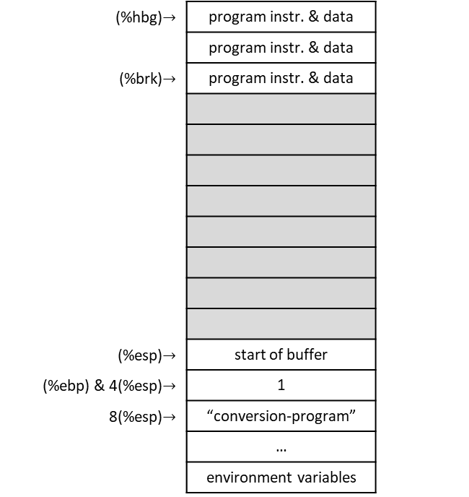
Counting conversion-program.s
  .include "linux.s"
  .section .data
  # This is where it will be stored
tmp_buffer:
  .ascii "\0\0\0\0\0\0\0\0\0\0\0" # 11 null bytes
  .section .text
  .globl _start
_start:
  movl %esp, %ebp
  pushl $tmp_buffer # storage for the result
  pushl $824 # number to convert
  call integer2string
  addl $8, %esp
  pushl $tmp_buffer # get the character count for our system call
  call count_chars
  addl $4, %esp
  movl %eax, %edx # the count goes in %edx for SYS_WRITE
  # Make the system call
  movl $SYS_WRITE, %eax
  movl $STDOUT, %ebx
  movl $tmp_buffer, %ecx
  int $LINUX_SYSCALL
  # Write a carriage return
  pushl $STDOUT
  call write_newline
  # Exit
  movl $SYS_EXIT, %eax
  movl $0, %ebx
  int $LINUX_SYSCALL
(%hbg)$→$ | program instr. & data
 | program instr. & data
(%brk)$→$ | program instr. & data
(%esp)$→$ | start of buffer
(%ebp) & 4(%esp)$→$ | 1
8(%esp)$→$ | “conversion-program”
 | …
 | environment variables
heap
stack
ECX = 0
EAX = ‘4’
EDI = 10
EDX = start of buffer + 3 = Ø
buffer
‘8’ | ‘2’ | ‘4’ | Ø | Ø | Ø | Ø | Ø | Ø | Ø | Ø

Slide 184
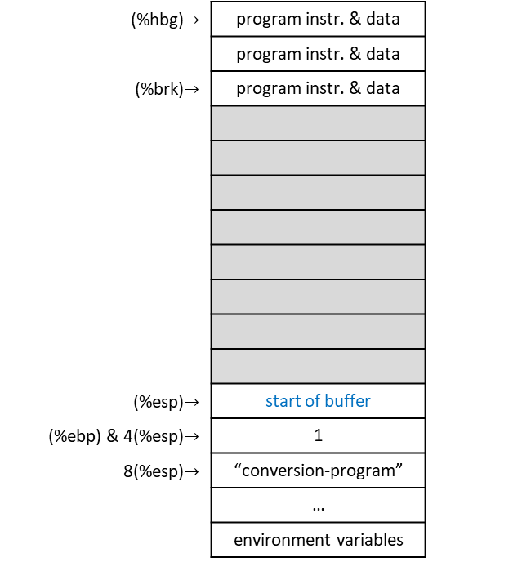
Counting conversion-program.s
  .include "linux.s"
  .section .data
  # This is where it will be stored
tmp_buffer:
  .ascii "\0\0\0\0\0\0\0\0\0\0\0" # 11 null bytes
  .section .text
  .globl _start
_start:
  movl %esp, %ebp
  pushl $tmp_buffer # storage for the result
  pushl $824 # number to convert
  call integer2string
  addl $8, %esp
  pushl $tmp_buffer # get the character count for our system call
  call count_chars
  addl $4, %esp
  movl %eax, %edx # the count goes in %edx for SYS_WRITE
  # Make the system call
  movl $SYS_WRITE, %eax
  movl $STDOUT, %ebx
  movl $tmp_buffer, %ecx
  int $LINUX_SYSCALL
  # Write a carriage return
  pushl $STDOUT
  call write_newline
  # Exit
  movl $SYS_EXIT, %eax
  movl $0, %ebx
  int $LINUX_SYSCALL
(%hbg)$→$ | program instr. & data
 | program instr. & data
(%brk)$→$ | program instr. & data
(%esp)$→$ | start of buffer
(%ebp) & 4(%esp)$→$ | 1
8(%esp)$→$ | “conversion-program”
 | …
 | environment variables
heap
stack
ECX = 0
EAX = 3
EDI = 10
EDX = start of buffer + 3 = Ø
buffer
‘8’ | ‘2’ | ‘4’ | Ø | Ø | Ø | Ø | Ø | Ø | Ø | Ø

Slide 185

Counting conversion-program.s
  .include "linux.s"
  .section .data
  # This is where it will be stored
tmp_buffer:
  .ascii "\0\0\0\0\0\0\0\0\0\0\0" # 11 null bytes
  .section .text
  .globl _start
_start:
  movl %esp, %ebp
  pushl $tmp_buffer # storage for the result
  pushl $824 # number to convert
  call integer2string
  addl $8, %esp
  pushl $tmp_buffer # get the character count for our system call
  call count_chars
  addl $4, %esp
  movl %eax, %edx # the count goes in %edx for SYS_WRITE
  # Make the system call
  movl $SYS_WRITE, %eax
  movl $STDOUT, %ebx
  movl $tmp_buffer, %ecx
  int $LINUX_SYSCALL
  # Write a carriage return
  pushl $STDOUT
  call write_newline
  # Exit
  movl $SYS_EXIT, %eax
  movl $0, %ebx
  int $LINUX_SYSCALL
(%hbg)$→$ | program instr. & data
 | program instr. & data
(%brk)$→$ | program instr. & data
(%ebp) & (%esp)$→$ | 1
4(%esp)$→$ | “conversion-program”
 | …
 | environment variables
heap
stack
ECX = 0
EAX = 3
EDI = 10
EDX = start of buffer + 3 = Ø
buffer
‘8’ | ‘2’ | ‘4’ | Ø | Ø | Ø | Ø | Ø | Ø | Ø | Ø

Slide 186
Counting conversion-program.s
  .include "linux.s"
  .section .data
  # This is where it will be stored
tmp_buffer:
  .ascii "\0\0\0\0\0\0\0\0\0\0\0" # 11 null bytes
  .section .text
  .globl _start
_start:
  movl %esp, %ebp
  pushl $tmp_buffer # storage for the result
  pushl $824 # number to convert
  call integer2string
  addl $8, %esp
  pushl $tmp_buffer # get the character count for our system call
  call count_chars
  addl $4, %esp
  movl %eax, %edx # the count goes in %edx for SYS_WRITE
  # Make the system call
  movl $SYS_WRITE, %eax
  movl $STDOUT, %ebx
  movl $tmp_buffer, %ecx
  int $LINUX_SYSCALL
  # Write a carriage return
  pushl $STDOUT
  call write_newline
  # Exit
  movl $SYS_EXIT, %eax
  movl $0, %ebx
  int $LINUX_SYSCALL
(%hbg)$→$ | program instr. & data
 | program instr. & data
(%brk)$→$ | program instr. & data
(%ebp) & (%esp)$→$ | 1
4(%esp)$→$ | “conversion-program”
 | …
 | environment variables
heap
stack
ECX = 0
EAX = 3
EDI = 10
EDX = 3
buffer
‘8’ | ‘2’ | ‘4’ | Ø | Ø | Ø | Ø | Ø | Ø | Ø | Ø

Slide 187
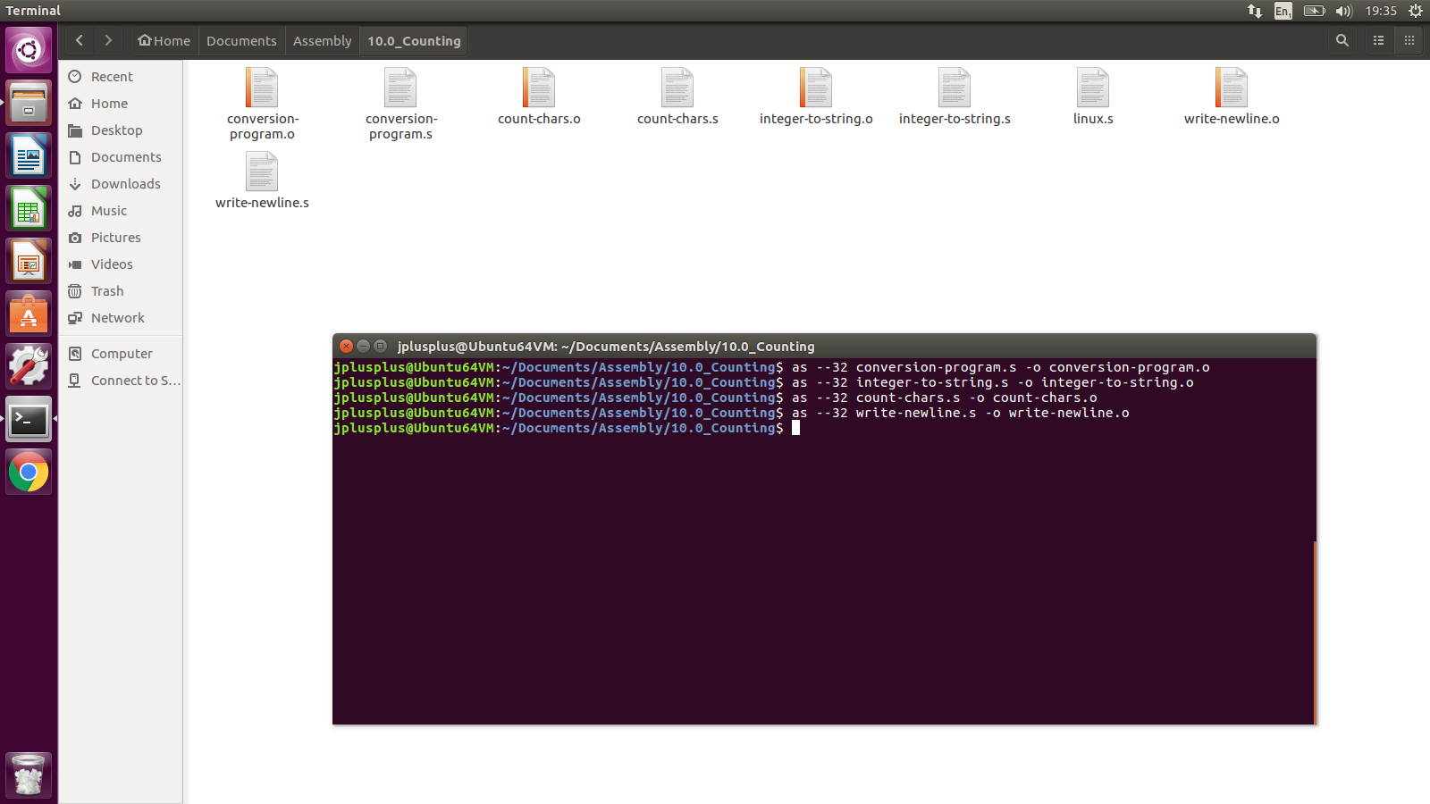
Counting conversion-program.s: Answer

Slide 188
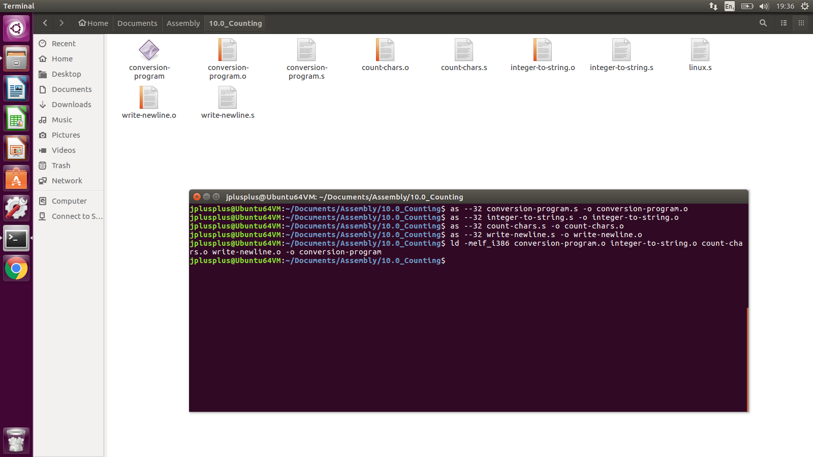
Counting conversion-program.s: Answer

Slide 189
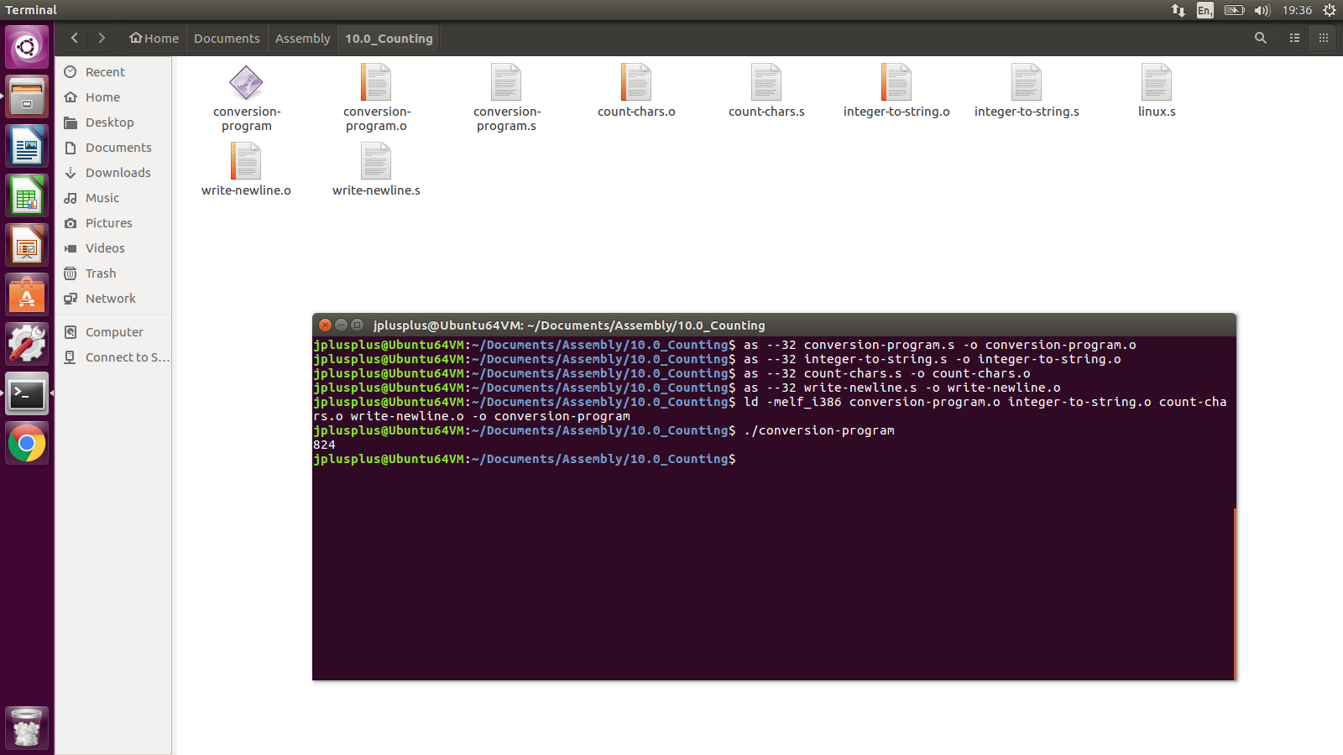
Counting conversion-program.s: Answer

