Slide 1
Higher Level Languages
Compiled: C
Interpreted: Perl

Slide 2
Compiled Languages (C)
#include <stdio.h>
/* PURPOSE: This program is mean to show a basic C program.
* All it does is print "Hello World!" to the screen and exit.
*/
int main(int argc, char **argv)
{
printf("Hello World!\n"); // print our string to standard output
return 0; // exit with status 0
}

Slide 3
Compiled Languages (C)
#include <stdio.h>
/* PURPOSE: This program is mean to show a basic C program.
* All it does is print "Hello World!" to the screen and exit.
*/
int main(int argc, char **argv)
{
printf("Hello World!\n"); // print our string to standard output
return 0; // exit with status 0
}
C compiling has two stages: preprocessor and compiler

Slide 4
Compiled Languages (C) preprocessor
#include <stdio.h>
/* PURPOSE: This program is mean to show a basic C program.
* All it does is print "Hello World!" to the screen and exit.
*/
int main(int argc, char **argv)
{
printf("Hello World!\n"); // print our string to standard output
return 0; // exit with status 0
}
C compiling has two stages: preprocessor and compiler
preprocessor: puts together the text of the program, sticks different files together, runs macros on your program text

Slide 5
Compiled Languages (C) preprocessor
#include <stdio.h>
/* PURPOSE: This program is mean to show a basic C program.
* All it does is print "Hello World!" to the screen and exit.
*/
int main(int argc, char **argv)
{
printf("Hello World!\n"); // print our string to standard output
return 0; // exit with status 0
}
C compiling has two stages: preprocessor and compiler
preprocessor: puts together the text of the program, sticks different files together, runs macros on your program text
#include <stdio.h> is a preprocessor directive: tells the preprocessor to look for the file stdio.h and paste it into your program

Slide 6
Compiled Languages (C) preprocessor
int* fopen();
int* fclose();
...
int getc();
int putc();
...
/* PURPOSE: This program is mean to show a basic C program.
* All it does is print "Hello World!" to the screen and exit.
*/
int main(int argc, char **argv)
{
printf("Hello World!\n"); // print our string to standard output
return 0; // exit with status 0
}
C compiling has two stages: preprocessor and compiler
preprocessor: puts together the text of the program, sticks different files together, runs macros on your program text
#include <stdio.h> is a preprocessor directive: tells the preprocessor to look for the file stdio.h and paste it into your program

Slide 7
Compiled Languages (C) preprocessor
int* fopen();
int* fclose();
...
int getc();
int putc();
...
/* PURPOSE: This program is mean to show a basic C program.
* All it does is print "Hello World!" to the screen and exit.
*/
int main(int argc, char **argv)
{
printf("Hello World!\n"); // print our string to standard output
return 0; // exit with status 0
}
C compiling has two stages: preprocessor and compiler
preprocessor: puts together the text of the program, sticks different files together, runs macros on your program text
#include <stdio.h> is a preprocessor directive: tells the preprocessor to look for the file stdio.h and paste it into your program
< > tells compiler to look in it’s standard paths for the file (/usr/include and /usr/local/include).
“ ” tells compiler to look in the current directory for the file

Slide 8
Compiled Languages (C) preprocessor
int* fopen();
int* fclose();
...
int getc();
int putc();
...
/* PURPOSE: This program is mean to show a basic C program.
* All it does is print "Hello World!" to the screen and exit.
*/
int main(int argc, char **argv)
{
printf("Hello World!\n"); // print our string to standard output
return 0; // exit with status 0
}
declarations for the standard input and output functions and variables
tells the compiler the available functions for input and output
C compiling has two stages: preprocessor and compiler
preprocessor: puts together the text of the program, sticks different files together, runs macros on your program text
#include <stdio.h> is a preprocessor directive: tells the preprocessor to look for the file stdio.h and paste it into your program
< > tells compiler to look in it’s standard paths for the file (/usr/include and /usr/local/include).
“ ” tells compiler to look in the current directory for the file

Slide 9
Compiled Languages (C) preprocessor
#include <stdio.h>
/* PURPOSE: This program is mean to show a basic C program.
* All it does is print "Hello World!" to the screen and exit.
*/
int main(int argc, char **argv)
{
printf("Hello World!\n"); // print our string to standard output
return 0; // exit with status 0
}
C compiling has two stages: preprocessor and compiler
preprocessor: puts together the text of the program, sticks different files together, runs macros on your program text
main compiler: places arguments on the stack, loads values in/out of registers, defines storage and manages pointers

Slide 10
Compiled Languages (C) compiler
#include <stdio.h>
/* PURPOSE: This program is mean to show a basic C program.
* All it does is print "Hello World!" to the screen and exit.
*/
int main(int argc, char **argv)
{
printf("Hello World!\n"); // print our string to standard output
return 0; // exit with status 0
}
C compiling has two stages: preprocessor and compiler
preprocessor: puts together the text of the program, sticks different files together, runs macros on your program text
main compiler: places arguments on the stack, loads values in/out of registers, defines storage and manages pointers

Slide 11
Compiled Languages (C) compiler
#include <stdio.h>
/* PURPOSE: This program is mean to show a basic C program.
* All it does is print "Hello World!" to the screen and exit.
*/
int main(int argc, char **argv)
{
printf("Hello World!\n"); // print our string to standard output
return 0; // exit with status 0
}
C compiling has two stages: preprocessor and compiler
preprocessor: puts together the text of the program, sticks different files together, runs macros on your program text
main compiler: places arguments on the stack, loads values in/out of registers, defines storage and manages pointers
 | Assembly | C
Entry point | _start | main

Slide 12
Compiled Languages (C) compiler
#include <stdio.h>
/* PURPOSE: This program is mean to show a basic C program.
* All it does is print "Hello World!" to the screen and exit.
*/
int main(int argc, char **argv)
{
printf("Hello World!\n"); // print our string to standard output
return 0; // exit with status 0
}
C compiling has two stages: preprocessor and compiler
preprocessor: puts together the text of the program, sticks different files together, runs macros on your program text
main compiler: places arguments on the stack, loads values in/out of registers, defines storage and manages pointers
 | Assembly | C
Entry point | _start | main
Function arguments | push onto stack, then call function | Call function with parentheses

Slide 13
Compiled Languages (C) compiler
#include <stdio.h>
/* PURPOSE: This program is mean to show a basic C program.
* All it does is print "Hello World!" to the screen and exit.
*/
int main(int argc, char **argv)
{
printf("Hello World!\n"); // print our string to standard output
return 0; // exit with status 0
}
C compiling has two stages: preprocessor and compiler
preprocessor: puts together the text of the program, sticks different files together, runs macros on your program text
main compiler: places arguments on the stack, loads values in/out of registers, defines storage and manages pointers
 | Assembly | C
Entry point | _start | main
Function arguments | push onto stack, then call function | Call function with parentheses
Return value | Store in %eax | return value;

Slide 14
Compiled Languages (C) compiler
#include <stdio.h>
/* PURPOSE: This program is mean to show a basic C program.
* All it does is print "Hello World!" to the screen and exit.
*/
int main(int argc, char **argv)
{
printf("Hello World!\n"); // print our string to standard output
return 0; // exit with status 0
}
C compiling has two stages: preprocessor and compiler
preprocessor: puts together the text of the program, sticks different files together, runs macros on your program text
main compiler: places arguments on the stack, loads values in/out of registers, defines storage and manages pointers
 | Assembly | C
Entry point | _start | main
Function arguments | push onto stack, then call function | Call function with parentheses
Return value | Store in %eax | return value;
OS / HW Dependency | Different code for each OS or HW | Same code can run on multiple OS or HWs

Slide 15
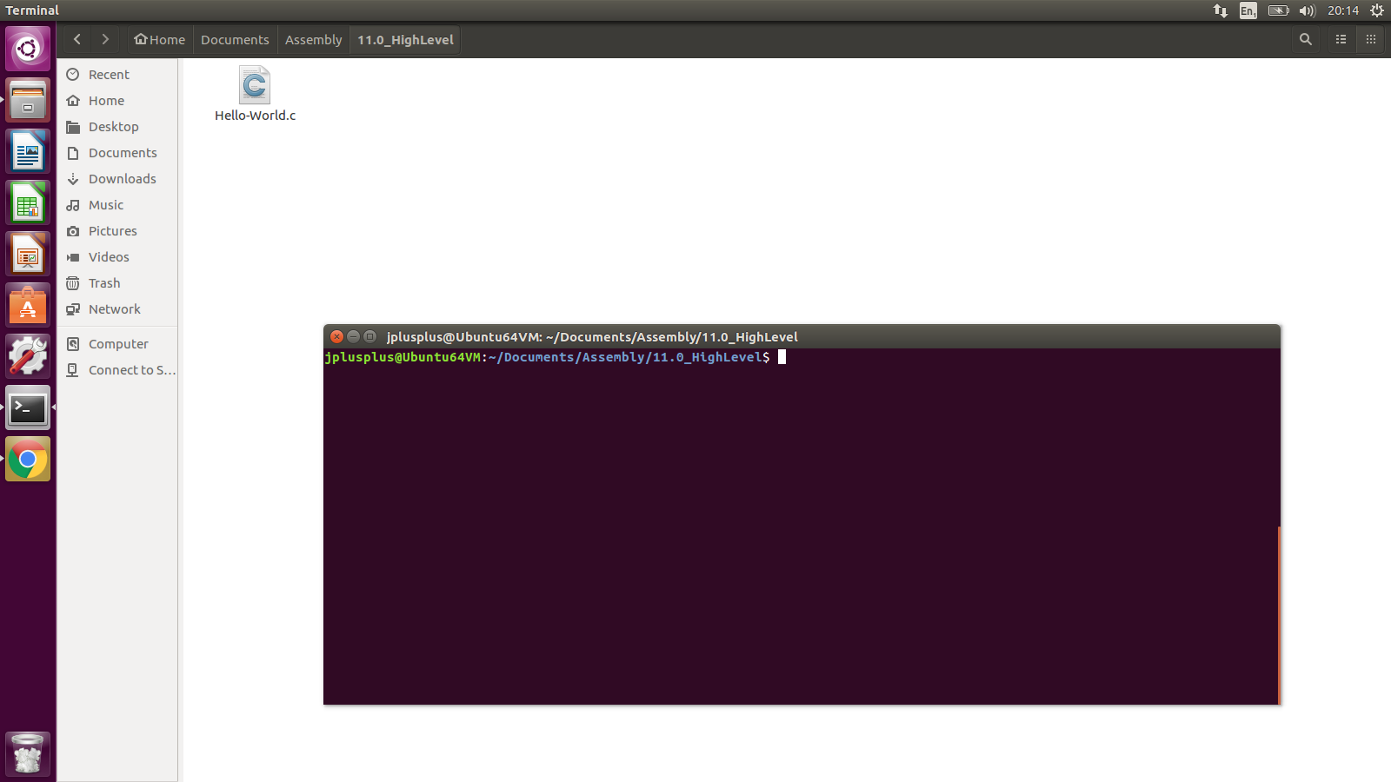
Compiled Languages (C) source

Slide 16
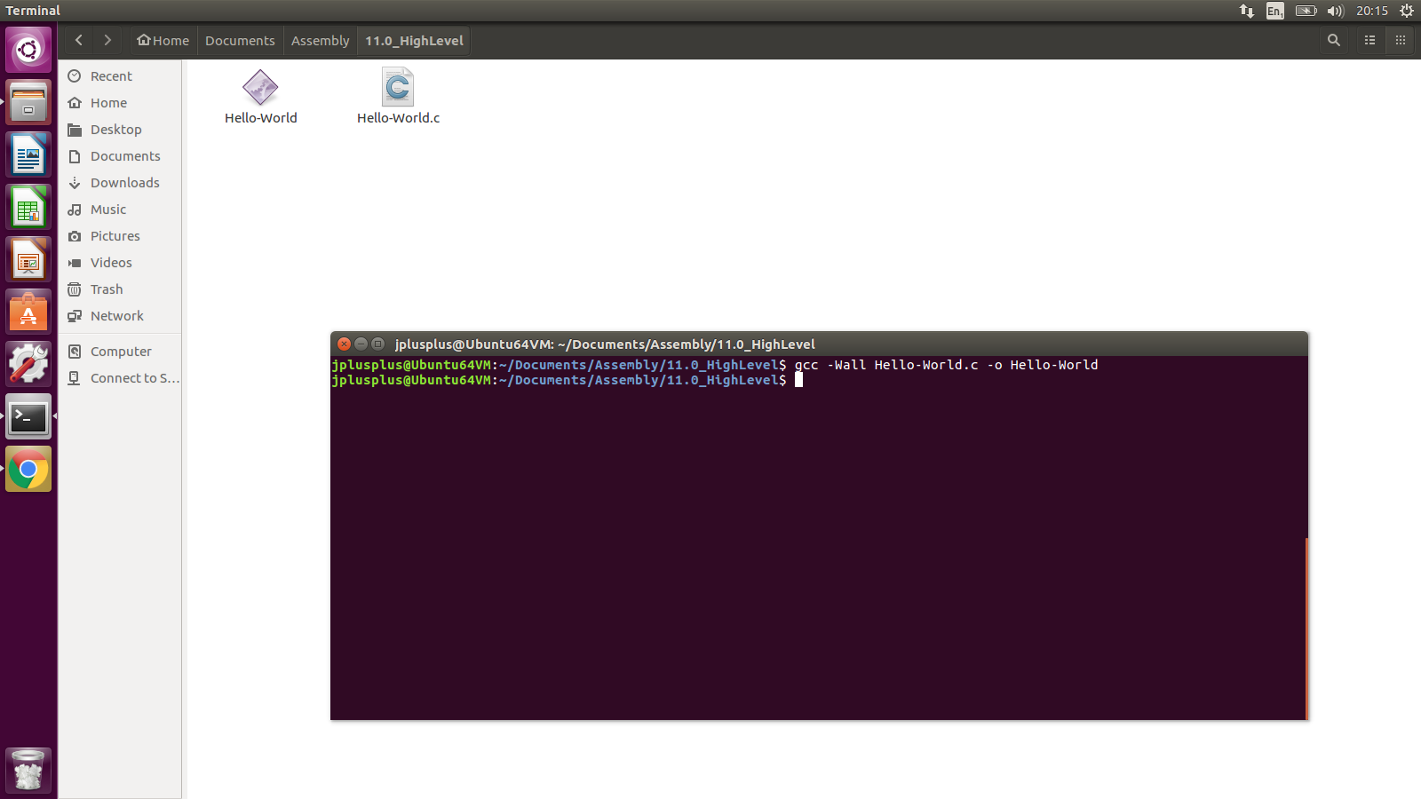
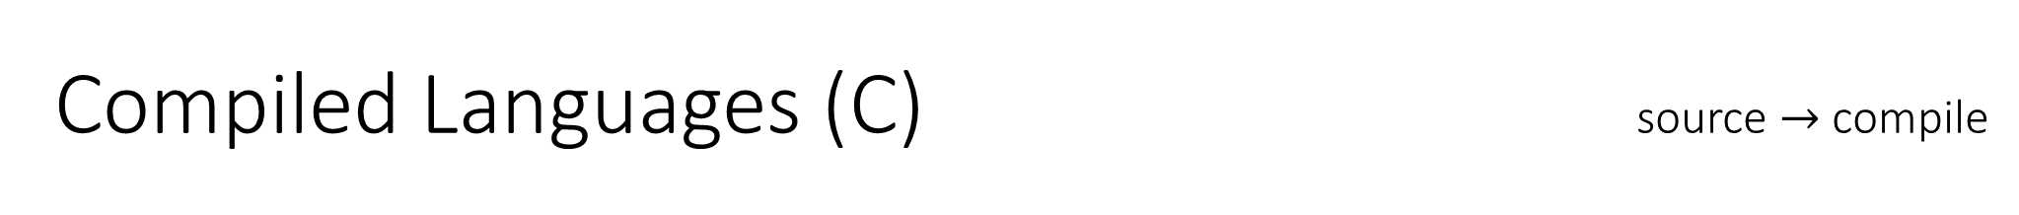
Compiled Languages (C) source $→$ compile

Slide 17

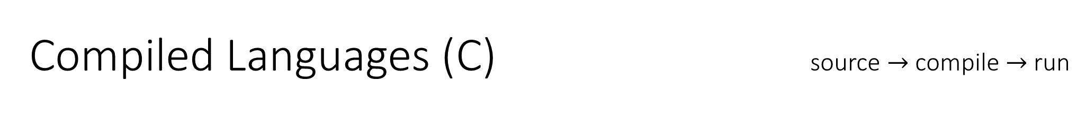
Compiled Languages (C) source $→$ compile $→$ run

Slide 18
Interpreted Languages (Perl) source
#!/usr/bin/perl
print("Hello world!\n");

Slide 19
Interpreted Languages (Perl) source
#!/usr/bin/perl
print("Hello world!\n");
With Perl you don’t have to declare any functions or program entry points.

Slide 20
Interpreted Languages (Perl) source
#!/usr/bin/perl
print("Hello world!\n");
With Perl you don’t have to declare any functions or program entry points.
Interpreted program: type commands → the interpreter will run them as it comes to them

Slide 21
Interpreted Languages (Perl) source
#!/usr/bin/perl
print("Hello world!\n");
With Perl you don’t have to declare any functions or program entry points.
Interpreted program: type commands → the interpreter will run them as it comes to them
#! tells the computer that this is an interpreted program

Slide 22
Interpreted Languages (Perl) source
#!/usr/bin/perl
print("Hello world!\n");
With Perl you don’t have to declare any functions or program entry points.
Interpreted program: type commands → the interpreter will run them as it comes to them
#! tells the computer that this is an interpreted program
/usr/bin/perl tells the computer to use the program /usr/bin/perl to interpret
(unnecessary if you run the program with perl Hello-World.pl)

Slide 23
Interpreted Languages (Perl) source
#!/usr/bin/perl
print("Hello world!\n");
With Perl you don’t have to declare any functions or program entry points.
Interpreted program: type commands → the interpreter will run them as it comes to them
#! tells the computer that this is an interpreted program
/usr/bin/perl tells the computer to use the program /usr/bin/perl to interpret
(unnecessary if you run the program with perl Hello-World.pl)
Perl built-in function

Slide 24
Interpreted Languages (Perl) source
#!/usr/bin/perl
print("Hello world!\n");
With Perl you don’t have to declare any functions or program entry points.
Interpreted program: type commands → the interpreter will run them as it comes to them
#! tells the computer that this is an interpreted program
/usr/bin/perl tells the computer to use the program /usr/bin/perl to interpret
(unnecessary if you run the program with perl Hello-World.pl)
Perl built-in function
No explicit return

Slide 25
Interpreted Languages (Perl) source
#!/usr/bin/perl
print("Hello world!\n");
With Perl you don’t have to declare any functions or program entry points.
Interpreted program: type commands → the interpreter will run them as it comes to them
#! tells the computer that this is an interpreted program
/usr/bin/perl tells the computer to use the program /usr/bin/perl to interpret
(unnecessary if you run the program with perl Hello-World.pl)
Perl built-in function
No explicit return
it knows to return because it runs off the end of the file
it knows to return 0 because there were no errors

Slide 26

Interpreted Languages (Perl) source
#!/usr/bin/perl
print("Hello world!\n");
With Perl you don’t have to declare any functions or program entry points.
Interpreted program: type commands → the interpreter will run them as it comes to them
#! tells the computer that this is an interpreted program
/usr/bin/perl tells the computer to use the program /usr/bin/perl to interpret
(unnecessary if you run the program with perl Hello-World.pl)
Perl built-in function
No explicit return
it knows to return because it runs off the end of the file
it knows to return 0 because there were no errors
Strings as values
$→$ compile

Slide 27
Interpreted Languages (Perl) source
#!/usr/bin/perl
print("Hello world!\n");
With Perl you don’t have to declare any functions or program entry points.
Interpreted program: type commands → the interpreter will run them as it comes to them
#! tells the computer that this is an interpreted program
/usr/bin/perl tells the computer to use the program /usr/bin/perl to interpret
(unnecessary if you run the program with perl Hello-World.pl)
Perl built-in function
No explicit return
it knows to return because it runs off the end of the file
it knows to return 0 because there were no errors
Strings as values
In assembly strings are treated as a sequence of multiple values, with a pointer to the first letter.
Perl pretends that strings can be stored directly as values, and thus hides the complication of manipulating
(one of Perl’s main strengths is it’s ability and speed at manipulating text)

Slide 28
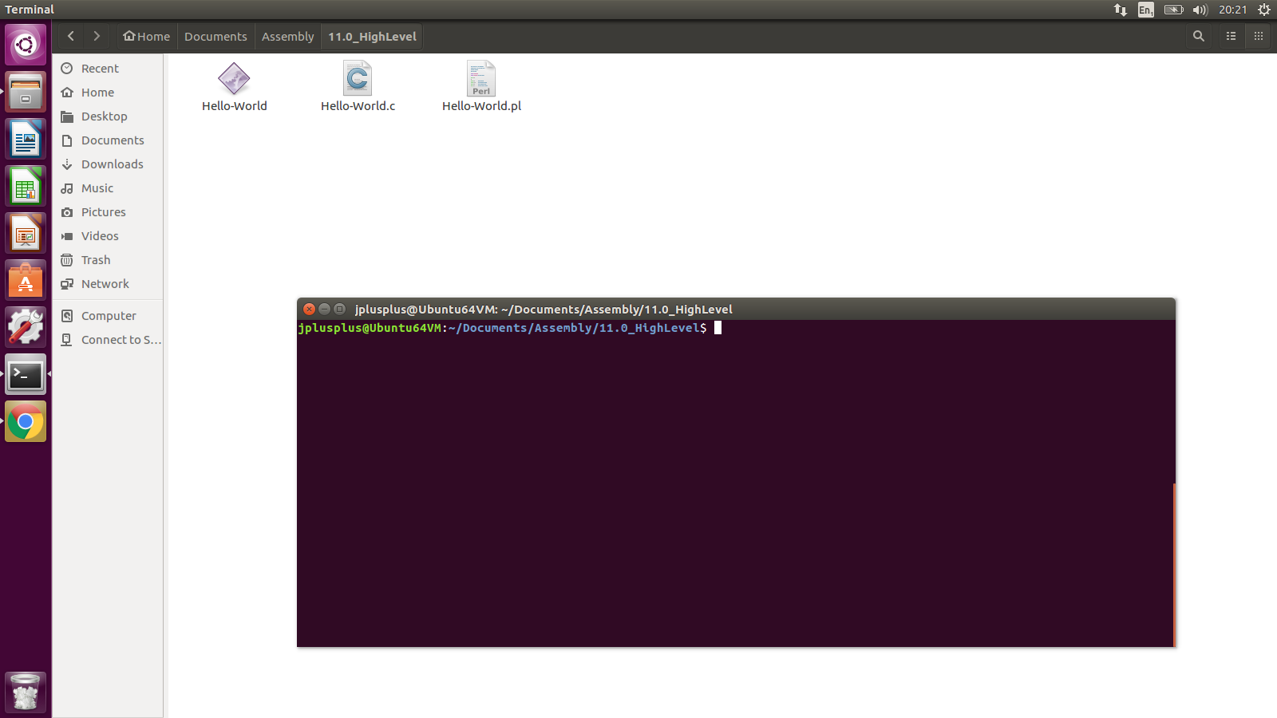
Interpreted Languages (Perl) source

Slide 29

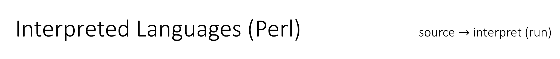
Interpreted Languages (Perl) source $→$ interpret (run)

