Slide 1
Case Study into Attrition!
By: Jordan Salsman

Slide 2
Correlation Plot of Numerical Responses
Correlation Plot

Slide 3
Tables of Attrition vs. Categorical Variables
Job Role | No Attrition | Attrition | Percent
Healthcare Rep. | 68 | 8 | 11.76470588
HR | 21 | 6 | 28.57142857
Lab Technician | 123 | 30 | 24.3902439
Manager | 47 | 4 | 8.510638298
Manufacturing Dir. | 85 | 2 | 2.352941176
Research Dir. | 50 | 1 | 2
Research Scientist | 140 | 32 | 22.85714286
Sales Executive | 167 | 33 | 19.76047904
Sales Rep. | 29 | 24 | 82.75862069
Marital Status | No Attrition | Attrition | Percent
Single | 199 | 70 | 35.1758794
Divorced | 179 | 12 | 6.703910615
Married | 352 | 58 | 16.47727273

Slide 4
Tables of Attrition vs Categorical Variables
Education Field | No Attrition | Attriton | Percent
HR | 11 | 4 | 36.36363636
Life Sciences | 305 | 53 | 17.37704918
Marketing | 80 | 20 | 25
Medical | 233 | 37 | 15.87982833
Other | 43 | 9 | 20.93023256
Technical Degree | 58 | 17 | 29.31034483
Department | No Attrition | Attrition | Percent
HR | 29 | 6 | 20.68965517
Research and Dev. | 487 | 75 | 15.40041068
Sales | 214 | 59 | 27.57009346

Slide 5
What is going on with Sales Reps and Single?
Corr | Job Level | Years Working | Years with Current Manager
Sales Rep | -0.22968 | -0.22449 | -0.17142
Corr | Stock Options | Age | Total Years Working With Co.
Single | -0.6117 | -0.123 | -0.10175
Sales Rep. is an entry level job which is producing more turnover.
Single people are more likely to be younger but there does appear to be something weird going on with stock options.

Slide 6
Scatterplot of Monthly Income vs. Stock Option while looking at Marital Status

Slide 7
3 Highest Correlated Variables with Attrition
1. Overtime (cor = .272, very significant in regression equation)
2. Job Involvement (cor = -0.18779, very significant in regression equation)
3. An Age dependent variable( Age, Total Working, Years at Company, Years in Current role, Sales Rep, Single) (Significant in lasso)

Slide 8
Solutions
Less overtime
Make sure all employees are feeling involved
Programs to keep younger employees wanting to stay

Slide 9
Investigation into Different Job Roles

Slide 10
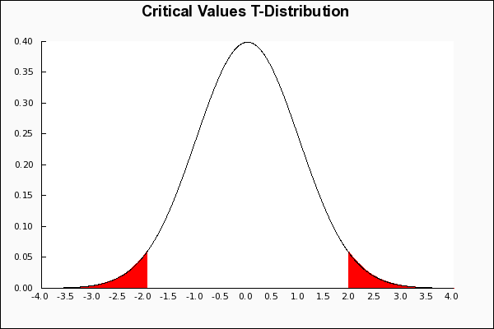
Hypothesis Testing
1) H₀: All the slopes are the same
H_{a:} At least one slope is different
2)
3&4)
Job | T-value | P-value
HR | 0.521 | 0.602
Lab Tech | 1.549 | 0.1217
Manager | -0.608 | 0.54387
Manufacturing Dir. | 0.452 | 0.651
Research Dir. | 0.805 | 0.421
Research Scientist | 2.25 | 0.02472
Sales Executive | 1.228 | 0.2198
Sales Representative | .456 | 0.885
5) We reject the null hypothesis
6) We are 95% confident that in the regression equation of Number of Previous Companies vs Current Job while controlling for years worked that Research Scientist has a different number of previous companies (p=.02472)

Slide 11
Prediction KNN
KNN with K=5
Classifications | No | Yes
Pred No | 171 | 30
Pred Yes | 11 | 6
Accuracy | Sensitivity | Specificity
0.8119 | 0.9396 | 0.1667

Slide 12
Prediction RF

Slide 13
Prediction RF
Classifications | No | Yes
Pred No | 140 | 29
Pred Yes | 46 | 94
Accuracy | Sensitivity | Specificity
0.7673 | 0.8284024 | 0.6714286
Lower accuracy overall than KNN but a lot better Specificity.

Slide 14
Thank You For Your Time!

