Slide 1
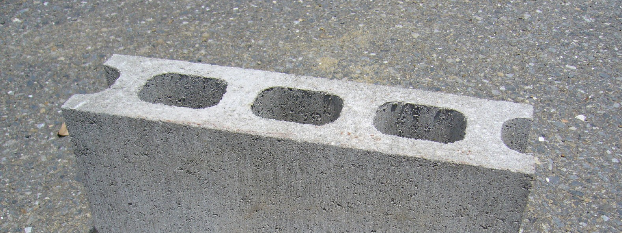
Blocks

Slide 2
Block = List of transactions with header
Block #5
Always the first tx
Version
hashPrevBlock
hashMerkleRoot
Time stamp
nbit
Nonce
TX
Coinbase
TX
51
TX
52
TX
53
TX
54
TX
55
TX
56
4 bytes
Block version
Currently 1
32 bytes
The hash of the merkle root
4 bytes
Block target number
Version
hashPrevBlock
hashMerkleRoot
Time stamp
nbit
Nonce
32 bytes
The hash of the previous block header
4 bytes
Block creation time
4 bytes
Random nonce

Slide 3
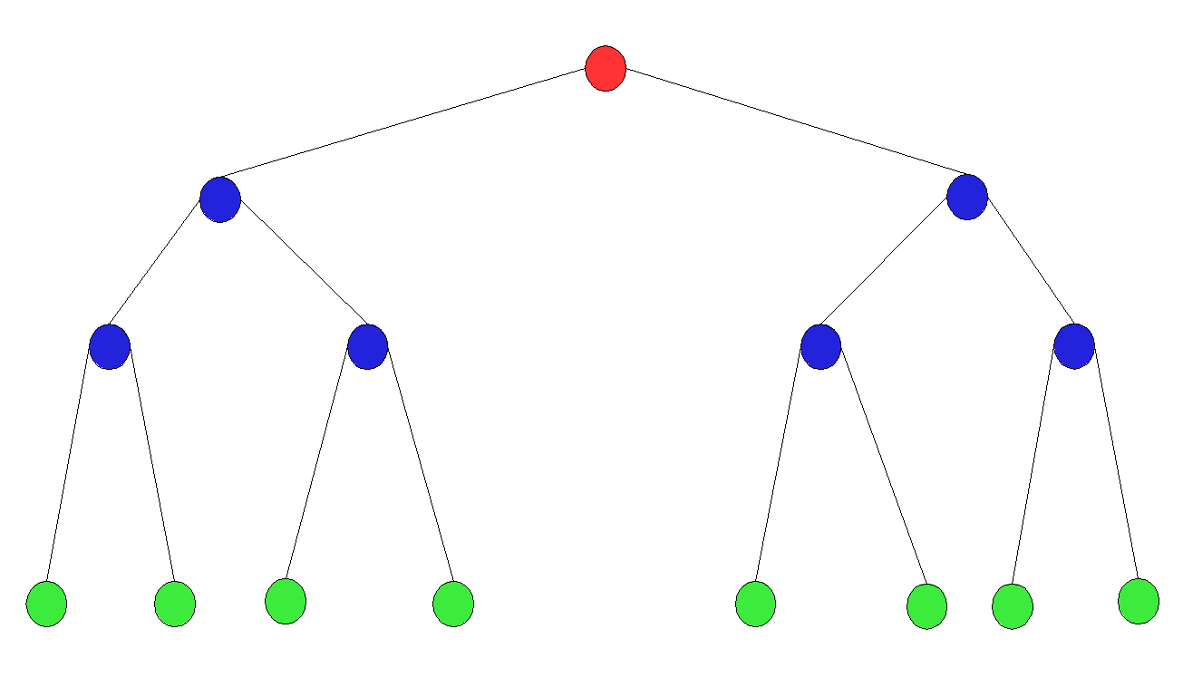
hashMerkleRoot
Each branch is hashed twice (also Each transaction is hashed twice)
In case of odd number of branches, the last branches (from the same level!) is duplicated.
The first transaction sis always the coinbase transaction.
Currently no ordering rules are applied to the transactions. Might change in the near future (compact blocks)
Notes:
תצייר את העץ על הלוח. רק שים לב להערות בעל עצי מרקל ב one note
אולי תרגיל?
שכל אחד יצייר עץ עבור
CB 1 2 3
CB 1 2
CB 1 2 3 4

Slide 4
Merkle root
H(H(1,2), H(3,4))
H(1,2)
H(3,4)
H(H(5,6), H(7,8))
H(5,6)
Root (publicly available in the block header)
Level 3
Level 2
H(7,8)
1
Level 1
2
3
4
5
6
7
8
Alice wants to prove that tx 7 is in the merkle root.
I don’t care what happens at the left side of the tree. All the I care for is:
the hash of the topmost (level 3) branch (H(H(1,2), H(3,4))
Any missing information required to validate the hash of the topmost (level 3) branch that includes my tx (H(H(5,6), H(7,8))
Notes:
SPV

Slide 5


A
X
We need protocol!
Folder 1
B
A
Y
X
Folder 2
C
B
Z
Y
C
Z

Slide 6
Some bitcoin protocol rules
Transactions are linked to each other.
Blocks are linked to each other.
All confirmed transactions are stored in a block.
Append only architecture Data can only be added to the chain.
No two transaction can stem from the same origin and be valid!
Each block need to provide a proof of work
New coins can only be generated when a new block created.
Transaction
1
Transaction
2
Block
1
Block
2

Slide 7


Clients or nodes (Assuming full client):
Receiving messages (mostly transactions and blocks) from other clients.
Validating this messages.
If the message is valid ->transmit it to other clients
The clients validate transactions
Transaction
1
Transaction
1
Transaction
1
Transaction
1
Client
Client
Client
Client

Slide 8

The clients also validate blocks
Block
1
Block
1
Block
1
Block
1
Transaction
1
Transaction
2
Transaction
1
Transaction
2
Transaction
1
Transaction
2
Transaction
1
Transaction
2
Client
According to the rules I know this isn’t a valid transaction. Therefor, the block isn’t valid as well
Client
Client
Client

