Slide 1

Difficulty

Slide 2
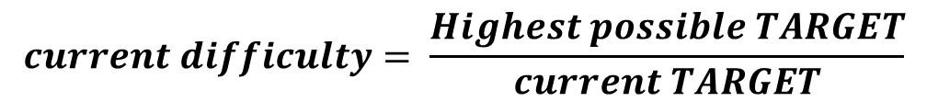
Difficulty and target
Target is a 256 bits number. The SHA256 of the block header must be lower than this number.
By changing the target number, we can adjust the rate at which new blocks are mined.
The SMALLER the TARGET
The HIGHER the DIFFICULTY
Difficulty
Target
Difficulty is another way to represent target.
Target is HUGE and inconvenient number
$$current difficulty= \frac{Highest possible TARGET}{current TARGET}$$

Slide 3
The HIGHEST POSSIBLE TARGET number:
0x00000000FFFFFFFFFFFFFFFFFFFFFFFFFFFFFFFFFFFFFFFFFFFFFFFFFFFFFFFF
Any SHA256 number that is LOWER than this number will be accepted. Therefor this number represents the LOWEST POSSIBLE DIFFICULTY.
$$current difficulty= \frac{higest possible TARGET}{current TARGET}=\frac{highest possible TARGET}{highest possible TARGET}=1$$
Assume HIGHEST possible target
1 is the lowest possible difficulty

Slide 4

Calculating the new target
Finding the target for block 2021
The new target is calculated every 2015 blocks (Originally it was meant to be every 2016 blocks). But due to consensus issues it’s calculated every 2015 blocks.
2016 blocks should fill exactly two weeks.
(two weeks = 1209600 seconds).
Pay attention that I don’t actually wait 2 weeks to calculate the block target. For each block the target is calculated by compering the latest block (block X) with the one that was mined 2015 blocks before it (block X – 2015).
Block
5
Block
5 + 2015
TX
1
TX
2
TX
60
TX
61
Target: X
Target: Y
Time: 1482502968
Time: 1483662568
$\text{1483662568}$ – 1482502968 = 1159600
The difference is only 1159600. Lower than two weeks.
Too many blocks were created during this time, there for the DIFFICULTY SHOLUD INCREAS and TARGET SHOULD DECREASE.

Slide 5
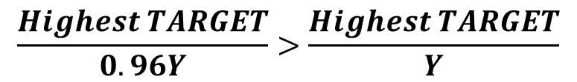
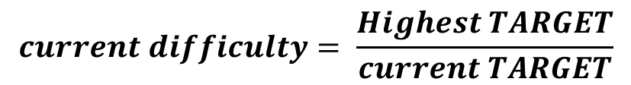
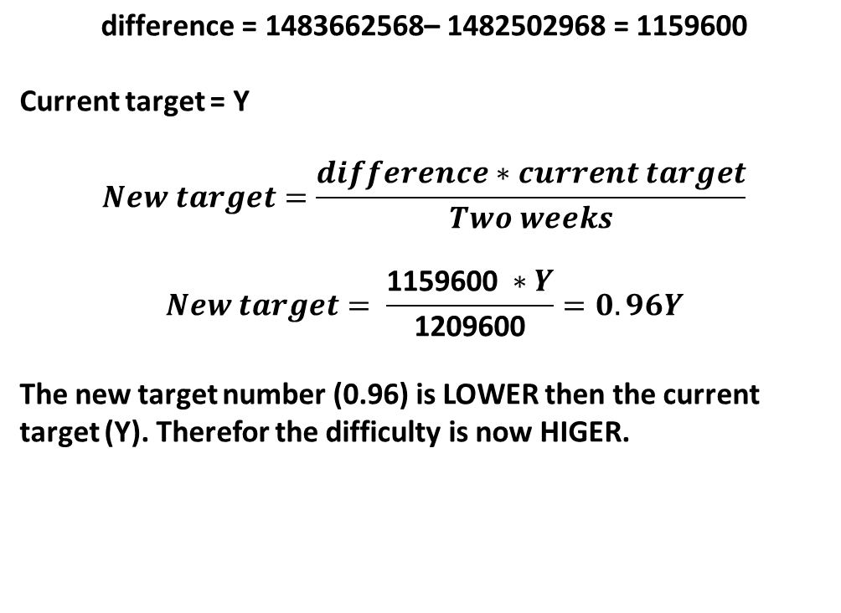
Calculating the new target
Finding the target for block 2021
$$\text{difference}\text{ = 1483662568– 1482502968 = 1159600}$$
Current target = Y
$$New target=\frac{difference∗current target}{Two weeks}$$
$$New target= \frac{\text{1159600} ∗Y}{\text{1209600}}=0.96Y$$
The new target number (0.96) is LOWER then the current target (Y). Therefor the difficulty is now HIGER.
Block
5
Block
5 + 2015
TX
1
TX
2
TX
60
TX
61
Target: X
Target: Y
Time: 1482502968
Time: 1483662568
$\text{1483662568}$ – 1482502968 = 1159600
$$current difficulty= \frac{Highest TARGET}{current TARGET}$$
The difference is only 1159600. Lower than two weeks.
Too many blocks were created during this time, there for the DIFFICULTY SHOLUD INCREASE and TARGET SHOULD DECREASE.
$$\frac{Highest TARGET}{0.96Y}>\frac{Highest TARGET}{Y}$$

Slide 6
$$New target=\frac{difference(sec)∗current target(int)}{Two weeks(sec)}=int$$
Target and difficulty have no units. They’re just numbers.
Notes:
Still, one can claim that if the difficulty is 2X more, than it will take twice as many hash power to reach the target in 10 minutes

Slide 7
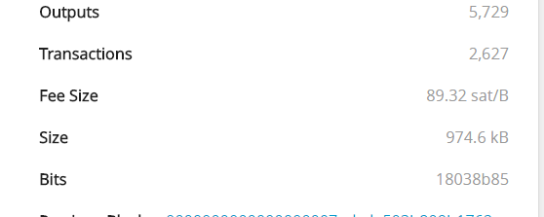
The HIGHEST POSSIBLE TARGET number:
0x00000000FFFFFFFFFFFFFFFFFFFFFFFFFFFFFFFFFFFFFFFFFFFFFFFFFFFFFFFF
Introducing the nBits.
Each block contains 4 bytes that represent this number in a shorthand version. Like scientific notation or floating point
HUGE number. inconvenient. Takes a lot of space to store (32 bytes)
18
03
8b
85
Size
3 most significant digits

Slide 8
$$current target=\text{significant} \text{digits} \text{∗ }2^{\text{8∗(}\text{Size}\text{ − 3)}}=\text{0}\text{x}\text{038}\text{b}\text{85∗ }2^{\text{8∗(}\text{0}\text{x}\text{18 − 3)}}= \\ 86923102180582917240747796162767475850640519180006195200$$
‘0x0000000000000000038b85000000000000000000000000000000000000000000'
In order to be valid, the next block hash needs to be LOWER than 869…
DEC
24
03
139
133
HEX
18
03
8b
85
Size
3 most significant digits

