Slide 1

Neural Networks and Deep Learning (Examples)
Introduction to Machine learning for Sciences and Ingeneering

Slide 2
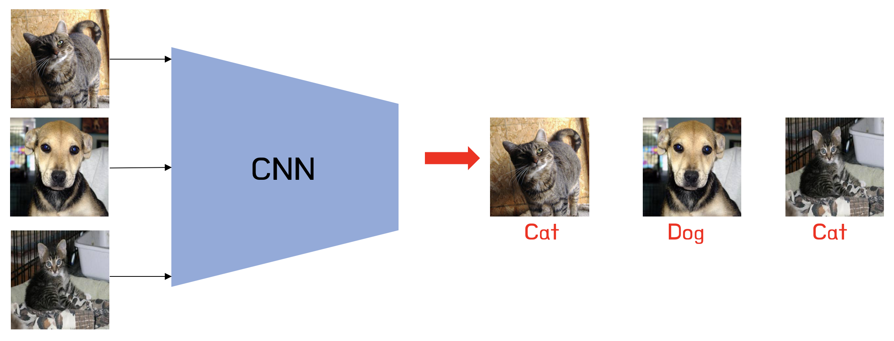

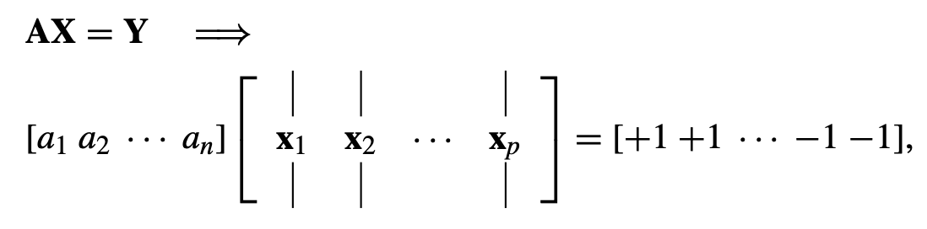

Dogs and Cats example (MatLab code)

Slide 3
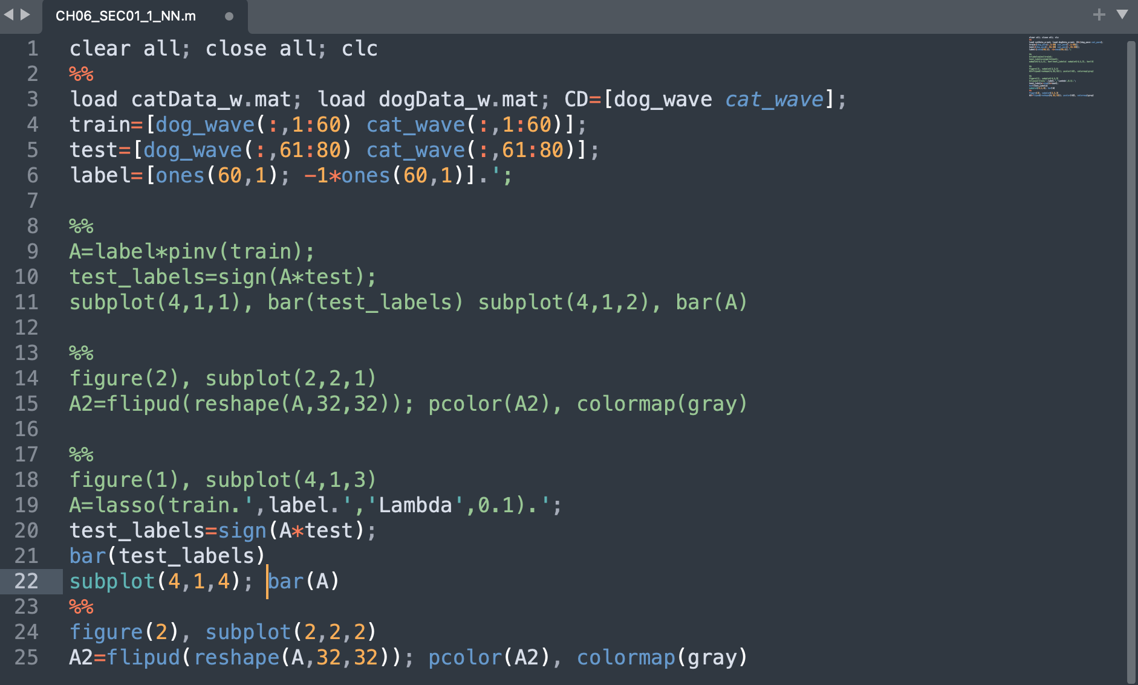

Slide 4
Training data
Testing data

Slide 5
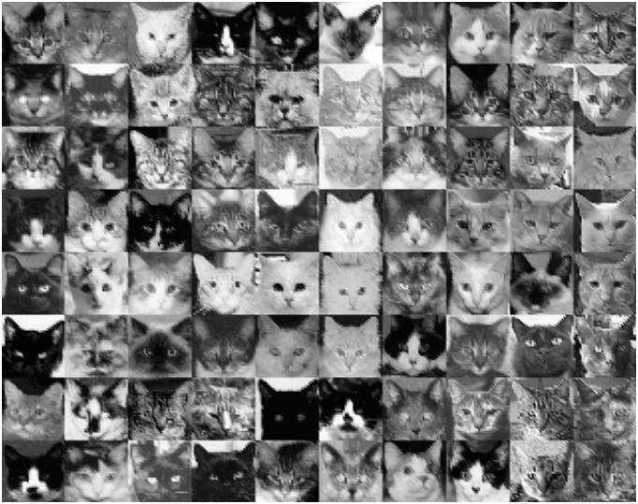
Training data
Testing data

Slide 6
Training data
Testing data
Labeling data

Slide 7
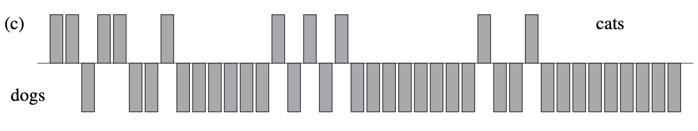
Solvning A
Testing Data

Slide 8
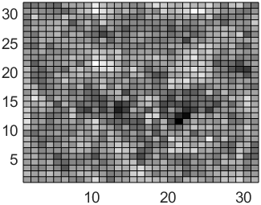
Matrix A

Slide 9
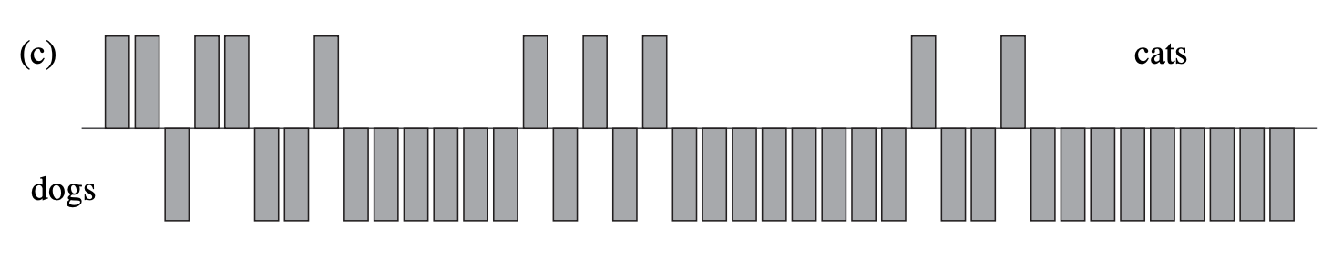
Solving A with LASSO
Testing Data

Slide 10
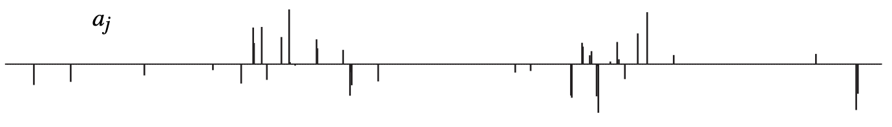
Solving A with LASSO
Testing Data

Slide 11
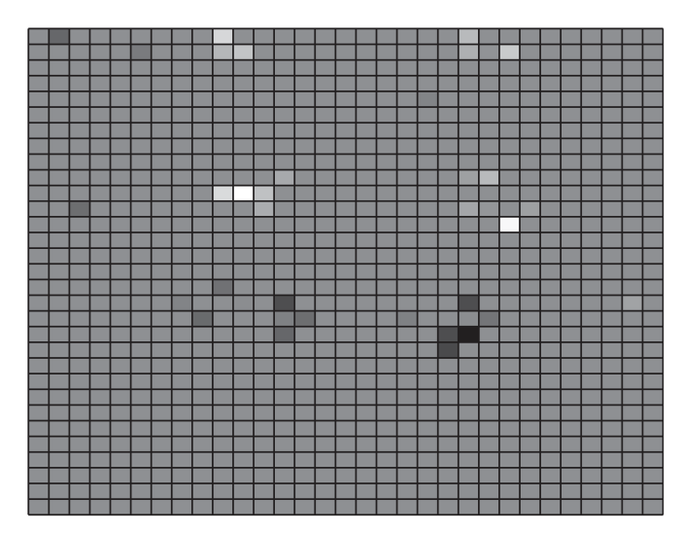
Solving A with LASSO
Testing Data

Slide 12
Mult-layer Newral Network MLNN

Slide 13
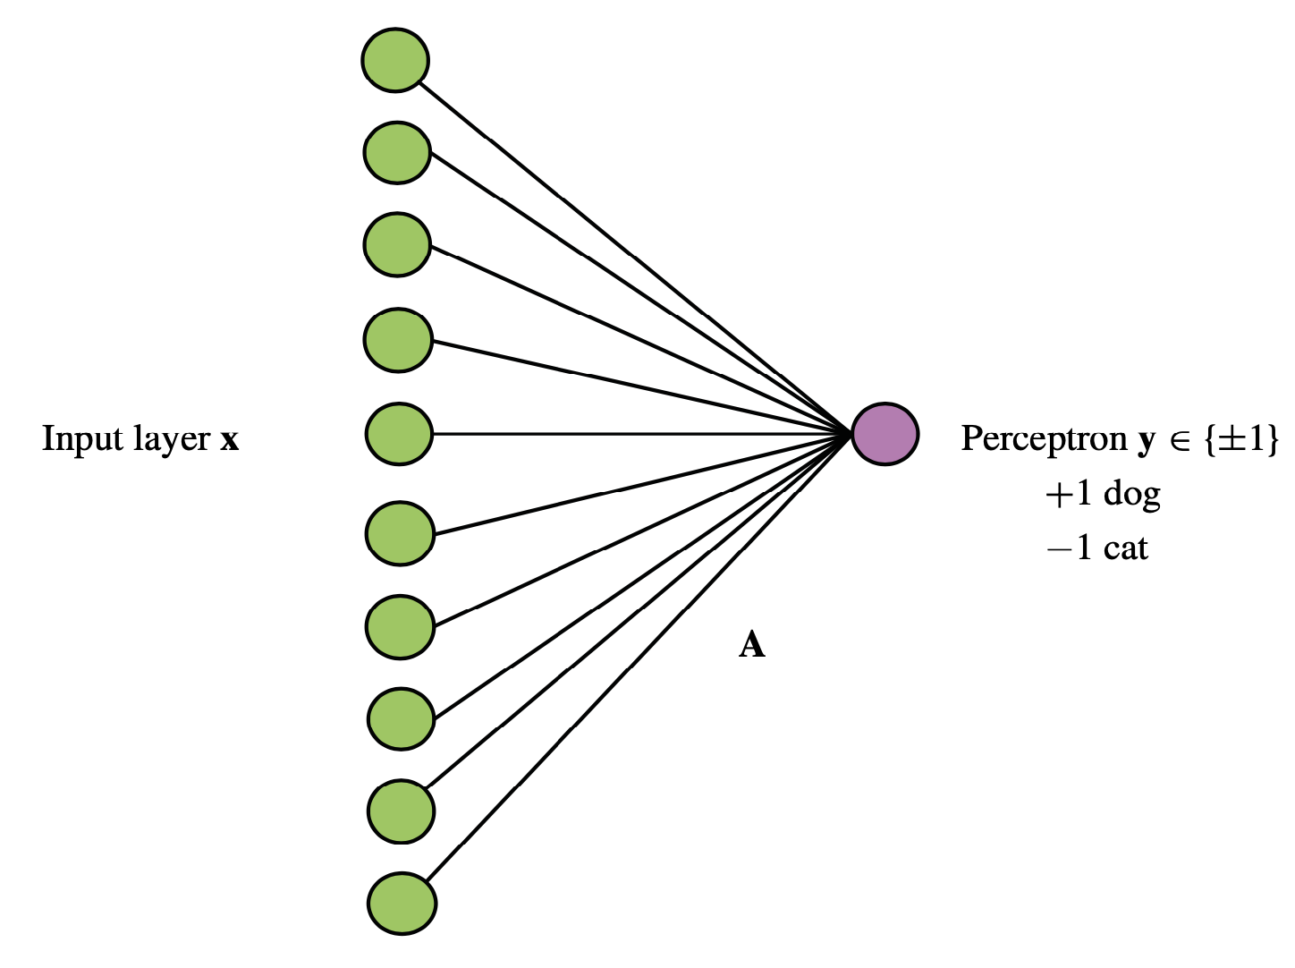
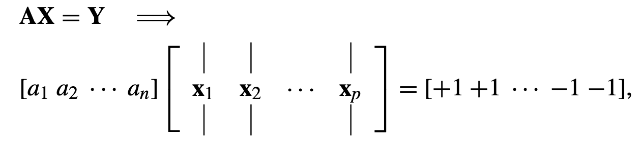
One Neuron

Slide 14
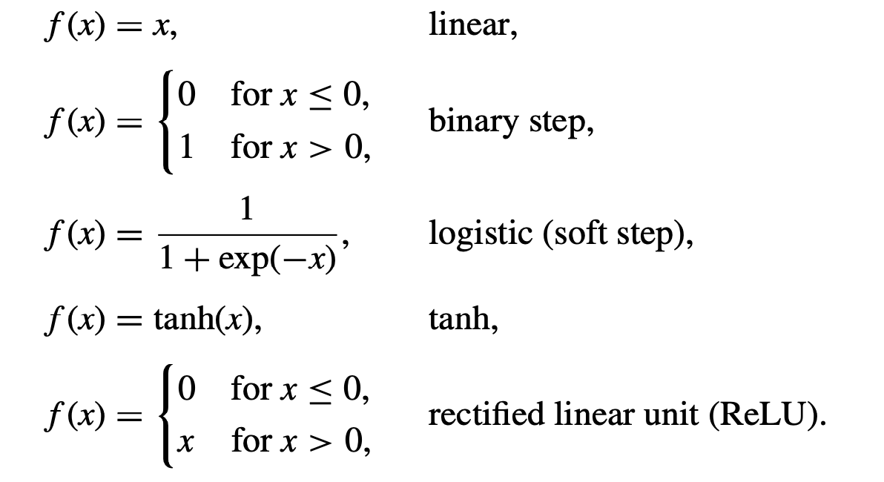
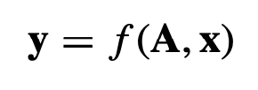
Importantly, the chosen function f (x) will be differentiated in order to be used in gradient descent algorithms for optimization.
Each of the functions above is either differentiable or piecewise differentiable

Slide 15
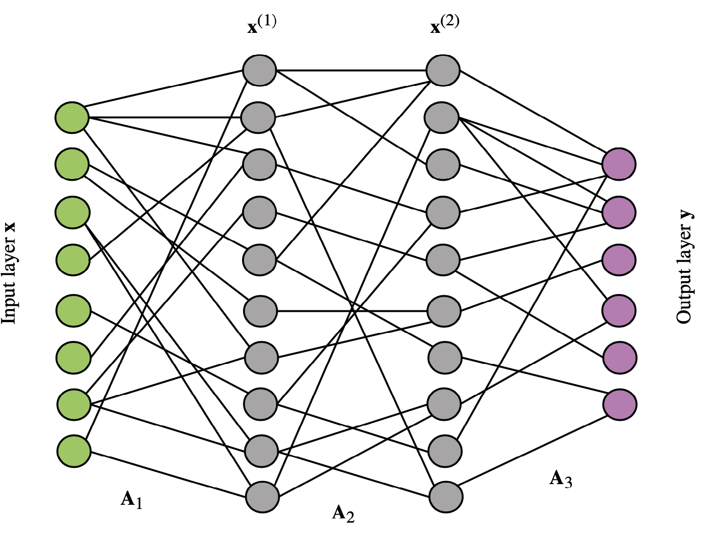


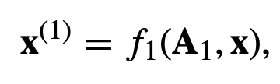
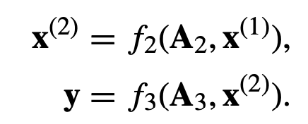





One NN Layer
One Neuron
Multiple Layer NN

Slide 16
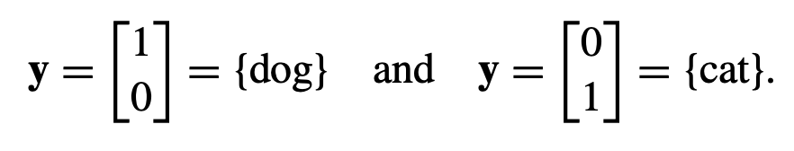
Dogs and Cats example (MatLab code)

Slide 17
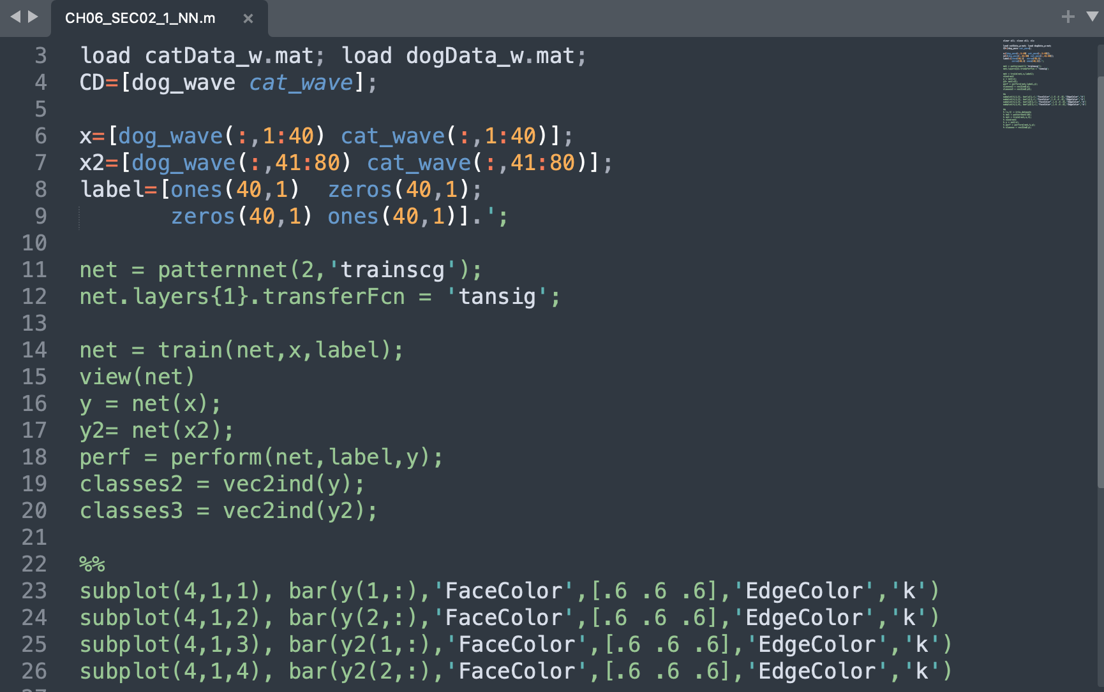
Data for training, and
Data for testing
Notes:
The multiple-layer structure significantly increases the size of the optimization problem, as each matrix element of the M matrices must be determined. Even for a single-layer structure, an optimization routine such as fminsearch will be severely challenged when considering a nonlinear transfer function, and one needs to move to a gradient descent- based algorithm.

Slide 18
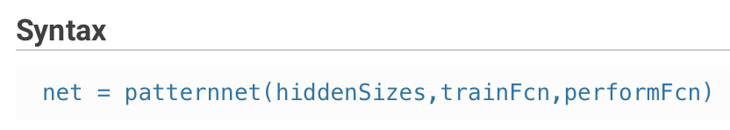
Notes:
The multiple-layer structure significantly increases the size of the optimization problem, as each matrix element of the M matrices must be determined. Even for a single-layer structure, an optimization routine such as fminsearch will be severely challenged when considering a nonlinear transfer function, and one needs to move to a gradient descent- based algorithm.

Slide 19
returns a pattern recognition neural network with:
a hidden layer size of hiddenSizes,
a training function, specified by trainFcn, and
a performance function, specified byperformFcn.
Scaled Conjugate Gradient
Notes:
The multiple-layer structure significantly increases the size of the optimization problem, as each matrix element of the M matrices must be determined. Even for a single-layer structure, an optimization routine such as fminsearch will be severely challenged when considering a nonlinear transfer function, and one needs to move to a gradient descent- based algorithm.

Slide 20
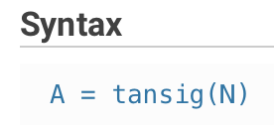
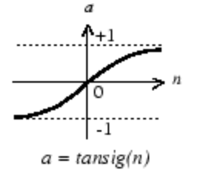
net.layers{i}.transferFcn
This function defines which of the transfer functions is used to calculate the ith layer's output, given the layer's net input, during simulation and training.
Notes:
The multiple-layer structure significantly increases the size of the optimization problem, as each matrix element of the M matrices must be determined. Even for a single-layer structure, an optimization routine such as fminsearch will be severely challenged when considering a nonlinear transfer function, and one needs to move to a gradient descent- based algorithm.

Slide 21
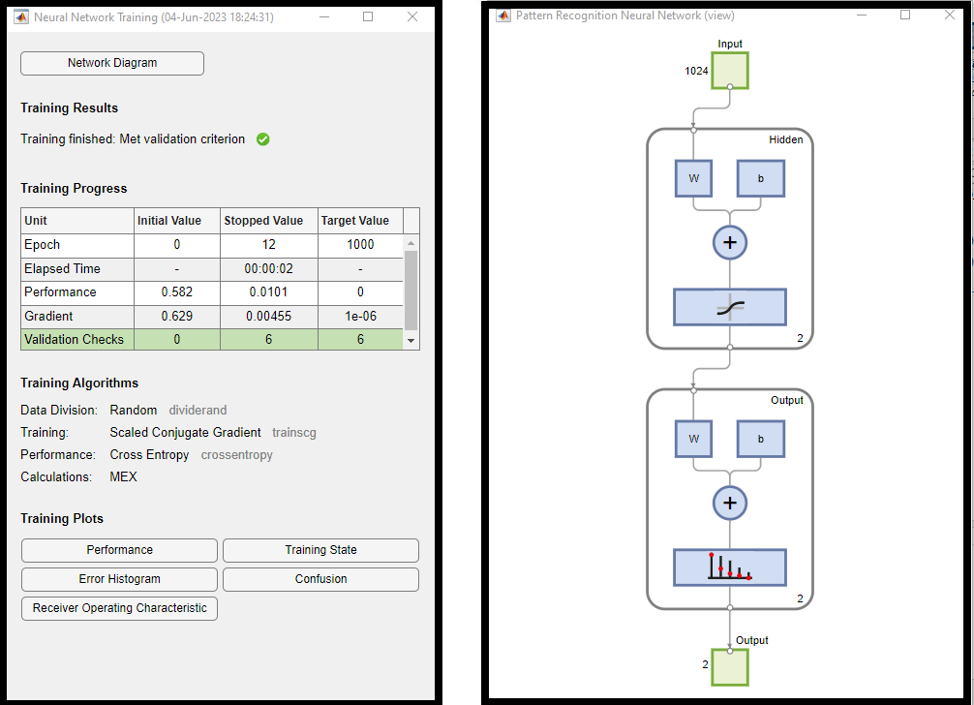
Notes:
The multiple-layer structure significantly increases the size of the optimization problem, as each matrix element of the M matrices must be determined. Even for a single-layer structure, an optimization routine such as fminsearch will be severely challenged when considering a nonlinear transfer function, and one needs to move to a gradient descent- based algorithm.

Slide 22
Notes:
The multiple-layer structure significantly increases the size of the optimization problem, as each matrix element of the M matrices must be determined. Even for a single-layer structure, an optimization routine such as fminsearch will be severely challenged when considering a nonlinear transfer function, and one needs to move to a gradient descent- based algorithm.

Slide 23
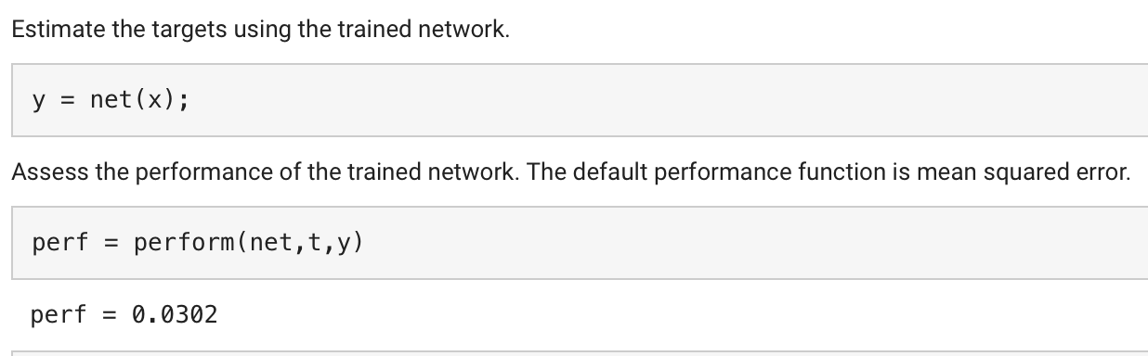
Notes:
The multiple-layer structure significantly increases the size of the optimization problem, as each matrix element of the M matrices must be determined. Even for a single-layer structure, an optimization routine such as fminsearch will be severely challenged when considering a nonlinear transfer function, and one needs to move to a gradient descent- based algorithm.

Slide 24
Convert vectors y and y2 to indices
Notes:
The multiple-layer structure significantly increases the size of the optimization problem, as each matrix element of the M matrices must be determined. Even for a single-layer structure, an optimization routine such as fminsearch will be severely challenged when considering a nonlinear transfer function, and one needs to move to a gradient descent- based algorithm.

Slide 25
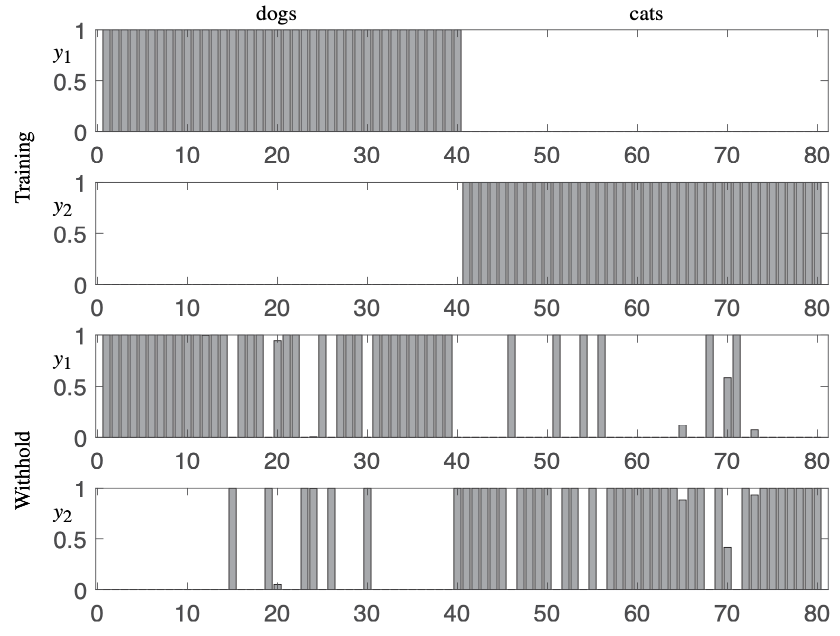
Notes:
The multiple-layer structure significantly increases the size of the optimization problem, as each matrix element of the M matrices must be determined. Even for a single-layer structure, an optimization routine such as fminsearch will be severely challenged when considering a nonlinear transfer function, and one needs to move to a gradient descent- based algorithm.

Slide 26
