Slide 1
Regression and Model Selection
Introduction to machine learning

Slide 2

Classic curve fitting
In what follows, we will consider curve fitting as a special case of regression
Regression is a broader mathematical viewpoint of curve fitting.
Like curve fitting, regression attempts to estimate the relationship among variables using a variety of statistical tools.
Regression function f(·) is typically prescribed and the parameters β are found by optimizing the goodness-of-fit of this function to data.
Regression and curve fitting discover relationships among variables by optimization.
Broadly speaking, machine learning is framed around regression techniques, which are themselves framed around optimization based on data.
Thus, at its absolute mathematical core, machine learning and data science revolve around positing an optimization problem.
The success of optimization itself depends critically on defining an objective function to be optimized

Slide 3
Least-squares fitting methods
To illustrate the concepts of regression, we will consider classic least-squarespolynomial fitting for characterizing trends in data.
The concept is straightforward and simple: use a simple function to describe a trend by minimizing the sum-square error between the selected function f (·) and its fit to the data
Classical curve fitting is formulated as a simple solution of Ax = b.

Slide 4
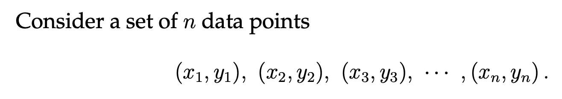
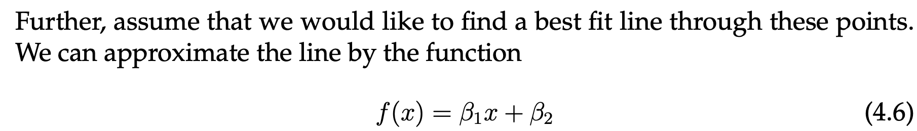


Least-squares fitting methods
Various error metrics can be minimized when approximating with a given function f (x).
The choice of error metric, or norm, used to compute a goodness- of-fit will be critical.
Three standard possibilities are often considered which are associated with the l2 (least-squares), l1, and l∞ norms

Slide 5
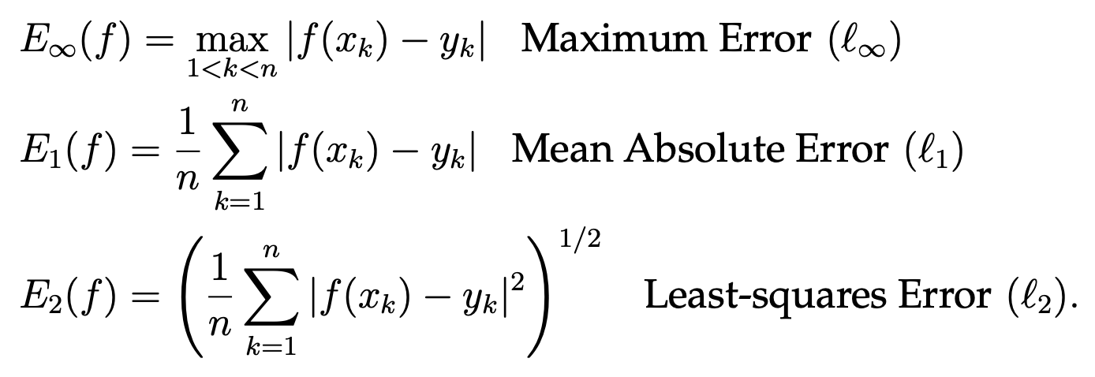
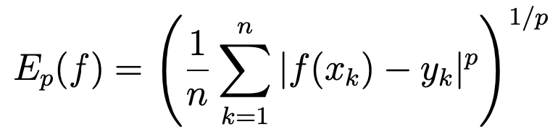
Least-squares fitting methods
In addition to these norms, one can more broadly consider the error based on the lp-norm:

Slide 6
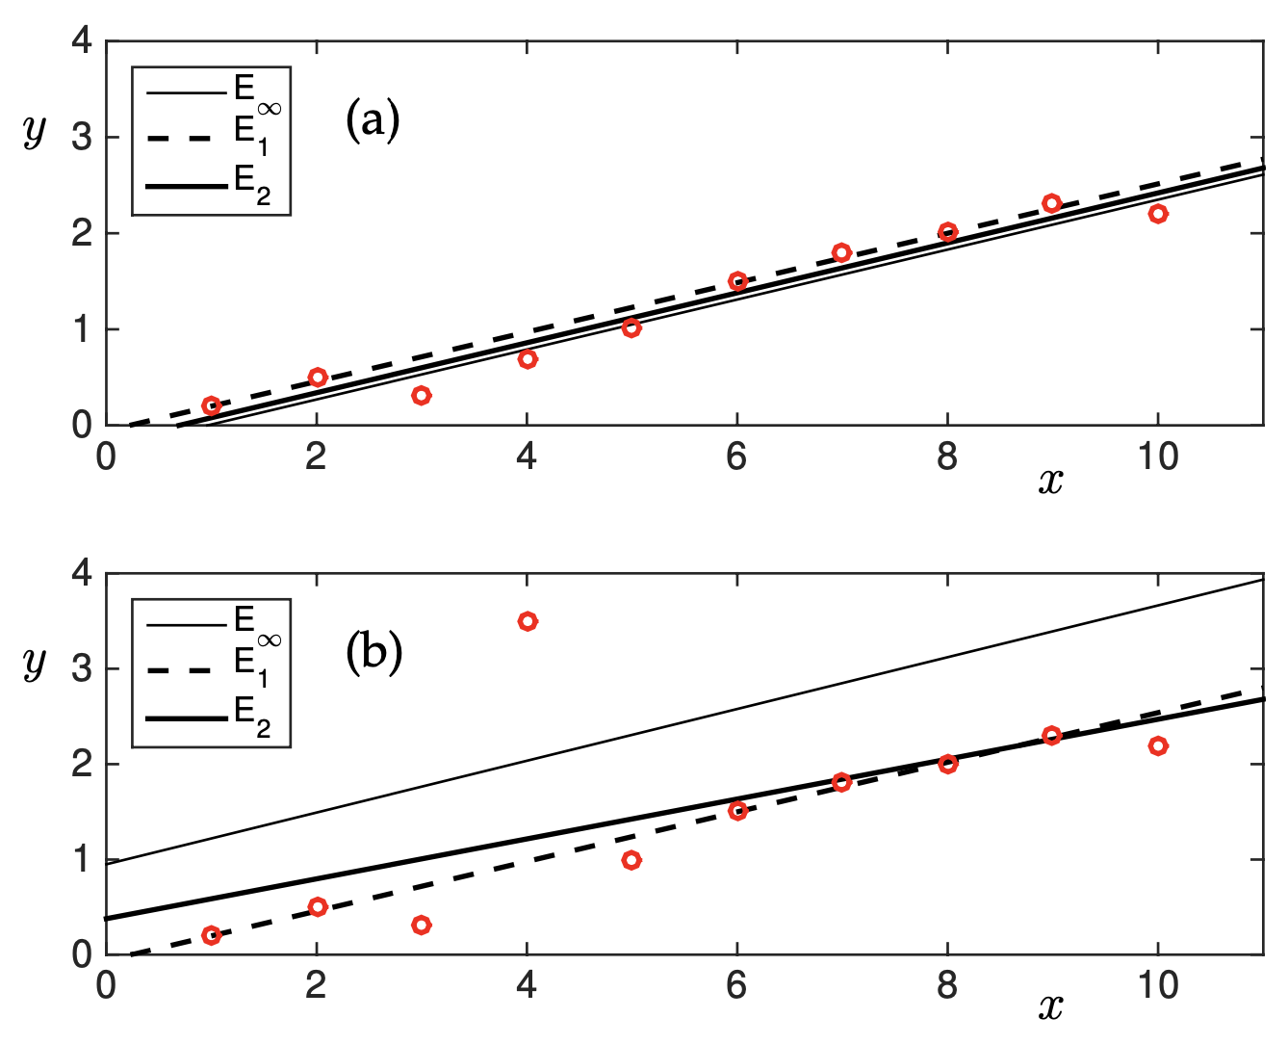

Slide 7

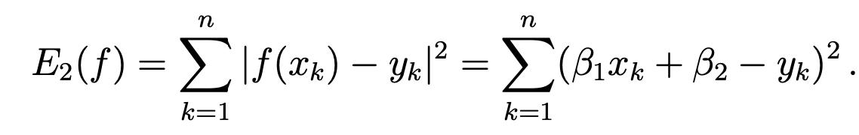
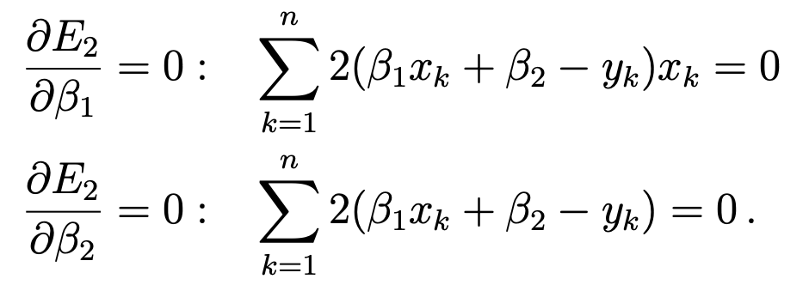
Least-squares line
Least-squares fitting to linear models has critical advantages over other norms and metrics:
Specifically, the optimization is inexpensive, since the error can be computed analytically
To show this explicitly, consider applying the least- square fit criteria to the data points (xk,yk) where k = 1,2,3,··· ,n. To fit the curve :
to this data, the error E2 is found by minimizing the sum:
Minimizing this sum requires differentiation. Specifically, the constants β1 and β2 are chosen so that a minimum occurs.
Thus, we require: ∂E2/∂β1 = 0 and ∂E2/∂β2 = 0.
The minimization condition gives:

Slide 8
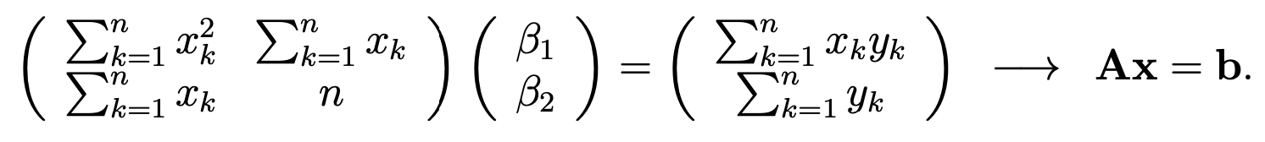
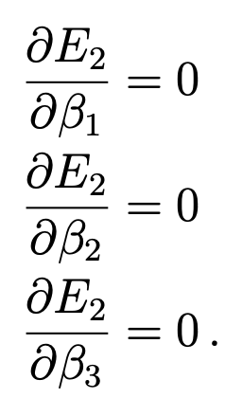
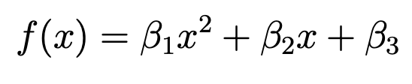
Least-squares line
Upon rearranging, a 2 × 2 system of linear equations is found for A and B
This linear system of equations can be solved using the backslash command in MATLAB.
Thus, an optimization procedure is unnecessary since the solution is computed exactly from a 2 × 2 matrix
This method can be easily generalized to higher polynomial fits.
In particular, a parabolic fit to a set of data requires the fitting function:
where now the three constants β1 , β2 , and β3 must be found.
These can be solved for with the 3×3 system resulting from minimizing the error E2(β1, β2, β3) by taking :

Slide 9
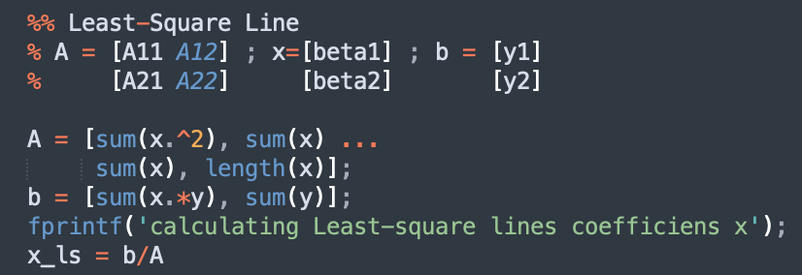

Least-squares line
Upon rearranging, a 2 × 2 system of linear equations is found for A and B
This linear system of equations can be solved using the backslash command in MATLAB.
Thus, an optimization procedure is unnecessary since the solution is computed exactly from a 2 × 2 matrix

Slide 10

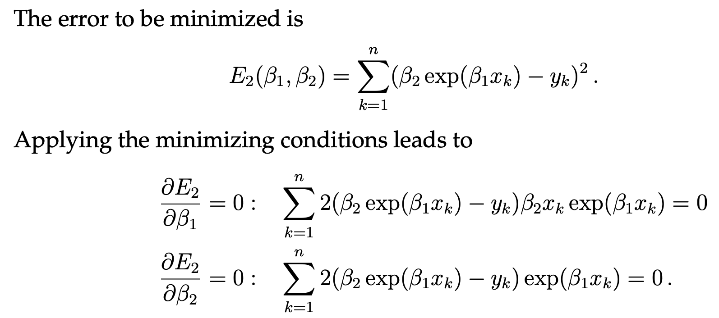
Data linearization
Although a powerful method, the minimization procedure for general fitting of arbitrary functions results in equations which are nontrivial to solve.
Specifically, consider fitting data to the exponential function

Slide 11
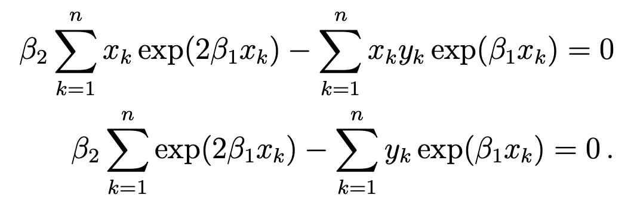
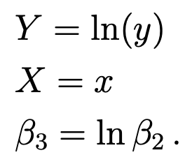


Data linearization
This in turn leads to the 2 × 2 system:
This system of equations is nonlinear and cannot be solved in a straightforward fashion.
Indeed, a solution may not even exist. Or many solution may exist.
We will describe a possible iterative procedure, called gradient descent, for solving this nonlinear system of equations.
To avoid the difficulty of solving this nonlinear system, the exponential fit can be linearized by the transformation:
Then the fit function:
can be linearized by taking the natural log of both sides:
By fitting to the natural log of the y-data:

Slide 12

Tarea:
Parte 1:
Tome datos con una tendencia lineal, pueden ser reales o simulados. Si son simulados, use su función de números aleatoreos para generar cierta dispersión en los datos, tenga cuidado con el valor aleatoreo máximo.
Use el método mostrado en clase y emplee las tres normas mostradas para generar una regresión lineal.

