Slide 1
PAP Treatment Effectiveness for Apnea and Hypopnea
DATA 211 Project. November 30, 2022. Jason Evans

Slide 2
DEFINITIONS:
PAP: positive airway pressure.
Apnea: a pause in breathing lasting 10 or more seconds
Hypopnea: an episode of overly shallow breathing or abnormally low respiration rate.
Apnea-Hypopnea Index (AHI): an index used to indicate the severity of sleep apnea. AHI is represented by the number of both apnea and hypopnea events per hour of sleep. With AHI, a lower number is better; any number under 5.0 is ideal.

Slide 3
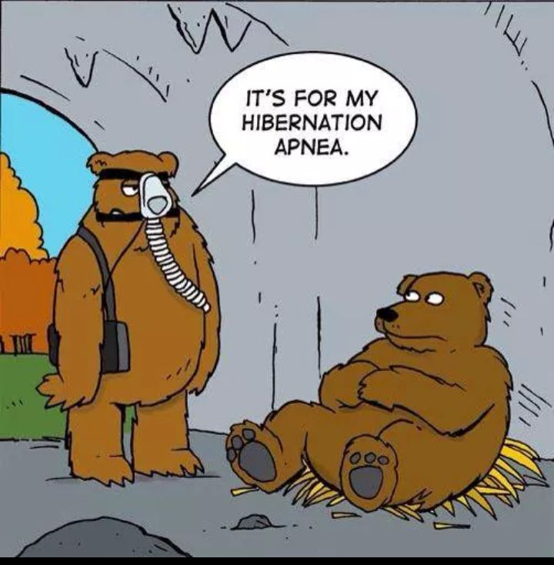
QUESTION:
Well, two questions. Is the prescribed PAP treatment effective and how long after the start of treatment could one see positive effects?

Slide 4
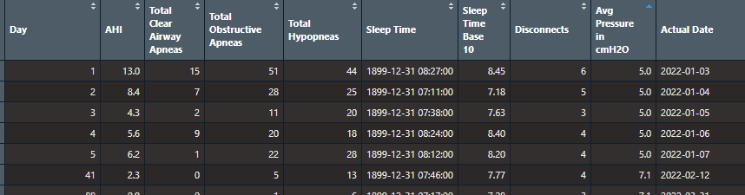
DATA COLLECTION:
Each time the PAP machine is activated it records key treatment data points including the following: AHI score, total clear airway apneas, total obstructive apneas, total hypopneas, sleep time, mask disconnects, and average pressure measured in cmH₂O, and date.
For our purposes, we will be looking at the Apnea-Hypopnea Index (AHI) score.

Slide 5
STATISTICAL TESTS:
We will be looking at the mean AHI score over the first 90 days in order to test overall treatment effectiveness by performing a One-Sample T-Test.
Then we will be looking at mean AHI score for the for each of the first three months in order to test whether there was treatment progress over these first three months using a One-Way ANOVA (analysis of variance) and a Tukey Test.
(For more information regarding One-Way ANOVA and Tukey Test, STAT 301 is excellent.)

Slide 6
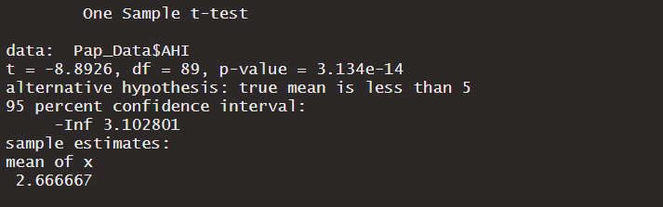
ONE SAMPLE T-TEST:
We will test the claim that the mean AHI score is less than the ideal AHI score of 5 using a significance level of 0.05. Let µ be the mean AHI score over the first 90 days.
H_{o}: µ = 5
H_{a}: µ < 5
The p-value is effectively zero so that p < α. We reject the null hypothesis.
There is sufficient evidence to support the claim that the mean AHI score is less than the ideal AHI score of 5.
The PAP treatment does seem to be effective in treating sleep apnea and hypopnea.

Slide 7
ONE-WAY ANOVA:
Our second question is how long after the start of treatment should we expect positive results. Using a significance level of 0.05, we test the claim that there is a difference in mean AHI scores in at least two of the first three months.
Let A be Days 1-30.
Let B be Days 31-60.
Let C be Days 61-90.
Let µ_{A} be the mean AHI score for A.
Let µ_{B} be the mean AHI score for B.
Let µ_{C} be the mean AHI score for C.

Slide 8
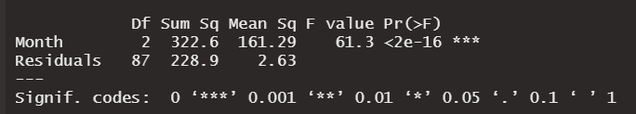
ONE-WAY ANOVA, CONTINUED:
H_{o}: µ_{A} = µ_{B} = µ_{c}
H_{a}: µ_{A} ≠ µ_{B} ≠ µ_{c}
The p-value is effectively zero so that p < α. We reject the null hypothesis. There is sufficient evidence to support the claim that the mean AHI scores in at least two months are different.
…but which months are different?

Slide 9
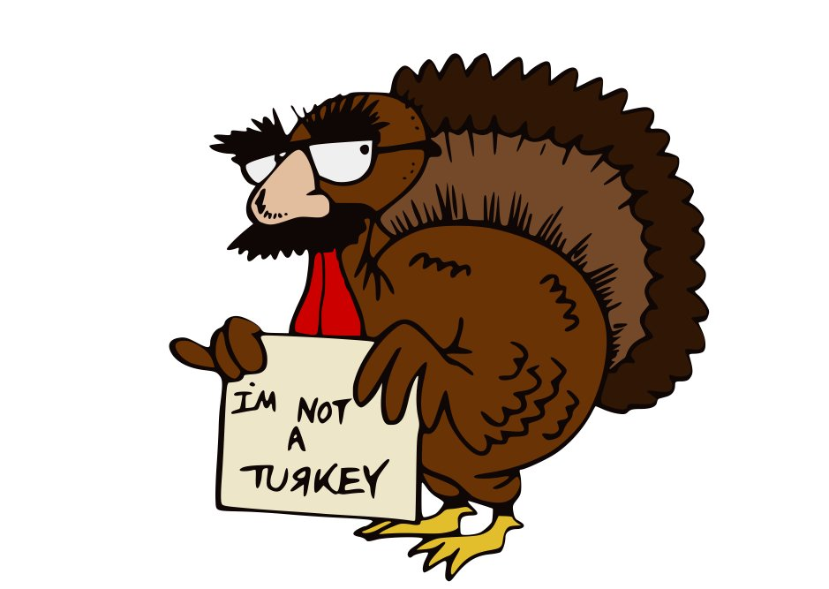
TUKEY POST-HOC TEST:
The Tukey test runs pairwise comparisons among each of the three groups A, B, and C and uses a conservative error estimate to find the groups which are statistically different from one another.
In other words, we will be testing the claim in each pairing whether there is a significance difference between the mean AHI score among the first three months.
Thus, we have three hypothesis tests…

Slide 10
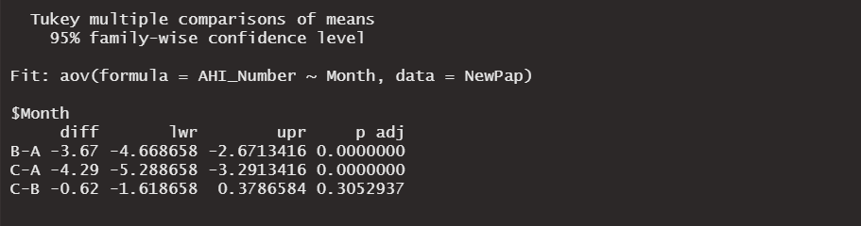
TUKEY POST-HOC TEST, CONTINUED:
Pairwise B - A
H_{o}: µ_{B} = µ_{A}
H_{a}: µ_{B} ≠ µ_{a}
_{p-value = 0}
Pairwise C - A
H_{o}: µ_{C} = µ_{A}
H_{a}: µ_{C} ≠ µ_{A}
_{p-value = 0}
Pairwise C - B
H_{o}: µ_{C} = µ_{B}
H_{a}: µ_{C} ≠ µ_{B}
_{p-value = 0.3052937}

Slide 11
TUKEY POST-HOC TEST, CONTINUED:
CONCLUSIONS:
There is a significant difference between the mean AHI scores of Day 31-60 (B) and Days 1-30 (A)
There is a significant difference between the mean AHI scores of Day 61-90 (c) and Days 1-30 (A)
There is not a significant difference between the mean AHI scores of Day 61-90 (C) and Days 31-61 (B)

Slide 12
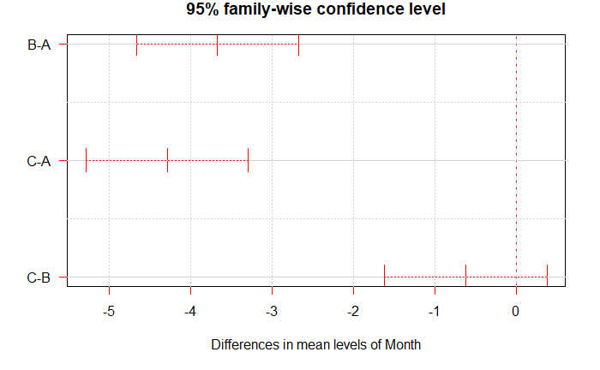
TUKEY POST-HOC TEST, CONTINUED:

Slide 13
TUKEY POST-HOC TEST, CONTINUED:
In words…
The 95% confidence interval is (-5.3, -3.2) which contains only negative numbers so that µ_{B} < µ_{A} (difference of the sample means equal to -3.67).
The 95% confidence interval is (-4.7 , -2.7) which contains only negative numbers so that µ_{C} < µ_{A} (difference of the sample means equal to -4.29).
The 95% confidence interval is (-1.6 0.4) which contains zero so that µ_{C =} µ_{B} (difference of the sample means equal to -0.62).

Slide 14
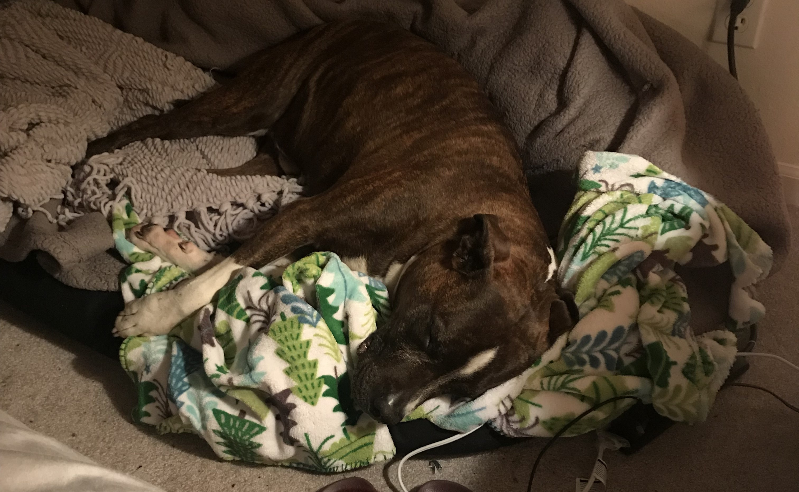
CONCLUSIONS IN CONTEXT:
The one-sample t-test allows us to reasonably conclude that the PAP treatment is effective in treating severe sleep apnea and hypopnea.
The one-way ANOVA and Tukey test allows us to reasonably conclude that one should expect positive results after one month of continued treatment as directed.
(Tiger sleeping!)

Slide 15
SOURCES:
Bevens, R. (2022, November 17). One-Way ANOVA: When and How to Use It. Scribbr.
https://www.scribbr.com/statistics/one-way-anova/
Bevens, R. (2022, March 6). ANOVA in R: A Complete Step-By-Step Guide with Examples. Scribbr.
https://www.scribbr.com/statistics/anova-in-r/#anova-graph
Fountain, L. (2022, November 8). CPAP Pressure Settings. Sleep Foundation.
https://www.sleepfoundation.org/cpap/cpap-pressure-settings
Respironics, P. (n.d.). FAQ - Philips Respironics DreamMapper. https://www.mydreammapper.com/Help/Faq
Schlegel, A. (2018, September 7). Tukey’s Test for Post-Hoc Analysis. R-Bloggers.
https://www.r-bloggers.com/2018/09/tukeys-test-for-post-hoc-analysis/

