Slide 1
Learning Lexical and Compositional Semantics with RSA
with Leon Bergen & Noah Goodman

Slide 2
Vague Adjectives
What does tall mean?
“x is tall” if height(x) > ϑ
Value of ϑ depends on context
Hoover tower is tall (for a building)
GCC is not tall (for a building)
John is tall (for a person)
Core of meaning is invariant of ϑ

Slide 3
Vague Adjectives
How do we learn meaning when ϑ varies with context?
Other examples: heavy, big, talented

Slide 4
Architecture overview
Semantic parser
RSA
Variational Inference

Slide 5
Semantic parser interface
Takes parameters to govern parsing
Takes utterance
Returns meaning function from worlds to truth values
Truth value is real number

Slide 6
RSA
Lifted variable RSA setup
Literal listener calls semantic parser
Pass utterance to parser
Pass world to resulting meaning function

Slide 7
RSA
var parser = createParser(params);
var literalListener = function (utterance) {
Infer({ method: 'enumerate' }, function () {
var truthFn = parser(utterance);
var world = worldPrior();
factor(Math.log(truthFn(world)));
return world;
})
})

Slide 8
Variational Inference
Goal: optimize parser parameters
Training data contains worlds and utterances
mapData calls pragmatic listener

Slide 9
Variational Inference
Optimize(function () {
var params = … // Calls modelParam
var listener = createListener(params);
mapData({ data: data }, function (d) {
var distribution = listener(d.utterance);
observe(distribution, d.world);
})
}, { … })

Slide 10
Semantic parser architecture
WebPPL package semppl
Takes a grammar and params
Chart parsing - start with words, build up to sentence
Chart cell has:
Set of intermediate parse trees
Score for each parse tree
Results in distribution over parses

Slide 11

Grammar specification
PCFG (probabilistic context free grammar)
Each rule:
LHS
RHS
Semantic function
Parser assigns weight $ω_{r}$ for each rule $r$

Slide 12
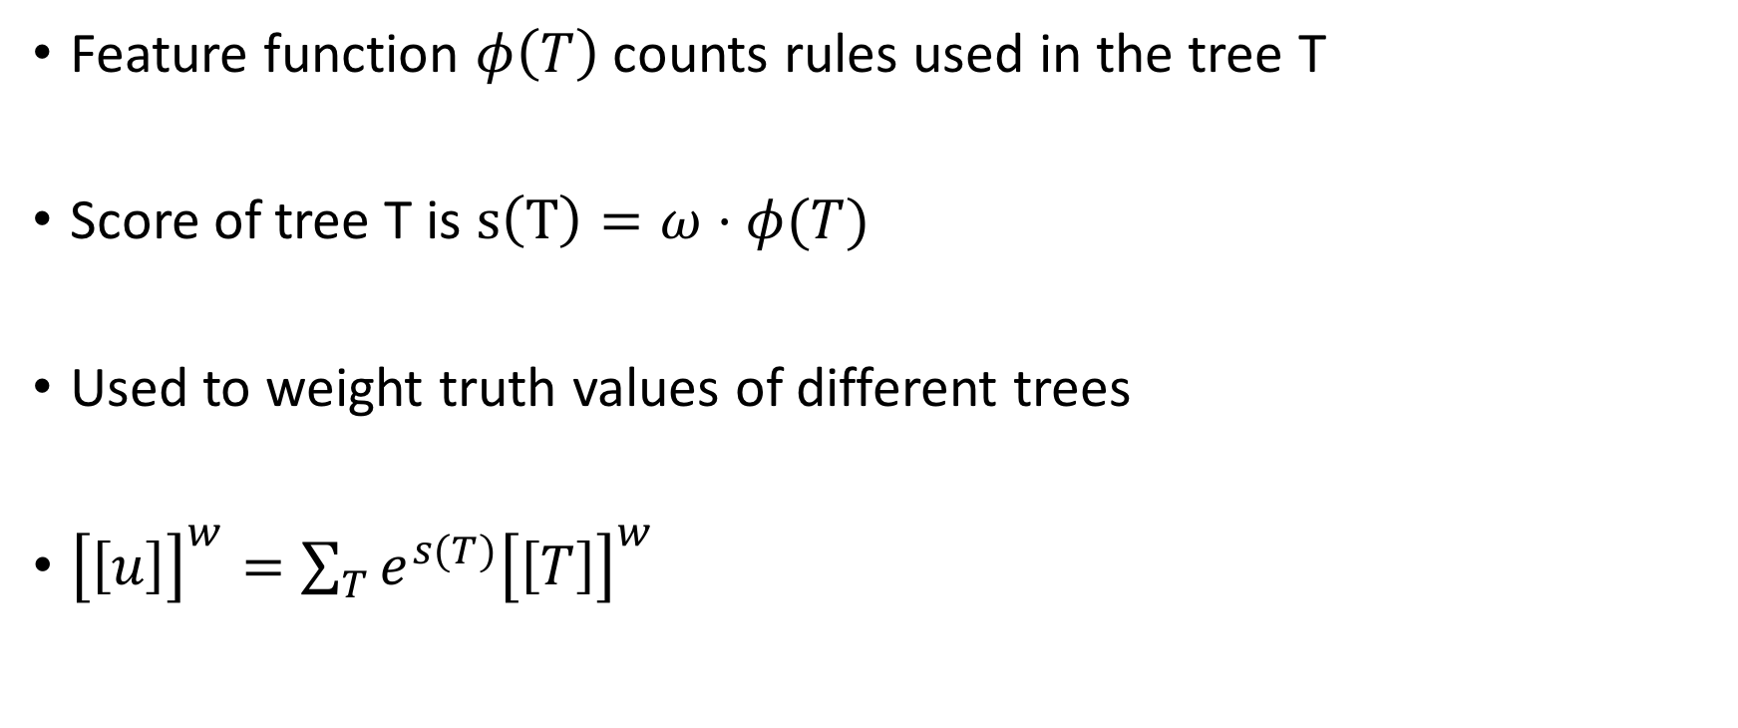
Scoring
Feature function $φ\left(T\right)$ counts rules used in the tree T
Score of tree T is $s\left(T\right)=ω⋅φ(T)$
Used to weight truth values of different trees
${\left[\left[u\right]\right]}^{w}=\sum_{T}{e^{s(T)}{\left[\left[T\right]\right]}^{w} }$

Slide 13
Semantic functions
In classical semantics, the semantic value of a parse is 1 or 0 (true or false).
This is a problem for learning: we want to use gradient descent, so we need the output of the semantics to be differentiable.

Slide 14
Semantic functions
Approach: neural networks with graded semantics for lexical items, arithmetic operations for composition rules.
Scalar adjective like “tall”: given a threshold, the semantic value is determined by a sigmoid centered at the threshold.
Arithmetic generalizations of logical operators: 1-x for negation, multiplication for conjunction, etc.

Slide 15
Experimental procedure
Generate data:
Run model with fixed ground truth grammar and scales
Sample from resulting distribution over worlds
Training:
Run parametrized model
mapData over the generated data

Slide 16
Lexical experiments: Learning Scales
Motivation: Can we learn the scale for height/weight?
3x3 grid of person heights/weights for training
Can the model reproduce distribution for 3x3 grid of person heights?
Learn parameters of scale networks

Slide 17
Lexical experiments: Learning Scales

Slide 18
Lexical experiments: Learning Scales

Slide 19
Lexical experiments: Generalizing
Can we generalize to a domain of buildings?
Different height and weight scales
Learn parameters of network: Invariant to comparison class

Slide 20
Lexical experiments: Generalizing

Slide 21
Lexical experiments: Generalizing

Slide 22
Can we do better?
Idea: Train on two different domains
Train on mixed dataset of people & trees
2 different classes of heights/weights
Test resulting distribution on buildings

Slide 23
Can we do better?

Slide 24
Can we do better?

Slide 25
Learning semantic composition
Logical operators AND, OR, NOT
John is tall and John is heavy
John is tall or John is heavy
John is not tall
Grammar seeded with candidate composition rules
Can parser identify correct rule?

Slide 26
Conjunction

Slide 27
Disjunction

Slide 28
Negation

Slide 29
Composition
Semantic grammar is modular
Can be augmented to support and learn different compositional constructs

