Slide 1
Learning Lexical and Compositional Semantics with RSA
with Leon Bergen & Noah Goodman

Slide 2
Architecture overview
Semantic parser
RSA
Variational Inference

Slide 3
Semantic parser interface
Takes parameters to govern parsing
Takes utterance
Returns meaning function from worlds to truth values
Truth value is real number

Slide 4
RSA
Standard RSA setup
Literal listener calls semantic parser
Pass utterance to parser
Pass world to resulting meaning function

Slide 5
RSA
var parser = createParser(params);
var literalListener = function (utterance) {
Infer({ method: 'enumerate' }, function () {
var truthFn = parser(utterance);
var world = worldPrior();
factor(Math.log(truthFn(world)));
return world;
})
})

Slide 6
Variational Inference
Goal: optimize parser parameters
Training data contains worlds and utterances
mapData calls pragmatic listener

Slide 7
Variational Inference
Optimize(function () {
var params = … // Calls modelParam
var listener = createListener(params);
mapData({ data: data }, function (d) {
var distribution = listener(d.utterance);
observe(distribution, d.world);
})
}, { … })

Slide 8
Semantic parser architecture
WebPPL package semppl
Takes a grammar and params
Chart parsing - start with words, build up to sentence
Chart cell has:
Set of intermediate parse trees
Score for each parse tree
Results in distribution over parses
PCFG – learns weights, each cell has a set of trees with cumulative scores
Log-linear scoring with features for each rule

Slide 9

Grammar specification
PCFG (probabilistic context free grammar)
Each rule:
LHS
RHS
Semantic function
Parser assigns weight $ω_{r}$ for each rule $r$

Slide 10
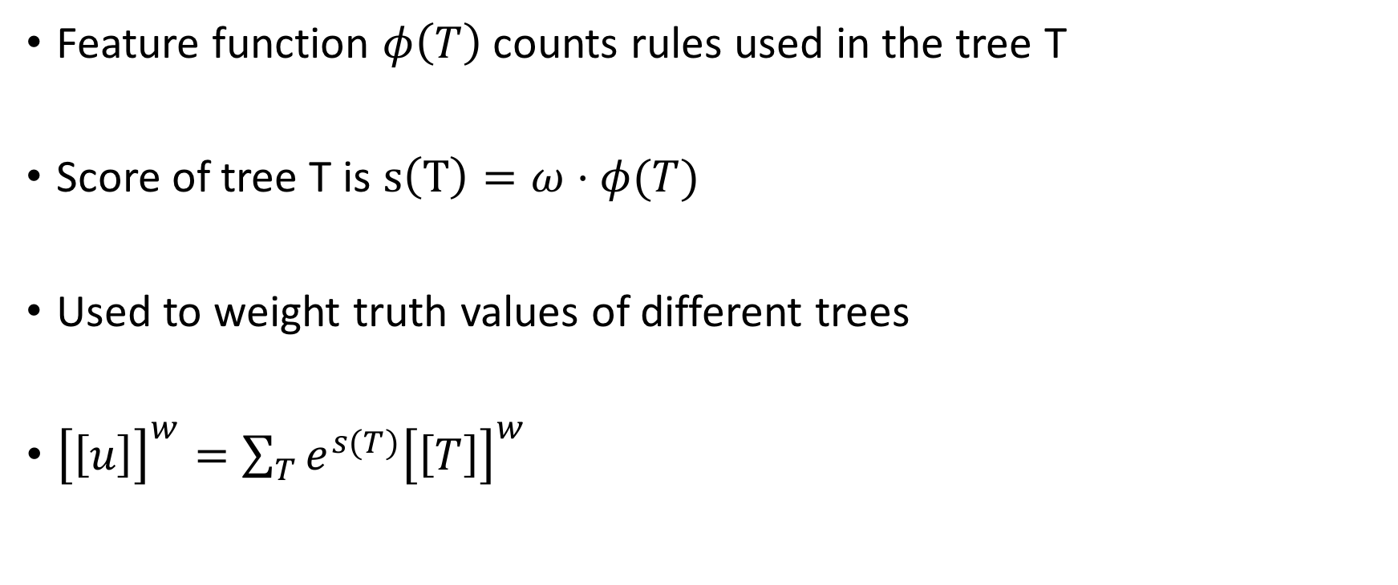
Scoring
Feature function $φ\left(T\right)$ counts rules used in the tree T
Score of tree T is $s\left(T\right)=ω⋅φ(T)$
Used to weight truth values of different trees
${\left[\left[u\right]\right]}^{w}=\sum_{T}{e^{s(T)}{\left[\left[T\right]\right]}^{w} }$

Slide 11
Semantic functions (Leon’s slide)

Slide 12
Data source
Ground truth model – fixed semantics
Generate samples from ground truth
(not so important) Triples of utterance, world, context
mapData in variational inference

Slide 13
World schema
Objects have height & weight
Different comparison classes
People, buildings

Slide 14
Lexical experiments (learning scales)
Motivation: Can we learn the scale?
Explain experiment
Show ground truth distribution and learned distribution

Slide 15
Lexical experiments (generalizing)

Slide 16
Learning semantic composition
Logical operators are implemented and experimented
Modular to support other kinds of compositional rules

